Slide 1
Cs1231S tutorial #6
Functions

Slide 2
Learning objectives of this tutorial
Functions
ranges of functions
equality of functions
composition of functions
surjectivity, injectivity and bijectivity
inverse functions
setwise images and setwise preimages

Slide 3



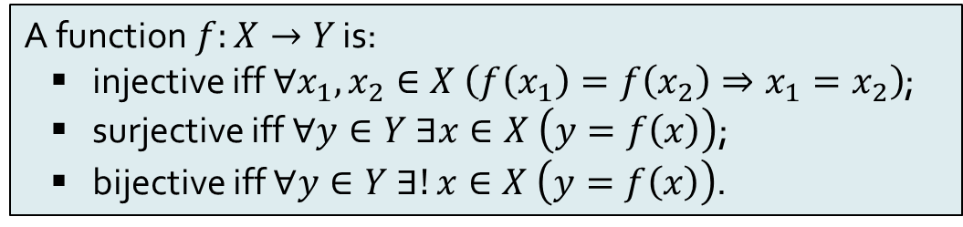








Recap: Definitions
A function$f:X→Y$ is:
injective iff $∀x_{1},x_{2}∈X \left(f\left(x_{1}\right)=f\left(x_{2}\right)⇒x_{1}=x_{2}\right)$;
surjective iff $∀y∈Y ∃x∈X \left(y=f\left(x\right)\right)$;
bijective iff $∀y∈Y ∃!x∈X \left(y=f\left(x\right)\right)$.
(Injective) Informally, every element in the codomain must have at most one arrow going into it.
(Surjective) Informally, every element in the codomain must have at least one arrow going into it.
(Bijective) Informally, every element in the codomain must have exactly one arrow going into it.
$$∧$$
$$≡$$
$$X$$
$$R_{4}$$
$$Y$$
$$X$$
$$R_{5}$$
$$Y$$
$$X$$
$$R_{6}$$
$$Y$$
Injective
Not injective
Injective
Not surjective
Surjective
Surjective
Bijective

Slide 4
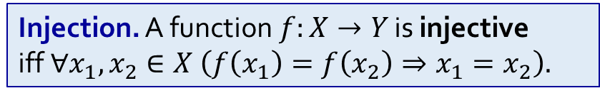
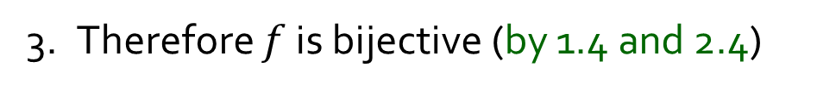
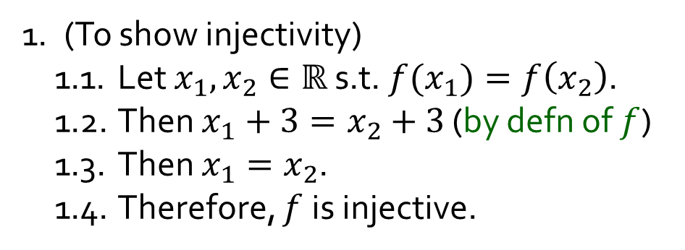
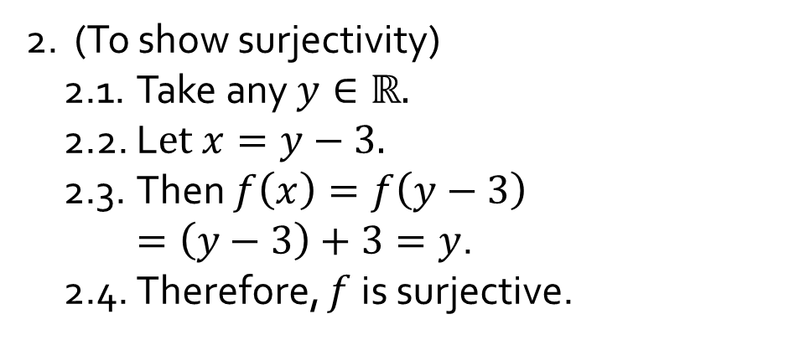
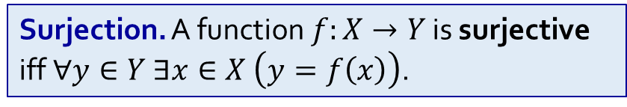
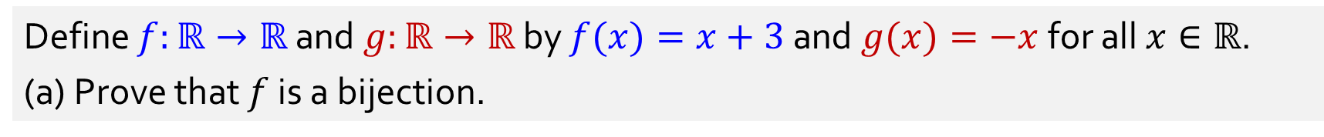
Q2.
Define $f:ℝ→ℝ$ and $g:ℝ→ℝ$ by $f(x)=x+3$and $g(x)=−x$for all $x∈ℝ$.
(a) Prove that $f$ is a bijection.
1. (To show injectivity)
1.1. Let $x_{1},x_{2}∈ℝ$ s.t. ${f(x}_{1})=f\left(x_{2}\right)$.
1.2. Then $x_{1}+3=x_{2}+3$ (by defn of $f$)
1.3. Then $x_{1}=x_{2}$.
1.4. Therefore, $f$is injective.
2. (To show surjectivity)
2.1. Take any $y∈ℝ.$
2.2. L$et x=y−3.$
2.3. Then $f\left(x\right)=f\left(y−3\right)$ $=\left(y−3\right)+3=y$.
2.4. Therefore, $f$is surjective.
3. Therefore $f$ is bijective (by 1.4 and 2.4)
Injection. A function$f:X→Y$ is injective
iff $∀x_{1},x_{2}∈X \left(f\left(x_{1}\right)=f\left(x_{2}\right)⇒x_{1}=x_{2}\right).$
Surjection. A function$f:X→Y$ is surjective iff $∀y∈Y ∃x∈X \left(y=f\left(x\right)\right)$.

Slide 5
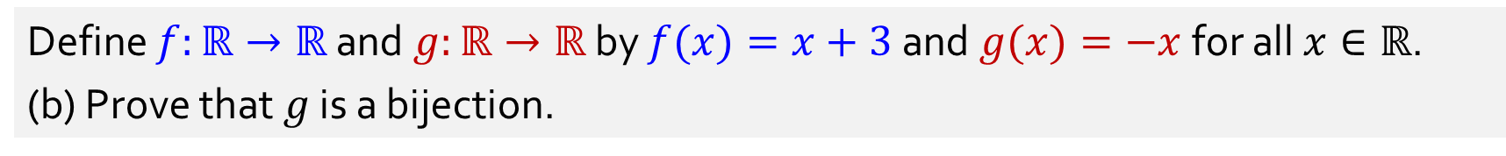
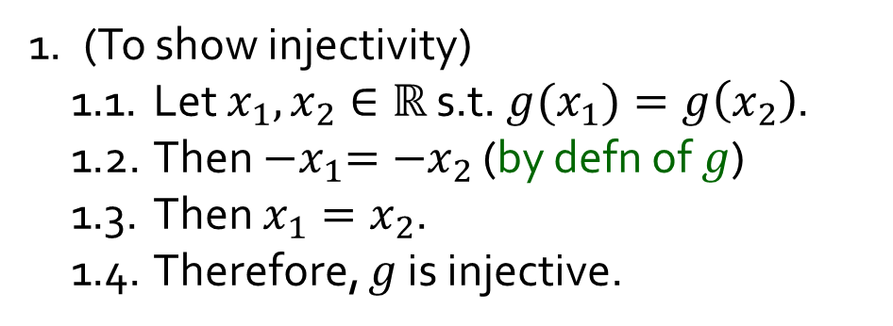
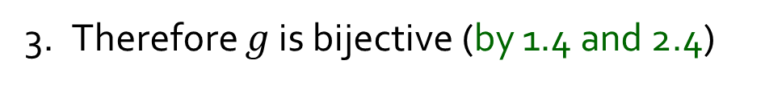
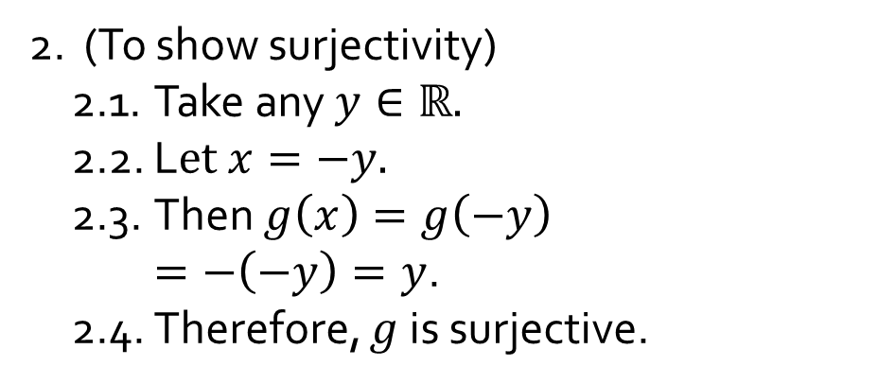
Q2.
Define $f:ℝ→ℝ$ and $g:ℝ→ℝ$ by $f(x)=x+3$and $g(x)=−x$for all $x∈ℝ$.
(b) Prove that $g$ is a bijection.
1. (To show injectivity)
1.1. Let $x_{1},x_{2}∈ℝ$ s.t. ${g(x}_{1})=g\left(x_{2}\right)$.
1.2. Then ${−x}_{1}={−x}_{2}$ (by defn of $g$)
1.3. Then $x_{1}=x_{2}$.
1.4. Therefore, $g$ is injective.
2. (To show surjectivity)
2.1. Take any $y∈ℝ.$
2.2. L$et x=−y.$
2.3. Then $g\left(x\right)=g\left(−y\right)$ $=−\left(−y\right)=y$.
2.4. Therefore, $g$is surjective.
3. Therefore $g$ is bijective (by 1.4 and 2.4)
Injection. A function$f:X→Y$ is injective
iff $∀x_{1},x_{2}∈X \left(f\left(x_{1}\right)=f\left(x_{2}\right)⇒x_{1}=x_{2}\right).$
Surjection. A function$f:X→Y$ is surjective iff $∀y∈Y ∃x∈X \left(y=f\left(x\right)\right)$.

Slide 6




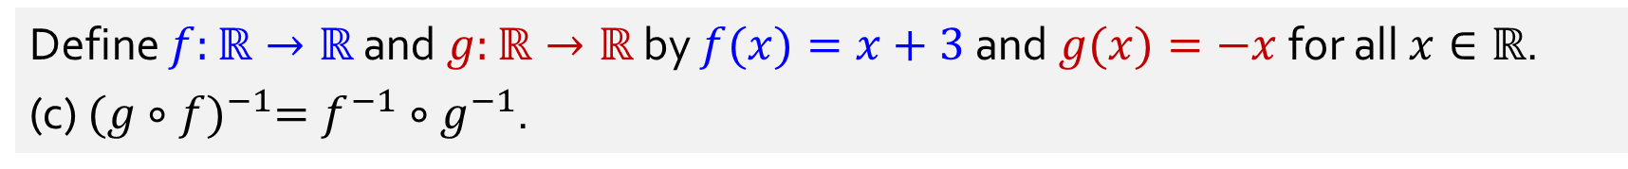





Q2.
Define $f:ℝ→ℝ$ and $g:ℝ→ℝ$ by $f(x)=x+3$and $g(x)=−x$for all $x∈ℝ$.
(c) ${(g∘f)}^{−1}=f^{−1}∘g^{−1}$.
$$f^{−1}\left(x\right)=$$
$$x−3$$
$$g^{−1}\left(x\right)=$$
$$−x$$
$${(f^{−1}∘g}^{−1})\left(x\right)=$$
$$f^{−1}\left(g^{−1}\left(x\right)\right)=f^{−1}\left(−x\right)=−x−3$$
$$(g∘f)\left(x\right)=$$
$$g\left(f\left(x\right)\right)=g\left(x+3\right)=−\left(x+3\right)=−x−3$$
$${(g∘f)}^{−1}\left(x\right)=$$
$$−x−3$$

Slide 7
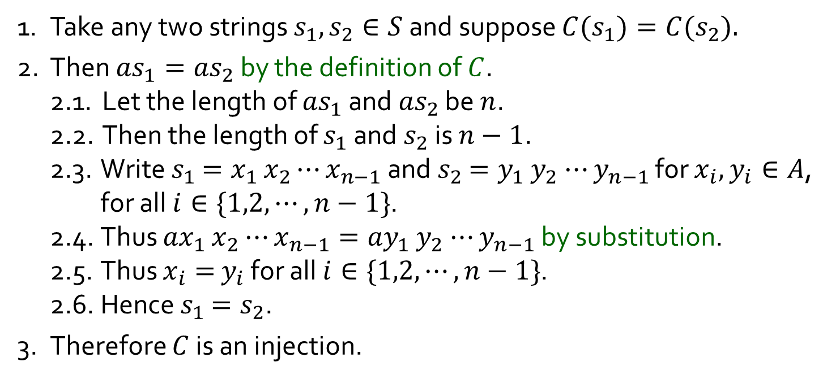
Q3.
Let $A=\{a,b\}$ and $S$ the set of all strings over $A$. Define function $C:S→S$ by $C(s)=as$for all $s∈S$. (a) Is $C$ an injection?
Yes
1. Take any two strings $s_{1},s_{2}∈S$ and suppose ${C(s}_{1})=C{(s}_{2}).$
2. Then ${as}_{1}={as}_{2}$ by the definition of $C$.
2.1. Let the length of ${as}_{1}$ and ${as}_{2}$ be $n$.
2.2. Then the length of $s_{1}$ and $s_{2}$ is $n−1$.
2.3. Write $s_{1}$ $=x_{1}$ $x_{2}$ $⋯x_{n−1}$ and $s_{2}$ $=y_{1}$ $y_{2}$ $⋯y_{n−1}$ for $x_{i},$ $y_{i}∈A$, for all $i∈\{1,2,⋯,n−1\}$.
2.4. Thus ${ax}_{1}$ $x_{2}$ $⋯x_{n−1}={ay}_{1}$ $y_{2}$ $⋯y_{n−1}$ by substitution.
2.5. Thus $x_{i}=$ $y_{i}$ for all $i∈\{1,2,⋯,n−1\}$.
2.6. Hence $s_{1}$ $=s_{2}$.
3. Therefore $C$ is an injection.
Injection. A function$f:X→Y$ is injective
iff $∀x_{1},x_{2}∈X \left(f\left(x_{1}\right)=f\left(x_{2}\right)⇒x_{1}=x_{2}\right).$

Slide 8
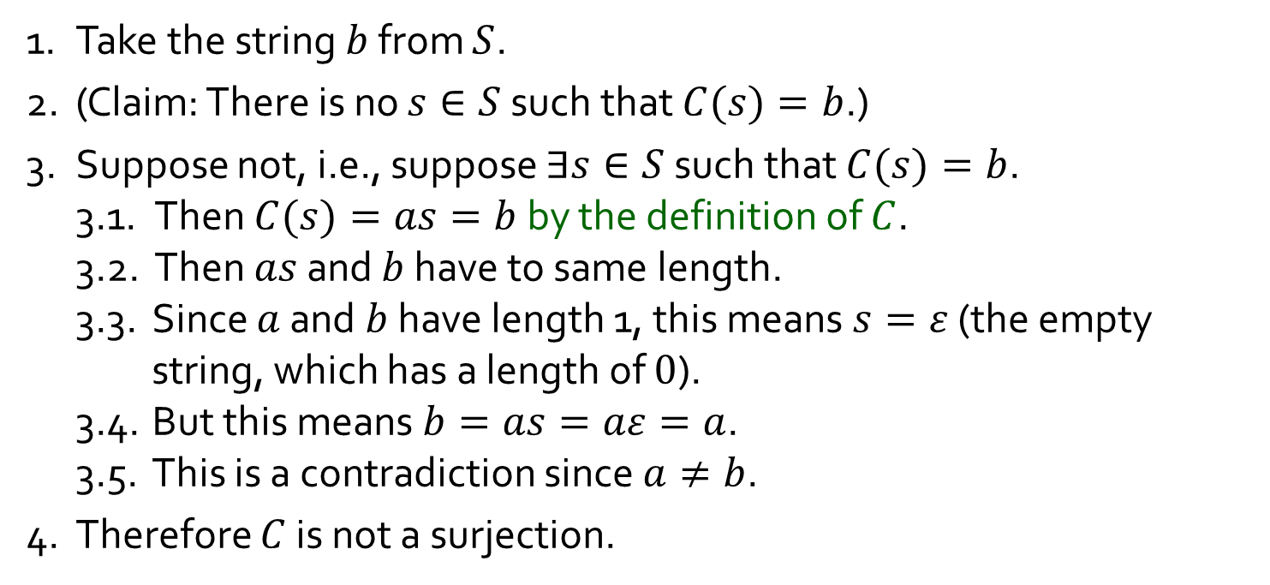
Q3.
Let $A=\{a,b\}$ and $S$ the set of all strings over $A$. Define function $C:S→S$ by $C(s)=as$for all $s∈S$. (b) Is $C$ a surjection?
No
1. Take the string $b$ from $S$.
2. (Claim: There is no $s∈S$ such that $C(s)=b$.)
3. Suppose not, i.e., suppose $∃s∈S$ such that $C(s)=b$.
3.1. Then $C(s)=as=b$by the definition of $C$.
3.2. Then $as$ and $b$ have to same length.
3.3. Since $a$ and $b$ have length 1, this means $s=ε$ (the empty string, which has a length of $0$).
3.4. But this means $b=as=aε=a$.
3.5. This is a contradiction since $a≠b$.
4. Therefore $C$ is not a surjection.
Surjection. A function$f:X→Y$ is surjective iff $∀y∈Y ∃x∈X \left(y=f\left(x\right)\right)$.

Slide 9

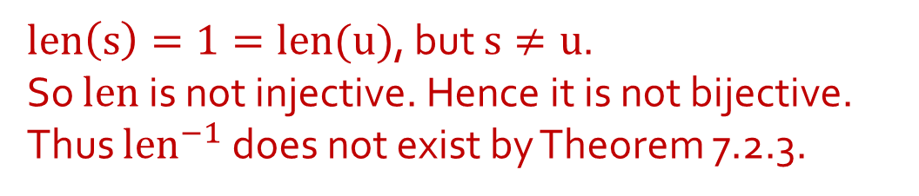

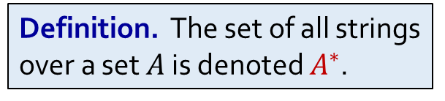
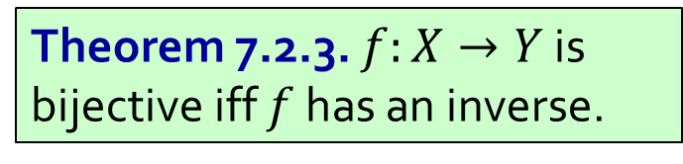
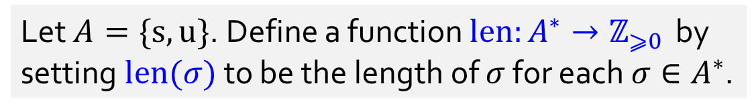
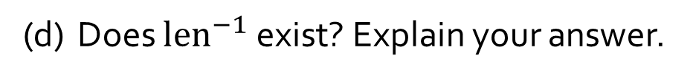

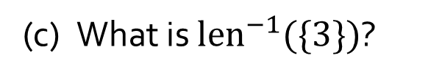
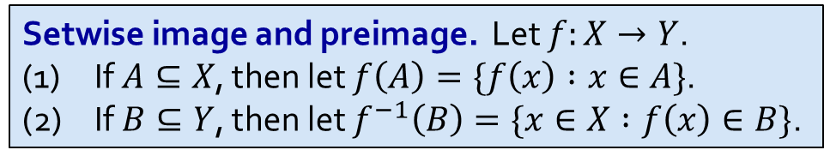
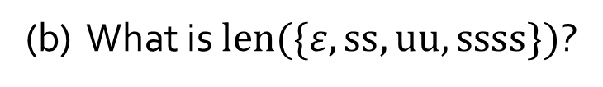

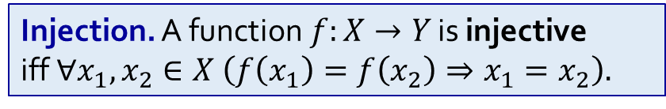
Q4.
Let $A=\{s,u\}$. Define a function $len:A^{∗}→ℤ_{⩾0 }$ by setting $len(σ)$ to be the length of $σ$ for each $σ∈A^{∗}$.
Definition. The set of all strings over a set $A$ is denoted $A^{∗}$.
$$3$$
(a) What is $len(suu)$?
(b) What is $len(\{ε,ss,uu,ssss\})$?
$$\{0,2,4\}$$
(c) What is ${len}^{−1}(\{3\})$?
$$\{sss,ssu,sus, uss,suu,usu,uus,uuu\}$$
(d) Does ${len}^{−1}$ exist? Explain your answer.
No.
$len\left(s\right)=1=len(u)$, but $s≠u$.
So $len$ is not injective. Hence it is not bijective.
Thus $len^{−1}$ does not exist by Theorem 7.2.3.
Theorem 7.2.3. $f:X→Y$ is bijective iff $f$ has an inverse.
Setwise image and preimage. Let $f:X→Y$.
(1) If $A⊆X$, then let $f\left(A\right)=\{f\left(x\right) :x∈A\}$.
(2) If $B⊆Y$, then let $f^{−1}\left(B\right)=\{x∈X :f\left(x\right)∈B\}$.
Injection. A function$f:X→Y$ is injective
iff $∀x_{1},x_{2}∈X \left(f\left(x_{1}\right)=f\left(x_{2}\right)⇒x_{1}=x_{2}\right).$

Slide 10


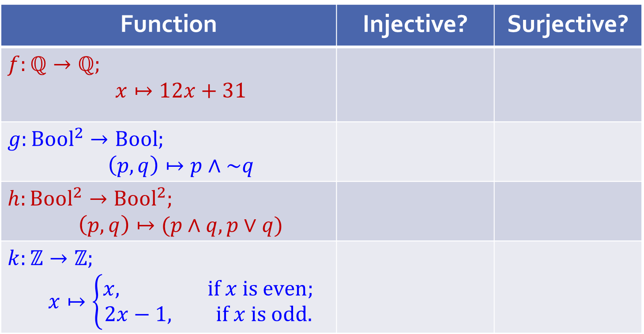
Q5.
Is the function injective? Surjective? Prove. If it is bijective, find the inverse function. Here denote by Bool the set {true; false}.
Quick check before we go into the details:
Function | Injective? | Surjective?
$$f:ℚ→ℚ;$$ $$x↦12x+31$$
$$g:Bool^{2}→Bool;$$ $$\left(p,q\right)↦p∧\sim q$$
$$h:Bool^{2}→Bool^{2};$$ $$\left(p,q\right)↦(p∧q,p∨q)$$
$$k:ℤ→ℤ;$$ $$x↦\left\{\begin{aligned}x, if x is even; \\ 2x−1, if x is odd.\end{aligned}\right.$$

Slide 11
Q5.
What does the previous table show?
A function can be
injective but not surjective;
surjective but not injective;
injective and surjective (i.e. bijective); or
neither injective nor surjective.
All four cases are possible!

Slide 12
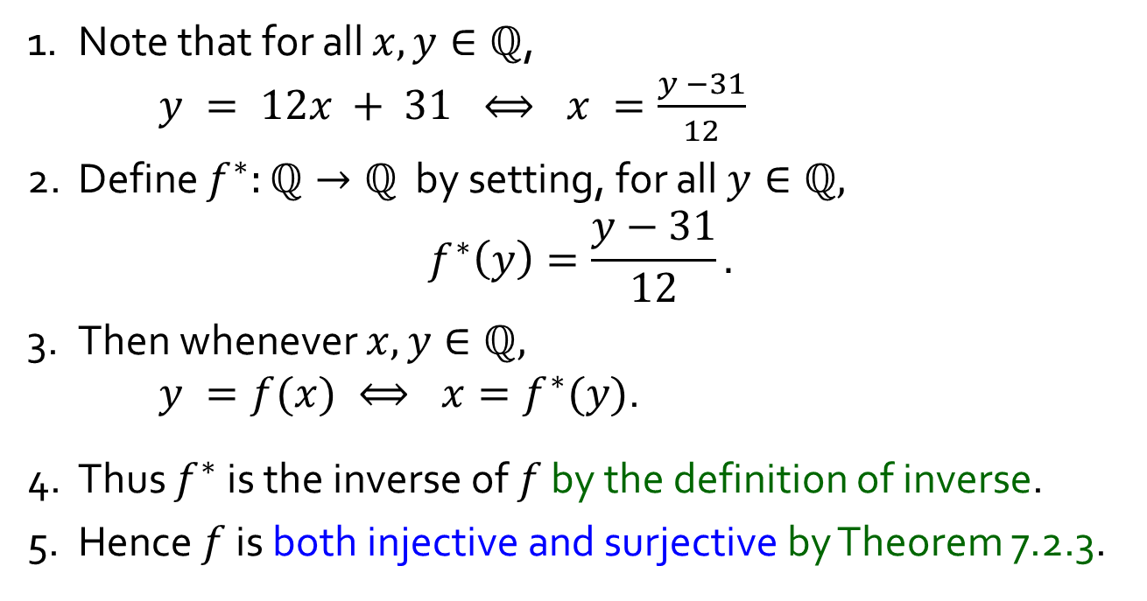
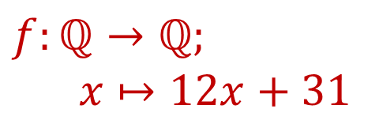
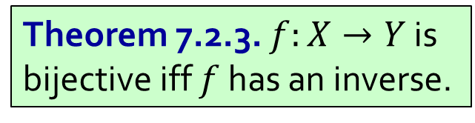
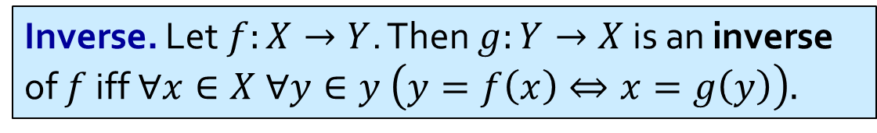
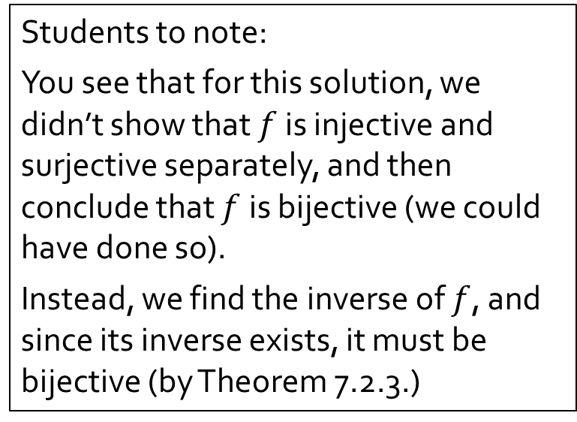
Q5a.
$$f:ℚ→ℚ;$$
$$x↦12x+31$$
Both Injective and Surjective
Students to note:
You see that for this solution, we didn’t show that $f$ is injective and surjective separately, and then conclude that $f$ is bijective (we could have done so).
Instead, we find the inverse of $f$, and since its inverse exists, it must be bijective (by Theorem 7.2.3.)
1. Note that for all $x,y∈ℚ$,
$y = 12x + 31 ⟺ x =\frac{y −31}{12}$
2. Define $f^{∗}:ℚ→ℚ$ by setting, for all $y∈ℚ,$ $$f^{∗}\left(y\right)=\frac{y−31}{12}.$$
3. Then whenever $x,y∈ℚ,$
$y =f(x) ⟺ x=f^{∗}(y)$.
4. Thus $f^{∗}$ is the inverse of $f$ by the definition of inverse.
5. Hence $f$ is both injective and surjective by Theorem 7.2.3.
Inverse. Let $f:X→Y$. Then $g:Y→X$ is an inverse of $f$ iff $∀x∈X ∀y∈y \left(y=f\left(x\right)⇔x=g\left(y\right)\right).$
Theorem 7.2.3. $f:X→Y$ is bijective iff $f$ has an inverse.

Slide 13
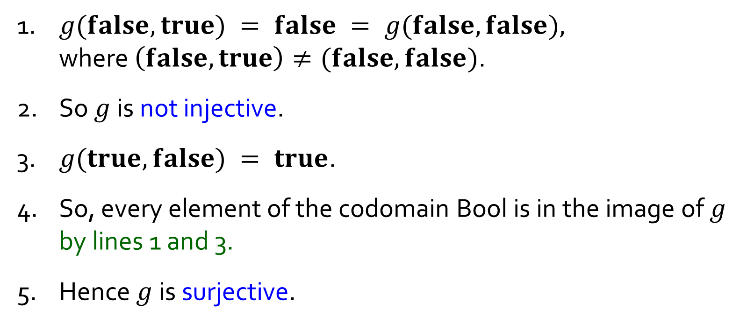
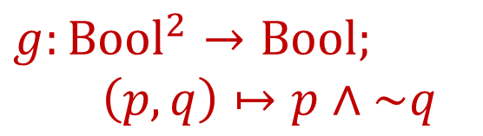
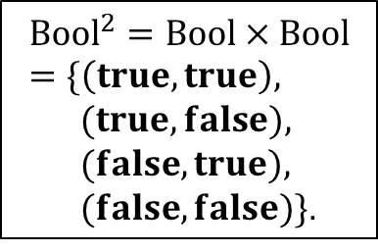
Q5b.
$$g:Bool^{2}→Bool;$$
$$\left(p,q\right)↦p∧\sim q$$
Not Injective But Surjective
$${Bool}^{2}=Bool×Bool=\{\left(true,true\right),$$
$(true,false),$
$(false,true),$
$(false,false)\}$.
1. $g(false,true) = false = g(false,false),$
where $\left(false,true\right)≠(false,false)$.
2. So $g$ is not injective.
3. $g(true, false) = true$.
4. So, every element of the codomain Bool is in the image of $g$ by lines 1 and 3.
5. Hence $g$is surjective.

Slide 14
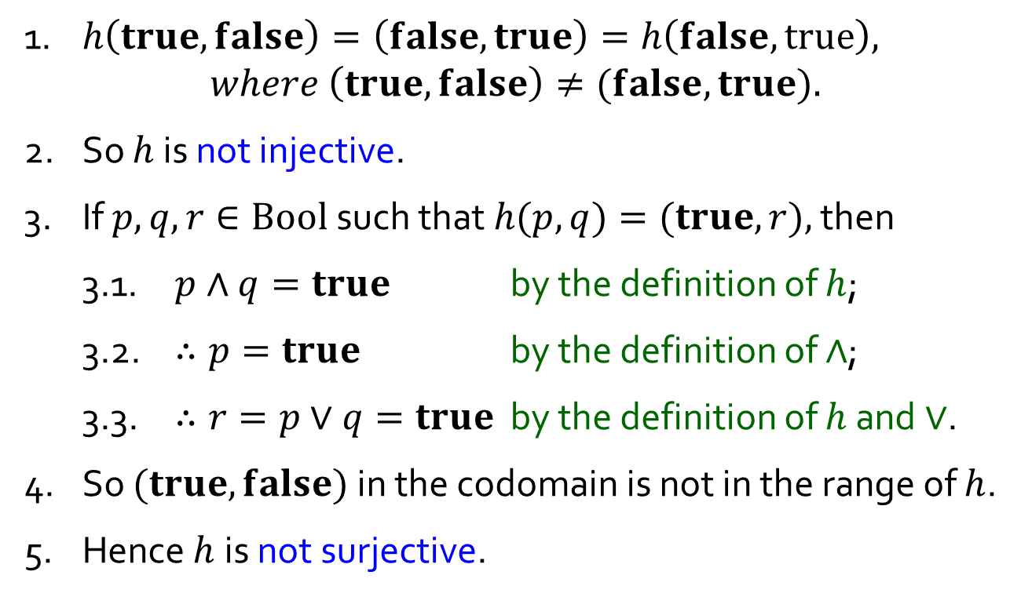
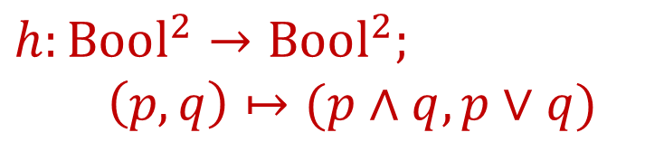
Q5c.
$$h:Bool^{2}→Bool^{2};$$
$$\left(p,q\right)↦(p∧q,p∨q)$$
Not Injective, Not Surjective
$${Bool}^{2}=Bool×Bool=\{\left(true,true\right),$$
$(true,false),$
$(false,true),$
$(false,false)\}$.
1. $h\left(true,false\right)=\left(false,true\right)=h\left(false, true\right),$
$$where \left(true, false\right)≠(false, true).$$
2. So $h$ is not injective.
3. If $p,q,r∈Bool$such that $h(p,q)=(true,r),$ then
3.1. $p∧q=true$ by the definition of $h$;
3.2. $∴p=true$ by the definition of $∧$;
3.3. $∴r=p∨q=true$ by the definition of $h$ and $∨$.
4. So $(true,false)$ in the codomain is not in the range of $h$.
5. Hence $h$is not surjective.

Slide 15



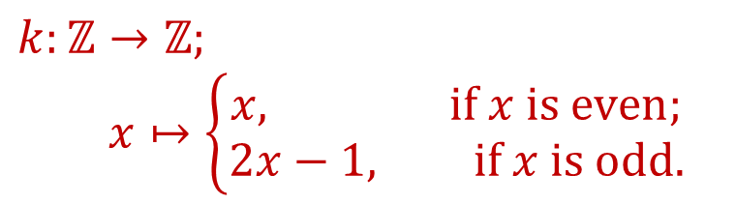



Q5d.
Assumption 1 (Lecture #1).
Every integer is even or odd, but not both.
$$k:ℤ→ℤ;$$
$$x↦\left\{\begin{aligned}x, if x is even; \\ 2x−1, if x is odd.\end{aligned}\right.$$
Injective, Not Surjective
$x$is odd
$6$ –
$4$ –
$2$ –
$x$is even
$$−6$$ | $$−4$$ | $$−2$$
| | | | |
– $−2$
– $−4$
– $−6$
| | | | | | |
 | $$2$$ | $$4$$ | $$6$$

Slide 16
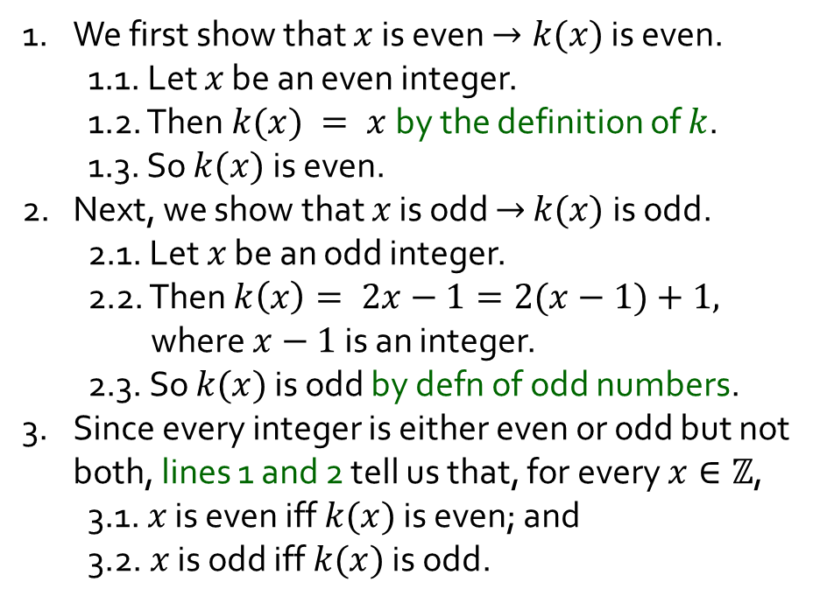
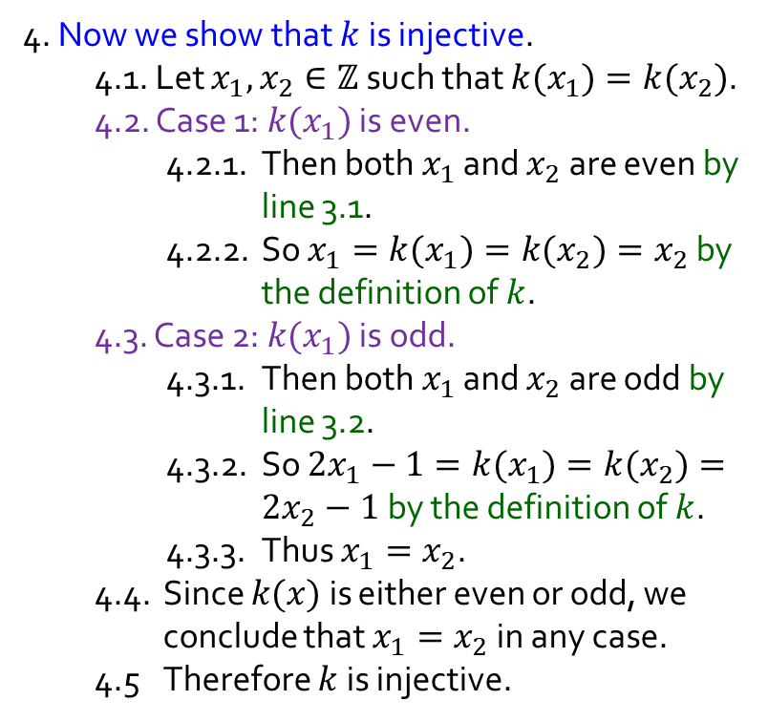
Q5d.
Assumption 1 (Lecture #1).
Every integer is even or odd, but not both.
$$k:ℤ→ℤ;$$
$$x↦\left\{\begin{aligned}x, if x is even; \\ 2x−1, if x is odd.\end{aligned}\right.$$
Injective, Not Surjective
4. Now we show that $k$ is injective.
4.1. Let $x_{1},x_{2}∈ℤ$such that $k(x_{1})=k(x_{2})$.
4.2. Case 1: $k(x_{1})$ is even.
4.2.1. Then both $x_{1}$ and $x_{2}$are even by line 3.1.
4.2.2. So $x_{1}=k(x_{1})=k(x_{2})=x_{2}$ by the definition of $k$.
4.3. Case 2: $k(x_{1})$ is odd.
4.3.1. Then both $x_{1}$ and $x_{2}$are odd by line 3.2.
4.3.2. So $2x_{1}−1=k(x_{1})=k(x_{2})=2x_{2}−1$ by the definition of $k$.
4.3.3. Thus $x_{1}=x_{2}$.
4.4. Since $k(x)$ is either even or odd, we conclude that $x_{1}=x_{2}$ in any case.
4.5 Therefore $k$ is injective.
1. We first show that $x$ is even $→k(x)$ is even.
1.1. Let $x$ be an even integer.
1.2. Then $k(x) = x$by the definition of $k$.
1.3. So $k(x)$ is even.
2. Next, we show that $x$ is odd $→$ $k(x)$is odd.
2.1. Let $x$ be an odd integer.
2.2. Then $k\left(x\right)= 2x−1=2(x−1)+1,$ where $x−1$is an integer.
2.3. So $k(x)$ is odd by defn of odd numbers.
3. Since every integer is either even or odd but not both, lines 1 and 2 tell us that, for every $x∈ℤ$,
3.1. $x$ is even iff $k(x)$ is even; and
3.2. $x$ is odd iff $k(x)$ is odd.
Continued …

Slide 17
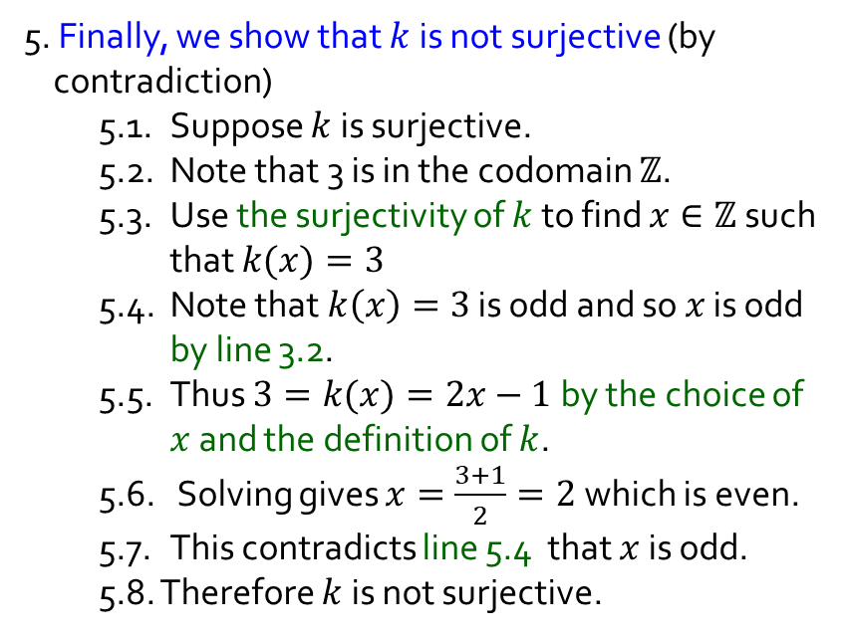

Q5d.
Assumption 1 (Lecture #1).
Every integer is even or odd, but not both.
$$k:ℤ→ℤ;$$
$$x↦\left\{\begin{aligned}x, if x is even; \\ 2x−1, if x is odd.\end{aligned}\right.$$
Injective, Not Surjective
5. Finally, we show that $k$ is not surjective (by contradiction)
5.1. Suppose $k$ is surjective.
5.2. Note that 3 is in the codomain $ℤ$.
5.3. Use the surjectivity of $k$ to find $x∈ℤ$ such that $k(x)=3$
5.4. Note that $k\left(x\right)=3$ is odd and so $x$ is odd by line 3.2.
5.5. Thus $3=k(x)=2x−1$ by the choice of $x$ and the definition of $k$.
5.6. Solving gives $x=\frac{3+1}{2}=2$ which is even.
5.7. This contradicts line 5.4 that $x$ is odd.
5.8. Therefore $k$ is not surjective.
4. Now we show that $k$ is injective.
4.1. Let $x_{1},x_{2}∈ℤ$such that $k(x_{1})=k(x_{2})$.
4.2. Case 1: $k(x_{1})$ is even.
4.2.1. Then both $x_{1}$ and $x_{2}$are even by line 3.1.
4.2.2. So$x_{1}=k(x_{1})=k(x_{2})=x_{2}$ by the definition of $k$.
4.3. Case 2: $k(x_{1})$ is odd.
4.3.1. Then both $x_{1}$ and $x_{2}$are odd by line 3.2.
4.3.2. So $2x_{1}−1=k(x_{1})=k(x_{2})=2x_{2}−1$ by the definition of $k$.
4.3.3. Thus $x_{1}=x_{2}$.
4.4. Since $k(x)$ is either even or odd, we conclude that $x_{1}=x_{2}$ in any case.
4.5 Therefore $k$ is injective.

Slide 18

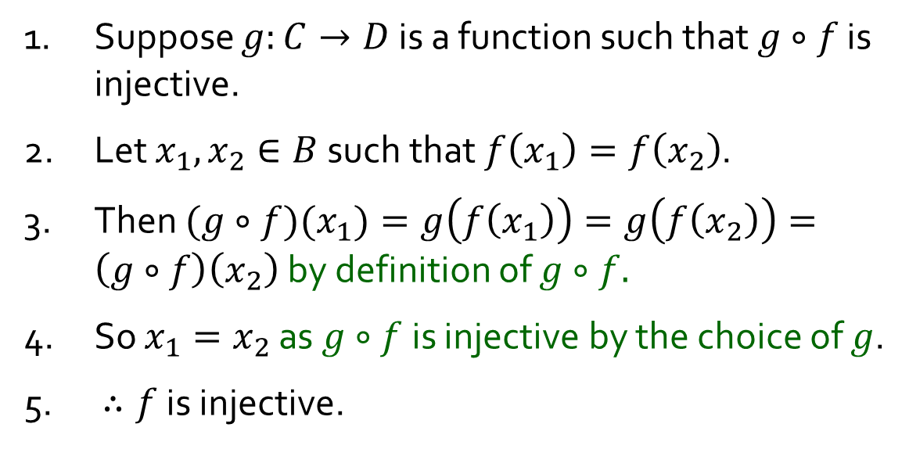

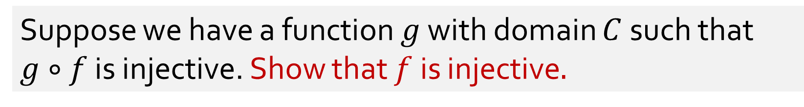



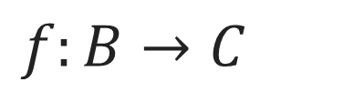

Q6.
$f:B→C$
Suppose we have a function $g$ with domain $C$ such that $g∘f$ is injective. Show that $f$is injective$.$
1. Suppose $g:C→D$ is a function such that $g∘f$ is injective.
2. Let $x_{1},x_{2}∈B$such that $f\left(x_{1}\right)=f\left(x_{2}\right)$.
3. Then $(g∘f)(x_{1})=g\left(f\left(x_{1}\right)\right)=g\left(f\left(x_{2}\right)\right)=\left(g∘f\right)\left(x_{2}\right)$ by definition of $g∘f.$
4. So $x_{1}=x_{2}$ as $g∘f$ is injective by the choice of $g$.
5. $∴f$ is injective.
$$B$$
$$C$$
$$D$$
$$f$$
$$g$$
$$g∘f$$
Injection. A function$f:X→Y$ is injective
iff $∀x_{1},x_{2}∈X \left(f\left(x_{1}\right)=f\left(x_{2}\right)⇒x_{1}=x_{2}\right).$

Slide 19


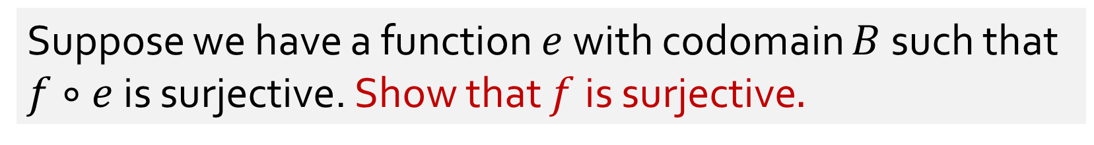


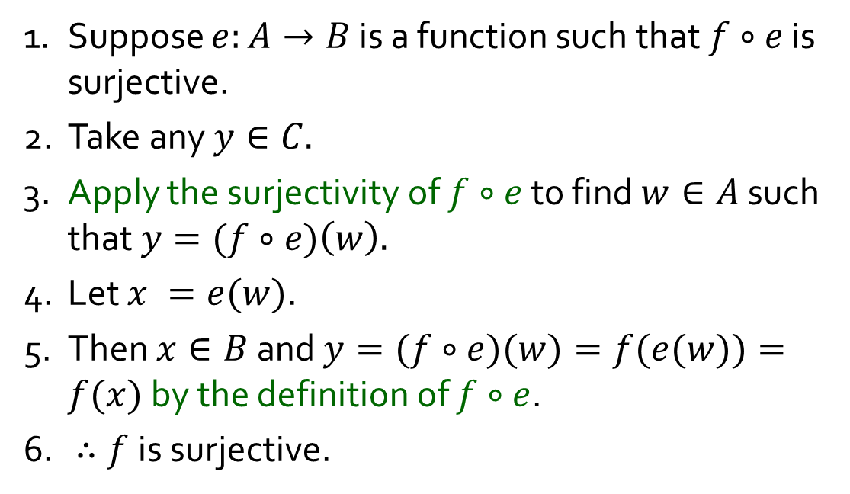


Q7.
$f:B→C$
Suppose we have a function $e$ with codomain $B$ such that $f∘e$ is surjective. Show that $f$is surjective$.$
1. Suppose $e:A→B$ is a function such that $f∘e$ is surjective.
2. Take any $y∈C.$
3. Apply the surjectivity of $f∘e$ to find $w∈A$ such that $y=(f∘e)\left(w\right).$
4. Let $x =e(w)$.
5. Then $x∈B$and $y=(f∘e)(w)=f(e(w))=f(x)$ by the definition of $f∘e$.
6. $∴f$ is surjective.
$$A$$
$$B$$
$$C$$
$$e$$
$$f$$
$$f∘e$$
Surjection. A function$f:X→Y$ is surjective iff $∀y∈Y ∃x∈X \left(y=f\left(x\right)\right)$.

Slide 20
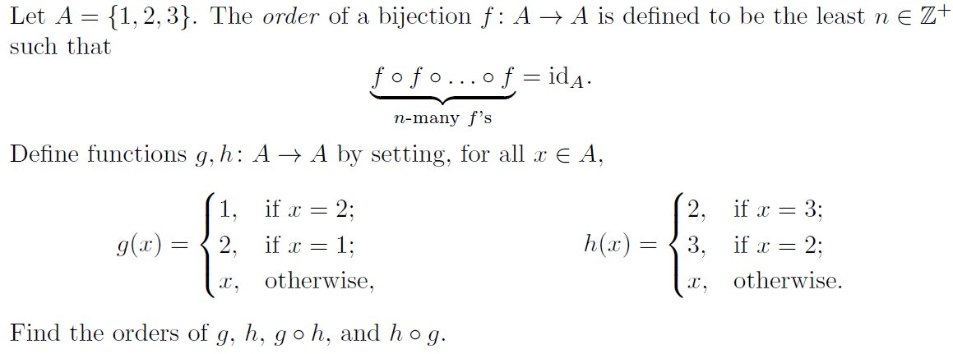


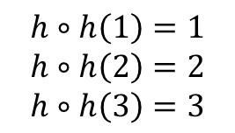







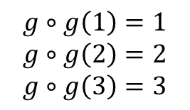



Q8.
$$A$$
$$g$$
$$A$$
$$g$$
$$A$$
$$A$$
$$h$$
$$A$$
$$h$$
$$A$$
1
2
3
1
2
3
1
2
3
$$g∘g\left(1\right)=1$$
$$g∘g\left(2\right)=2$$
$$g∘g\left(3\right)=3$$
1
2
3
1
2
3
1
2
3
$$h∘h\left(1\right)=1$$
$$h∘h\left(2\right)=2$$
$$h∘h\left(3\right)=3$$
$∴$ order of $g$ = 2
$∴$ order of $h$ = 2

Slide 21
















Q8.
Is $\left(g∘h\right)∘\left(g∘h\right)={id}_{A}$?
Is $\left(g∘h\right)∘\left(g∘h\right)∘\left(g∘h\right)={id}_{A}$?
$$A$$
$$h$$
$$A$$
$$g$$
$$A$$
$$A$$
$$A$$
$$A$$
$$A$$
1
2
3
1
2
3
1
2
3
1
2
3
1
2
3
1
2
3
1
2
3
$$≡$$
$$g∘h$$
$$g∘h$$
$$g∘h$$
$$g∘h$$

Slide 22










Q8.
Is $\left(h∘g\right)∘\left(h∘g\right)={id}_{A}$?
Is $\left(h∘g\right)∘\left(h∘g\right)∘\left(h∘g\right)={id}_{A}$?
$$A$$
$$g$$
$$A$$
$$h$$
$$A$$
$$A$$
$$A$$
$$A$$
$$A$$
1
2
3
1
2
3
1
2
3
1
2
3
1
2
3
1
2
3
1
2
3
$$≡$$
$$h∘g$$
$$h∘g$$
$$h∘g$$
$$h∘g$$

Slide 23

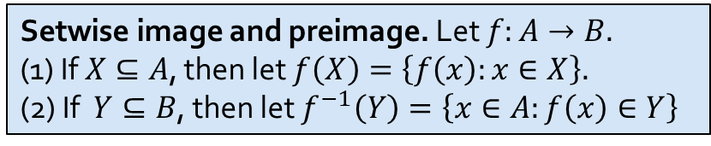
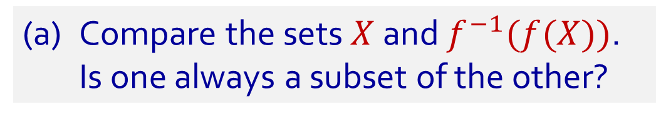
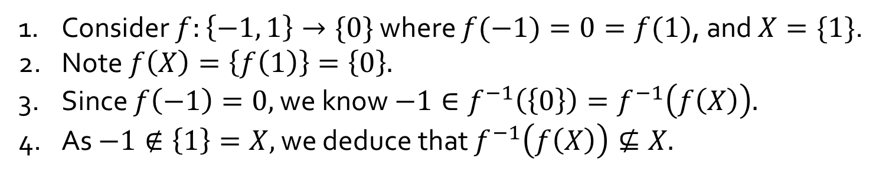








Q9.
Let $f:A→B$ be a function. Let $X⊆A$ and $Y⊆B$.
(a) Compare the sets $X$ and $f^{−1}(f(X))$.
Is one always a subset of the other?
$$A$$
$$f$$
$$B$$
$$f^{−1}\left(f\left(X\right)\right)$$
Is $X⊆f^{−1}(f(X))$ always true?
Yes
$$f(X)$$
1. Let $x∈X.$
2. Then $f\left(x\right)∈f\left(X\right)$ by the definition of $f\left(X\right).$
3. So $x∈f^{−1}(f(X))$ by the definition of $f^{−1}(f(X))$ .
$$X$$
Is$f^{−1}(f(X))⊆X$ always true?
No
1. Consider $f:\left\{−1, 1\right\}→\{0\}$ where $f(−1)=0=f(1)$, and $X=\{1\}$.
2. Note $f\left(X\right)=\left\{f\left(1\right)\right\}=\left\{0\right\}.$
3. Since $f\left(−1\right)=0,$ we know $−1∈f^{−1}\left(\left\{0\right\}\right)=f^{−1}\left(f\left(X\right)\right).$
4. As $−1∉\left\{1\right\}=X,$ we deduce that $f^{−1}\left(f\left(X\right)\right)⊈X.$
Setwise image and preimage. Let $f:A→B.$
(1) If $X⊆A$, then let $f\left(X\right)=\left\{f\left(x\right):x∈X\right\}.$
(2) If $Y⊆B$, then let $f^{−1}\left(Y\right)=\left\{x∈A:f\left(x\right)∈Y\right\}$
23

Slide 24









Q9.
Let $f:A→B$ be a function. Let $X⊆A$ and $Y⊆B$.
(b) Compare the sets $Y$ and $f(f^{−1}(Y))$.
Is one always a subset of the other?
$$A$$
$$f$$
$$B$$
Is $f(f^{−1}(Y))⊆Y$ always true?
Yes
$f^{−1}(Y$)
$$f\left(f^{−1}\left(Y\right)\right)$$
Take any $y∈f(f^{−1}\left(Y\right)).$
2. There is some $x∈f^{−1}\left(Y\right)$ s.t. $y=f\left(x\right)$ by the def^{n} of $f\left(f^{−1}\left(Y\right)\right)$.
3. As $x∈f^{−1}\left(Y\right),$ we get $y′∈Y$ which makes $y′=f(x)$.
4. Since $f$ is a function, $y=f\left(x\right)=y^{′}∈Y$.
$$Y$$
Is $Y⊆f(f^{−1}(Y))$ always true?
No
1. Consider $f:\{0\}→\left\{−1, 1\right\}$ where $f\left(0\right)=1$, and $Y=\{−1\}$.
2. Note that no $x∈\left\{0\right\}$ makes $f\left(X\right)=−1.$
3. So $f^{−1}\left(Y\right)=∅$ by the definition of $f^{−1}\left(Y\right).$
4. This entails $f\left(f^{−1}\left(Y\right)\right)=∅⊉\left\{−1\right\}=Y$ by the definition of $f(f^{−1}\left(Y\right))$.
Setwise image and preimage. Let $f:A→B.$
(1) If $X⊆A$, then let $f\left(X\right)=\left\{f\left(x\right):x∈X\right\}.$
(2) If $Y⊆B$, then let $f^{−1}\left(Y\right)=\left\{x∈A:f\left(x\right)∈Y\right\}$
24

Slide 25

Q10(+)
Consider the equivalence relation $∼$ on $ℚ$ defined by
$$∀x,y∈ℚ ( x∼y ⇔ x−y∈ℤ ).$$
Define addition on $ℚ/\sim$ by setting, for all $\left[x\right],\left[y\right]∈ℚ/\sim$,
$$\left[x\right]+\left[y\right]=\left[x+y\right].$$
Is $+$ well defined on $ℚ/\sim$?
In other words, is it true that, according to this definition, for all $\left[x_{1}\right],\left[y_{1}\right],\left[x_{2}\right],\left[y_{2}\right]∈ℚ/\sim$,
$$\left[x_{1}\right]=\left[x_{2}\right]∧\left[y_{1}\right]=\left[y_{2}\right] ⇒ \left[x_{1}\right]+\left[y_{1}\right]=\left[x_{2}\right]+\left[y_{2}\right]?$$
Consider $A=\left\{…,−\frac{8}{3},−\frac{5}{3},−\frac{2}{3},\frac{1}{3},\frac{4}{3},\frac{7}{3},\frac{10}{3},…\right\}$ and $B=\left\{…,−\frac{13}{5},−\frac{8}{5},−\frac{3}{5},\frac{2}{5},\frac{7}{5},\frac{12}{5},\frac{17}{5},…\right\}$.
Note $A,B∈ℚ/\sim$. What is $A+B$?
Since $A=\left[\frac{1}{3}\right]$ and $B=\left[\frac{2}{5}\right]$, the definition above tells us $A+B=\left[\frac{1}{3}\right]+\left[\frac{2}{5}\right]=\left[\frac{1}{3}+\frac{2}{5}\right]=\left[\frac{11}{15}\right].$
$$=$$
Since $A=\left[\frac{4}{3}\right]$ and $B=\left[\frac{7}{5}\right]$, the definition above tells us $A+B=\left[\frac{4}{3}\right]+\left[\frac{7}{5}\right]=\left[\frac{4}{3}+\frac{7}{5}\right]=\left[\frac{41}{15}\right].$
25

Slide 26

Q10(+)
Consider the equivalence relation $∼$ on $ℚ$ defined by
$$∀x,y∈ℚ ( x∼y ⇔ x−y∈ℤ ).$$
Define addition on $ℚ/\sim$ by setting, for all $\left[x\right],\left[y\right]∈ℚ/\sim$,
$$\left[x\right]+\left[y\right]=\left[x+y\right].$$
Yes!
Is $+$ well defined on $ℚ/\sim$?
In other words, is it true that, according to this definition, for all $\left[x_{1}\right],\left[y_{1}\right],\left[x_{2}\right],\left[y_{2}\right]∈ℚ/\sim$,
$$\left[x_{1}\right]=\left[x_{2}\right]∧\left[y_{1}\right]=\left[y_{2}\right] ⇒ \left[x_{1}\right]+\left[y_{1}\right]=\left[x_{2}\right]+\left[y_{2}\right]?$$
1. Let $\left[x_{1}\right],\left[y_{1}\right],\left[x_{2}\right],\left[y_{2}\right]∈ℚ/\sim$ such that $\left[x_{1}\right]=[x_{2}]$ and $\left[y_{1}\right]=\left[y_{2}\right]$.
2. So $x_{1}∼x_{2}$ and $y_{1}∼y_{2}$ by Lemma Rel.1.
3. Use the definition of $∼$ to find $k,ℓ∈ℤ$ such that $x_{1}−x_{2}=k$ and $y_{1}−y_{2}=ℓ$.
4. Note $\left(x_{1}+y_{1}\right)−\left(x_{2}+y_{2}\right)=\left(x_{1}−x_{2}\right)+\left(y_{1}−y_{2}\right)=k+ℓ∈ℤ$ as $ℤ$ is closed under $+$.
5. So $x_{1}+y_{1}∼x_{2}+y_{2}$ by the definition of $\sim$.
6. Hence $\left[x_{1}\right]+\left[y_{1}\right]=\left[x_{1}+y_{1}\right]=\left[x_{2}+y_{2}\right]=\left[x_{2}\right]+\left[y_{2}\right]$ by Lemma Rel.1.
Lemma Rel.1. The following are equivalent: (i) $x∼y$; (ii) $\left[x\right]=\left[y\right]$; (iii) $\left[x\right]∩\left[y\right]≠∅$.
26

Slide 27

Q10(⋅)
Consider the equivalence relation $∼$ on $ℚ$ defined by
$$∀x,y∈ℚ ( x∼y ⇔ x−y∈ℤ ).$$
Define addition on $ℚ/\sim$ by setting, for all $\left[x\right],\left[y\right]∈ℚ/\sim$,
$$\left[x\right]+\left[y\right]=\left[x+y\right].$$
No!
Is $⋅$ well defined on $ℚ/\sim$?
In other words, is it true that, according to this definition, for all $\left[x_{1}\right],\left[y_{1}\right],\left[x_{2}\right],\left[y_{2}\right]∈ℚ/\sim$,
$$\left[x_{1}\right]=\left[x_{2}\right]∧\left[y_{1}\right]=\left[y_{2}\right] ⇒ \left[x_{1}\right]⋅\left[y_{1}\right]=\left[x_{2}\right]⋅\left[y_{2}\right]?$$
So $\left[\frac{1}{2}\right]=\left[\frac{−1}{2}\right]$ by Lemma Rel.1.
So $\left[\frac{1}{4}\right]≠\left[\frac{−1}{4}\right]$ by Lemma Rel.1.
1. Note that $\frac{1}{2}−\frac{−1}{2}=1∈ℤ$. This implies $\frac{1}{2}∼\frac{−1}{2}$. So $\left[\frac{1}{2}\right]=\left[\frac{−1}{2}\right]$ by Lemma 6.3.4.
2. Note also $\frac{1}{4}−\frac{−1}{4}=\frac{1}{2}∉ℤ$. This implies $\frac{1}{4}≁\frac{−1}{4}$. So $\left[\frac{1}{4}\right]≠\left[\frac{−1}{4}\right]$ by Lemma 6.3.4.
3. Therefore, according to the definition of $⋅$ on $ℚ/\sim$ above,
$$\left[\frac{1}{2}\right]⋅\left[\frac{1}{2}\right]=\left[\frac{1}{2}⋅\frac{1}{2}\right]=\left[\frac{1}{4}\right]≠\left[\frac{−1}{4}\right]=\left[\frac{1}{2}⋅\frac{−1}{2}\right]=\left[\frac{1}{2}\right]⋅\left[\frac{−1}{2}\right].$$
This implies $\frac{1}{2}∼\frac{−1}{2}$. $\left[\frac{1}{2}\right]$
This implies $\frac{1}{4}≁\frac{−1}{4}$. $\left[\frac{1}{2}\right]$
$$\left[\frac{1}{2}⋅\frac{1}{2}\right]$$
$$=\left[\frac{1}{4}\right]$$
$$\left[\frac{−1}{4}\right]=$$
$$\left[\frac{1}{2}⋅\frac{−1}{2}\right]$$
$$≠$$
Lemma Rel.1. The following are equivalent: (i) $x∼y$; (ii) $\left[x\right]=\left[y\right]$; (iii) $\left[x\right]∩\left[y\right]≠∅$.
27

Slide 28
END OF FILE

