Slide 1
CS1231S Tutorial #2
Predicate Logic and Proofs
(AY2022/23 Semester 1)
Prepared by Aaron Tan

Slide 2
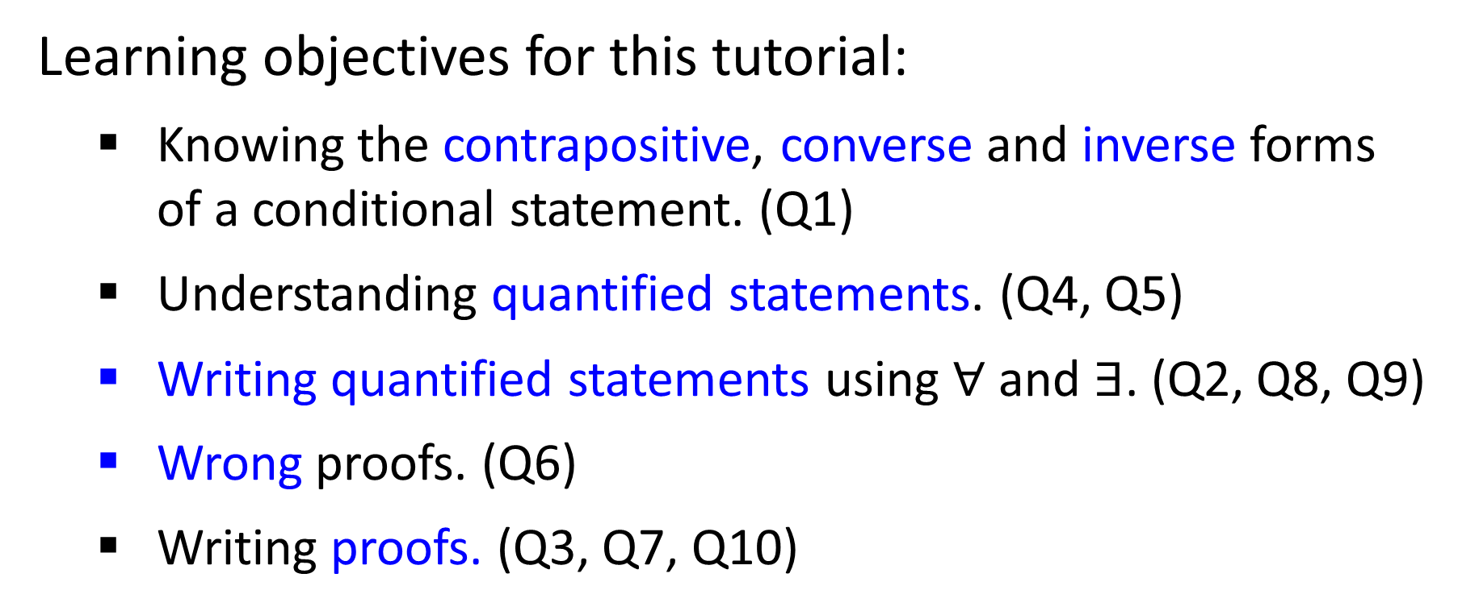
Learning objectives for this tutorial:
Knowing the contrapositive, converse and inverse forms of a conditional statement. (Q1)
Understanding quantified statements. (Q4, Q5)
Writing quantified statements using $∀$and $∃$. (Q2, Q8, Q9)
Wrong proofs. (Q6)
Writing proofs. (Q3, Q7, Q10)

Slide 3




Q1
Converse, inverse and contrapositive.
Quick recap:
Conditional statement:
$$p →q$$
Converse:
$$q →p$$
Inverse:
$$\sim p →\sim q$$
Contrapositive:
$$\sim q →\sim p$$

Slide 4
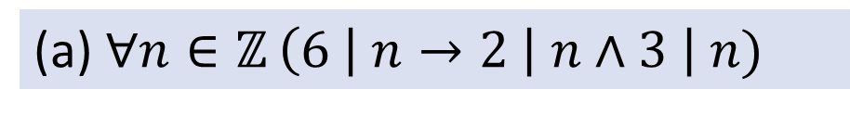
Q1
Converse, inverse and contrapositive.
Are they true or false?
(a) $∀n∈ℤ$ $\left(6 \right| n→2 \left| n∧3 \right| n)$
True
True
Converse:
$$∀n∈ℤ \left(2 \right| n ∧3 | n→6 | n)$$
$$∀n∈ℤ (6∤n→2∤n∨3∤n)$$
Inverse:
True
Contrapositive:
$$∀n∈ℤ (2∤n∨3∤n→6∤n)$$
True

Slide 5
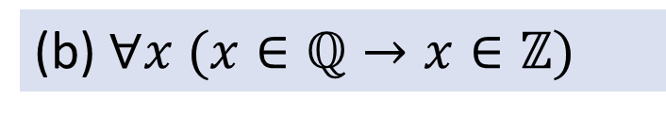
Q1
Converse, inverse and contrapositive.
Are they true or false?
(b) $∀x (x∈ℚ→x∈ℤ)$
False
True
Converse:
$$∀x (x∈ℤ→x∈ℚ)$$
$$∀x (x∉ℚ→x∉ℤ)$$
Inverse:
True
$$∀x (x∉ℤ→x∉ℚ)$$
Contrapositive:
False
Counterexample for original statement and contrapositive?

Slide 6
Q1
Converse, inverse and contrapositive.
Are they true or false?
(c) $∀p,q∈ℤ \left(Even\left(p\right)∧Even\left(q\right)→Even\left(p+q\right)\right)$.
True
Converse:
$$∀p,q∈ℤ \left(Even\left(p+q\right)→Even\left(p\right)∧Even\left(q\right)\right).$$
False
Inverse:
$$∀p,q∈ℤ \left(\sim Even\left(p\right)∨\sim Even\left(q\right)→\sim Even\left(p+q\right)\right)\text{.}$$
False
Contrapositive:
$$∀p,q∈ℤ \left(\sim Even\left(p+q\right)→\sim Even\left(p\right)∨\sim Even\left(q\right)\right).$$
True
Counterexample for converse and inverse?

Slide 7


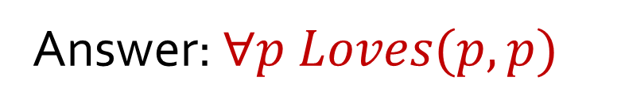
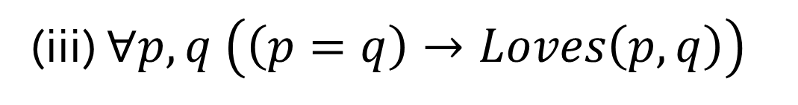
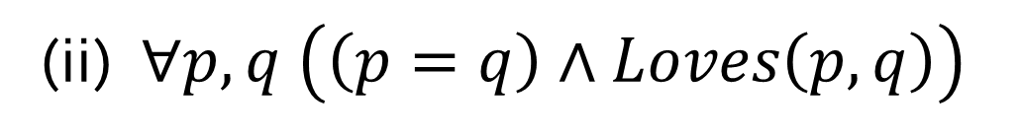
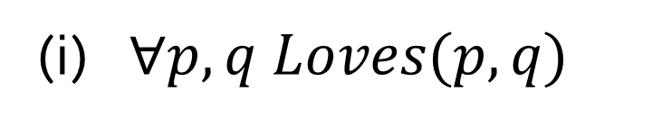
Q2
(a) Everybody loves himself or herself.
(i) $∀p,q Loves(p,q)$
Everybody loves everybody.
Unless there is only one person.
(ii) $∀p,q \left(\left(p=q\right)∧Loves\left(p,q\right)\right)$
(iii) $∀p,q \left(\left(p=q\right)→Loves\left(p,q\right)\right)$
Answer: $∀p Loves(p,p)$

Slide 8
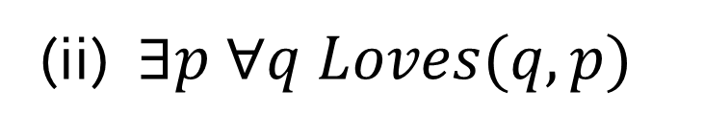
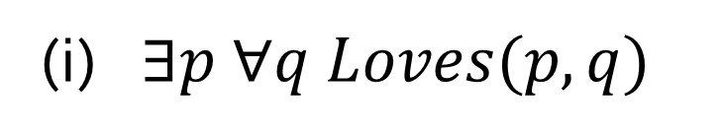
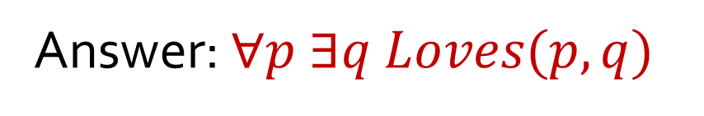
Q2
(b) Everybody loves somebody.
There is a person who loves everybody.
(i) $∃p ∀q Loves(p,q)$
There is a person whom everybody loves.
(ii) $∃p ∀q Loves(q,p)$
Answer: $∀p ∃q Loves(p,q)$

Slide 9
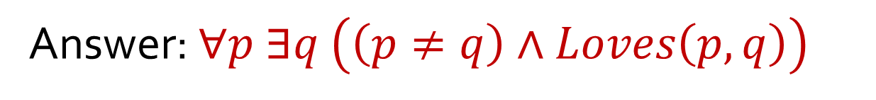
Q2
(c) Everybody loves somebody else.
Is this the same as (b) Everybody love somebody ($∀p ∃q Loves(p,q)$)?
No
Answer: $∀p ∃q \left(\left(p≠q\right)∧Loves\left(p,q\right)\right)$

Slide 10

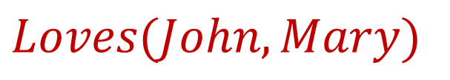
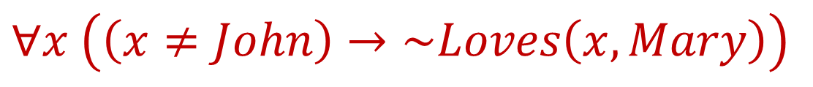
Q2
(d) Nobody except John loves Mary.
$$Loves(John,Mary)$$
$$∧$$
$$∀x \left(\left(x≠John\right)→\sim Loves\left(x,Mary\right)\right)$$

Slide 11
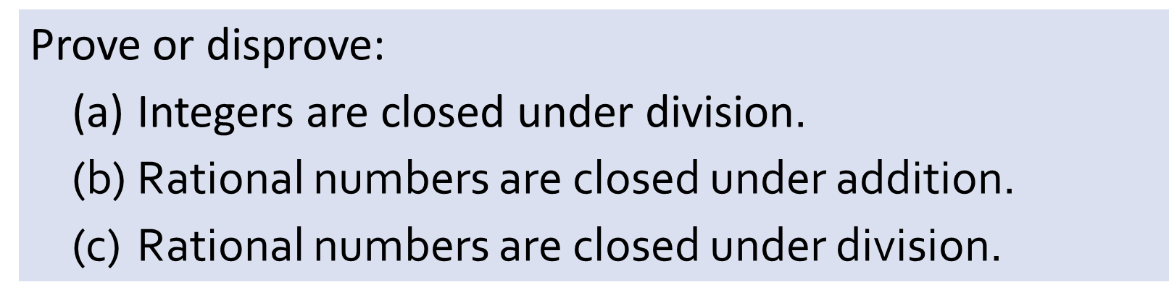
Q3
Prove or disprove:
(a) Integers are closed under division$\text{.}$
(b) Rational numbers are closed under addition.
(c) Rational numbers are closed under division.
Counterexample for (a)?
Counterexample for (c)?

Slide 12
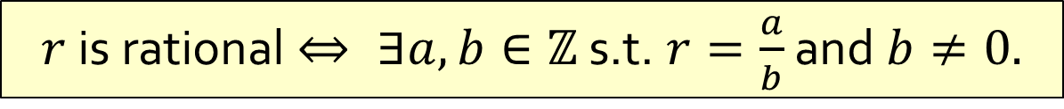
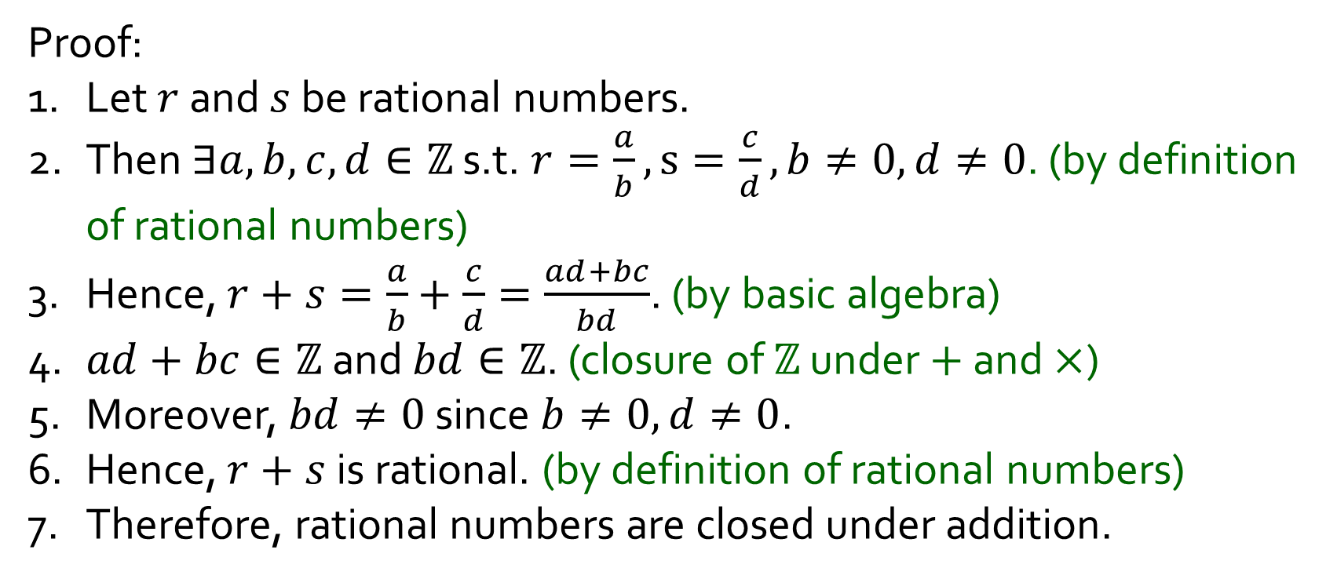
Q3
Prove: (b) Rational number are closed under addition.
Proof:
1. Let $r$ and $s$ be rational numbers.
2. Then $∃a,b,c,d∈ℤ$ s.t. $r=\frac{a}{b},s=\frac{c}{d},b≠0,d≠0$. (by definition of rational numbers)
3. Hence, $r+s=\frac{a}{b}+\frac{c}{d}=\frac{ad+bc}{bd}$. (by basic algebra)
4. $ad+bc∈ℤ$ and $bd∈ℤ$. (closure of $ℤ$ under $+$ and $×$)
5. Moreover, $bd≠0$ since $b≠0,d≠0$.
6. Hence, $r+s$ is rational. (by definition of rational numbers)
7. Therefore, rational numbers are closed under addition.
$r$ is rational $⇔ ∃a,b∈ℤ$ s.t. $r=\frac{a}{b}$ and $b≠0.$

Slide 13
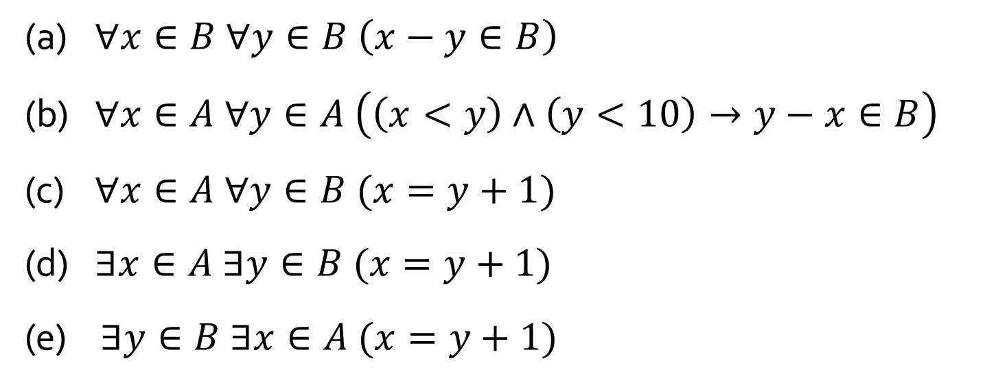
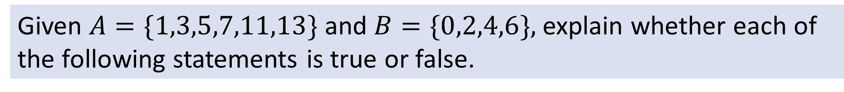
Q4
Given $A=\{1,3,5,7,11,13\}$and $B=\{0,2,4,6\},$explain whether each of the following statements is true or false.
(a) $∀x∈B ∀y∈B \left(x−y∈B\right)$
(b) $∀x∈A ∀y∈A \left(\left(x<y\right)∧\left(y<10\right)→y−x∈B\right)$
(c) $∀x∈A ∀y∈B (x=y+1)$
(d) $∃x∈A ∃y∈B (x=y+1)$
(e) $∃y∈B ∃x∈A (x=y+1)$
False
True
False
True
True
Note: (d) and (e) are equivalent.

Slide 14
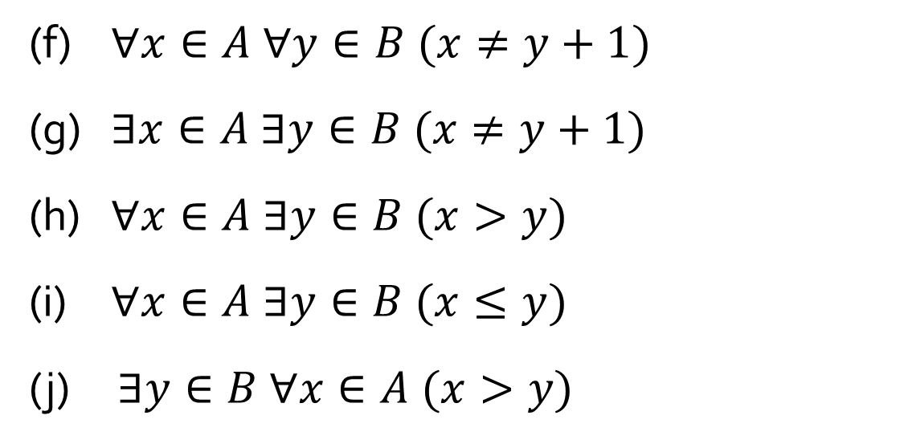
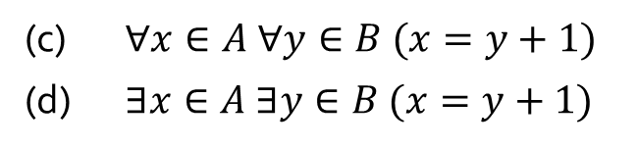
Q4
Given $A=\{1,3,5,7,11,13\}$and $B=\{0,2,4,6\},$explain whether each of the following statements is true or false.
(f) $∀x∈A ∀y∈B (x≠y+1)$
(g) $∃x∈A ∃y∈B (x≠y+1)$
(h) $∀x∈A ∃y∈B (x>y)$
(i) $∀x∈A ∃y∈B (x≤y)$
(j) $∃y∈B ∀x∈A (x>y)$
False
True
True
False
True
Note: (f) is the negation of (d); (g) is the negation of (c).
(c) $∀x∈A ∀y∈B (x=y+1)$
(d) $∃x∈A ∃y∈B (x=y+1)$

Slide 15
Q5
(a) None of the members goes to a single club for all his/her activities.
False;
Counter-example: Carl goes to Yishun Club for all his activities.
(b) There is a unique activity which has the most number of members participating.
False;
Swimming and running have four members participating.
(c) There are wo members who do not share any common activity.
True; Betty and Fandi (or Emily and Fandi)

Slide 16
Q5
(d) There are two clubs that are attended by the same group of members.
True;
TPY Club and Clementi Club are attended by Aiken, Betty, Dueet and Emily.
(e) All the clubs are attended by the same number of members.
True;
Every club is attended by four members.

Slide 17
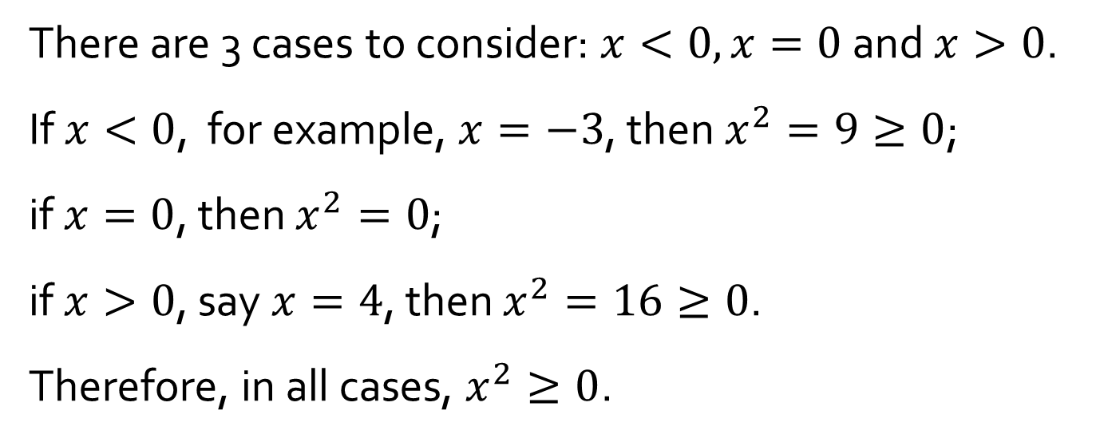
Q6
(a) Proof for: $∀x∈ℝ (x^{2}≥0)$. What is wrong with this “proof”?
There are 3 cases to consider: $x<0,x=0$ and $x>0$.
If $x<0$, for example, $x=−3$, then $x^{2}=9≥0$;
if $x=0$, then $x^{2}=0$;
if $x>0$, say $x=4$, then $x^{2}=16≥0$.
Therefore, in all cases, $x^{2}≥0$.
(b) Use the same logic in (a) to prove: $∀x∈ℝ (x^{3}=x)$.

Slide 18
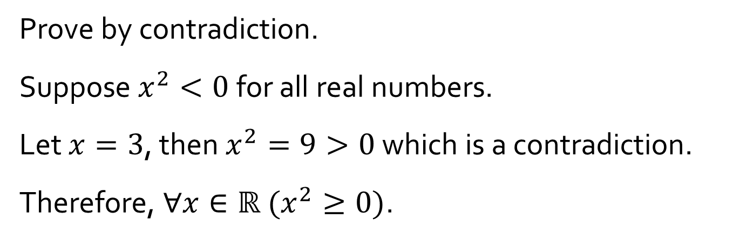
Q6
(c) Proof for: $∀x∈ℝ (x^{2}≥0)$. What is wrong with this “proof”?
Prove by contradiction.
Suppose $x^{2}<0$ for all real numbers.
Let $x=3$, then $x^{2}=9>0$ which is a contradiction.
Therefore, $∀x∈ℝ (x^{2}≥0)$.
(d) Use the same logic in (c) to prove: $∀x∈ℝ (x^{3}=x)$.

Slide 19
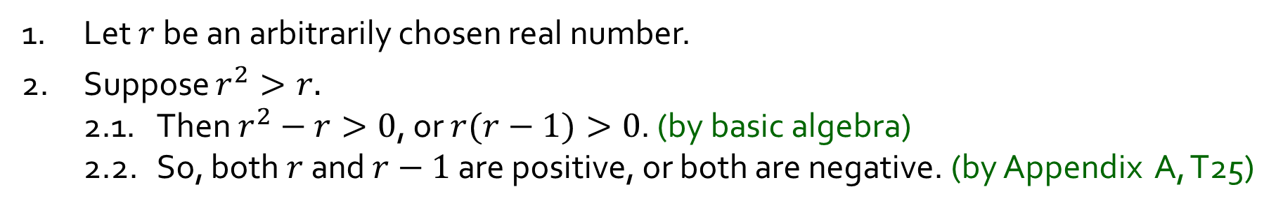
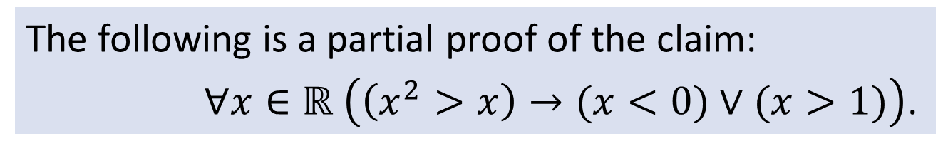
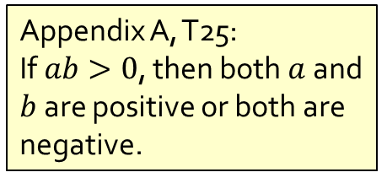
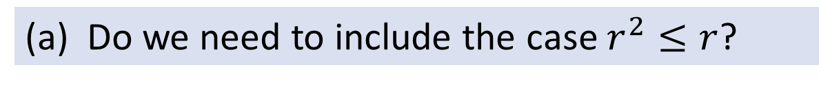
Q7
The following is a partial proof of the claim:
$∀x∈ℝ \left(\left(x^{2}>x\right)→(x<0)∨(x>1)\right)$.
Appendix A, T25:
If $ab>0$, then both $a$ and $b$ are positive or both are negative.
1. Let $r$ be an arbitrarily chosen real number.
2. Suppose $r^{2}>r.$
2.1. Then $r^{2}−r>0$, or $r(r−1)>0$. (by basic algebra)
2.2. So, both $r$ and $r−1$ are positive, or both are negative. (by Appendix A, T25)
(a) Do we need to include the case $r^{2}≤r$?
No. A conditional statement is true (true by default/vacuously true) when its hypotheses is false.
3. Therefore, $∀x∈ℝ \left(\left(x^{2}>x\right)→\left(x<0\right)∨\left(x>1\right)\right).$

Slide 20
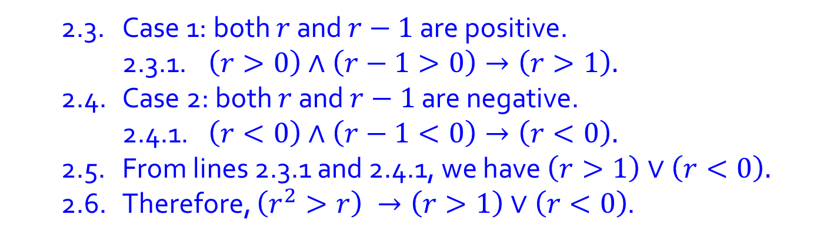
Q7
The following is a partial proof of the claim:
$∀x∈ℝ \left(\left(x^{2}>x\right)→(x<0)∨(x>1)\right)$.
(b) Complete the proof.
1. Let $r$ be an arbitrarily chosen real number.
2. Suppose $r^{2}>r.$
2.1. Then $r^{2}−r>0$, or $r(r−1)>0$. (by basic algebra)
2.2. So, both $r$ and $r−1$ are positive, or both are negative. (by Appendix A, T25)
2.3. Case 1: both $r$ and $r−1$ are positive.
2.3.1. $\left(r>0\right)∧\left(r−1>0\right)→\left(r>1\right).$
2.4. Case 2: both $r$ and $r−1$ are negative.
2.4.1. $\left(r<0\right)∧\left(r−1<0\right)→\left(r<0\right).$
2.5. From lines 2.3.1 and 2.4.1, we have $\left(r>1\right)∨\left(r<0\right).$
2.6. Therefore, $\left(r^{2}>r\right) →\left(r>1\right)∨\left(r<0\right)$.
3. Therefore, $∀x∈ℝ \left(\left(x^{2}>x\right)→\left(x<0\right)∨\left(x>1\right)\right).$

Slide 21
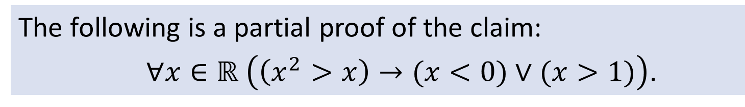
Q7
The following is a partial proof of the claim:
$∀x∈ℝ \left(\left(x^{2}>x\right)→(x<0)∨(x>1)\right)$.
1. Let $r$ be an arbitrarily chosen real number.
2. Suppose $r^{2}>r.$
2.1. Then $r^{2}−r>0$, or $r(r−1)>0$. (by basic algebra)
2.2. So, both $r$ and $r−1$ are positive, or both are negative. (by Appendix A, T25)
3. Therefore, $∀x∈ℝ \left(\left(x^{2}>x\right)→\left(x<0\right)∨\left(x>1\right)\right).$
(c) Step 3 is an application of universal generalization. Explain what it means.

Slide 22
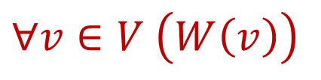
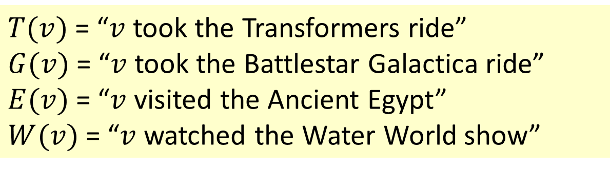
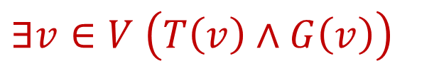
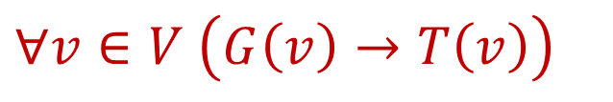
Q8
$T(v)$= “$v$ took the Transformers ride”
$G(v)$= “$v$ took the Battlestar Galactica ride”
$E(v)$= “$v$ visited the Ancient Egypt”
$W(v)$= “$v$ watched the Water World show”
(a) Every visitor watched the Water World show.
$$∀v∈V \left(W\left(v\right)\right)$$
(b) Every visitor who took the Battlestar Galactica ride also took the Transformers ride.
$$∀v∈V \left(G\left(v\right)→T\left(v\right)\right)$$
(c) There is a visitor who took both the Transformers ride and the Battlestar Galactica ride.
$$∃v∈V \left(T\left(v\right)∧G\left(v\right)\right)$$

Slide 23
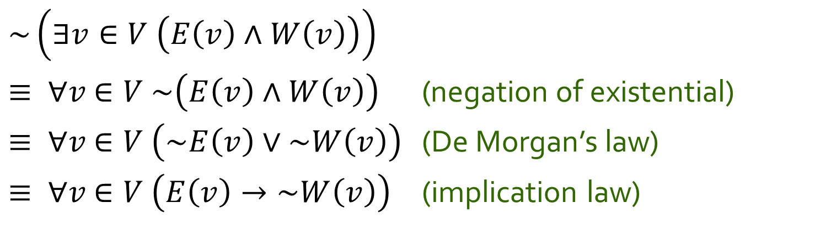
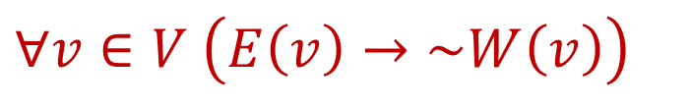
Q8
(d) No visitor who visited the Ancient Egypt watched the Water World show.
$$∀v∈V \left(E\left(v\right)→\sim W\left(v\right)\right)$$
Equivalently,
~(there is a visitor who visited the Ancient Egypt and watched the Water World show).
$$\sim \left(∃v∈V \left(E\left(v\right)∧W\left(v\right)\right)\right)$$
$≡ ∀v$ $∈V \sim \left(E\left(v\right)∧W\left(v\right)\right)$ (negation of existential)
$≡ ∀v$ $∈V \left(\sim E\left(v\right)∨\sim W\left(v\right)\right)$ (De Morgan’s law)
$≡ ∀v$ $∈V \left(E\left(v\right)→\sim W\left(v\right)\right)$ (implication law)

Slide 24
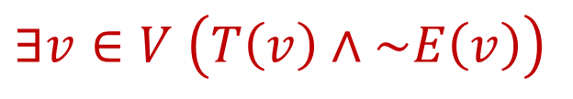
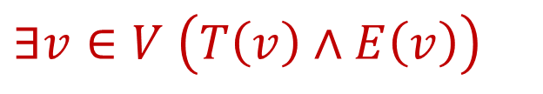

Q8
(e) Some visitors who took the Transformers ride also visited the Ancient Egypt but some (who took the Transformers ride) did not (visit the Ancient Egypt).
$$∃v∈V \left(T\left(v\right)∧E\left(v\right)\right)$$
$$∧$$
$$∃v∈V \left(T\left(v\right)∧\sim E\left(v\right)\right)$$

Slide 25
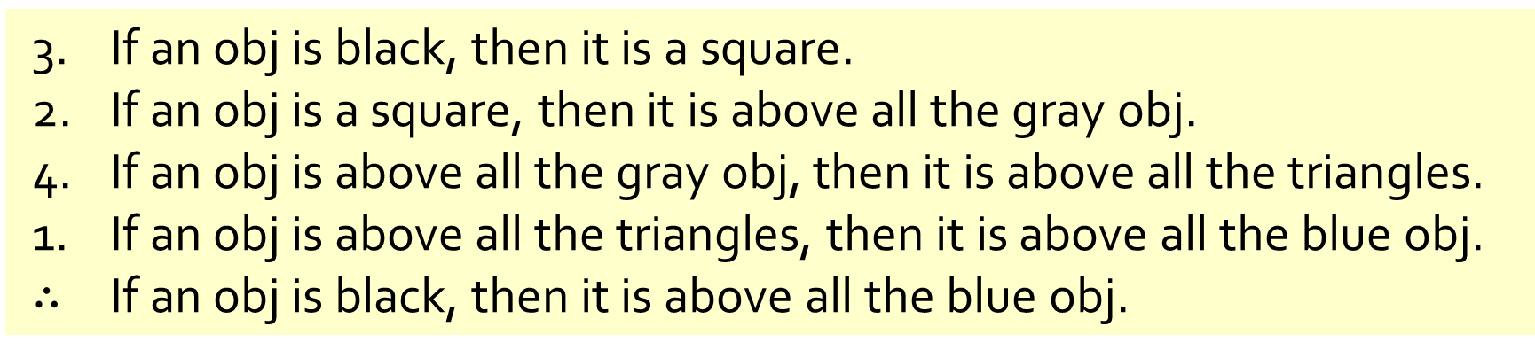
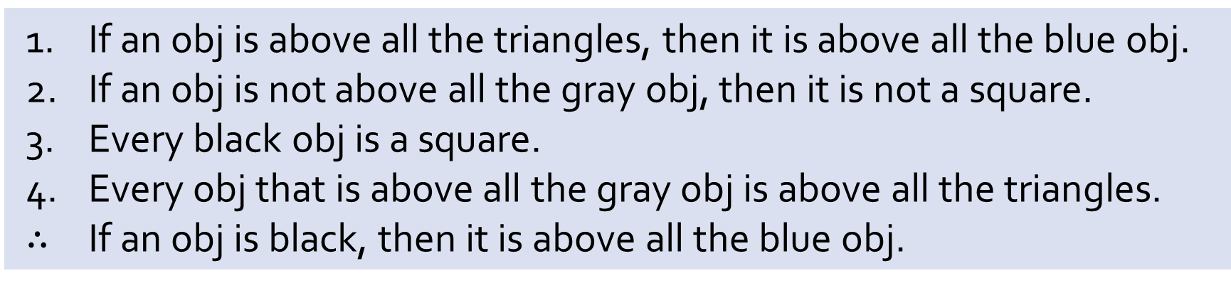
Q9
If an obj is above all the triangles, then it is above all the blue obj.
If an obj is not above all the gray obj, then it is not a square.
Every black obj is a square.
Every obj that is above all the gray obj is above all the triangles.
$∴$ If an obj is black, then it is above all the blue obj.
(a) Reorder the premises to show that the conclusion follows as a valid consequence from the premises by applying universal transitivity.
3. If an obj is black, then it is a square.
2. If an obj is a square, then it is above all the gray obj.
4. If an obj is above all the gray obj, then it is above all the triangles.
1. If an obj is above all the triangles, then it is above all the blue obj.
$∴$ If an obj is black, then it is above all the blue obj.

Slide 26
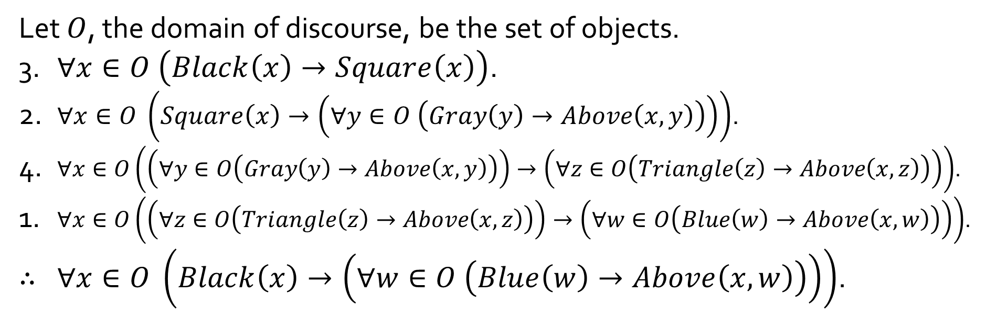
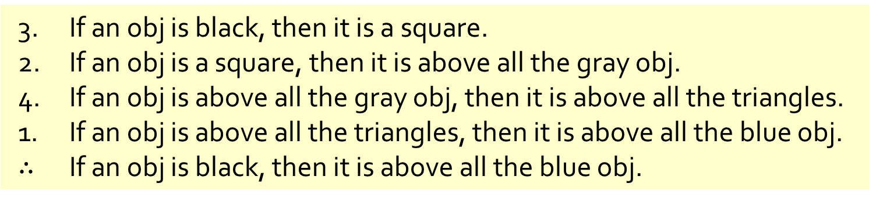
Q9
3. If an obj is black, then it is a square.
2. If an obj is a square, then it is above all the gray obj.
4. If an obj is above all the gray obj, then it is above all the triangles.
1. If an obj is above all the triangles, then it is above all the blue obj.
$∴$ If an obj is black, then it is above all the blue obj.
(b) Rewrite your answer in (a) using predicates and quantified statements.
Let $O$, the domain of discourse, be the set of objects.
3. $∀x∈O \left(Black\left(x\right)→Square\left(x\right)\right)$.
2. $∀x∈O \left(Square\left(x\right)→\left(∀y∈O \left(Gray\left(y\right)→Above\left(x,y\right)\right)\right)\right)$.
4. $∀x∈O\left(\left(∀y∈O\left(Gray\left(y\right)→Above\left(x,y\right)\right)\right)→\left(∀z∈O\left(Triangle\left(z\right)→Above\left(x,z\right)\right)\right)\right)$.
1. $∀x∈O\left(\left(∀z∈O\left(Triangle\left(z\right)→Above\left(x,z\right)\right)\right)→\left(∀w∈O\left(Blue\left(w\right)→Above\left(x,w\right)\right)\right)\right)$.
$∴$ $∀x∈O \left(Black\left(x\right)→\left(∀w∈O \left(Blue\left(w\right)→Above\left(x,w\right)\right)\right)\right)$.

Slide 27
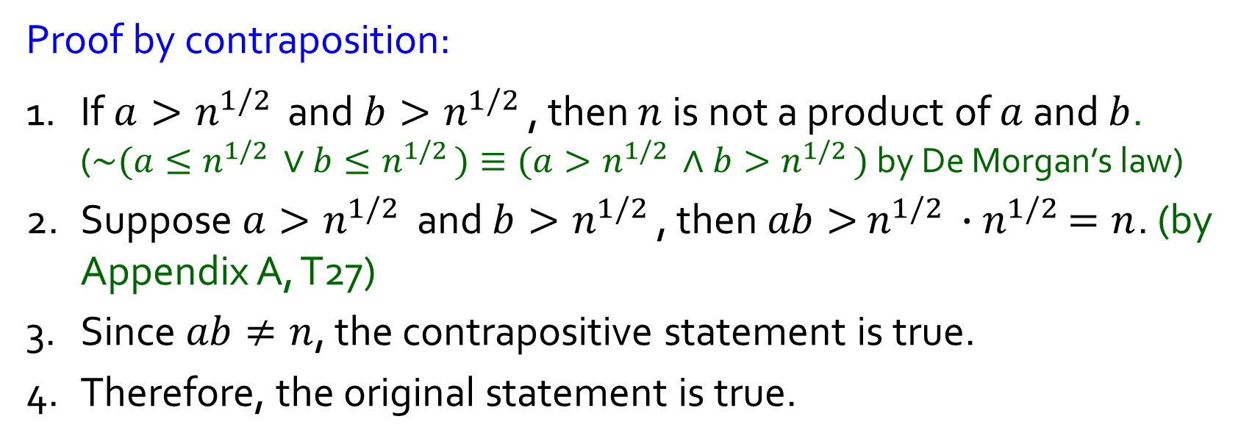
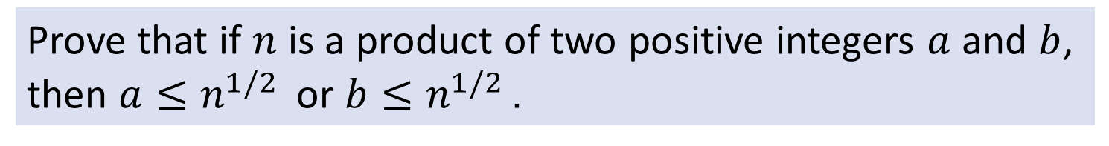

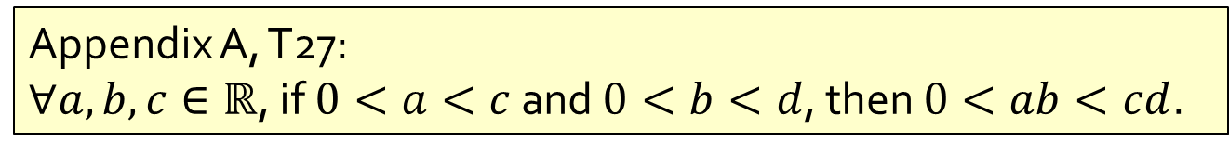
Q10
Prove that if $n$ is a product of two positive integers $a$ and $b$, then $a≤n^{1/2 }$ or $b≤n^{1/2 }$.
$$p→q≡\sim q→\sim p$$
Proof by contraposition:
1. If $a>n^{1/2 }$ and $b>n^{1/2 }$, then $n$ is not a product of $a$ and $b$. ($\sim (a≤n^{1/2 }∨b≤n^{1/2 })≡(a>n^{1/2 }∧b>n^{1/2 })$ by De Morgan’s law)
2. Suppose $a>n^{1/2 }$ and $b>n^{1/2 }$, then $ab>$ $n^{1/2 }{∙n}^{1/2 }=n$. (by Appendix A, T27)
3. Since $ab≠n$, the contrapositive statement is true.
4. Therefore, the original statement is true.
Appendix A, T27:
$∀a,b,c∈ℝ$, if $0<a<c$ and $0<b<d$, then $0<ab<cd$.

Slide 28

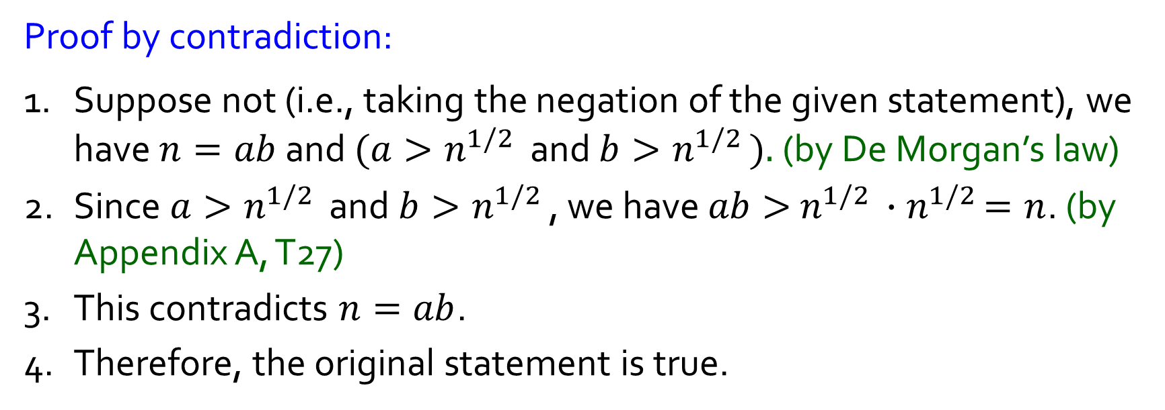
Q10
Prove that if $n$ is a product of two positive integers $a$ and $b$, then $a≤n^{1/2 }$ or $b≤n^{1/2 }$.
$$\sim (p→q)≡p∧\sim q$$
Proof by contradiction:
1. Suppose not (i.e., taking the negation of the given statement), we have $n=ab$ and $(a>n^{1/2 }$ and $b>n^{1/2 }).$ (by De Morgan’s law)
2. Since $a>n^{1/2 }$ and $b>n^{1/2 }$, we have $ab>$ $n^{1/2 }{∙n}^{1/2 }=n$. (by Appendix A, T27)
3. This contradicts $n=ab$.
4. Therefore, the original statement is true.
Appendix A, T27:
$∀a,b,c∈ℝ$, if $0<a<c$ and $0<b<d$, then $0<ab<cd$.

Slide 29
THE END

