Slide 1
Cs1231S tutorial #5
Relations & Partial orders

Slide 2
Learning objectives of this tutorial
Partial orders
Determining whether a relation is antisymmetric
Determining whether a relation is asymmetric
Reasoning about partial orders
Drawing Hasse diagrams of partial orders
Knowing about comparability and compatibility of elements in a partial order
Distinguishing minimal/maximal elements from smallest/largest elements
Understanding linearizations

Slide 3
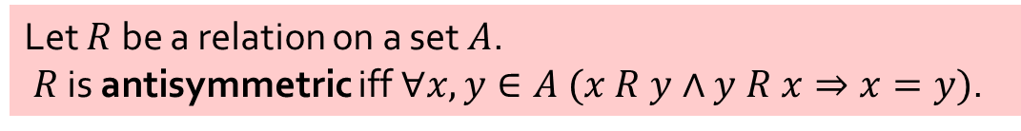
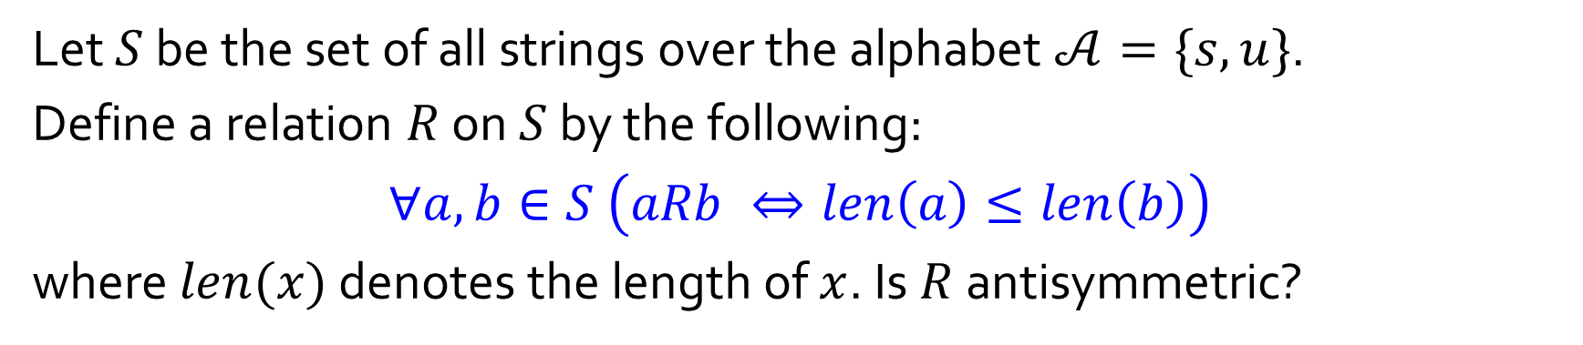
Q1.
Let $S$ be the set of all strings over the alphabet $𝒜=\{s,u\}$.
Define a relation $R$ on $S$ by the following:
$$∀a,b∈S \left(aRb ⇔len\left(a\right)≤len\left(b\right)\right)$$
where $len(x)$ denotes the length of $x$. Is $R$ antisymmetric?
False
Counterexample?
Let $R$ be a relation on a set $A$.
$R$ is antisymmetric iff$∀x,y∈A (x R y∧y R x⇒x=y)$.

Slide 4

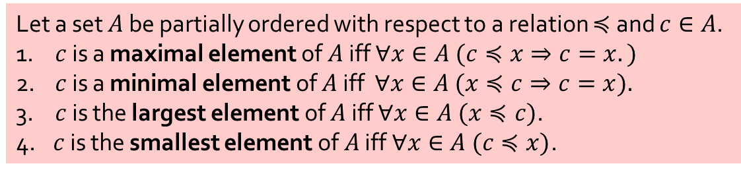
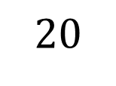


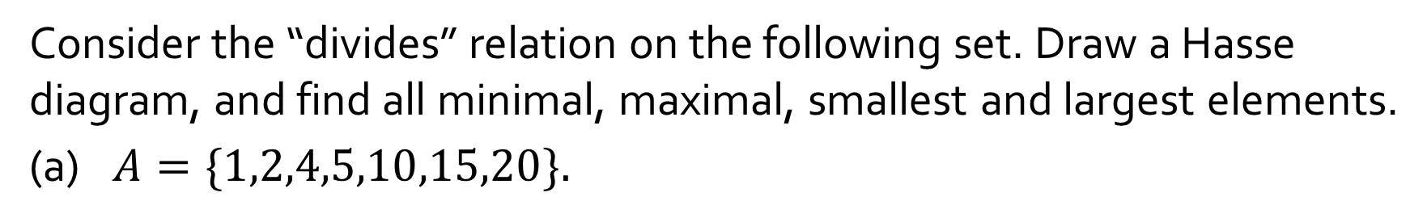
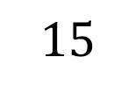

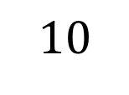



Q2.
Consider the “divides” relation on the following set. Draw a Hasse diagram, and find all minimal, maximal, smallest and largest elements.
(a) $A=\{1,2,4,5,10,15,20\}.$
$$20$$
$$1$$
Minimal:
Maximal:
Smallest:
Largest:
$$4$$
$$10$$
$$15$$
$$15, 20$$
$$2$$
$$5$$
$$1$$
$$1$$
None
Let a set $A$ be partially ordered with respect to a relation $≼$ and $c∈A$.
1. $c$ is a maximal element of $A$ iff $∀x∈A (c≼x⇒c=x.)$
2. $c$ is a minimal element of $A$ iff $∀x∈A (x≼c⇒c=x).$
3. $c$ is the largest element of $A$ iff $∀x∈A (x≼c)$.
4. $c$ is the smallest element of $A$ iff $∀x∈A (c≼x)$.

Slide 5

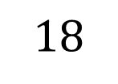

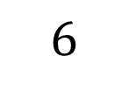
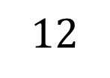
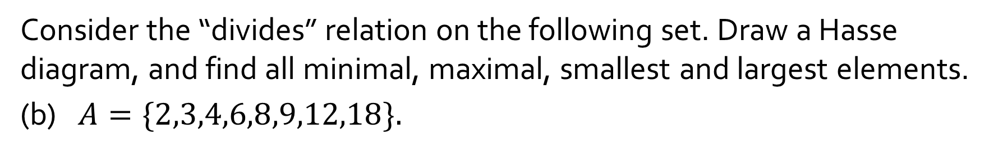

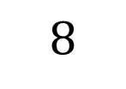




Q2.
Consider the “divides” relation on the following set. Draw a Hasse diagram, and find all minimal, maximal, smallest and largest elements.
(b) $A=\{2,3,4,6,8,9,12,18\}.$
$$2,3$$
Minimal:
Maximal:
Smallest:
Largest:
$$8$$
$$12$$
$$18$$
$$8,12, 18$$
$$4$$
$$6$$
$$9$$
$$\text{None}$$
$$2$$
$$3$$
None
Let a set $A$ be partially ordered with respect to a relation $≼$ and $c∈A$.
1. $c$ is a maximal element of $A$ iff $∀x∈A (c≼x⇒c=x.)$
2. $c$ is a minimal element of $A$ iff $∀x∈A (x≼c⇒c=x).$
3. $c$ is the largest element of $A$ iff $∀x∈A (x≼c)$.
4. $c$ is the smallest element of $A$ iff $∀x∈A (c≼x)$.

Slide 6
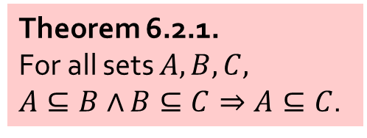
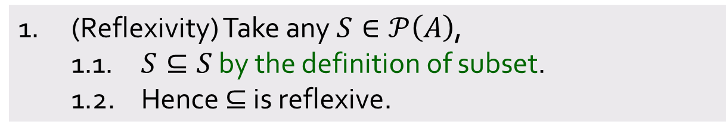
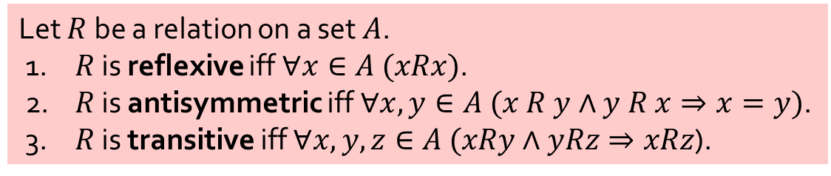

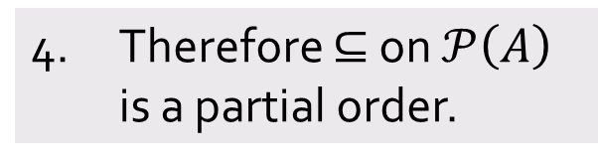
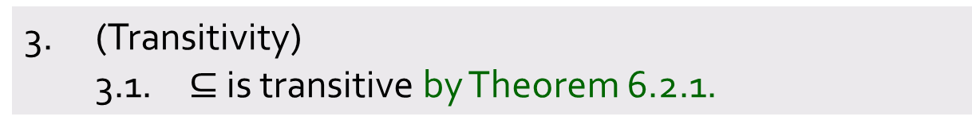
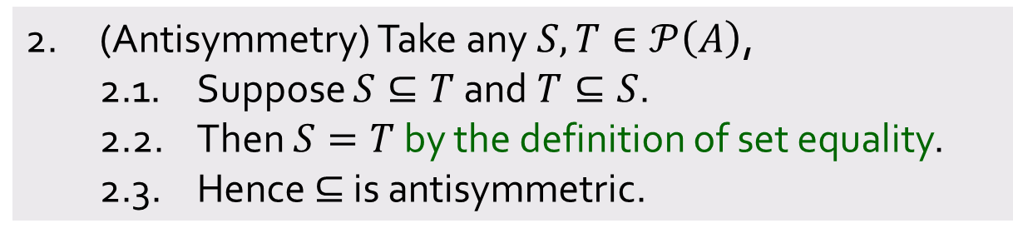
Q3.
Let $A$ be a set and $𝒫(A)$ the power set of $A$. Prove that the binary relation $⊆$ on$𝒫(A)$ is a partial order.
1. (Reflexivity) Take any $S∈𝒫\left(A\right)$,
1.1. $S⊆S$ by the definition of subset.
1.2. Hence $⊆$ is reflexive.
2. (Antisymmetry) Take any $S,T∈𝒫\left(A\right)$,
2.1. Suppose $S⊆T$ and $T⊆S$.
2.2. Then $S=T$ by the definition of set equality.
2.3. Hence $⊆$ is antisymmetric.
Theorem 6.2.1.
For all sets $A,B,C,$
$A⊆B∧$ $B⊆C⇒A⊆C$.
3. (Transitivity)
3.1. $⊆$ is transitive by Theorem 6.2.1.
4. Therefore $⊆$ on $𝒫\left(A\right)$ is a partial order.
Let $R$ be a relation on a set $A$.
1. $R$ is reflexive iff $∀x∈A (xRx)$.
2. $R$ is antisymmetric iff$∀x,y∈A (x R y∧y R x⇒x=y)$.
3. $R$ is transitive iff $∀x,y,z∈A (xRy∧yRz⇒xRz$).

Slide 7
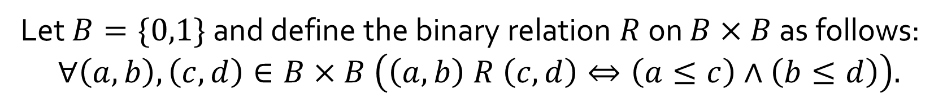
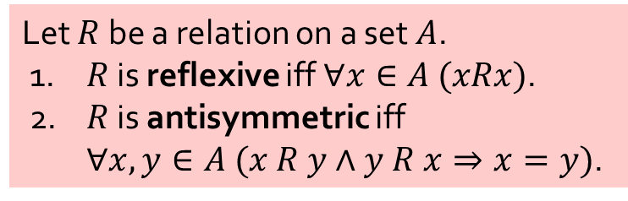
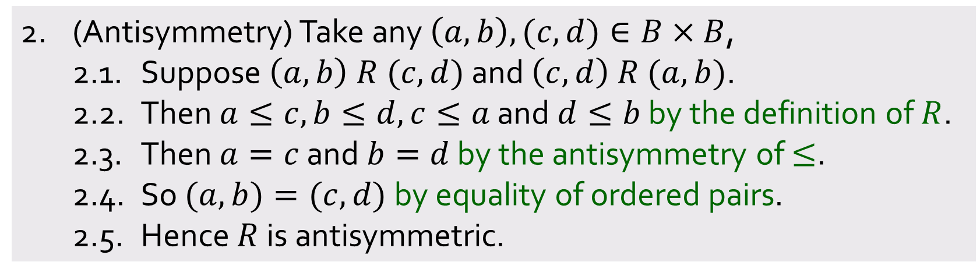
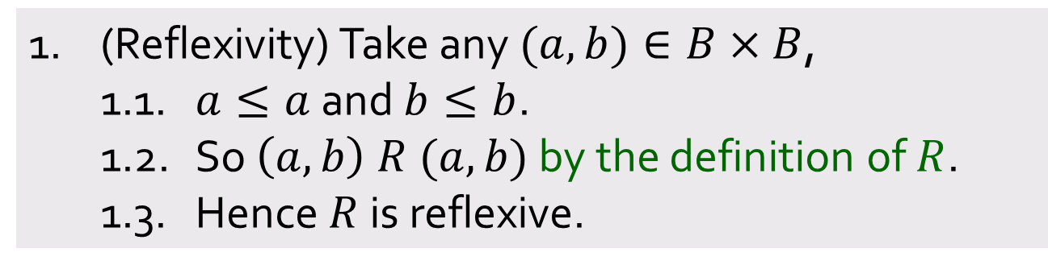
Q4.
Let $B=\{0,1\}$ and define the binary relation $R$ on $B×B$ as follows:
$$∀\left(a,b\right),\left(c,d\right)∈B×B \left(\left(a,b\right) R \left(c,d\right)⇔\left(a≤c\right)∧\left(b≤d\right)\right).$$
(a) Prove that $R$ is a partial order.
Let $R$ be a relation on a set $A$.
1. $R$ is reflexive iff $∀x∈A (xRx)$.
2. $R$ is antisymmetric iff
$∀x,y∈A (x R y∧y R x⇒x=y)$.
1. (Reflexivity) Take any $(a,b)∈B×B$,
1.1. $a≤a$ and $b≤b$.
1.2. So $\left(a,b\right) R (a,b)$ by the definition of $R$.
1.3. Hence $R$ is reflexive.
Aim:
2. (Antisymmetry) Take any $\left(a,b\right),(c,d)∈B×B$,
2.1. Suppose $\left(a,b\right) R (c,d)$ and $\left(c,d\right) R (a,b)$.
2.2. Then $a≤c,b≤d,c≤a$ and $d≤b$ by the definition of $R$.
2.3. Then $a=c$ and $b=d$ by the antisymmetry of $≤$.
2.4. So $(a,b)=(c,d)$by equality of ordered pairs.
2.5. Hence $R$ is antisymmetric.
Aim:

Slide 8
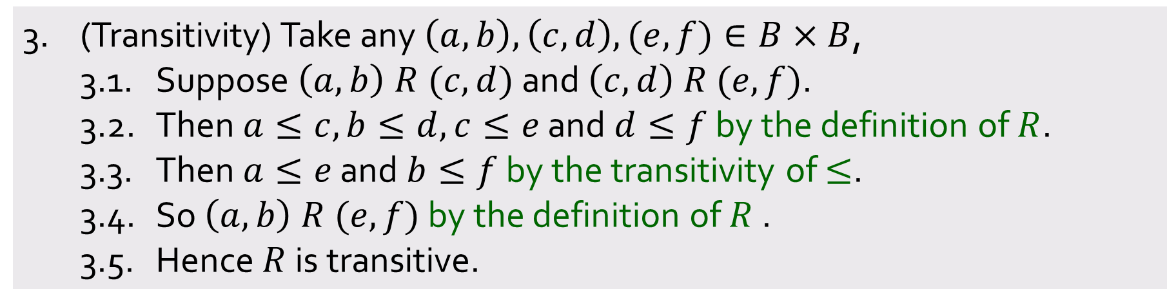
Q4.
Let $B=\{0,1\}$ and define the binary relation $R$ on $B×B$ as follows:
$$∀\left(a,b\right),\left(c,d\right)∈B×B \left(\left(a,b\right) R \left(c,d\right)⇔\left(a≤c\right)∧\left(b≤d\right)\right).$$
(a) Prove that $R$ is a partial order.
3. (Transitivity) Take any $\left(a,b\right),\left(c,d\right),(e,f)∈B×B$,
3.1. Suppose $\left(a,b\right) R (c,d)$ and $\left(c,d\right) R (e,f)$.
3.2. Then $a≤c,b≤d,c≤e$ and $d≤f$ by the definition of $R$.
3.3. Then $a≤e$ and $b≤f$ by the transitivity of $≤$.
3.4. So $\left(a,b\right) R (e,f)$ by the definition of $R$ .
3.5. Hence $R$ is transitive.
Aim:
4. Therefore $R$ on $B×B$ is a partial order.
Let $R$ be a relation on a set $A$.
1. $R$ is reflexive iff $∀x∈A (xRx)$.
2. $R$ is antisymmetric iff$∀x,y∈A (x R y∧y R x⇒x=y)$.
3. $R$ is transitive iff $∀x,y,z∈A (xRy∧yRz⇒xRz$).

Slide 9
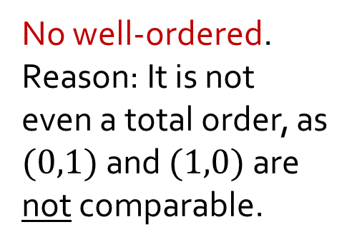
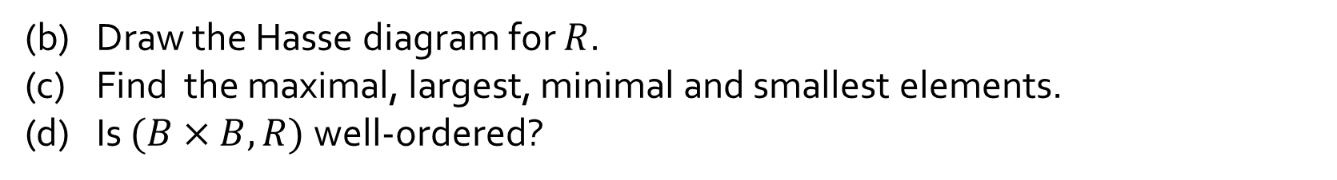




Q4.
Let $B=\{0,1\}$ and define the binary relation $R$ on $B×B$ as follows:
$$∀\left(a,b\right),\left(c,d\right)∈B×B \left(\left(a,b\right) R \left(c,d\right)⇔\left(a≤c\right)∧\left(b≤d\right)\right).$$
(b) Draw the Hasse diagram for $R$.
(c) Find the maximal, largest, minimal and smallest elements.
(d) Is $(B×B,R)$ well-ordered?
Maximal:
Largest:
Minimal:
Smallest:
$$(1,1)$$
(1,1)
No well-ordered.
Reason: It is not even a total order, as $(0,1)$and $(1,0)$are not comparable.
$$(1,1)$$
(1,0)
(0,1)
$$(0,0)$$
$$(0,0)$$
(0,0)
Let a set $A$ be partially ordered with respect to a relation $≼$ and $c∈A$.
1. $c$ is a maximal element of $A$ iff $∀x∈A (c≼x⇒c=x.)$
2. $c$ is a minimal element of $A$ iff $∀x∈A (x≼c⇒c=x).$
3. $c$ is the largest element of $A$ iff $∀x∈A (x≼c)$.
4. $c$ is the smallest element of $A$ iff $∀x∈A (c≼x)$.

Slide 10
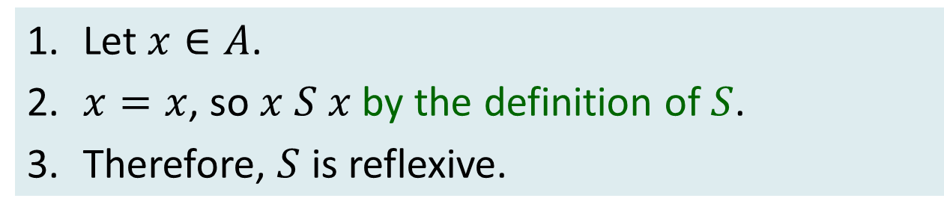
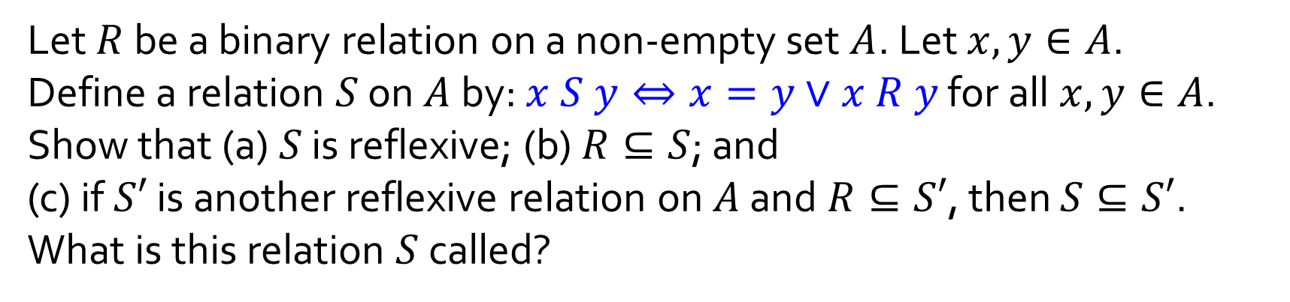
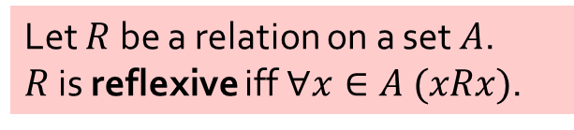
Q5.
Let $R$ be a binary relation on a non-empty set $A$. Let $x,y∈A$.
Define a relation $S$ on $A$ by: $x S y⇔x=y∨x R y$ for all $x,y∈A$.
Show that (a) $S$ is reflexive; (b) $R⊆S$; and
(c) if $S′$ is another reflexive relation on $A$ and $R⊆S′$, then $S⊆S′$.
What is this relation $S$ called?
(a)
1. Let $x∈A$.
2. $x=x$, so $x S x$ by the definition of $S$.
3. Therefore, $S$ is reflexive.
Let $R$ be a relation on a set $A$.
$R$ is reflexive iff $∀x∈A (xRx)$.

Slide 11
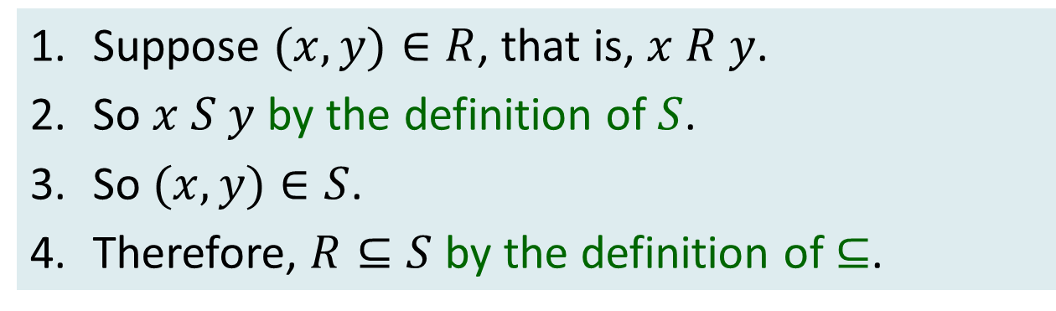

Q5.
Let $R$ be a binary relation on a non-empty set $A$. Let $x,y∈A$.
Define a relation $S$ on $A$ by: $x S y⇔x=y∨x R y$ for all $x,y∈A$.
Show that (a) $S$ is reflexive; (b) $R⊆S$; and
(c) if $S′$ is another reflexive relation on $A$ and $R⊆S′$, then $S⊆S′$.
What is this relation $S$ called?
(b)
1. Suppose $(x,y)∈R$, that is, $x R y$.
2. So $x S y$ by the definition of $S$.
3. So $(x,y)∈S$.
4. Therefore, $R⊆S$ by the definition of$⊆$.
Aim: To arrive at $(x,y)∈S$.

Slide 12
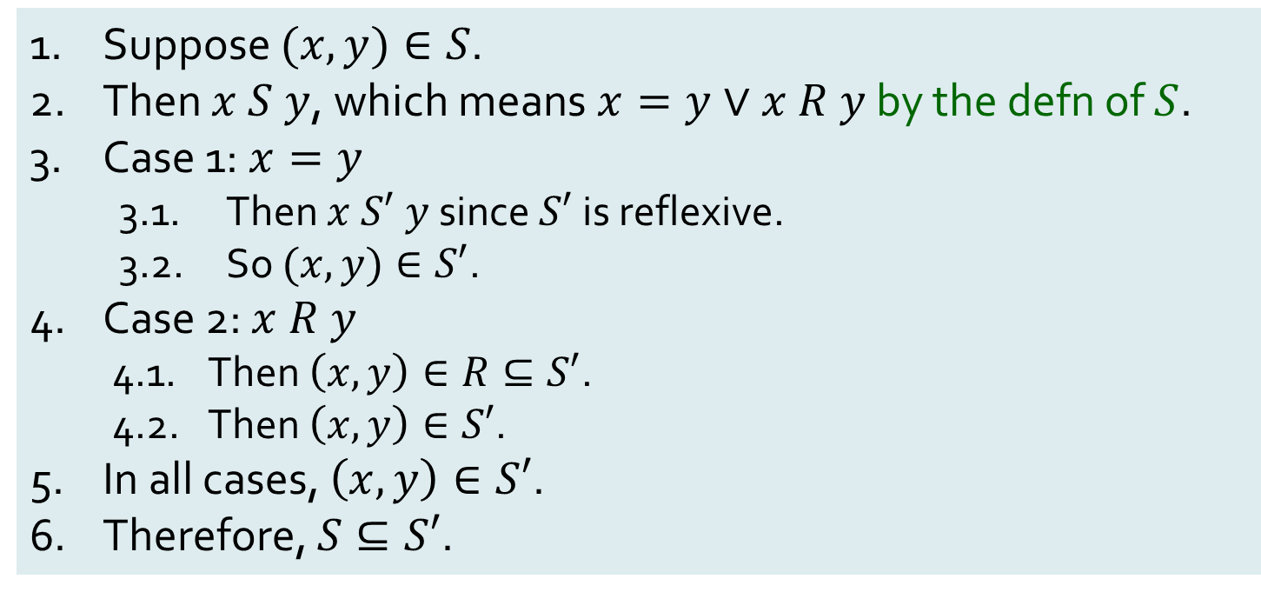
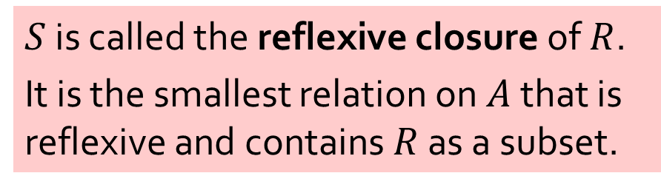
Q5.
Let $R$ be a binary relation on a non-empty set $A$. Let $x,y∈A$.
Define a relation $S$ on $A$ by: $x S y⇔x=y∨x R y$ for all $x,y∈A$.
Show that (a) $S$ is reflexive; (b) $R⊆S$; and
(c) if $S′$ is another reflexive relation on $A$ and $R⊆S′$, then $S⊆S′$.
What is this relation $S$ called?
(c)
Suppose $(x,y)∈S$.
Then $x S y$, which means $x=y∨x R y$ by the defn of $S$.
Case 1: $x=y$
3.1. Then $x S′ y$since $S′$ is reflexive.
3.2. So $(x,y)∈S′$.
Case 2: $x R y$
4.1. Then $\left(x,y\right)∈R⊆S′$.
4.2. Then $\left(x,y\right)∈S′$.
In all cases, $\left(x,y\right)∈S′$.
Therefore, $S⊆S′$.
$S$ is called the reflexive closure of $R$.
It is the smallest relation on $A$ that is reflexive and contains $R$ as a subset.
Aim:

Slide 13


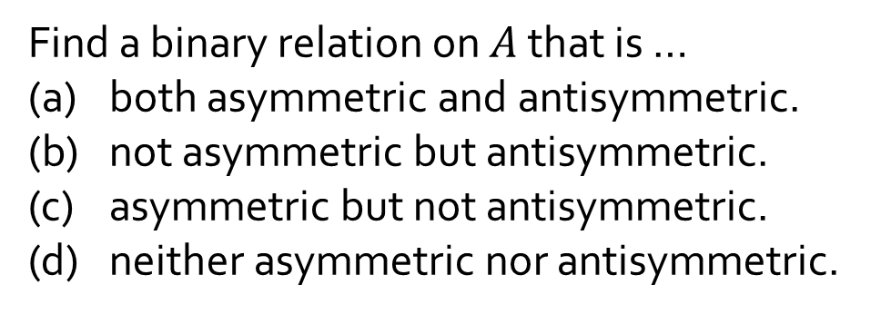


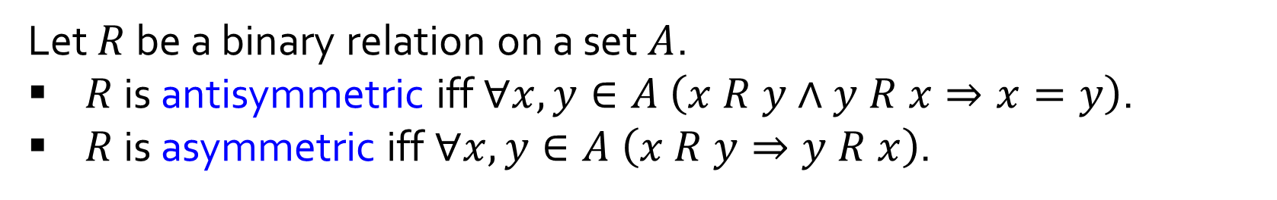









Q6.
Let $R$ be a binary relation on a set $A$.
$R$ is antisymmetric iff $∀x,y∈A \left(x R y∧y R x⇒x=y\right)$.
$R$ is asymmetric iff $∀x,y∈A \left(x R y⇒y R x\right)$.
Find a binary relation on $A$ that is …
(a) both asymmetric and antisymmetric.
(b) not asymmetric but antisymmetric.
(c) asymmetric but not antisymmetric.
(d) neither asymmetric nor antisymmetric.
Let $A=\{a,b,c\}.$
(a)
(b)
(c)
(d)
$$R=\left\{\left(a,b\right),\left(a,c\right)\right\}.$$
$$R=\left\{\left(a,a\right),\left(b,c\right)\right\}.$$
$$R=\left\{\left(a,b\right),\left(b,a\right),\left(a,c\right)\right\}.$$
$$a$$
$$a$$
?
$$a$$
$$b$$
$$b$$
$$b$$
$$c$$
$$c$$
$$c$$

Slide 14
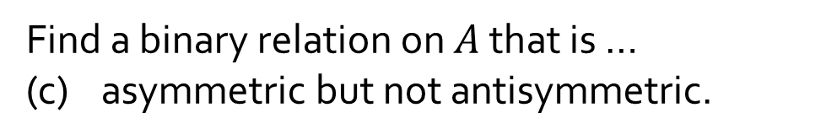
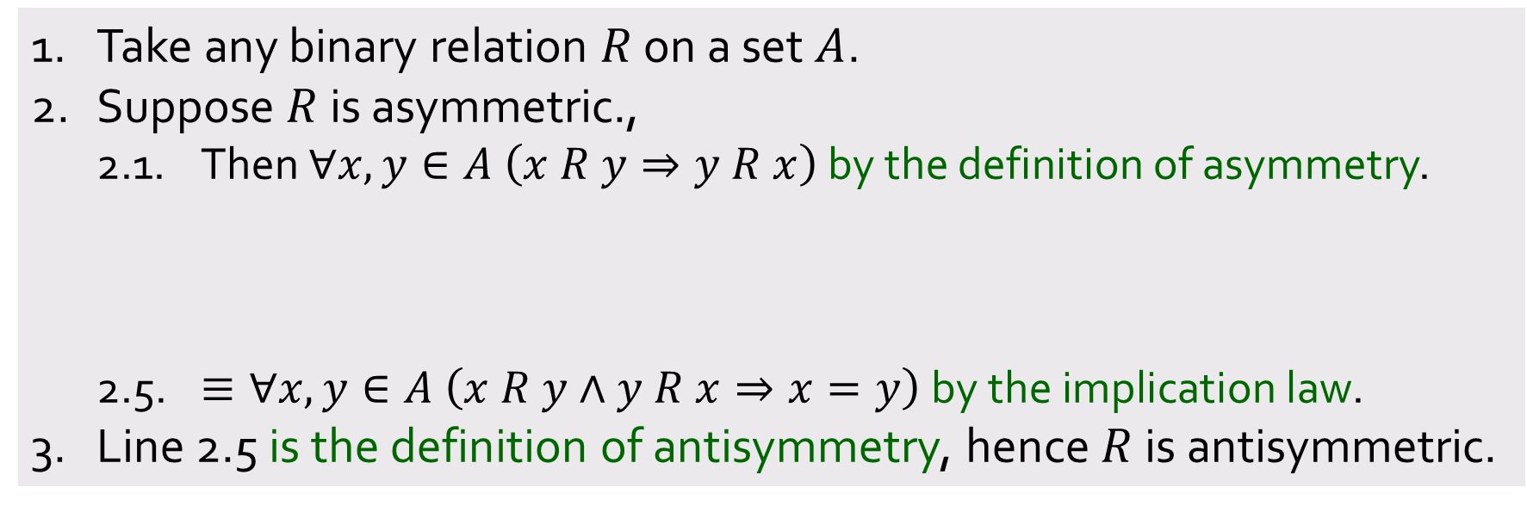
Q6.
Let $R$ be a binary relation on a set $A$.
$R$ is antisymmetric iff $∀x,y∈A \left(x R y∧y R x⇒x=y\right)$.
$R$ is asymmetric iff $∀x,y∈A \left(x R y⇒y R x\right)$.
Find a binary relation on $A$ that is …
(c) asymmetric but not antisymmetric.
To prove:
Every asymmetric relation is antisymmetric.
1. Take any binary relation $R$ on a set $A$.
2. Suppose $R$ is asymmetric.,
2.1. Then $∀x,y∈A \left(x R y⇒y R x\right)$ by the definition of asymmetry.
2.5. $≡∀x,y∈A \left(x R y∧y R x⇒x=y\right) \text{by} \text{the} \text{implication} \text{law}\text{.}$
3. Line 2.5 is the definition of antisymmetry, hence $R$ is antisymmetric.
2.2. $≡∀x,y∈A \left(x R y∨y R x\right) \text{by} \text{the} \text{implication} \text{law}\text{.}$
2.3. $⇒∀x,y∈A \left(\left(x R y∨y R x\right)∨x=y\right) \text{by} \text{generalization}\text{.}$
2.4. $≡∀x,y∈A \left(\sim \left(x R y∧y R x\right)∨x=y\right) \text{by} \text{the} \text{De} \text{Morgan}\text{′}\text{s} \text{law}\text{.}$
Aim:

Slide 15
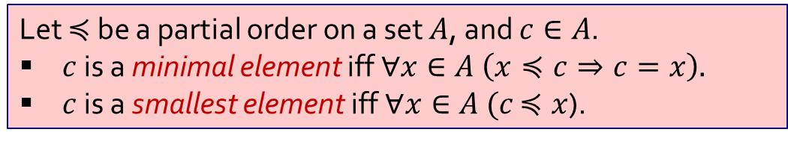
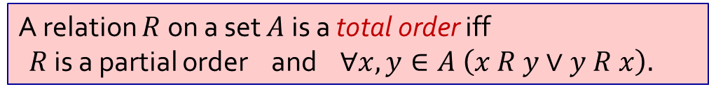

Q7.
Consider a set $A$ and a total order $≼$ on $A$. Show that all minimal elements are smallest.
A relation $R$ on a set $A$ is a total order iff
$R$ is a partial order and $∀x,y∈A \left(x R y∨y R x\right).$
Let $≼$ be a partial order on a set $A$, and $c∈A$.
$c$ is a minimal element iff $∀x∈A \left(x≼c⇒c=x\right).$
$c$ is a smallest element iff $∀x∈A (c$ $≼x$).
nothing is below
minimal
Totality: Everything is either below or above.
everything is above
smallest

Slide 16
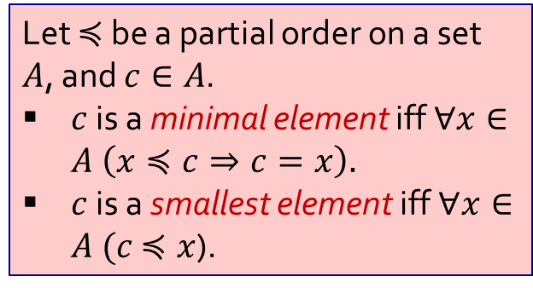
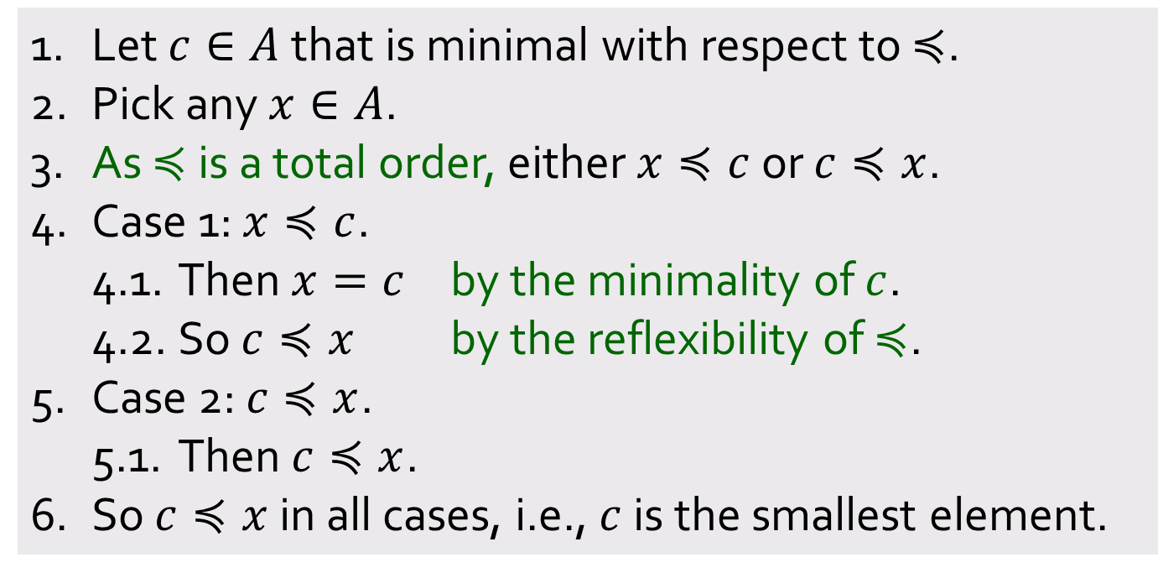
Q7.
Consider a set $A$ and a total order $≼$ on $A$. Show that all minimal elements are smallest.
A relation $R$ on a set $A$ is a total order iff
$R$ is a partial order and $∀x,y∈A \left(x R y∨y R x\right).$
Let $≼$ be a partial order on a set $A$, and $c∈A$.
$c$ is a minimal element iff $∀x∈A \left(x≼c⇒c=x\right).$
$c$ is a smallest element iff $∀x∈A (c$ $≼x$).
1. Let $c∈A$ that is minimal with respect to $≼$.
2. Pick any $x∈A$.
3. As $≼$ is a total order, either $x≼c$ or $c≼x$.
4. Case 1: $x≼c$.
4.1. Then $x=c$ by the minimality of $c$.
4.2. So $c≼x$ by the reflexibility of $≼$.
5. Case 2: $c≼x$.
5.1. Then $c≼x$.
6. So $c≼x$ in all cases, i.e., $c$ is the smallest element.
Aim:

Slide 17



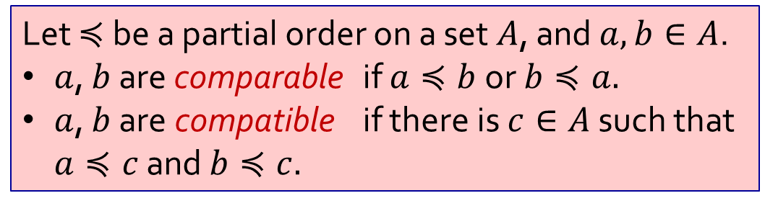
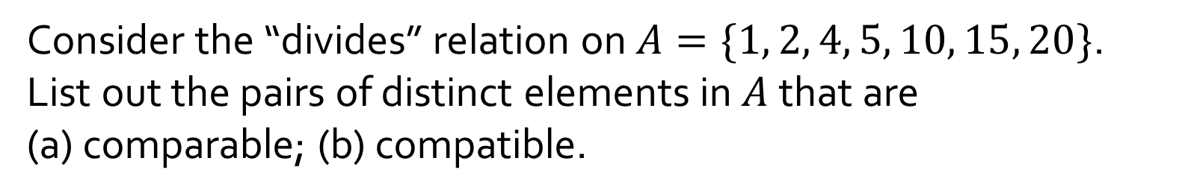

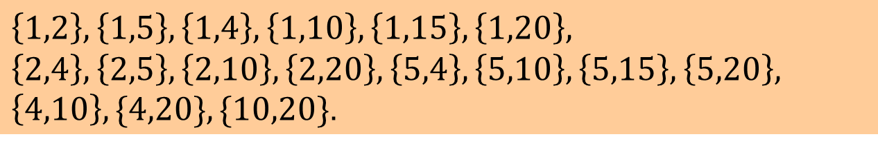




Q8.
Consider the “divides” relation on $A=\{1, 2, 4, 5, 10, 15, 20\}$. List out the pairs of distinct elements in $A$ that are
(a) comparable; (b) compatible.
$$20$$
Let $≼$ be a partial order on a set $A$, and $a, b∈A$.
$a$, $b$ are comparable if $a≼b$ or $b≼a.$
$a$, $b$ are compatible if there is $c∈A$ such that $a≼c$ and $b≼c.$
$$4$$
$$10$$
$$15$$
$$2$$
$$5$$
$$1$$
(a) Comparable:
$$\left\{1,2\right\}, \left\{1,5\right\},\left\{1,4\right\},\left\{1,10\right\},\left\{1,15\right\},\left\{1,20\right\},$$
$\{2,4\},\{2,10\},\{2,20\},\{5,10\},\{5,15\},\{5,20\},\{4,20\},\{10,20\}$.
(b) Compatible:
$$\left\{1,2\right\}, \left\{1,5\right\},\left\{1,4\right\},\left\{1,10\right\},\left\{1,15\right\},\left\{1,20\right\},$$
$$\left\{2,4\right\},\left\{2,5\right\},\left\{2,10\right\},\left\{2,20\right\},\left\{5,4\right\},\left\{5,10\right\},\left\{5,15\right\},\left\{5,20\right\},$$
$\left\{4,10\right\},\{4,20\},\{10,20\}$.

Slide 18










Q9.
Let $A=\{a,b,c,d\}$. Consider the following partial order on $A$:
$$R=\left\{\left(a,a\right),\left(a,b\right),\left(a,c\right),\left(a,d\right),\left(b,b\right),\left(b,c\right),\left(c,c\right),\left(d,d\right)\right\}.$$
Hasse diagram of $R$
Hasse diagrams of all the linearizations of $R$
$$c$$
$$b$$
$$d$$
$$a$$
Let $≼$ be a partial order on a set $A$. A Hasse diagram of $≼$ satisfises the following condition for all $x,y∈A$:
If $x≺y$ and no $z∈A$ is such that $x≺z≺y$, then $x$ is placed below $y$ and there is a line joining $x$ to $y$, else no line joins $x$ to $y$.
A linearization of a partial order $≼$ on a set $A$ is a total order $≼^{∗}$ on $A$ such that
$$∀x,y∈A \left(x≼y⇒x≼^{∗}y\right).$$
Kahn’s Algorithm. Pick out a minimal element and place it at the bottom of the total order. Repeat until nothing is left.
A relation $R$ on a set $A$ a total order iff $R$ is a partial order and $∀x,y∈A \left(x R y∨y R x\right).$

Slide 19













Q9.
Let $A=\{a,b,c,d\}$. Consider the following partial order on $A$:
$$R=\left\{\left(a,a\right),\left(a,b\right),\left(a,c\right),\left(a,d\right),\left(b,b\right),\left(b,c\right),\left(c,c\right),\left(d,d\right)\right\}.$$
Hasse diagram of $R$
Hasse diagrams of all the linearizations of $R$
$$c$$
$$c$$
$$c$$
$$d$$
$$b$$
$$d$$
$$b$$
$$d$$
$$c$$
$$a$$
$$d$$
$$b$$
$$b$$
$$a$$
$$a$$
$$a$$
Let $≼$ be a partial order on a set $A$. A Hasse diagram of $≼$ satisfises the following condition for all $x,y∈A$:
If $x≺y$ and no $z∈A$ is such that $x≺z≺y$, then $x$ is placed below $y$ and there is a line joining $x$ to $y$, else no line joins $x$ to $y$.
A linearization of a partial order $≼$ on a set $A$ is a total order $≼^{∗}$ on $A$ such that
$$∀x,y∈A \left(x≼y⇒x≼^{∗}y\right).$$
Kahn’s Algorithm. Pick out a minimal element and place it at the bottom of the total order. Repeat until nothing is left.
A relation $R$ on a set $A$ a total order iff $R$ is a partial order and $∀x,y∈A \left(x R y∨y R x\right).$

Slide 20


Q10.
State whether the following is true or false and justify your answer.
Let $≼$ be a partial order on a set $A$, and $a, b∈A$.
$a$, $b$ are comparable if $a≼b$ or $b≼a.$
$a$, $b$ are compatible if there is $c∈A$ such that $a≼c$ and $b≼c.$
(a) In all partially ordered set, any two comparable elements are compatible.
True
1. Let $a, b∈A$ such that $a,b$ are comparable.
2. Then either $a≼b$ or $b≼a$ by the definition of comparability.
3. Case 1: $a≼b$.
3.1. Let $c=b$.
3.2. Then $a≼b=c$ by assumption and
$b≼b=c$ by reflexivity.
3.3. So $a$, $b$ are compatible by the definition of compatibility.
4. Case 2: $b≼a$.
4.1. Let $c=a$.
4.2. Then $b≼a=c$ by assumption and
$a≼a=c$ by reflexivity.
4.3. So $a$, $b$ are compatible by the definition of compatibility.
5. So $a$, $b$ are compatible in any case.
The 2 cases are symmetrical, so may just use WLOG to prove one of the cases.

Slide 21

Q10.
State whether the following is true or false and justify your answer.
Let $≼$ be a partial order on a set $A$, and $a, b∈A$.
$a$, $b$ are comparable if $a≼b$ or $b≼a.$
$a$, $b$ are compatible if there is $c∈A$ such that $a≼c$ and $b≼c.$
(b) In all partially ordered set, any two compatible elements are comparable.
False
1. Consider the “divides” relation | on $ℤ^{+}$, which is a partial order.
2. Then $2$ and $3$ are compatible as $2 | 6$ and $3 | 6$.
3. But $2$ and $3$ are not comparable as $2∤3$ and $3∤2$.

Slide 22
END OF FILE

