Slide 1
CS1231S Tutorial #1
Propositional Logic and Proofs
(AY2022/23 Semester 1)

Slide 2


Introduction
Theodore Leebrant
Year 4 Computer Science & Mathematics + USP
Living in Cinnamon College
Telegram: @kagamination
Email: theodoreleebrant@u.nus.edu
T13C: Wednesday
T23B: Friday

Slide 3
About the Module
First module in the 3-chain of module CS1231S -> CS2040S -> CS3230
Also the foundation math modules, if you are interested in math modules beyond SoC
Not so much a computation module, more of a comprehension module
Module policy: Tutorial attendance taken; missing tutorials would require a valid reason and supporting document. Attendance will only be marked on your own tutorial group.

Slide 4
About the Tutorial
Safe space
Questions, mistakes, comments are welcome
Please sound out if you have anything to say
Expectations
Come to tutorial prepared for discussion!
(Try to) finish the tutorial questions
If you can’t, at least read the questions
Workflow
We will go through the tutorial questions
Will stay back until :40 for any questions if needed
I will occasionally post extra material

Slide 5
Learning objectives for this tutorial:
Understanding “if” and “only if”. (Q1)
Applying laws of logical equivalences to simplify statements and to prove equivalence. (Q2, Q3)
Knowing the negation, contrapositive, converse and inverse forms of a conditional statement and their logical relationship. (Q4)
Using rules of inference. (Q5)
Determining whether an argument is valid or invalid. (Q6, Q7)
Solving knights and knaves problems. (Q8)
Writing simple proofs. (Q9, Q10)

Slide 6

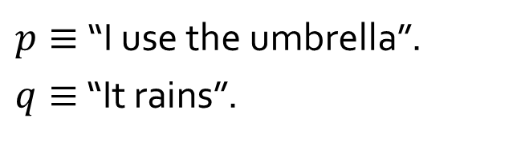


Q1a
$p≡$ “I use the umbrella”.
$q≡$ “It rains”.
Propositional statement
I use the umbrella if it rains.
$$q→p$$
I use the umbrella only if it rains.
$$p→q$$

Slide 7
Q1b
I use the umbrella if it rains.
necessary
“I use the umbrella” is a ______________ condition for “it rains”.
sufficient
“It rains” is a _____________ condition for “I use the umbrella”.

Slide 8





Q1c/d
$p≡$ “I use the umbrella”.
$q≡$ “It rains”.
$$(q→p)$$
$$∧$$
$$(p→q)$$
$$≡$$
$$(p↔q)$$
I use the umbrella if and only if it rains.
necessary and sufficient
“I use the umbrella” is a ____________________ condition for “it rains”.

Slide 9
Q2
For now till midterm test, follow this table and do not skip steps in your answers.
Theorem 2.1.1 Logical Equivalences
1 | Commutative laws | p ∧ q ≡ q ∧ p | p ∨ q ≡ q ∨ p
2 | Associative laws | p ∧ q ∧ r ≡ (p ∧ q) ∧ r ≡ p ∧ (q ∧ r) | p ∨ q ∨ r ≡ (p ∨ q) ∨ r ≡ p ∨ (q ∨ r)
3 | Distributive laws | p ∧ (q ∨ r) ≡ (p ∧ q) ∨ (p ∧ r) | p ∨ (q ∧ r) ≡ (p ∨ q) ∧ (p ∨ r)
4 | Identity laws | p ∧ true ≡ p | p ∨ false ≡ p
5 | Negation laws | p ∨ ~p ≡ true | p ∧ ~p ≡ false
6 | Double negative law | ~(~p) ≡ p
7 | Idempotent laws | p ∧ p ≡ p | p ∨ p ≡ p
8 | Universal bound laws | p ∨ true ≡ true | p ∧ false ≡ false
9 | De Morgan’s laws | ~(p ∧ q) ≡ ~p ∨ ~q | ~(p ∨ q) ≡ ~p ∧ ~q
10 | Absorption laws | p ∨ (p ∧ q) ≡ p | p ∧ (p ∨ q) ≡ p
11 | Negation of true and false | ~true ≡ false | ~false ≡ true

Slide 10
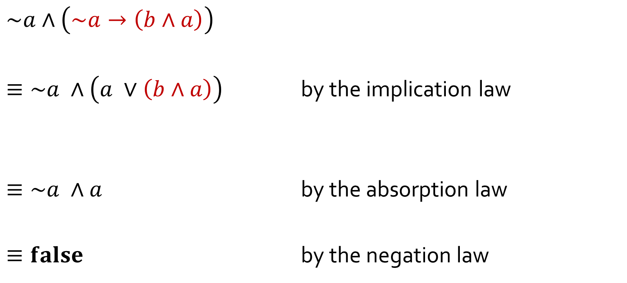
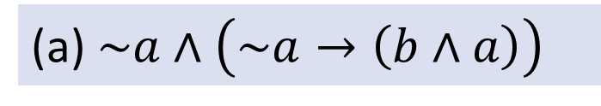
Q2
(a) $\sim a∧\left(\sim a→\left(b∧a\right)\right)$
$$\sim a∧\left(\sim a→\left(b∧a\right)\right)$$
$≡\sim a ∧\left(a ∨\left(b∧a\right)\right)$ by the implication law
$≡\sim a ∧a$ by the absorption law
$≡false$ by the negation law
$≡\sim a ∧\left(\sim (\sim a) ∨\left(b∧a\right)\right)$ by the implication law
double negative law
$≡\sim a ∧\left(a ∨\left(a∧b\right)\right)$ by the commutative law
$≡a∧\sim a$ by the commutative law

Slide 11
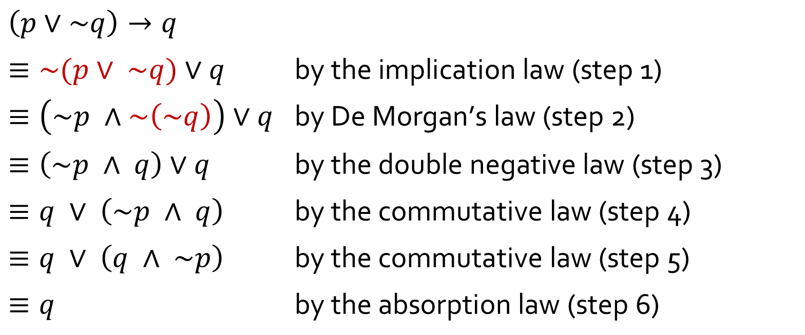
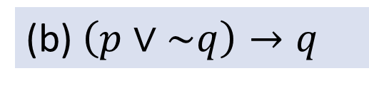
Q2
(b) $\left(p∨\sim q\right)→q$
$$\left(p∨\sim q\right)→q$$
$≡\sim (p∨ \sim q)∨q$ $\text{by} \text{the} \text{implication} \text{law}\text{ (}\text{step}\text{ 1)}$
$≡\left(\sim p ∧\sim \left(\sim q\right)\right)∨q$ $\text{by} \text{De} \text{Morgan}\text{’}\text{s} \text{law}\text{ (}\text{step}\text{ 2)}$
$≡\left(\sim p ∧ q\right)∨q$ $\text{by} \text{the} \text{double} \text{negative} \text{law}\text{ (}\text{step}\text{ 3)}$
$≡q ∨ \left(\sim p ∧ q\right)$ $\text{by} \text{the} \text{commutative} \text{law}\text{ (}\text{step}\text{ 4)}$
$≡q ∨ \left(q ∧ \sim p\right)$ $\text{by} \text{the} \text{commutative} \text{law}\text{ (}\text{step}\text{ 5)}$
$≡q$ $\text{by} \text{the} \text{absorption} \text{law}\text{ (}\text{step}\text{ 6)}$

Slide 12
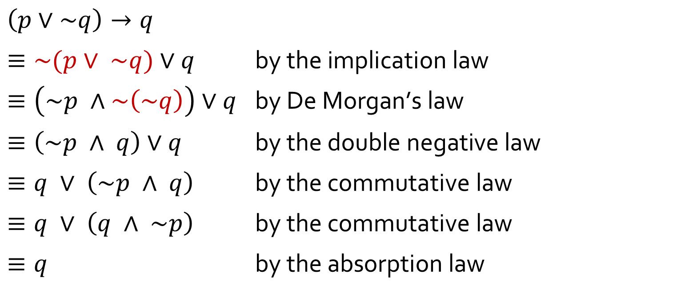
Q2
(b) $\left(p∨\sim q\right)→q$
You may combine two simple steps into one line, by citing the laws applied. Try not to combine more than 2 steps into one line or it may confuse your readers.
$$\left(p∨\sim q\right)→q$$
$≡\sim (p∨ \sim q)∨q$ $\text{by} \text{the} \text{implication} \text{law}$
$≡\left(\sim p ∧\sim \left(\sim q\right)\right)∨q$ $\text{by} \text{De} \text{Morgan}\text{’}\text{s} \text{law}$
$≡\left(\sim p ∧ q\right)∨q$ $\text{by} \text{the} \text{double} \text{negative} \text{law}$
$≡q ∨ \left(\sim p ∧ q\right)$ $\text{by} \text{the} \text{commutative} \text{law}$
$≡q ∨ \left(q ∧ \sim p\right)$ $\text{by} \text{the} \text{commutative} \text{law}$
$≡q$ $\text{by} \text{the} \text{absorption} \text{law}$
twice

Slide 13
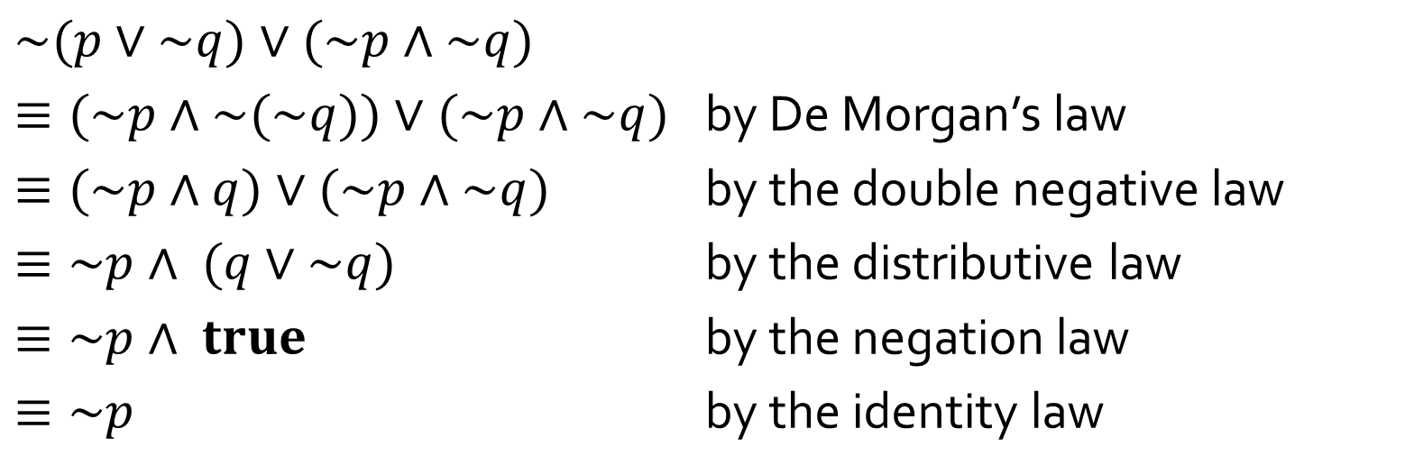
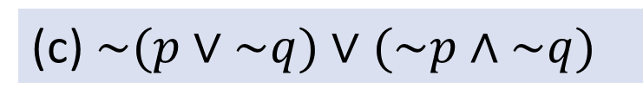
Q2
(c)$\sim (p∨\sim q)∨(\sim p∧\sim q)$
$$\sim (p∨\sim q)∨(\sim p∧\sim q)$$
$≡(\sim p∧\sim (\sim q))∨(\sim p∧\sim q)$ by De Morgan’s law
$≡(\sim p∧q)∨(\sim p∧\sim q)$ by the double negative law
$≡\sim p∧ (q∨\sim q)$ by the distributive law
$≡\sim p∧ true$ by the negation law
$≡\sim p$ by the identity law

Slide 14
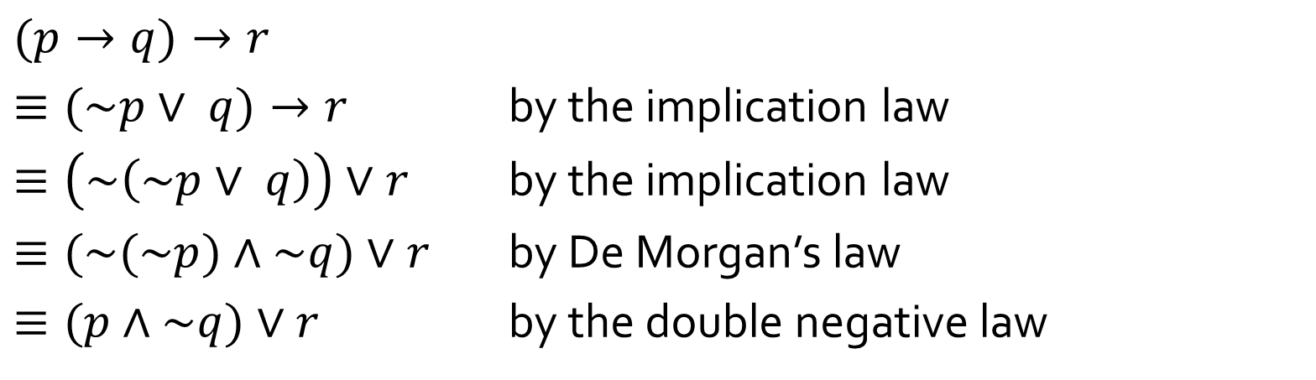
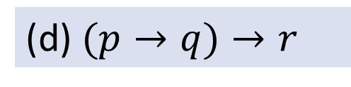
Q2
(d)$(p→q)→r$
$$(p→q)→r$$
$≡(\sim p∨ q)→r$ by the implication law
$≡\left(\sim \left(\sim p∨ q\right)\right)∨r$ by the implication law
$≡(\sim (\sim p)∧\sim q)∨r$ by De Morgan’s law
$≡(p∧\sim q)∨r$ by the double negative law

Slide 15

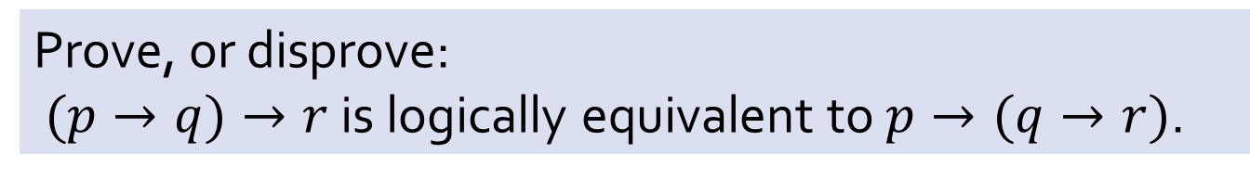
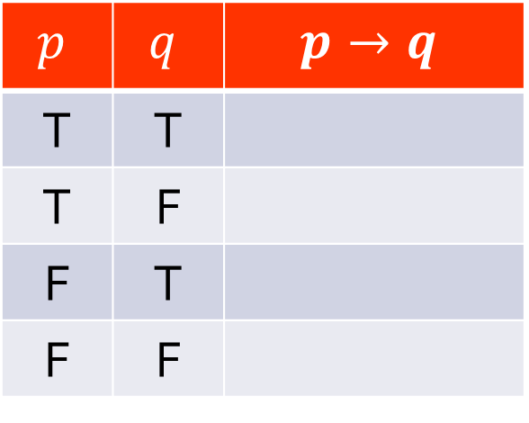

Q3
Prove, or disprove:
$(p→q)→r$ is logically equivalent to $p→(q→r)$.
Definition of conditional statement $p→q$:
$$p$$ | $$q$$ | $$p→q$$
T | T
T | F
F | T
F | F
T
F
T
T

Slide 16

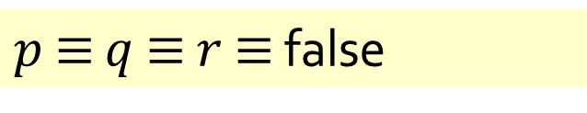













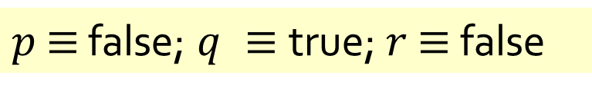


Q3
Prove, or disprove:
$(p→q)→r$ is logically equivalent to $p→(q→r)$.
True or false?
If false, what do you need?
What counterexample can you give?
$p$ $≡$ false; $q ≡$true; $r$ $≡$ false
$p$ $≡$ $q$ $≡$ $r$ $≡$ false
$$(p→q)→r$$
$$(p→q)→r$$
$$≡(F→T)→F$$
$$≡(F→F)→F$$
$$≡T→F$$
$$≡F$$
Any of these two counterexamples suffices.
$$≡T→F$$
$$≡F$$
$$p→(q→r)$$
$$p→(q→r)$$
$$≡F→(T→F)$$
$$≡F→(F→F)$$
$$≡F→F$$
$$≡T$$
$$≡F→F$$
$$≡T$$

Slide 17
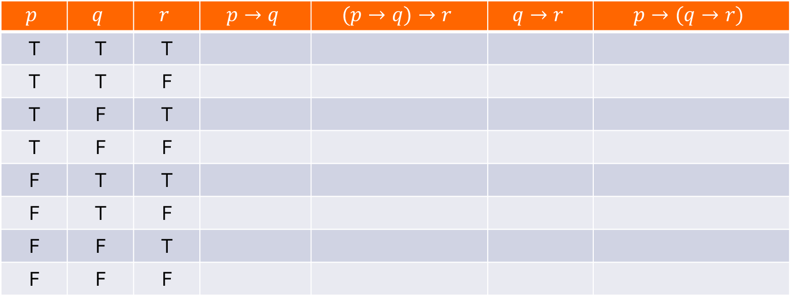
Q3
Prove, or disprove:
$(p→q)→r$ is logically equivalent to $p→(q→r)$.
If you do not know if it is true or false, you may have to draw the truth table to find out:
$$p$$ | $$q$$ | $$r$$ | $$p→q$$ | $$(p→q)→r$$ | $$q→r$$ | $$p→(q→r)$$
T | T | T
T | T | F
T | F | T
T | F | F
F | T | T
F | T | F
F | F | T
F | F | F
T
T
F
F
T
T
T
T
T
F
T
T
T
F
T
F
T
F
T
T
T
F
T
T
T
F
T
T
T
T
T
T

Slide 18
Q4
Given the conditional statement “If $12x−7=29$, then $x=3$”.
Negation:
$12x−7=29$ and $x≠3$.
Contrapositive:
If $x≠3,$ then $12x−7≠29$.
Converse:
If $x=3,\text{then} 12x−7=29$.
Inverse:
If $12x−7≠29,\text{then} x≠3$.
Is the given conditional statement true?
Yes.
Is the converse true?
Yes.
In general, possible for converse to be true but inverse false?
No.

Slide 19
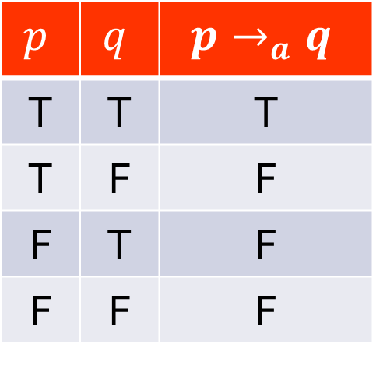
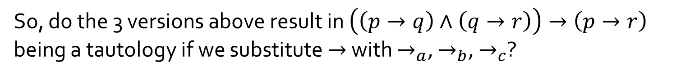

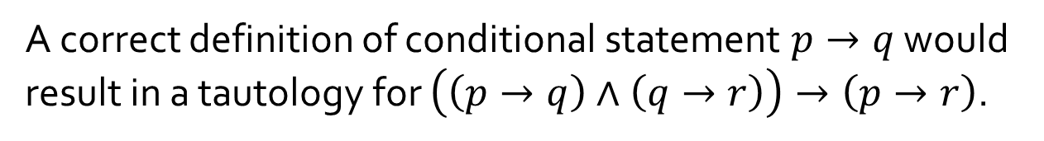

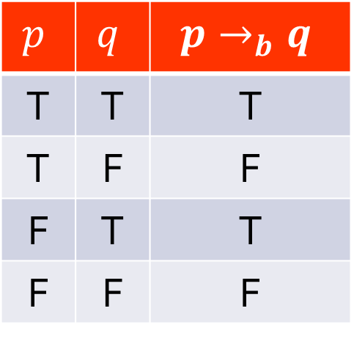
Q5
$$\left(\left(p→q\right)∧\left(q→r\right)\right)→\left(p→r\right)$$
$$p$$ | $$q$$ | $$p→_{a}q$$
T | T | T
T | F | F
F | T | F
F | F | F
$$p$$ | $$q$$ | $$p→_{b}q$$
T | T | T
T | F | F
F | T | T
F | F | F
$$p$$ | $$q$$ | $$p→_{c}q$$
T | T | T
T | F | F
F | T | F
F | F | T
A correct definition of conditional statement $p→q$ would result in a tautology for $\left(\left(p→q\right)∧\left(q→r\right)\right)→\left(p→r\right)$.
So, do the 3 versions above result in $\left(\left(p→q\right)∧\left(q→r\right)\right)→\left(p→r\right)$
being a tautology if we substitute $→$ with $→_{a}$, $→_{b}$, $→_{c}$?

Slide 20
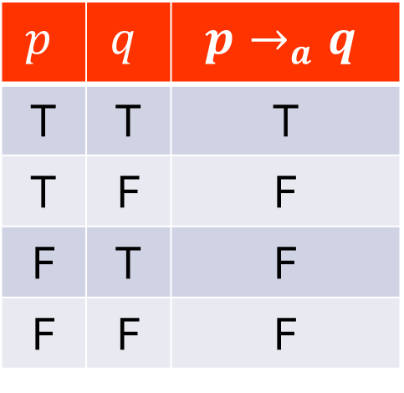
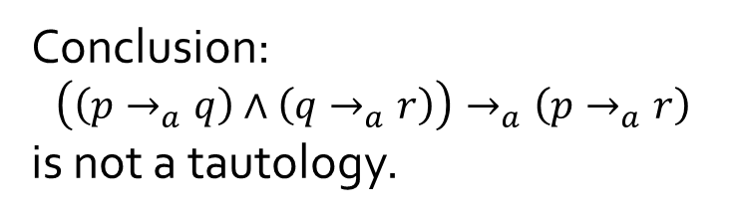
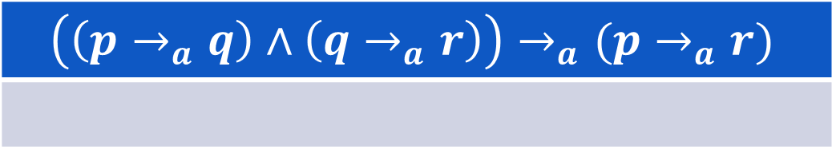
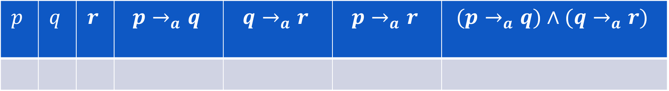
Q5
$$\left(\left(p→q\right)∧\left(q→r\right)\right)→\left(p→r\right)$$
$$p$$ | $$q$$ | $$p→_{a}q$$
T | T | T
T | F | F
F | T | F
F | F | F
$$p$$ | $$q$$ | $$r$$ | $$p→_{a}q$$ | $$q→_{a}r$$ | $$p→_{a}r$$ | $$(p→_{a}q)∧(q→_{a}r)$$
T
T
F
T
F
F
F
Conclusion:
$$\left(\left(p→_{a}q\right)∧\left(q→_{a}r\right)\right)→_{a}\left(p→_{a}r\right)$$
is not a tautology.
$$\left(\left(p→_{a}q\right)∧\left(q→_{a}r\right)\right)→_{a}(p→_{a}r)$$
F

Slide 21
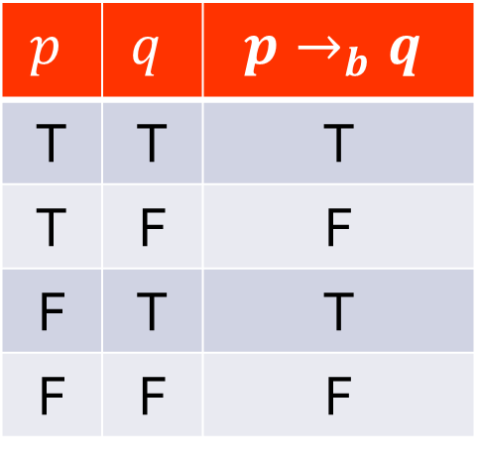
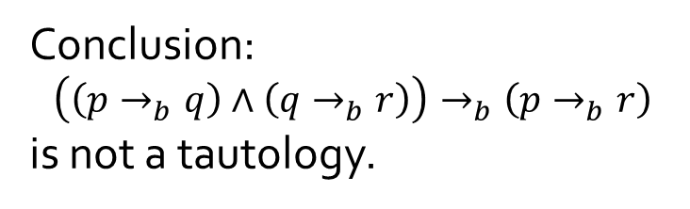
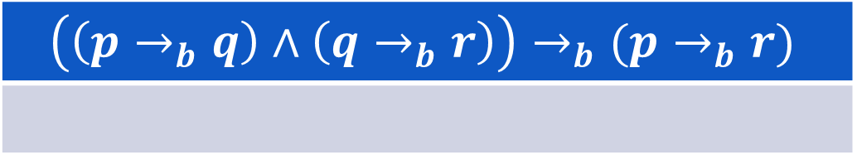
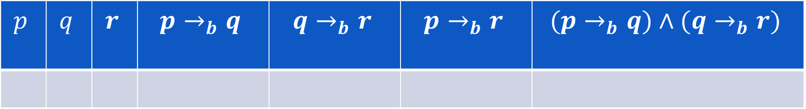
Q5
$$\left(\left(p→q\right)∧\left(q→r\right)\right)→\left(p→r\right)$$
$$p$$ | $$q$$ | $$p→_{b}q$$
T | T | T
T | F | F
F | T | T
F | F | F
$$p$$ | $$q$$ | $$r$$ | $$p→_{b}q$$ | $$q→_{b}r$$ | $$p→_{b}r$$ | $$(p→_{b}q)∧(q→_{b}r)$$
T
T
F
T
F
F
F
Conclusion:
$$\left(\left(p→_{b}q\right)∧\left(q→_{b}r\right)\right)→_{b}\left(p→_{b}r\right)$$
is not a tautology.
$$\left(\left(p→_{b}q\right)∧\left(q→_{b}r\right)\right)→_{b}(p→_{b}r)$$
F

Slide 22
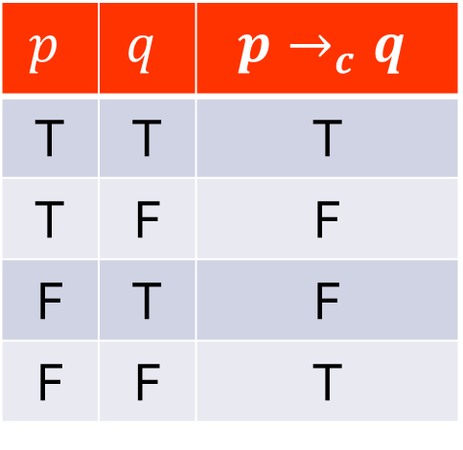
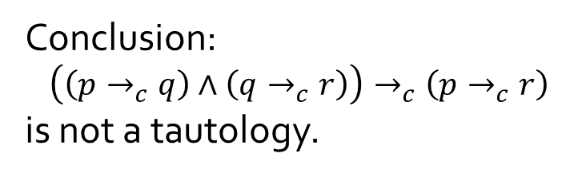
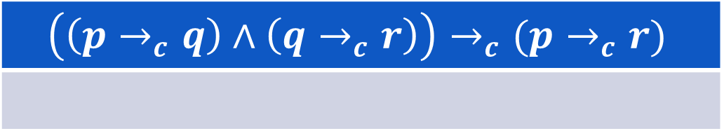
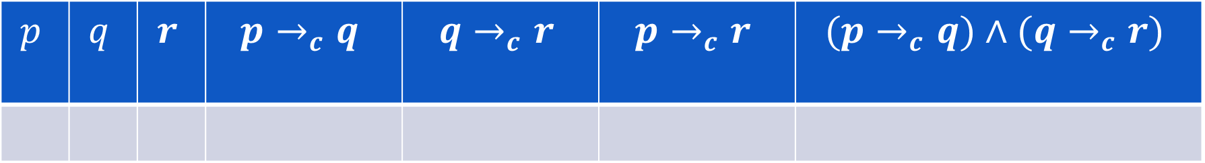
Q5
$$\left(\left(p→q\right)∧\left(q→r\right)\right)→\left(p→r\right)$$
$$p$$ | $$q$$ | $$p→_{c}q$$
T | T | T
T | F | F
F | T | F
F | F | T
$$p$$ | $$q$$ | $$r$$ | $$p→_{c}q$$ | $$q→_{c}r$$ | $$p→_{c}r$$ | $$(p→_{c}q)∧(q→_{c}r)$$
F
T
F
F
F
T
F
Conclusion:
$$\left(\left(p→_{c}q\right)∧\left(q→_{c}r\right)\right)→_{c}\left(p→_{c}r\right)$$
is not a tautology.
$$\left(\left(p→_{c}q\right)∧\left(q→_{c}r\right)\right)→_{c}(p→_{c}r)$$
F

Slide 23
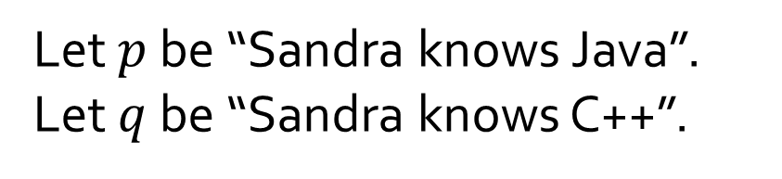
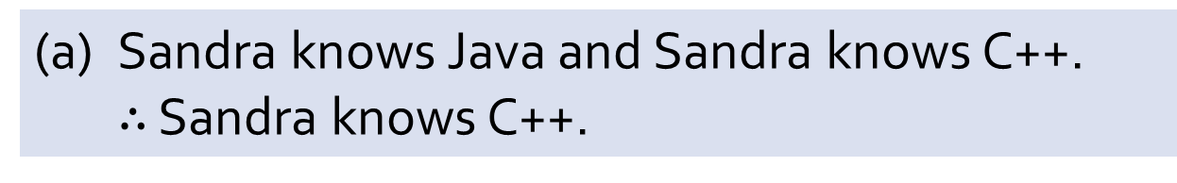
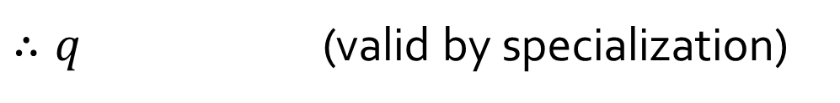
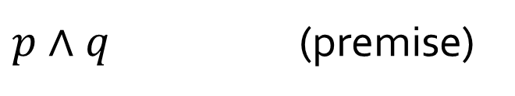
Q6
(a) Sandra knows Java and Sandra knows C++.
$∴$ Sandra knows C++.
Let $p$ be “Sandra knows Java”.
Let $q$ be “Sandra knows C++”.
$p∧q$ (premise)
$∴q$ (valid by specialization)

Slide 24
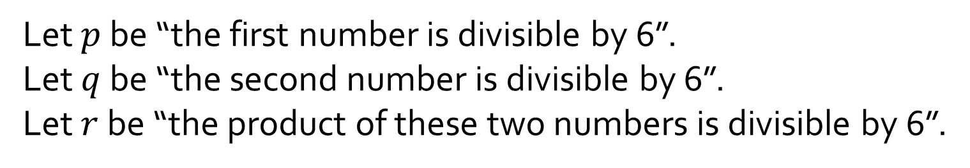
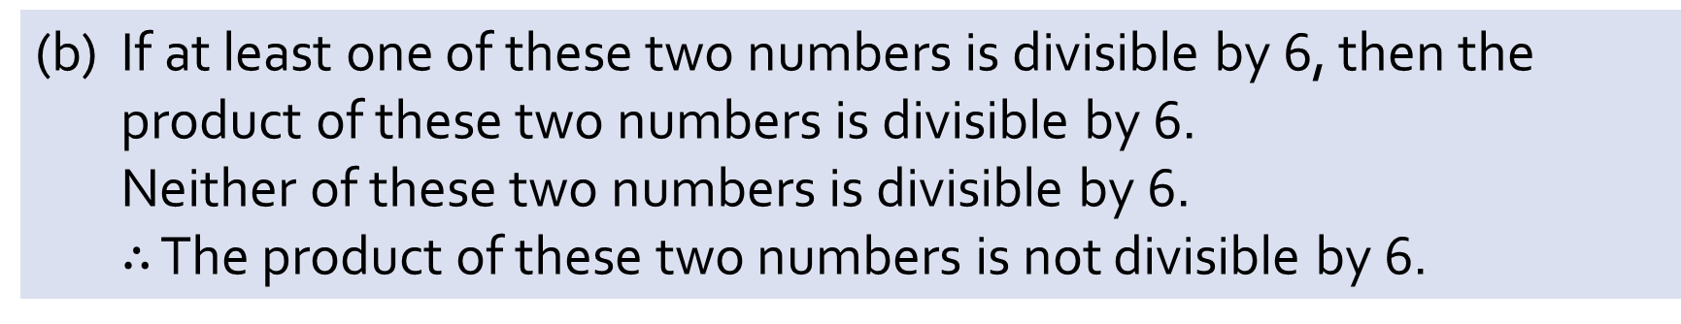
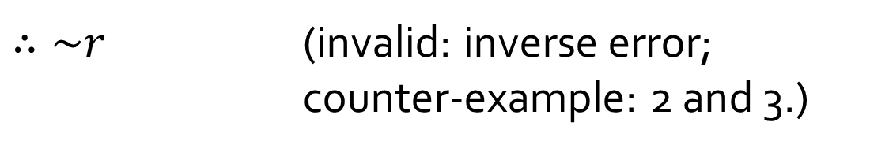
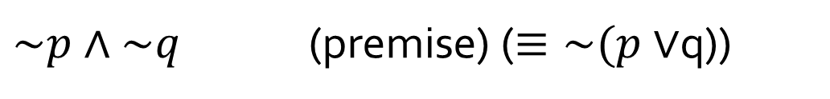
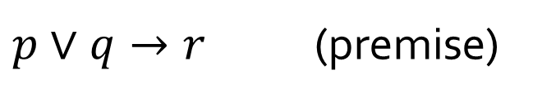
Q6
(b) If at least one of these two numbers is divisible by 6, then the product of these two numbers is divisible by 6.
Neither of these two numbers is divisible by 6.
$∴$ The product of these two numbers is not divisible by 6.
Let $p$ be “the first number is divisible by 6”.
Let $q$ be “the second number is divisible by 6”.
Let $r$ be “the product of these two numbers is divisible by 6”.
$p∨q→r$ (premise)
$\sim p∧\sim q$ (premise) ($≡\sim (p∨$q))
$∴\sim r$ (invalid: inverse error;
counter-example: 2 and 3.)

Slide 25
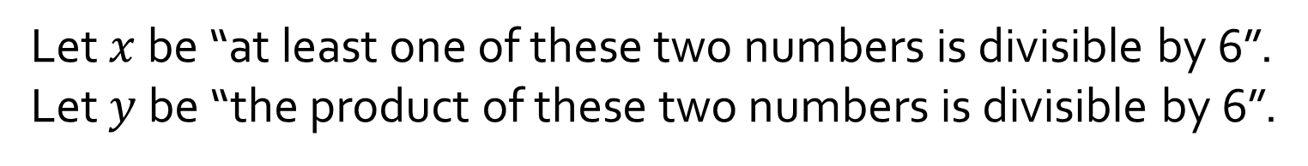
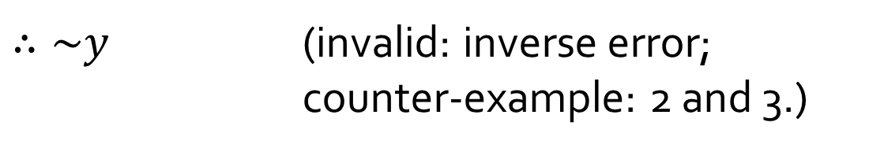
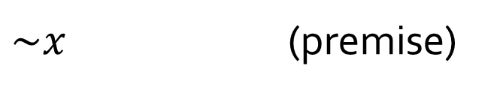
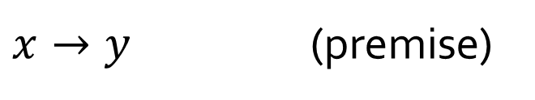
Q6
(b) If at least one of these two numbers is divisible by 6, then the product of these two numbers is divisible by 6.
Neither of these two numbers is divisible by 6.
$∴$ The product of these two numbers is not divisible by 6.
Let’s discuss this version:
Let $x$ be “at least one of these two numbers is divisible by 6”.
Let $y$ be “the product of these two numbers is divisible by 6”.
$x→y$ (premise)
Which version is better?
$\sim x$ (premise)
$∴\sim y$ (invalid: inverse error;
counter-example: 2 and 3.)

Slide 26
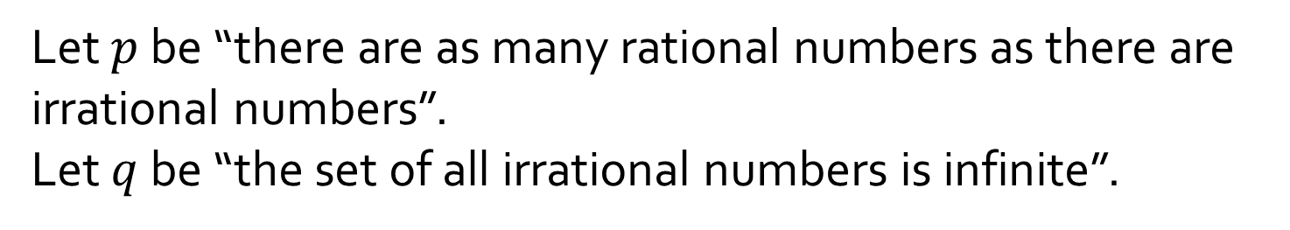
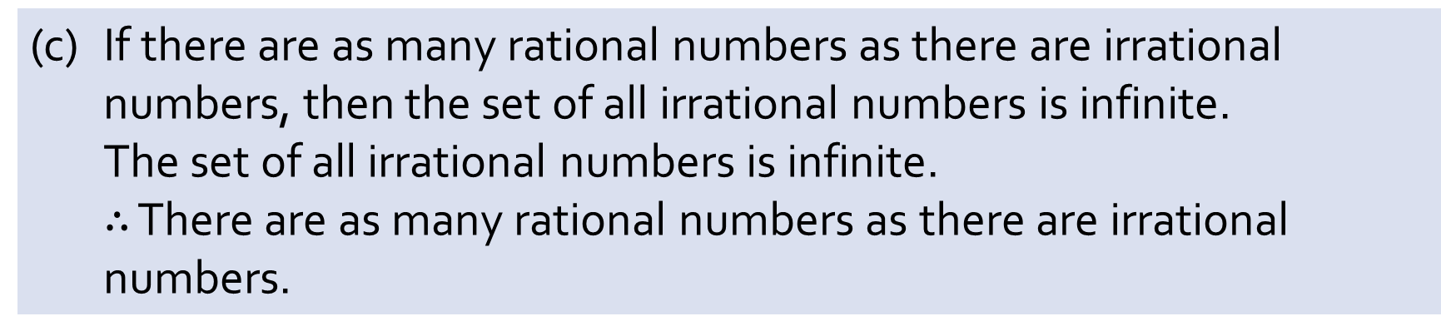
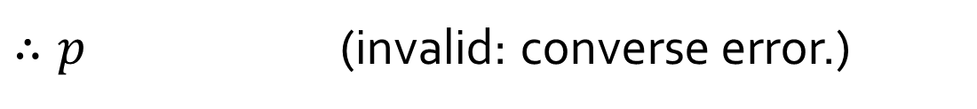
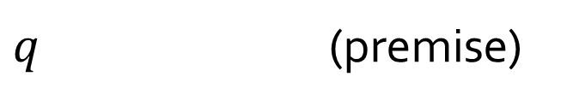
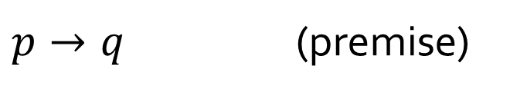
Q6
(c) If there are as many rational numbers as there are irrational numbers, then the set of all irrational numbers is infinite.
The set of all irrational numbers is infinite.
$∴$ There are as many rational numbers as there are irrational numbers.
Let $p$ be “there are as many rational numbers as there are irrational numbers”.
Let $q$ be “the set of all irrational numbers is infinite”.
$p→q$ (premise)
$q$ (premise)
$∴p$ (invalid: converse error.)

Slide 27
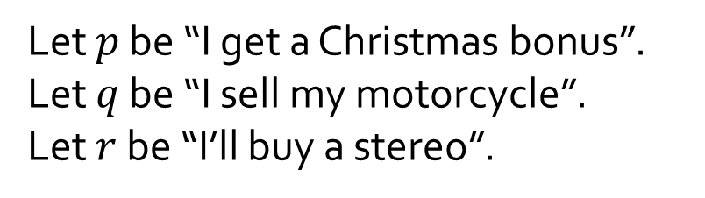



Q6
(d) If I get a Christmas bonus, I’ll buy a stereo.
If I sell my motorcycle, I’ll buy a stereo.
$∴$ If I get a Christmas bonus or I sell my motorcycle, I’ll buy a stereo.
Let $p$ be “I get a Christmas bonus”.
Let $q$ be “I sell my motorcycle”.
Let $r$ be “I’ll buy a stereo”.
Many students cite Proof by Division into Cases (Lecture #2 slide 66). This is NOT proof by division into cases.
$p→r$ (premise)
$q→r$ (premise)
$(p→r)∧(q→r)$ (conjunction of rule of inference)
How do you fill in the gap?
$(\sim p∨r)∧(\sim q∨r)$ (implication law)
$(\sim p∧\sim q)∨r$ (distributive law)
$\sim (p∨q)∨r$ (De Morgan’s law)
$∴(p∨q)→r$ (implication law)

Slide 28




Q7
(a) Given the following argument:
$$p∨\left(q∧r\right)$$
$$\sim p$$
$$∴q∧r$$
Without actually drawing the truth table, determine the values of $p$, $q$ and $r$ in the critical row(s) of the truth table.
$$p≡false$$
$$q≡true$$
$$r≡true$$
$$q∧r≡true$$
Is the argument valid?
Yes

Slide 29


Q7
(b) Give a counterexample to show that the following argument is invalid:
$$p∨\left(q∧r\right)$$
$$\sim (p∧q)$$
$$∴r$$
$$p≡true$$
$$q≡false$$
$$r≡false$$

Slide 30



Q7
(c) Determine whether the following argument is valid or invalid.
If I go to the beach, I will take my shades or my sunscreen.
I am taking my shades but not my sunscreen.
Therefore, I will go to the beach.
Let $p$ be “I go to the beach”;
$q$ be “I take my shades”;
$r$ be “I take my sunscreen”.
$$p→q∨r$$
$$q∧\sim r$$
$$∴p$$
Critical row: $p≡false; q≡true; r≡false.$
Conclusion: false.
Argument is invalid.

Slide 31


Q7
(c)
$$p$$ | $$q$$ | $$r$$ | $$\sim r$$ | $$q∨r$$ | $$p→(q∨r)$$ | $$q∧\sim r$$ | $$p$$
T | T | T | F | T | T | F | T
T | T | F | T | T | T | T | T
T | F | T | F | T | T | F | T
T | F | F | T | F | F | F | T
F | T | T | F | T | T | F | F
F | T | F | T | T | T | T | F
F | F | T | F | T | T | F | F
F | F | F | T | F | T | F | F
$$p→q∧r$$
$$q∧\sim r$$
$$∴p$$

Slide 32


Q7
(d) Determine whether the following argument is valid or invalid.
I will buy a new goat or a used Yugo.
If I buy both a new goat and a used Yugo, I will need a loan.
I bought a used Yugo but I don’t need a loan.
Therefore, I didn’t buy a new goat.
$$p∨q$$
$$(p∧q)→r$$
$$q∧\sim r$$
$$∴\sim p$$
Let $p$ be “I buy a new goat”;
$q$ be “I buy a used Yugo”;
$r$ be “I need a loan”.
Critical row: $p≡false; q≡true; r≡false.$
Conclusion: true.
Argument is valid.

Slide 33


Q7
(d)
$$p$$ | $$q$$ | $$r$$ | $$\sim r$$ | $$p∧q$$ | $$p∨q$$ | $$(p∧q)→r$$ | $$q∧\sim r$$ | $$\sim p$$
T | T | T | F | T | T | T | F | F
T | T | F | T | T | T | F | T | F
T | F | T | F | F | T | T | F | F
T | F | F | T | F | T | T | F | F
F | T | T | F | F | T | T | F | T
F | T | F | T | F | T | T | T | T
F | F | T | F | F | F | T | F | T
F | F | F | T | F | F | T | F | T
$$p∨q$$
$$(p∧q)→r$$
$$q∧\sim r$$
$$∴\sim p$$

Slide 34


Q8
(a) Two natives A and B:
A says: Both of us are knights.
B says: A is a knave.
Tempting to say “Contradiction” right after 1.4. However, this is not valid because contradiction requires $p∧\sim p$, but ‘knave’ is not the negation of ‘knight’.
Hence 1.5 is required before we arrive at the contradiction in 1.6.
Proof (by contradiction):
1. If A is a knight, then:
1.1 What A says is true. (by definition of knight)
1.2 ∴ B is a knight too. (that’s what A says)
1.3 ∴ What B says is true. (by definition of knight)
1.4 ∴ A is a knave. (that’s what B says)
1.5 ∴ A is not a knight. (since A is either a knight or a knave, but not both)
1.6 ∴ Contradiction to 1.
2. ∴ A is not a knight.
3. ∴ A is a knave. (since A is either a knight or a knave, but not both)
4. ∴ What B says is true.
5. ∴ B cannot be a knave. (as B has said something true)
6. ∴ B is a knight. (as there are only knights and knaves)
7. Conclusion: A is a knave and B is a knight.

Slide 35
Q8
(b) Two natives C and D:
C says: D is a knave.
D says: C is a knave.
How many knights and knaves are there?
Proof (by division in cases):
1. If C is a knight, then:
1.1 What C says is true. (by definition of knight)
1.2 ∴ D is a knave. (that’s what C says)
2. If C is not a knight, then:
2.1 Then C is a knave. (one is either a knight or a knave)
2.2 ∴ what C says is false. (by definition of knave)
2.3 ∴ D is not a knave. (C says D is a knave, but what C says is false)
2.4 ∴ D is a knight. (one is either a knight or a knave)
3. Conclusion: in both cases, there is one knight and one knave.

Slide 36

Q9
Prove:
The product of any two odd integers is an odd integer.
Definitions of even and odd integers are given in lecture (lect #1 slide 27)
Direct proof:
1. Take any two odd integers $n,m$.
2. Then $n=2k+1$ and $m=2p+1$, for $k,p∈ℤ$ (by definition of odd integers)
Hence $nm=\left(2k+1\right)\left(2p+1\right)$
$=\left(2k\left(2p+1\right)\right)+\left(2p+1\right)$
$=\left(4kp+2k\right)+(2p+1)$
$=2\left(2kp+k+p\right)+1$ (by basic algebra)
4. Let $q=2kp+k+p$ which is an integer (by closure of integers under $+$ and $×$).
5. Then $nm=2q+1$ which is odd (by definition of odd integers)
6. Therefore, the product of any two odd integers is an odd integer.
Give justification
Closure?

Slide 37


Q10
Let $n$ be an integer. Then $n^{2}$ is odd if and only if $n$ is odd.
(a) Smart’s attempt:
Proof (by contradiction)
1. Suppose $n$ is an even integer.
2. Then $∃k∈ℤ$ s.t. $n=2k$.
Squaring both sides, we get $n^{2}={(2k)}^{2}=4k^{2}=2(2k^{2}).$
4. Since $k$ is an integer, so is $2k^{2}$.
5. Hence $n^{2}=2p$, with $p=2k^{2}∈ℤ$.
6. Therefore, $n^{2}$ is even.
7. So, if $n$ is even, then $n^{2}$ is even, which is the same as saying, if $n^{2}$ is odd, then $n$ is odd.
8. Therefore, $n^{2}$ is odd if and only if $n$ is odd.
Missing justifications.
?
(by definition of even integers)
(by closure of integers under $×$)
(by definition of even integers)
Prove only one direction.

Slide 38

Q10
Let $n$ be an integer. Then $n^{2}$ is odd if and only if $n$ is odd.
(b) Write your own proof.
Proof:
1. ($⇒$) Proving the contraposition of “if $n^{2}$ is odd, then $n$ is odd”.
1.1. Suppose $n$ is even.
1.2. Then $∃k∈ℤ$ s.t. $n=2k$. (by definition of even integers)
1.3. Squaring both sides, we get $n^{2}={(2k)}^{2}=4k^{2}=2(2k^{2}).$ (by basic algebra)
1.4. Hence $n^{2}=2p$, with $p=2k^{2}∈ℤ$. (by closure of integers under $×$)
1.5. Therefore, , $n^{2}$ is even. (by definition of even integers)
1.6. This proves that if $n^{2}$ is odd, then $n$ is odd.
2. ($⇐$) If $n$ is odd, then $n×n=n^{2}$ is odd. (by question 9)
3. Therefore, $n^{2}$ is odd if and only if $n$ is odd. (by lines 1.6 and 2)

Slide 39


Feedback
T13C: Wednesday, 1200-1400
T23B: Friday, 1200-1400
Tutorial answers will be uploaded on Canvas at the end of the week.
If you still have any doubts, please post on Canvas.

