Slide 1
Cs1231S tutorial #11
Graphs and Trees

Slide 2
Learning objectives of this tutorial
Graphs and Trees
Complement graphs and self-complementary graphs.
Counting spanning trees in a graph
Isomorphic and non-isomorphic trees,
Theorem on trees
Counting Binary Trees
Understanding pre-order, in-order and post-order traversals.
Finding MST using Kruskal’s, Prim-Dijkstra’s algorithms (and for fun, with Guan’s algorithm)

Slide 3

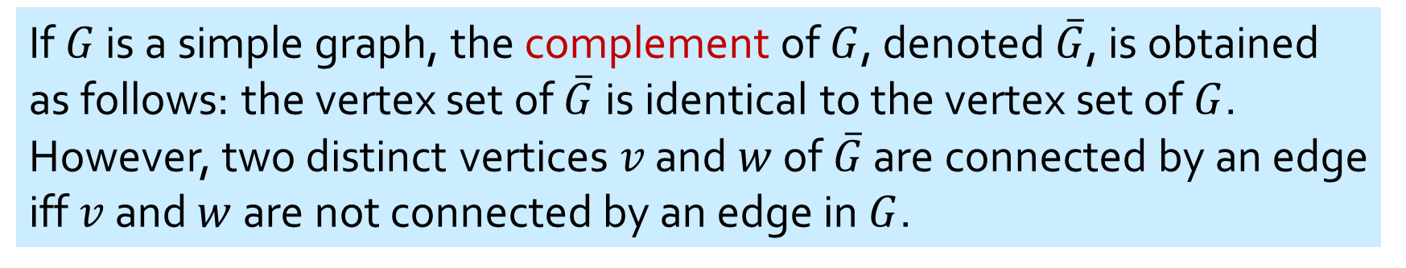
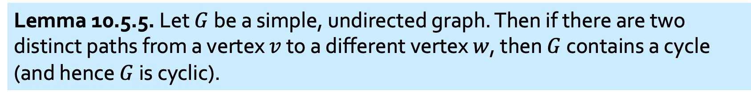


Definitions and Theorems
If $G$ is a simple graph, the complement of $G$, denoted $\overline{G}$, is obtained as follows: the vertex set of $\overline{G}$is identical to the vertex set of $G$. However, two distinct vertices $v$ and $w$ of $\overline{G}$ are connected by an edge iff $v$ and $w$ are not connected by an edge in $G$.
$G$:
$\overline{G}$:
A self-complementary graph is isomorphic with its complement.
A graph $G$ and its complement $\overline{G}$.
Lemma 10.5.5. Let $G$ be a simple, undirected graph. Then if there are two distinct paths from a vertex $v$ to a different vertex $w$, then $G$ contains a cycle (and hence $G$ is cyclic).

Slide 4
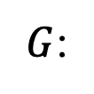
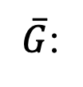
Q1.
(a) For graph $G$, draw its complement graph $\overline{G}$.
Complement graph
$G$:
$\overline{G}$:
Not Self Complementary

Slide 5
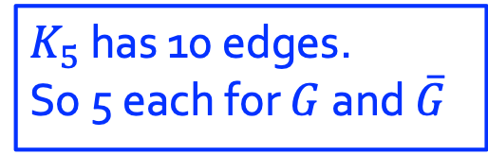

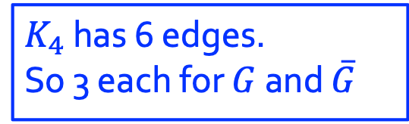

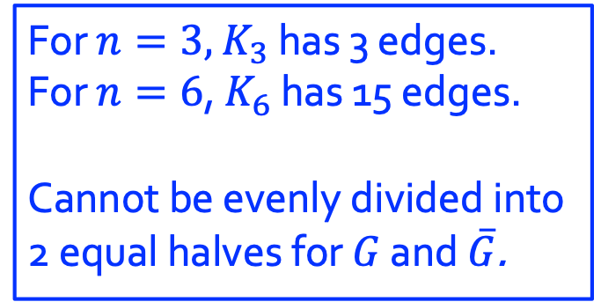


Q1.
(b) Draw all self-complementary graphs with
Complement graph
$K_{4}$ has 6 edges.
So 3 each for $G$ and $\overline{G}$
4 vertices
How about this?
$$≅$$
$$≇$$
$K_{5}$ has 10 edges.
So 5 each for $G$ and $\overline{G}$
5 vertices
3 & 6 vertices
$$≅$$
For $n=3,$ $K_{3}$ has 3 edges.
For $n=6$, $K_{6}$ has 15 edges.
Cannot be evenly divided into 2 equal halves for $G$ and $\overline{G}$.
$$≅$$

Slide 6
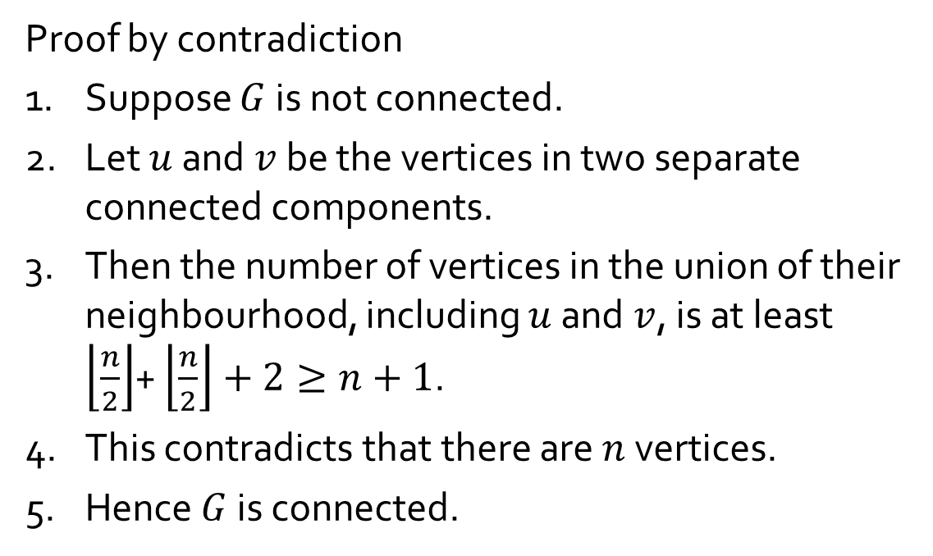
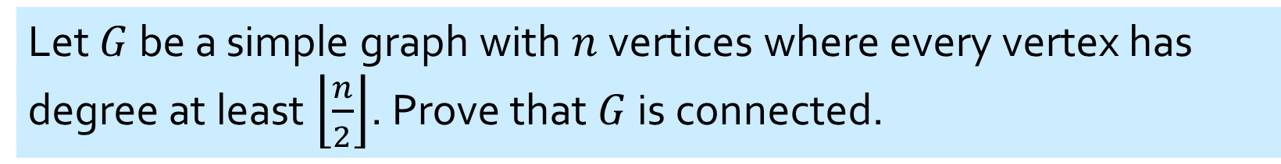
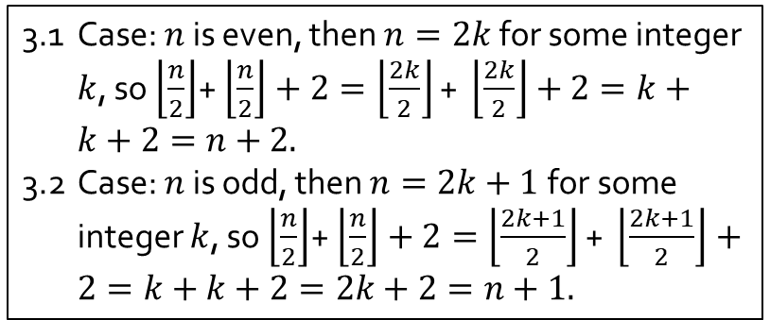


Q2.
Let $G$ be a simple graph with $n$ vertices where every vertex has degree at least $\left\lfloor \frac{n}{2}\right\rfloor$. Prove that $G$ is connected.
Proof by contradiction
1. Suppose $G$ is not connected.
2. Let $u$ and $v$ be the vertices in two separate connected components.
3. Then the number of vertices in the union of their neighbourhood, including $u$ and $v$, is at least $\left\lfloor \frac{n}{2}\right\rfloor$+ $\left\lfloor \frac{n}{2}\right\rfloor +2≥n+1$.
4. This contradicts that there are $n$ vertices.
5. Hence $G$ is connected.
$$u$$
$$v$$
3.1 Case: $n$ is even, then $n=2k$for some integer $k$, so $\left\lfloor \frac{n}{2}\right\rfloor$+ $\left\lfloor \frac{n}{2}\right\rfloor +2=\left\lfloor \frac{2k}{2}\right\rfloor \text{+} \left\lfloor \frac{2k}{2}\right\rfloor +2=k+k+2=n+2.$
3.2 Case: $n$ is odd, then $n=2k+1$for some integer $k$, so $\left\lfloor \frac{n}{2}\right\rfloor$+ $\left\lfloor \frac{n}{2}\right\rfloor +2=\left\lfloor \frac{2k+1}{2}\right\rfloor \text{+} \left\lfloor \frac{2k+1}{2}\right\rfloor +2=k+k+2=2k+2=n+1.$

Slide 7
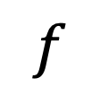


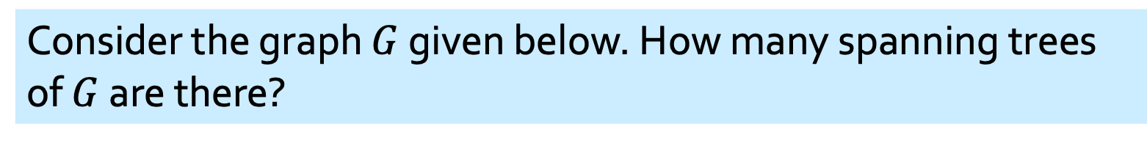



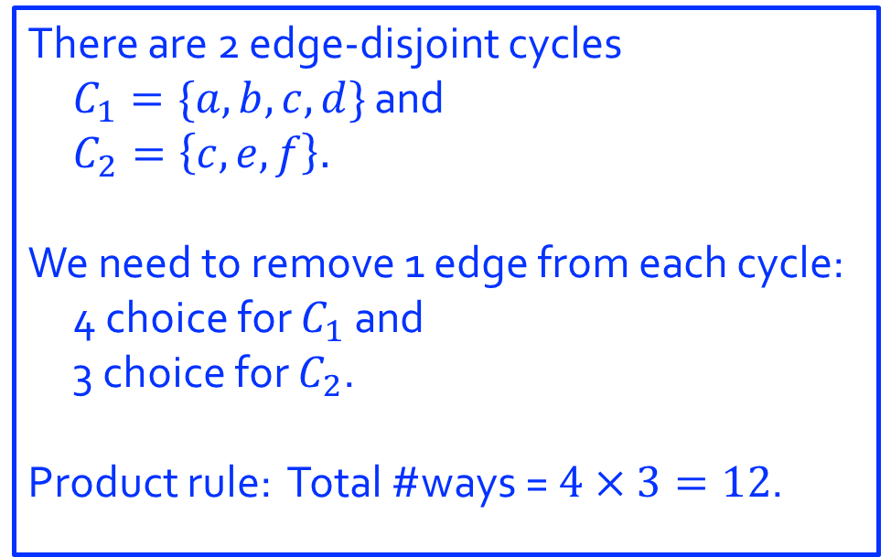
Q3.
Consider the graph $G$ given below. How many spanning trees of $G$ are there?
There are 2 edge-disjoint cycles
$C_{1}=\{a,b,c,d\}$ and
$C_{2}=\left\{c, e,f\right\}.$
We need to remove 1 edge from each cycle: 4 choice for $C_{1}$ and
3 choice for $C_{2}$.
Product rule: Total #ways = $4×3=12$.
$$a$$
$$d$$
$$f$$
$$b$$
$$c$$
$$e$$
DIY: Draw these 12 spanning trees.

Slide 8
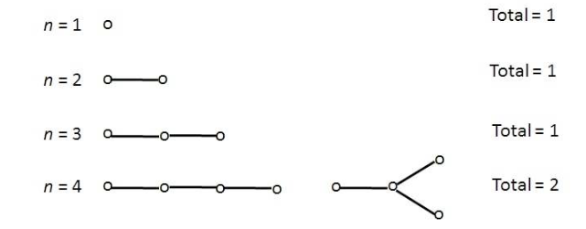
Q4.
(a) Draw all non-isomorphic trees with $n$ nodes, $n=1,2,3,4$.

Slide 9
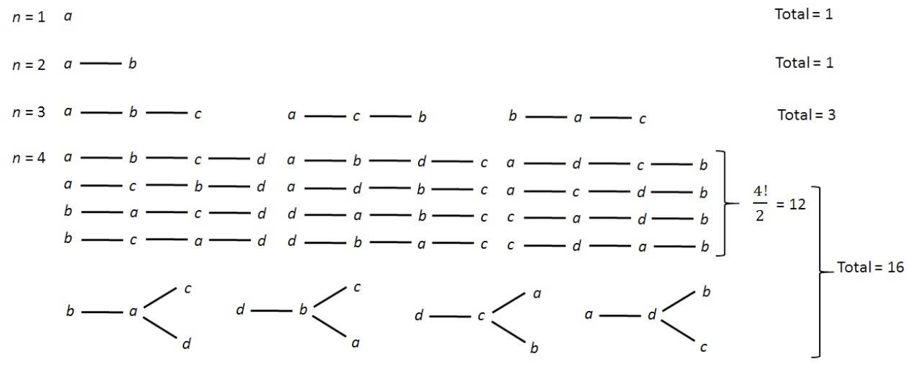
Q4.
(b) For each non-isomorphic tree in part (a), how many isomorphic copies are there?

Slide 10
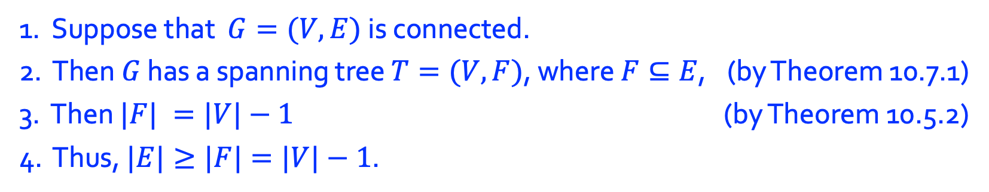
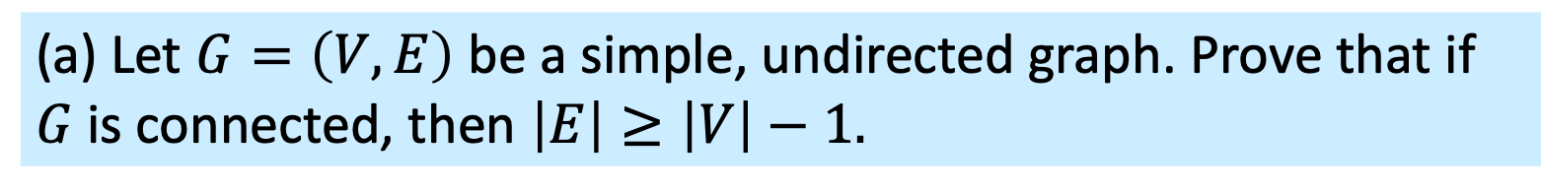

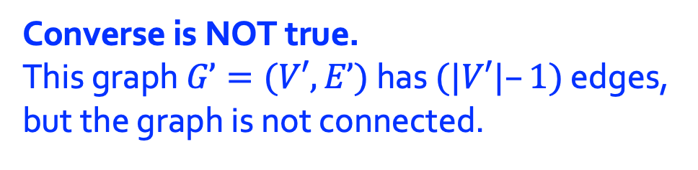
Q5.
(a) Let $G=\left(V,E\right)$ be a simple, undirected graph. Prove that if $G$ is connected, then $\left|E\right|≥\left|V\right|−1.$
1. Suppose that $G=(V,E)$ is connected.
2. Then $G$ has a spanning tree $T=(V,F)$, where $F⊆E$, (by Theorem 10.7.1)
3. Then $|F| =|V|−1$ (by Theorem 10.5.2)
4. Thus, $|E|≥|F|=|V|−1$.
(b) Is the converse true?
Converse is NOT true.
This graph $G’=(V′,E’)$ has $(|V′|–1)$ edges, but the graph is not connected.
$$G^{′}=(V^{′},E^{′})$$

Slide 11
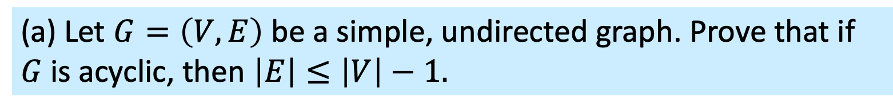
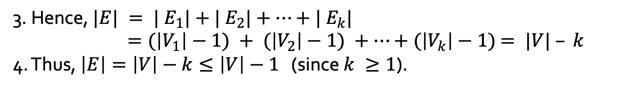
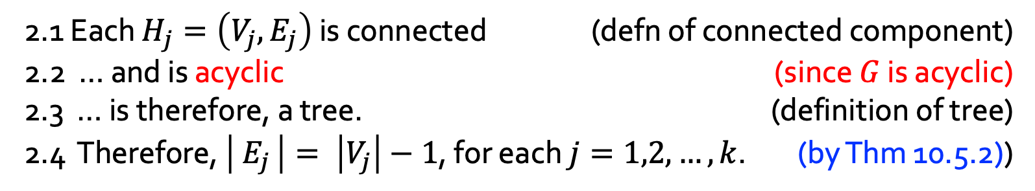
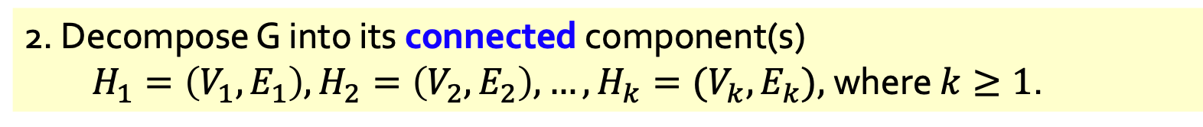
Q6.
(a) Let $G=\left(V,E\right)$ be a simple, undirected graph. Prove that if $G$ is acyclic, then $\left|E\right|≤\left|V\right|−1.$
1. Suppose that $G=(V,E)$ is acyclic.
2. Decompose G into its connected component(s) $H_{1}=\left(V_{1},E_{1}\right), H_{2}=\left(V_{2},E_{2}\right),…,H_{k}=(V_{k},E_{k}),$where $k≥1$.
2.1 Each $H_{j}=\left(V_{j}, E_{j}\right)$ is connected (defn of connected component)
2.2 … and is acyclic (since $G$ is acyclic)
2.3 … is therefore, a tree. (definition of tree)
2.4 Therefore, $\left| E_{j} \right|= \left|V_{j}\right|−1$, for each $j=1,2,…,k$. (by Thm 10.5.2))
3. Hence, $|E| = | E_{1}|+| E_{2}|+…+| E_{k}|$ $=(\left|V_{1}\right|−1) + (\left|V_{2}\right|−1) +…+(\left|V_{k}\right|−1)$ $= |V| – k$
4. Thus, $\left|E\right|=\left|V\right|−k≤\left|V\right|−1$ (since $k ≥1$).

Slide 12
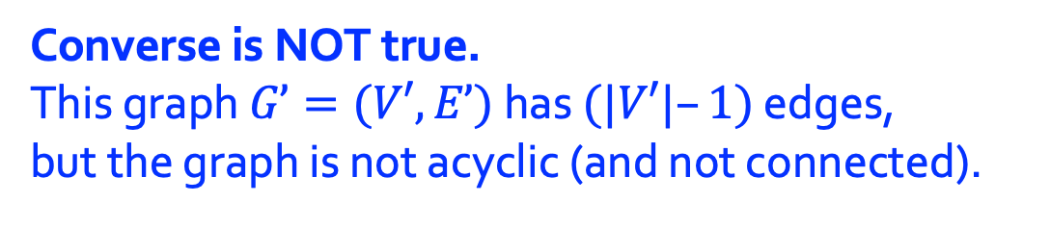

Q6.
(a) Let $G=\left(V,E\right)$ be a simple, undirected graph. Prove that if $G$ is acyclic, then $\left|E\right|≤\left|V\right|−1.$
(b) Is the converse true?
Converse is NOT true.
This graph $G’=(V′,E’)$ has $(|V′|–1)$ edges, but the graph is not acyclic (and not connected).
$$G^{′}=(V^{′},E^{′})$$

Slide 13
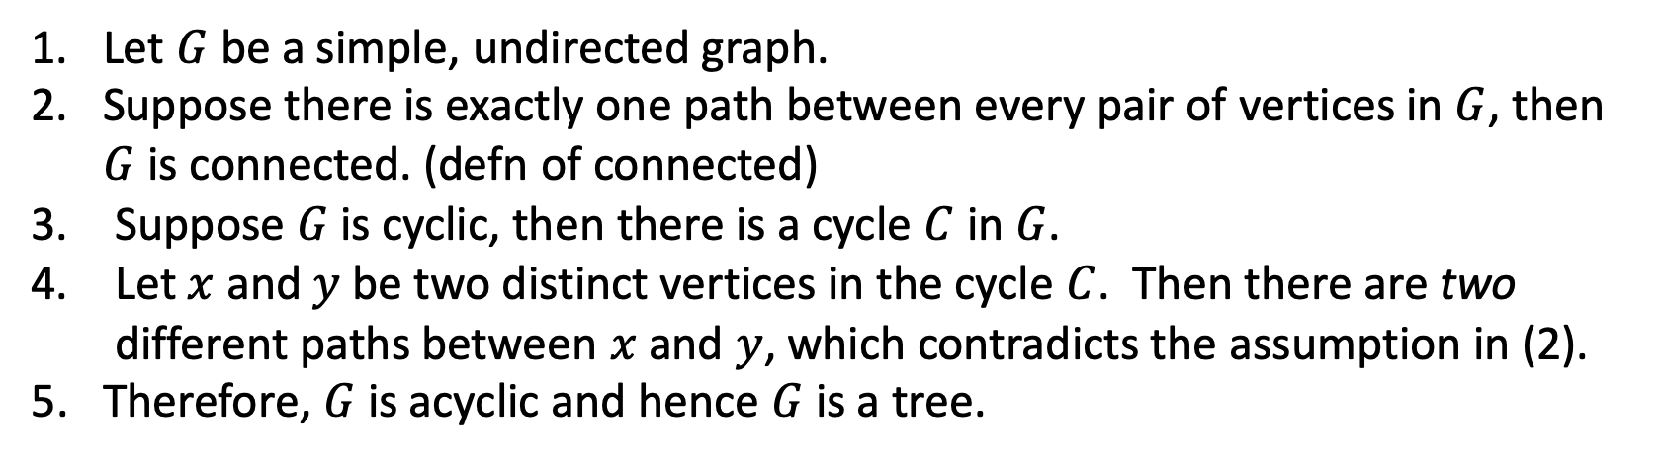
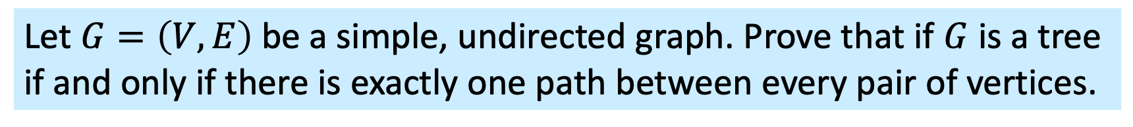
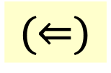
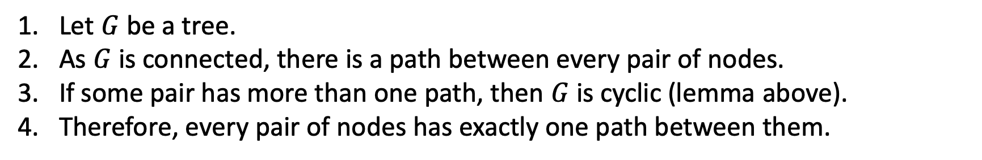
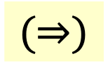
Q7.
Let $G=\left(V,E\right)$ be a simple, undirected graph. Prove that if $G$ is a tree if and only if there is exactly one path between every pair of vertices.
Lemma 10.5.5. Let $G$ be a simple, undirected graph. Then if there are two distinct paths from a vertex $v$ to a different vertex $w$, then $G$ contains a cycle (and hence $G$ is cyclic).
$$(⇒)$$
1. Let $G$ be a tree.
2. As $G$ is connected, there is a path between every pair of nodes.
3. If some pair has more than one path, then $G$ is cyclic (lemma above).
4. Therefore, every pair of nodes has exactly one path between them.
$$(⇐)$$
1. Let $G$ be a simple, undirected graph.
2. Suppose there is exactly one path between every pair of vertices in $G$, then $G$ is connected. (defn of connected)
Suppose $G$ is cyclic, then there is a cycle $C$ in $G$.
Let $x$ and $y$ be two distinct vertices in the cycle $C$. Then there are two different paths between $x$ and $y$, which contradicts the assumption in (2).
5. Therefore, $G$ is acyclic and hence $G$ is a tree.

Slide 14
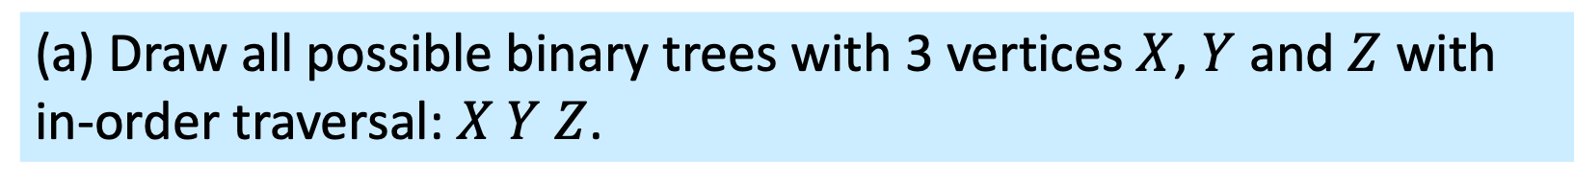
Q8.
(a) Draw all possible binary trees with 3 vertices $X$, $Y$ and $Z$ with in-order traversal: $X Y Z$.
STRATEGY:
Fix the ROOT of the binary tree;
Then, know # nodes in Left-Subtree,
#nodes in Right-Subtree
X
X
Y
Z
Z
Y
Z
Z
X
X
Y
Z
Y
Y
X
Total: 5

Slide 15
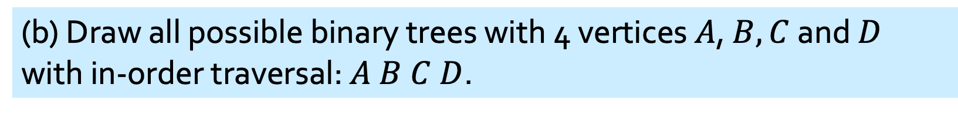
Q8.
(b) Draw all possible binary trees with 4 vertices $A$, $B, C$ and $D$ with in-order traversal: $A B C D$.
Total: 14
Rooted at A: 5
Rooted at B: 2
A
A
A
A
A
B
B
B
B
C
D
D
A
D
A
C
C
D
B
D
C
B
C
D
D
C
B
C
Rooted at D: 5
Rooted at C: 2
A
D
D
D
D
C
C
B
C
B
A
A
D
A
D
B
C
A
C
A
B
C
B
A
D
B
C
B

Slide 16
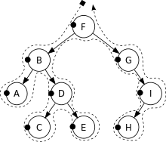
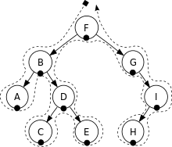







Trees Rooted Trees Spanning trees and Shortest Paths
Binary Tree Traversal
Depth-First Search
Pre-order:
F, B, A, D, C, E, G, I, H
In-order:
Post-order:
A, B, C, D, E, F, G, H, I
A, C, E, D, B, H, I, G, F
R
$$T_{l}$$
$$T_{r}$$
$$T_{l}$$
R
$$T_{r}$$
$$T_{l}$$
$$T_{r}$$
R
F
B A D C E
G I H
A B C D E
F
$$\text{G} \text{H} \text{I}$$
$$\text{A} \text{C} \text{E} \text{D} \text{B}$$
H I G
F
Acknowledgement: Wikipedia https://en.wikipedia.org/wiki/Tree_traversal


Slide 17

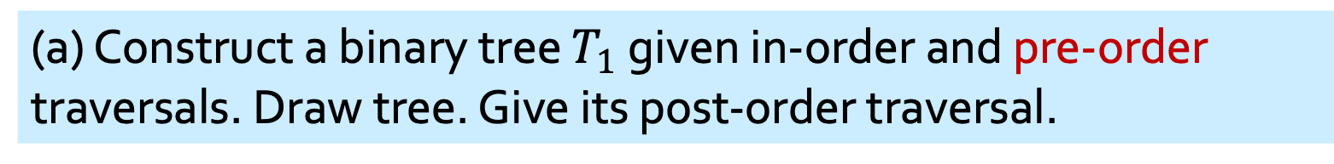

Q9.
(a) Construct a binary tree $T_{1}$ given in-order and pre-order traversals. Draw tree. Give its post-order traversal.
In-order: E A C K F H D B G
Pre-order: F A E K C D H G B
$$T_{l}$$
R
$$T_{r}$$
R
$$T_{l}$$
$$T_{r}$$
STRATEGY:
Identify ROOT
Identify Left-Subtree, Right-Subtree
Recursively Solve Left-Subtree, Recursively Solve Right-Subtree;
F
….
….
( E A C K )
F
( H D B G )
F
( A E K C )
(D H G B )
F
(EACK)
(AEKC)
(HDBG)
(DHGB)

Slide 18
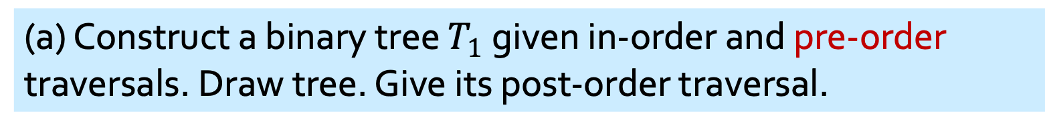
Q9.
(a) Construct a binary tree $T_{1}$ given in-order and pre-order traversals. Draw tree. Give its post-order traversal.
In-order: E A C K F H D B G
Pre-order: F A E K C D H G B
F
A
D
E
K
H
G
C
B
Post-order: E C K A H B G D F

Slide 19
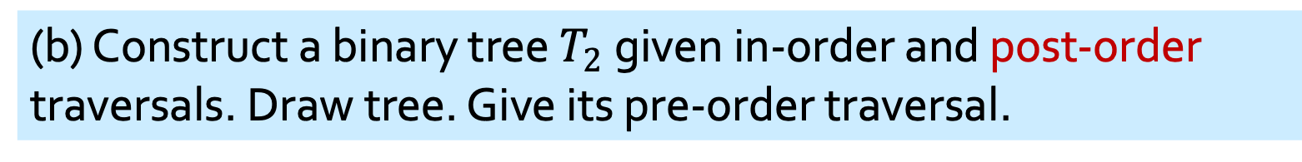

Q9.
(b) Construct a binary tree $T_{2}$ given in-order and post-order traversals. Draw tree. Give its pre-order traversal.
In-order: D B F E A G C H K
Post-order: D F E B G K H C A
$$T_{l}$$
R
$$T_{r}$$
$$T_{l}$$
$$T_{r}$$
R
SAME STRATEGY:
In post-order traversal, ROOT is last node.
A
B
C
D
E
G
H
F
K
Pre-order: A B D E F C G H K

Slide 20
Q10.
Find the MST of the graph below.
Kruskal’s algorithm
Edges in non-decreasing order:
2
3
5
7
8
12
13
16
18
20
21
25
20
5

16

2
13
3
18

7
8

12

25
21
Weight of MST = $2+3+5+8+13+21=52.$

Slide 21
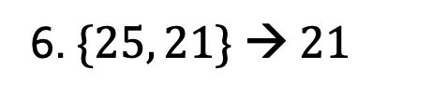
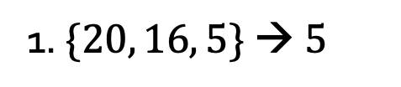
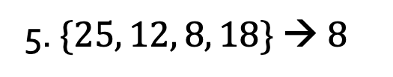
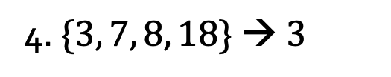
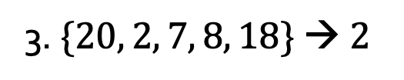
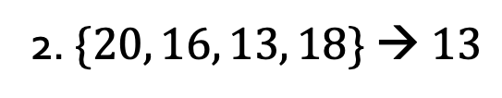
Q10.
Find the MST of the graph below.
Prim-Dijkstra’s algorithm
Start from top vertex.
20
5
20
5
20
5
16
16
16
1. $\{20, 16, 5\} → 5$
2
13
2
13
2
13
3
18
3
18
3
18
2. $\{20, 16, 13, 18\} → 13$
7
8
7
8
7
8
12
12
12
3. $\{20, 2, 7, 8, 18\} → 2$
25
21
25
21
25
21
4. $\{3, 7, 8, 18\} → 3$
20
5
20
5
20
5
5. $\{25, 12, 8, 18\} → 8$
16
16
16
2
13
2
13
2
13
6. $\{25, 21\} → 21$
3
18
3
18
3
18
7
8
7
8
7
8
12
12
12
25
21
25
21
25
21
Weight of MST = $2+3+5+8+13+21=52.$

Slide 22
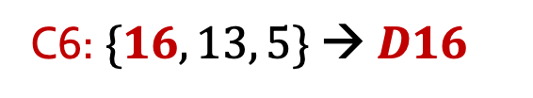
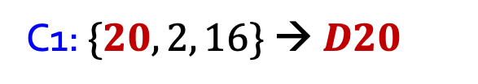
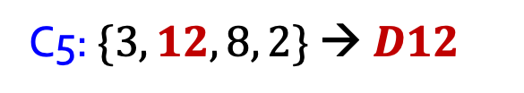
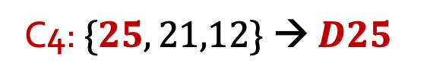
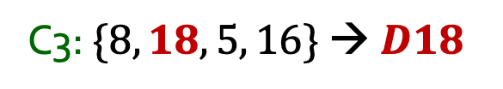
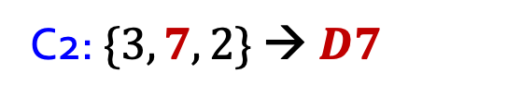
Q10.
Find the MST of the graph below.
Guan’s algorithm
Cycles considered:
20
5
20
5
20
5
16
16
16
2
13
2
13
2
13
C1: $\{20, 2, 16\} → D20$
3
18
3
18
3
18
7
8
7
8
7
8
C2: $\{3, 7, 2\} → D7$
12
12
12
25
21
25
21
25
21
C3: $\{8, 18, 5, 16\} → D18$
C4: $\{25, 21,12\} → D25$
20
5
16
2
13
C5: $\{3, 12, 8, 2\} → D12$
3
18
7
8
C6: $\{16, 13, 5\} → D16$
12
25
21
Weight of MST = $2+3+5+8+13+21=52.$

Slide 23
THE END

