Slide 1
Cs1231 T12 tutorial #5
Functions and partial orders
With contents from Goh Siau Chiak, Sanjay Saha, and Aaron Tan Edited by Theodore

Slide 2
Learning objectives of this tutorial
Functions
learning the definition and the terminology: domain and codomains
determining whether a function is well defined
Partial orders
proving a relation is antisymmetric
reasoning about partial orders
drawing Hasse diagrams of partial orders
understanding linearizations

Slide 3


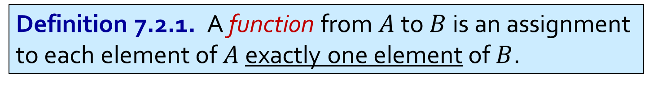
Q1
Which of the following functions are well defined? Which are not?
(a) Define $f:ℚ→ℚ$ by setting $f\left(n\right)=±n$ for each $n∈ℚ$.
(b) Define $g:ℚ→ℚ$ by setting $g\left(n\right)=2\sqrt{n}$ for each $n∈ℚ$.
(c) Define $h:ℚ→ℚ$ by setting $h(n)=\frac{1}{n^{2}+1}$ for each $n∈ℚ$.
(d) Define $k:ℚ→ℚ$ by setting $k\left(n\right)=⌊sin{n⌋}$ for each $n∈ℚ$.
Here $\left\lfloor x\right\rfloor$ denotes the biggest integers that is bigger than or equal to $x$.
Definition 7.2.1. A function from $A$ to $B$ is an assignment to each element of $A$ exactly one element of $B$.

Slide 4
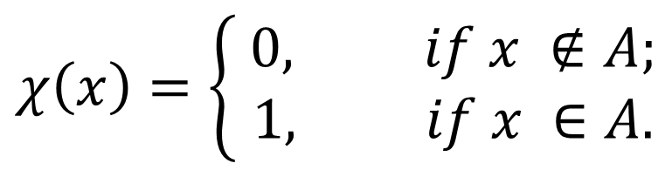
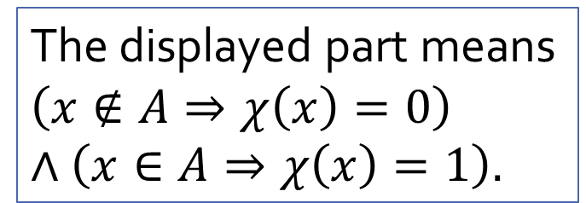

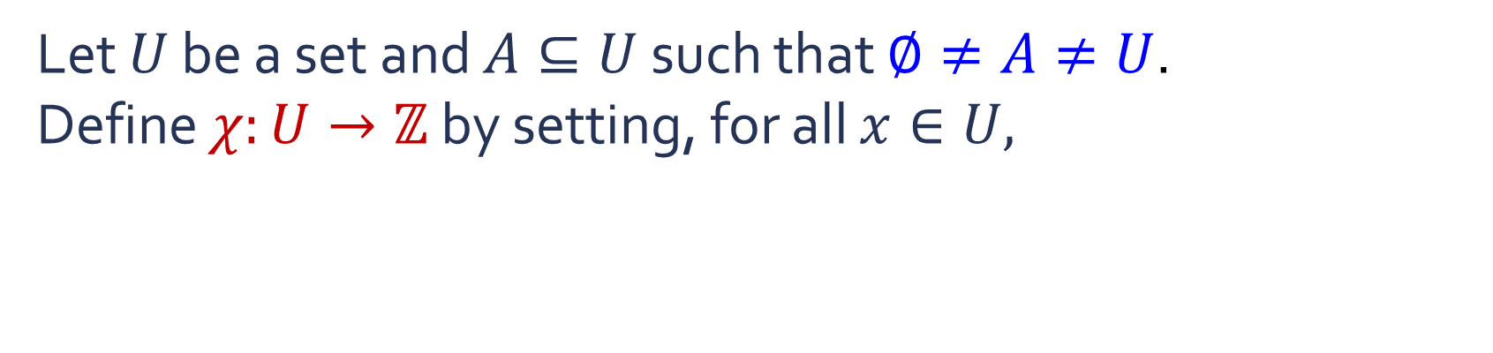


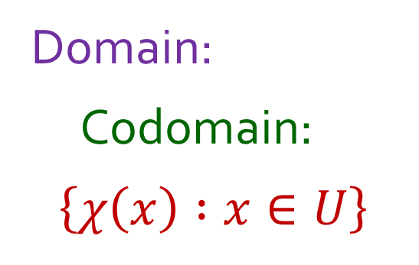
Q2
Let $U$ be a set and $A⊆U$ such that $∅≠A≠U$.
Define $χ:U→ℤ$ by setting, for all $x∈U,$
$$χ\left(x\right)=\left\{\begin{aligned} 0, if x ∉A; \\ 1, if x ∈A.\end{aligned}\right.$$
Domain:
Codomain:
$$\left\{χ\left(x\right) :x∈U\right\}$$
$$U$$
$$ℤ$$
$=\{0, 1\}$
The displayed part means
$$\left(x∉A⇒χ\left(x\right)=0\right)$$
$$∧\left(x∈A⇒χ\left(x\right)=1\right).$$

Slide 5
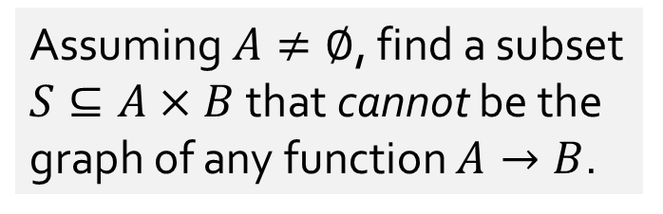
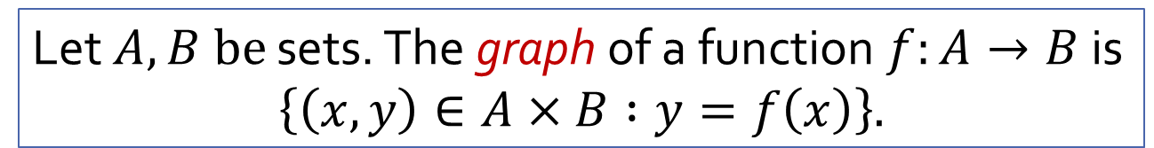
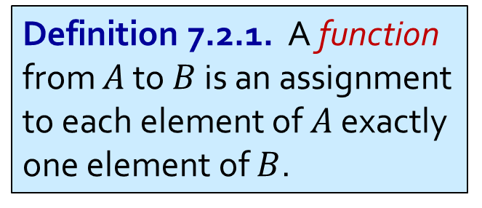
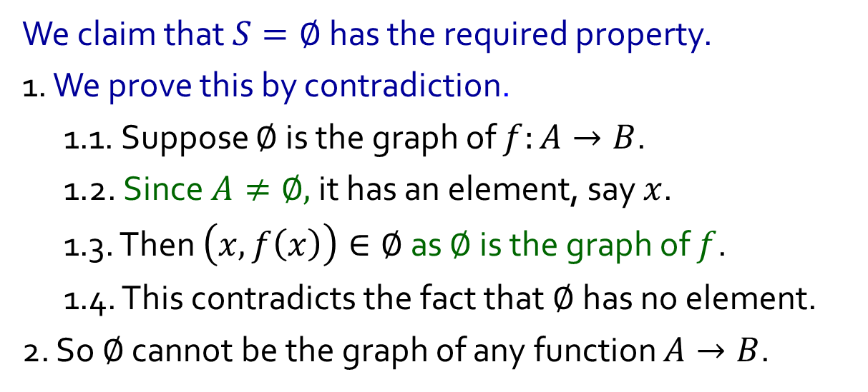
Q3(a)
Let $A, B be$ sets. The graph of a function $f:A→B$ is
$$\left\{\left(x,y\right)∈A×B :y=f\left(x\right)\right\}.$$
Assuming $A≠∅$, find a subset $S⊆A×B$that cannot be the graph of any function $A→B$.
We claim that $S=∅$has the required property.
1. We prove this by contradiction.
1.1. Suppose $∅$is the graph of $f:A→B$.
1.2. Since $A≠∅,$it has an element, say $x$.
1.3. Then $\left(x, f\left(x\right)\right)∈∅$ as $∅$ is the graph of $f$.
1.4. This contradicts the fact that $∅$ has no element.
2. So $∅$ cannot be the graph of any function $A→B$.
Definition 7.2.1. A function from $A$ to $B$ is an assignment to each element of $A$ exactly one element of $B$.

Slide 6

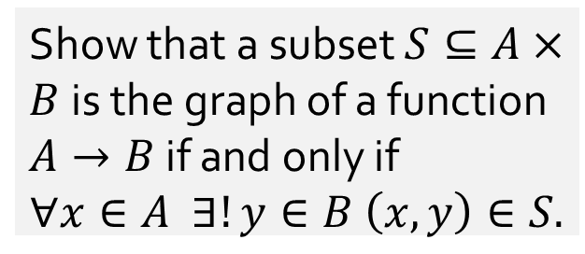
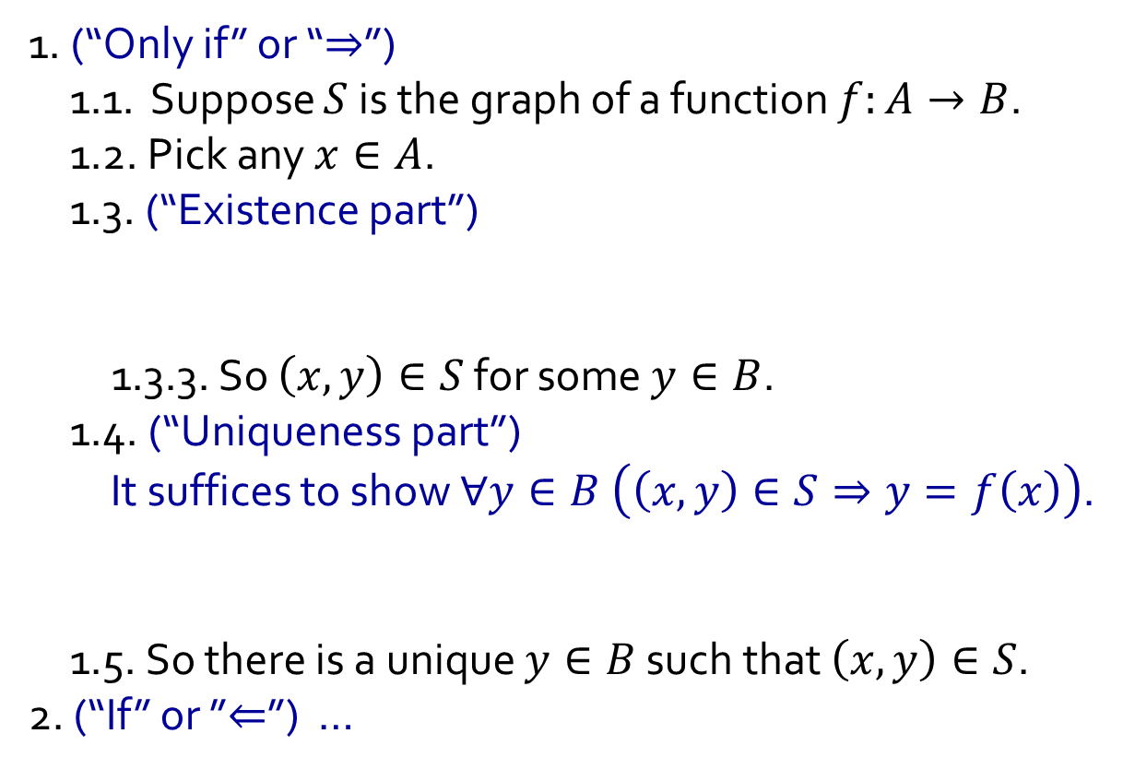
Q3(b)
Let $A, B be$ sets. The graph of a function $f:A→B$ is
$$\left\{\left(x,y\right)∈A×B :y=f\left(x\right)\right\}.$$
Show that a subset $S⊆A×B$is the graph of a function $A→B$ if and only if
$$∀x∈A ∃!y∈B \left(x,y\right)∈S.$$
1. (“Only if” or “$⇒$”)
1.1. Suppose $S$ is the graph of a function $f:A→B$.
1.2. Pick any $x∈A$.
1.3. (“Existence part”)
1.3.1. Then $f\left(x\right)∈B$ as $B$ is the codomain of $f$.
1.3.2. As $S$ is the graph of $f$, we know$\left(x,f\left(x\right)\right)∈S$.
1.3.3. So $\left(x,y\right)∈S$ for some $y∈B$.
1.4. (“Uniqueness part”)
It suffices to show $∀y∈B \left(\left(x,y\right)∈S⇒y=f\left(x\right)\right)$.
1.4.1. Let $y∈B$ such that $\left(x,y\right)∈S$.
1.4.2. As $S$ is the graph of $f$, we know $y=f\left(x\right)$.
1.5. So there is a unique $y∈B$ such that $\left(x,y\right)∈S$.
2. (“If” or ”$⇐$”) …
Definition 7.2.1. A function from $A$ to $B$ is an assignment to each element of $A$ exactly one element of $B$.
Recall $∃!$ means “there exists unique”.

Slide 7
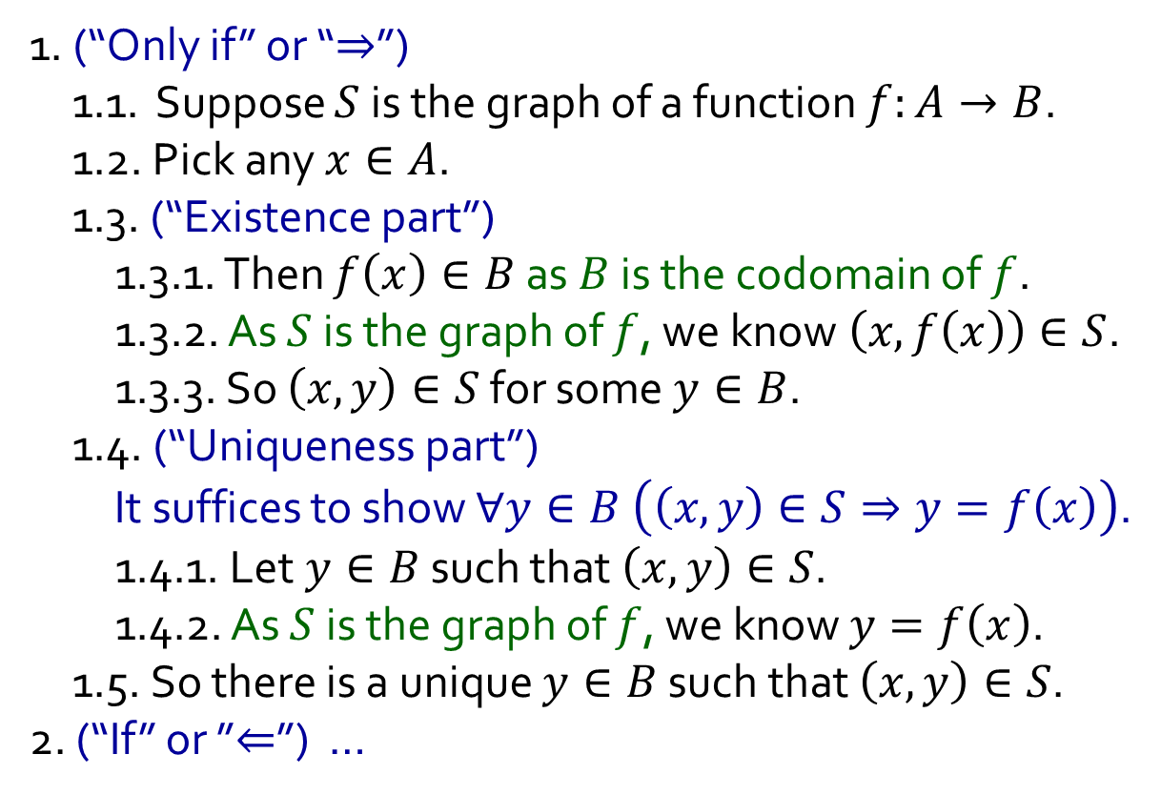
Q3(b)
Let $A, B be$ sets. The graph of a function $f:A→B$ is
$$\left\{\left(x,y\right)∈A×B :y=f\left(x\right)\right\}.$$
Show that a subset $S⊆A×B$is the graph of a function $A→B$ if and only if
$$∀x∈A ∃!y∈B \left(x,y\right)∈S.$$
1. (“Only if” or “$⇒$”)
1.1. Suppose $S$ is the graph of a function $f:A→B$.
1.2. Pick any $x∈A$.
1.3. (“Existence part”)
1.3.1. Then $f\left(x\right)∈B$ as $B$ is the codomain of $f$.
1.3.2. As $S$ is the graph of $f$, we know$\left(x,f\left(x\right)\right)∈S$.
1.3.3. So $\left(x,y\right)∈S$ for some $y∈B$.
1.4. (“Uniqueness part”)
It suffices to show $∀y∈B \left(\left(x,y\right)∈S⇒y=f\left(x\right)\right)$.
1.4.1. Let $y∈B$ such that $\left(x,y\right)∈S$.
1.4.2. As $S$ is the graph of $f$, we know $y=f\left(x\right)$.
1.5. So there is a unique $y∈B$ such that $\left(x,y\right)∈S$.
2. (“If” or ”$⇐$”) …
Definition 7.2.1. A function from $A$ to $B$ is an assignment to each element of $A$ exactly one element of $B$.
Recall $∃!$ means “there exists unique”.

Slide 8
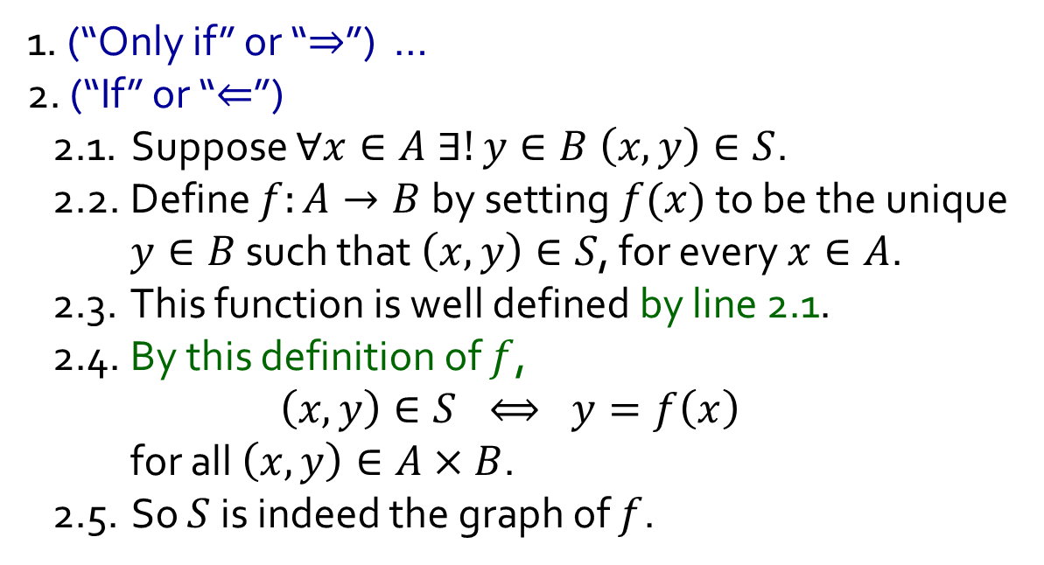
Q3(b)
Let $A, B be$ sets. The graph of a function $f:A→B$ is
$$\left\{\left(x,y\right)∈A×B :y=f\left(x\right)\right\}.$$
Show that a subset $S⊆A×B$is the graph of a function $A→B$ if and only if
$$∀x∈A ∃!y∈B \left(x,y\right)∈S.$$
1. (“Only if” or “$⇒$”) …
2. (“If” or “$⇐$”)
2.1. Suppose $∀x∈A ∃!y∈B \left(x,y\right)∈S$.
2.2. Define $f:A→B$ by setting $f(x)$ to be the unique $y∈B$ such that $\left(x,y\right)∈S$, for every $x∈A$.
2.3. This function is well defined by line 2.1.
2.4. By this definition of $f$,
$$\left(x,y\right)∈S ⟺ y=f\left(x\right)$$
for all $\left(x,y\right)∈A×B$.
2.5. So $S$ is indeed the graph of $f$.
Definition 7.2.1. A function from $A$ to $B$ is an assignment to each element of $A$ exactly one element of $B$.
Recall $∃!$ means “there exists unique”.

Slide 9

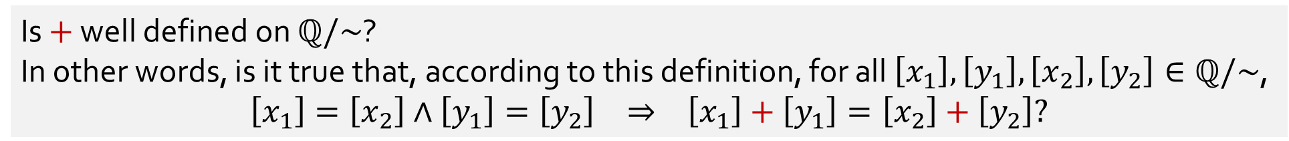
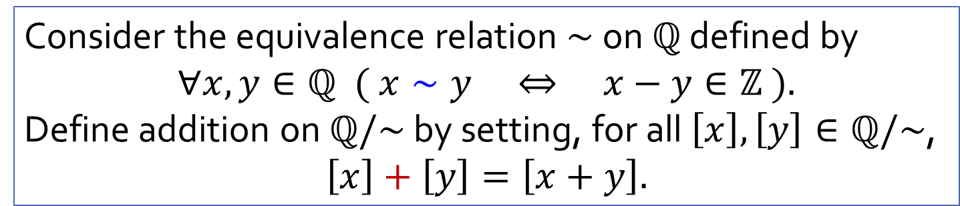
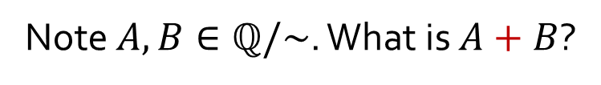
Q4(+)
Consider the equivalence relation $∼$ on $ℚ$ defined by
$$∀x,y∈ℚ ( x∼y ⇔ x−y∈ℤ ).$$
Define addition on $ℚ/\sim$ by setting, for all $\left[x\right],\left[y\right]∈ℚ/\sim$,
$$\left[x\right]+\left[y\right]=\left[x+y\right].$$
Is $+$ well defined on $ℚ/\sim$?
In other words, is it true that, according to this definition, for all $\left[x_{1}\right],\left[y_{1}\right],\left[x_{2}\right],\left[y_{2}\right]∈ℚ/\sim$,
$$\left[x_{1}\right]=\left[x_{2}\right]∧\left[y_{1}\right]=\left[y_{2}\right] ⇒ \left[x_{1}\right]+\left[y_{1}\right]=\left[x_{2}\right]+\left[y_{2}\right]?$$
Consider $A=\left\{…,−\frac{8}{3},−\frac{5}{3},−\frac{2}{3},\frac{1}{3},\frac{4}{3},\frac{7}{3},\frac{10}{3},…\right\}$ and $B=\left\{…,−\frac{13}{5},−\frac{8}{5},−\frac{3}{5},\frac{2}{5},\frac{7}{5},\frac{12}{5},\frac{17}{5},…\right\}$.
Note $A,B∈ℚ/\sim$. What is $A+B$?
Since $A=\left[\frac{1}{3}\right]$ and $B=\left[\frac{2}{5}\right]$, the definition above tells us $A+B=\left[\frac{1}{3}\right]+\left[\frac{2}{5}\right]=\left[\frac{1}{3}+\frac{2}{5}\right]=\left[\frac{11}{15}\right].$
$$=$$
Since $A=\left[\frac{4}{3}\right]$ and $B=\left[\frac{7}{5}\right]$, the definition above tells us $A+B=\left[\frac{4}{3}\right]+\left[\frac{7}{5}\right]=\left[\frac{4}{3}+\frac{7}{5}\right]=\left[\frac{41}{15}\right].$

Slide 10
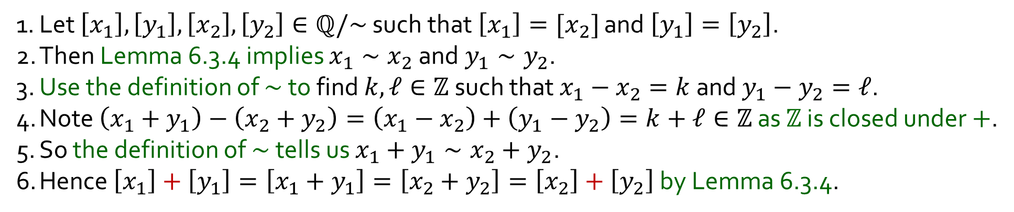
Q4(+)
Consider the equivalence relation $∼$ on $ℚ$ defined by
$$∀x,y∈ℚ ( x∼y ⇔ x−y∈ℤ ).$$
Define addition on $ℚ/\sim$ by setting, for all $\left[x\right],\left[y\right]∈ℚ/\sim$,
$$\left[x\right]+\left[y\right]=\left[x+y\right].$$
Yes!
Is $+$ well defined on $ℚ/\sim$?
In other words, is it true that, according to this definition, for all $\left[x_{1}\right],\left[y_{1}\right],\left[x_{2}\right],\left[y_{2}\right]∈ℚ/\sim$,
$$\left[x_{1}\right]=\left[x_{2}\right]∧\left[y_{1}\right]=\left[y_{2}\right] ⇒ \left[x_{1}\right]+\left[y_{1}\right]=\left[x_{2}\right]+\left[y_{2}\right]?$$
1. Let $\left[x_{1}\right],\left[y_{1}\right],\left[x_{2}\right],\left[y_{2}\right]∈ℚ/\sim$ such that $\left[x_{1}\right]=[x_{2}]$ and $\left[y_{1}\right]=\left[y_{2}\right]$.
2. Then Lemma 6.3.4 implies $x_{1}∼x_{2}$ and $y_{1}∼y_{2}$.
3. Use the definition of $∼$ to find $k,ℓ∈ℤ$ such that $x_{1}−x_{2}=k$ and $y_{1}−y_{2}=ℓ$.
4. Note $\left(x_{1}+y_{1}\right)−\left(x_{2}+y_{2}\right)=\left(x_{1}−x_{2}\right)+\left(y_{1}−y_{2}\right)=k+ℓ∈ℤ$ as $ℤ$ is closed under $+$.
5. So the definition of $∼$ tells us $x_{1}+y_{1}∼x_{2}+y_{2}$.
6. Hence $\left[x_{1}\right]+\left[y_{1}\right]=\left[x_{1}+y_{1}\right]=\left[x_{2}+y_{2}\right]=\left[x_{2}\right]+\left[y_{2}\right]$ by Lemma 6.3.4.
Lemma 6.3.4. The following are equivalent: (i) $x∼y$; (ii) $\left[x\right]=\left[y\right]$; (iii) $\left[x\right]∩\left[y\right]=∅$.

Slide 11

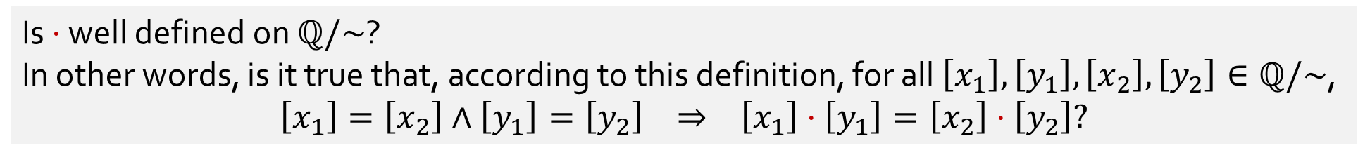
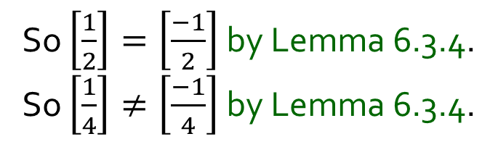

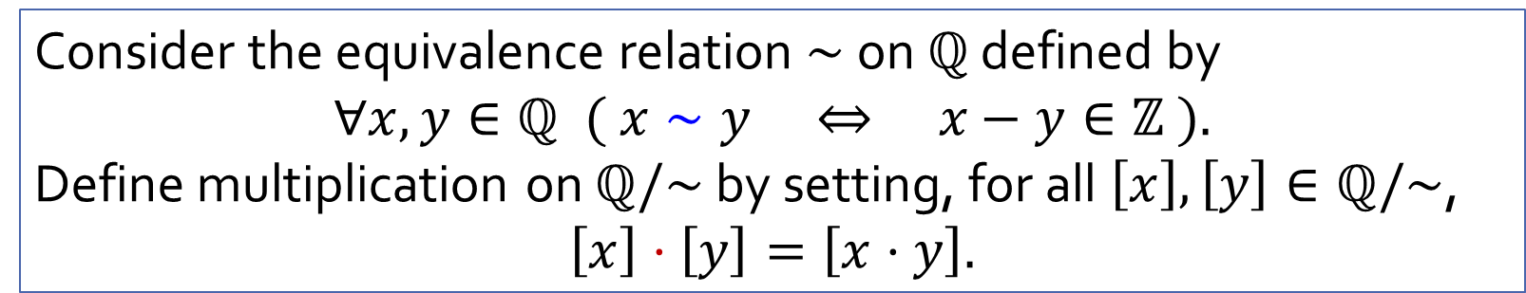



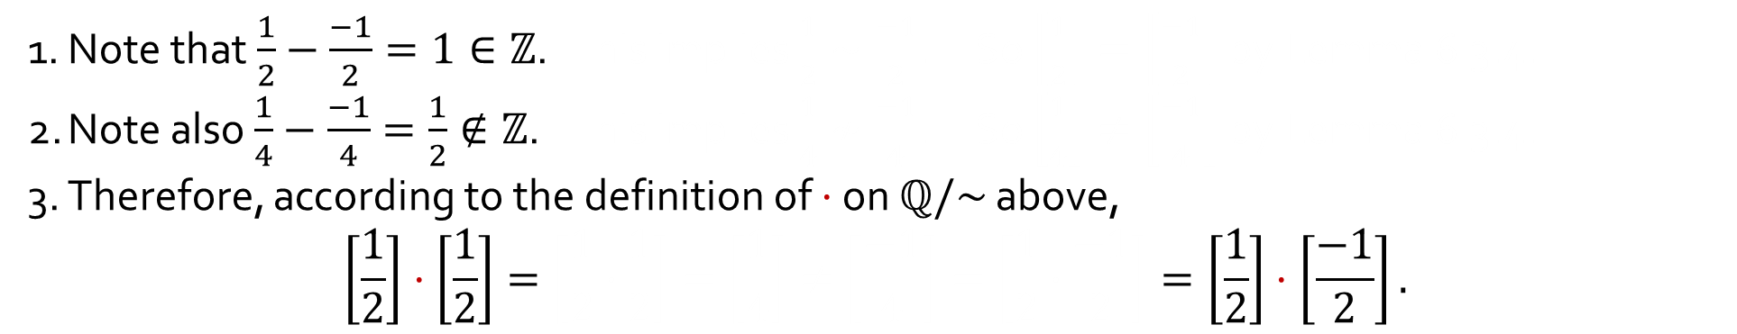

Q4(⋅)
Consider the equivalence relation $∼$ on $ℚ$ defined by
$$∀x,y∈ℚ ( x∼y ⇔ x−y∈ℤ ).$$
Define multiplication on $ℚ/\sim$ by setting, for all $\left[x\right],\left[y\right]∈ℚ/\sim$,
$$\left[x\right]⋅\left[y\right]=\left[x⋅y\right].$$
No!
Is $⋅$ well defined on $ℚ/\sim$?
In other words, is it true that, according to this definition, for all $\left[x_{1}\right],\left[y_{1}\right],\left[x_{2}\right],\left[y_{2}\right]∈ℚ/\sim$,
$$\left[x_{1}\right]=\left[x_{2}\right]∧\left[y_{1}\right]=\left[y_{2}\right] ⇒ \left[x_{1}\right]⋅\left[y_{1}\right]=\left[x_{2}\right]⋅\left[y_{2}\right]?$$
So $\left[\frac{1}{2}\right]=\left[\frac{−1}{2}\right]$ by Lemma 6.3.4.
So $\left[\frac{1}{4}\right]≠\left[\frac{−1}{4}\right]$ by Lemma 6.3.4.
1. Note that $\frac{1}{2}−\frac{−1}{2}=1∈ℤ$. This implies $\frac{1}{2}∼\frac{−1}{2}$. So $\left[\frac{1}{2}\right]=\left[\frac{−1}{2}\right]$ by Lemma 6.3.4.
2. Note also $\frac{1}{4}−\frac{−1}{4}=\frac{1}{2}∉ℤ$. This implies $\frac{1}{4}≁\frac{−1}{4}$. So $\left[\frac{1}{4}\right]≠\left[\frac{−1}{4}\right]$ by Lemma 6.3.4.
3. Therefore, according to the definition of $⋅$ on $ℚ/\sim$ above,
$$\left[\frac{1}{2}\right]⋅\left[\frac{1}{2}\right]=\left[\frac{1}{2}⋅\frac{1}{2}\right]=\left[\frac{1}{4}\right]≠\left[\frac{−1}{4}\right]=\left[\frac{1}{2}⋅\frac{−1}{2}\right]=\left[\frac{1}{2}\right]⋅\left[\frac{−1}{2}\right].$$
This implies $\frac{1}{2}∼\frac{−1}{2}$. $\left[\frac{1}{2}\right]$
This implies $\frac{1}{4}≁\frac{−1}{4}$. $\left[\frac{1}{2}\right]$
$$\left[\frac{1}{2}⋅\frac{1}{2}\right]$$
$$=\left[\frac{1}{4}\right]$$
$$\left[\frac{−1}{4}\right]=$$
$$\left[\frac{1}{2}⋅\frac{−1}{2}\right]$$
$$≠$$
Lemma 6.3.4. The following are equivalent: (i) $x∼y$; (ii) $\left[x\right]=\left[y\right]$; (iii) $\left[x\right]∩\left[y\right]=∅$.

Slide 12
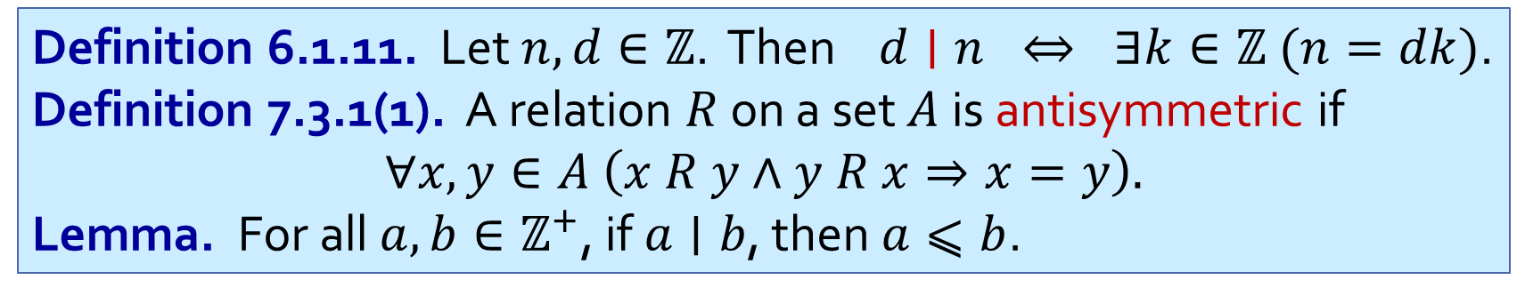
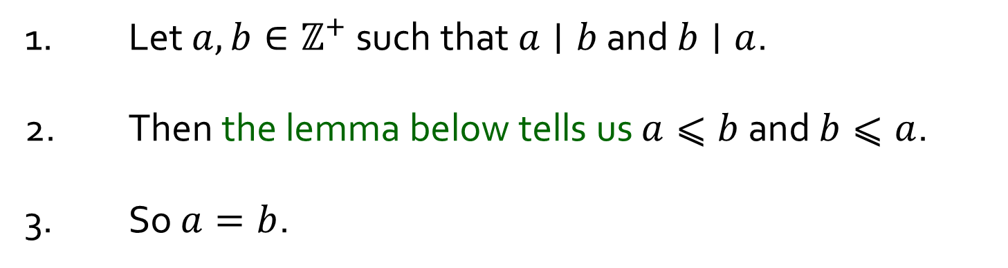
Q5
Prove that the divisibility relation $|$ on $ℤ^{+}$ is antisymmetric.
1. Let $a,b∈ℤ^{+}$ such that $a∣b$ and $b∣a$.
2. Then the lemma below tells us $a⩽b$ and $b⩽a$.
3. So $a=b$.
Definition 6.1.11. Let $n,d∈ℤ$. Then $d∣n ⇔ ∃k∈ℤ (n=dk)$.
Definition 7.3.1(1). A relation $R$ on a set $A$ is antisymmetric if
$$∀x,y∈A \left(x R y∧y R x⇒x=y\right).$$
Lemma. For all $a,b∈ℤ^{+}$, if $a∣b$, then $a⩽b$.

Slide 13

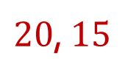
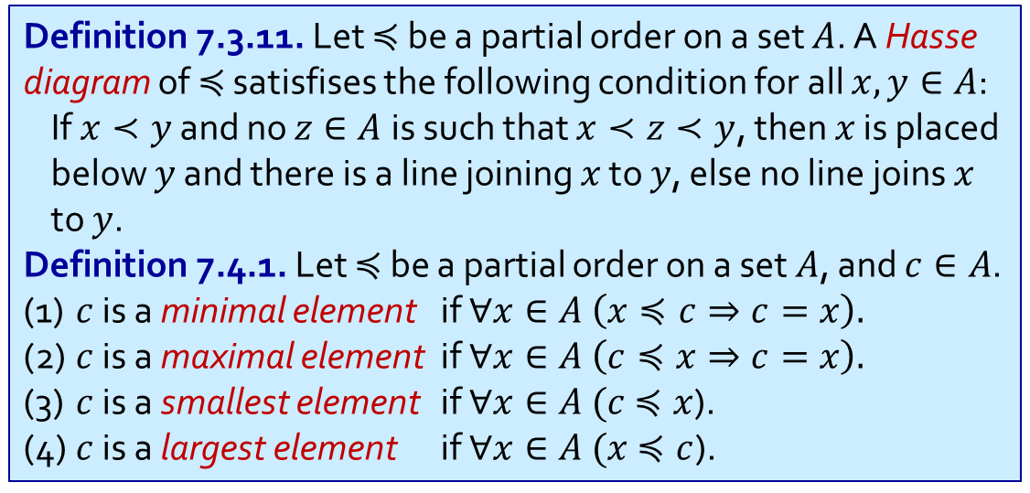


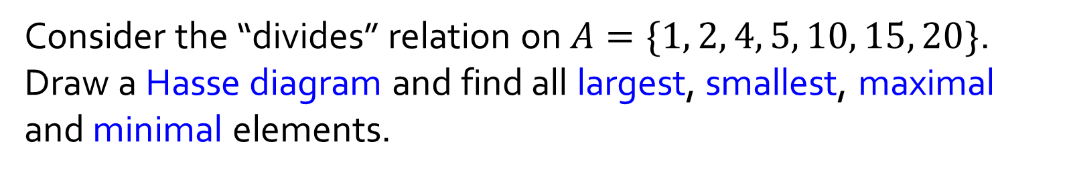






Q6(a)
Consider the “divides” relation on $A=\{1, 2, 4, 5, 10, 15, 20\}$. Draw a Hasse diagram and find all largest, smallest, maximal and minimal elements.
Definition 7.3.11. Let $≼$ be a partial order on a set $A$. A Hasse diagram of $≼$ satisfises the following condition for all $x,y∈A$:
If $x≺y$ and no $z∈A$ is such that $x≺z≺y$, then $x$ is placed below $y$ and there is a line joining $x$ to $y$, else no line joins $x$ to $y$.
Definition 7.4.1. Let $≼$ be a partial order on a set $A$, and $c∈A$.
(1) $c$ is a minimal element if $∀x∈A \left(x≼c⇒c=x\right).$
(2) $c$ is a maximal element if $∀x∈A \left(c≼x⇒c=x\right).$
(3) $c$ is a smallest element if $∀x∈A (c$ $≼x$).
(4) $c$ is a largest element if $∀x∈A (x$ $≼c$).
$$20$$
$$4$$
$$10$$
$$15$$
$$2$$
$$5$$
$$1$$
minimal elements
$$1$$
maximal elements
$20$, $15$
smallest element
$$1$$
largest element
none

Slide 14




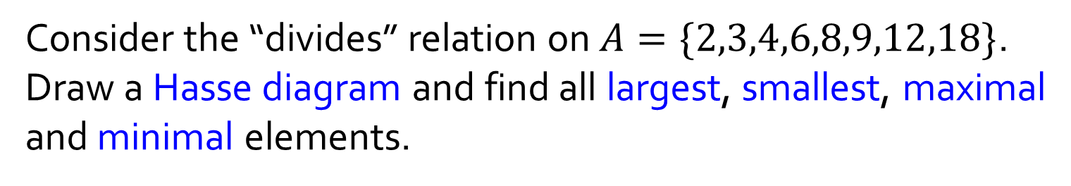


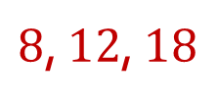

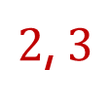

Q6(b)
Consider the “divides” relation on $A=\{2,3,4,6,8,9,12,18\}$. Draw a Hasse diagram and find all largest, smallest, maximal and minimal elements.
Definition 7.3.11. Let $≼$ be a partial order on a set $A$. A Hasse diagram of $≼$ satisfises the following condition for all $x,y∈A$:
If $x≺y$ and no $z∈A$ is such that $x≺z≺y$, then $x$ is placed below $y$ and there is a line joining $x$ to $y$, else no line joins $x$ to $y$.
Definition 7.4.1. Let $≼$ be a partial order on a set $A$, and $c∈A$.
(1) $c$ is a minimal element if $∀x∈A \left(x≼c⇒c=x\right).$
(2) $c$ is a maximal element if $∀x∈A \left(c≼x⇒c=x\right).$
(3) $c$ is a smallest element if $∀x∈A (c$ $≼x$).
(4) $c$ is a largest element if $∀x∈A (x$ $≼c$).
$$8$$
$$12$$
$$18$$
$$4$$
$$6$$
$$9$$
$$2$$
$$3$$
minimal elements
$2$, $3$
maximal elements
$8$, $12$, $18$
smallest element
none
largest element
none

Slide 15
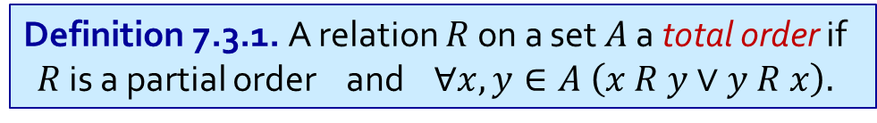

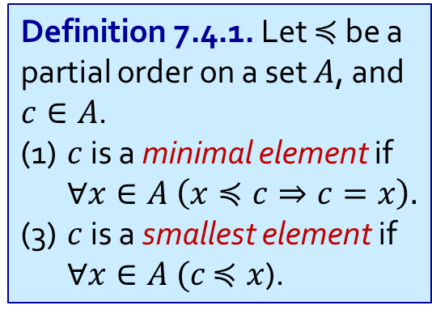
Q7
Definition 7.4.1. Let $≼$ be a partial order on a set $A$, and $c∈A$.
(1) $c$ is a minimal element if $∀x∈A \left(x≼c⇒c=x\right).$
(3) $c$ is a smallest element if $∀x∈A (c$ $≼x$).
Consider a set $A$ and a total order $≼$ on $A$. Show that all minimal elements are smallest.
Definition 7.3.1. A relation $R$ on a set $A$ a total order if
$R$ is a partial order and $∀x,y∈A \left(x R y∨y R x\right).$
nothing is below
minimal
Totality: Everything is either below or above.
everything is above
smallest

Slide 16
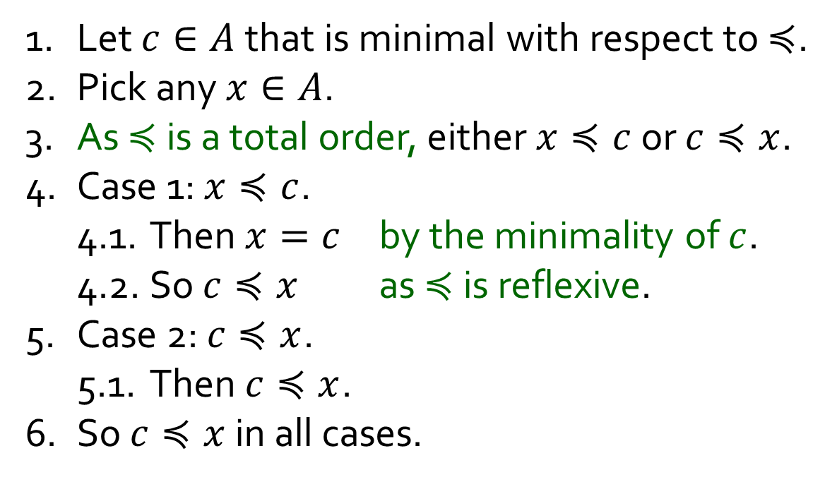
Q7
Definition 7.4.1. Let $≼$ be a partial order on a set $A$, and $c∈A$.
(1) $c$ is a minimal element if $∀x∈A \left(x≼c⇒c=x\right).$
(3) $c$ is a smallest element if $∀x∈A (c$ $≼x$).
Consider a set $A$ and a total order $≼$ on $A$. Show that all minimal elements are smallest.
Definition 7.3.1. A relation $R$ on a set $A$ a total order if
$R$ is a partial order and $∀x,y∈A \left(x R y∨y R x\right).$
1. Let $c∈A$ that is minimal with respect to $≼$.
2. Pick any $x∈A$.
3. As $≼$ is a total order, either $x≼c$ or $c≼x$.
4. Case 1: $x≼c$.
4.1. Then $x=c$ by the minimality of $c$.
4.2. So $c≼x$ as $≼$ is reflexive.
5. Case 2: $c≼x$.
5.1. Then $c≼x$.
6. So $c≼x$ in all cases.

Slide 17
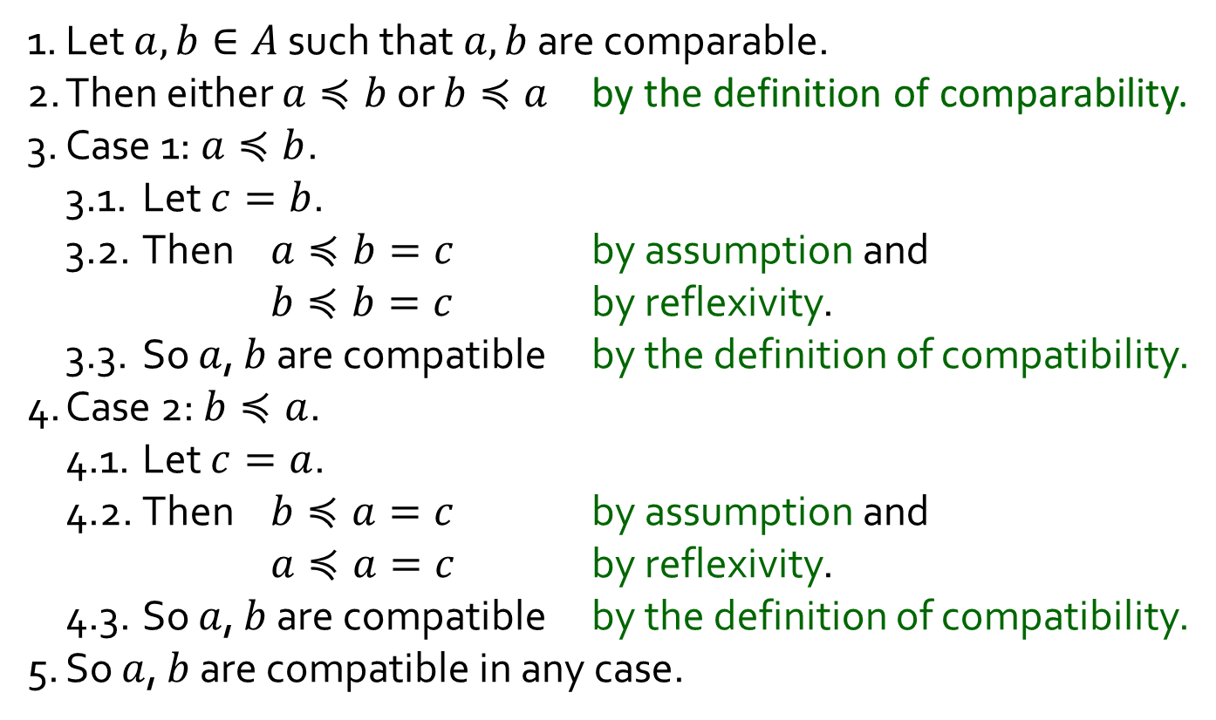
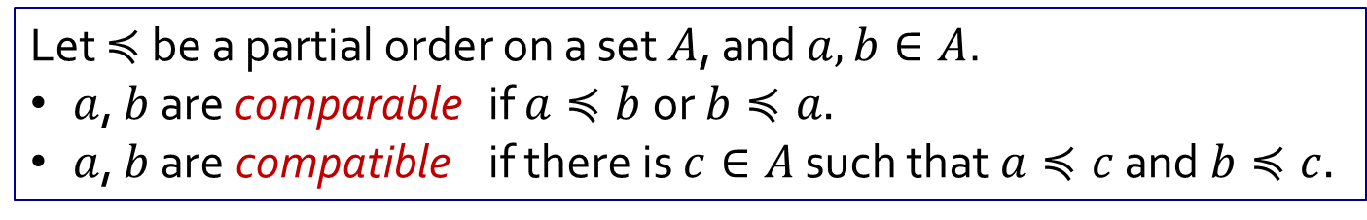
Q8(a)
Let $≼$ be a partial order on a set $A$, and $a, b∈A$.
$a$, $b$ are comparable if $a≼b$ or $b≼a.$
$a$, $b$ are compatible if there is $c∈A$ such that $a≼c$ and $b≼c.$
Is it true that in all partially ordered sets, any two comparable elements are compatible?
1. Let $a, b∈A$ such that $a,b$ are comparable.
2. Then either $a≼b$ or $b≼a$ by the definition of comparability.
3. Case 1: $a≼b$.
3.1. Let $c=b$.
3.2. Then $a≼b=c$ by assumption and
$b≼b=c$ by reflexivity.
3.3. So $a$, $b$ are compatible by the definition of compatibility.
4. Case 2: $b≼a$.
4.1. Let $c=a$.
4.2. Then $b≼a=c$ by assumption and
$a≼a=c$ by reflexivity.
4.3. So $a$, $b$ are compatible by the definition of compatibility.
5. So $a$, $b$ are compatible in any case.
Yes!

Slide 18
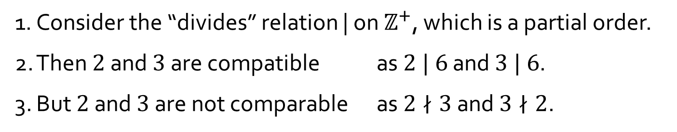
Q8(b)
Let $≼$ be a partial order on a set $A$, and $a, b∈A$.
$a$, $b$ are comparable if $a≼b$ or $b≼a.$
$a$, $b$ are compatible if there is $c∈A$ such that $a≼c$ and $b≼c.$
Is it true that in all partially ordered sets, any two compatible elements are comparable?
1. Consider the “divides” relation | on $ℤ^{+}$, which is a partial order.
2. Then $2$ and $3$ are compatible as $2 | 6$ and $3 | 6$.
3. But $2$ and $3$ are not comparable as $2∤3$ and $3∤2$.
No!

Slide 19

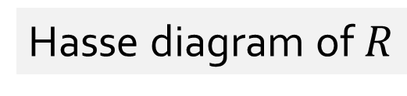
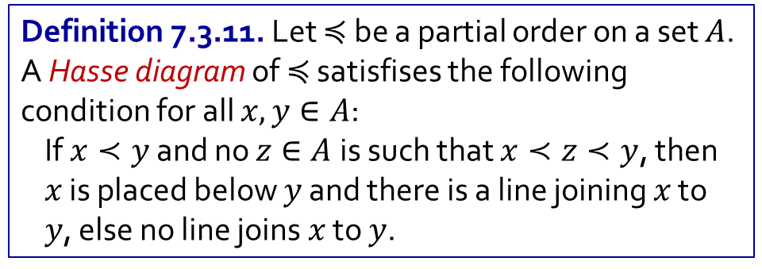

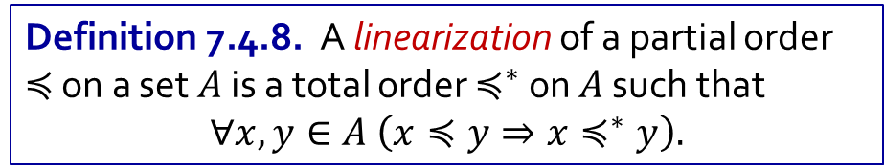

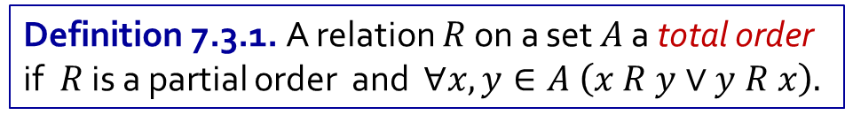

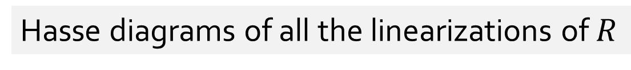

Q9
Let $A=\{a,b,c,d\}$, where $a,b,c,d$ are mutually distinct. Consider
$$R=\left\{\left(a,a\right),\left(a,b\right),\left(a,c\right),\left(a,d\right),\left(b,b\right),\left(b,c\right),\left(c,c\right),\left(d,d\right)\right\}.$$
Hasse diagram of $R$
Hasse diagrams of all the linearizations of $R$
$$c$$
$$b$$
$$d$$
$$a$$
Definition 7.3.11. Let $≼$ be a partial order on a set $A$. A Hasse diagram of $≼$ satisfises the following condition for all $x,y∈A$:
If $x≺y$ and no $z∈A$ is such that $x≺z≺y$, then $x$ is placed below $y$ and there is a line joining $x$ to $y$, else no line joins $x$ to $y$.
Definition 7.4.8. A linearization of a partial order $≼$ on a set $A$ is a total order $≼^{∗}$ on $A$ such that
$$∀x,y∈A \left(x≼y⇒x≼^{∗}y\right).$$
Algorithm 7.4.11 (Kahn’s Algorithm). Pick out a minimal element and place it at the bottom of the total order. Repeat until nothing is left.
Definition 7.3.1. A relation $R$ on a set $A$ a total order
if$R$ is a partial order and $∀x,y∈A \left(x R y∨y R x\right).$

Slide 20













Q9
Let $A=\{a,b,c,d\}$, where $a,b,c,d$ are mutually distinct. Consider
$$R=\left\{\left(a,a\right),\left(a,b\right),\left(a,c\right),\left(a,d\right),\left(b,b\right),\left(b,c\right),\left(c,c\right),\left(d,d\right)\right\}.$$
Hasse diagram of $R$
Hasse diagrams of all the linearizations of $R$
$$c$$
$$c$$
$$c$$
$$d$$
$$b$$
$$d$$
$$b$$
$$d$$
$$c$$
$$a$$
$$d$$
$$b$$
$$b$$
Definition 7.3.11. Let $≼$ be a partial order on a set $A$. A Hasse diagram of $≼$ satisfises the following condition for all $x,y∈A$:
If $x≺y$ and no $z∈A$ is such that $x≺z≺y$, then $x$ is placed below $y$ and there is a line joining $x$ to $y$, else no line joins $x$ to $y$.
$$a$$
$$a$$
$$a$$
Definition 7.4.8. A linearization of a partial order $≼$ on a set $A$ is a total order $≼^{∗}$ on $A$ such that
$$∀x,y∈A \left(x≼y⇒x≼^{∗}y\right).$$
Algorithm 7.4.11 (Kahn’s Algorithm). Pick out a minimal element and place it at the bottom of the total order. Repeat until nothing is left.
Definition 7.3.1. A relation $R$ on a set $A$ a total order
if$R$ is a partial order and $∀x,y∈A \left(x R y∨y R x\right).$

Slide 21
END OF FILE

