Slide 1
Cs1231s tutorial #4
Equivalence relations
with contents by Goh Siau Chiak and Aaron Tan edited by Theodore

Slide 2
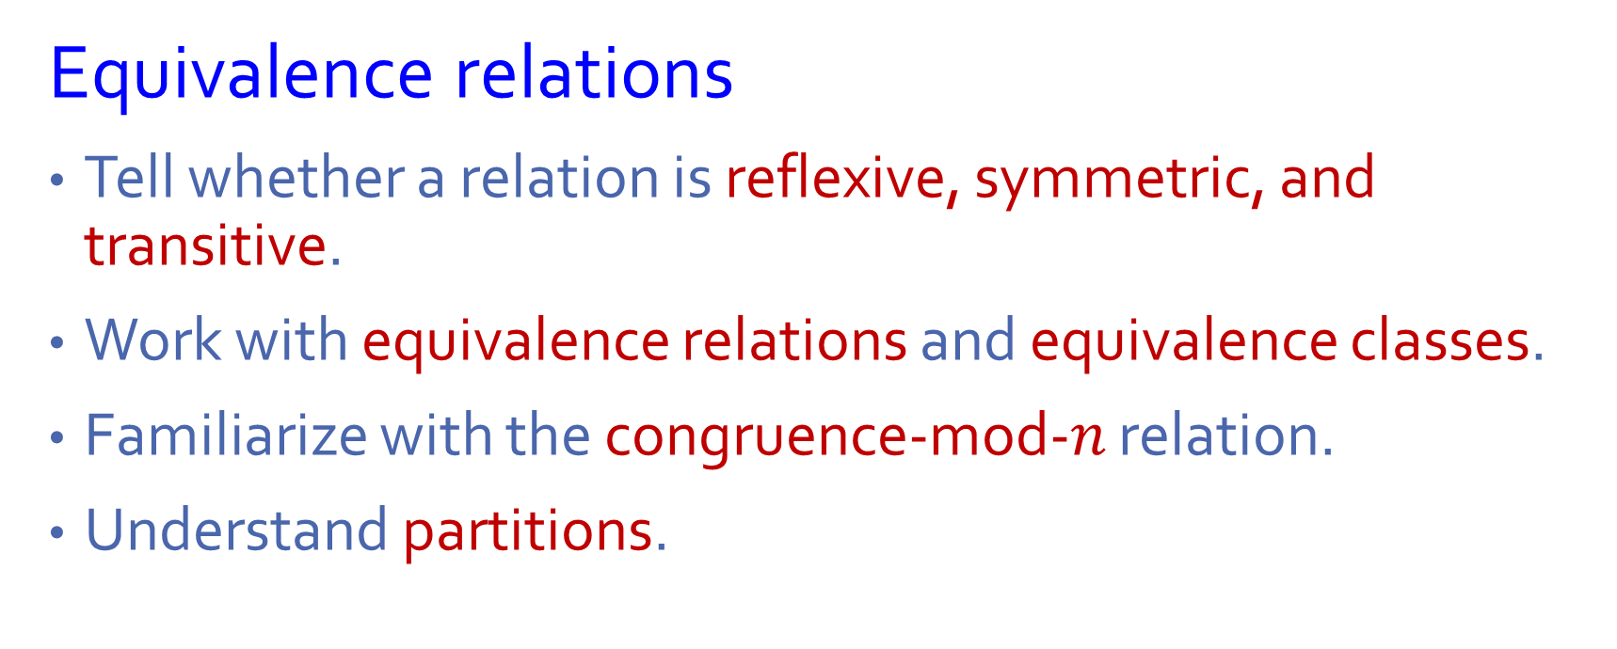
Learning objectives of this tutorial
Equivalence relations
Tell whether a relation is reflexive, symmetric, and transitive.
Work with equivalence relations and equivalence classes.
Familiarize with the congruence-mod-$n$ relation.
Understand partitions.

Slide 3
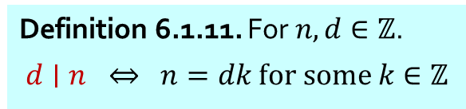

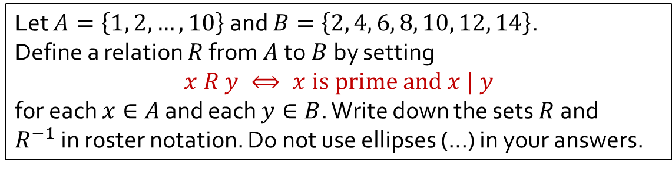





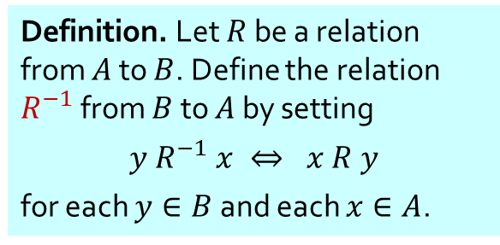


Q1
Let $A=\left\{1, 2, …, 10\right\}$ and $B=\left\{2, 4, 6, 8, 10, 12, 14\right\}$.
Define a relation $R$ from $A$to $B$by setting
$$x R y ⟺ x is prime and x | y$$
for each $x∈A$ and each $y∈B$. Write down the sets $R$and $R^{−1}$in roster notation. Do not use ellipses (…) in your answers.
Definition. A positive integer is prime if it has exactly two positive divisors.
Definition 6.1.11. For $n,d∈ℤ$.
$$d∣n ⇔ n=dk for some k∈ℤ$$
$$R^{−1}$$
Definition. Let $R$ be a relation from $A$ to $B$. Define the relation $R^{−1}$ from $B$ to $A$ by setting
$$y R^{−1} x ⇔ x R y$$
for each $y∈B$ and each $x∈A$.
$$A$$
$$R$$
$$B$$
$$A$$
$$B$$
(Arrow diagrams shown for illustration purpose only.)
1
2
3
4
5
6
7
8
9
10
2
4
6
8
10
12
14
1
2
3
4
5
6
7
8
9
10
•
•
•
•
•
•
•
•
•
•
2
4
6
8
10
12
14
•
•
•
•
•
•
•
•
•
•
$$R=$$
$$\{\text{(2,2), (2,4), (2,6), (2,8), (2,10), (2,12), }\text{(2,14),}\text{(3,6), (3,12), (5,10), (7,14)}\text{\}}\text{.}$$
$$R^{−1}=$$
$\{\text{(2,2), (4,2), (6,2), (8,2), (10,2), (12,2),}\text{(14,2),}\text{ (6,3), (12,3), (10,5), (14,7)}\text{\}}$.

Slide 4

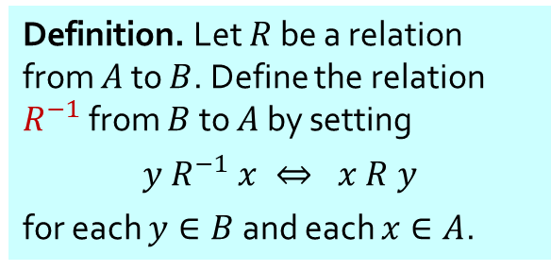

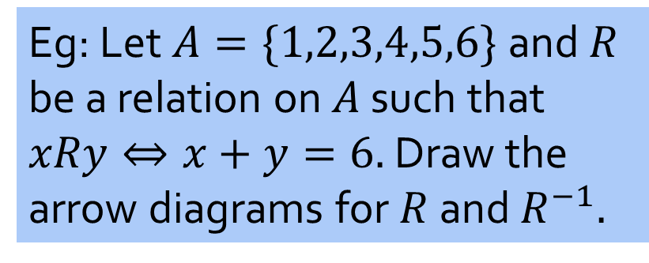
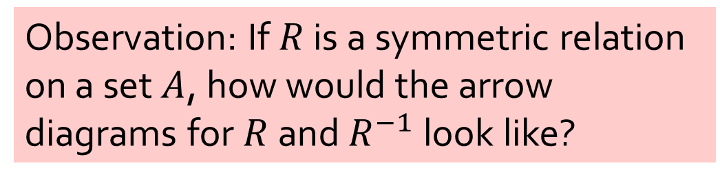
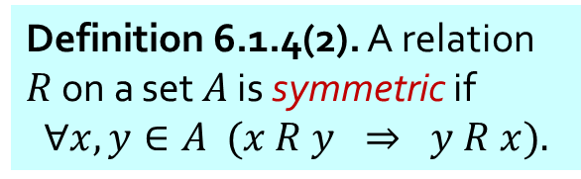
Q2
Let $R$be a relation on set $A$. Show that $R$is symmetric if and only if $R=R^{−1}.$
Definition 6.1.4(2). A relation $R$ on a set $A$ is symmetric if
$$∀x,y∈A (x R y ⇒ y R x).$$
Observation: If $R$ is a symmetric relation on a set $A$, how would the arrow diagrams for $R$ and $R^{−1}$ look like?
Definition. Let $R$ be a relation from $A$ to $B$. Define the relation $R^{−1}$ from $B$ to $A$ by setting
$$y R^{−1} x ⇔ x R y$$
for each $y∈B$ and each $x∈A$.
Eg: Let $A=\{1,2,3,4,5,6\}$and $R$ be a relation on $A$ such that $xRy⇔x+y=6.$Draw the arrow diagrams for $R$ and $R^{−1}.$
$$R$$
$$R^{−1}$$
• 6
• 6
• 1
• 1
• 5
• 5
• 2
• 2
• 4
• 4
• 3
• 3

Slide 5

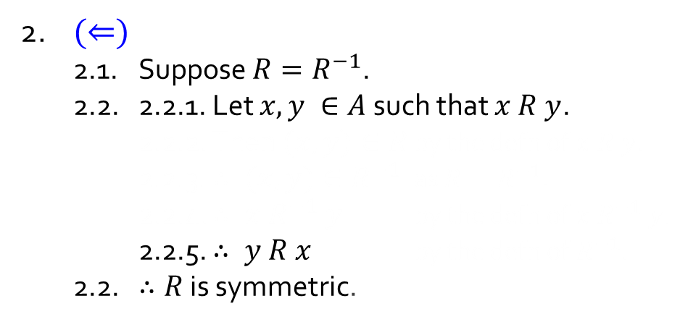
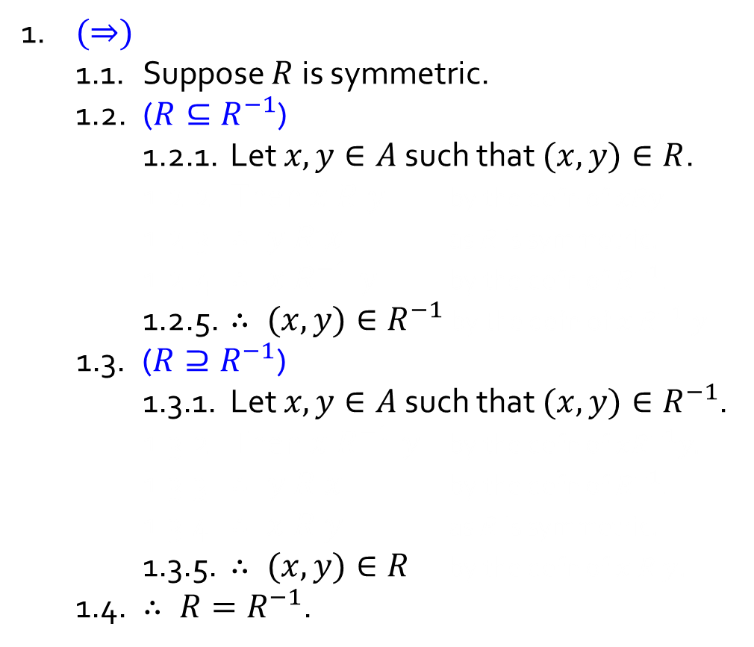
Q2
Let $R$be a relation on set $A$. Show that $R$is symmetric if and only if $R=R^{−1}.$
Definition 6.1.4(2). A relation $R$ on a set $A$ is symmetric if
$$∀x,y∈A (x R y ⇒ y R x).$$
1. $(⇒)$
1.1. Suppose $R$ is symmetric.
1.2. ($R{⊆R}^{−1}$)
1.2.1. Let $x, y∈A$ such that $(x, y)∈R$.
1.2.2. Then $x R y$ by the defn of $xRy$.
1.2.3. $∴ y R x$ as $R$ is symmetric.
1.2.4. $∴ x{ R}^{−1} y$ by the defn of$R^{−1}$.
1.2.5. $∴ (x,y)∈R^{−1}$ by the defn of ${x R}^{−1} y$.
1.3. ($R⊇R^{−1}$)
1.3.1. Let $x, y∈A$ such that $(x, y)∈R^{−1}$.
1.3.2. Then $x{ R}^{−1} y$ by the defn of $xR^{−1}y.$
1.3.3. $∴ y R x$ by the defn of$R^{−1}$.
1.3.4. $∴ x R y$ as $R$ is symmetric.
1.3.5. $∴ (x,y)∈R$ by the defn of$x R y$.
1.4. $∴ R=R^{−1}$.
Definition. Let $R$ be a relation from $A$ to $B$. Define the relation $R^{−1}$ from $B$ to $A$ by setting
$$y R^{−1} x ⇔ x R y$$
for each $y∈B$ and each $x∈A$.
2. $(⇐)$
2.1. Suppose $R=R^{−1}$.
2.2. 2.2.1. Let $x,y ∈A$ such that $x R y$.
2.2.2. Then $(x, y)∈R$ by the defn of $x R y$.
2.2.3. $∴ (x, y)∈R^{−1}$ as $R=R^{−1}$.
2.2.4. $∴ x{ R}^{−1} y$ by the defn of ${x R}^{−1} y$.
2.2.5. $∴ y R x$ by the defn of$R^{−1}$.
2.2. $∴R$ is symmetric.
3. Therefore, $R$is symmetric iff $R=R^{−1}$.

Slide 6
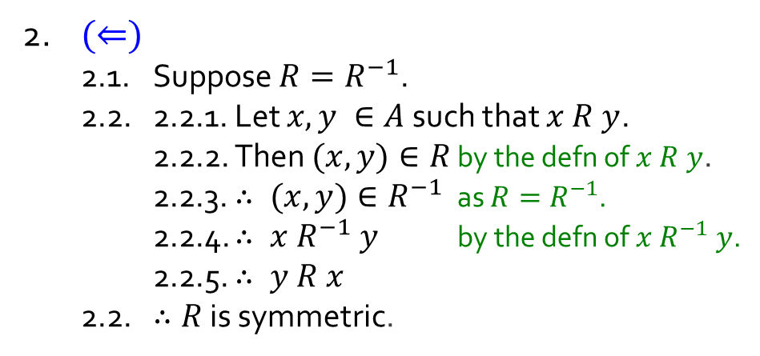
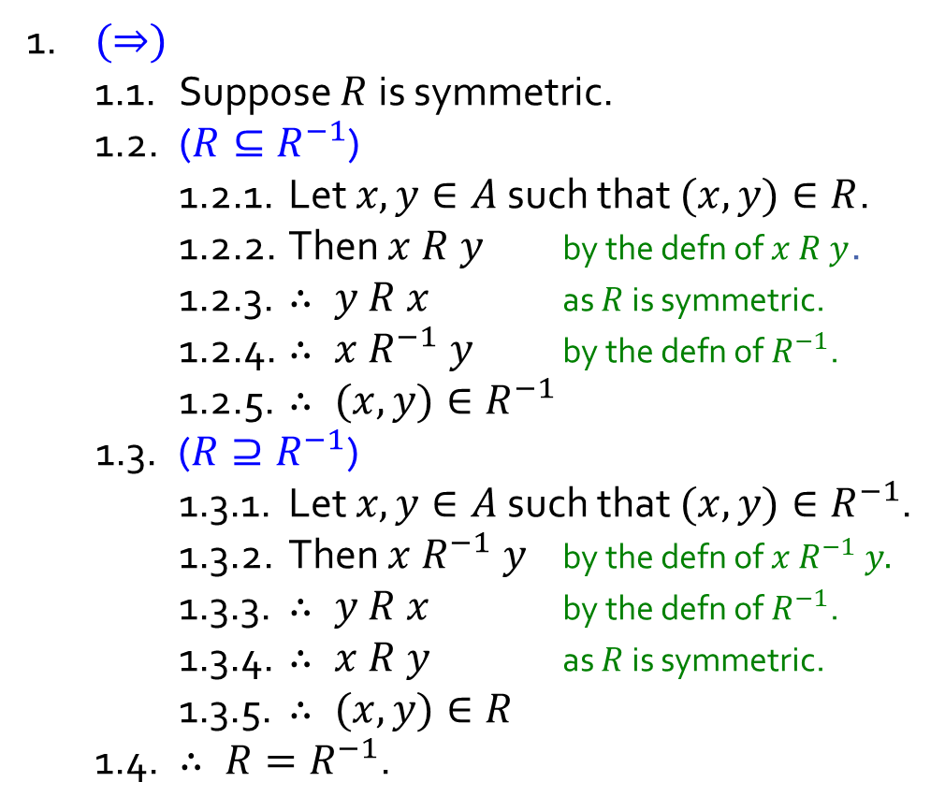



Q2
Let $R$be a relation on set $A$. Show that $R$is symmetric if and only if $R=R^{−1}.$
Definition 6.1.4(2). A relation $R$ on a set $A$ is symmetric if
$$∀x,y∈A (x R y ⇒ y R x).$$
1. $(⇒)$
1.1. Suppose $R$ is symmetric.
1.2. ($R{⊆R}^{−1}$)
1.2.1. Let $x, y∈A$ such that $(x, y)∈R$.
1.2.2. Then $x R y$ by the defn of $x R y$.
1.2.3. $∴ y R x$ as $R$ is symmetric.
1.2.4. $∴ x{ R}^{−1} y$ by the defn of$R^{−1}$.
1.2.5. $∴ (x,y)∈R^{−1}$
1.3. ($R⊇R^{−1}$)
1.3.1. Let $x, y∈A$ such that $(x, y)∈R^{−1}$.
1.3.2. Then $x{ R}^{−1} y$ by the defn of $x R^{−1} y.$
1.3.3. $∴ y R x$ by the defn of$R^{−1}$.
1.3.4. $∴ x R y$ as $R$ is symmetric.
1.3.5. $∴ (x,y)∈R$
1.4. $∴ R=R^{−1}$.
Definition. Let $R$ be a relation from $A$ to $B$. Define the relation $R^{−1}$ from $B$ to $A$ by setting
$$y R^{−1} x ⇔ x R y$$
for each $y∈B$ and each $x∈A$.
by the defn of ${x R}^{−1} y$.
2. $(⇐)$
2.1. Suppose $R=R^{−1}$.
2.2. 2.2.1. Let $x,y ∈A$ such that $x R y$.
2.2.2. Then $(x, y)∈R$ by the defn of $x R y$.
2.2.3. $∴ (x, y)∈R^{−1}$ as $R=R^{−1}$.
2.2.4. $∴ x{ R}^{−1} y$ by the defn of ${x R}^{−1} y$.
2.2.5. $∴ y R x$
2.2. $∴R$ is symmetric.
by the defn of $R^{−1}$.
by the defn of $x R y$.
3. Therefore, $R$is symmetric iff $R=R^{−1}$.

Slide 7

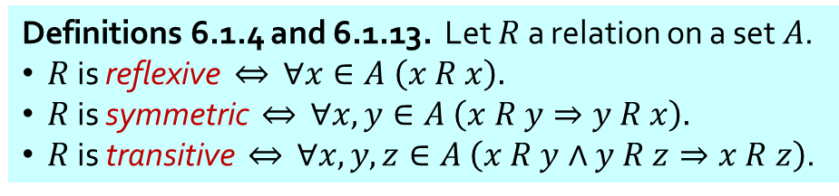
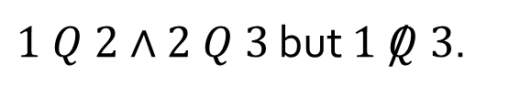
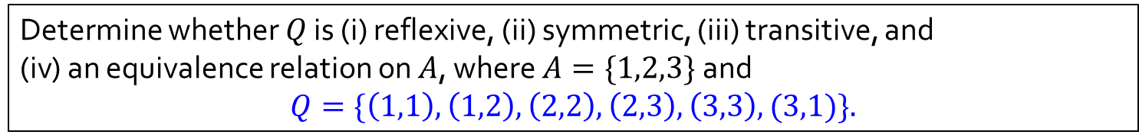
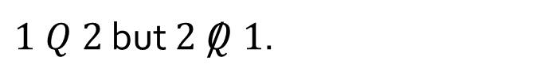

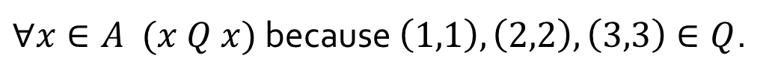

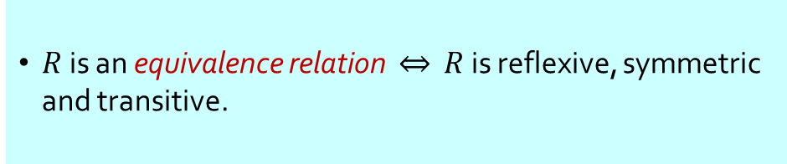

Q3(a)
Determine whether $Q$ is (i) reflexive, (ii) symmetric, (iii) transitive, and
(iv) an equivalence relation on $A$, where $A=\{1,2,3\}$ and $$Q=\{\left(1,1\right),\left(1,2\right),\left(2,2\right),\left(2,3\right),\left(3,3\right),(3,1)\}.$$
Definitions 6.1.4 and 6.1.13. Let $R$ a relation on a set $A$.
$R$ is reflexive $⇔$ $∀x∈A \left(x R x\right).$
$R$ is symmetric $⇔$ $∀x,y∈A \left(x R y⇒y R x\right).$
$R$ is transitive $⇔$ $∀x,y,z∈A \left(x R y∧y R z⇒x R z\right)$.
$R$ is an equivalence relation $⇔$ $R$ is reflexive, symmetric and transitive.
✓
Reflexive?
$∀x∈A (x Q x)$ because $\left(1,1\right),\left(2,2\right),\left(3,3\right)∈Q$.
$$1$$
✘
Symmetric?
$1 Q 2$ but $2 /Q 1$.
✘
Transitive?
$1 Q 2∧2 Q 3$ but $1 /Q 3$.
$$2$$
$$3$$
✘
Equivalence relation?
$Q$ is not symmetric and not transitive.

Slide 8

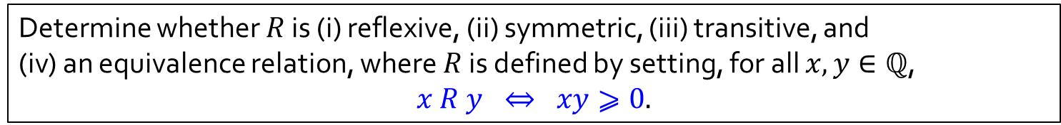
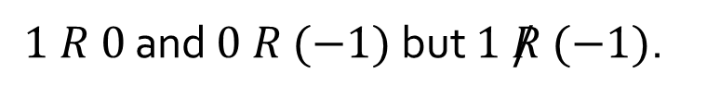

Q3(b)
Determine whether $R$ is (i) reflexive, (ii) symmetric, (iii) transitive, and
(iv) an equivalence relation, where $R$ is defined by setting, for all $x,y∈ℚ$, $$x R y ⇔ xy⩾0.$$
Definitions 6.1.4 and 6.1.13. Let $R$ a relation on a set $A$.
$R$ is reflexive $⇔$ $∀x∈A \left(x R x\right).$
$R$ is symmetric $⇔$ $∀x,y∈A \left(x R y⇒y R x\right).$
$R$ is transitive $⇔$ $∀x,y,z∈A \left(x R y∧y R z⇒x R z\right)$.
$R$ is an equivalence relation $⇔$ $R$ is reflexive, symmetric and transitive.
✓
Reflexive?
$$∀x∈ℚ x∙x=x^{2}⩾0.$$
✓
Symmetric?
$∀x, y∈ℚ (xy⩾0 ⇒yx=xy⩾0)$ (by commutativity of multiplication)
✘
Transitive?
$1 R 0$ and $0 R (−1)$ but $1 /R (−1)$.
✘
Equivalence relation?
$R$ is not transitive.

Slide 9
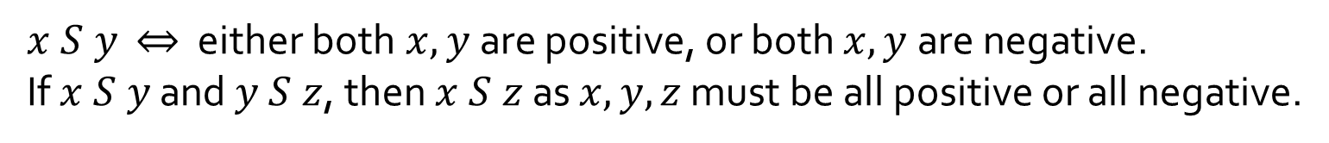

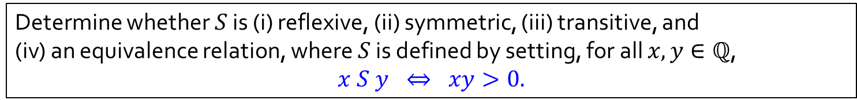

Q3(c)
Determine whether $S$ is (i) reflexive, (ii) symmetric, (iii) transitive, and
(iv) an equivalence relation, where $S$ is defined by setting, for all $x,y∈ℚ$, $$x S y ⇔ xy>0.$$
Definitions 6.1.4 and 6.1.13. Let $R$ a relation on a set $A$.
$R$ is reflexive $⇔$ $∀x∈A \left(x R x\right).$
$R$ is symmetric $⇔$ $∀x,y∈A \left(x R y⇒y R x\right).$
$R$ is transitive $⇔$ $∀x,y,z∈A \left(x R y∧y R z⇒x R z\right)$.
$R$ is an equivalence relation $⇔$ $R$ is reflexive, symmetric and transitive.
✘
Reflexive?
$$0 /S 0.$$
✓
Symmetric?
$∀x, y∈ℚ (xy>0⇒yx=xy>0)$ (by commutativity of multiplication)
$x S y$ $⇔$ either both$x,y$are positive, or both $x,y$are negative.
If $x S y$ and $y S z$, then $x S z$ as $x,y,z$ must be all positive or all negative.
✓
Transitive?
✘
Equivalence relation?
$S$ is not reflexive.

Slide 10
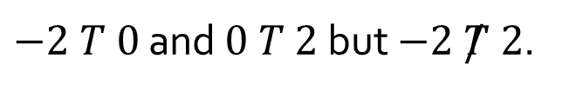

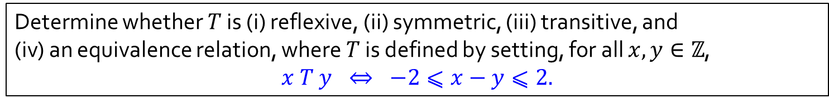

Q3(d)
Determine whether $T$ is (i) reflexive, (ii) symmetric, (iii) transitive, and
(iv) an equivalence relation, where $T$ is defined by setting, for all $x,y∈ℤ$, $$x T y ⇔ −2⩽x−y⩽2.$$
Definitions 6.1.4 and 6.1.13. Let $R$ a relation on a set $A$.
$R$ is reflexive $⇔$ $∀x∈A \left(x R x\right).$
$R$ is symmetric $⇔$ $∀x,y∈A \left(x R y⇒y R x\right).$
$R$ is transitive $⇔$ $∀x,y,z∈A \left(x R y∧y R z⇒x R z\right)$.
$R$ is an equivalence relation $⇔$ $R$ is reflexive, symmetric and transitive.
✓
Reflexive?
$$∀x∈ℤ (−2⩽x−x⩽2).$$
✓
Symmetric?
$∀x∈ℤ (−2⩽x−y⩽2 ⇒ −2⩽y−x⩽2)$.
✘
Transitive?
$−2 T 0$ and $0 T 2$ but $−2 /T 2$.
✘
Equivalence relation?
$T$ is not transitive.

Slide 11

















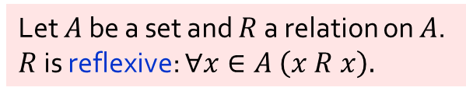










Given a set $A=\{a,b,c\}$and a relation defined on $A$ as follows.
Which of the relations below are REFLEXIVE?
Let $A$ be a set and $R$ a relation on $A$.
$R$ is reflexive: $∀x∈A \left(x R x\right).$
$$R_{1}$$
$$R_{2}$$
$$R_{3}$$
$$R_{4}$$
$$a$$
$$b$$
$$a$$
$$b$$
$$a$$
$$b$$
$$a$$
$$b$$
$$c$$
$$c$$
$$c$$
$$c$$
$$a$$
$$b$$
$$a$$
$$b$$
$$a$$
$$b$$
$$a$$
$$b$$
$$c$$
$$c$$
$$c$$
$$c$$
$$R_{5}$$
$$R_{6}$$
$$R_{7}$$
$$R_{8}$$

Slide 12


























Given a set $A=\{a,b,c\}$and a relation defined on $A$ as follows.
Which of the relations below are REFLEXIVE?
Let $A$ be a set and $R$ a relation on $A$.
$R$ is reflexive: $∀x∈A \left(x R x\right).$
$$R_{1}$$
$$R_{2}$$
$$R_{3}$$
$$R_{4}$$
$$a$$
$$b$$
$$a$$
$$b$$
$$a$$
$$b$$
$$a$$
$$b$$
$$c$$
$$c$$
$$c$$
$$c$$
$$a$$
$$b$$
$$a$$
$$b$$
$$a$$
$$b$$
$$a$$
$$b$$
$$c$$
$$c$$
$$c$$
$$c$$
$$R_{5}$$
$$R_{6}$$
$$R_{7}$$
$$R_{8}$$

Slide 13




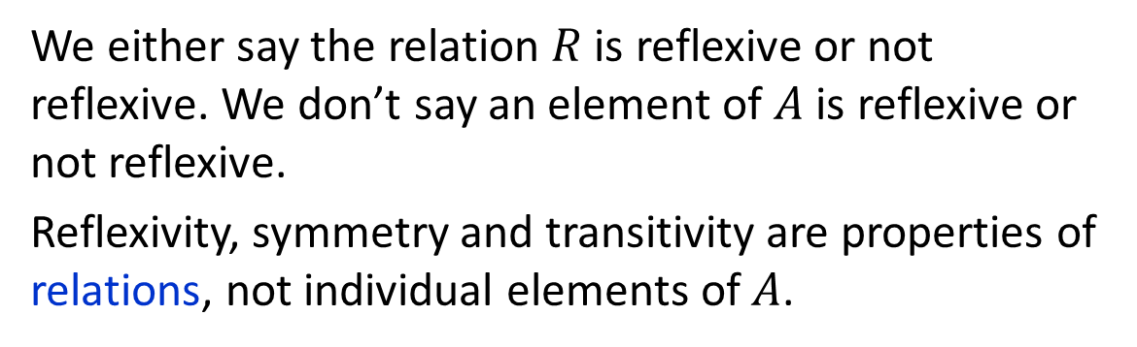
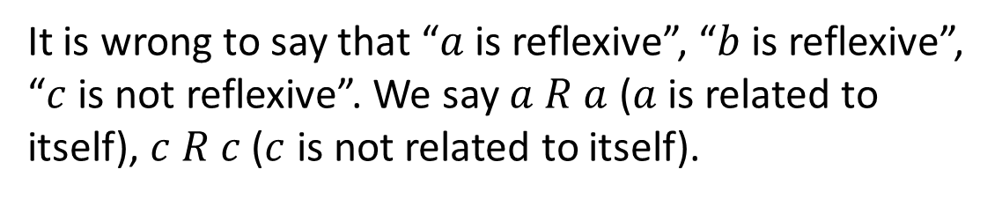
Given a set $A=\{a,b,c\}$and a relation defined on $A$ as follows.
Common mistake
It is wrong to say that “$a$ is reflexive”, “$b$ is reflexive”, “$c$ is not reflexive”. We say $a R a$ ($a$ is related to itself), $c R c$ ($c$ is not related to itself).
$$R$$
$$a$$
$$b$$
We either say the relation $R$ is reflexive or not reflexive. We don’t say an element of $A$ is reflexive or not reflexive.
Reflexivity, symmetry and transitivity are properties of relations, not individual elements of $A$.
$$c$$

Slide 14
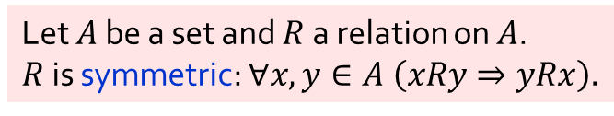
Given a set $A=\{a,b,c\}$and a relation defined on $A$ as follows.
Which of the relations below are SYMMETRIC?
Let $A$ be a set and $R$ a relation on $A$.
$R$ is symmetric: $∀x,y∈A \left(xRy⇒yRx\right).$
$$R_{1}$$
$$R_{2}$$
$$R_{3}$$
$$R_{4}$$
$$a$$
$$b$$
$$a$$
$$b$$
$$a$$
$$b$$
$$a$$
$$b$$
$$c$$
$$c$$
$$c$$
$$c$$
$$a$$
$$b$$
$$a$$
$$b$$
$$a$$
$$b$$
$$a$$
$$b$$
$$c$$
$$c$$
$$c$$
$$c$$
$$R_{5}$$
$$R_{6}$$
$$R_{7}$$
$$R_{8}$$

Slide 15
Given a set $A=\{a,b,c\}$and a relation defined on $A$ as follows.
Which of the relations below are SYMMETRIC?
Let $A$ be a set and $R$ a relation on $A$.
$R$ is symmetric: $∀x,y∈A \left(xRy⇒yRx\right).$
$$R_{1}$$
$$R_{2}$$
$$R_{3}$$
$$R_{4}$$
$$a$$
$$b$$
$$a$$
$$b$$
$$a$$
$$b$$
$$a$$
$$b$$
$$c$$
$$c$$
$$c$$
$$c$$
$$a$$
$$b$$
$$a$$
$$b$$
$$a$$
$$b$$
$$a$$
$$b$$
$$c$$
$$c$$
$$c$$
$$c$$
$$R_{5}$$
$$R_{6}$$
$$R_{7}$$
$$R_{8}$$

Slide 16
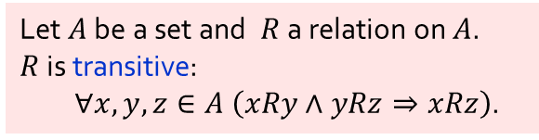
Given a set $A=\{a,b,c\}$and a relation defined on $A$ as follows.
Which of the relations below are TRANSITIVE?
Let $A$ be a set and $R$ a relation on $A$.
$R$ is transitive:
$∀x,y,z∈A \left(xRy∧yRz⇒xRz\right)$.
$$R_{1}$$
$$R_{2}$$
$$R_{3}$$
$$R_{4}$$
$$a$$
$$b$$
$$a$$
$$b$$
$$a$$
$$b$$
$$a$$
$$b$$
$$c$$
$$c$$
$$c$$
$$c$$
$$a$$
$$b$$
$$a$$
$$b$$
$$a$$
$$b$$
$$a$$
$$b$$
$$c$$
$$c$$
$$c$$
$$c$$
$$R_{5}$$
$$R_{6}$$
$$R_{7}$$
$$R_{8}$$

Slide 17
Given a set $A=\{a,b,c\}$and a relation defined on $A$ as follows.
Which of the relations below are TRANSITIVE?
Let $A$ be a set and $R$ a relation on $A$.
$R$ is transitive:
$∀x,y,z∈A \left(xRy∧yRz⇒xRz\right)$.
$$R_{1}$$
$$R_{2}$$
$$R_{3}$$
$$R_{4}$$
$$a$$
$$b$$
$$a$$
$$b$$
$$a$$
$$b$$
$$a$$
$$b$$
$$c$$
$$c$$
$$c$$
$$c$$
$$a$$
$$b$$
$$a$$
$$b$$
$$a$$
$$b$$
$$a$$
$$b$$
$$c$$
$$c$$
$$c$$
$$c$$
$$R_{5}$$
$$R_{6}$$
$$R_{7}$$
$$R_{8}$$

Slide 18
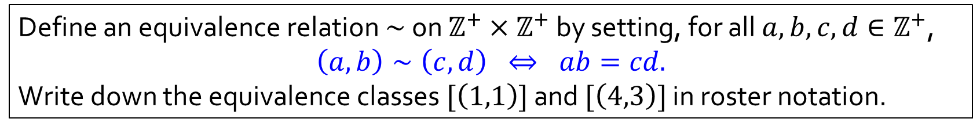

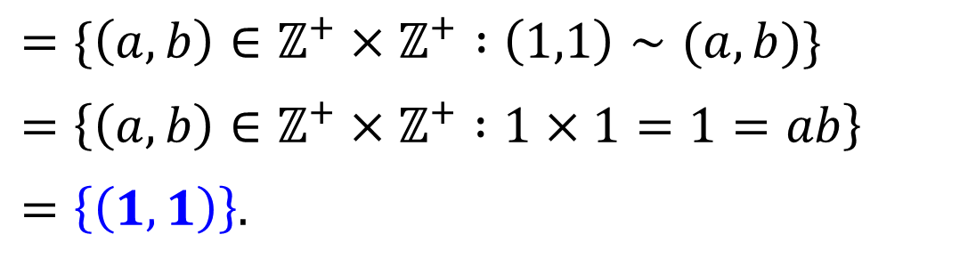

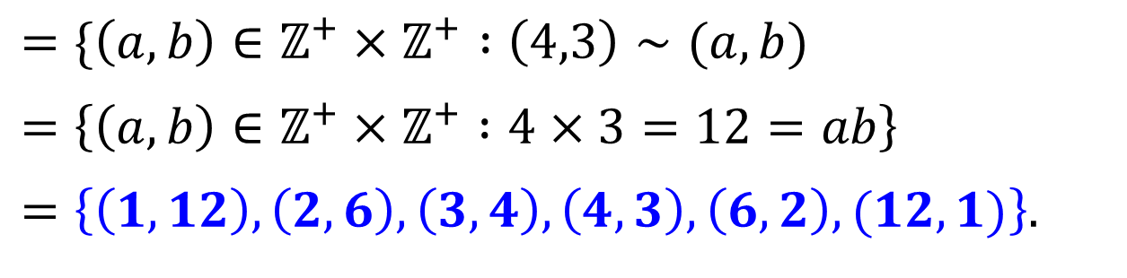
Q4
Define an equivalence relation $∼$ on $ℤ^{+}×ℤ^{+}$ by setting, for all $a,b,c,d∈ℤ^{+}$,
$$\left(a,b\right)∼\left(c,d\right) ⇔ ab=cd.$$
Write down the equivalence classes $[\left(1,1\right)]$ and $[\left(4,3\right)]$ in roster notation.
Definition 6.3.1. Let $∼$ be an equivalence relation on a set $A$, and $x∈A$. Then $\left[x\right]=\{y∈A :x∼y\}$.
$$\left[\left(1,1\right)\right]$$
$$=\{\left(a,b\right)∈ℤ^{+}×ℤ^{+} :\left(1,1\right)∼(a,b)\}$$
$$=\left\{\left(a,b\right)∈ℤ^{+}×ℤ^{+} :1×1=1=ab\right\}$$
$$=\left\{\left(1,1\right)\right\}.$$
$$\left[\left(4,3\right)\right]$$
$$=\{\left(a,b\right)∈ℤ^{+}×ℤ^{+} :\left(4,3\right)∼(a,b)$$
$$=\left\{\left(a,b\right)∈ℤ^{+}×ℤ^{+} :4×3=12=ab\right\}$$
$$=\left\{\left(1,12\right),\left(2,6\right),\left(3,4\right),\left(4,3\right),\left(6,2\right),(12,1)\right\}.$$

Slide 19
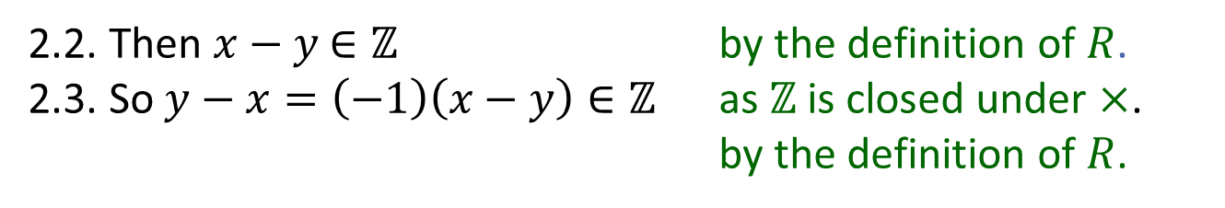
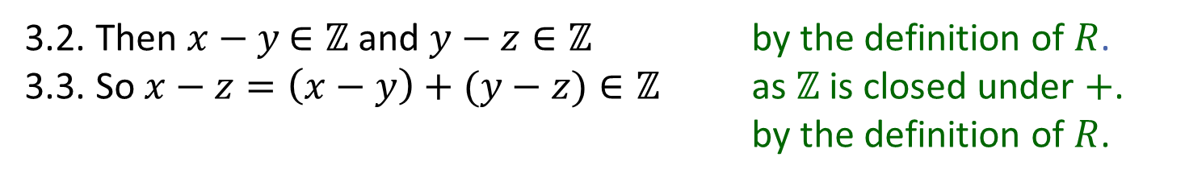

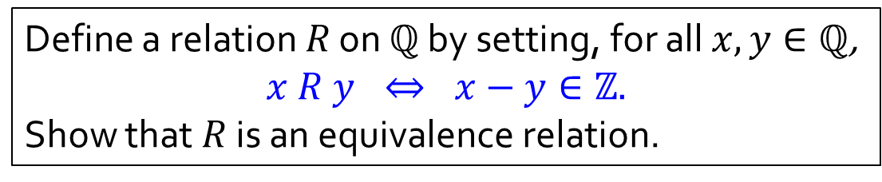


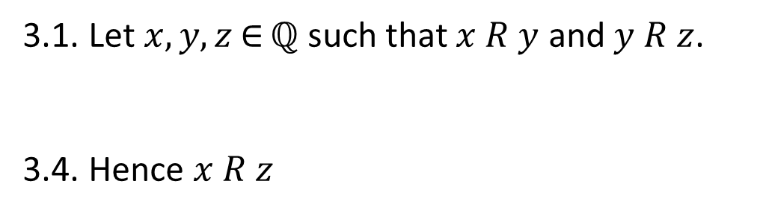
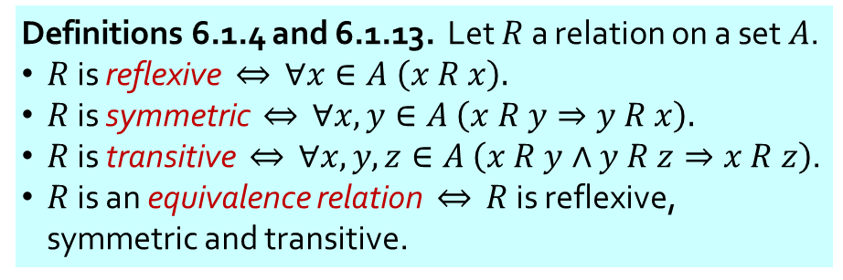
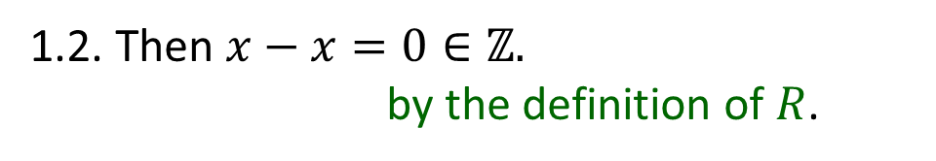
Q5(a)
Define a relation $R$ on $ℚ$ by setting, for all $x,y∈ℚ$,
$$x R y ⇔ x−y∈ℤ.$$
Show that $R$ is an equivalence relation.
Definitions 6.1.4 and 6.1.13. Let $R$ a relation on a set $A$.
$R$ is reflexive $⇔$ $∀x∈A \left(x R x\right).$
$R$ is symmetric $⇔$ $∀x,y∈A \left(x R y⇒y R x\right).$
$R$ is transitive $⇔$ $∀x,y,z∈A \left(x R y∧y R z⇒x R z\right)$.
$R$ is an equivalence relation $⇔$ $R$ is reflexive, symmetric and transitive.
1. (Reflexivity)
1.1. Let $x∈ℚ$.
1.3. So $x R x$
1.2. Then $x−x=0∈ℤ.$
by the definition of $R$.
2. (Symmetry)
2.1. Let $x, y∈$ $ℚ$ such that $x R y$.
2.4. Hence $y R x$
2.2. Then $x−y$ $∈ℤ$ by the definition of $R$.
2.3. So $y−x=\left(−1\right)\left(x−y\right)∈ℤ$ as $ℤ$ is closed under $×$.
by the definition of $R$.
3. (Transitivity)
3.1. Let $x,y,z$ $∈$ $ℚ$ such that $x R y$ and $y R z$.
3.4. Hence $x R z$
3.2. Then $x−y$ $∈ℤ$ and $y−z∈ℤ$ by the definition of $R$.
3.3. So $x−z=\left(x−y\right)+(y−z)∈ℤ$ as $ℤ$ is closed under $+$.
by the definition of $R$.
4. So $R$ is an equivalence relation.

Slide 20
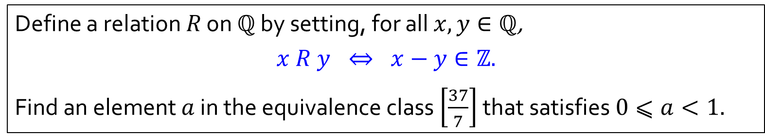
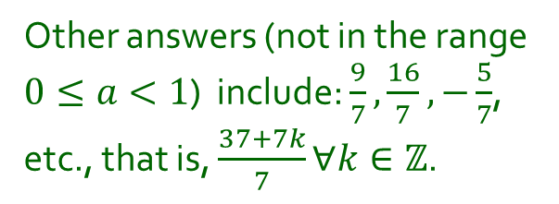
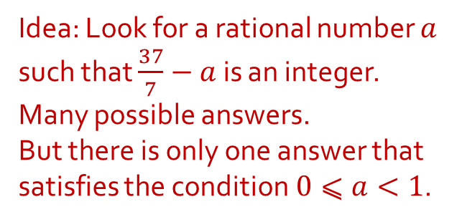
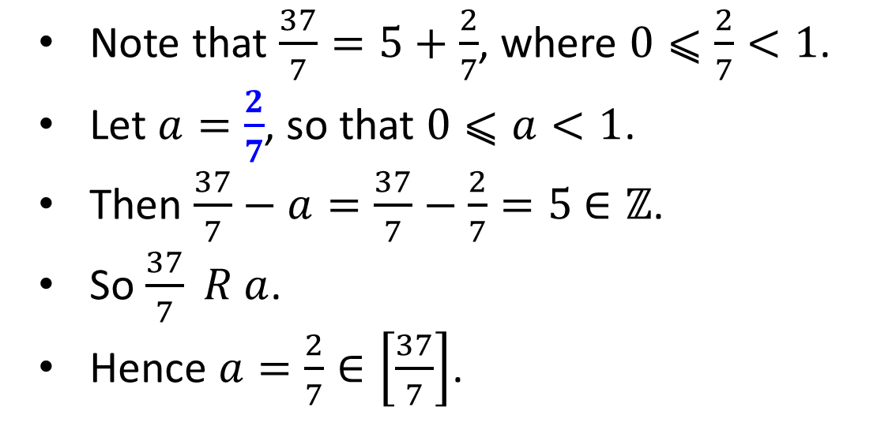
Q5(b)
Define a relation $R$ on $ℚ$ by setting, for all $x,y∈ℚ$,
$$x R y ⇔ x−y∈ℤ.$$
Find an element $a$ in the equivalence class $\left[\frac{37}{7}\right]$ that satisfies $0⩽a<1.$
Idea: Look for a rational number $a$ such that $\frac{37}{7}−a$ is an integer.
Many possible answers.
But there is only one answer that satisfies the condition$0⩽a<1$.
Note that $\frac{37}{7}=5+\frac{2}{7}$, where $0⩽\frac{2}{7}<1$.
Let $a=\frac{2}{7}$, so that $0⩽a<1$.
Then $\frac{37}{7}−a=\frac{37}{7}−\frac{2}{7}=5$ $∈ℤ$.
So $\frac{37}{7} R a$.
Hence $a=\frac{2}{7}∈\left[\frac{37}{7}\right]$.
Other answers (not in the range $0≤a<1$) include: $\frac{9}{7},\frac{16}{7},−\frac{5}{7}$, etc., that is, $\frac{37+7k}{7}∀k∈ℤ$.
Definition 6.3.1. Let $∼$ be an equivalence relation on a set $A$, and $x∈A$. Then $\left[x\right]=\{y∈A :x∼y\}$.

Slide 21
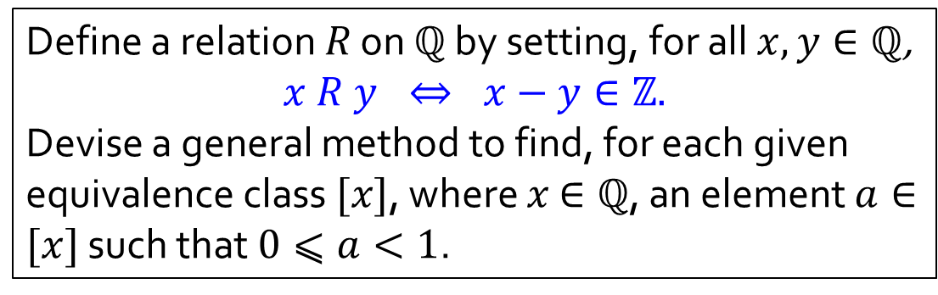
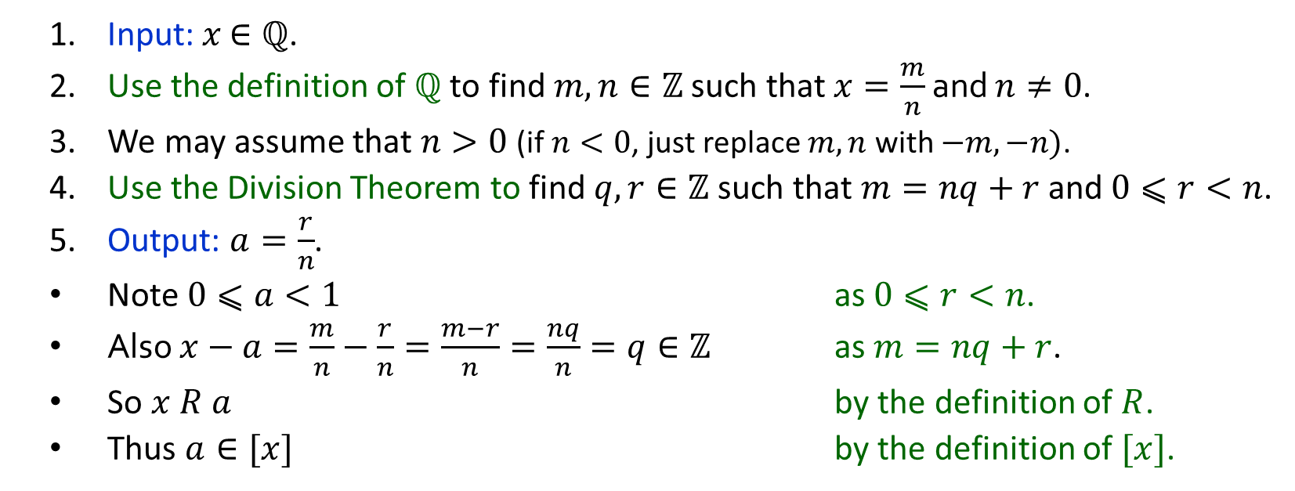
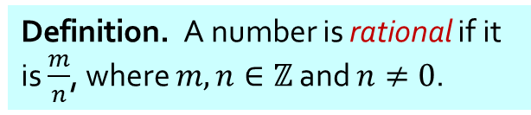
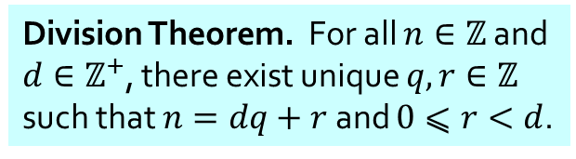
Q5(c)
Define a relation $R$ on $ℚ$ by setting, for all $x,y∈ℚ$,
$$x R y ⇔ x−y∈ℤ.$$
Devise a general method to find, for each given equivalence class $[x]$, where $x$ $∈ℚ$, an element $a∈[x]$ such that $0⩽a<1$.
Definition. A number is rational if it is $\frac{m}{n}$, where $m,n∈ℤ$ and $n≠0$.
Division Theorem. For all $n∈ℤ$ and $d∈ℤ^{+}$, there exist unique $q,r∈ℤ$ such that $n=dq+r$ and $0⩽r<d$.
1. Input: $x$ $∈ℚ$.
2. Use the definition of $ℚ$ to find $m,n∈ℤ$ such that $x=\frac{m}{n}$ and $n≠0$.
3. We may assume that $n>0$ (if $n<0$, just replace $m,n$ with $−m,−n)$.
4. Use the Division Theorem to find $q,r∈ℤ$ such that $m=nq+r$ and $0⩽r<n$.
5. Output: $a=\frac{r}{n}$.
Note $0⩽a<1$ as $0⩽r<n$.
Also $x−a=\frac{m}{n}−\frac{r}{n}=\frac{m−r}{n}=\frac{nq}{n}=q∈ℤ$ as $m=nq+r$.
So $x R a$ by the definition of $R$.
Thus $a∈[x]$ by the definition of $[x]$.
Definition 6.3.1. Let $∼$ be an equivalence relation on a set $A$, and $x∈A$. Then $\left[x\right]=\{y∈A :x∼y\}$.

Slide 22

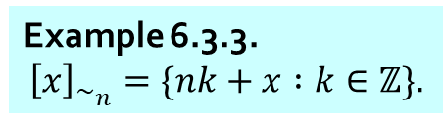
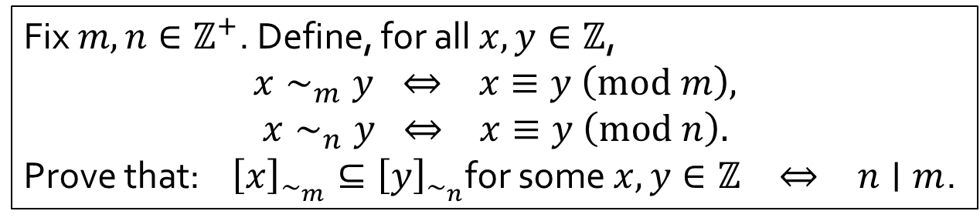



Q6
Fix $m,n∈ℤ^{+}$. Define, for all $x,y∈ℤ$,
$$x∼_{m}y ⇔ x≡y \left(mod m\right),$$
$$x∼_{n}y ⇔ x≡y \left(mod n\right).$$
Prove that: ${\left[x\right]}_{∼_{m}}⊆{\left[y\right]}_{∼_{n}}$for some $x,y∈ℤ$ $⇔$ $n∣m$.
Definition 6.1.11. For $n,d∈ℤ$.
$$d∣n ⇔ n=dk for some k∈ℤ$$
Example 6.3.3.
$${\left[x\right]}_{∼_{n}}=\{nk+x :k∈ℤ\}.$$
${\left[0\right]}_{∼_{3}}=\{…,−24,−21,−18,−15,−12,−9,−6,−3,0,3,6,9,12,15,18,21,24,…\}$.
${\left[1\right]}_{∼_{3}}=\{…,−23,−20,−17,−14,−11,−8,−5,−2,1,4,7,10,13,16,19,22,25,…\}$.
Skip every other number.
${\left[2\right]}_{∼_{3}}=\{…,−22,−19,−16,−13,−10,−7,−4,−1,2,5,8,11,14,17,20,23,26,…\}$.
$${\left[0\right]}_{∼_{6}}=$$
${\left[0\right]}_{∼_{6}}=\{…,−24,−21,−18,−15,−12,−9,−6,−3,0,3,6,9,12,15,18,21,24,…\}$.
$${\left[1\right]}_{∼_{6}}=$$
${\left[1\right]}_{∼_{6}}=\{…,−23,−20,−17,−14,−11,−8,−5,−2,1,4,7,10,13,16,19,22,25,…\}$.
$${\left[2\right]}_{∼_{6}}=$$
${\left[2\right]}_{∼_{6}}=\{…,−22,−19,−16,−13,−10,−7,−4,−1,2,5,8,11,14,17,20,23,26,…\}$.
The elements of ${\left[x\right]}_{∼_{n}}$ are exactly $n$ apart.
If ${\left[x\right]}_{∼_{m}}⊆{\left[y\right]}_{∼_{n}}$, then there must be two elements of ${\left[y\right]}_{∼_{n}}$ that are exactly $m$ apart.

Slide 23







Q6
Fix $m,n∈ℤ^{+}$. Define, for all $x,y∈ℤ$,
$$x∼_{m}y ⇔ x≡y \left(mod m\right),$$
$$x∼_{n}y ⇔ x≡y \left(mod n\right).$$
Prove that: ${\left[x\right]}_{∼_{m}}⊆{\left[y\right]}_{∼_{n}}$for some $x,y∈ℤ$ $⇔$ $n∣m$.
Definition 6.1.11. For $n,d∈ℤ$.
$$d∣n ⇔ n=dk for some k∈ℤ$$
Example 6.3.3.
$${\left[x\right]}_{∼_{n}}=\{nk+x :k∈ℤ\}.$$
1. (“$⇐$”)
1.1. Suppose $n∣m$..
1.2. Use the definition of divisibility to find $a∈ℤ$ such that $m=an$.
1.3. Then ${\left[0\right]}_{∼_{m}}=\{mk+0 :k∈ℤ\}$ by Example 6.3.3;
1.4. $=\{\left(an\right)k+0 :k∈ℤ\}$ by the choice of $a$;
1.5. $⊆\{nℓ+0 :ℓ∈ℤ\}$ as $ℤ$ is closed under $×$;
1.6. $={\left[0\right]}_{∼_{n}}$ by Example 6.3.3.
(Want to show that ${\left[0\right]}_{∼_{m}}$ $⊆ {\left[0\right]}_{∼_{n}}$)
2. (“$⇒$”)
2.1. Suppose there exists $x,y∈ℤ$ such that ${\left[x\right]}_{∼_{m}}⊆{\left[y\right]}_{∼_{n}}$.
2.6. So $n∣m$
2.2. Then Example 6.3.3 tells us $\left\{mk+x :k∈ℤ\right\}⊆\{nℓ+y :ℓ∈ℤ\}$.
2.3. Find $ℓ_{1},ℓ_{2}∈ℤ$ such that $x=m⋅0+x=nℓ_{1}+y$ and $x+m=m⋅1+x=nℓ_{2}+y$.
2.4. Then $m=\left(x+m\right)−x=\left(nℓ_{2}+y\right)−\left(nℓ_{1}+y\right)=n(ℓ_{2}−ℓ_{1})$.
2.5. As $ℓ_{1},ℓ_{2}∈ℤ$, we know $ℓ_{2}−ℓ_{1}∈ℤ$ because $ℤ$ is closed under $−$.
by the definition of divisibility.

Slide 24









Q7(a)
Let $𝒞$ be a partition of a set $A$. Define an equivalence relation $∼$ on $A$ by setting,
$x∼y$ $⇔$ $x,y∈S$ for some $S∈𝒞$
for all $x,y∈A$. Prove that if $x∈S∈𝒞$, then $\left[x\right]=S$.
1. Let $x∈S∈𝒞$.
2. (“$⊇$”) We want to show that $S⊆$ $[x]$
definition of $∼$, as $x,y∈S∈𝒞$;
2.3. $∴y∈[x]$ by the definition of $[x]$.
3. (“$⊆$”) We want to show that $𝒞⊆$ $[x]$
3.1. Let $y∈[x]$.
3.5. Hence $y∈\hat{S}=S$.
4. Thus $\left[x\right]=S$.
$$𝒞$$
2.1 Suppose $y∈S$
2.2. $x∼y$ by the definition of $∼$, as $x,y∈S∈𝒞$;
by the definition of $[x]$.
$$S$$
$$x$$
3.2. Then $x∼y$ by the definition of $[x]$.
3.3. Use the definition of $∼$ to find $\hat{S}∈𝒞$ such that $x,y∈\hat{S}$.
3.4. Since $x∈S∩\hat{S}$, we deduce that $S=\hat{S}$ as $S,\hat{S}$ are components in the partition $𝒞$
$$\hat{S}=$$
Definition 5.4.1. Call $𝒞$ a partition of a set $A$ if
(1) $𝒞$ is a set of which all elements are nonempty subsets of $A$; and
(2) every element of $A$ is in exactly one element of $𝒞$.
Definition 6.3.1. Let $∼$ be an equivalence relation on a set $A$, and $x∈A$. Then $\left[x\right]=\{y∈A :x∼y\}$.

Slide 25








Q7(b)
Let $𝒞$ be a partition of a set $A$. Define an equivalence relation $∼$ on $A$ by setting,
$x∼y$ $⇔$ $x,y∈S$ for some $S∈𝒞$
for all $x,y∈A$. Prove that $A/\sim =𝒞$.
Q7(a). If $x∈S∈𝒞$, then $\left[x\right]=S$.
1. (“$⊆$”) We want to show $A/\sim ⊆𝒞$
1.1. Let $\left[x\right]∈A/\sim$.
1.3. Then $\left[x\right] ∈𝒞$.
2. (“$⊇$”) We want to show $𝒞⊆A/\sim$
2.1. Let $S∈𝒞$.
2.4. Then $S ∈A/\sim$.
3. Hence $A/\sim =𝒞$.
$$𝒞$$
1.2. Use the assumption that $𝒞$ is a partition of $A$ to find $S∈𝒞$
such that $x∈S$.
part (a) implies
$$=S$$
$$S$$
$$x$$
2.2. Then $S≠∅$ as $S$ is a component in a partition.
2.3. Take $x∈S$.
part (a) implies
$$=\left[x\right]$$
Definition 5.4.1. Call $𝒞$ a partition of a set $A$ if
(1) $𝒞$ is a set of which all elements are nonempty subsets of $A$; and
(2) every element of $A$ is in exactly one element of $𝒞$.
Definition 6.3.6. If $∼$ is an equivalence relation on a set $A$, then
$$A/\sim =\left\{\left[x\right] :x∈A\right\}.$$
Definition 6.3.1. Let $∼$ be an equivalence relation on a set $A$, and $x∈A$. Then $\left[x\right]=\{y∈A :x∼y\}$.

Slide 26
END OF FILE

