Slide 1
Cs1231 T12 tutorial #3
Sets
based on slides by Simon Teo, Ling Yan Hao, and Aaron Tan edited by Theodore

Slide 2
Learning objectives of this tutorial
Sets
roster, set-builder, replacement notation
membership, inclusion, and equality of sets
power sets, Cartesian products
Boolean operations, set identities

Slide 3







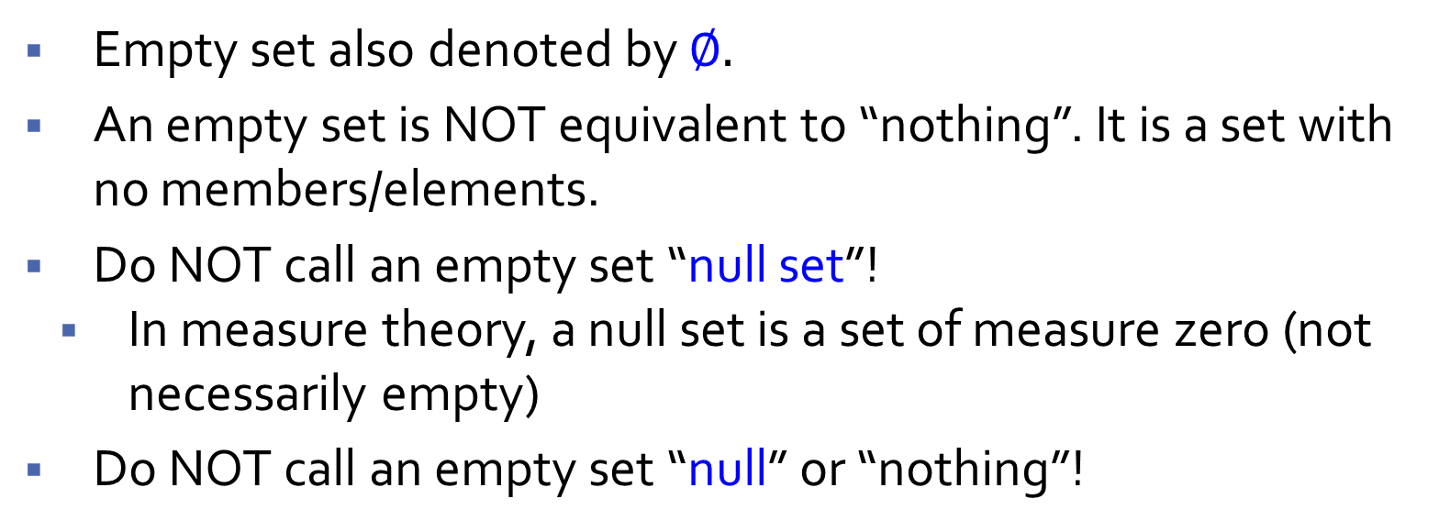
Empty set
Which of the following is an empty set?
$$\{ \}$$
$$=∅$$
$$\{ \{ \} \}$$
$$=\{∅\}$$
Empty set also denoted by $∅.$
An empty set is NOT equivalent to “nothing”. It is a set with no members/elements.
Do NOT call an empty set “null set”!
In measure theory, a null set is a set of measure zero (not necessarily empty)
Do NOT call an empty set “null” or “nothing”!

Slide 4
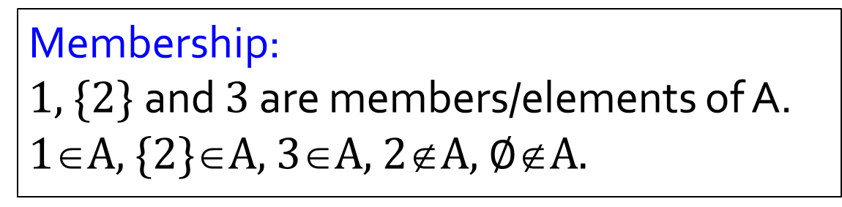
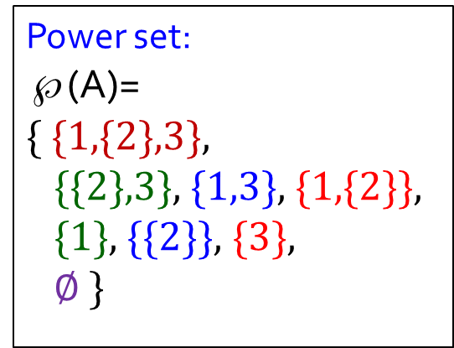
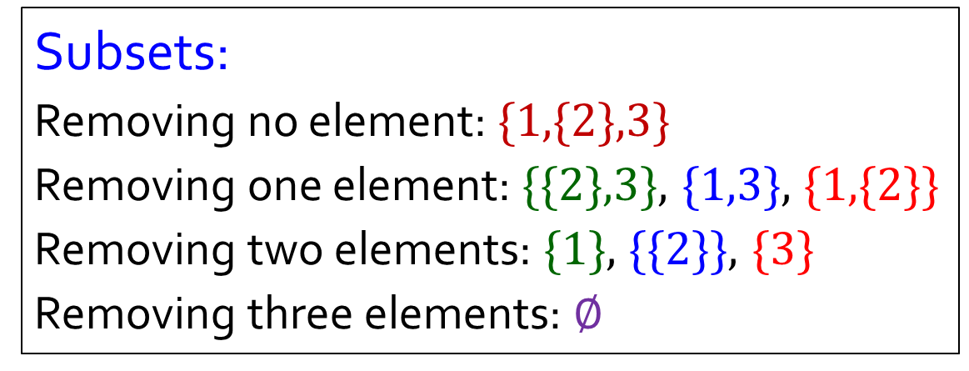
Quick Quiz
A
A = {1, {2}, 3}
Membership:
1, {2} and 3 are members/elements of A.
1∈A, {2}∈A, 3∈A, 2∉A, $∅$∉A.
1
2
3
Subsets:
Removing no element: {1,{2},3}
Removing one element: {{2},3}, {1,3}, {1,{2}}
Removing two elements: {1}, {{2}}, {3}
Removing three elements: $∅$
Power set:
℘(A)=
{ {1,{2},3},
{{2},3}, {1,3}, {1,{2}},
{1}, {{2}}, {3},
$∅$ }

Slide 5
Quick check
Is subset transitive?
$$(A⊆B)∧(B⊆C)→A⊆C$$
Is membership transitive?
$$(X∈Y)∧(Y∈Z)→X∈Z$$
Check for yourself, and write proofs to convince yourself that these are true/false.

Slide 6
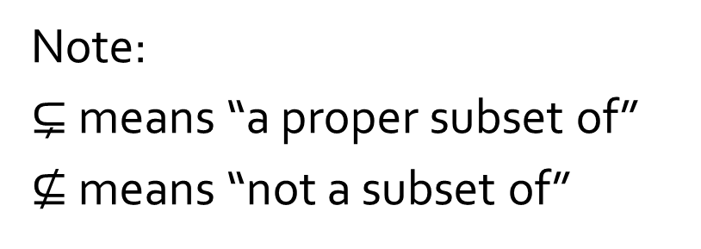
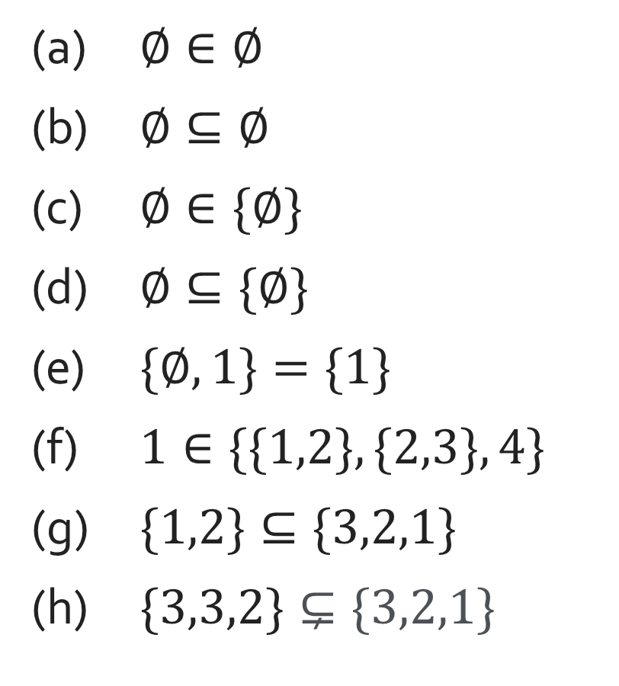
Q1.
For each of the following, state whether it is true or false.
False
(a) $∅∈∅$
(b) $∅⊆∅$
(c) $∅∈\{∅\}$
(d) $∅⊆\{∅\}$
(e) $\{∅,1\}=\{1\}$
(f) $1∈\{\{1,2\},\{2,3\},4\}$
(g) $\{1,2\}⊆\{3,2,1\}$
(h) $\{3,3,2\}⊊\{3,2,1\}$
True
Note:
$⊊$ means “a proper subset of”
$⊈$ means “not a subset of”
True
True
False
False
True
True

Slide 7
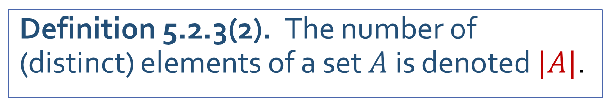
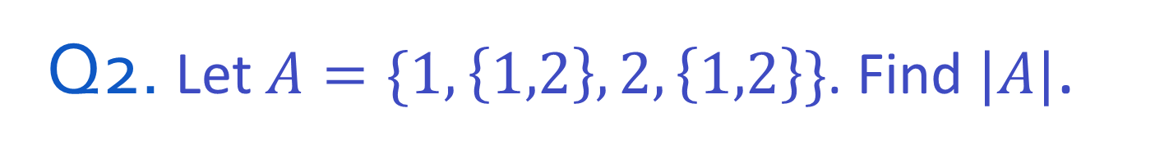
Q2. Let $A=\{1,\left\{1,2\right\},2,\left\{1,2\right\}\}$. Find $|A|$.
A
|A| = 3
1
1,2
2
Definition 5.2.3(2). The number of (distinct) elements of a set $A$ is denoted $|A|$.

Slide 8
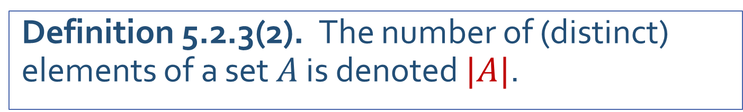
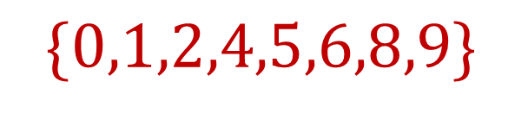

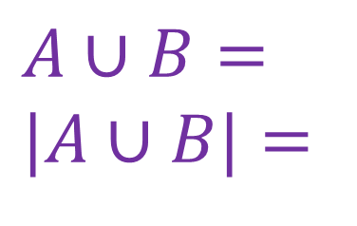

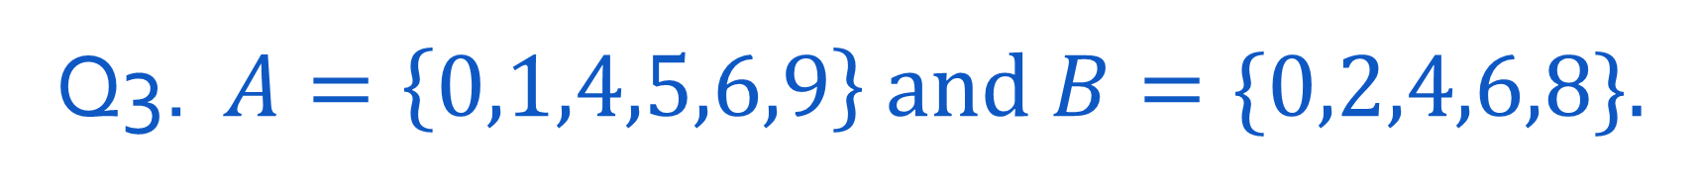


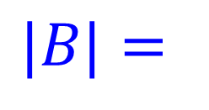

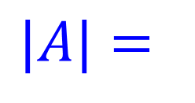


Q3. $A=\left\{0,1,4,5,6,9\right\}$ and $B=\{0,2,4,6,8\}$.
Find $|A|$, $|B|$, $|A∩B|$, $|A∪B|$.
Definition 5.2.3(2). The number of (distinct) elements of a set $A$ is denoted $|A|$.
$$\{0,4,6\}$$
$$|A|=$$
$$A∩B=$$
$$|A∩B|=$$
$$6$$
$$3$$
$$|B|=$$
$$5$$
$$A∪B=$$
$$|A∪B|=$$
$$\{0,1,2,4,5,6,8,9\}$$
$$8$$

Slide 9
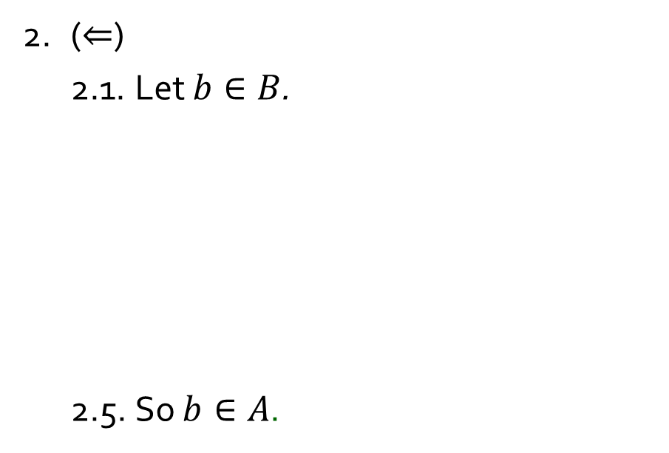
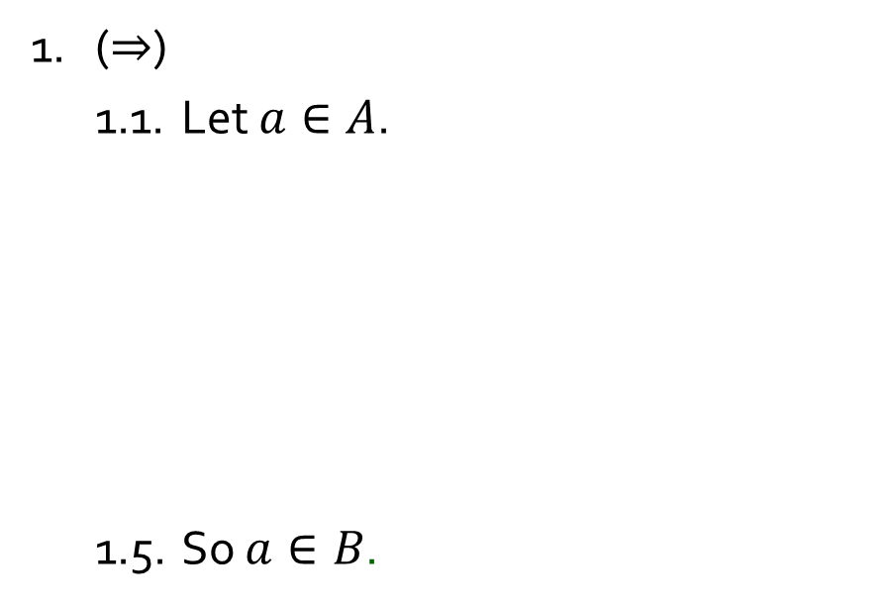
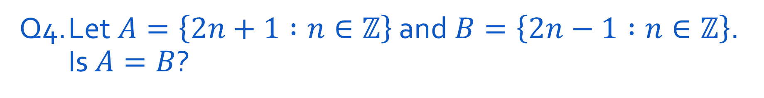
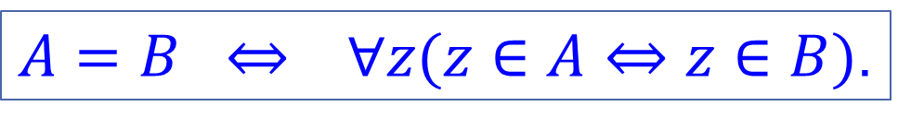
Q4. Let$A=\left\{2n+1 :n∈ℤ\right\}$ and$B=\left\{2n−1 :n∈ℤ\right\}$. Is $A=B$?
Yes or no?
$A=B ⇔ ∀z(z∈A⇔z∈B)$.
1. ($⇒$)
1.1. Let $a∈A$.
1.5. So $a∈B$.
2. ($⇐$)
2.1. Let $b∈B$.
2.5. So $b∈A$.
3. Hence $A=B$ by the definition of set equality.

Slide 10
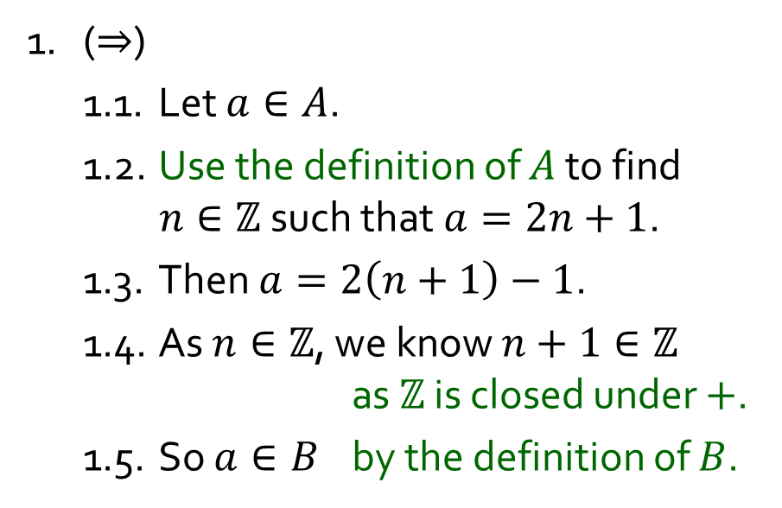
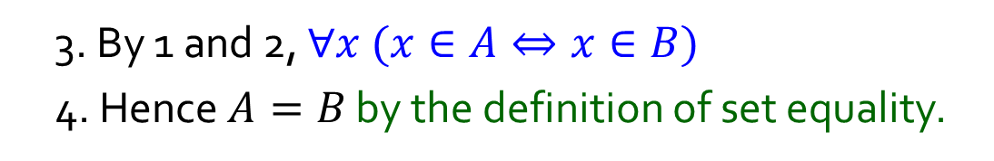
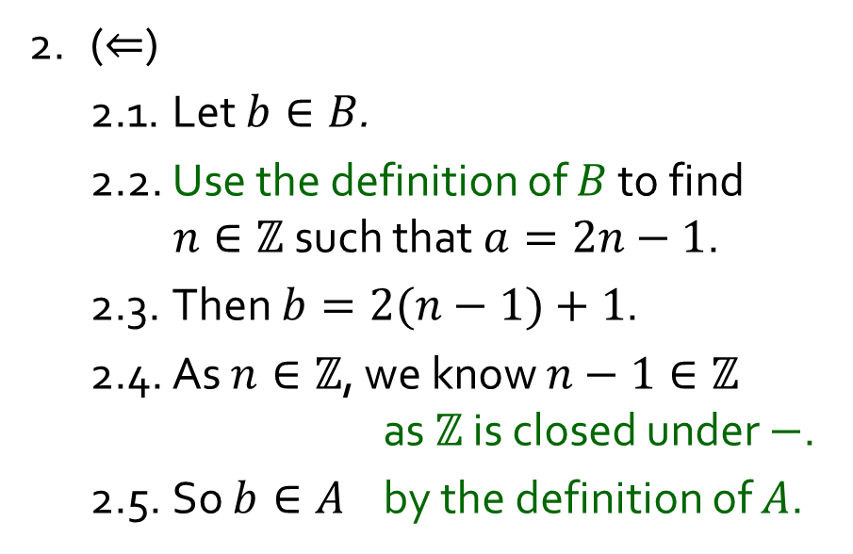
Q4. Let$A=\left\{2n+1 :n∈ℤ\right\}$ and$B=\left\{2n−1 :n∈ℤ\right\}$. Is $A=B$?
Yes or no?
$A=B ⇔ ∀z(z∈A⇔z∈B)$.
1. ($⇒$)
1.1. Let $a∈A$.
1.2. Use the definition of $A$ to find $n∈ℤ$ such that $a=2n+1$.
1.3. Then $a=2\left(n+1\right)−1$.
1.4. As $n∈ℤ$, we know $n+1∈ℤ$ as $ℤ$ is closed under $+$.
1.5. So $a∈B$ by the definition of $B$.
2. ($⇐$)
2.1. Let $b∈B$.
2.2. Use the definition of $B$ to find $n∈ℤ$ such that $a=2n−1$.
2.3. Then $b=2(n−1)+1$.
2.4. As $n∈ℤ$, we know $n−1∈ℤ$ as $ℤ$ is closed under $−$.
2.5. So $b∈A$ by the definition of $A$.
3. By 1 and 2, $∀x (x∈A⇔x∈B)$
4. Hence $A=B$ by the definition of set equality.

Slide 11
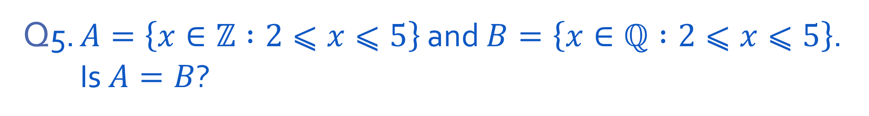
Q5. $A=\left\{x∈ℤ :2⩽x⩽5\right\}$ and $B=\left\{x∈ℚ :2⩽x⩽5\right\}$. Is $A=B$?
Yes or no?
$A=B ⇔ ∀z(z∈A⇔z∈B)$.

Slide 12
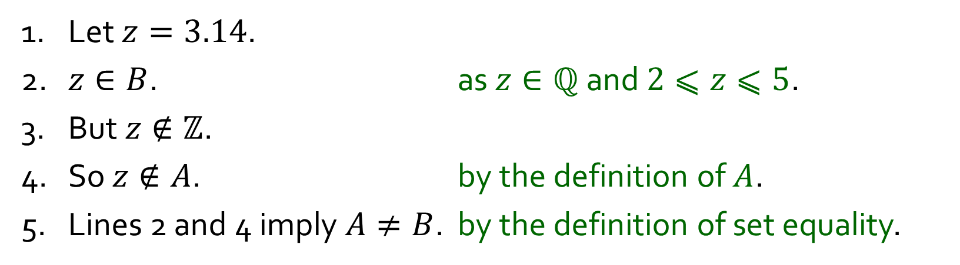
Q5. $A=\left\{x∈ℤ :2⩽x⩽5\right\}$ and $B=\left\{x∈ℚ :2⩽x⩽5\right\}$. Is $A=B$?
Yes or no?
$A=B ⇔ ∀z(z∈A⇔z∈B)$.
1. Let $z=3.14$.
2. $z∈B$. as $z∈ℚ$ and $2⩽z⩽5$.
3. But $z∉ℤ$.
4. So $z∉A$. by the definition of $A$.
5. Lines 2 and 4 imply $A≠B$. by the definition of set equality.

Slide 13
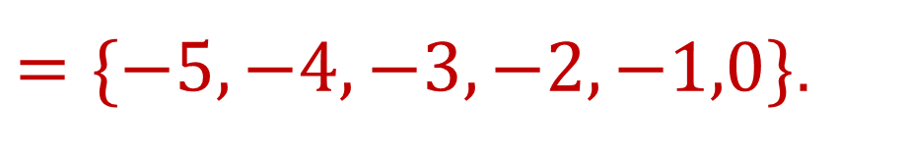
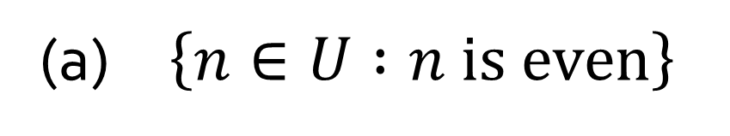
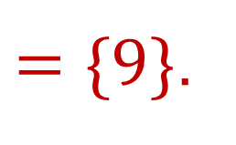

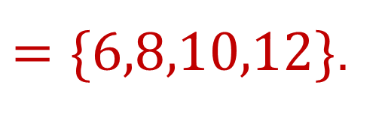
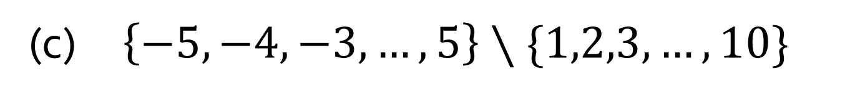

Q6. Let $U=\{5,6,7,8,9,10,11,12\}$.
(a) $\left\{n∈U :n is even\right\}$
$=\{6,8,10,12\}$.
(b) $\left\{n∈U :n=m^{2} for some m∈ℤ\right\}$
$=\{9\}$.
(c) $\left\{−5, −4, −3,…,5\right\}∖\{1,2,3,…,10\}$
$=\{−5,−4,−3,−2,−1,0\}$.

Slide 14
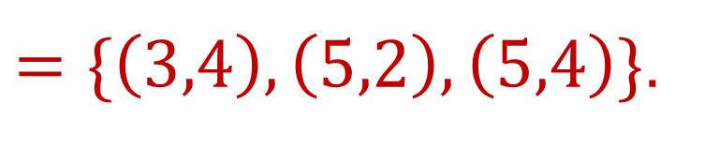
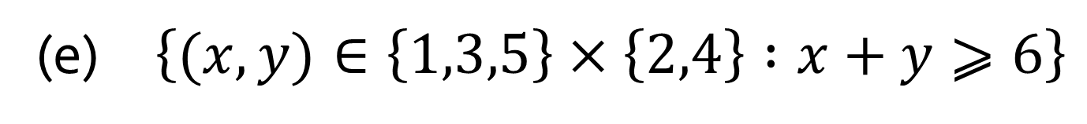
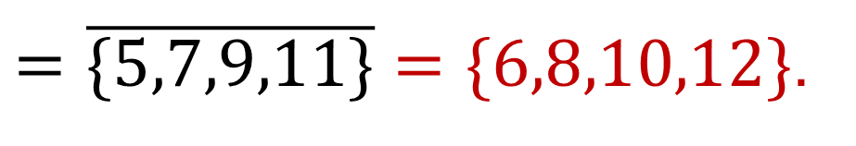
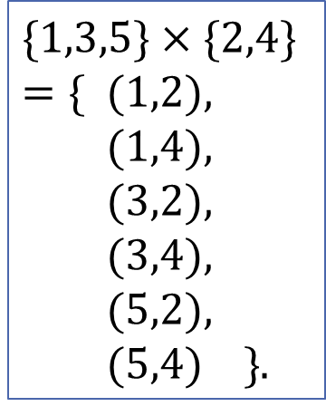

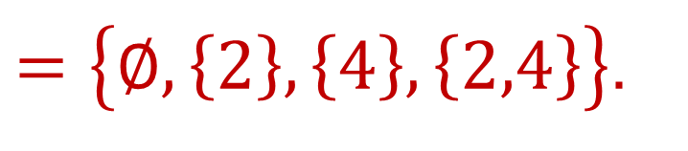
Q6. Let $U=\{5,6,7,8,9,10,11,12\}$.
(d) $\overline{\left\{5,7,9\right\}∪\{9,11\}}$ where $U$ is the universal set
$=\overline{\{5,7,9,11\}}=\{6,8,10,12\}$.
$$\{1,3,5\}×\{2,4\}$$
$=\{$ $(1,2),$
$(1,4),$
$(3,2),$
$(3,4),$
$(5,2),$
$(5,4) \}$.
What is this called?
(e) $\left\{(x, y)∈\left\{1,3,5\right\}×\left\{2,4\right\} :x+y⩾6\right\}$
$=\{\left(3,4\right),\left(5,2\right),\left(5,4\right)\}$.
Ordered pairs
$=\left\{∅,\left\{2\right\},\left\{4\right\},\left\{2,4\right\}\right\}$.
(f) $𝒫(\left\{2,4\right\})$

Slide 15
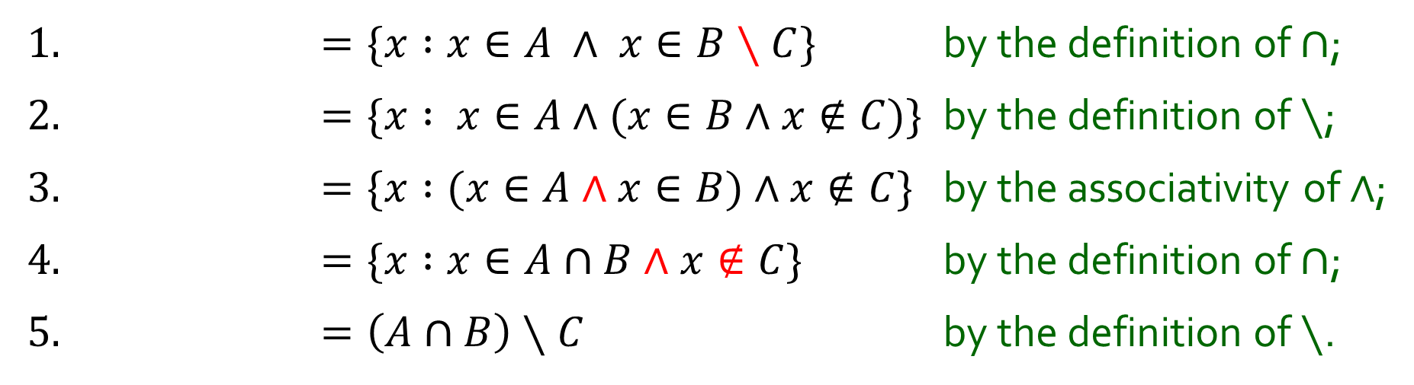
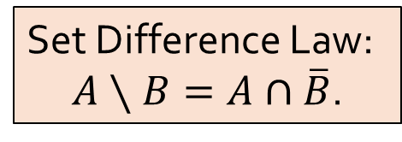


Q7. Show that for all sets $A$, $B$, $C$, $A∩\left(B∖C\right)=\left(A∩B\right)∖C.$
Set Difference Law:
$A∖B=A∩\overline{B}$.
1. $=\{x :x∈A ∧ x∈B∖C\}$ by the definition of $∩$;
2. $=\{x : x∈A∧(x∈B∧x∉C$)} by the definition of $∖$;
3. $=\{x :(x∈A∧x∈B)∧x∉C$} by the associativity of $∧$;
4. $=\{x :x∈A∩B∧x∉C$} by the definition of $∩$;
5. $=\left(A∩B\right)∖C$ by the definition of $∖$.
$$A∩\left(B∖C\right)=$$

Slide 16
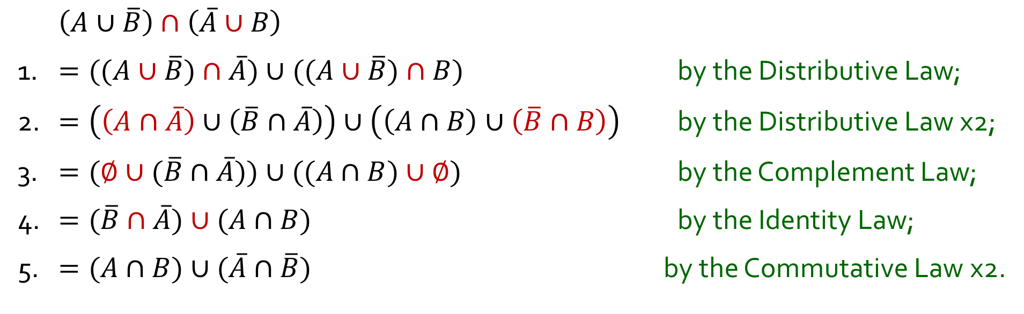
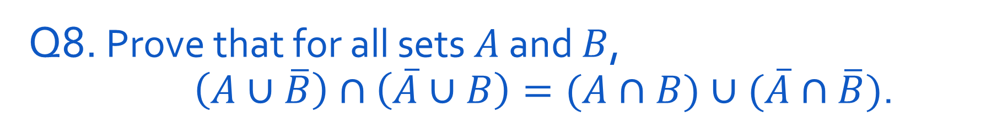
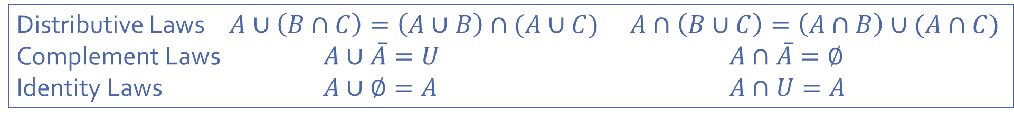
Q8. Prove that for all sets $A$ and $B$, $\left(A∪\overline{B}\right)∩\left(\overline{A}∪B\right)=(A∩B)∪(\overline{A}∩\overline{B})$.
$\left(A∪\overline{B}\right)∩\left(\overline{A}∪B\right)$
1. $=((A∪\overline{B})∩\overline{A})∪((A∪\overline{B})∩B)$ by the Distributive Law;
2. $=\left(\left(A∩\overline{A}\right)∪\left(\overline{B}∩\overline{A}\right)\right)∪\left(\left(A∩B\right)∪\left(\overline{B}∩B\right)\right)$ by the Distributive Law x2;
3. $=(∅∪(\overline{B}∩\overline{A}))∪((A∩B)∪∅)$ by the Complement Law;
4. $=(\overline{B}∩\overline{A})∪(A∩B)$ by the Identity Law;
5. $=(A∩B)∪(\overline{A}∩\overline{B})$ by the Commutative Law x2.
Distributive Laws $A∪\left(B∩C\right)=\left(A∪B\right)∩(A∪C)$ $A∩\left(B∪C\right)=\left(A∩B\right)∪(A∩C)$
Complement Laws $A∪\overline{A}=U$ $A∩\overline{A}=∅$
Identity Laws $A∪∅=A$ $A∩U=A$

Slide 17
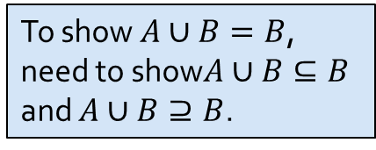
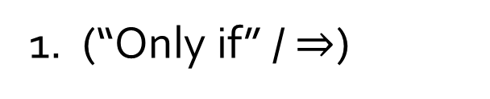
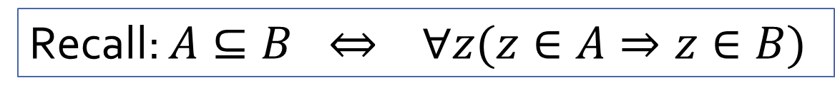

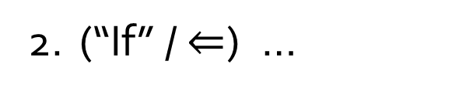
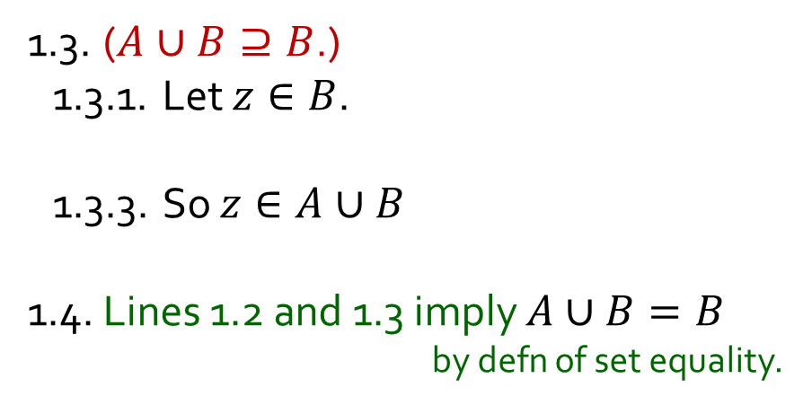
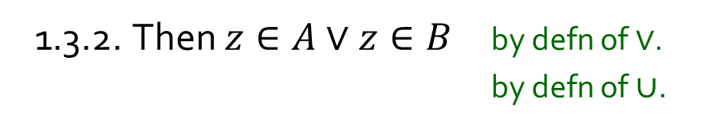


Q9. Let $A$, $B$ be sets. Show that $A⊆B$ if and only if $A∪B=B$.
Recall: $A⊆B ⇔ ∀z(z∈A⇒z∈B)$
1. (“Only if” / $⇒$)
To show $A∪B=B$, need to show$A∪B⊆B$ and $A∪B⊇B$.
1.1. Suppose $A⊆B$.
1.2. ($A∪B⊆B$.)
1.2.1. Let $z∈A∪B$.
1.2.5. In all cases, $z∈B$.
1.3. ($A∪B⊇B$.)
1.3.1. Let $z∈B$.
1.3.3. So $z∈A∪B$
1.4. Lines 1.2 and 1.3 imply $A∪B=B$ by defn of set equality.
1.3.2. Then $z∈A∨z∈B$ by defn of $∨$.
by defn of$∪$.
1.2.2. Then $z∈A$ or $z∈B$ by defn of $∪$.
1.2.3. Case 1: $z∈A$.
1.2.3.1. Then $z∈B$ as $A⊆B$ by 1.1.
1.2.4. Case 2: $z∈B$.
1.2.4.1. Then $z∈B$.
2. (“If” / $⇐$) …

Slide 18


Q9. Let $A$, $B$ be sets. Show that $A⊆B$ if and only if $A∪B=B$.
Recall: $A⊆B ⇔ ∀z(z∈A⇒z∈B)$
1. (“Only if” / $⇒$) …
2. (“If” / $⇐$)
2.1. Suppose $A∪B=B$.
2.2. We show that $A⊆B$ as follows.
2.2.1. Let $z∈A$.
2.2.4. Thus $z∈B$
2.2.2. Then $z∈A$ $∨$ $z∈B$ by definition of$∨$.
2.2.3. So $z∈A∪B$ by definition of $∪$.
as $A∪B=B$ by 2.1.
3. $∴$ $A⊆B$ if and only if $A∪B=B$ by lines 1 and 2.

Slide 19








Q10(a). For all sets $A$ and $B$, define $A⊕B=(A∖B)∪(B∖A)$.
Let $A=\{1,4,9,16\}$ and $B=\{2,4,6,8,10,12,14,16\}$. Find $A⊕B$.
$$A∖B=$$
$\left\{1,9\right\}$.
$$B∖A=$$
$\{2,6,8,10,12,14\}$.
$$A⊕B=$$
$\{1,2,6,8,9,10,12,14\}$.

Slide 20


Q10(b). For all sets $A$ and $B$, define $A⊕B=(A∖B)∪(B∖A)$.
Set Difference Law:
$A∖B=A∩\overline{B}$.
Show that $A⊕B=\left(A∪B\right)∖(A∩B)$ for all sets $A$, $B$.
$$A⊕B$$
$=\left(A∖B\right)∪(B∖A)$ by the defn of $⊕$;
$=(A∩\overline{B})∪(B∩\overline{A})$ by the Set Difference Law x2;
$=((A∩\overline{B})∪B)∩((A∩\overline{B})∪\overline{A})$ by the Distributive Law;
$=(A∪B)∩(\overline{B}∪B)∩(A∪\overline{A})∩(\overline{B}∪\overline{A})$ by the Distributive Law x2;
$=(A∪B)∩U∩U∩(\overline{B}∪\overline{A})$ by the Complement Law x2;
$=(A∪B)∩U∩U∩(\overline{B∩A})$ by De Morgan’s Law;
$=(A∪B)∩(\overline{B∩A})$ by the Identity Law x2;
$=(A∪B)∩(\overline{A∩B})$ by the Commutative Law;
$=\left(A∪B\right)∖(A∩B$) by the Set Difference Law.

Slide 21



Q11
False
1. It suffices to show its negation:
$$∀z∈S ∃x,y∈S z⩽\left|x−y\right|.$$
2. Take any particular but arbitrary $z∈S$.
3. Let $x=8$ and $y=−9$.
4. Then $x,y∈S$and
$$\left|x−y\right|=\left|8−\left(−9\right)\right|=17>z$$
True
1. $−1∈S$.
2. $\left|x−y\right|⩾0>−1$ for all $x,y∈S$.

Slide 22






Q12(a). For sets $A_{m},A_{m+1},…,A_{n}$, define $\bigcup_{i=m}^{n}{A_{i}}=A_{m}∪A_{m+1}∪…{∪A}_{n}$ and $\bigcap_{i=m}^{n}{A_{i}}=A_{m}∩A_{m+1}∩…∩A_{n}$.
Let $A_{i}=\left\{x∈ℤ :x⩾i\right\}$ for each $i∈ℤ$.
Write down $\bigcup_{i=2}^{5}{A_{i}}$ and $\bigcap_{i=2}^{5}{A_{i}}$ in roster notation.
$$\bigcup_{i=2}^{5}{A_{i}}=$$
$$\bigcap_{i=2}^{5}{A_{i}}=$$
$$\left\{2,3,4,…\right\}.$$
$$\left\{5,6,7,…\right\}.$$

Slide 23




Q12(b) Let $B_{1},B_{2},…,B_{k},C_{1},C_{2},…,C_{ℓ}$ be sets such that $\bigcup_{i=1}^{k}{B_{i}}⊆$ $\bigcap_{j=1}^{ℓ}{C_{j}}$.
For sets $A_{m, }A_{m+1},…,A_{n}$, define $\bigcup_{i=m}^{n}{A_{i}}=A_{m}∪A_{m+1}∪…{∪A}_{n}$ and $\bigcap_{i=m}^{n}{A_{i}}=A_{m}∩A_{m+1}∩…∩A_{n}$.
Show that $B_{i}⊆C_{j}$ for all $i∈\left\{1,2,…,k\right\} and all j∈\{1,2,…,ℓ\}$.
1. Let $B_{1},B_{2},…,B_{k},C_{1},C_{2},…,C_{ℓ}$ be sets such that $\bigcup_{i=1}^{k}{B_{i}}⊆$ $\bigcap_{j=1}^{ℓ}{C_{j}}$.
2. 2.1. Let $r∈\left\{1,2,…,k\right\} \text{and} s∈\{1,2,…,ℓ\}$.
2.2. Take any $z∈B_{r}$.
2.7. In particular, we know that $z∈C_{s}$
3. So $B_{i}⊆C_{j}$ for any $i∈\left\{1,2,…,k\right\} and any j∈\{1,2,…,ℓ\}$.
2.3. Then $z∈B_{1}$ or $z∈B_{2}$ or … or $z∈B_{k}$ by defn of “or”, as $r∈\left\{1,2,…,k\right\}$.
2.4. So $z∈B_{1}∪B_{2}∪…∪B_{k}=\bigcup_{i=1}^{k}{B_{i}}$ by defn of $∪$ and ⋃.
2.5. Hence $z∈\bigcap_{j=1}^{ℓ}{C_{j}=C_{1}∩C_{2}∩…∩C_{ℓ}}$ as $\bigcup_{i=1}^{k}{B_{i}}⊆\bigcap_{j=1}^{ℓ}{C_{j}}$ by line 1.
2.6. Thus $z∈C_{1}$ and $z∈C_{2}$ and $…and z∈C_{ℓ}$ by defn of $∩$.
as $s∈\left\{1,2,…,ℓ\right\}$.

Slide 24
THE END

