Slide 1
Part 3

Slide 2
Goal: To test if estimated parameters in RLWM are reliable predictors of stable learning strategies.
1. Do a real replication study using the same experiment and models with a new group of people.
3. Change the models:
Increase the likelihood that WM would be used for easier conditions.
Increase load by providing a “Richer” experience of stimuli by defining more (overlapping) features (color, subject, orientation etc.)
Slower RL by altering parameter range?
2. Change the task:
Discourage WM use – what’s left when WM can’t be used?
dynamic ISI
Discourage declarative learning for some blocks.
Utilize difficult stimuli (stars?)
Detect RL vs LTM use by flipping associates.
4. Predict performance in a new task +:
Weather Prediction Task or others
- Perhaps collect new data with additional tasks (span tasks, e.g.)
- New expanded range of RLWM parameters

Slide 3
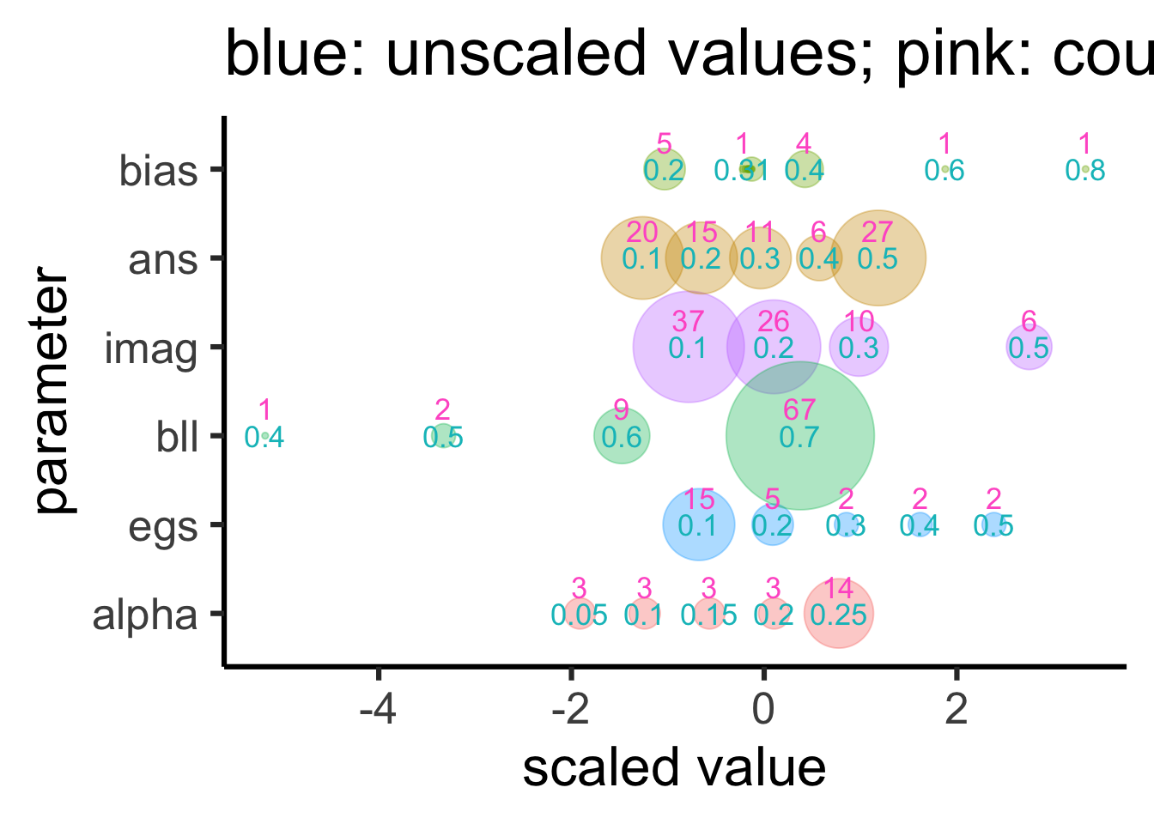
Estimated parameters in Exp 1
Participant counts
% RL used integrated models
Unscaled parameter values
LTM noise
Spreading act. (WM)
LTM decay rate
RL decision noise
RL learning rate
Notes:
Decision point here:Should we expand the parameter space and fit again?

Slide 4
Goal: To test if estimated parameters in RLWM are reliable predictors of stable learning strategies.
Available data:
Experiment | n
RLWM | 83
PSS | 60 (stag +uclimb)
Weather Prediction | 35 (stag)
N-back | 60 (stag +uclimb)
Span Tasks | 48(realm + uclimb)
Artificial Grammar | 35 (stag)
All-UCLIMB | 25 (uclimb)
ACT-R Models that exist in some form:
- SPAN and N-back (Lovett et al.)
- PSS (Stocco et al.)
- Weather Prediction (TheT3ddy)
Perhaps we could use all four tasks to test the reliability of
Working memory function/parameters
Reinforcement Learning function/parameters
LTM function/parameters
Note: probably fit all RLWM subjects to an integrated model to estimate both RL and LTM parameters.
Notes:
We can collect new data

