Slide 1
Goals and hypotheses:
The goal of this project is to explain individual learning mechanisms by measuring learning strategies and relating them to varying task or learner characteristics.
Given that all learners have multiple learning strategies available, what are the conditions that lead to deployment of a specific strategy?
Individual differences in strategy deployment are driven by:
Individual cognitive capacities: E.g., WM capacity, LTM decay-rate
Individual meta-learning strategy: E.g., assessment of recent success or failure.
Individual prior knowledge and experience: E.g., expertise or general world knowledge
Interaction with task characteristics :E.g., difficulty, novelty and complexity

Slide 2
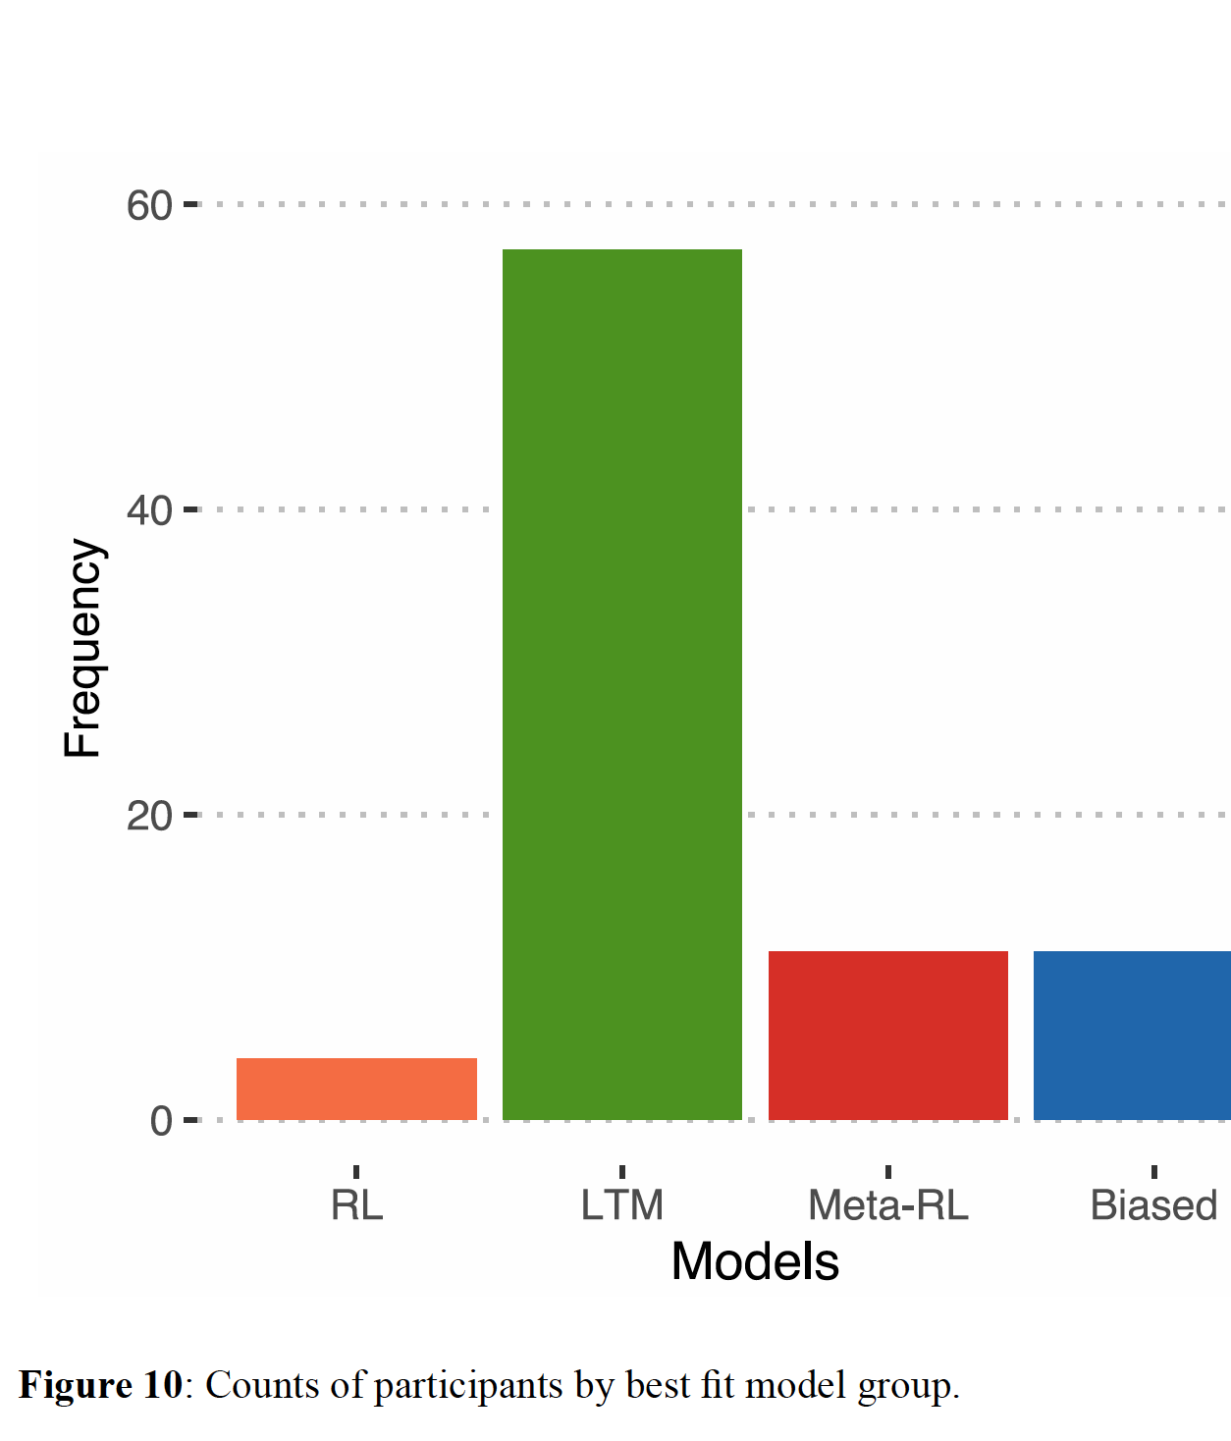
Results from Ex-1
RLWM
We have shown that:
Different learners use different strategies to learn even a simple task.
For the RLWM task, a declarative LTM strategy was most popular with our sample.

Slide 3
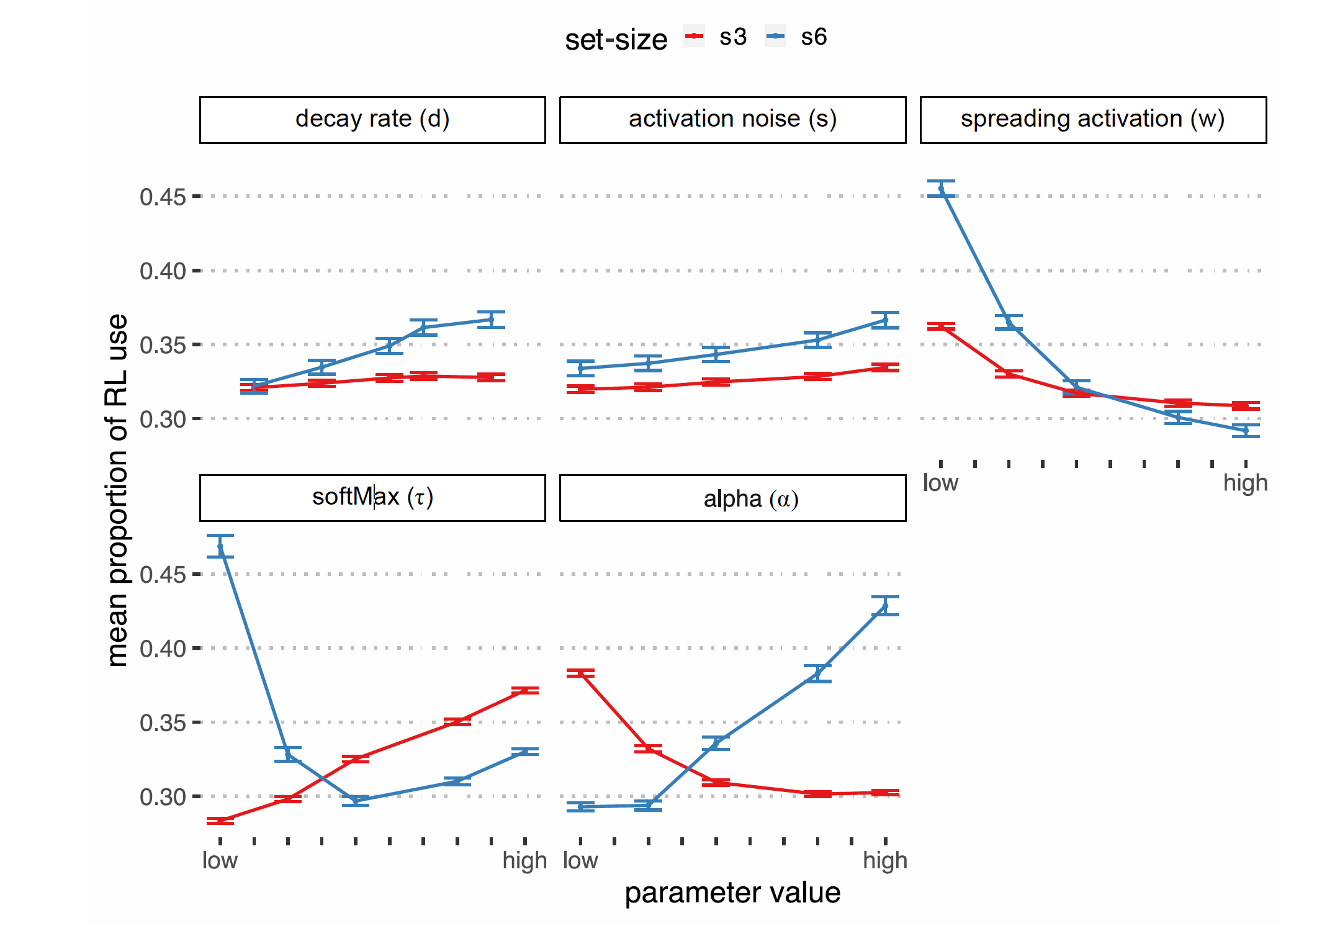
Results from Ex-1
model simulations show that different strategies were preferred for different task conditions depending on changing parameter values which suggests that:
Learning characteristics are affected by cognitive characteristics.
Individual cognitive capacities interact with task demands.
Meta-learning model.

Slide 4
Outstanding questions for Ex-2:
How sensitive are our models and model-fitting procedures in revealing individual strategy use?
Can they detect changes with learning?
Can they detect changes with task demands?
Is strategy selection stable or dynamic in a learner?
Is the task diagnostic enough to differentiate RL from LTM?
Approach:
Part 1: Split the data in half and fit models.
Part 2: Split the data in half and fit set-size 3 and set-size 6 separately.

Slide 5
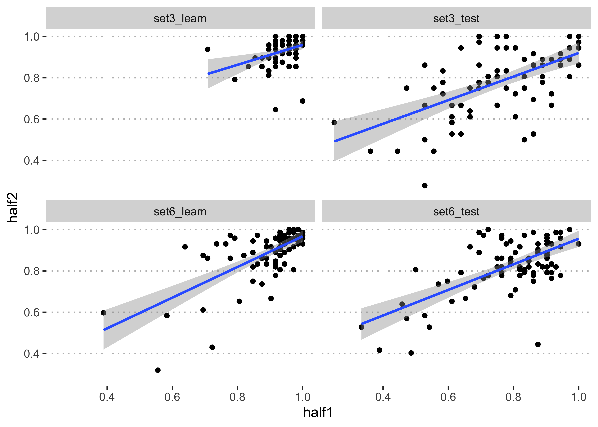
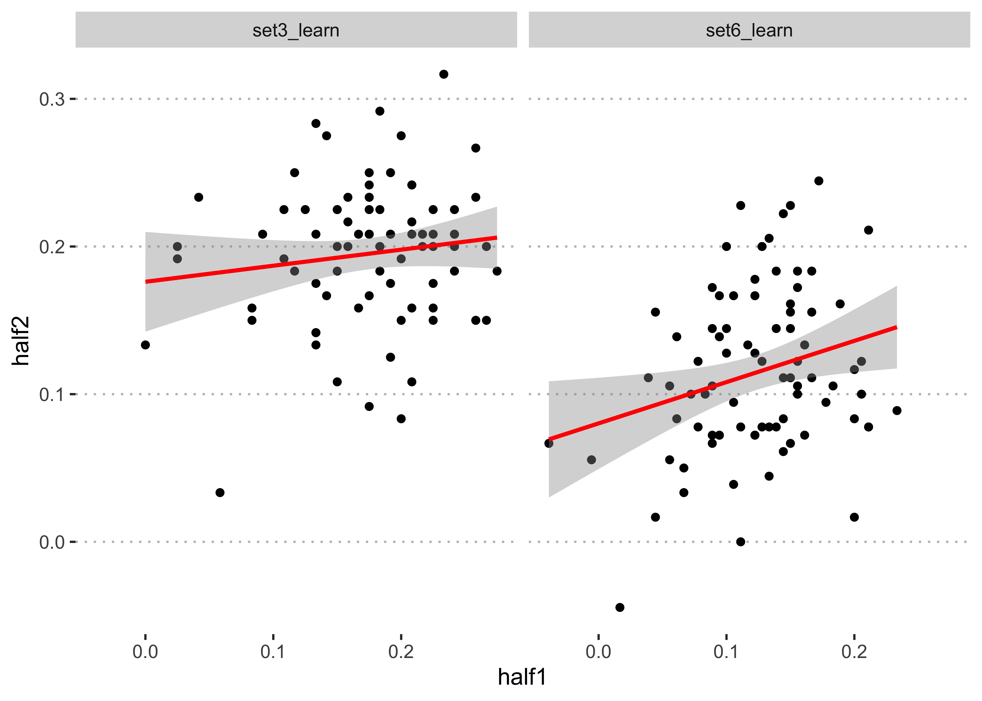
Summary of H1 vs H2 behavioral findings:
Correlations of outcomes: learn and test accuracies
r=0.34**
r=0.57**
Correlations of learning rate
r=0.13
r=0.26*
r=0.67**
r=0.65**
*0.05 **0.01
Differences between the halves are not significant, p=0.33
Notes:
On the surface on average, behavior in the two halves seem similar, at least when considering final learning outcomes.
But we can't say that people are doing the same thing in the two halves
There are a lot of features to consider here, and The specific value in the modelling approach is that it considers all these properties at once.

Slide 6
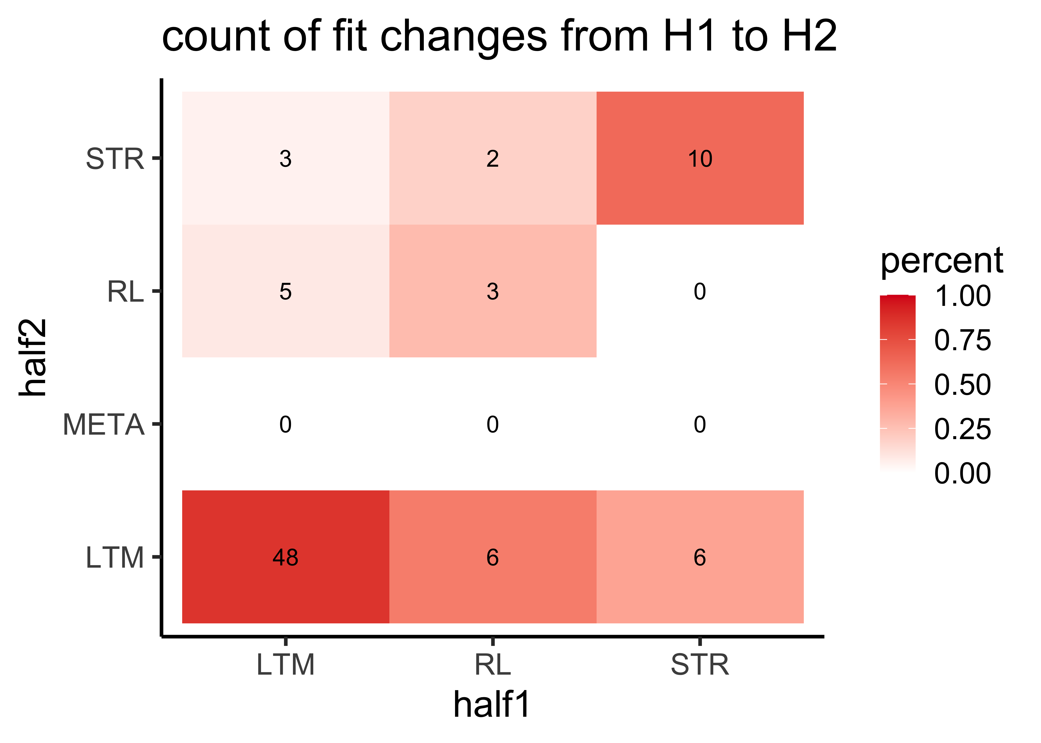
How sensitive are our models and model-fitting procedures in revealing individual strategy use?
Can they detect changes with learning (split the data in half)?
55.4% of participants have halves 1 and 2 that fit the same model as in Exp1.
Of the remaining 44.6 % (n=37):
13.5% of participants, fit the same models for half 1 and Exp1 and,
24.3% for the second half and Exp1.
35.1% have both halves that are different from Exp1.
Totals:
15
8
0
More people in general fit LTM.
44% of those that fit RL and STR in half 1, fit LTM in half 2.
This piece suggests that our modelling approach comes to the same broad conclusions as in Exp1, for this group, on this task.
60
Totals: 56 11 16
Notes:
Perhaps, models are better than looking at behavior alone.
Perhaps we are picking up changes in individuals - but do we know if this is sensitivity of models or learning dynamics?

Slide 7
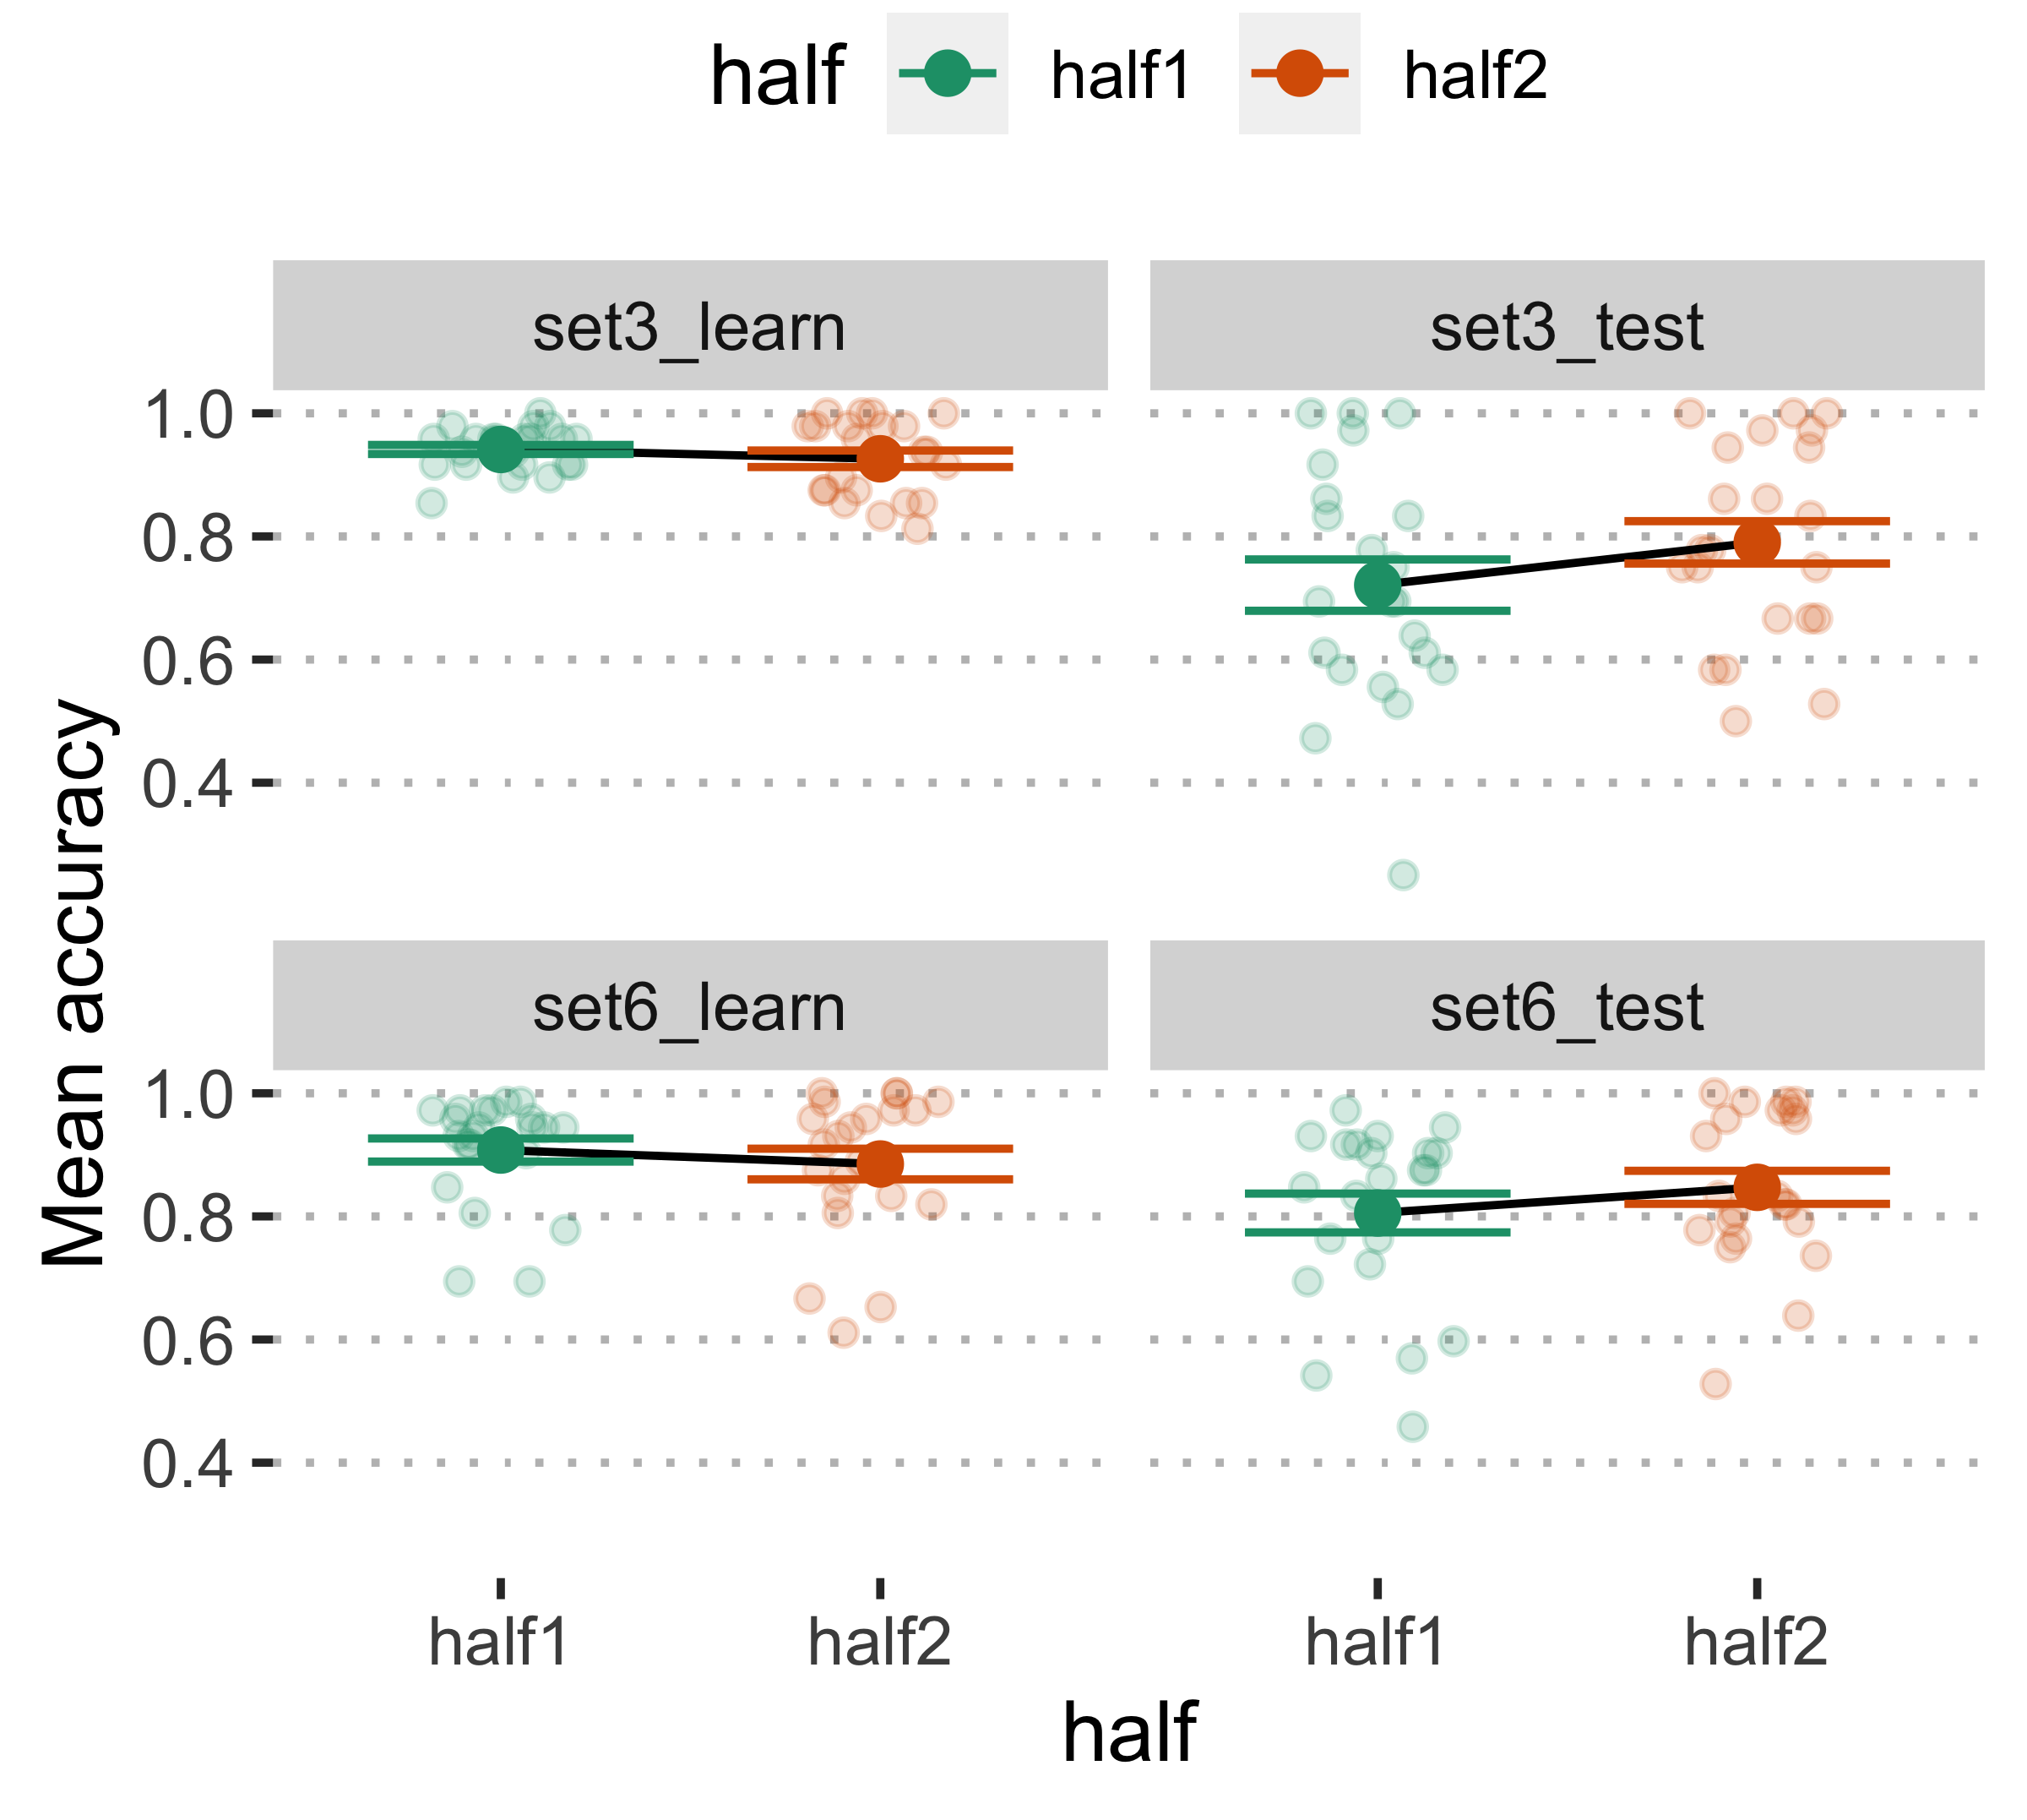
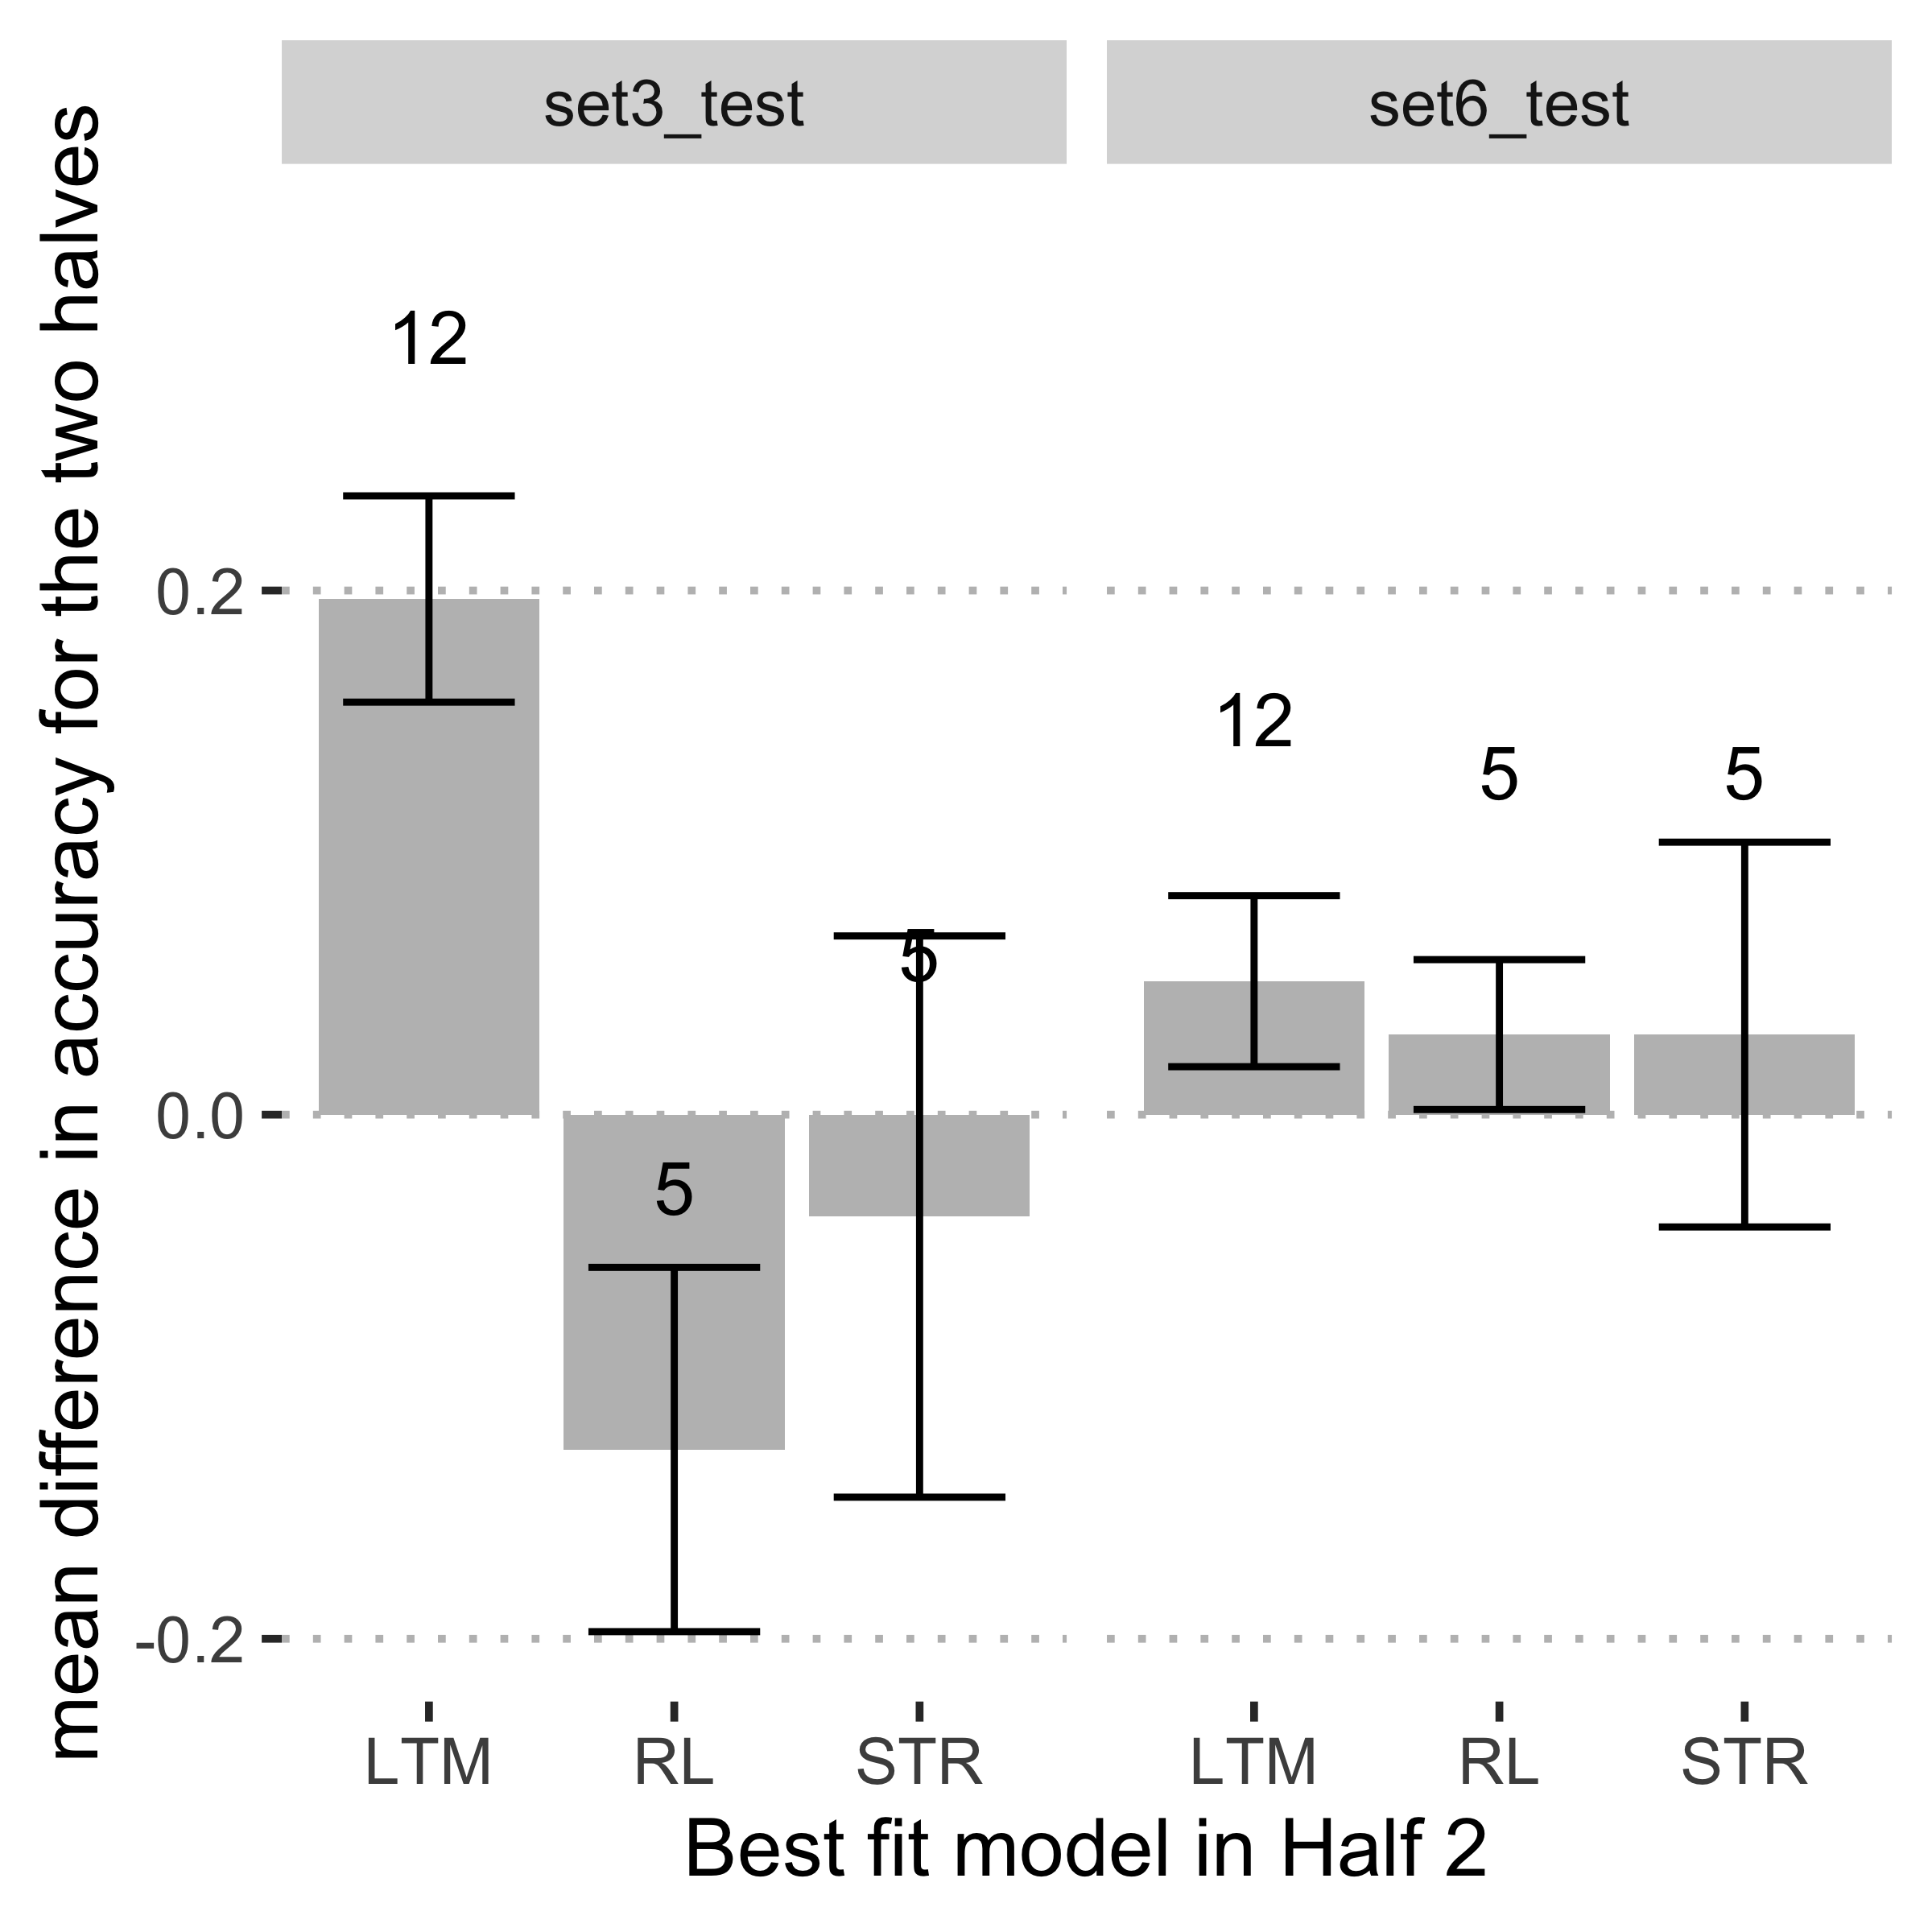
Learning outcomes for those participants who fit different models in H1 and H2 (n = 22).
How sensitive are our models and model-fitting procedures in revealing individual strategy use?
Are these differences reflected in learning outcomes?
Test accuracy marginally improved for most people in the second half.
Model fitting procedure might be more sensitive to measuring learning mechanisms than learning accuracies.
LTM seems to lead to more success, but we don’t know about individual characteristics. Why would someone settle on LTM vs the others?
All pairwise t-tests are p > 0.2

Slide 8
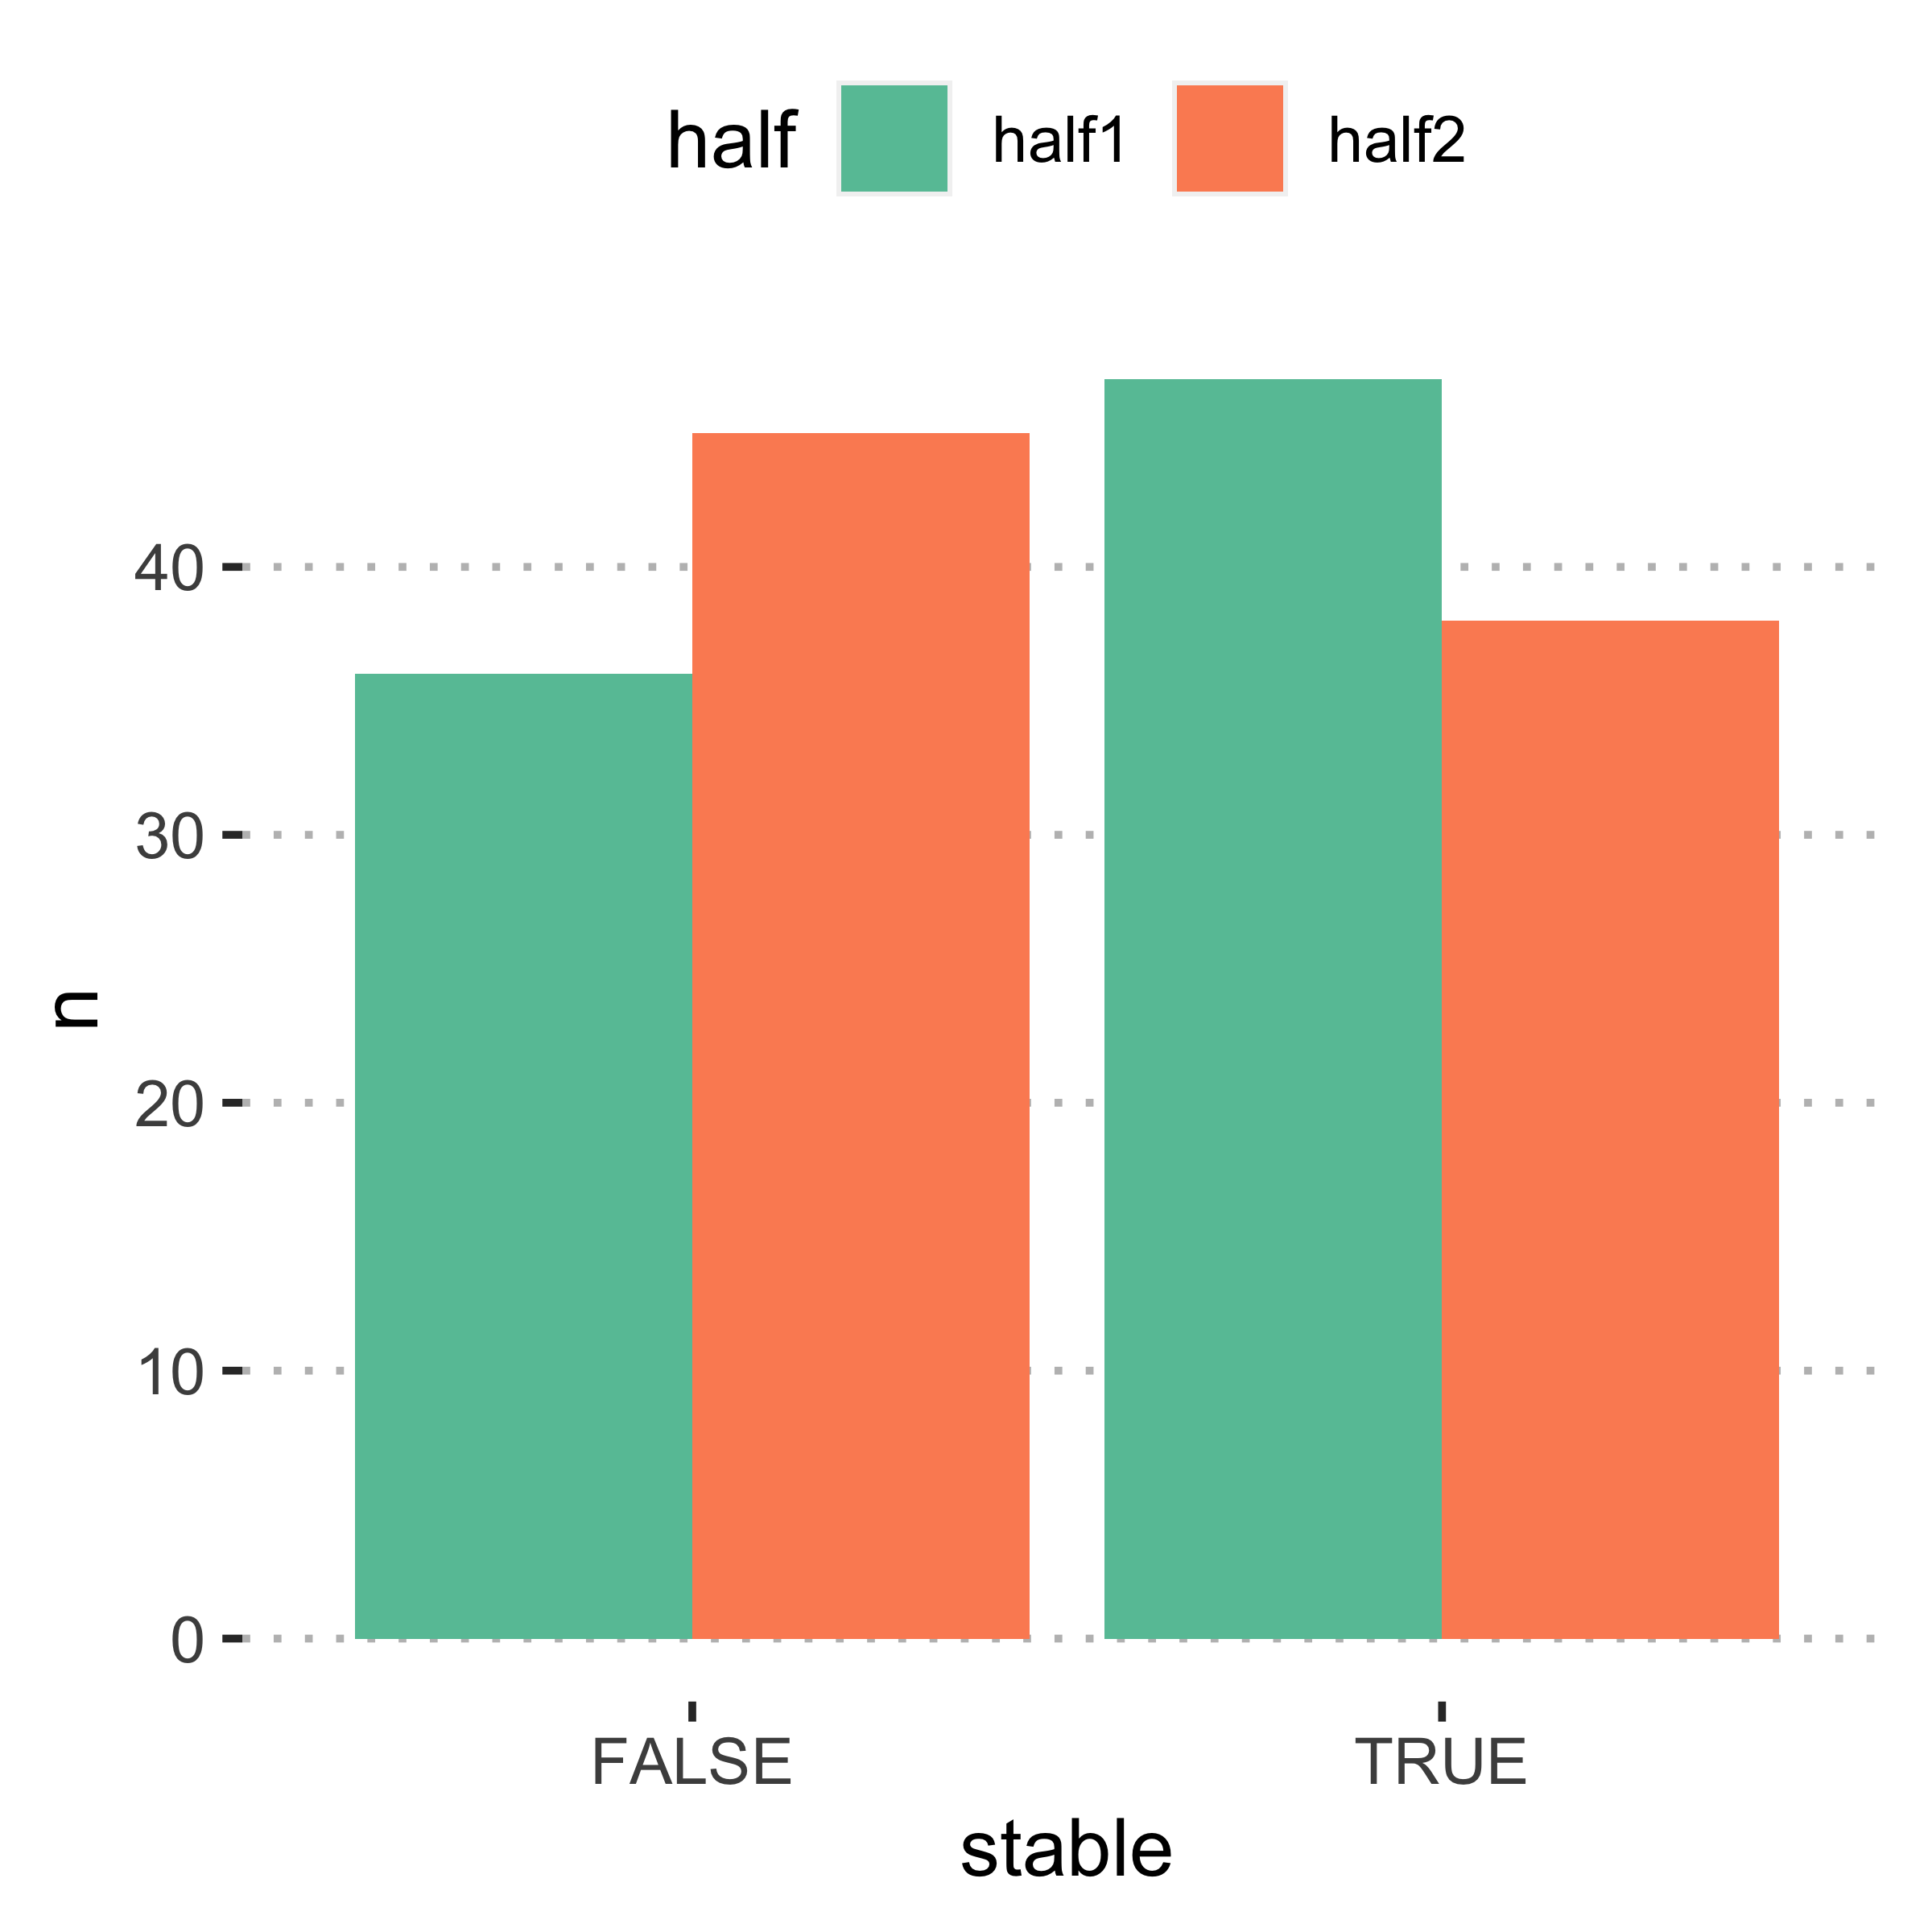
Part 2: Fit 3 and 6 separately.
b. Can they detect changes with task demands?
More people in the second half fit different models for set 3 and set 6 than the first half.
Fit different models
Fit same models
Set-3 vs set-6 fits
Notes:
This is a summary of the counts but what does it mean?

Slide 9
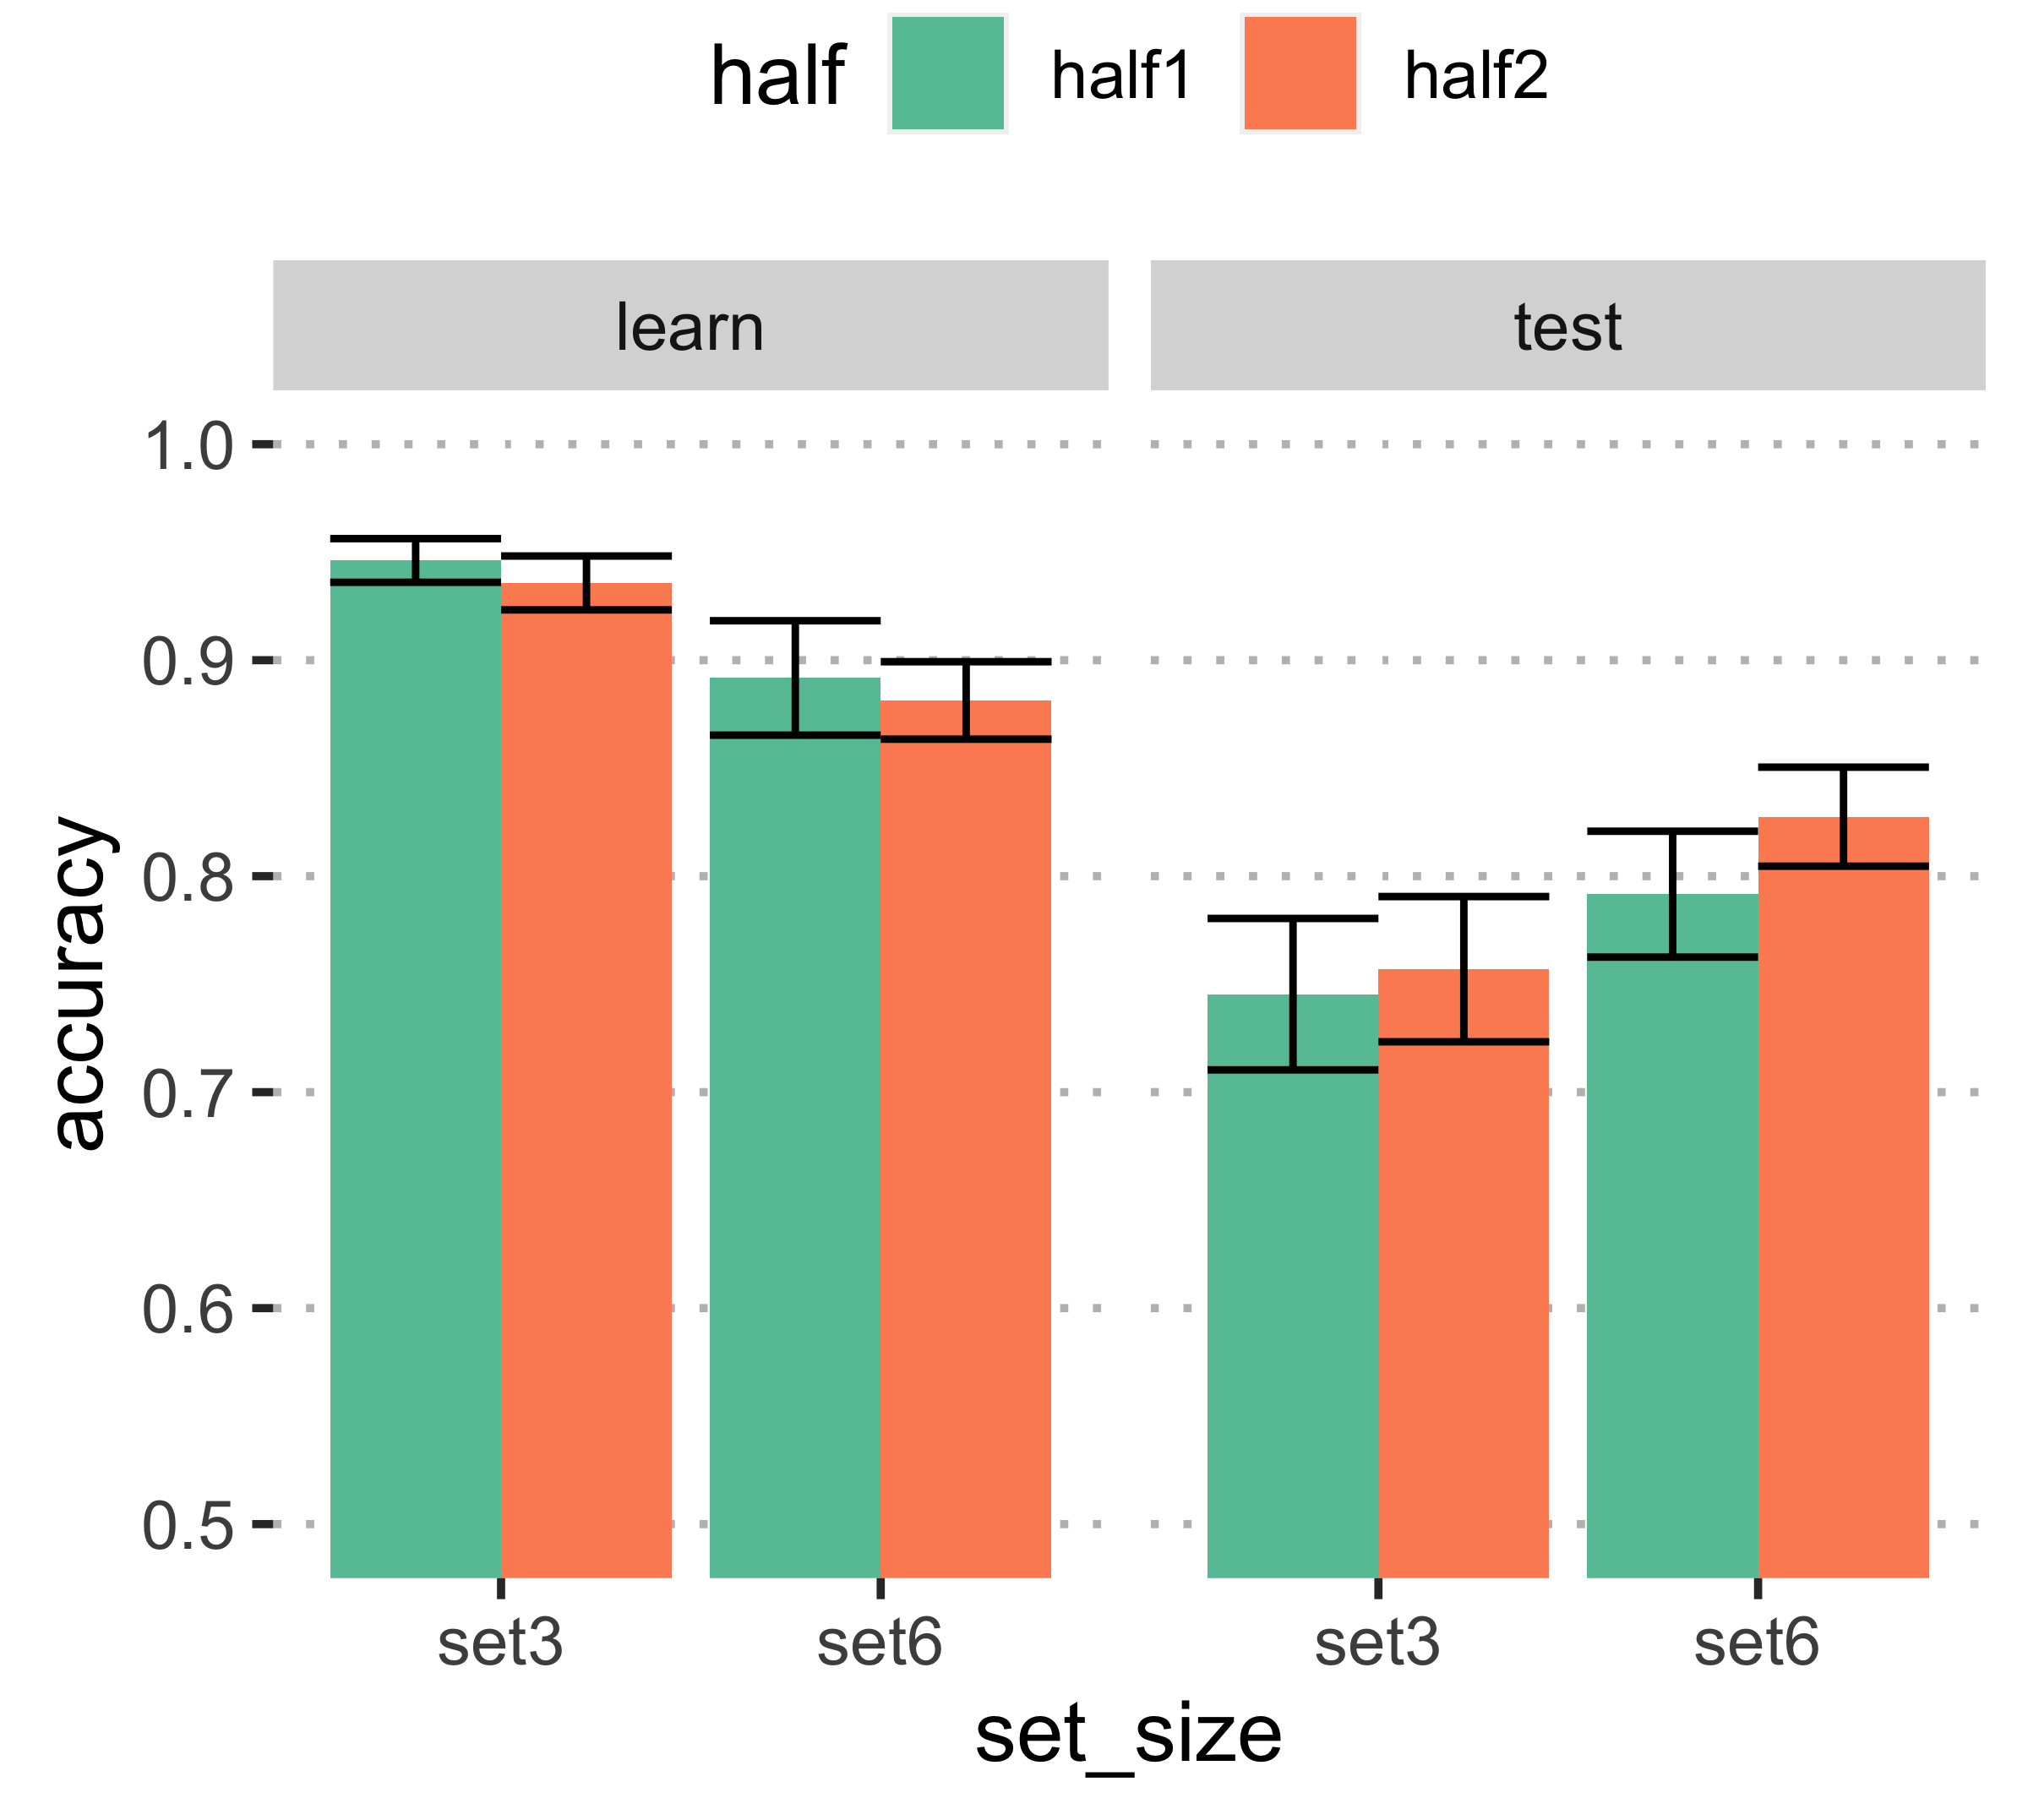
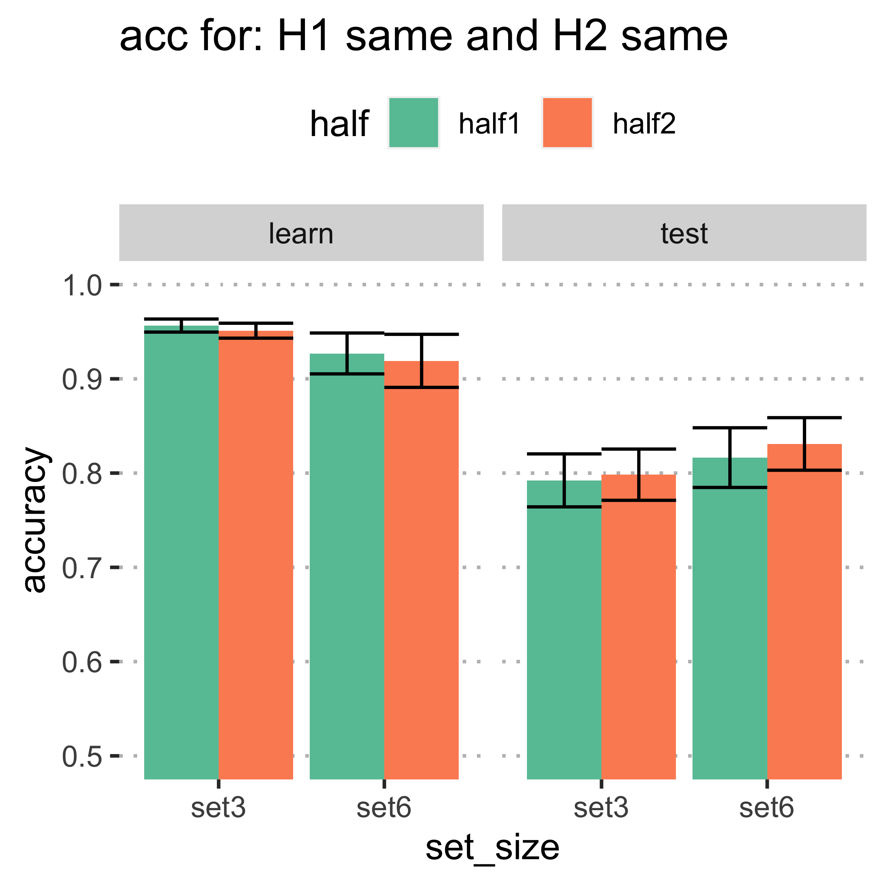
b. Can they detect changes with task demands?
Regardless of model type, learning outcomes seem to be similar both between the set-sizes and halves. However, this is not split up by model type.
To compare, here are accuracies for subjects who fit the same models for s3 and s6 in both halves. Note that this doesn’t mean that both halves have the same models.
Learning outcomes for subjects who fit the same models in H1 but different models in H2 for s3 and s6

Slide 10
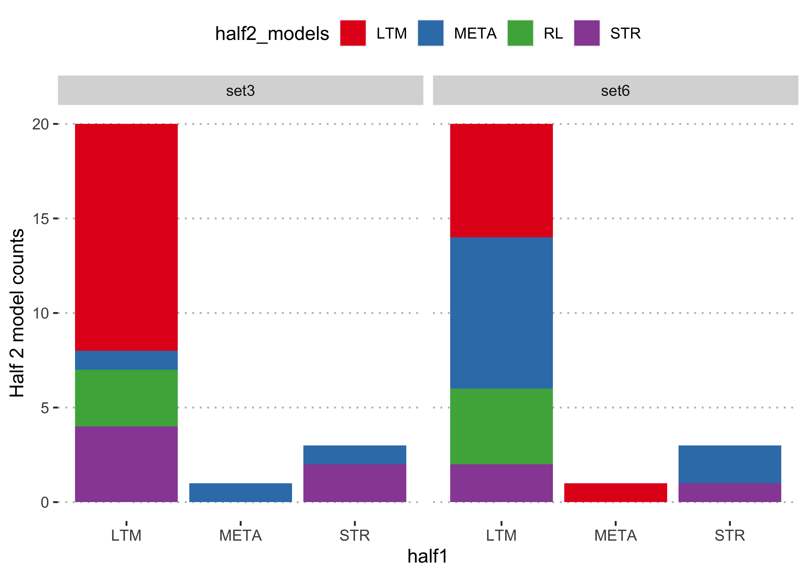
Analysis by model: For those subjects who fit the same models in H1 but different models in H2 for s3 and s6, which models fit them best in half 2?
Does this align with what Collins’ theory expects?
More people fit LTM in set-3 than in set-6. And marginally more people fit RL for set-6 than set-3.

Slide 11
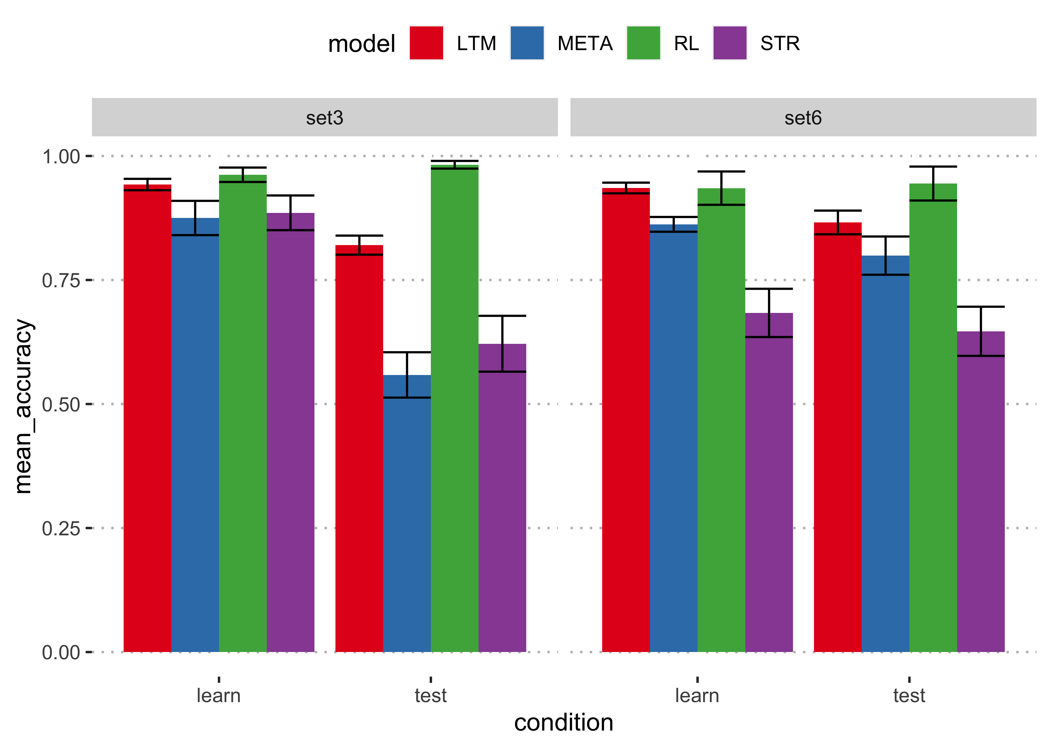
Analysis by model: For those subjects who fit the same models in H1 but different models in H2 for s3 and s6, what were learning outcomes affected?
As far as I can tell this pattern is not different for the learners who fit the same models for the set-sizes in both halves.
NOTE: there are minor errors here that I have to figure out (counts don’t match the plot in the previous slide)

Slide 12
Is the task diagnostic enough to differentiate RL from LTM?
We already know that:
For each condition in the task, there exists a model with an optimal set of parameters that results in good learning outcomes. Therefore, the task can be learned with both RL and LTM mechanisms.

