Slide 1
Goal: More reliably detect interactions between individual effects and task demands

Slide 2
Changes to the task:
Discourage WM use – what’s left when WM can’t be used?
dynamic ISI
Discourage declarative learning for some blocks.
Utilize difficult stimuli (stars?)
Detect RL vs LTM use by flipping associates.
Changes to the models:
Increase the likelihood that WM would be used for easier tasks.
Increase load by providing a “Richer” experience of stimuli by defining more (overlapping) features (color, subject, orientation etc.)
Slower RL by altering parameter range?

Slide 3






Difficile:
38
Size
35
32
Color

Slide 4
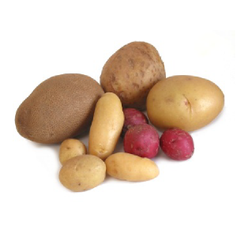
Half 1
Learning Blocks
Set-size
3 A stable | 6 A flip | 3 B stable | 3 A flip | 6 B flip | 3 B flip | 6 A stable
6 B stable | 3 A stable | 3 B stable | 6 A flip | 3 A flip | 6 B stable | 3 B flip
category
Associate
reliability
Half 2

