Slide 1
Integrated Platform
for
Autonomic Computing
IPAC
2008

Slide 2
Integrated Platform for Autonomic Computing (IPAC)
What we will see
IPAC Introduction
Components and Component Description
Design and Future Ideas
Challenges

Slide 3
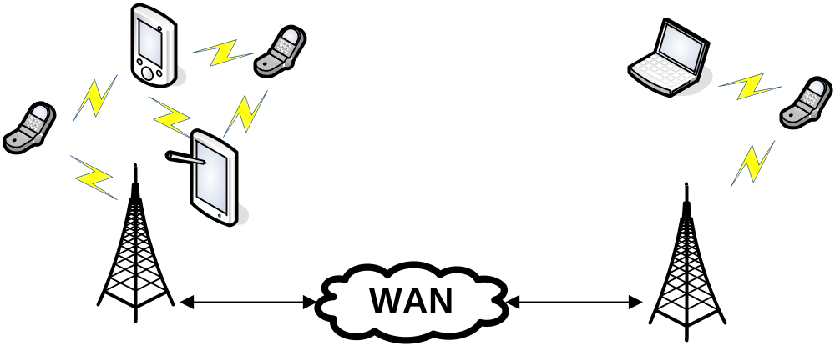
Integrated Platform for Autonomic Computing (IPAC)
IPAC introduction and requirements
Middleware and Service Creation platform of mobile nodes
Communication’s state of the art platform
Enabling intelligent context-aware mobile applications
Integration with sensors

Slide 4
Integrated Platform for Autonomic Computing (IPAC)
IPAC introduction and requirements
Characteristics
Very large scale system Non predictable number of
entities
Amorphous dynamic structures/behaviors P2P architecture, entity mobility
Heterogeneous entities differ dramatically in
hardware, applications and
behavior
Unreliable and Insecure environment Components, communication

Slide 5
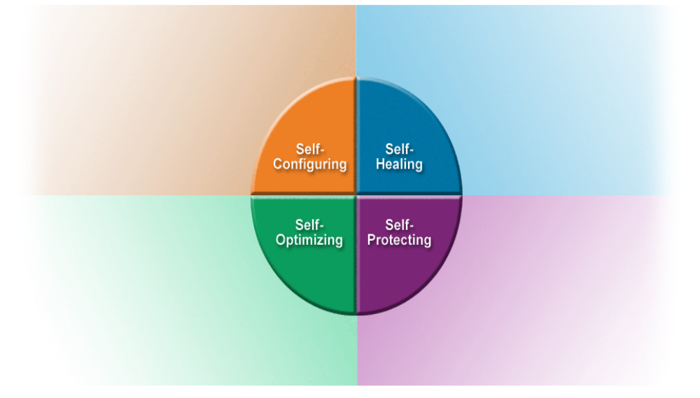
Integrated Platform for Autonomic Computing (IPAC)
IPAC introduction and requirements
Requirements
Autonomic computing
  Fully Adaptable (self-CHOP)
  Self-manageable
  Self-Descriptive
Application creation component
Cope with:
  Very large scale Ad hoc
  p2p dynamic structures
  Unreliable communication
  Unreliable components

Slide 6
Integrated Platform for Autonomic Computing (IPAC)
IPAC introduction and requirements
Requirements (Cont.)
Intelligent, Reliable and Secure communication enabled platform
  Nodes
    Relaying nodes
    End Nodes
  Encryption, Digital signature-Certificate and Authentication schemes
  Limit redundant transmissions
    Intelligent sort distance information dissemination, flooding, epidemical dissemination, etc.
Context awareness
Collaborative behavior
Application relevant
Punish non collaborating nodes

Slide 7
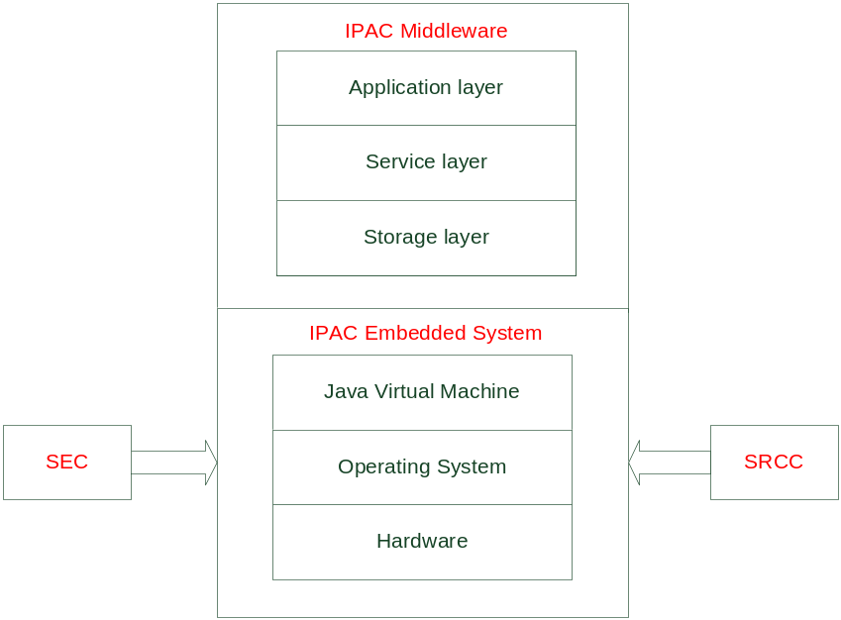
Integrated Platform for Autonomic Computing (IPAC)
Components and component description
Relaying
and end nodes
different only in application existence
at application layer
Application Creation
component
IPAC middleware:
  Runtime environment for user applications to run, implementing business logic.
  Service layer where dispatching modules-services, mediation services, coordination services.
  Storage layer where service and application layers can save data and messages

Slide 8
Integrated Platform for Autonomic Computing (IPAC)
Components and component description
Application Creation
component
Sensor Elements Component:
Drivers for WiseNode sensor platforms (currently temperature and 2D accelerator –Not enough for system’s requirements-)
Fuzzy Logic (FL) and probabilistic reasoning to protect from measurement variance.
Measurement Feedback
Wireless Sensor’s API

Slide 9
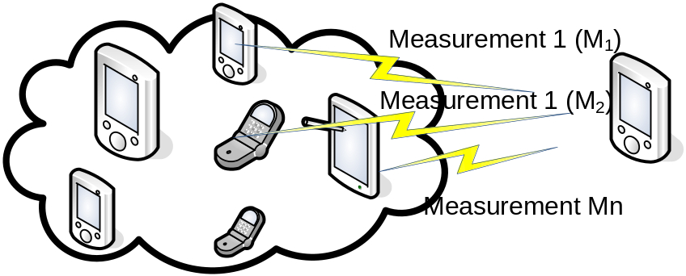

Integrated Platform for Autonomic Computing (IPAC)
Components and component description
Sensor Elements Component
- Intelligent combined measurements -
M
n different measurements {M_{1,}M₂,… M_{n}} of one environmental characteristic.
M_{k} measurement differs a lot!!!
Solution:
M= M_{k} ignored, may be malfunction or hostile
K mobile platform informed

Slide 10
Integrated Platform for Autonomic Computing (IPAC)
Components and component description
Sensor Elements Component
- Intelligent combined measurements -
Autonomous tuning,
Autonomous configuration
Silencing measurements
Intelligent but simple
Protection
using received
Information from
multiple nodes
M
Healing weight=
M_{k}-M

Slide 11
Integrated Platform for Autonomic Computing (IPAC)
Components and component description
Application Creation
component
Sort Range Communication Component
Combination of the following:
    ZigBEE
    Dedicated Short Range Communication
    Bluetooth
Applications will decide which
SRCC component to use.

Slide 12
Integrated Platform for Autonomic Computing (IPAC)
Components and component description
Application Creation
component
Application Creation Component
Open application programming Platform
    Development Environment
    Emulation Environment
    Integration with IDE, i.e. NetBeans
    Rapid development → Component and service built applications
    Middleware stack and sensing component emulation

Slide 13
Integrated Platform for Autonomic Computing (IPAC)
Discovering procedure
  Nodes, know, adjusted nodes and their applications, thus, communication policies can be applied.
Application Message format
  Concrete message format i.e. as below will be used.
Message size | short
Application id | Integer
To | IMEI
From | IMEI 16-byte hash
Timestamp | double
Lat, long, alt | Double
flags | Integer
data | Byte[]
Module use in service and application layer
Concrete format allows message dispatching and easy module component architecture
…
String size | short
String | Selected encoding
…

Slide 14
Integrated Platform for Autonomic Computing (IPAC)
Challenges
  Peer to peer connections in mobile devices are highly unstable
  Information management complicated
Thank you

