Slide 1
Smart Seat Occupancy and Safety System
MAE 6291 - Midterm Project
Eliot Hunter, MAE

Slide 2
Introduction & Motivation
Key points:
Ensure seat is occupied
Ensure occupant is authorized
Ensure environment is safe
Inform supervisor of occupant presence/device subversion
Motivations:
Allows lab manager to better monitor graduate students
Allows graduate students to protect seats/desks
Ensures safe, clean environment for student/neighbors
Goals and Expectations:
The concept arose from the want to employ certain systems in a project, and the best use case was for personnel verification.
The goal is to have a tool that professors could use to manage their lab and ensure timeliness/working hours in an ethical manner.

Slide 3
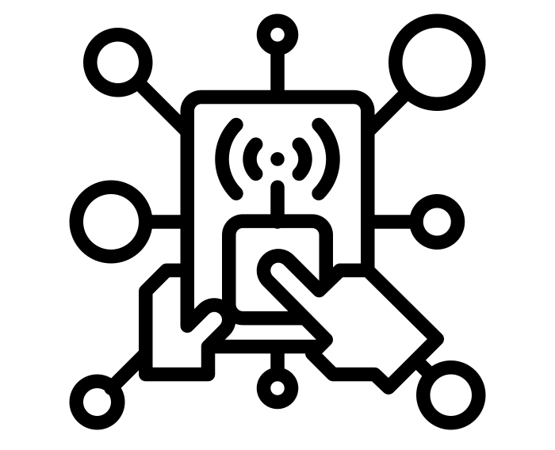


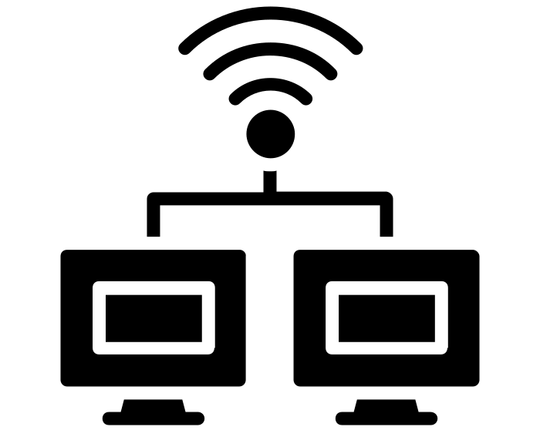
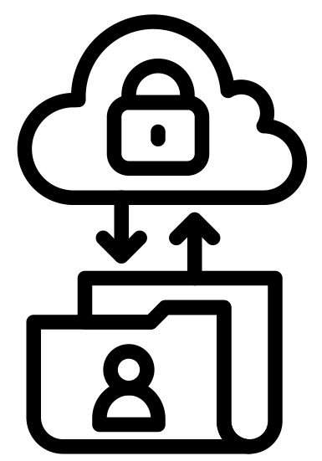




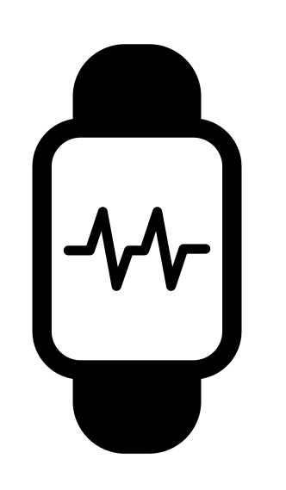
Model correlation
Interface-layer
The Interface layer is represented by the button, buzzer, and personnel deterrent.
The Service layer is the emails received by the professor and students determining seat occupancy.
The Network layer is the interconnections required to send emails.
The Sensing layer is composed of the ultraviolet and gas sensors to determine occupancy and environmental quality.
Service-layer
Network-layer
Sensing-layer

Slide 4
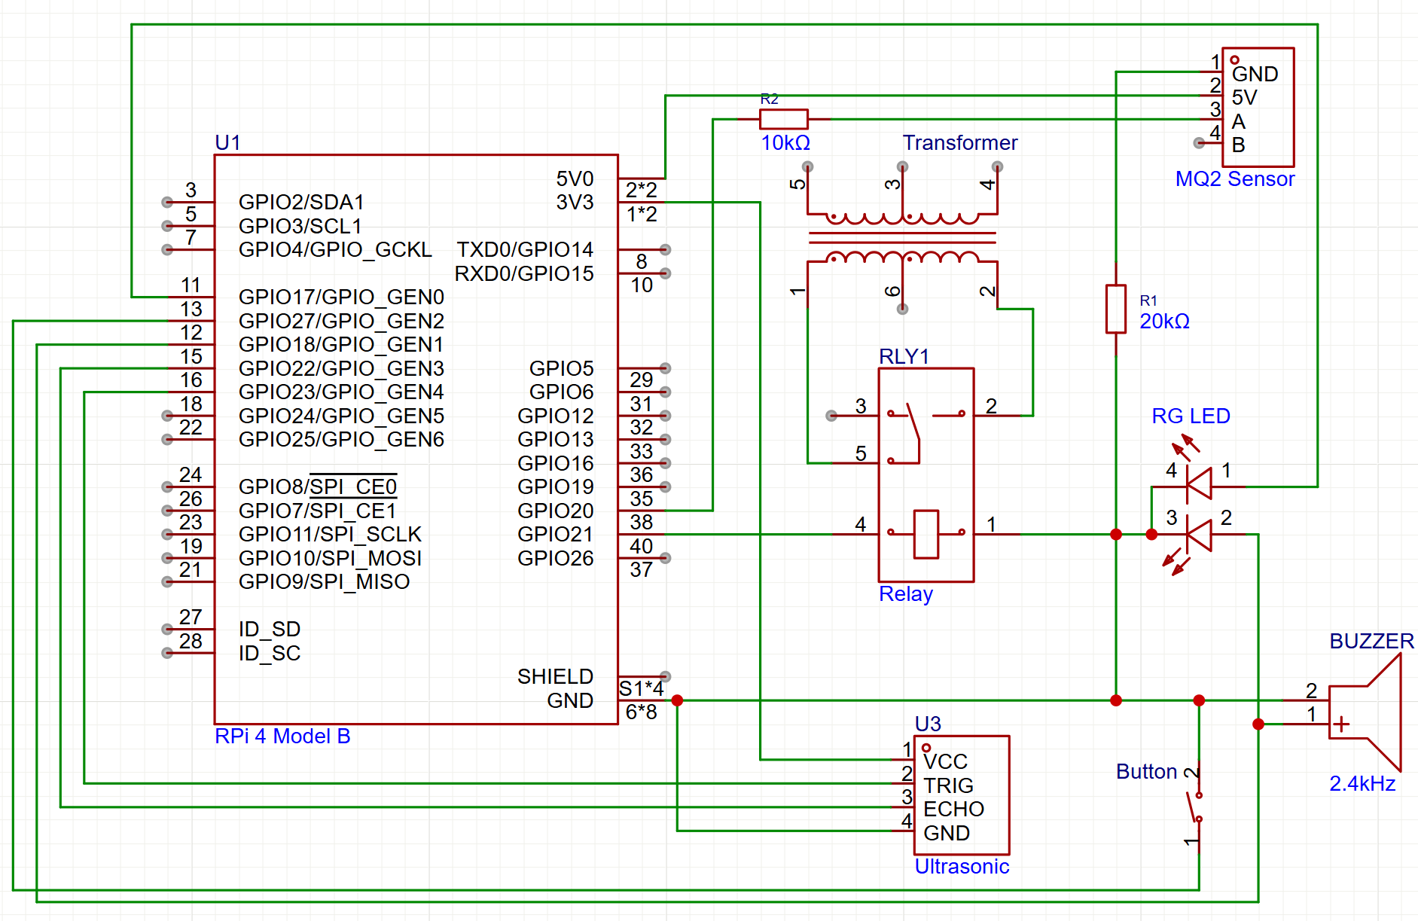
Materials and Methods
Materials & Hardware:
Raspberry Pi 4 Model B
Wi-Fi Protocol
Sensors: Gas | Ultrasonic
Notifiers: LED | Active Buzzer
Physical: Button | Deterrent
App Development:
Python & GPIO Library
Yagmail Communication Library

Slide 5
Conclusions and Demonstration
The project functions as intended, however some modifications had to be made for simplicity. For instance, due to the lack of a camera module, the verification solution would have to be a secret button. Originally, the ultraviolet sensor was a knock sensor, however it was largely inaccurate and could not detect continued occupation. However, the deterrent method, emailing system, and LED/Active buzzer systems worked well.
In conclusion, goals were met, and the steps moving forward are clear. A productivity enhancement option, such as a keylogger with an AI observer connected to the deterrent method, could also be added in future iterations.

Slide 6
Questions?
THANK YOU
Eliot Hunter
ehunter25@gwu.edu
www.EliotHunter.com

