Slide 1
GPT4 Turing Tumble
Romania 2025

Slide 2
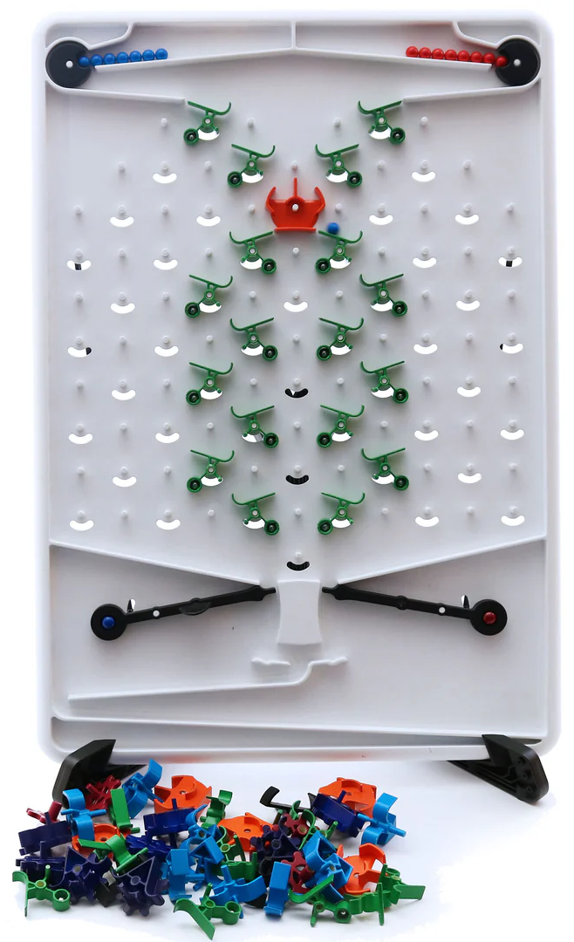
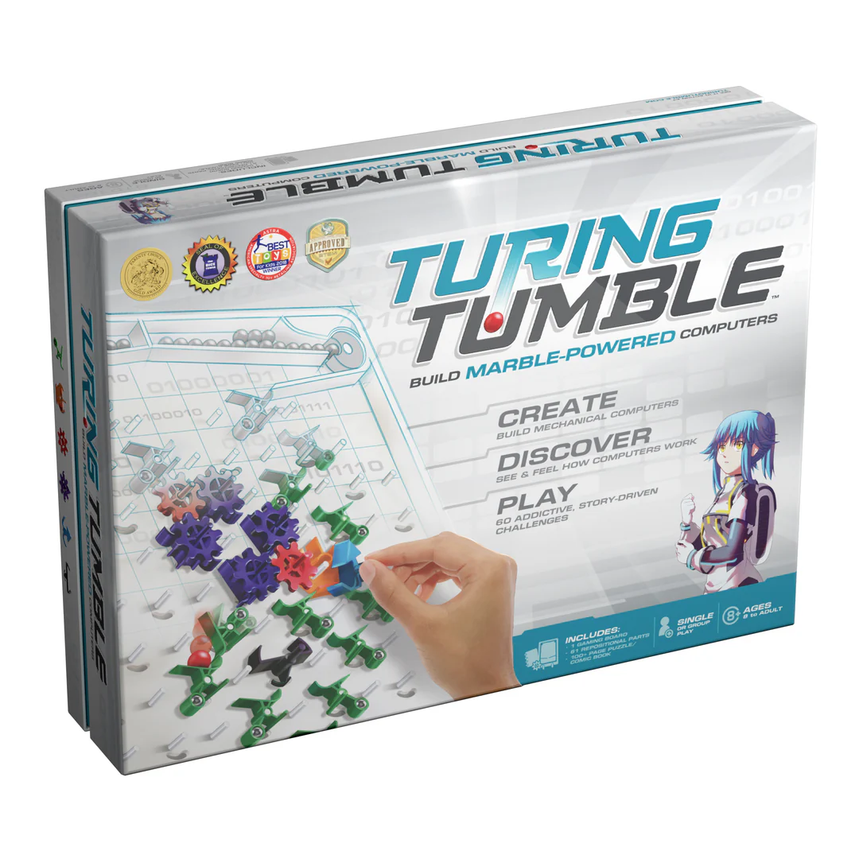
What is Turing Tumble
Board game
Helps players understand basic computing and the underlying algorithms

Slide 3
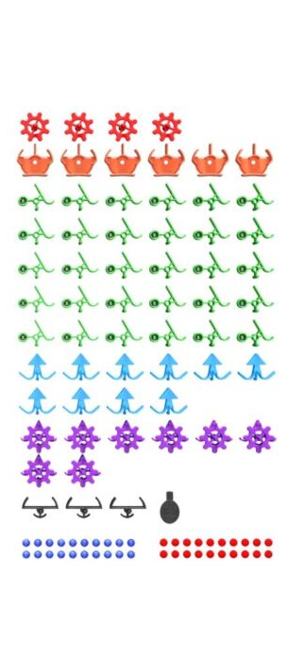
What is Turing Tumble
Different parts to use on the board
Different functionalities and uses
Everyone can create their own algorithms
Challenges from the game

Slide 4
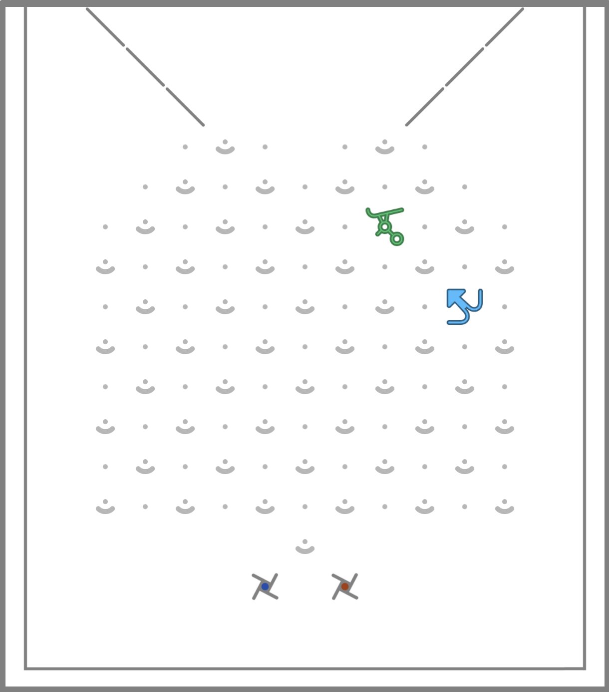
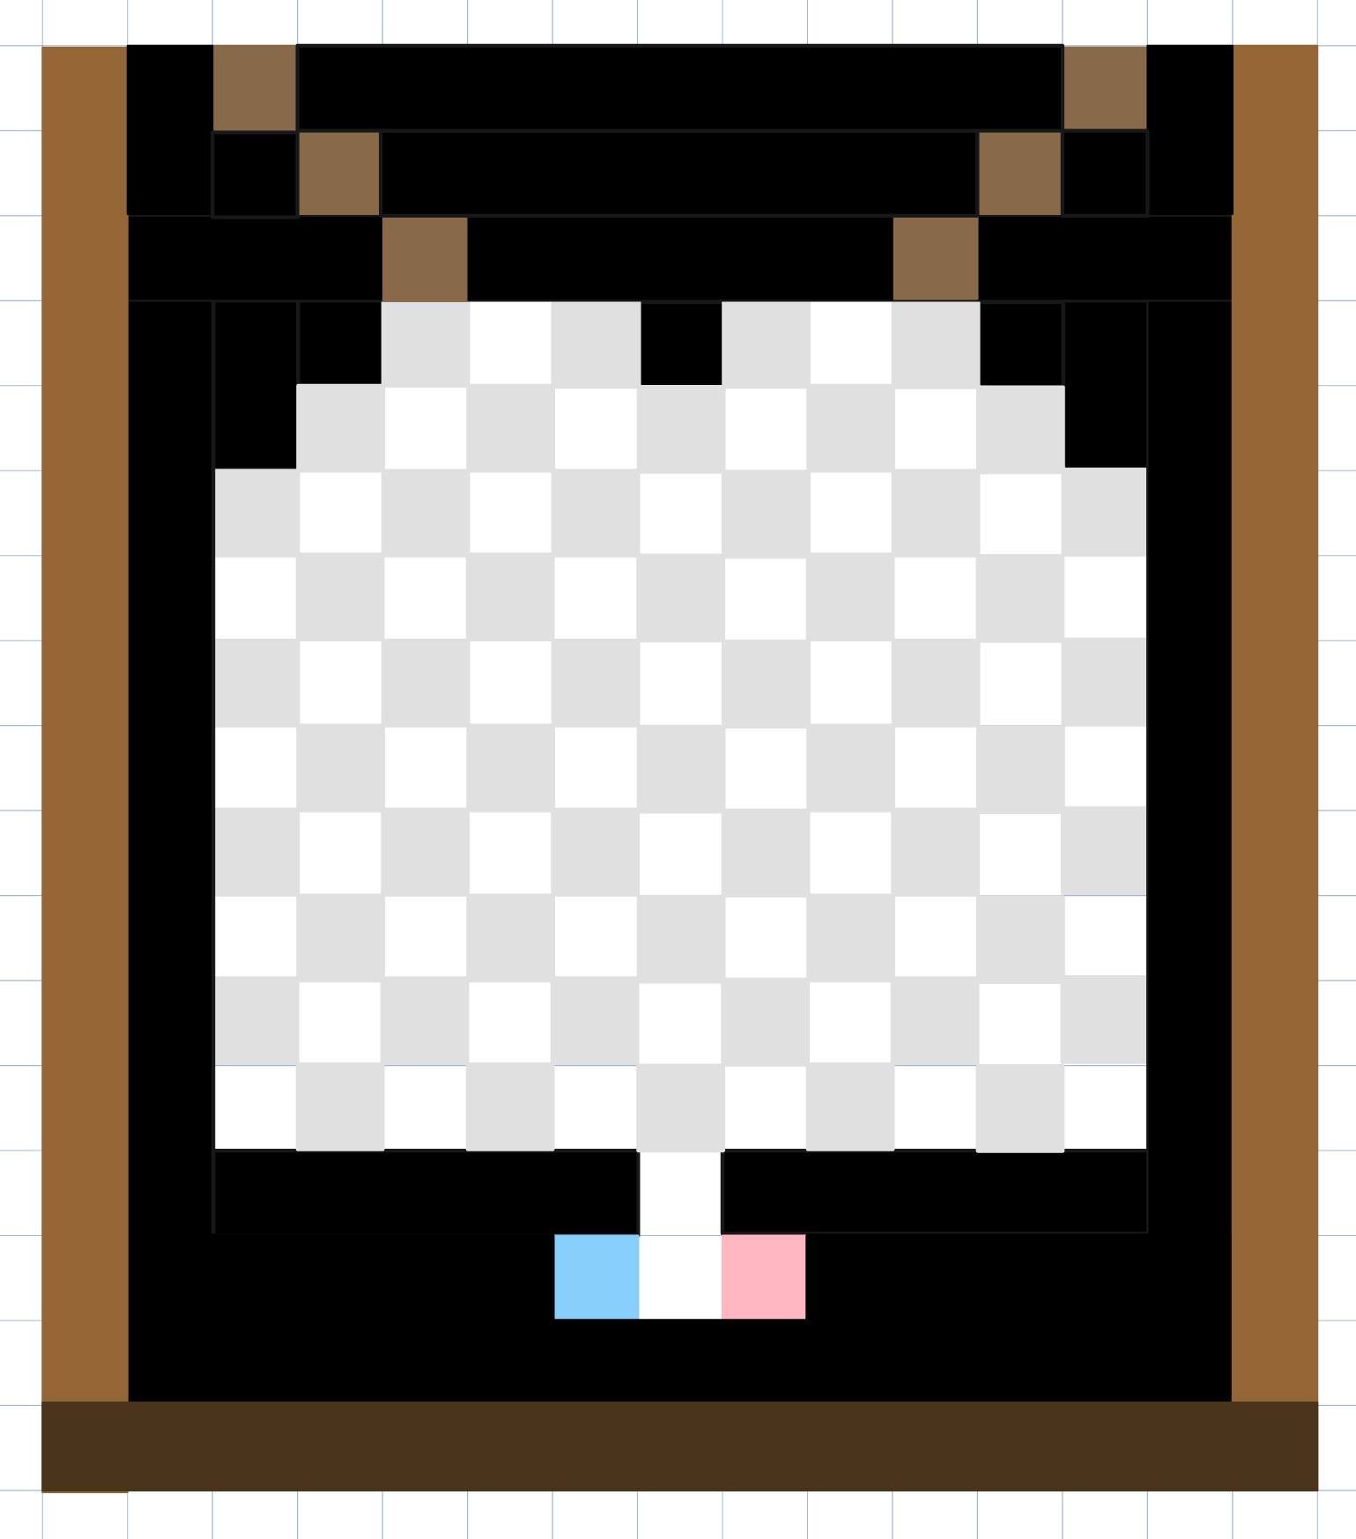
Board creation progress
Board is a matrix
Borders are unused
Triggers at the bottom

Slide 5
Functionality
Theos Video of placing parts

Slide 6
Gamelogic in python
Ana will do this

Slide 7
Game in Console
Talhas console game

Slide 8
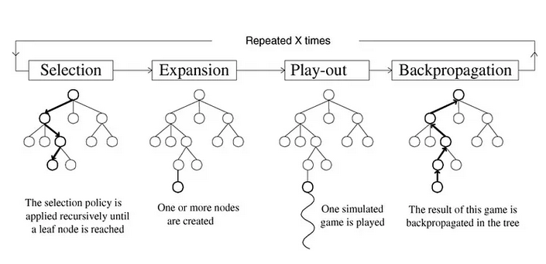
MCTS definition

Slide 9
MCTS training
Video or picture of MCTS playing connect 4

Slide 10
MCTS showcase
Showcase of the new training process

Slide 11
Working in Cluj

