Slide 1
SI 618 – Week 11
Instructor: Ceren Budak
Some slides from: Yuhang Wang and Kevyn Collins-Thompson

Slide 2
Dimensionality Reduction Methods
A set of useful and important tools for exploring data with many variables.
There are two main tools for dimensionality reduction:
Principal Components Analysis (PCA)
PCA projects data to lower dimensions. PCA extracts all variance.
Exploratory Factor Analysis (EFA)
EFA seeks to find a small number of unobserved underlying variables that might explain the common variance (not all variance) in the data.
The goal of dimensionality reduction methods is to "explain" many observed variables in terms of a much smaller number of unobserved variables.

Slide 3
Consider an athlete competing in a set of events (e.g. heptathlon)
Athlete
100m
sprint
200m
run
110m hurdles
Long jump
High jump
Javelin
shotput
We observe their score in each event = variable

Slide 4
Given a particular athlete, is their score in one event completely unrelated to their score in other events?
Athlete
No.
It's likely some events have correlated performance
100m
sprint
200m
run
110m hurdles
Long jump
High jump
Javelin
shotput
Each event score = variable

Slide 5
We might be able to describe an athlete's abilities in terms of a smaller number of factors that strongly influence their scores in all events.
What are three possible factors
you could hypothesize?
Athlete
Factors are hidden variables we don't observe directly but influence observed outcomes
Runningability
Jumping ability
Throwing ability
100m
sprint
200m
run
110m hurdles
Long jump
High jump
Javelin
shotput
Each event score = variable

Slide 6
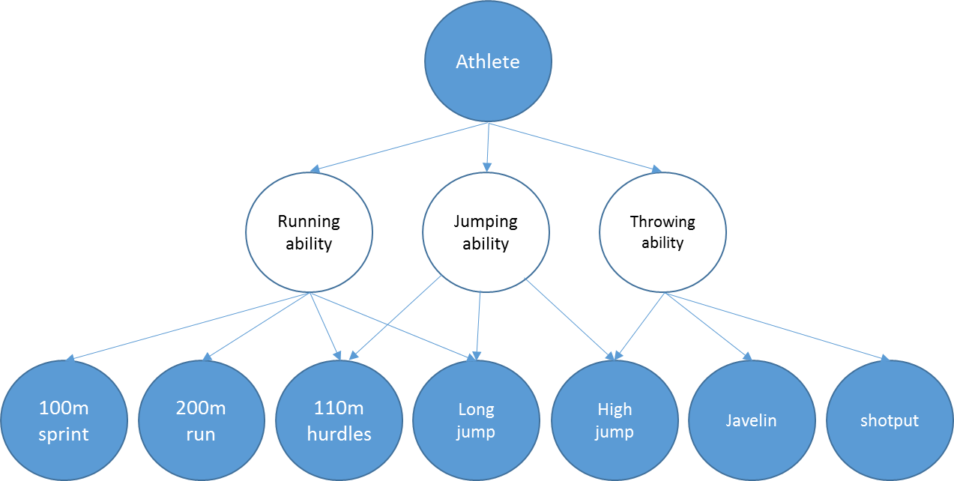
Factors and factor loadings
Factor variables:
F_{RUN} : Running ability (-1 to 1)
F_{JUMP} : Jumping ability (-1 to 1)
F_{THROW} : Throwing ability (-1 to 1)
Goal: Rewrite our data in terms of the factor variables
The factor loadings are the weights that relate the observed variables to the factor variables in a linear model
Score(A_{E}) = w_{RUN}F_{RUN}(A_{E})+ w_{JUMP}F_{JUMP}(A_{E})+ w_{THROW}F_{THROW}(A_{E})

Slide 7
Principal Components Analysis (PCA): Why is it used?
Identify combinations of variables that explain most of the variation in the data
Compress high-dimensional datasets to a few dimensions
Filter noise from data (as a result of the approximation)

Slide 8
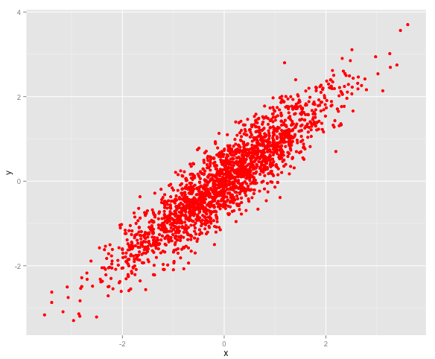
Towards Principal Component Analysis (PCA): Here's a hypothetical 2-dimensional distribution of two variables
library(MASS)
library(ggplot2)
Sigma <- matrix(c(1.1,1,1,1),2,2)
# simulate from a Multivariate Normal
# Distribution
toy = mvrnorm(n=10000, c(0, 0), Sigma)
toy.df = as.data.frame(toy)
colnames(toy.df) = c('x', 'y')
qplot(x, y, data = toy.df, colour = I("red"), size = I(2))
Notes:
Mvnorm: Produces one or more samples from the specified multivariate normal distribution.
mvrnorm(n = 1, mu, Sigma, tol = 1e-6, empirical = FALSE, EISPACK = FALSE)
Sigma: a positive-definite symmetric matrix specifying the covariance matrix of the variables.

Slide 9
Each point is described with (x,y) coordinates. Suppose to save space you only had enough memory to store 1 number per point instead of 2. What number would you store to best approximate a point's position?

Slide 10
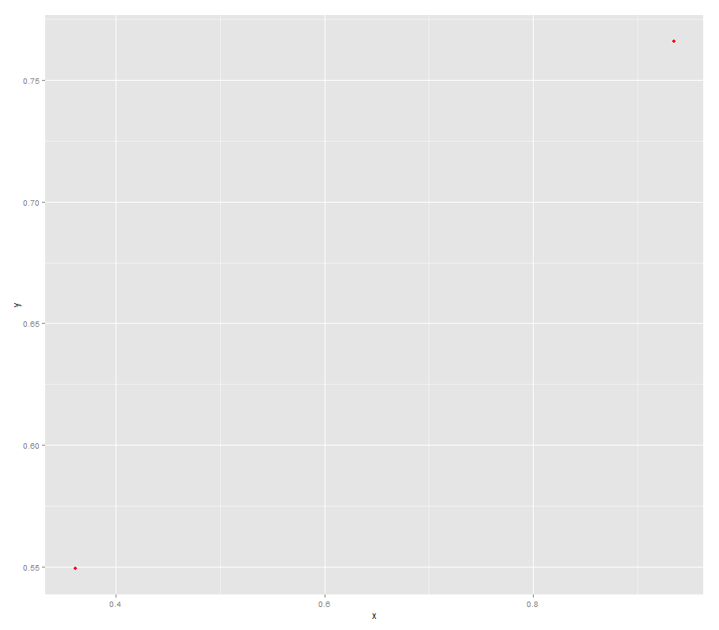
Basic idea: Collapse the 2-D cloud to 1 dimension, then approximate a point (x_{i}, y_{i}) by its projected position d_{i} onto the line.
Data point (x₁, y₁)
d₁ = 2.3
d_{Mean} = 0
d₂ = -1.2
Data point (x₂, y₂)
2-dimensional cloud
A 1-dimensional approximation
to the cloud (using a linear model)

Slide 11
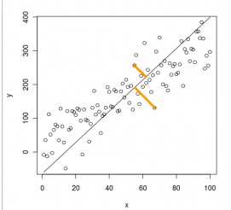
But how do we pick the 'best' linear approximation? This is what PCA does!
Minimum total error
(PCA)
High total
error
The vector describing this line is called the first principal component. It explains most of the variation in the data.
PCA finds the unique model line that minimizes error orthogonal (perpendicular) to the model line.
Source: http://www.cerebralmastication.com/2010/09/principal-component-analysis-pca-vs-ordinary-least-squares-ols-a-visual-explination/

Slide 12
We can repeat this process to improve the approximation. In what direction is the next highest variance in the data? This will give us the second principal component.
First principal component
Second principal component
The second principal component (yellow)
captures the next highest direction of variance.
PCA attempts to find the next PC that is uncorrelated with previous PCs.
The principal component vectors have an origin that is the mean (centroid) of the cloud
Source: http://www.cerebralmastication.com/2010/09/principal-component-analysis-pca-vs-ordinary-least-squares-ols-a-visual-explination/

Slide 13
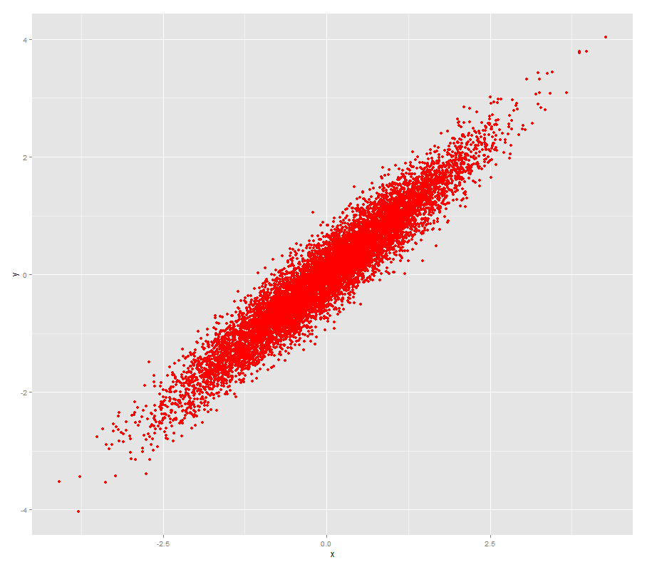
Let's apply PCA to our toy dataset: The R function is prcomp
> toy.pr = prcomp(toy.df,scale=TRUE)
> toy.pr
Standard deviations:
[1] 1.3823240 0.2986307
Rotation:
PC1 PC2
x 0.7071068 0.7071068
y 0.7071068 -0.7071068
PC1
PC2
* Another R function princomp() does PCA using a different internal method.
Also, prcomp() can handle when # variables > # of observations, princomp can't.
So there's no advantage to using princomp().
Notes:
Suppose we have pp features, and nn data points, comprising an n×pn×p matrix XX. Without loss of generality, we may assume that the means for each feature have been subtracted (so that the columns of X each average to 0), and that each feature has also been normalized by its measured standard deviation (so that the standard deviation of each column is 1).
We can form the correlation matrix of X as
S=1nXTXS=
1
nXTX,
and determine its orthonormal eigenvectors u→1..u→pu→
1
..u→p, and corresponding positive eigenvalues d1..dpd
1
..dp. These eigenvectors are referred to as "principal components".

Slide 14
Scaling is important for PCA
Like k-means clustering, PCA is sensitive to the scaling of the variables. Scaling = TRUE invokes prcomp scaling.
Variables in different units must be scaled (e.g. temperature vs mass).
Variables in the same units but having wildly different variances should be scaled.
Two typical pre-processing steps for PCA:
1. Mean subtraction (a.k.a. "mean centering") (Default: center = TRUE)
Needed before performing PCA to ensure that the first principal component describes the direction of maximum variance. If mean subtraction is not performed, the first principal component might instead correspond more or less to the mean of the data. A mean of zero is needed for finding a basis that minimizes the mean square error of the approximation of the data.
Variable scaling (Default: scale = FALSE)
Set scale = TRUE
Divide each variable by its standard deviation.

Slide 15
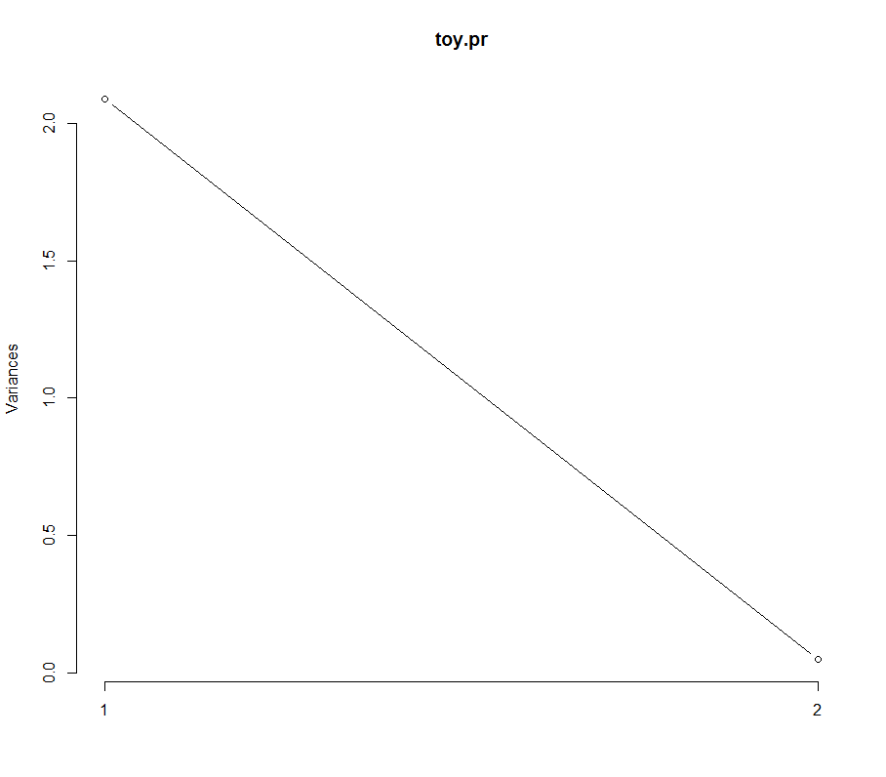
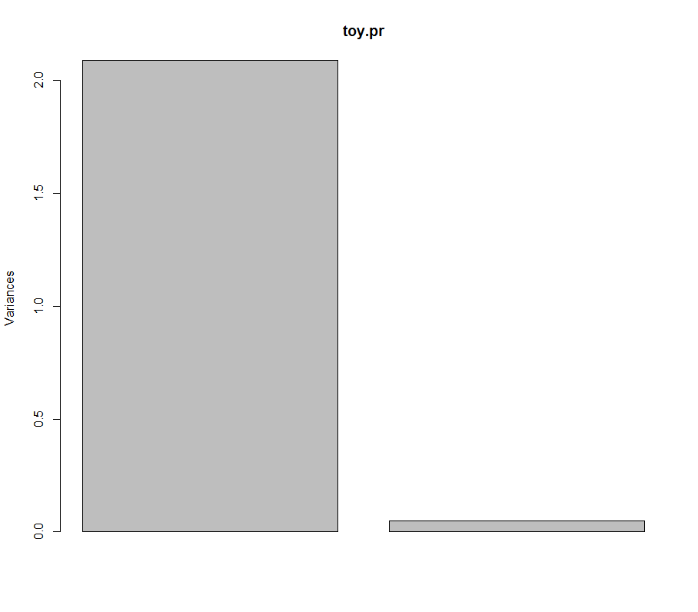
Screeplots show how much variance is explained by each principal component
Screeplot y-values are always decreasing… why?
PC1
PC2
PC1
PC1
screeplot(toy.pr) screeplot(toy.pr, type = "lines")

Slide 16
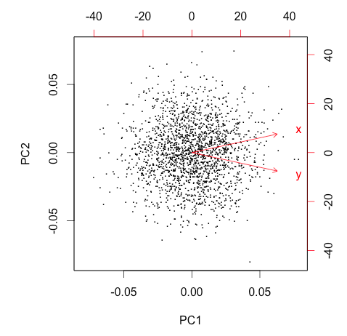
Visualizing PCA results with biplots
A biplot shows:
The data points (top/right scale)
The variables (bottom/left scale)
Data are plotted as "seen" from the PC axes
Variables are plotted by their PC loadings
The angle formed by the vectors for any two variables reflects their actual pairwise correlation
PC1
PC2
Original plot
Biplot

Slide 17
Biplot: combines data scatterplot with variable plot (vectors)
Points close =
Observations with
similar component projections
Vectors close =
Variables that are correlated
Observations whose points project furthest in the direction of a variable have the most of whatever the variable measures.
biplot(toy.pr, xlabs=rep(".",nrow(toy.df)))
Notes:
A vector points in the direction which is most like the variable represented by the vector. This is the direction which has the highest squared multiple correlation with the principal components. The length of the vector is proportional to the squared multiple correlation between the fitted values for the variable and the variable itself.

Slide 18

Heptathlon dataset Scores in 7 events: Seoul 1988 Olympics
> heptathlon
hurdles highjump shot run200m longjump javelin run800m score
Joyner-Kersee (USA) 12.69 1.86 15.80 22.56 7.27 45.66 128.51 7291
John (GDR) 12.85 1.80 16.23 23.65 6.71 42.56 126.12 6897
Behmer (GDR) 13.20 1.83 14.20 23.10 6.68 44.54 124.20 6858
Sablovskaite (URS) 13.61 1.80 15.23 23.92 6.25 42.78 132.24 6540
Choubenkova (URS) 13.51 1.74 14.76 23.93 6.32 47.46 127.90 6540
Schulz (GDR) 13.75 1.83 13.50 24.65 6.33 42.82 125.79 6411
Fleming (AUS) 13.38 1.80 12.88 23.59 6.37 40.28 132.54 6351
Greiner (USA) 13.55 1.80 14.13 24.48 6.47 38.00 133.65 6297
Lajbnerova (CZE) 13.63 1.83 14.28 24.86 6.11 42.20 136.05 6252
Bouraga (URS) 13.25 1.77 12.62 23.59 6.28 39.06 134.74 6252
Wijnsma (HOL) 13.75 1.86 13.01 25.03 6.34 37.86 131.49 6205
Dimitrova (BUL) 13.24 1.80 12.88 23.59 6.37 40.28 132.54 6171
Scheider (SWI) 13.85 1.86 11.58 24.87 6.05 47.50 134.93 6137
Braun (FRG) 13.71 1.83 13.16 24.78 6.12 44.58 142.82 6109
25 observations (athletes), 8 variables

Slide 19
Step 1: Scaling the data
Some results are measured in seconds (lower numbers better), others in scores, or meters (higher numbers better).
> heptathlon
hurdles highjump shot run200m longjump javelin run800m score
Joyner-Kersee (USA) 12.69 1.86 15.80 22.56 7.27 45.66 128.51 7291
John (GDR) 12.85 1.80 16.23 23.65 6.71 42.56 126.12 6897
Behmer (GDR) 13.20 1.83 14.20 23.10 6.68 44.54 124.20 6858
Sablovskaite (URS) 13.61 1.80 15.23 23.92 6.25 42.78 132.24 6540
Choubenkova (URS) 13.51 1.74 14.76 23.93 6.32 47.46 127.90 6540
…
> heptathlon.scaled = scale(heptathlon[,c(1:7)])
> heptathlon.scaled
hurdles highjump shot run200m longjump javelin run800m
Joyner-Kersee (USA) -1.56112593 1.0007405 1.79799456 -2.154798275 2.35675020 1.1782304 -0.9098926366
John (GDR) -1.34392580 0.2309401 2.08622065 -1.030573634 1.17584459 0.3039212 -1.1981539571
Behmer (GDR) -0.86880052 0.6158403 0.72552539 -1.597842949 1.11258179 0.8623510 -1.4297279049
Sablovskaite (URS) -0.31222519 0.2309401 1.41592742 -0.752095971 0.20581498 0.3659689 -0.4600119984
Choubenkova (URS) -0.44797527 -0.5388603 1.10088960 -0.741781983 0.35342818 1.6858939 -0.9834656096
…

Slide 20
Step 2: How is performance in one event correlated with other events?
> round(cor(heptathlon.scaled),2)
hurdles highjump shot run200m longjump javelin run800m
hurdles 1.00 -0.81 -0.65 0.77 -0.91 -0.01 0.78
highjump -0.81 1.00 0.44 -0.49 0.78 0.00 -0.59
shot -0.65 0.44 1.00 -0.68 0.74 0.27 -0.42
run200m 0.77 -0.49 -0.68 1.00 -0.82 -0.33 0.62
longjump -0.91 0.78 0.74 -0.82 1.00 0.07 -0.70
javelin -0.01 0.00 0.27 -0.33 0.07 1.00 0.02
run800m 0.78 -0.59 -0.42 0.62 -0.70 0.02 1.00

Slide 21
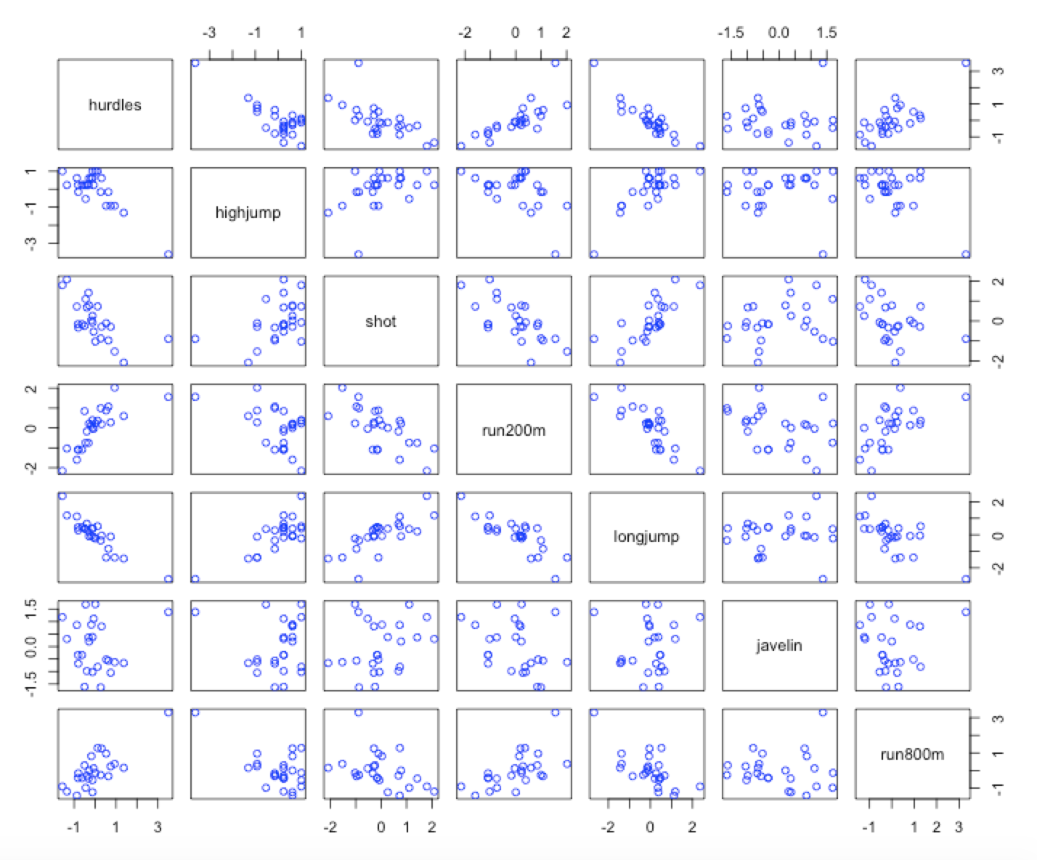
Scatterplots confirm what we observed in the correlation matrix
Observations?
1. Clear linear relationships between hurdles, high jump, shot put, 200m, and long jump.
2. Javelin and, to some extent, 800m results are less correlated with the other events.
pairs(heptathlon.scaled, col="blue")

Slide 22
Running PCA
Note that the seven events have very different variances. Standard deviation for the 800m is 8.29 (sec) whereas for the high jump it's only 0.078 (m).
If we work with unscaled scores, the 800m results will have a disproportionate effect.
Thus we will tell the PCA function to scale all results to have a variance of 1.0.
hepPCA = prcomp(heptathlon.scaled, retx= TRUE)
Same as:
hepPCA = prcomp(heptathlon[,c(1:7)], retx= TRUE, scale=TRUE)

Slide 23
Summary of PCA results for heptathlon data
> print(hepPCA)
Standard deviations:
[1] 2.1119364 1.0928497 0.7218131 0.6761411 0.4952441 0.2701029 0.2213617
Rotation:
PC1 PC2 PC3 PC4 PC5 PC6 PC7
hurdles 0.4528710 -0.15792058 -0.04514996 0.02653873 -0.09494792 -0.78334101 -0.38024707
highjump -0.3771992 0.24807386 0.36777902 -0.67999172 -0.01879888 -0.09939981 -0.43393114
shot -0.3630725 -0.28940743 -0.67618919 -0.12431725 -0.51165201 0.05085983 -0.21762491
run200m 0.4078950 0.26038545 0.08359211 -0.36106580 -0.64983404 0.02495639 0.45338483
longjump -0.4562318 0.05587394 -0.13931653 -0.11129249 0.18429810 -0.59020972 0.61206388
javelin -0.0754090 -0.84169212 0.47156016 -0.12079924 -0.13510669 0.02724076 0.17294667
run800m 0.3749594 -0.22448984 -0.39585671 -0.60341130 0.50432116 0.15555520 0.09830963
> summary(hepPCA)
Importance of components:
PC1 PC2 PC3 PC4 PC5 PC6 PC7
Standard deviation 2.1119 1.0928 0.72181 0.67614 0.49524 0.27010 0.2214
Proportion of Variance 0.6372 0.1706 0.07443 0.06531 0.03504 0.01042 0.0070
Cumulative Proportion 0.6372 0.8078 0.88223 0.94754 0.98258 0.99300 1.0000

Slide 24
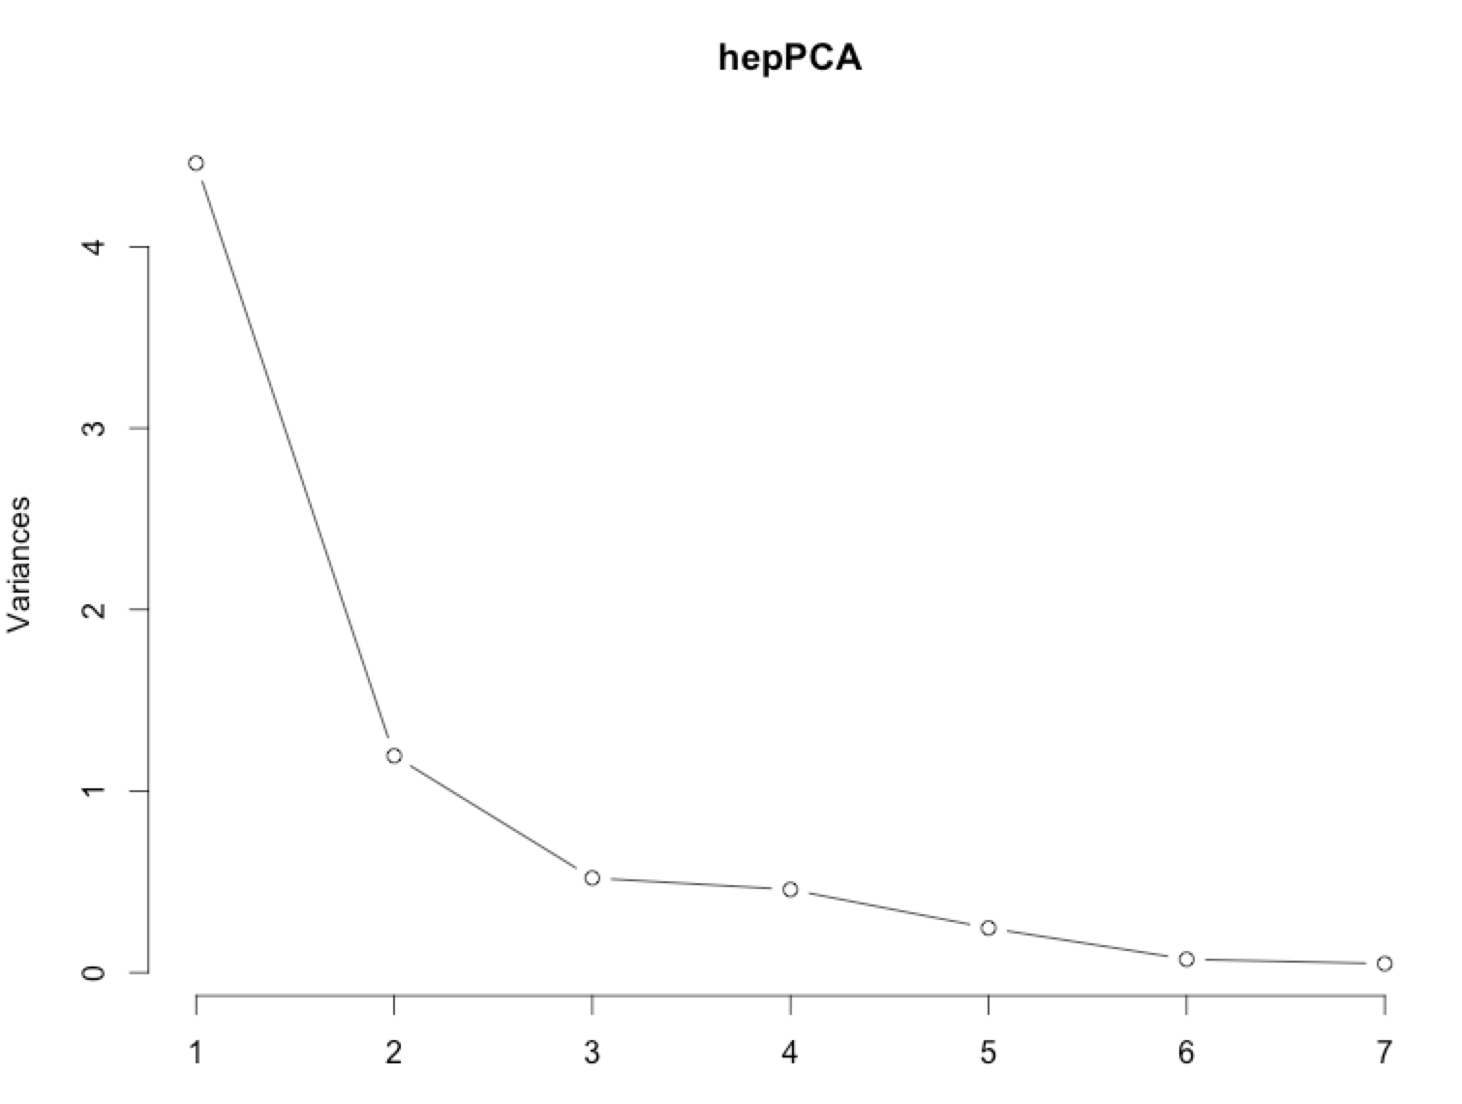
Screeplot of heptathlon PCA components
screeplot(hepPCA, type = "lines")

Slide 25
Let’s look at the projected data
> hepPCA$x
PC1 PC2 PC3 PC4 PC5 PC6 PC7
Joyner-Kersee (USA) -4.121447626 -1.24240435 -0.36991309 -0.02300174 0.42600624 -0.339329222 0.347921325
John (GDR) -2.882185935 -0.52372600 -0.89741472 0.47545176 -0.70306588 0.238087298 0.144015774
Behmer (GDR) -2.649633766 -0.67876243 0.45917668 0.67962860 0.10552518 -0.239190707 -0.129647756
Sablovskaite (URS) -1.343351210 -0.69228324 -0.59527044 0.14067052 -0.45392816 0.091805638 -0.486577968
Choubenkova (URS) -1.359025696 -1.75316563 0.15070126 0.83595001 -0.68719483 0.126303968 0.239482044
Schulz (GDR) -1.043847471 0.07940725 0.67453049 0.20557253 -0.73793351 -0.355789386 -0.103414314
Fleming (AUS) -1.100385639 0.32375304 0.07343168 0.48627848 0.76299122 0.084844490 -0.142871612
Greiner (USA) -0.923173639 0.80681365 -0.81241866 0.03022915 -0.09086737 -0.151561253 0.034237928
Lajbnerova (CZE) -0.530250689 -0.14632191 -0.16122744 -0.61590242 -0.56851477 0.265359696 -0.249591589
Bouraga (URS) -0.759819024 0.52601568 -0.18316881 0.66756426 1.02148109 0.396397714 -0.020405097
Wijnsma (HOL) -0.556268302 1.39628179 0.13619463 -0.40503603 -0.29221101 -0.344582964 -0.182701990
Dimitrova (BUL) -1.186453832 0.35376586 0.08201243 0.48123479 0.78103608 0.233718538 -0.070605615
Scheider (SWI) 0.015461226 -0.80644305 1.96745373 -0.73341733 0.02177427 -0.004249913 0.036155878
Braun (FRG) 0.003774223 -0.71479785 0.32496780 -1.06604134 0.18389959 0.272903729 0.044351160
Ruotsalainen (FIN) 0.090747709 -0.76304501 0.94571404 -0.26883477 0.18416945 0.141403697 0.135136482
Yuping (CHN) -0.137225440 0.53724054 -1.06529469 -1.63144151 0.21162048 -0.280043639 -0.171160984
Hagger (GB) 0.171128651 1.74319472 -0.58701048 -0.47103131 0.05781435 0.147155606 0.520000710
Brown (USA) 0.519252646 -0.72696476 0.31302308 -1.28942720 0.49779301 -0.071211150 -0.005529394
Mulliner (GB) 1.125481833 0.63479040 -0.72530080 0.57961844 0.15611502 -0.427484048 0.081522940
Hautenauve (BEL) 1.085697646 1.84722368 -0.01452749 0.25561691 -0.19143514 -0.100087033 0.085430091
Kytola (FIN) 1.447055499 0.92446876 0.64596313 0.21493997 -0.49993839 -0.072673266 -0.125585203
Geremias (BRA) 2.014029620 0.09304121 -0.64802905 -0.02454548 -0.24445870 0.640572055 -0.215626046
Hui-Ing (TAI) 2.880298635 0.66150588 0.74936718 1.11903480 0.47418755 -0.180568513 -0.207364881
Jeong-Mi (KOR) 2.970118607 0.95961101 0.57118753 0.11547402 -0.58055249 0.183940799 0.381783751
Launa (PNG) 6.270021972 -2.83919926 -1.03414797 0.24141489 0.16568672 -0.255722133 0.061044365

Slide 26
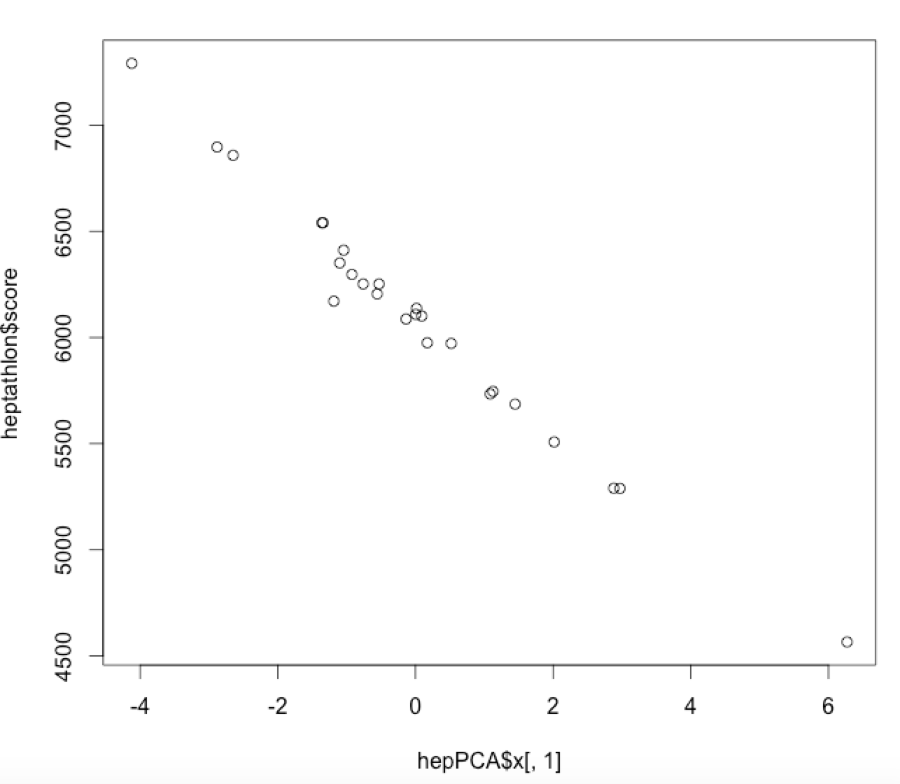
Let’s compare the projected data on the first PC to the original total score
> cor(hepPCA$x[,1],heptathlon$score)
[1] -0.9910978
> plot(hepPCA$x[,1],heptathlon$score)

Slide 27
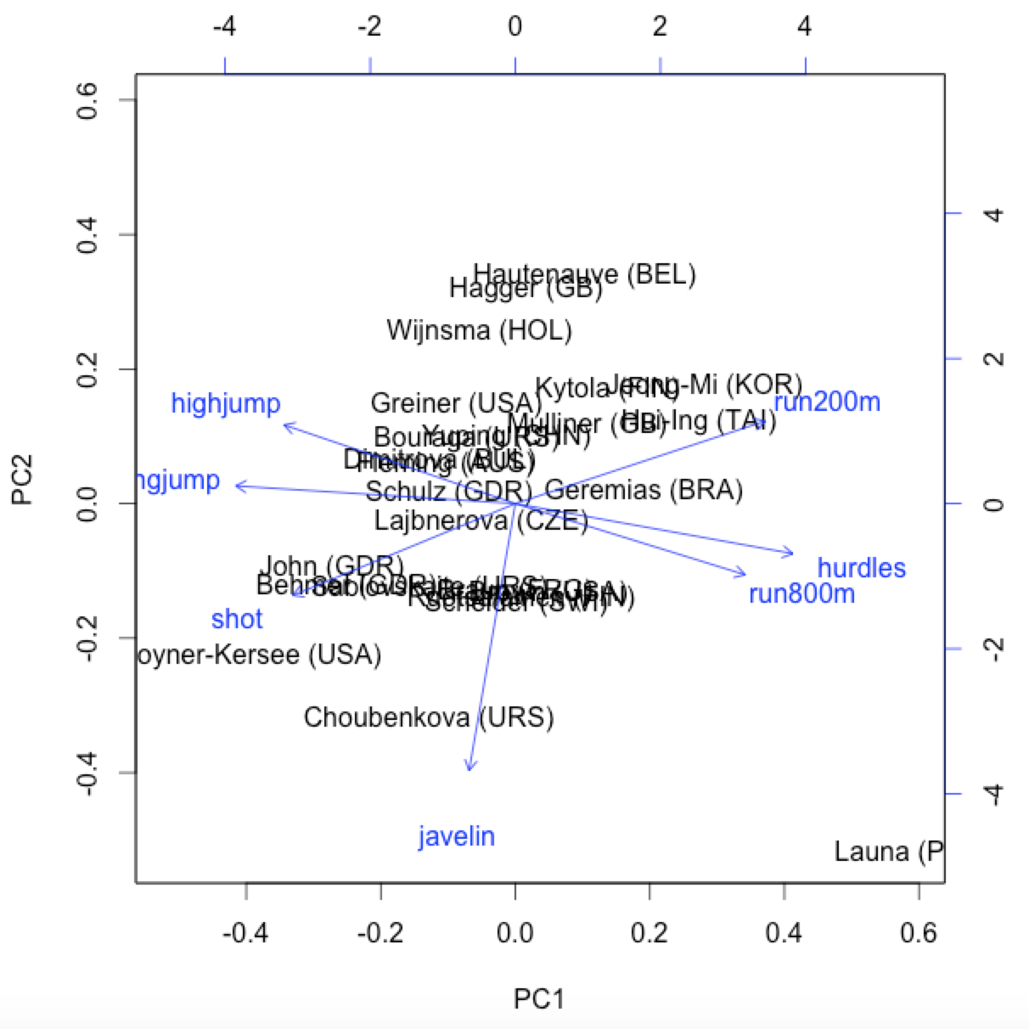
Biplot of heptathlon PCA components
Remember:
For any pair of variables, the angle between their biplot vectors reflects their actual correlation

Slide 28
Could we find a small set of latent athletic abilities (factors) that mostly explain the event scores (variables)?
Is there a "running factor" that would lead to good results across multiple running events?
A "jumping factor" ?
A "throwing factor" (arm strength) ?
Endurance?

Slide 29
Exploratory factor analysis: recall our original goal
What are three possible factors
you could hypothesize?
Athlete
Factors are hidden variables we don't observe directly but influence observed outcomes
Running
ability
Jumping ability
Throwing ability
100m
sprint
200m
run
110m hurdles
Long jump
High jump
Javelin
shotput
Each event score = variable

Slide 30
Exploratory factor analysis
Finds k factors that "explain" the correlation structure in the observed variables
You must specify k
You can specify whether the factors can be correlated or uncorrelated
More flexible and general than PCA
variables
factors
variables
Data
Data
summary
factors
Factor loadings
=
x
observations
observations
Factor analysis finds this decomposition of
your data matrix

Slide 31
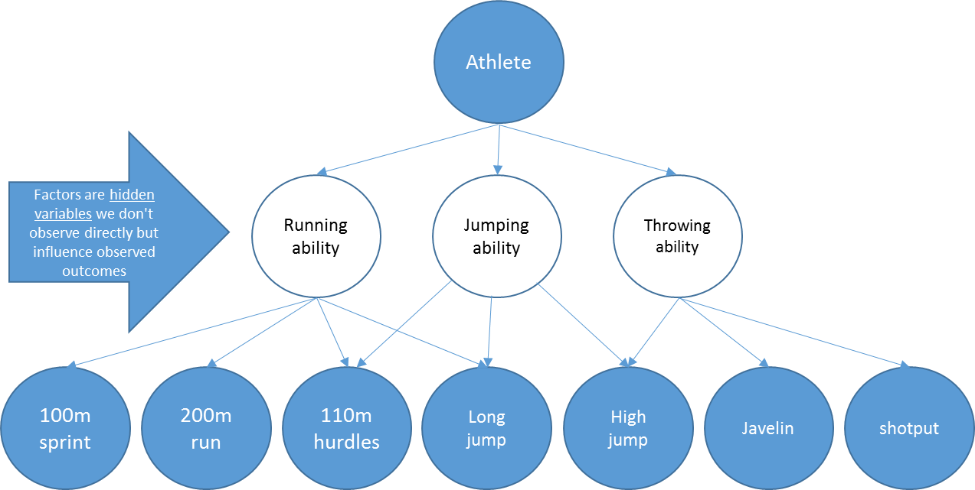
Factors in the hepthalon
event scores
factors
event scores
Data
running ability
factors
jumping ability
=
x
throwing ability
athletes
athletes
throwing ability
jumping ability
running ability

Slide 32
Performing EFA in R using factanal
Factor Analysis
Description
Perform maximum-likelihood factor analysis on a covariance matrix or data matrix.
Usage
factanal(x, factors, data = NULL, covmat = NULL, n.obs = NA,
subset, na.action, start = NULL,
scores = c("none", "regression", "Bartlett"),
rotation = "varimax", control = NULL, ...)
Key Arguments:
x
A formula or a numeric matrix or an object that can be coerced to a numeric matrix.
factors
The number of factors to be fitted.
rotation
character. "none" or the name of a function to be used to rotate the factors: it will be called with first argument the loadings matrix, and should return a list with component loadings giving the rotated loadings, or just the rotated loadings.
factanal(x = smoke, factors = 2, rotation = "varimax")

Slide 33
EFA: Allowing correlated factors with "promax" rotation method
Call:
factanal(x = smoke, factors = 2, rotation = "varimax")
Uniquenesses:
qn1 qn2 qn3 qn4 qn5
0.025 0.197 0.389 0.010 0.042
Loadings:
Factor1 Factor2
qn1 0.987
qn2 0.885 -0.138
qn3 -0.110 0.774
qn4 0.994
qn5 0.978
Factor1 Factor2
SS loadings 2.760 1.577
Proportion Var 0.552 0.315
Cumulative Var 0.552 0.867
Test of the hypothesis that 2 factors are sufficient.
The chi square statistic is 0.69 on 1 degree of freedom.
The p-value is 0.405
Call:
factanal(x = smoke, factors = 2, rotation = "promax")
Uniquenesses:
qn1 qn2 qn3 qn4 qn5
0.025 0.197 0.389 0.010 0.042
Loadings:
Factor1 Factor2
qn1 0.993
qn2 0.881
qn3 0.775
qn4 1.002
qn5 0.986
Factor1 Factor2
SS loadings 2.770 1.581
Proportion Var 0.554 0.316
Cumulative Var 0.554 0.870
Factor Correlations:
Factor1 Factor2
Factor1 1.000 -0.171
Factor2 -0.171 1.000
Test of the hypothesis that 2 factors are sufficient.
The chi square statistic is 0.69 on 1 degree of freedom.
The p-value is 0.405

Slide 34
EFA: Rotation parameter
factanal(x = smoke, factors = 2, rotation = "varimax")
Rotation: optimization method used to find factors that make the pattern of loadings clearer
varimax: orthogonal factors (uncorrelated)
promax: oblique (correlated)
Note that with promax, you get a matrix of factor correlations
Strategy: First try promax, look at correlations among factors
Look at factor correlation matrix for correlations > 0.32
If many correlations exceed 0.32 there is 10% or more overlap in variance among factors and promax is justified
Otherwise use varimax
Factor Correlations:
Factor1 Factor2
Factor1 1.000 -0.171
Factor2 -0.171 1.000
More information: http://jalt.org/test/PDF/Brown31.pdf

Slide 35
EFA: The number of observed variables limits the number of factors
If you set k too high, you will get this error:
e.g. "k factors are too many for 7 variables"
It means you don't have enough data to fit a model with the # of parameters implied by k factors

Slide 36
EFA on smoking survey dataset
Data source:
http://en.wikiversity.org/wiki/Survey_research_and_design_in_psychology/Tutorials/Psychometrics/Exploratory_factor_analysis
Five observed variables are the responses to these 5 questions:
1. I think smoking is acceptable.
2. I don't care if people smoke around me.
3. I don't think people should smoke in restaurants
4. I think people should have the right to smoke.
5. I don't think people should smoke around food.
Each person's response to Q1-Q5 is on a scale of 1-100.
N=107 people responded to the survey.
smoke = spss.get("data_14_1.sav") # Hmisc package
smoke.fac = factanal(smoke, factors=2,rotation="varimax")

Slide 37
Results of EFA on smoking survey data. How well does a 2-factor model fit?
factanal(x = smoke, factors = 2, rotation = "varimax")
Uniquenesses:
qn1 qn2 qn3 qn4 qn5
0.025 0.197 0.389 0.010 0.042
Loadings:
Factor1 Factor2
qn1 0.987
qn2 0.885 -0.138
qn3 -0.110 0.774
qn4 0.994
qn5 0.978
Factor1 Factor2
SS loadings 2.760 1.577
Proportion Var 0.552 0.315
Cumulative Var 0.552 0.867
Test of the hypothesis that 2 factors are sufficient.
The chi square statistic is 0.69 on 1 degree of freedom.
The p-value is 0.405
Uniquenesses are the proportion of variance in each item that is not explained by the factors.
Significance level of p-value
Large p means hypothesis of perfect fit cannot be rejected
Small p (< 0.05) means hypothesis of perfect fit is rejected

Slide 38
What about a 1-factor model?
factanal(x = smoke, factors = 1, rotation = "varimax")
Uniquenesses:
qn1 qn2 qn3 qn4 qn5
0.024 0.208 0.981 0.012 0.993
Loadings:
Factor1
qn1 0.988
qn2 0.890
qn3 -0.139
qn4 0.994
qn5
Factor1
SS loadings 2.782
Proportion Var 0.556
Test of the hypothesis that 1 factor is sufficient.
The chi square statistic is 95.08 on 5 degrees of freedom.
The p-value is 5.75e-19
Significance level of p-value
Large p means hypothesis of perfect fit cannot be rejected
Small p (< 0.05) means hypothesis of perfect fit is rejected
Thus the 2-factor model is more likely to be a perfect fit,
while the 1-factor model is highly unlikely to be a perfect fit

Slide 39
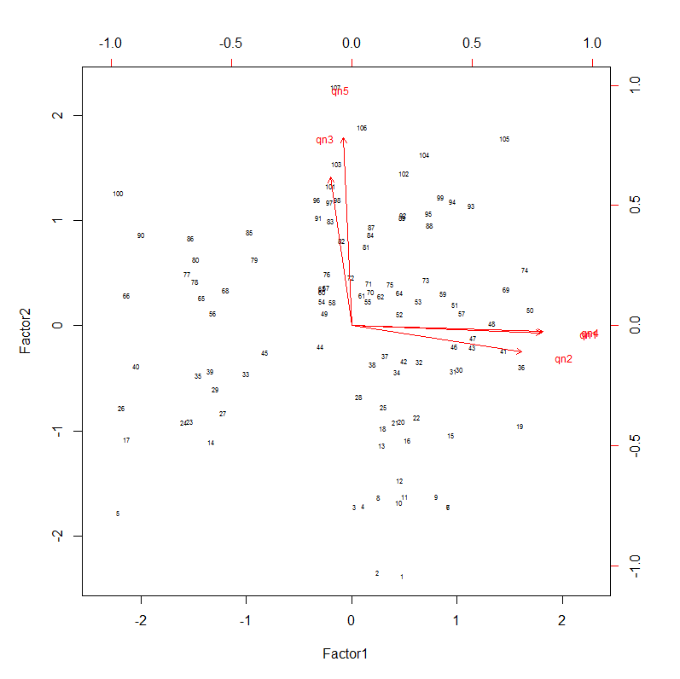
Biplot for a two-factor EFA analysis of smoking survey responses
5
# 1 I think smoking is acceptable.
# 2 I don't care if people smoke around me.
# 3 I don't think people should smoke in restaurants
# 4 I think people should have the right to smoke.
# 5 I don't think people should smoke around food.
3
4
Loadings:
Factor1 Factor2
qn1 0.987
qn2 0.885 -0.138
qn3 -0.110 0.774
qn4 0.994
qn5 0.978
1
2
biplot(smoke.fac$scores, smoke.fac$loadings, cex=c(0.5,0.75))

Slide 40
How should we interpret and name the factors?
Examine the variables that load heavily on the factor
Try do decide what model is common to these variables.
Name the factor after that construct.
How would you interpret the two smoking survey factors?
Factor 1: Pro-smoking
Factor 2: Anti-smoking
# 1 I think smoking is acceptable.
# 2 I don't care if people smoke around me.
# 3 I don't think people should smoke in restaurants
# 4 I think people should have the right to smoke.
# 5 I don't think people should smoke around food.
Loadings:
Factor1 Factor2
qn1 0.987
qn2 0.885 -0.138
qn3 -0.110 0.774
qn4 0.994
qn5 0.978

Slide 41


When have we found factors with "simple" structure?
Smoking survey
Thurstone (1947) listed five criteria:
1. Each variable should produce at least one zero loading on some factor.
2. Each factor should have at least as many zero loadings as there are factors.
3. Each pair of factors should have variables with significant loadings on one and zero loadings on the other.
4. Each pair of factors should have a large proportion of zero loadings on both factors (if > 3 factors total).
5. Each pair of factors should have only a few complex variables.
Loadings:
Factor1 Factor2
qn1 0.987
qn2 0.885 -0.138
qn3 -0.110 0.774
qn4 0.994
qn5 0.978
N/A
Source: Thurstone, L.L. (1947), Multiple Factor Analysis, U of C Press.

Slide 42
How can we interpret heptathlon factors?
> heptathlon.fac = factanal(heptathlon.scaled, factors = 3, rotation = "varimax", scores="regression")
> heptathlon.fac
Call:
factanal(x = heptathlon.scaled, factors = 3, scores = "regression", rotation = "varimax”)
Uniquenesses:
hurdles highjump shot run200m longjump javelin run800m
0.005 0.241 0.421 0.005 0.005 0.725 0.387
Loadings:
Factor1 Factor2 Factor3
hurdles 0.948 -0.300
highjump -0.744 0.404 0.205
shot -0.504 0.502 -0.271
run200m 0.653 -0.346 0.670
longjump -0.746 0.642 -0.161
javelin -0.522
run800m 0.755 -0.189
Factor1 Factor2 Factor3
SS loadings 3.261 1.074 0.876
Proportion Var 0.466 0.153 0.125
Cumulative Var 0.466 0.619 0.744
Test of the hypothesis that 3 factors are sufficient.
The chi square statistic is 7.2 on 3 degrees of freedom.
The p-value is 0.0659
Factor interpretations
Factor 1: Leg endurance?
Factor 2: Overall strength?
Factor 3: Leg power?

Slide 43
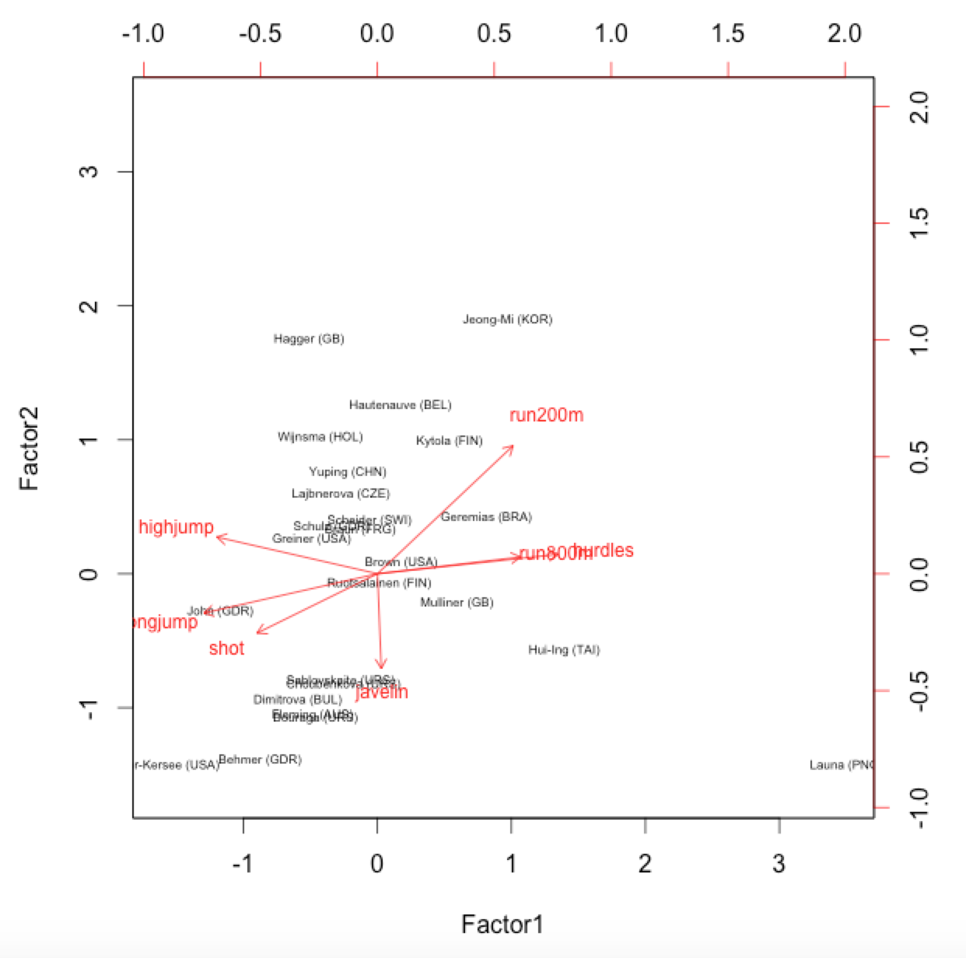
A two-factor EFA analysis of heptathlon results
> heptathlon.fac = factanal(heptathlon.scaled, factors = 2, rotation = "varimax", scores="regression")
> biplot(heptathlon.fac$scores, heptathlon.fac$loadings, cex=c(0.5,0.75))
Notes:
Scores: Type of scores to produce, if any. The default is none, "regression" gives Thompson's scores, "Bartlett" given Bartlett's weighted least-squares scores. Partial matching allows these names to be abbreviated.

Slide 44
Comparing PCA and EFA
Both are variable reduction techniques:
Explain lots of observed variables in terms of a few hidden variables
But they solve different optimization problems
PCA
Can reduce data using a small number of principal components that account for most of the variance
Typically used when variables are highly correlated
Good as a fast, initial look at likely number of factors
Sensitive to scaling
Solution is usually a means to an end, e.g. compress the data
EFA
More general and flexible than PCA in finding interesting structure
Identifies the number and nature of likely latent variables (factors)
Factors may be correlated or have specific structure
Not sensitive to scaling (if maximum likelihood method)
Solution is of interest in itself
Considering k+1 components does not change first k PCA.. But it may change solution to EFA factors.
Notes:
PCA tries to find a set of eigenvectors of the correlation matrix, in order to find directions in the data with the largest variance. One can then reduce the dimensionality of the data set by projecting onto those eigenvectors with the largest eigenvalues. In this way one reduces the effective size of the feature space without losing too much information.
Factor Analysis begins with a different point of view; it tries to model correlations between measured variables in the data by writing them as linear combinations of some smaller set of underlying "factors". EFA does not care about intrinsic variance in a measured variable due to measurement error, and therefore only tries to model the off-diagonal elements of the correlation matrix.

