Slide 1
SI 618: Week 13
Ceren Budak
Some slides from Yuhang Wang and Kevyn Collins-Thompson

Slide 2
Today’s schedule
Introduction to Anomaly/Outlier Detection
Work on your projects

Slide 3
How can we make the notion of 'outlier' more precise? Enter the field of Anomaly/Outlier Detection
What are anomalies/outliers?
The set of data points considerably different than "normal" data
Not noise: the points looks as if they were generated by a different mechanism
Applications:
Credit card fraud detection
Telecom fraud detection
Network intrusion detection
Fault detection
Early warning: medical analysis and epidemics
Sources for Outlier detection: Tan, Steinbach, Kumar: Introduction to Data Mining, Chap. 10.
J. Han and M. Kamber. Data Mining: Concepts and Techniques

Slide 4
Anomaly Detection
Challenges
How many outliers are there in the data?
Method is (most commonly) unsupervised
Validation can be quite challenging (just like for clustering)
Finding needle in a haystack
Application specific outlier definition
Understandability
Working assumption:
There are considerably more “normal” observations than “abnormal” observations (outliers/anomalies) in the data

Slide 5
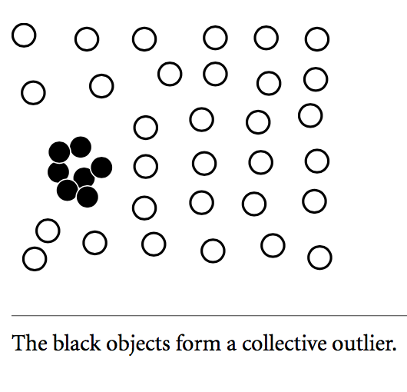
Types of Outliers
Global Outliers
Deviates from the rest of the data set. Also referred to as point anomalies
Contextual Outliers
The temperature today is 28◦C. Is it exceptional (i.e., an outlier)?
Collective Outliers
Given a data set, a subset of data objects forms a collective outlier if the objects as a whole deviate significantly from the entire data set. Importantly, the individual data objects may not be outliers.

Slide 6
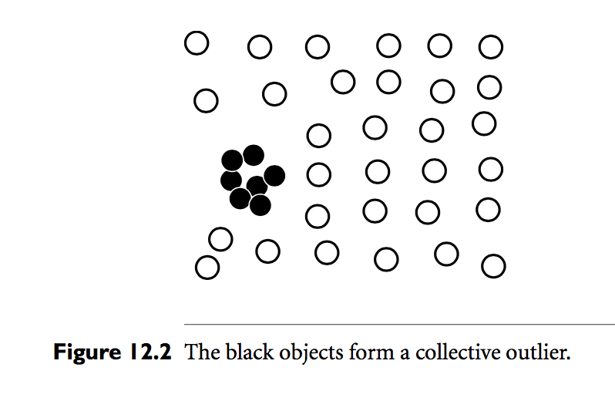
Outlier Detection Methods
Supervised Methods
Outlier detection as a classification problem. Challenges:
Imbalanced classes -> oversampling outliers to increase their distribution but representativeness still a problem
Importance of recall over precision
Unsupervised Methods
Assumption: Normal points are “clustered”. First apply clustering algorithms, then outliers are those that do not belong to clusters. But challenges exist
Semisupervised Methods
When only a small set of labeled data is available
Notes:
This assumption may not be true all the time. For example, in Figure 12.2, the normal objects do not share any strong patterns. Instead, they are uniformly distributed. The collective outliers, however, share high similarity in a small area.

Slide 7
Outlier Detection Methods – according to assumptions made
Statistical Methods (or model based methods)
Assume data generated by a statistical model, and data not following are outliers. E.g. gaussian model
Proximity-Based Methods
Assume that an object is an outlier if the nearest neighbors are far away in feature space
Clustering-Based Methods
Assume that normal data objects belong to large and dense clusters, whereas outliers belong to small and sparse clusters or do not belong to one

Slide 8
Statistical Methods
The goal is to learn a generative model fitting the given dataset and then identify the objects in low-probability regions as outliers. Two types:
Parametric approach: Assumes that the normal data objects are generated by a parametric distribution with parameter a. The probability density function of the parametric distribution f (x, a) gives the probability that object x is generated by the distribution. The smaller this value, the more likely x is an outlier.
Nonparametric approach: Does not assume an a priori statistical model. Instead, a nonparametric method tries to determine the model from the input data. Examples of nonparametric methods include histogram and kernel density estimation.

Slide 9
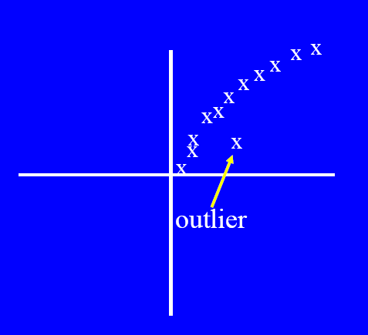
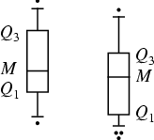
Graphical Approaches
Boxplot (1-D), Scatter plot (2-D or 3-D)
Limitations
Time consuming
Subjective
Move beyond subjective to Tukey method
Notes:
Such straightforward methods for statistical outlier detection can also be used in visualization. For example, the boxplot method (described in Chapter 2) plots the uni- variate input data using a five-number summary (Figure 12.3): the smallest nonoutlier value (Min), the lower quartile (Q1), the median (Q2), the upper quartile (Q3), and the largest nonoutlier value (Max). The interquantile range (IQR) is defined as Q3 − Q1. Any object that is more than 1.5 × IQR smaller than Q1 or 1.5 × IQR larger than Q3 is treated as an outlier because the region between Q1 − 1.5 × IQR and Q3 + 1.5 × IQR contains 99.3% of the objects. The rationale is similar to using 3σ as the threshold for normal distribution.

Slide 10
Tukey’s Method
Given the data x₁, x₂, x₃, …, x_{n}:
Determine:
Q1: the first quartile
Q3: the third quartile
Inter quartile range (IQR) = Q3 - Q1
The values
Outside the range [(Q1 -1.5 * IQR),(Q3 + 1.5* IQR)] are considered outliers
Outside the range [(Q1 -1.5 * IQR),(Q3 + 1.5* IQR)] are considered extreme outliers
Suppose the dataset is: 1,2,60,1,1,4,1,4,6,-30
So, the ordered data: -30,1,1,1,1,2,4,4,6,60
Q1:?
Q3:?
IQR = Q3 – Q1=?
And the outliers are: ?

Slide 11
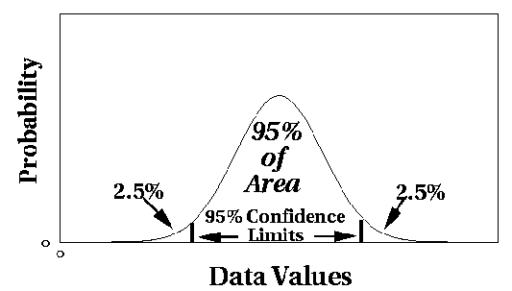
Statistical Approaches (parametric)
Assume a parametric model describing the distribution of the data (e.g., normal distribution)
Apply a statistical test that depends on
Data distribution
Parameter of distribution (e.g., mean, variance)
Number of expected outliers (confidence limit)

Slide 12

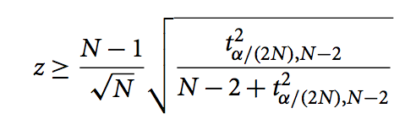
Grubbs’ Test
Detect outliers in univariate data
Assume data comes from normal (Gaussian) distribution
For each object x in a data set, we define a z-score as
where x ̄ is the mean, and s is the standard deviation of the input data. An object x is an outlier if
where t²_{α/(2N ),N −2} is the value taken by a t-distribution at a significance level of α/(2N), and N is the number of objects in the data set.
Notes:
with tα/(2N),N−2 denoting the critical value of the t distribution with (N-2) degrees of freedom and a significance level of α/(2N).
For one-sided tests, we use a significance level of level of α/N.

Slide 13
Grubbs’ Test
Detects one outlier X at a time, remove the outlier, and repeat. Hypothesis test:
H₀: There is no outlier in data
H_{A}: There is at least one outlier
Grubbs’ test statistic:
Reject H₀ if:
If you have multiple outliers, you can also think of other generalized methods (e.g. Tietjen-Moore test)
If data are not normally distributed, this approach is not a good idea.

Slide 14
Grubb’s test in R
Notes:
Arguments
x a numeric vector for data values.
opposite a logical indicating whether you want to check not the value with largest difference from the mean,
type Integer value indicating test variant. 10 is a test for one outlier (side is detected automatically and can be reversed by opposite parameter). 11 is a test for two outliers on opposite tails, 20 is test for two outliers in one tail.
two.sided Logical value indicating if there is a need to treat this test as two-sided.

Slide 15

Multivariate Outliers
Multivariate data: A data set involving two or more attributes or variables
Transform the multivariate outlier detection task into a univariate outlier detection problem
Method 1. Using the Mahalanobis distance.
For a multivariate data set, let o ̄ be the mean vector. For an object, o, in the data set, the Mahalanobis distance from o to o ̄ is
where S is the covariance matrix. MDist(o,o ̄) is a univariate variable, and thus Grubb’s test can be applied to this measure.

Slide 16

Multivariate Outliers
Multivariate data: A data set involving two or more attributes or variables
Transform the multivariate outlier detection task into a univariate outlier detection problem
Method 2. Use χ² –statistic:
where oi is the value of o on the ith dimension, E_{i} is the mean of the i-dimension among all objects, and n is the dimensionality
If χ² –statistic is large, then object o_{i} is an outlier

Slide 17
Multivariate Outlier Detection in R

Slide 18
Cooks Method
Cook's distance is a commonly used estimate of the influence of a data point when performing a least-squares regression analysis
Idea: Measure the effect of deleting a given observation on the estimates (Y^hat for all data points) to find data points with high leverage.
Uses:
to indicate influential data points that are particularly worth checking for validity
to indicate regions where it would be good to be able to obtain more data points

Slide 19
Cooks Method in R

Slide 20
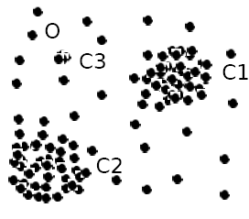
Statistical-based – Likelihood Approach
Assume the data set D contains samples from a mixture of two probability distributions:
M (majority distribution)
A (anomalous distribution)
General Approach:
Initially, assume all the data points belong to M
Let L_{t}(D) be the log likelihood of D at step t
For each point x_{t} that belongs to M, move it to A
Let L_{t+1} (D) be the new log likelihood.
Compute the difference, Δ = L_{t}(D) – L_{t+1} (D)
If Δ > c (some threshold), then x_{t} is declared as an anomaly and moved permanently from M to A
M
A

Slide 21
Statistical methods that don't assume a specific distribution (non-parametric)
Outlier detection using histograms
Figure shows the histogram of purchase amounts in transactions
A transaction in the amount of $7,500 is an outlier, since only 0.2% transactions have an amount higher than $5,000
Problem: Hard to choose an appropriate bin size
Too small → normal objects in empty/rare bins, false positive
Too big → outliers in some frequent bins, false negative
P($7500) < 0.002
Probability

Slide 22
Limitations of Statistical Approaches
Most of the tests are for a single attribute
In many cases, data distribution may not be known
For high dimensional data, it may be difficult to estimate the true distribution

Slide 23
Distance-based Approaches
Intuition: Objects that are far away from others are outliers
Three major approaches
Nearest-neighbor based
Density-based
Clustering-based

Slide 24
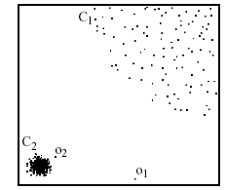
Nearest-Neighbor (NN) Approach
Approach:
Compute the distance between every pair of data points
There are various ways to define outliers:
Data points for which there are fewer than p neighboring points within a distance D
The top n data points whose distance to the k-th nearest neighbor is greatest
The top n data points whose average distance to the k nearest neighbors is greatest
p₂
×
p₁
×

Slide 25
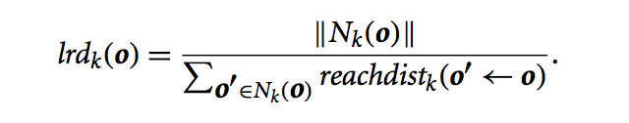
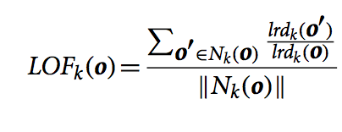
Density-based: LOF approach
Assumption: Density around a nonoutlier is similar to the density around its neighbors, while the density around an outlier is significantly different
For each point, compute the density of its local neighborhood
Compute local outlier factor (LOF) of a sample p as the average ratios of:
The density of sample p
The density of its nearest neighbors
Outliers are points with largest LOF value
Number of neighbors that are bounded by the distance to the k-th neighbor
Distances from such neighbors

Slide 26
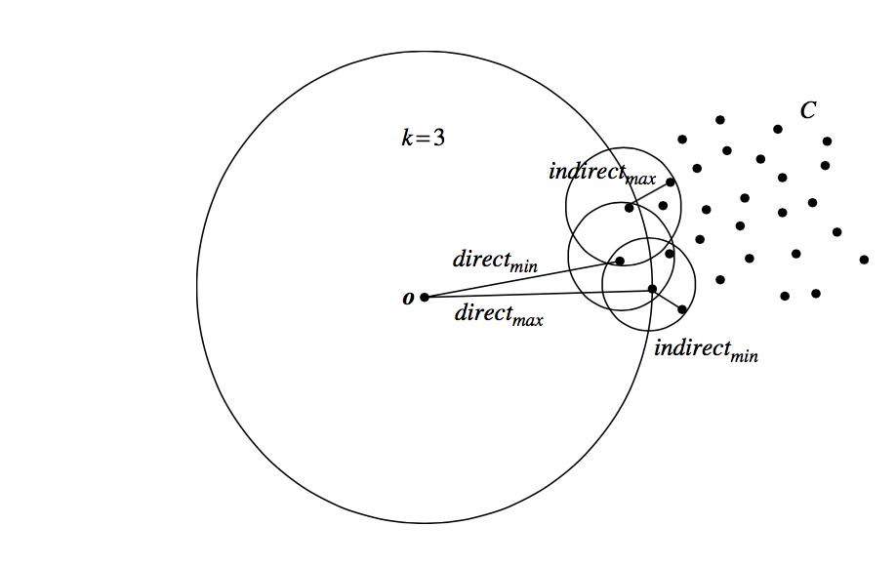
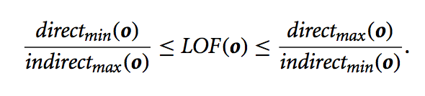
Density-based: LOF approach
LOF interpretation:
LOF is bounded by:
In the NN approach, p₂ is not considered as outlier, while LOF approach find both p₁ and p₂ as outliers
p₂
×
p₁
×

Slide 27
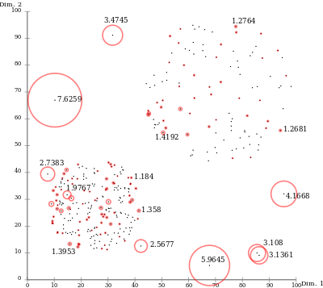
Examples of LOF values
Due to the local approach, LOF
is able to identify outliers in a
data set that would not be outliers
in another area of the data set.
For example, a point at a "small"
distance to a very dense cluster
is an outlier, while a point within
a sparse cluster might exhibit
similar distances to its neighbors.
Source: http://en.wikipedia.org/wiki/Local_outlier_factor
Notes:
A value of 1 or even less indicates a clear inlier, but there is no clear rule for when a point is an outlier. In one data set, a value of 1.1 may already be an outlier, in another dataset and parameterization (with strong local fluctuations) a value of 2 could still be an inlier. These differences can also occur within a dataset due to the locality of the method. There exist extensions of LOF that try to improve over LOF in these aspects:

Slide 28
LOF Outlier Detection in R

Slide 29
Outliers in Lower Dimensional Projection
In high-dimensional space, data is sparse and notion of proximity becomes meaningless
Every point is an almost equally good outlier from the perspective of proximity-based definitions
Lower-dimensional projection methods
A point is an outlier if in some lower dimensional projection, it is present in a local region of abnormally low density

Slide 30

Outliers in Lower Dimensional Projection
Divide each attribute into x equal-depth intervals
Each interval contains a fraction f = 1/x of the records
Consider a k-dimensional cube created by picking grid ranges from k different dimensions
If attributes are independent, we expect region to contain a fraction f^{k} of the records
For N points, we can measure sparsity of a cube D as:
Negative sparsity indicates cube contains smaller number of points than expected

Slide 31
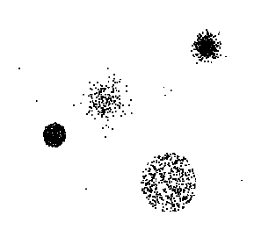
Clustering-Based
Basic idea: Cluster the data into groups of different density
Does the object belong to any cluster? If not, then it is identified as an outlier.
Is there a large distance between the object and the cluster to which it is closest? If yes, it is an outlier.
Is the object part of a small or sparse cluster? If yes, then all the objects in that cluster are outliers.

Slide 32
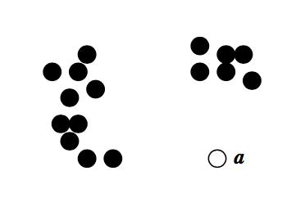
Clustering-Based Methods
Does the object belong to any cluster? If not, then it is identified as an outlier.
Using a density- based clustering method, such as DBSCAN, we note that the black points belong to clusters. The white point, a, does not belong to any cluster, and thus is declared an outlier.
You can use package dbscan in R.

Slide 33
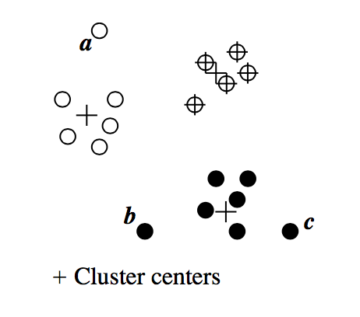
Clustering-Based Methods
Is there a large distance between the object and the cluster to which it is closest?
Using the k-means clustering method, we can partition the data points.
For each object, o, we can assign an outlier score to the object according to the distance between the object and the center that is closest to the object. Suppose the closest center to o is co; then the distance between o and co is dist(o, co), and the average distance between co and the objects assigned to o is lc . The ratio dist(o,co)/ l_{co} measures how dist(o, co) stands out from the average. The larger the ratio, the farther away o is relative from the center, and the more likely o is an outlier.

Slide 34
Clustering Based Outlier Detection in R

Slide 35
Cluster-based outliers: Strengths and weaknesses
Strengths
Detect outliers without requiring any labeled data
Works for many types of data
Clusters can be regarded as summaries of the data
Once the clusters are obtained, need only compare any object against the clusters to determine whether it is an outlier (fast)
Weaknesses
Effectiveness depends highly on the clustering method used—they may not be optimized for outlier detection
High computational cost: Need to first find clusters

Slide 36
Classification-based outliers
Idea: Train a classification model to distinguish "normal" from outliers.
One-class model
The classifier is trained to recognize "normal" objects
Learn the decision boundary e.g. Support Vector Machine
Anything not classified as normal is an outlier
Strength: Can generalize to new outliers that may not be close to known outliers.
Weakness: Quality depends on training data, which may be expensive to obtain

Slide 37
Outlier Detection - Three core problems
Regression
Problem: Predicting a continuous output variable from one or more continuous input variables
Algorithms: Linear models, Logistic regression
Clustering
Problem: Assignment of each data instance to one of K cluster labels
Algorithms: Hierarchical clustering, k-means
Classification
Problem: Predicting a categorical output from continuous and/or categorical variables

Slide 38
Projects

