Slide 1
VE281 Data Structures and Algorithms
Hash Table Size, Rehashing, and Applications of Hashing
Learning Objectives:
Know how to determine hash table size
Know why rehashing is needed and how to rehash
Know amortized analysis
Know a few typical applications of hashing

Slide 2
Outline
Hash Table Size and Rehashing
Applications of Hashing

Slide 3

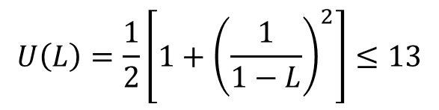


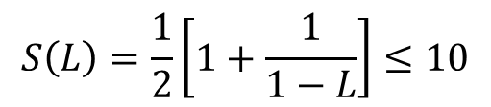
Determine Hash Table Size
First, given performance requirements, determine the maximum permissible load factor.
Example: we want to design a hash table based on linear probing so that on average
An unsuccessful search requires no more than 13 compares.
A successful search requires no more than 10 compares.
$$U\left(L\right)=\frac{1}{2}\left[1+{\left(\frac{1}{1−L}\right)}^{2}\right]≤13$$
$$⇒L≤\frac{4}{5}$$
$$L≤\frac{4}{5}$$
$$S\left(L\right)=\frac{1}{2}\left[1+\frac{1}{1−L}\right]≤10$$
$$⇒L≤\frac{18}{19}$$

Slide 4
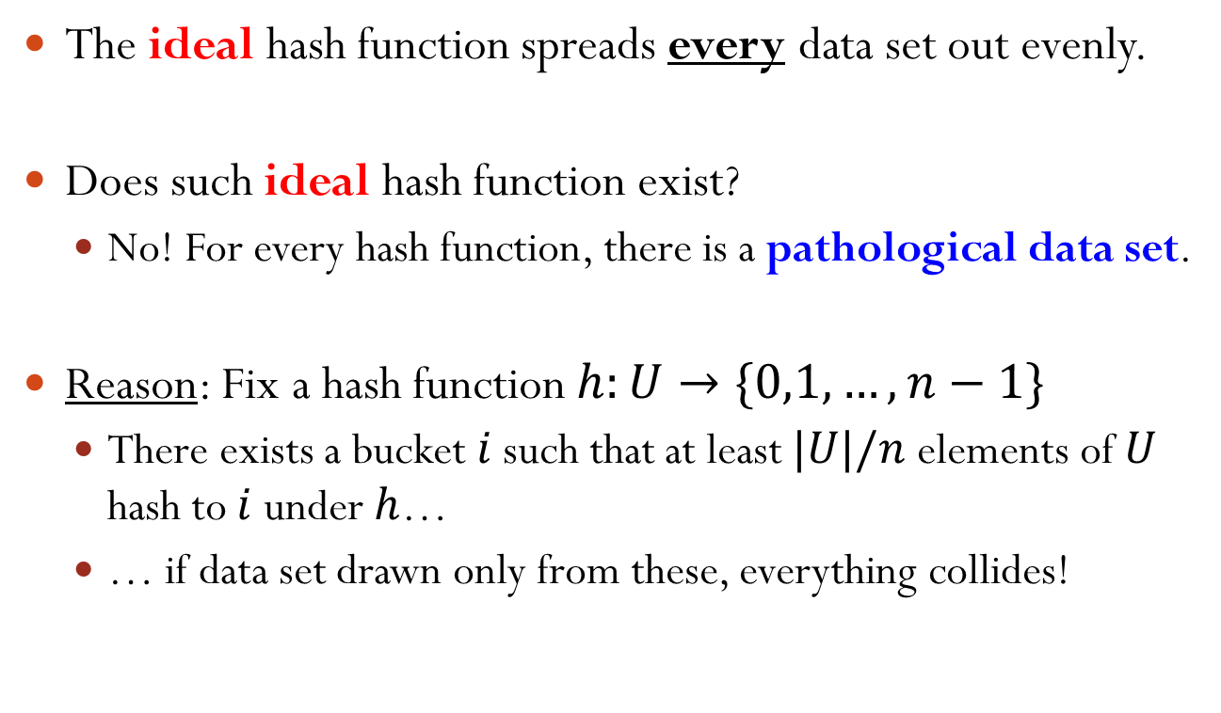
Determine Hash Table Size
For a fixed table size, estimate maximum number of items that will be inserted.
Example: no more than 1000 items.
For load factor $L=\frac{|S|}{n}≤\frac{4}{5}$, table size
$$n≥\frac{5}{4}∙1000=1250$$
Pick $n$ as a prime number. For example, $n=1259$.
However, sometimes there is no limit on the number of items to be inserted.

Slide 5
Rehashing Motivation
With more items inserted, the load factor increases. At some point, it will exceed the threshold (4/5 in the previous example) determined by the performance requirement.
For the separate chaining scheme, the hash table becomes inefficient when load factor L is too high.
If the size of the hash table is fixed, search performance deteriorates with more items inserted.
Even worse, for the open addressing scheme, when the hash table becomes full, we cannot insert a new item.

Slide 6
Rehashing
To solve these problems, we need to rehash:
Create a larger table, scan the current table, and then insert items into new table using the new hash function.
Note: The order is from the beginning to the end of the current table. Not original insertion order.
We can approximately double the size of the current table.
Observation: The single operation of rehashing is time-consuming. However, it does not occur frequently.
How should we justify the time complexity of rehashing?

Slide 7
Amortized Analysis
Amortized analysis: A method of analyzing algorithms that considers the entire sequence of operations of the program.
The idea is that while certain operations may be costly, they don’t occur frequently; the less costly operations are much more than the costly ones in the long run.
Therefore, the cost of those expensive operations is averaged over a sequence of operations.
In contrast, our previous complexity analysis only considers a single operation, e.g., insert, find, etc.

Slide 8
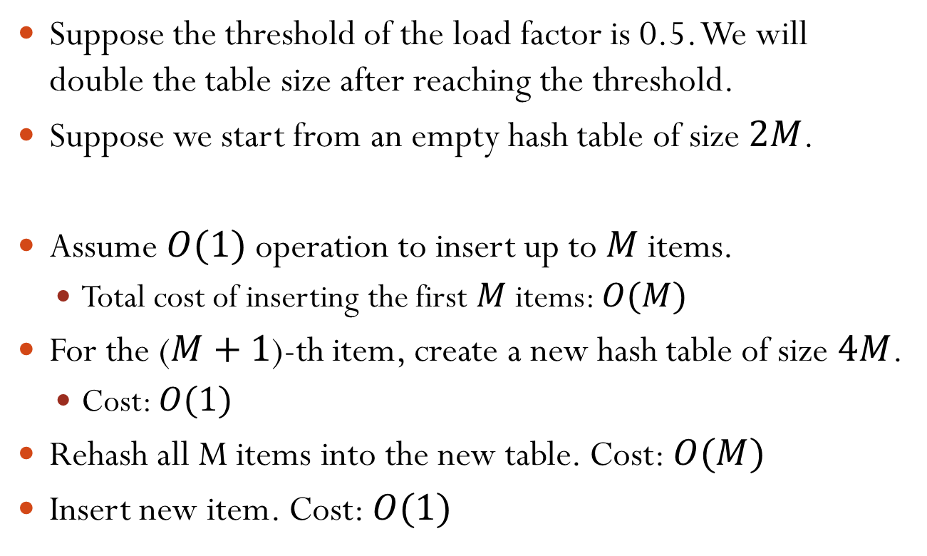
Amortized Analysis of Rehashing
Suppose the threshold of the load factor is 0.5. We will double the table size after reaching the threshold.
Suppose we start from an empty hash table of size $2M$.
Assume $O(1)$ operation to insert up to $M$ items.
Total cost of inserting the first $M$ items: $O(M)$
For the ($M+1$)-th item, create a new hash table of size $4M$.
Cost: $O(1)$
Rehash all M items into the new table. Cost: $O(M)$
Insert new item. Cost: $O(1)$
Total cost for inserting $M+1$ items is $2O\left(M\right)+2O\left(1\right)=O(M)$.

Slide 9
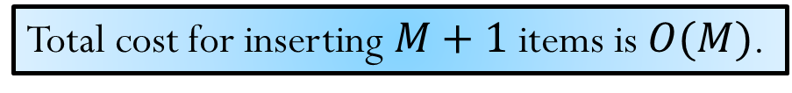

Amortized Analysis of Rehashing
The average cost to insert $M+1$ items is O(1).
Rehashing cost is amortized over individual inserts.
Total cost for inserting $M+1$ items is $O(M)$.

Slide 10
Outline
Hash Table Size and Rehashing
Applications of Hashing

Slide 11
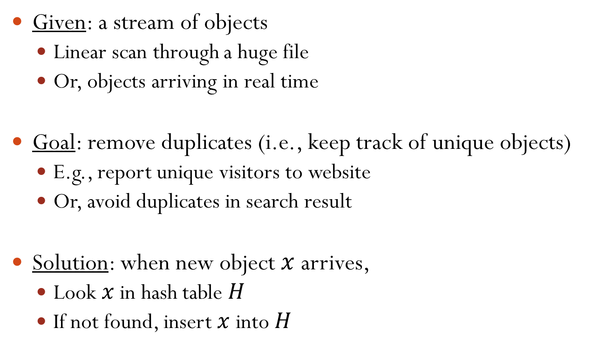
Application: De-Duplication
Given: a stream of objects
Linear scan through a huge file
Or, objects arriving in real time
Goal: remove duplicates (i.e., keep track of unique objects)
E.g., report unique visitors to website
Or, avoid duplicates in search result
Solution: when new object $x$ arrives,
Look $x$ in hash table $H$
If not found, insert $x$ into $H$

Slide 12
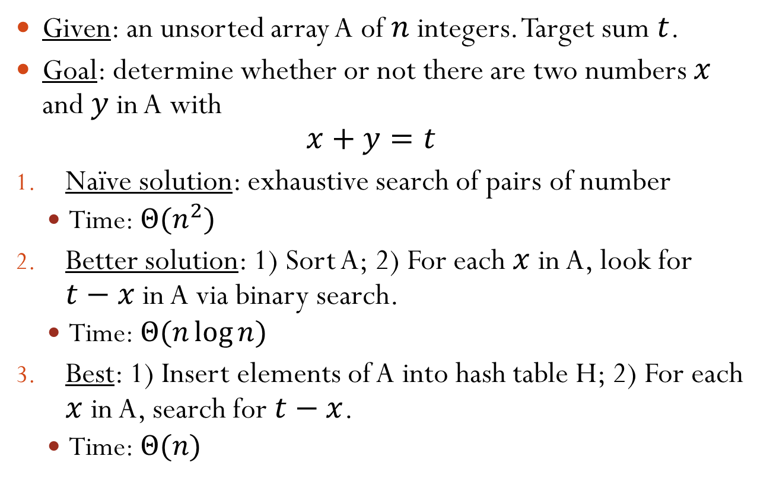
Application: 2-SUM Problem
Given: an unsorted array A of $n$ integers. Target sum $t$.
Goal: determine whether or not there are two numbers $x$ and $y$ in A with $x+y=t$
Naïve solution: exhaustive search of pairs of number
Time: $Θ(n^{2})$
Better solution: 1) Sort A; 2) For each $x$ in A, look for $t−x$ in A via binary search.
Time: $Θ(n\log{n})$
Best: 1) Insert elements of A into hash table H; 2) For each $x$ in A, search for $t−x$.
Time: $Θ(n)$

Slide 13
Further Immediate Application
Spellchecker
Database
Notes:
Store the valid English words in a hash table. Needs quick check of whether a word is valid.

Slide 14
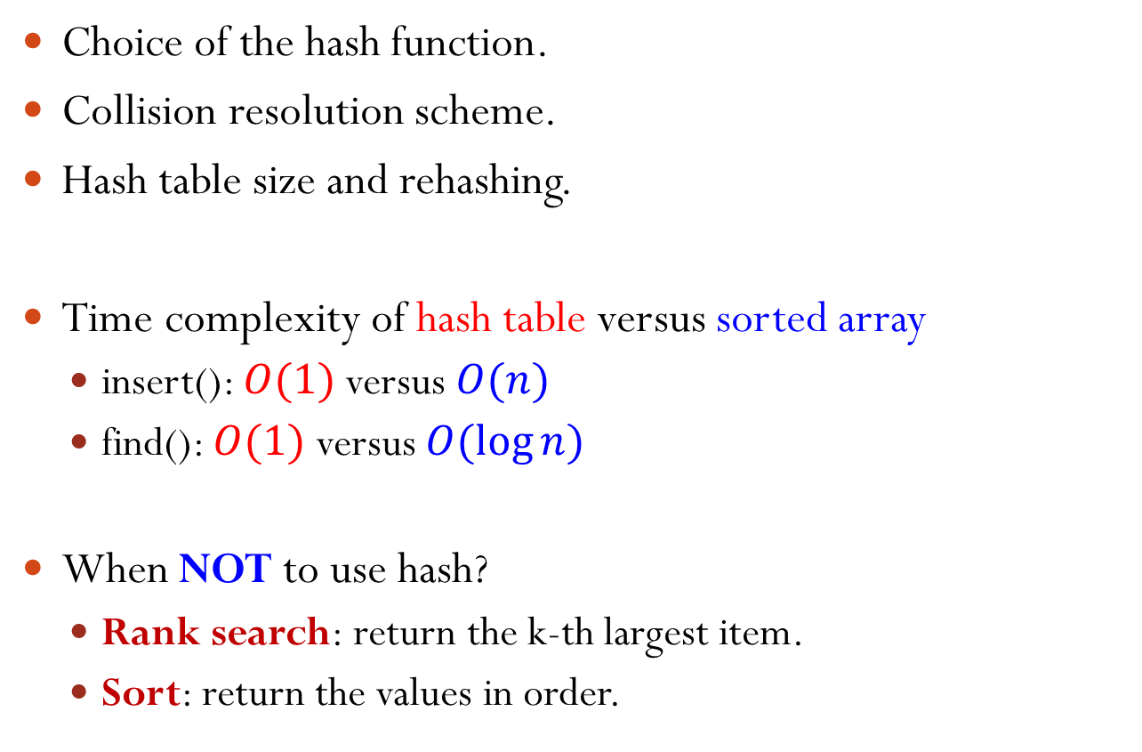
Hash Table Summary
Choice of the hash function.
Collision resolution scheme.
Hash table size and rehashing.
Time complexity of hash table versus sorted array
insert(): $O(1)$ versus $O(n)$
find(): $O(1)$ versus $O(\log{n})$
When NOT to use hash?
Rank search: return the k-th largest item.
Sort: return the values in order.

