Slide 1
VE281 Data Structures and Algorithms
Trees
Learning Objectives:
Know some basic terminology of trees and binary trees
Know some basic properties of binary trees
Know how to represent a binary tree by an array and a linked list

Slide 2
Outline
Trees
Binary Trees

Slide 3
Trees
Tree is an extension of linked list data structure:
Each node connects to multiple nodes.
A tree is a “natural” way to represent hierarchical structure and organization.
Many problems in computer science can be solved by breaking it down into smaller pieces and arranging the pieces in some form of hierarchical structure.
For example: merge sort.
Notes:
Draw a tree.

Slide 4
Tree Terminology
root
Just like lists, trees are collections of nodes.
The node at the top of the hierarchy is the root.
Nodes are connected by edges.
Edges define parent-child relationship.
Root has no parent.
All other nodes have exactly one parent.
A node with no children is called a leaf.
a
b
c
d
e
f
g
h
leaves

Slide 5
Subtrees
a
Subtree can be defined for any node in general, not just for the root node.
b
c
d
e
f
g
h
i
j
k
l
Notes:
Subtree of a node r is a tree rooted at a child of node r

Slide 6
More Tree Terminology
f is the child of b.
b is the parent of f.
Nodes that share the same parent are siblings.
b and c are the siblings of d.
e is the sibling of f.
a
b
c
d
e
f
g
h
i
j
k
l

Slide 7
Path
A path is a sequence of nodes such that the next node in the sequence is a child of the previous.
E.g., a→b→e→h is a path.
The path length is 3.
Path length may be 0, e.g., b going to itself is a path and its length is 0.
Claim: If there exists a path between two nodes, then this path is the unique path between these two nodes.
a
b
c
d
e
f
g
h

Slide 8
Ancestors and Descendants
If there exists a path from a node A to a node B, then A is an ancestor of B and B is a descendant of A.
E.g., a is an ancestor of h and h is a descendant of a.
a
b
c
d
e
f
g
h

Slide 9
Depth, Level, and Height of a Node
The depth or level of a node is the length of the unique path from the root to the node.
E.g., depth(b)=1, depth(a)=0.
The height of a node is the length of the longest path from the node to a leaf.
E.g., height(b)=2, height(a)=3.
All leaves have height zero.
a
b
c
d
e
f
g
h
Notes:
Note: definition on node.
Height of a node: there may exist multiple paths, each leading to a leaf.

Slide 10
Depth, Level, and Height of a Tree
The height of a tree is the height of its root.
This is also known as the depth of a tree.
The depth of the tree on the right is 3.
The number of levels of a tree is the height of the tree plus one.
The number of levels of the tree on the right is 4.
a
b
c
d
e
f
g
h
Notes:
Note: definition on tree

Slide 11
Degree
The degree of a node is the number of children of a node.
E.g., degree(a) = 3, degree(c) = 1.
The degree of a tree is the maximum degree of a node in the tree.
The degree of the tree on the right is 3.
a
b
c
d
e
f
g
h
i
j
k
l

Slide 12
A Simple Implementation of Tree
Each node is part of a linked list of siblings.
Additionally, each node stores a pointer to its first child.
struct node { Item item; node *firstChild; node *nextSibling; };
a
a
b
c
b
c
d
e
f
d
e
f

Slide 13
Outline
Trees
Binary Trees

Slide 14
Binary Tree
Every node can only have at most two children.
An empty tree is a special binary tree.
a
b
c
d
e
f
g
h

Slide 15
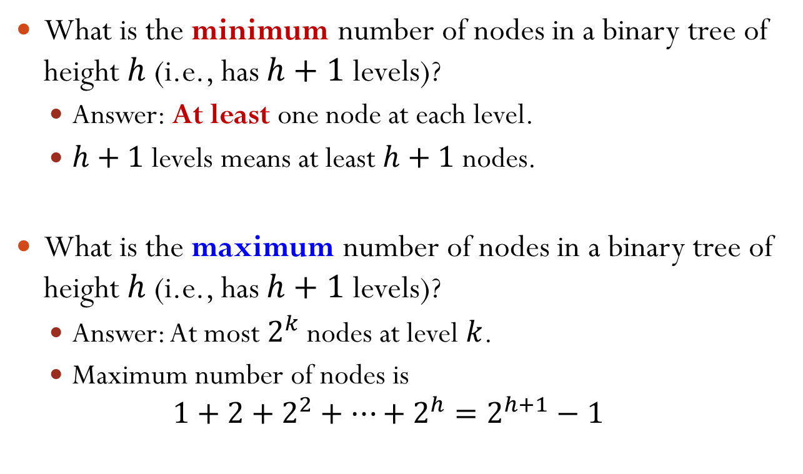
Binary Tree Properties
What is the minimum number of nodes in a binary tree of height $h$ (i.e., has $h+1$ levels)?
Answer: At least one node at each level.
$h+1$ levels means at least $h+1$ nodes.
What is the maximum number of nodes in a binary tree of height $h$ (i.e., has $h+1$ levels)?
Answer: At most $2^{k}$ nodes at level $k$.
Maximum number of nodes is $1+2+2^{2}+⋯+2^{h}=2^{h+1}−1$

Slide 16

Number Of Nodes and Height
Claim (from the previous slide): Let $n$ be the number of nodes in a binary tree whose height is $h$ (i.e., has $h+1$ levels).
We have ${h+1≤n≤2}^{h+1}−1$.
Question: given $n$ nodes, what is the height $h$ of the tree?
$\log_{2}{(n+1)}−1≤h≤n−1$

Slide 17
Types of Binary Trees
A binary tree is proper if every node has 0 or 2 children.
A binary tree is complete if:
every level except the lowest is fully populated, and
the lowest level is populated from left to right.
A binary tree is perfect if every level is fully populated.

Slide 18

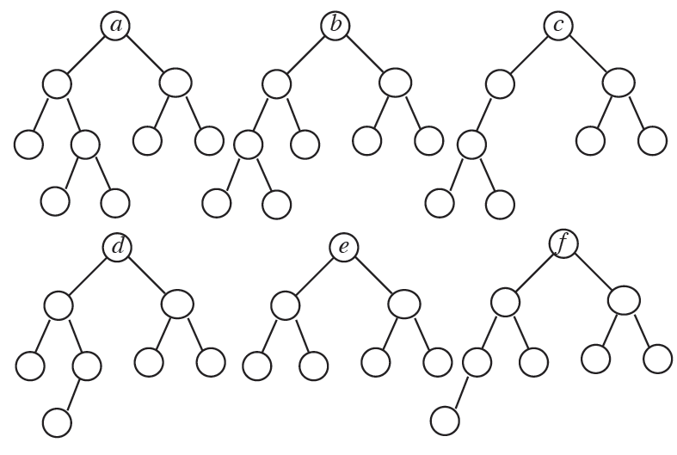

Which Statements Are Correct?
A. Trees a and d are proper. B. Tree c is complete.
C. Trees b and f are complete. D. Tree e is perfect.
Notes:
Answer: C and D

Slide 19

Numbering Nodes In a Perfect Binary Tree
Numbering nodes from 1 to $2^{h+1}−1$.
Numbering from top to bottom level.
Within a level, numbering from left to right.
1
2
3
4
5
6
7
8
9
10
11
12
13
14
15

Slide 20
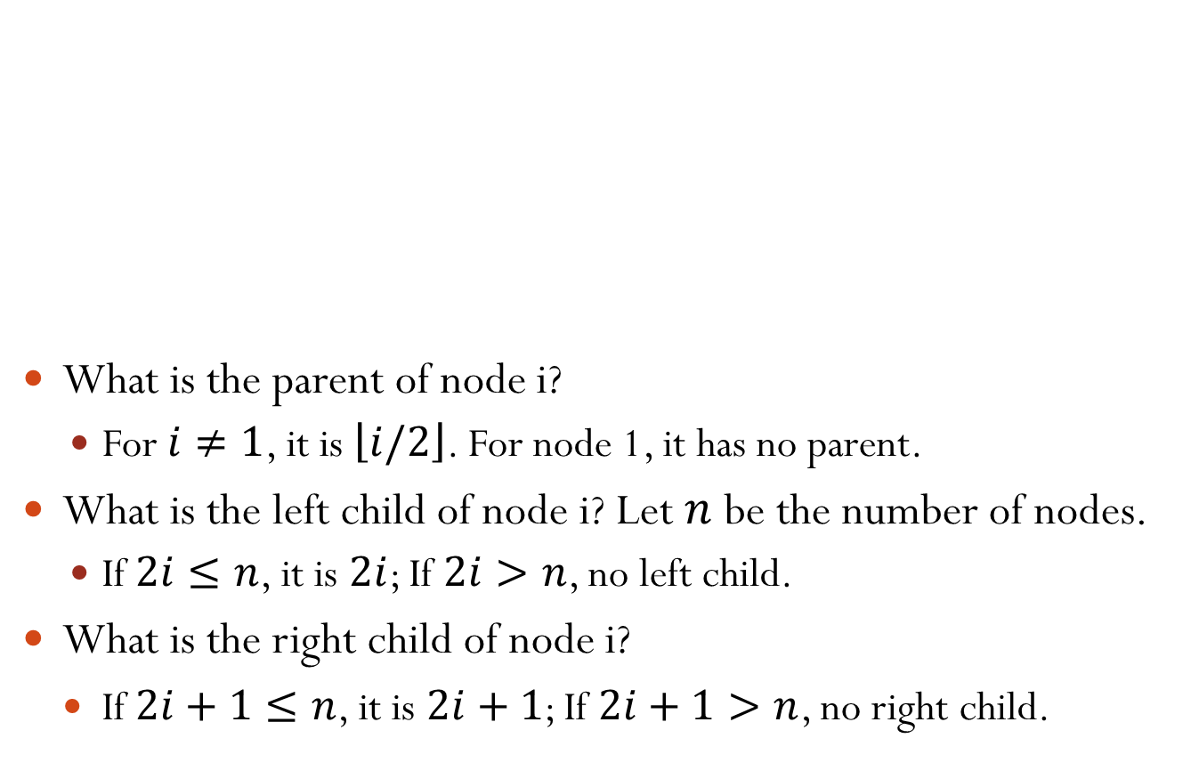
Numbering Nodes In a Perfect Binary Tree
1
What is the parent of node i?
For $i≠1$, it is $\left\lfloor i/2\right\rfloor$. For node 1, it has no parent.
What is the left child of node i? Let $n$ be the number of nodes.
If $2i≤n$, it is $2i$; If $2i>n$, no left child.
What is the right child of node i?
If $2i+1≤n$, it is $2i+1$; If $2i+1>n$, no right child.
2
3
4
5
6
7
8
9
10
11
12
13
14
15

Slide 21
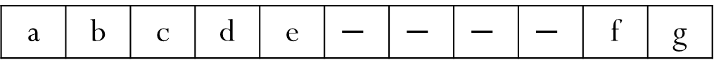
Representing Binary Tree Using Array
Based on the numbering scheme for a perfect binary tree.
If the number of the node in a perfect binary tree is i, then the node is put at index i of the array.
a
1
b
2
c
3
d
4
e
5
10
f
g
11
a | b | c | d | e | $$−$$ | $$−$$ | $$−$$ | $$−$$ | f | g
[1] | [2] | [3] | [4] | [5] | [6] | [7] | [8] | [9] | [10] | [11]
Notes:
We can represent binary tree either using an array or using a linked structure.
Note that index starts from 1.

Slide 22

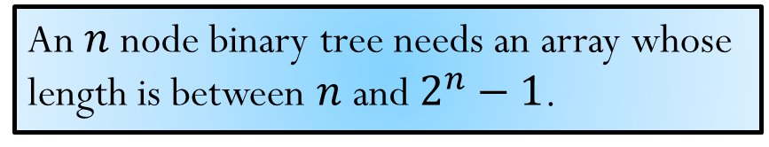
How Would You Represent a Right-skewed Binary Tree?
a
Assume array index starts from 1.
b
[1]
[3]
[5]
[7]
[9]
[11]
[13]
[15]
c
A.
B.
C.
D.
a | b | $$−$$ | c | $$−$$ | $$−$$ | $$−$$ | d | $$−$$ | $$−$$ | $$−$$ | $$−$$ | $$−$$ | $$−$$ | $$−$$
d
a | b | c | d | $$−$$ | $$−$$ | $$−$$ | $$−$$ | $$−$$ | $$−$$ | $$−$$ | $$−$$ | $$−$$ | $$−$$ | $$−$$
a | $$−$$ | b | $$−$$ | $$−$$ | $$−$$ | c | $$−$$ | $$−$$ | $$−$$ | $$−$$ | $$−$$ | $$−$$ | $$−$$ | d
a | $$−$$ | b | $$−$$ | c | $$−$$ | d | $$−$$ | $$−$$ | $$−$$ | $$−$$ | $$−$$ | $$−$$ | $$−$$ | $$−$$
[1]
[3]
[5]
[7]
[9]
[11]
[13]
[15]
An $n$ node binary tree needs an array whose length is between $n$ and $2^{n}−1$.
Notes:
Answer: C

Slide 23
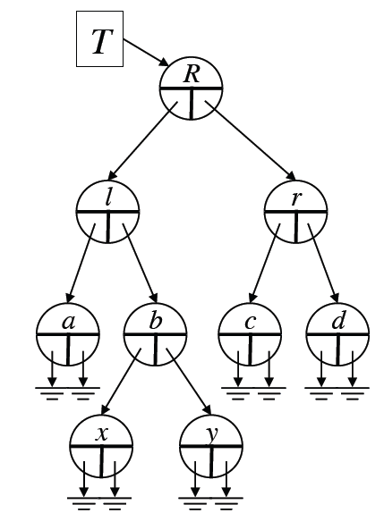
Representing Binary Tree Using Linked Structure
struct node { Item item; node *left; node *right; };
left/right points to a left/right subtree.
If the subtree is an empty one, the pointer points to NULL.
For a leaf node, both its left and right pointers are NULL.

