Slide 1
VE281 Data Structures and Algorithms
Binary Tree Traversal
Learning Objectives:
Know the effect and procedure of pre-order, post-order, and in-order depth-first traversal
Know the effect and procedure of level-order traversal

Slide 2
Binary Tree Traversal
Many binary tree operations are done by performing a traversal of the binary tree.
In a traversal, each node of the binary tree is visited exactly once.
During the visit of a node, all actions (making a clone, displaying, evaluating the operator, etc.) with respect to this node are taken.

Slide 3
Binary Tree Traversal Methods
Depth-first traversal
Pre-order
Post-order
In-order
Level-order traversal

Slide 4
Pre-Order Depth-First Traversal Procedure
Visit the node
Visit its left subtree
Visit its right subtree
void preOrder(node *n) { if(!n) return; visit(n); preOrder(n->left); preOrder(n->right);
}
a
b
c
a→b→c
Notes:
The input argument is a pointer to a node.

Slide 5
Pre-Order Depth-First Traversal Example
a
a
b
b
c
d
g
d
e
f
h
e
g
h
i
j
i
c
f
j
a→b→d→g→h→e→i→c→f→j

Slide 6
Post-Order Depth-First Traversal Procedure
Visit the left subtree
Visit the right subtree
Visit the node
void postOrder(node *n) { if(!n) return; postOrder(n->left); postOrder(n->right); visit(n); }
a
b
c
b→c→a

Slide 7
Post-Order Depth-First Traversal Example
a
g
b
c
h
d
d
e
f
i
e
b
g
h
i
j
j
f
c
a
g→h→d→i→e→b→j→f→c→a

Slide 8
In-Order Depth-First Traversal Procedure
Visit the left subtree
Visit the node
Visit the right subtree
void inOrder(node *n) { if(!n) return; inOrder(n->left); visit(n); inOrder(n->right); }
a
b
c
b→a→c

Slide 9


What Is the Result of In-Order Depth-First Traversal?
A. g, d, h, b, e, i, a, c, f, j
B. g, d, h, b, e, i, a, f, j, c
C. g, d, h, b, i, e, a, j, f, c
D. g, d, h, b, i, e, a, f, j, c
a
b
c
d
e
f
g
h
i
j
Notes:
Answer: B

Slide 10
Level-Order Traversal
We want to traverse the tree level by level from top to bottom.
Within each level, traverse from left to right.
a
b
c
How can we implement this traversal?
d
e
f
g
h
i
j
a→b→c→d→e→f→g→h→i→j

Slide 11
Level-Order Traversal Procedure
Use a queue!
Enqueue the root node into an empty queue.
While the queue is not empty, dequeue a node from the front of the queue.
Visit the node.
Enqueue its left child (if exists) and right child (if exists) into the queue.
Loop

Slide 12
Level-Order Traversal Code and Example
void levelOrder(node *root) { queue q; // Empty queue q.enqueue(root); while(!q.isEmpty()) { node *n = q.dequeue(); visit(n); if(n->left) q.enqueue(n->left); if(n->right) q.enqueue(n->right); } }
a
Queue:
a
b
c
d
e
f
b
c
Output:
a
b
c
d
e
f
d
e
f
Notes:
Now we show the code.

Slide 13
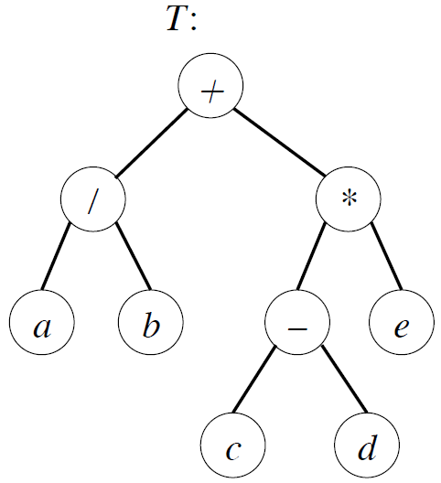
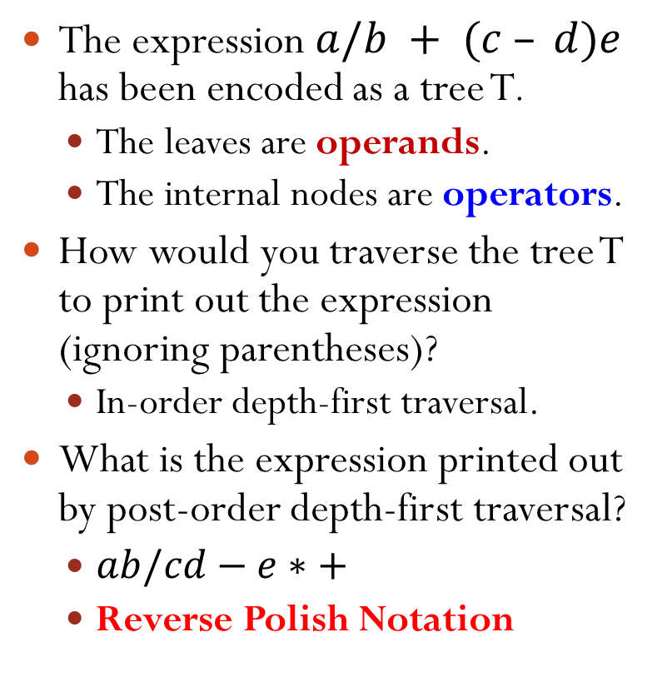
Binary Tree Traversal Application
The expression $a/b + (c – d)e$ has been encoded as a tree T.
The leaves are operands.
The internal nodes are operators.
How would you traverse the tree T to print out the expression (ignoring parentheses)?
In-order depth-first traversal.
What is the expression printed out by post-order depth-first traversal?
$ab/cd−e∗+$
Reverse Polish Notation
Notes:
In-order depth-first traversal: we ignore parentheses
Combining RPN with stack, we can obtain the expression result very easily by visiting the RPN from the beginning to the end.

