Slide 1
VE281 Data Structures and Algorithms
Dynamic Programming
Learning Objectives:
Understand the basic idea of dynamic programming
Know under what situation dynamic programming could be applied

Slide 2
Outline
Dynamic Programming
Motivation
Example: Matrix-Chain Multiplication
Summary

Slide 3
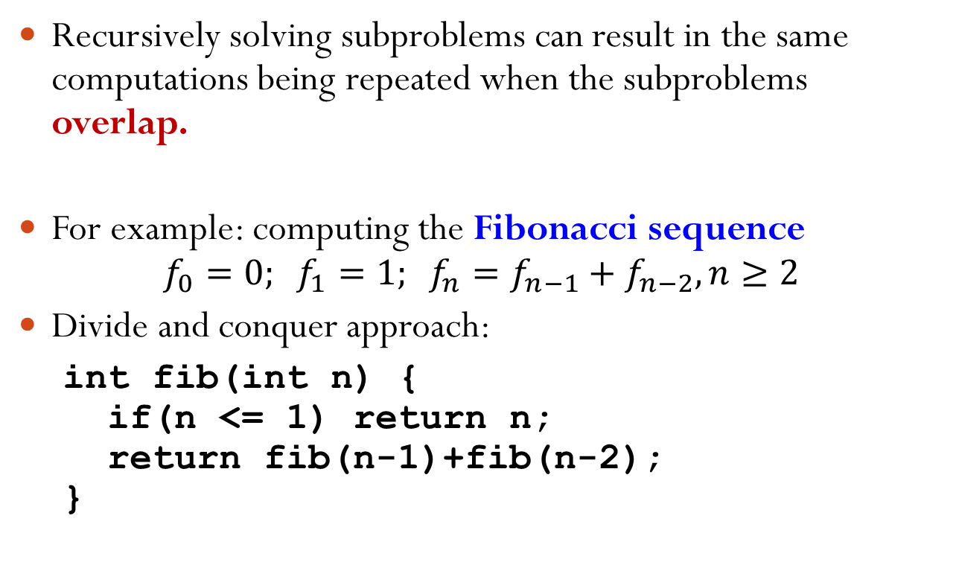
Limitation of Divide and Conquer
Recursively solving subproblems can result in the same computations being repeated when the subproblems overlap.
For example: computing the Fibonacci sequence
$$f_{0}=0; f_{1}=1; f_{n}=f_{n−1}+f_{n−2}, n≥2$$
Divide and conquer approach:
int fib(int n) { if(n <= 1) return n; return fib(n-1)+fib(n-2); }

Slide 4
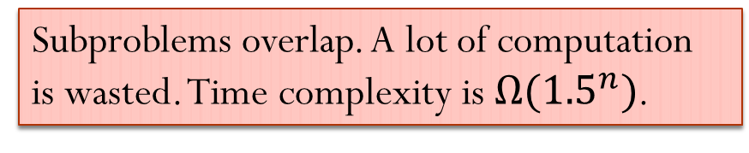
Fibonacci Sequence Divide and Conquer Solution
int fib(int n) { if(n <= 1) return n; return fib(n-1)+fib(n-2); }
fib(5)
fib(4)
fib(3)
fib(3)
fib(2)
fib(2)
fib(1)
fib(2)
fib(1)
fib(1)
fib(0)
fib(1)
fib(0)
fib(1)
fib(0)
Subproblems overlap. A lot of computation is wasted. Time complexity is $Ω({1.5}^{n})$.

Slide 5
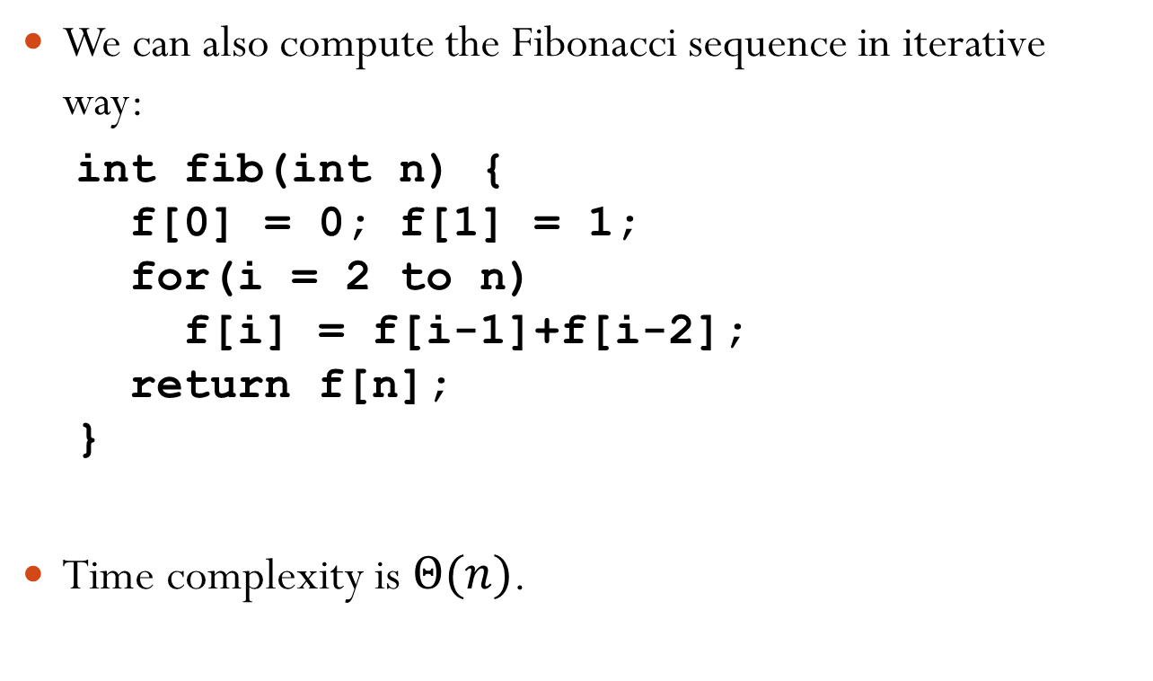
Fibonacci Sequence Iterative Solution
We can also compute the Fibonacci sequence in iterative way:
int fib(int n) { f[0] = 0; f[1] = 1; for(i = 2 to n) f[i] = f[i-1]+f[i-2]; return f[n]; }
Time complexity is $Θ(n)$.

Slide 6
Dynamic Programming
Used when a problem can be divided into subproblems that overlap.
Solve each subproblem once and store the solution in a table.
If a subproblem is encountered again, simply look up its solution in the table.
Reconstruct the solution to the original problem from the solutions to the subproblems.
The more overlap the better, as this reduces the number of subproblems.
Dynamic programming can be applied to solve optimization problem.

Slide 7
Optimization Problem
Many problems we encounter are optimization problems:
A problem in which some function (called the objective function) is to be optimized (usually minimized or maximized) subject to some constraints.
The solutions that satisfy the constraints are called feasible solutions.
The number of feasible solutions is typically very large.
We obtain the optimal solution by searching the feasible solution space.

Slide 8
Optimization Problem Example
Minimum spanning tree.
Objective function: the sum of all edge weights.
Constraints: the subgraph must be a spanning tree.

Slide 9
Outline
Dynamic Programming
Motivation
Example: Matrix-Chain Multiplication
Summary

Slide 10
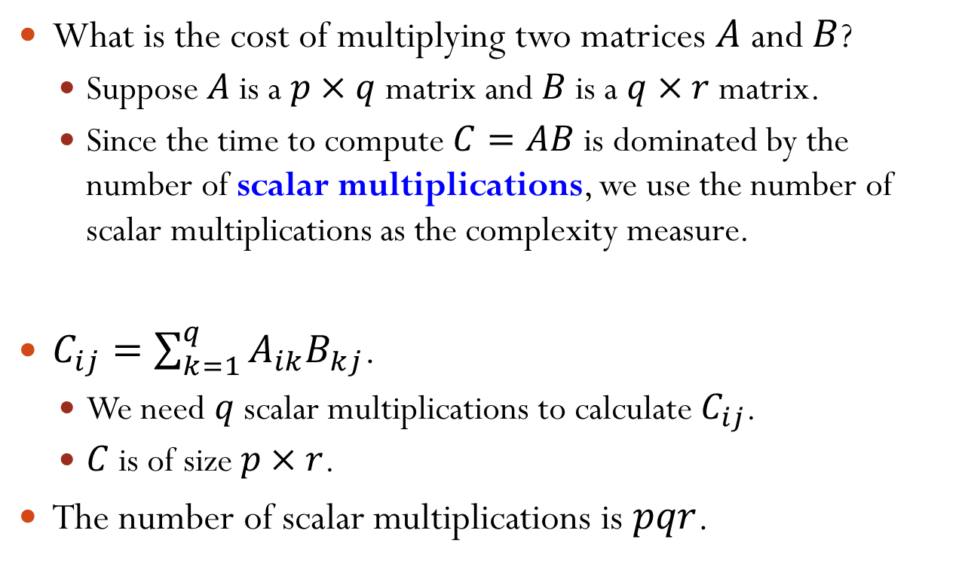
Matrix-Chain Multiplication
What is the cost of multiplying two matrices $A$ and $B$?
Suppose $A$ is a $p×q$ matrix and $B$ is a $q×r$ matrix.
Since the time to compute $C=AB$ is dominated by the number of scalar multiplications, we use the number of scalar multiplications as the complexity measure.
$C_{ij}=\sum_{k=1}^{q}{A_{ik}B_{kj}}$.
We need $q$ scalar multiplications to calculate $C_{ij}$.
$C$ is of size $p×r$.
The number of scalar multiplications is $pqr$.

Slide 11
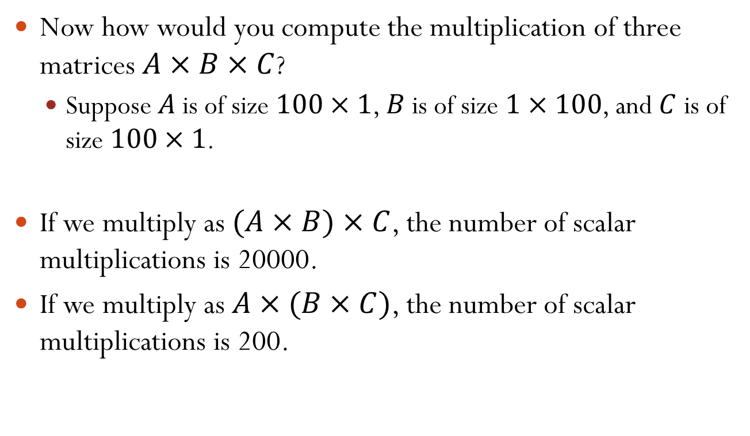
Matrix-Chain Multiplication
Now how would you compute the multiplication of three matrices $A×B×C$?
Suppose $A$ is of size $100×1$, $B$ is of size $1×100$, and $C$ is of size $100×1$.
If we multiply as $(A×B)×C$, the number of scalar multiplications is 20000.
If we multiply as $A×(B×C)$, the number of scalar multiplications is 200.
Notes:
(AxB)xC: 100*1*100 + 100*100*1 = 20000
Ax(BxC): 1*100*1 + 100*1*1 = 200

Slide 12
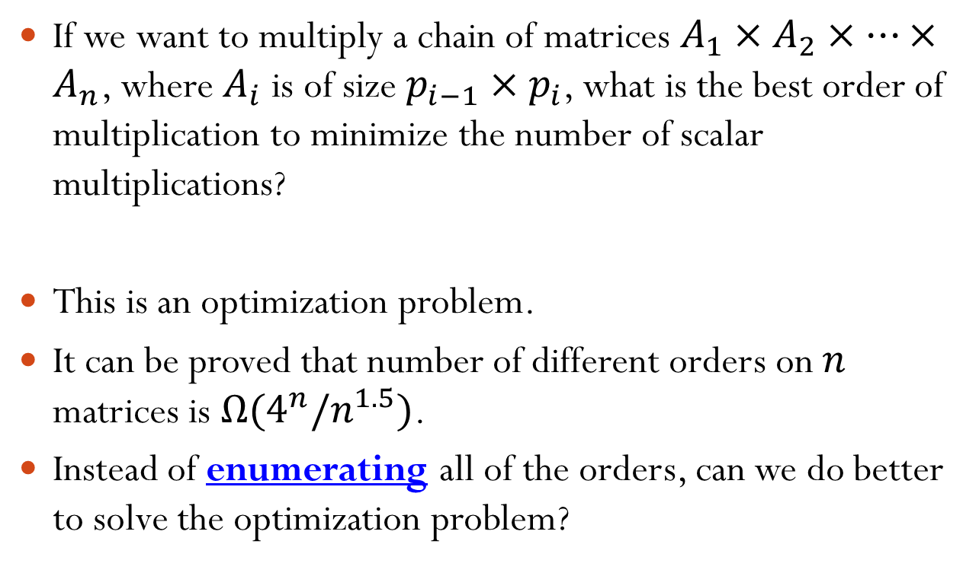
Matrix-Chain Multiplication
If we want to multiply a chain of matrices $A_{1}×A_{2}×⋯×A_{n}$, where $A_{i}$ is of size $p_{i−1}×p_{i}$, what is the best order of multiplication to minimize the number of scalar multiplications?
This is an optimization problem.
It can be proved that number of different orders on $n$ matrices is $Ω(4^{n}/n^{1.5})$.
Instead of enumerating all of the orders, can we do better to solve the optimization problem?
Notes:
One requirement of valid matrix multiplication is: if we multiple A and B, A is a x b and B is c x d, then we require b = c.

Slide 13

Matrix-Chain Multiplication
For simplicity, define the problem of finding the optimal order to multiply $A_{i}×A_{i+1}×⋯×A_{j}$ as $Q_{ij}$. The minimal number of scalar multiplications is $m_{ij}$.
We ultimately want to solve $Q_{1n}$.

Slide 14
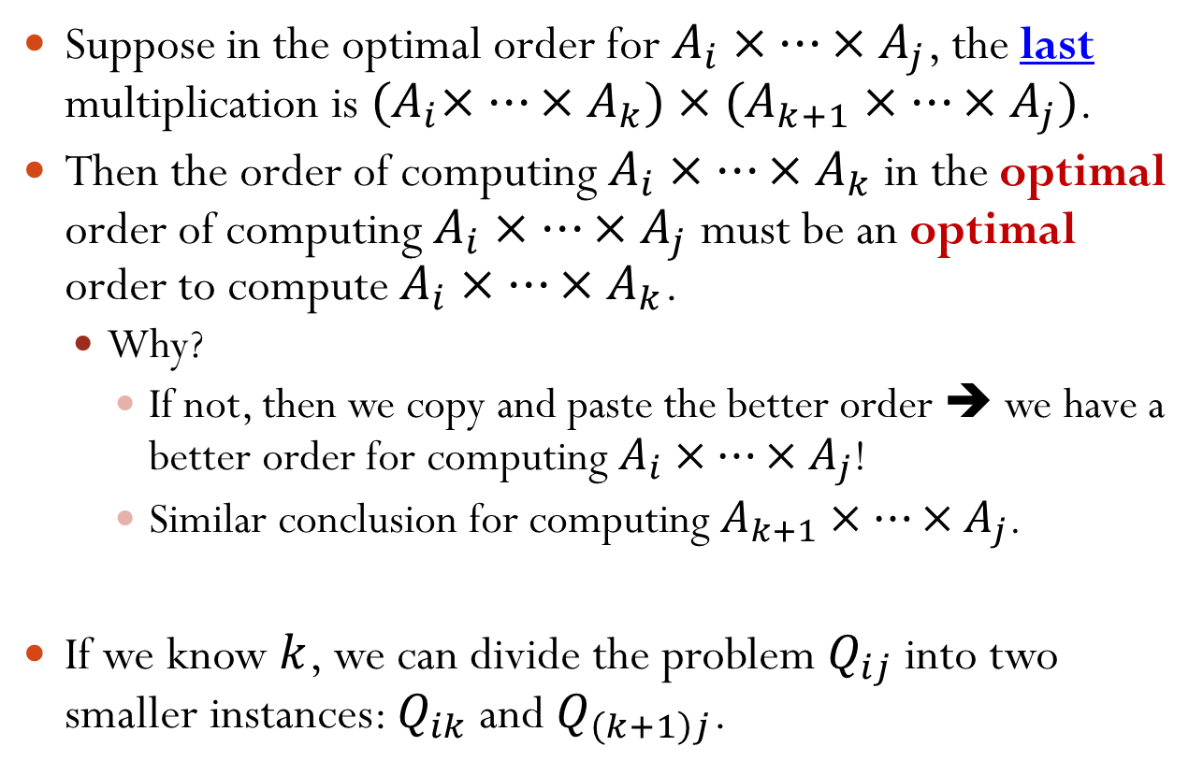
Matrix-Chain Multiplication
Suppose in the optimal order for $A_{i}×⋯×A_{j}$, the last multiplication is ${(A}_{i}×⋯×A_{k})×(A_{k+1}×⋯×A_{j})$.
Then the order of computing $A_{i}×⋯×A_{k}$ in the optimal order of computing $A_{i}×⋯×A_{j}$ must be an optimal order to compute $A_{i}×⋯×A_{k}$.
Why?
If not, then we copy and paste the better order ➔ we have a better order for computing $A_{i}×⋯×A_{j}$!
Similar conclusion for computing $A_{k+1}×⋯×A_{j}$.
If we know $k$, we can divide the problem $Q_{ij}$ into two smaller instances: $Q_{ik}$ and $Q_{\left(k+1\right)j}$.

Slide 15
Matrix-Chain Multiplication
Assume we have known the minimum number of scalar multiplications for $Q_{ik}$ and $Q_{\left(k+1\right)j}$ as $m_{ik}$ and $m_{\left(k+1\right)j}$.
Then $m_{ij}=m_{ik}+m_{\left(k+1\right)j}+p_{i−1}p_{k}p_{j}$.
However, we don’t know $k$! We need to consider all possible divisions, i.e., all $i≤k≤j−1$.
Thus, in order to solve $Q_{ij}$, we need to consider all subproblems $Q_{ik}$ and $Q_{\left(k+1\right)j}$, for all $i≤k≤j−1$.
$m_{ij}=\min_{i≤k≤j−1}{(m_{ik}+m_{\left(k+1\right)j}+p_{i−1}p_{k}p_{j})}$
Notes:
A_i x ... x A_k has dimension p_{i-1} x p_k; A_{k+1} x ... x A_j has dimension p_k x p_j
Thus, last matrix multiplication needs # scalar multiplications = p_{i-1} x p_k x p_j.
When k = i, it is A_i x (A_{i+1} x ... x A_j)
When k = j-1, it is (A_i x ... x A_{j-1}) x A_j

Slide 16















Matrix-Chain Multiplication
In summary, we can divide the problem into subproblems of the same form.
$$Q_{14}$$
$$Q_{11}$$
$$Q_{24}$$
$$Q_{12}$$
$$Q_{34}$$
$$Q_{13}$$
$$Q_{44}$$
$$Q_{22}$$
$$Q_{34}$$
$$Q_{23}$$
$$Q_{44}$$
$$Q_{11}$$
$$Q_{23}$$
$$Q_{12}$$
$$Q_{33}$$
Many subproblems are overlapped.
Notes:
Q_{i, j} is determined by Q_{i, i} & Q_{i+1, j}, Q_{i, i+1} & Q_{i+2, j}, ..., Q_{i, j-1} & Q_{j, j}
Many subproblems are overlapped, e.g., Q12, Q23, Q34

Slide 17
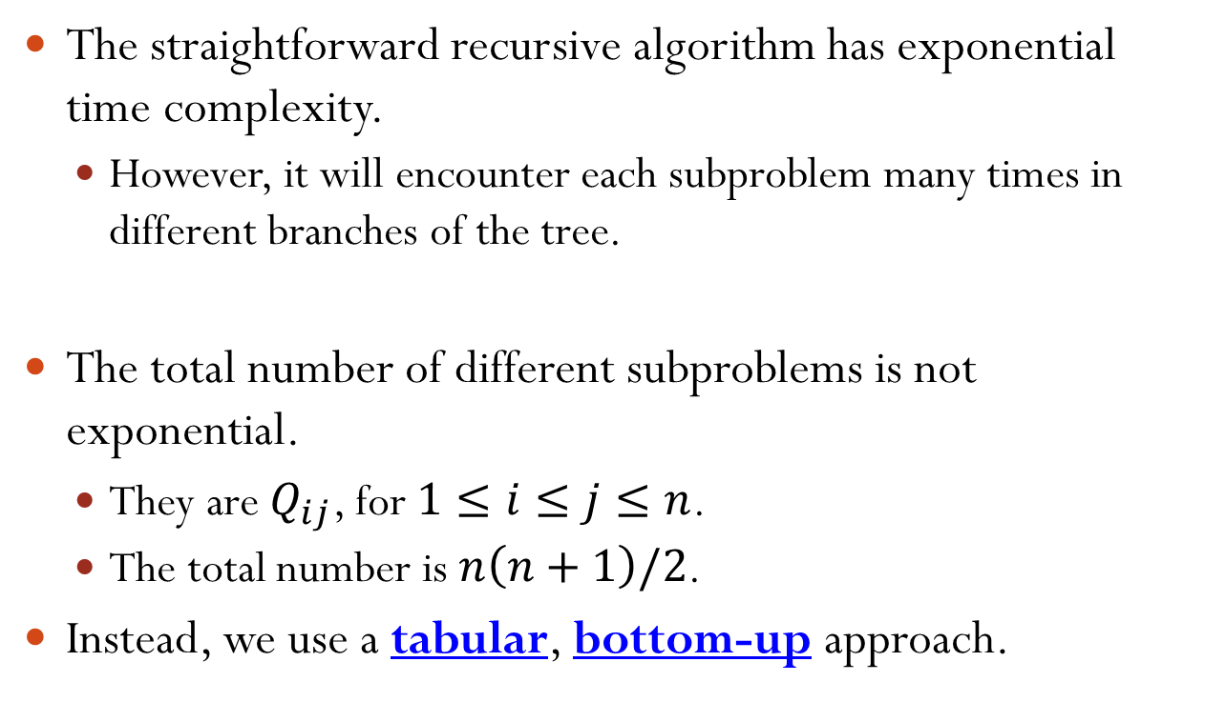
Matrix-Chain Multiplication
The straightforward recursive algorithm has exponential time complexity.
However, it will encounter each subproblem many times in different branches of the tree.
The total number of different subproblems is not exponential.
They are $Q_{ij}$, for $1≤i≤j≤n$.
The total number is $n\left(n+1\right)/2$.
Instead, we use a tabular, bottom-up approach.

Slide 18
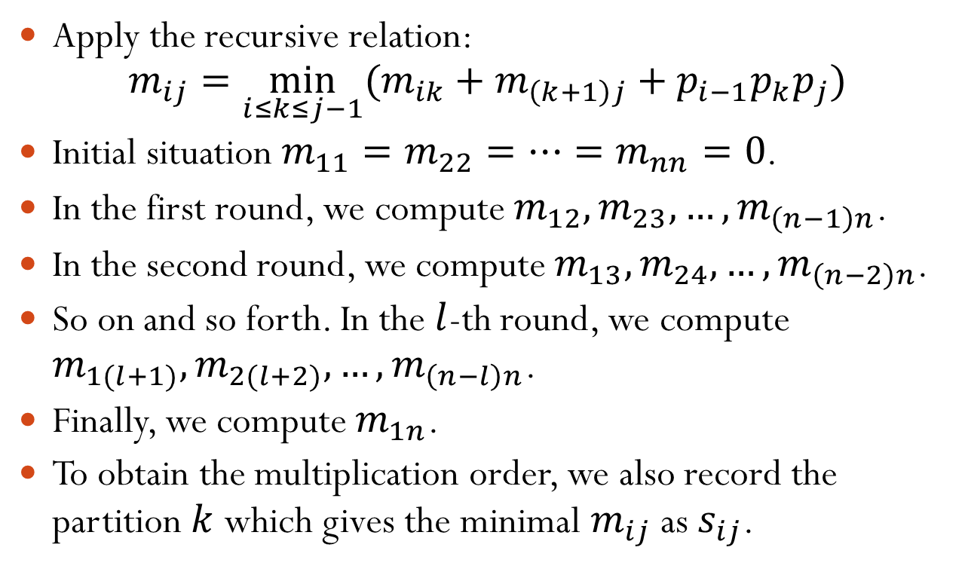
Matrix-Chain Multiplication Bottom-up Approach
Apply the recursive relation: $m_{ij}=\min_{i≤k≤j−1}{(m_{ik}+m_{\left(k+1\right)j}+p_{i−1}p_{k}p_{j})}$
Initial situation $m_{11}=m_{22}=⋯=m_{nn}=0$.
In the first round, we compute $m_{12}, m_{23}, …, m_{\left(n−1\right)n}$.
In the second round, we compute $m_{13}, m_{24}, …, m_{\left(n−2\right)n}$.
So on and so forth. In the $l$-th round, we compute $m_{1(l+1)}, m_{2(l+2)}, …, m_{\left(n−l\right)n}$.
Finally, we compute $m_{1n}$.
To obtain the multiplication order, we also record the partition $k$ which gives the minimal $m_{ij}$ as $s_{ij}$.
Notes:
What is m_ii? It is the minimum # of scalar multiplications for getting A_ii, which is 0.
s_ij: First compute A_i x A_{i+1} x ... x A_{s_ij} and then compute A_{s_ij + 1} x A_{s_ij + 2} x ... x A_j

Slide 19



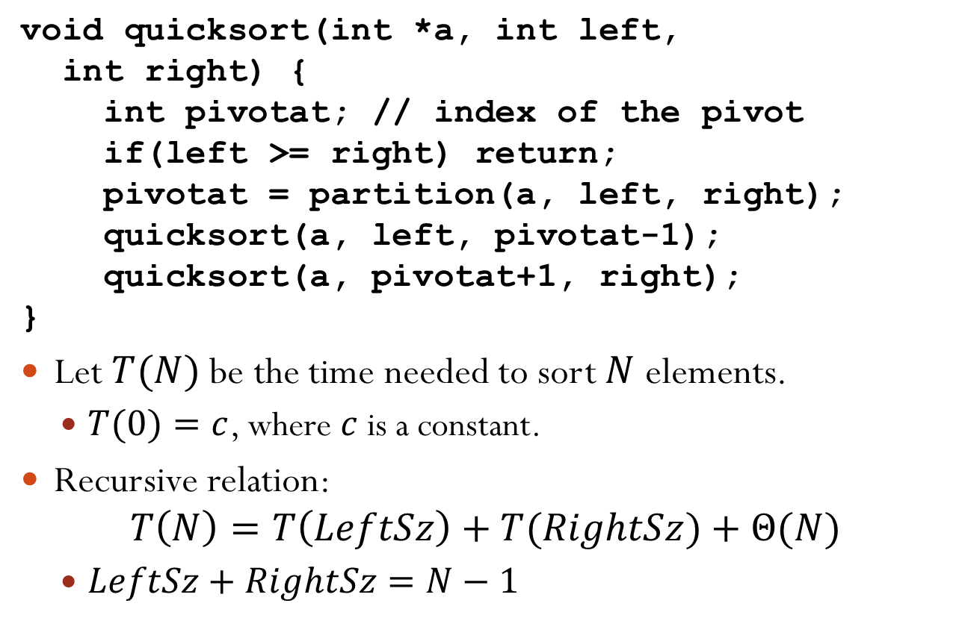

Matrix-Chain Multiplication Example
$n=4$, $A_{1}×A_{2}×A_{3}×A_{4}$.
$p_{0}=10, p_{1}=1, p_{2}=10, p_{3}=1, p_{4}=20$.
$$m_{ij}$$
$$j$$
$$s_{ij}$$
$$j$$
1 | 2 | 3 | 4
1 | 2 | 3 | 4
1
2
3
4
0
− | 0
− | − | 0
− | − | − | 0
1
2
3
4
−
− | −
− | − | −
− | − | − | −
$$i$$
$$i$$
Notes:
I.e., A1 is 10x1, A2 is 1x10, A3 is 10x1, and A4 is 1x20

Slide 20


Matrix-Chain Multiplication Example
$n=4$, $A_{1}×A_{2}×A_{3}×A_{4}$.
$p_{0}=10, p_{1}=1, p_{2}=10, p_{3}=1, p_{4}=20$.
$$m_{ij}$$
$$j$$
$$s_{ij}$$
$$j$$
1 | 2 | 3 | 4
1 | 2 | 3 | 4
1
2
3
4
0
− | 0
− | − | 0
− | − | − | 0
1
2
3
4
−
− | −
− | − | −
− | − | − | −
$$i$$
$$i$$
$$m_{i(i+1)}=m_{ii}+m_{(i+1)(i+1)}+p_{i−1}p_{i}p_{i+1}$$
$$=p_{i−1}p_{i}p_{i+1}$$

Slide 21
Matrix-Chain Multiplication Example
$n=4$, $A_{1}×A_{2}×A_{3}×A_{4}$.
$p_{0}=10, p_{1}=1, p_{2}=10, p_{3}=1, p_{4}=20$.
$$m_{ij}$$
$$j$$
$$s_{ij}$$
$$j$$
1 | 2 | 3 | 4
1 | 2 | 3 | 4
1
2
3
4
0 | 100
− | 0 | 10
− | − | 0 | 200
− | − | − | 0
1
2
3
4
− | 1
− | − | 2
− | − | − | 3
− | − | − | −
$$i$$
$$i$$
$$m_{i(i+1)}=m_{ii}+m_{(i+1)(i+1)}+p_{i−1}p_{i}p_{i+1}$$
$$=p_{i−1}p_{i}p_{i+1}$$

Slide 22

Matrix-Chain Multiplication Example
$n=4$, $A_{1}×A_{2}×A_{3}×A_{4}$.
$p_{0}=10, p_{1}=1, p_{2}=10, p_{3}=1, p_{4}=20$.
$$m_{ij}$$
$$j$$
$$s_{ij}$$
$$j$$
1 | 2 | 3 | 4
1 | 2 | 3 | 4
1
2
3
4
0 | 100
− | 0 | 10
− | − | 0 | 200
− | − | − | 0
1
2
3
4
− | 1
− | − | 2
− | − | − | 3
− | − | − | −
$$i$$
$$i$$
$$m_{i(i+2)}=\min_{}{\{m_{ii}+m_{(i+1)(i+2)}+p_{i−1}p_{i}p_{i+2},}$$
$$m_{i(i+1)}+m_{(i+2)(i+2)}+p_{i−1}p_{i+1}p_{i+2}\}$$

Slide 23


Matrix-Chain Multiplication Example
$n=4$, $A_{1}×A_{2}×A_{3}×A_{4}$.
$p_{0}=10, p_{1}=1, p_{2}=10, p_{3}=1, p_{4}=20$.
$$m_{ij}$$
$$j$$
$$s_{ij}$$
$$j$$
1 | 2 | 3 | 4
1 | 2 | 3 | 4
1
2
3
4
0 | 100
− | 0 | 10
− | − | 0 | 200
− | − | − | 0
1
2
3
4
− | 1
− | − | 2
− | − | − | 3
− | − | − | −
$$i$$
$$i$$
$$m_{13}=\min_{}{\{m_{11}+m_{23}+p_{0}p_{1}p_{3},}$$
$$m_{12}+m_{33}+p_{0}p_{2}p_{3}\}$$
$$=\min{\{20, 200\}}$$

Slide 24
Matrix-Chain Multiplication Example
$n=4$, $A_{1}×A_{2}×A_{3}×A_{4}$.
$p_{0}=10, p_{1}=1, p_{2}=10, p_{3}=1, p_{4}=20$.
$$m_{ij}$$
$$j$$
$$s_{ij}$$
$$j$$
1 | 2 | 3 | 4
1 | 2 | 3 | 4
1
2
3
4
0 | 100 | 20
− | 0 | 10
− | − | 0 | 200
− | − | − | 0
1
2
3
4
− | 1 | 1
− | − | 2
− | − | − | 3
− | − | − | −
$$i$$
$$i$$
$$m_{13}=\min_{}{\{m_{11}+m_{23}+p_{0}p_{1}p_{3},}$$
$$m_{12}+m_{33}+p_{0}p_{2}p_{3}\}$$
$$=\min{\{20, 200\}}$$

Slide 25



Matrix-Chain Multiplication Example
$n=4$, $A_{1}×A_{2}×A_{3}×A_{4}$.
$p_{0}=10, p_{1}=1, p_{2}=10, p_{3}=1, p_{4}=20$.
$$m_{ij}$$
$$j$$
$$s_{ij}$$
$$j$$
1 | 2 | 3 | 4
1 | 2 | 3 | 4
1
2
3
4
0 | 100 | 20
− | 0 | 10
− | − | 0 | 200
− | − | − | 0
1
2
3
4
− | 1 | 1
− | − | 2
− | − | − | 3
− | − | − | −
$$i$$
$$i$$
$$m_{24}=\min_{}{\{m_{22}+m_{34}+p_{1}p_{2}p_{4},}$$
$$m_{23}+m_{44}+p_{1}p_{3}p_{4}\}$$
$$=\min{\{400, 30\}}$$

Slide 26
Matrix-Chain Multiplication Example
$n=4$, $A_{1}×A_{2}×A_{3}×A_{4}$.
$p_{0}=10, p_{1}=1, p_{2}=10, p_{3}=1, p_{4}=20$.
$$m_{ij}$$
$$j$$
$$s_{ij}$$
$$j$$
1 | 2 | 3 | 4
1 | 2 | 3 | 4
1
2
3
4
0 | 100 | 20
− | 0 | 10 | 30
− | − | 0 | 200
− | − | − | 0
1
2
3
4
− | 1 | 1
− | − | 2 | 3
− | − | − | 3
− | − | − | −
$$i$$
$$i$$
$$m_{24}=\min_{}{\{m_{22}+m_{34}+p_{1}p_{2}p_{4},}$$
$$m_{23}+m_{44}+p_{1}p_{3}p_{4}\}$$
$$=\min{\{400, 30\}}$$

Slide 27

Matrix-Chain Multiplication Example
$n=4$, $A_{1}×A_{2}×A_{3}×A_{4}$.
$p_{0}=10, p_{1}=1, p_{2}=10, p_{3}=1, p_{4}=20$.
$$m_{ij}$$
$$j$$
$$s_{ij}$$
$$j$$
1 | 2 | 3 | 4
1 | 2 | 3 | 4
1
2
3
4
0 | 100 | 20
− | 0 | 10 | 30
− | − | 0 | 200
− | − | − | 0
1
2
3
4
− | 1 | 1
− | − | 2 | 3
− | − | − | 3
− | − | − | −
$$i$$
$$i$$
$$m_{i(i+3)}=\min_{i≤k≤i+2}{(m_{ik}+m_{\left(k+1\right)(i+3)}+p_{i−1}p_{k}p_{(i+3)})}$$

Slide 28

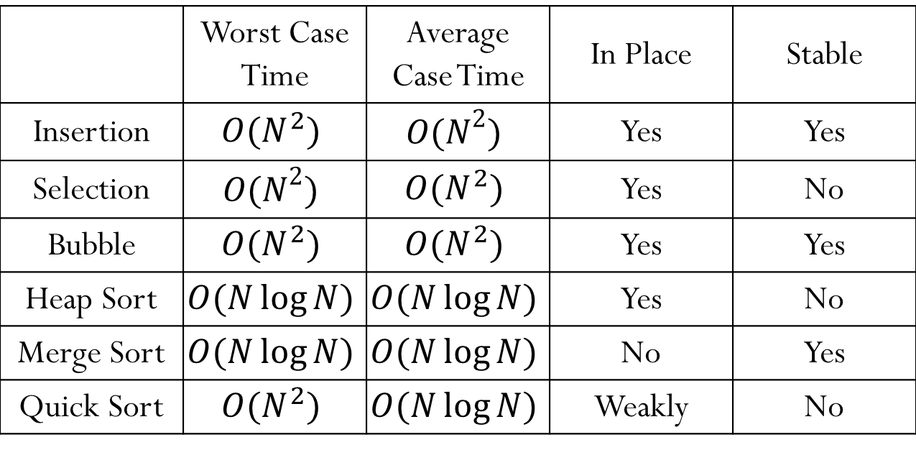
Matrix-Chain Multiplication Example
$n=4$, $A_{1}×A_{2}×A_{3}×A_{4}$.
$p_{0}=10, p_{1}=1, p_{2}=10, p_{3}=1, p_{4}=20$.
$$m_{ij}$$
$$j$$
$$s_{ij}$$
$$j$$
1 | 2 | 3 | 4
1 | 2 | 3 | 4
1
2
3
4
0 | 100 | 20
− | 0 | 10 | 30
− | − | 0 | 200
− | − | − | 0
1
2
3
4
− | 1 | 1
− | − | 2 | 3
− | − | − | 3
− | − | − | −
$$i$$
$$i$$
$$m_{14}=\min_{1≤k≤3}{(m_{1k}+m_{\left(k+1\right)4}+p_{0}p_{k}p_{4})}$$
$$=\min{\{230, 2300,220\}}$$

Slide 29
Matrix-Chain Multiplication Example
$n=4$, $A_{1}×A_{2}×A_{3}×A_{4}$.
$p_{0}=10, p_{1}=1, p_{2}=10, p_{3}=1, p_{4}=20$.
$$m_{ij}$$
$$j$$
$$s_{ij}$$
$$j$$
1 | 2 | 3 | 4
1 | 2 | 3 | 4
Optimal Value
1
2
3
4
0 | 100 | 20 | 220
− | 0 | 10 | 30
− | − | 0 | 200
− | − | − | 0
1
2
3
4
− | 1 | 1 | 3
− | − | 2 | 3
− | − | − | 3
− | − | − | −
$$i$$
$$i$$
$$m_{14}=\min_{1≤k≤3}{(m_{1k}+m_{\left(k+1\right)4}+p_{0}p_{k}p_{4})}$$
$$=\min{\{230, 2300,220\}}$$

Slide 30
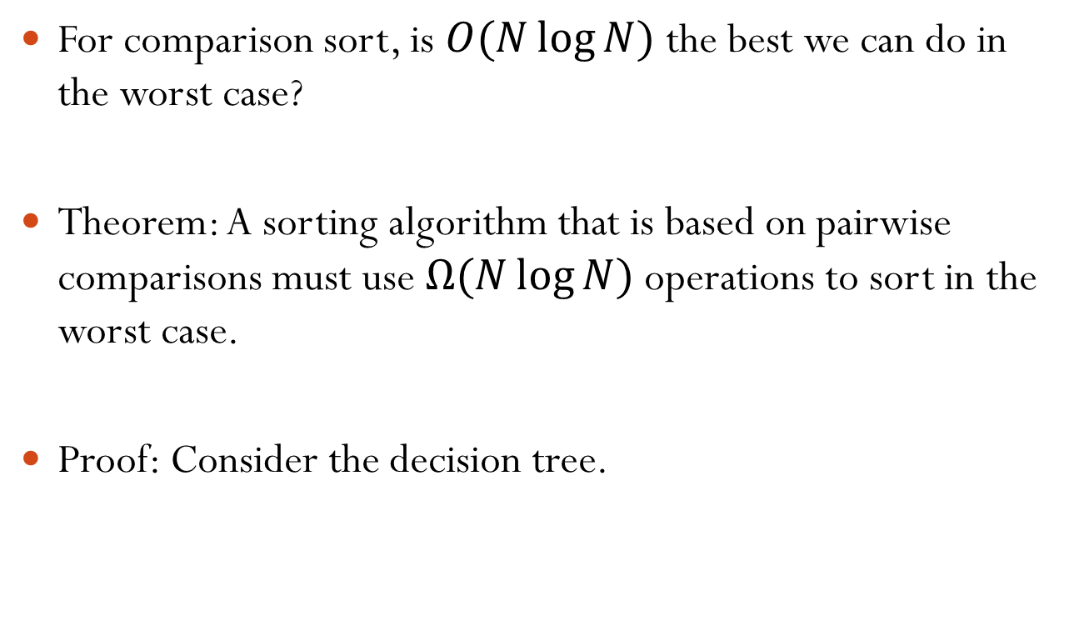
Matrix-Chain Multiplication Constructing an Optimal Order
We can construct an optimal order based on the records $s_{ij}$.
Print_Order(s, i, j) { if(i == j) cout << "A_{i}"; else { cout << "("; Print_Order(s, i, s_{ij}); cout << "*"; Print_Order(s, s_{ij}+1, j); cout << ")"; } }
Initial call is Print_Order(s, 1, n);
Notes:
The final output looks like ((A1 * A2) * (A3 * A4))

Slide 31







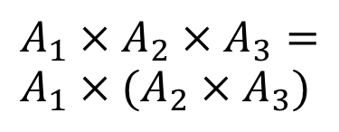


Matrix-Chain Multiplication Example
Construct an optimal order
$n=4$, $A_{1}×A_{2}×A_{3}×A_{4}$.
$p_{0}=10, p_{1}=1, p_{2}=10, p_{3}=1, p_{4}=20$.
$$s_{ij}$$
$$j$$
$$A_{1}×A_{2}×A_{3}×A_{4}=$$
$$(A_{1}×A_{2}×A_{3})×A_{4}$$
1 | 2 | 3 | 4
$$s_{14}=3$$
1
2
3
4
− | 1 | 1 | 3
− | − | 2 | 3
− | − | − | 3
− | − | − | −
$$s_{13}=1$$
$$A_{1}×A_{2}×A_{3}= \\ A_{1}×(A_{2}×A_{3})$$
$$i$$
$$s_{23}=2$$
$$A_{2}×A_{3}=A_{2}×A_{3}$$
$$A_{1}×A_{2}×A_{3}×A_{4}=(A_{1}×(A_{2}×A_{3}))×A_{4}$$
Notes:
Indeed, this give the minimum of 220 multiplications.

Slide 32
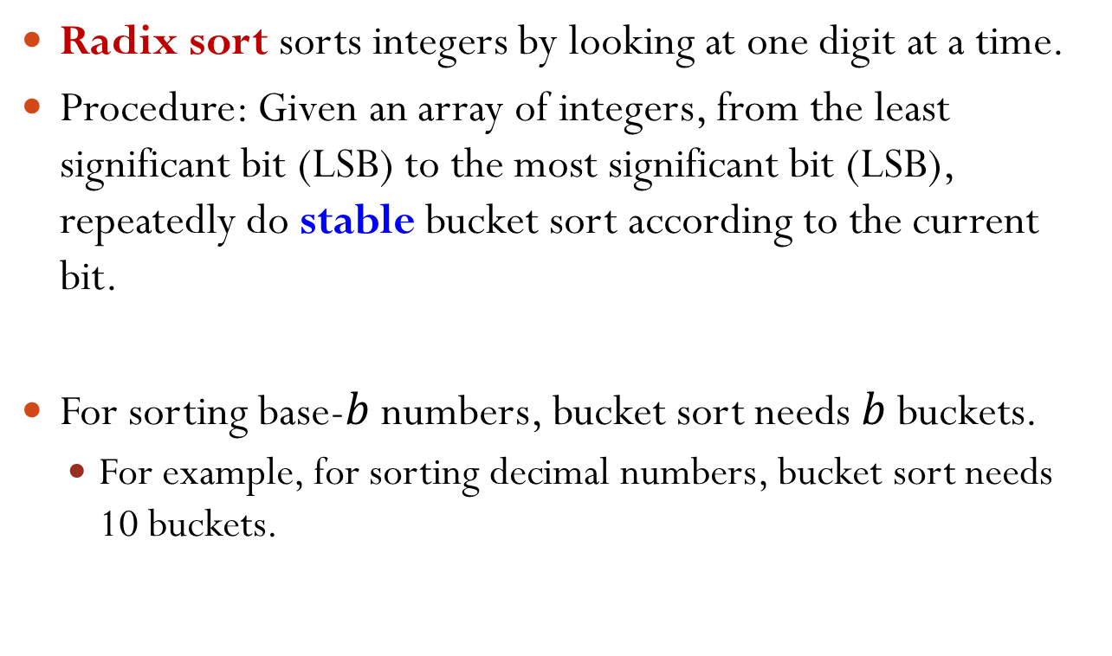
Matrix-Chain Multiplication Time Complexity
Get the minimum number of scalar multiplications:
We need to obtain all $m_{ij}$ and $s_{ij}$, for $1≤i≤j≤n$.
$O(n^{2})$ records
Each $m_{ij}$ is the minimum of $O(n)$ terms.
Total time complexity is $O(n^{3})$.
Obtain the optimal order:
$O(n)$
Notes:
Obtain the optimal order: O(n) recursive calls.
Indeed, since each non-base recursive call produces a *, # of non-base recursive calls is (n-1). # of base recursive calls is n.

Slide 33
Matrix-Chain Multiplication Summary
Matrix-chain multiplication is an optimization problem.
The solution is based on dynamic programming.
The original problem can be divided into same subproblems that overlap.
Each subproblem is solved once and stored in a table.
If a subproblem is encountered again, simply look up its solution in the table.
Reconstruct the solution to the original problem from the solutions to the subproblems.

Slide 34
Outline
Dynamic Programming
Motivation
Example: Matrix-Chain Multiplication
Summary

Slide 35
Dynamic Programming for Optimization
There are two key ingredients that an optimization problem must have in order for dynamic programming to apply:
Optimal substructure;
Overlapping subproblems.
Notes:
Note: for optimization problem

Slide 36
Optimal Substructure
An optimal solution to the problem contains within it optimal solutions to subproblems.
In matrix-chain multiplication, the optimal order on calculating $A_{i}×⋯×A_{j}$ that splits the product between $A_{k}$ and $A_{k+1}$ contains within it optimal solutions to the problem of ordering $A_{i}×⋯×A_{k}$ and $A_{k+1}×⋯×A_{j}$.
You can show optimal substructure property by supposing that each of the subproblem solutions is not optimal and then deriving a contradiction.

Slide 37
Overlapping Subproblems
A recursive algorithm for the problem solves the same subproblems over and over, rather than always generating new subproblems.
E.g., subproblems of matrix-chain multiplication overlap.
In contrast, a problem for which a divide-and-conquer approach is suitable usually generates brand-new problems at each step of the recursion.
Dynamic-programming algorithms take advantage of overlapping subproblems by
solving each subproblem once …
… and then storing the solution in a table where it can be looked up when needed.

Slide 38
Designing a Dynamic-Programming Algorithm
Characterize the structure of an optimal solution.
Usually, we need to define a general problem.
Recursively define the value of an optimal solution.
Compute the value of an optimal solution, typically in a bottom-up fashion.
Construct an optimal solution from computed information.

