Slide 1
Ve 280 Programming and Elementary Data Structures
Linux
Learning objectives:
Learn how to navigate the directory tree
Learn how to manipulate files/directory
Understand I/O redirection
And a few other useful commands (diff, apt-get…)

Slide 2
Unix
An operating system supporting multitasking and multi-user
Developed in 1969 by Ken Thompson, Dennis Ritchie, etc. from AT&T Bell Labs
Many variants (Unix-like OS)
Linux
BSD (from UC Berkeley)
Solaris (from Sun Microsystems)
Android (from Google)
iOS (from Apple)
…
Notes:
multi-user: a number of users can use the system simultaneously.
Bell lab: several Nobel prizes and Turing awards

Slide 3

Linux
A free and open source Unix-like operating system
First released in 1991 by Linus Torvalds
Many distributions
Gentoo
Red Hat
Ubuntu
…

Slide 4
Installing Linux
Recommended version: Ubuntu
You can get the .iso file from: http://www.ubuntu.com/download/desktop
Suggest to use the latest version.
Install it directly on your machine
OR install it on a virtual machine on your Windows/Mac operating system.
Install a virtual machine such as VirtualBox (https://www.virtualbox.org/) or VMware (http://www.vmware.com/) first.

Slide 5
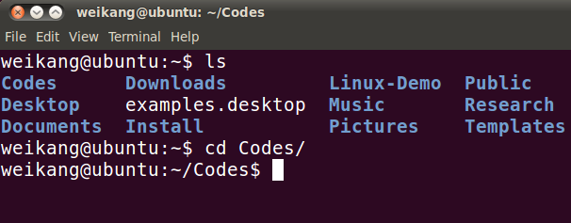
Using Terminal in Linux
We type commands in the terminal in Linux
Notes:
Case-sensitive!

Slide 6
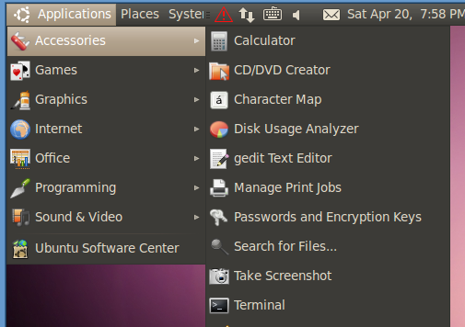
Start a Terminal

Slide 7
Change Directory
Basic command: cd pathname
E.g., cd /usr/bin
Special characters for directories
root directory: /
home directory: ~
Linux is a multi-user operating system. It is your “home directory”.
current directory: .
parent directory: ..
typical path name format
Notes:
Linux is organized using directories.

Slide 8
Aside: Root Directory
Directory in Linux is organized as a tree
The topmost directory is root directory “/”
/
bin/
home/
lib/
...
mary/
peter/
...
Notes:
/bin, /usr/bin
Contains program
/bin: system program
/usr/bin: user’s program
/lib
Shared libraries
/home
Where users keep their own works

Slide 9
List Contents of a Directory
Basic command: ls directory
e.g., ls /home
ls (i.e., “ls” alone): list the current working directory
ls -l [directory]: list in long format
ls -a [directory]: list all files including the hidden files
Hidden files: file name begin with a dot, e.g., “.bash_history”
In Linux, options can be combined together.
“ls -la” or “ls -l -a”
Options

Slide 10
Aside: Long Format of File Information
ls -l
File permission
First character: ‘-’ regular file; ‘d’ directory
Next three: read, write, execution permission of the owner
Next three: read, write, execution permission of the group
Final three: read, write, execution permission of everyone else
group
modification time
-rw------- 1 john john 576 Apr 17 1998 weather.txt drwxr-xr-x 6 john john 1024 Oct 9 1999 web_page -rw-rw-r-- 1 john john 276480 Feb 11 20:41 web_site.tar -rwx------ 1 john john 5743 Dec 16 1998 my_app
permission
owner
file size (in bytes)
file name

Slide 11
Manipulating Files/Directories
Create directories: mkdir dir
Delete directories: rmdir dir
Can only remove empty directory
Create an empty file: touch file
Notes:
Try to remove a non-empty folder

Slide 12
Copy Files/Directories
Basic command: cp source dest
Variations
cp file1 file2: copy the content of file1 into file2
cp file1 dir: copy file into a directory
cp file1 file2 dir
cp file* dir
*: wildcard. Can represent any character string (even an empty string!)
cp -r dir1 dir2: If dir2 does not exist, copy dir1 as dir2. If dir2 exists, copy dir1 inside dir2
Notes:
Demo:
$cp –r dir1 dir2
$cp –r dir1 dir2
? matches one character

Slide 13


Which Commands List ALL Files with the xyz Extension in Current Folder?
Assume no hidden files. Select all the correct answers.
A. ls ./*xyz
B. ls *.xyz
C. ls *xyz
D. None of the above.
Notes:
Correct answer: B
In general, if xyz=cpp, A, B, and C could list the cpp files.

Slide 14
Rename/Move a File
Basic command: mv source dest
Variations
mv file1 file2: rename file1 as file2
mv file1 dir: move file into a directory
mv dir1 dir2: If dir2 does not exist, then rename dir1 as dir2. If dir2 exists, then move dir1 inside dir2

Slide 15
Delete Files/Directories
Basic command: rm file
Variations
rm file: delete file
rm file1 file2: delete file1 and file2
rm -r dir: delete dir along with its contents
Useful options -i: prompt before every removal
To use: alias rm=‘rm -i’;
Put it into ~/.bashrc
Notes:
Demo of option -i: delete main* except main.cpp

Slide 16
Edit/Show a File
Edit file: nano file gedit file
advanced editor: vim, emacs
Show file content
cat file
less file
quit ‘less’: press ‘q’
go to the end: press ‘G’ (shift + g)
go to the beginning: press ‘g’
search: press ‘/’, then enter the thing to be searched
press ‘n’ for the next match; press ‘N’ for the previous match.
Notes:
nano hello_world.cpp
less cubeList.cpp
search for char

Slide 17
I/O Redirection
Most command line programs display their results on the standard output.
By default, standard output is our display.
We can redirect from standard output to a file by using ‘>’.
E.g., ls -l > ls_rst.txt: the “ls” result is now in ls_rst.txt
Notes:
ls /bin: using the terminal, it is hard to see whether there is a program called “ls”.
Solution: put the output into a file and search using less

Slide 18
I/O Redirection
Many commands can accept input from a facility called standard input.
By default, standard input is our keyboard.
We can redirect standard input from a file instead of keyboard by using ‘<’.
One application: testing
E.g., my_add < input.txt # my_add is a program taking two inputs from keyboard and output their sum on screen

Slide 19

What does the Following Command Do?
sort < fruit.txt > my_favorite.txt
Select all the correct answers.
A. The command reads fruit.txt and my_favorite.txt
B. The command reads fruit.txt and writes in my_favorite.txt
C. The elements of fruit.txt are in alphabetic order
D. The elements of my_favorite are in alphabetic order
Notes:
Give a quick explanation of sort, which sorts its input line by line. Show “sort”. End sort with Ctrl+D
Correct answer: B and D

Slide 20
Other Commands
Auto completion: type a few characters; then press ‘Tab’
If there is a single match, Linux completes the remaining.
If there are multiple matches, hit the second time, Linux shows all the possible candidates.
Compare two files: diff file1 file2
If files are the same, no output
If there are differences: lines after “<” are from the first file; lines after “>” are from the second file
In a summary line: ‘c’: change; ‘a’: add; ‘d’: delete
Useful option “-w”: ignore white spaces (space, tab)
Notes:
Tab twice: ls x (has two files x1.txt and x2.txt)
same: test1 and test2
a: test1 and test3
d: test3 and test1
c: test1 and test4
-w: test1 and test5
diff output: what does the number in 1a2 mean?

Slide 21
Other Commands
Install a program: sudo apt-get install program
E.g., sudo apt-get install emacs
sudo command: execute command as a superuser
Requires you to type your password
Remove a program: sudo apt-get autoremove program
Looking for help? man command e.g., man ls
Browse the manual using the same command as for ‘less’
Notes:
sudo gives a superuser permission
Example for sudo: ls –l /bin/sed: the owner is root and the right for others is r-x
sudo cp sed seeed

Slide 22
Reference
http://linuxcommand.org/

