Slide 1
Ve 280 Programming and Elementary Data Structures
Developing and Compiling Programs on Linux
Learning Objectives:
Understand the compilation process
How to compile a single source file
How to compile multiple source files

Slide 2

Basic Working Mechanism of Computer
int main() {…}
01001101 10100101 …
Compiler+Linker (Programs)

Slide 3
Developing a Program on Linux Single Source File
Write the source code, for example, using gedit
Compile the program
Compiler: g++
Command: g++ -o program source.cpp
-o option tells what the name of the output file is.
Run the program: ./program
Useful options of g++
-g: Put debugging information in the executable file
-Wall: Turn on all warnings!
Notes:
Show the successful compilation and also the failed compilation
-Wall: try using an unused variable
Why turn on warning? Because many bugs can be fixed by first fixing some warnings.

Slide 4
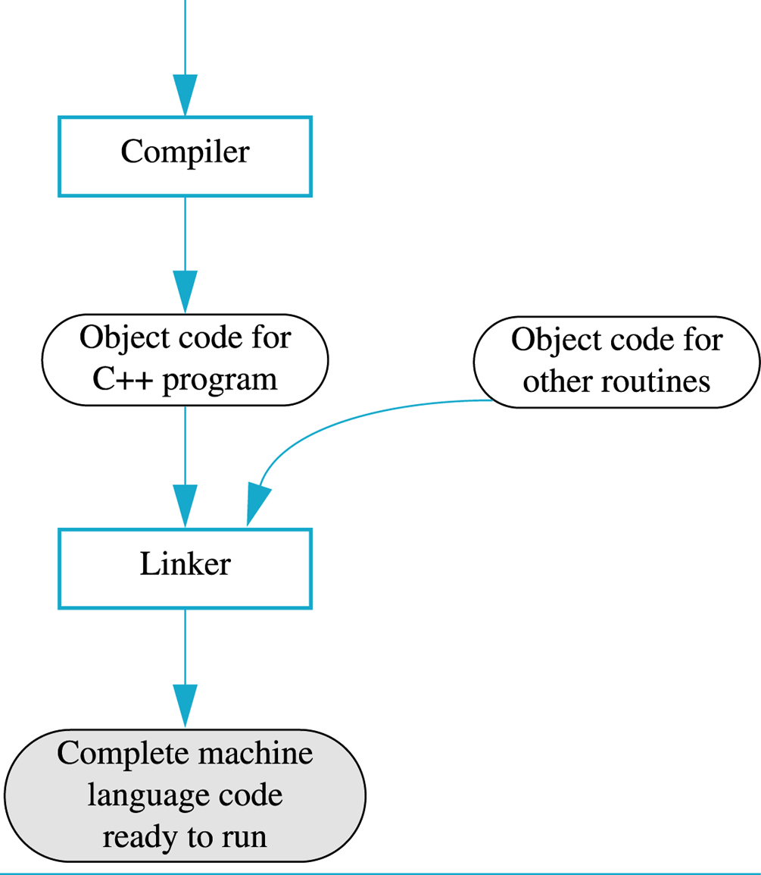
Compile a Program
g++ -o program source.cpp
C++ Source Code
A text file
g++ -c source.cpp
=
g++ -o program source.o
Link command
Object code: portion of machine code that has NOT yet been linked into a complete program
Just machine code for one particular library or module
Can be generated by command g++ -c source.cpp
*.o
A binary file

Slide 5


A large project is usually split into several source files in order to be manageable. Why?
Select all the correct answers.
A. To speed up compilation – changing a single line only requires recompiling a single small source file. Much faster!
B. To increase organization – make it easier for you to find functions, variables, etc.
C. To facilitate code reuse.
D. To split coding responsibilities among programmers.
Notes:
Correct answers: A, B, C, and D
To speed up compilation: compilation time is linear to the number of lines. in contrast, if you put everything in a single file. The compilation time will be much longer
Increase organization: easy to see all the functions related to a specific class. It is just like how we organize things in our daily life. For example, taking notes for different lectures.
Code reuse: you divide your code into different files. Then it is easy for others to use part of the files. In most cases, they just need one specific function, not all the function you have.
To split coding responsibilities: it is very inconvenient, if not impossible, to have several programmers working on a same file

Slide 6
Developing Program on Linux Multiple Source Files
Multiple source files include two types of files
header files – “.h” files: normally contain class definitions and function declarations.
C++ source files – “.cpp” files: normally contain function definitions and member functions of classes.
Example
// add.h #ifndef ADD_H
#define ADD_H
int add(int a, int b); #endif
// add.cpp int add(int a, int b)
{
return a+b;
}
Notes:
Show an example of class
class boat {
...
};

Slide 7
Developing Program on Linux Multiple Source Files
If a function in another file calls function add(), we should put #include “add.h” in that file.
Example
// run_add.cpp #include “add.h”
int main() {
add(2,3);
return 0;
}
In C++, the preprocessor replaces each #include by the contents of the specified file.
Notes:
The preprocessor runs before the compiler. It manipulates the source text of our programs.
The preprocessor replaces each #include by the contents of the specified file.

Slide 8
Headers Often Need Other Headers
line.h
Consequence: A header file may be included more than once in a single source file
E.g., in drawing.h, we include point.h twice
#include “point.h”
...
drawing.h
#include “point.h”
#include “line.h”
...

Slide 9
Problem of Multiple Inclusions
The including of a header file more than once may cause multiple definitions of the classes and functions defined in the header file.
Compiler complains!
Solution: header guard.
It avoids reprocessing the contents of a header file if the header has already been seen.
Notes:
If not done properly, a file may see multiple definitions of the classes and functions defined in the header file.
Compiler will not be happy about this.
A common way to achieve this purpose is to use the preprocessor to define a header guard (or include guard).

Slide 10
Header Guard
#ifndef VAR: a conditional directive --- tests whether the preprocessor variable VAR has not been defined.
If not defined, #ifndef succeeds and all lines up to #endif are processed.
Specially, #define defines VAR.
If defined, #ifndef fails and all lines between #ifndef and #endif are ignored.
// add.h #ifndef ADD_H
#define ADD_H
int add(int a, int b); #endif
Header guard to prevent multiple definitions!
Notes:
Syntax: 1) #ifndef is followed by #define. 2) Both has the same variable ADD_H. 3) There is a matching #endif at the end.
Convention: The VAR in header guard is usually the capitalization of the file name.
Ended 05/19/2018

Slide 11
Header Guard
What happens if the header is included first time?
#ifndef succeeds. ADD_H is defined and the content is included
What happens if the header is included second time?
Since ADD_H has been defined the first time we include the header, #ifndef fails. The lines between #ifndef and #endif are ignored
Good! No multiple declarations of the function add
With header guard, we guarantee that the definition in the header is just seen once!
// add.h #ifndef ADD_H
#define ADD_H
int add(int a, int b); #endif
Notes:
Since ADD_H is a special name, before the first inclusion, there is no ADD_H defined yet.

Slide 12
Compiling Multiple Source Files
To compile multiple source files, use command
g++ -Wall -o program src1.cpp src2.cpp src3.cpp
E.g., g++ -Wall -o run_add run_add.cpp add.cpp
Note: you don’t put “.h” in the compiling command
I.e., you don’t need g++ -Wall -o program src1.cpp src1.h src2.cpp src3.cpp
Why? “.h” files are already included. E.g., run_add.cpp includes add.h
Program name
All .cpp files

Slide 13
One More Thing
For our example on defining function, there is no need to “#include add.h” in “add.cpp”
However, for defining class, you need to include the .h file
// add.h #ifndef ADD_H
#define ADD_H
int add(int a, int b); #endif
// add.cpp int add(int a, int b)
{
return a+b;
}

Slide 14
Another Way
Generate the object codes (.o files) first
Example: g++ -Wall -o run_add run_add.cpp add.cpp
Equivalent way: g++ -Wall -c run_add.cpp # will produce run_add.o g++ -Wall -c add.cpp # will produce add.o g++ -Wall -o run_add run_add.o add.o
Notes:
Advantage? Disadvantage? See next slide for a quiz.

Slide 15

What are the advantages/disadvantages of compiling the cpp files separately?
Select all the correct answers.
A. Advantage: Only changed files need to be recompile.
B. Advantage: It facilitates code reuse.
C. Disadvantage: It requires a lot of typing!
D. Disadvantage: It requires us to remember which files have been changed.
Notes:
Correct answers: A, C, and D
Show an example of changing run_add.cpp, but keep the add.cpp
Disadvantage: lots of typing; need to remember what are changed recently, what are not.

Slide 16
A Better Way: Makefile
all: run_add
run_add: run_add.o add.o
g++ -o run_add run_add.o add.o
run_add.o: run_add.cpp
g++ -c run_add.cpp
add.o: add.cpp
g++ -c add.cpp
clean:
rm -f run_add *.o
The file name is “Makefile”
Type “make” on command-line
A Rule
Target: Dependency
<Tab> Command
Don’t forget the Tab!
Dependency: A list of files that the target depends on

Slide 17
A Better Way: Makefile
There is a target called “all”
It is the default target
Its dependency is program name
It has no command
all: run_add
run_add: run_add.o add.o
g++ -o run_add run_add.o add.o
run_add.o: run_add.cpp
g++ -c run_add.cpp
add.o: add.cpp
g++ -c add.cpp
clean:
rm -f run_add *.o
A Rule
Target: Dependency
<Tab> Command
Usually, there is a target called “clean”
A dummy target. Type “make clean”
It has no dependency!
Question: what does “clean” do?

Slide 18
A Better Way: Makefile
A Rule
all: run_add
run_add: run_add.o add.o
g++ -o run_add run_add.o add.o
run_add.o: run_add.cpp
g++ -c run_add.cpp
add.o: add.cpp
g++ -c add.cpp
clean:
rm -f run_add *.o
Target: Dependency
<Tab> Command
Dependency Graph
When is a command issued?
Answer: When dependency is more recent than target
run_add
run_add.o
add.o
run_add.cpp
add.cpp
Notes:
It will trigger a sequence of updates.

Slide 19
References
Makefile
http://www.cs.colby.edu/maxwell/courses/tutorials/maketutor/
Developing Programs on Linux
C++ Primer, 4th Edition, Chapter 2.9

