Slide 1
Ve 280 Programming and Elementary Data Structures
Queue
Learning Objectives:
Understand what is a queue
Know how to implement it
Discover some applications of queue
Understand what is a deque

Slide 2
Outline
Queue
Implementation
Applications
Relative: Deque

Slide 3

Queues
A “line” of items in which the first item inserted into the queue is the first one out.
Restricted form of a linear list: insert at one end and remove from the other.
FIFO access: first in, first out.

Slide 4
Methods of Queue
size(): number of elements in the queue.
isEmpty(): check if queue has no elements.
enqueue(Object o): add object o to the rear of the queue.
dequeue(): remove the front object of the queue if not empty; otherwise, throw queueEmpty.
Object &front(): return a reference to the front element of the queue.
Object &rear(): return a reference to the rear element of the queue.

Slide 5
Queues Using Linked Lists
Which type of linked list should we choose?
We need fast enqueue and dequeue operations.
Double-ended singly-linked list is sufficient!
enqueue(Object o): append object at the end LinkedList::insertLast(Object o);
dequeue(): remove the first node LinkedList::removeFirst();
first
front
rear
last
Notes:
For the double-ended singly-linked list, which end will be front and which end will be rear?

Slide 6
Queues Using Linked Lists
size(): LinkedList::size();
isEmpty(): LinkedList::isEmpty();
Object &front(): return a reference to the object stored in the first node.
Object &rear(): return a reference to the object stored in the last node.
first
front
rear
last

Slide 7


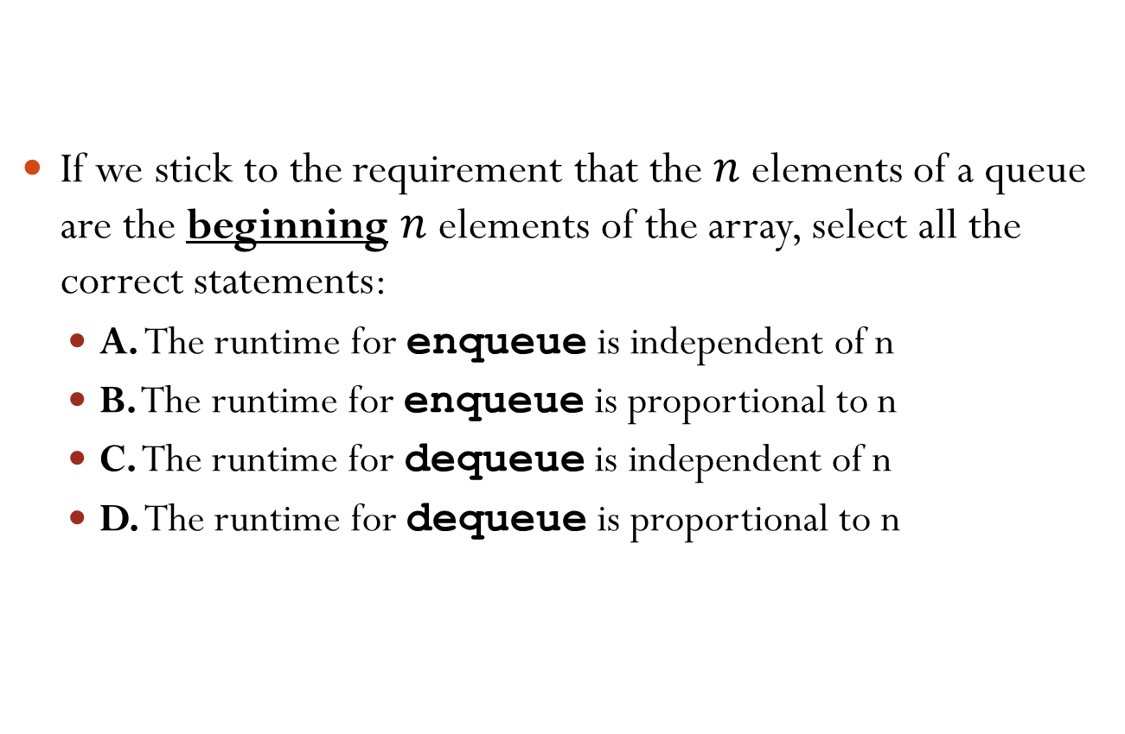
Queues Using Arrays
If we stick to the requirement that the $n$ elements of a queue are the beginning $n$ elements of the array, select all the correct statements:
A. The runtime for enqueue is independent of n
B. The runtime for enqueue is proportional to n
C. The runtime for dequeue is independent of n
D. The runtime for dequeue is proportional to n
Array[MAXSIZE]:
2
3
1
4
front
rear
Notes:
Answer: A and D
#Operations for enqueue is O(1)
#Operations for dequeue is O(n)

Slide 8
Queues Using Arrays
A better way is to let the elements “drift” within the array.
enqueue(6);
dequeue();
dequeue();
Array[MAXSIZE]:
2
3
1
4
front
rear
2
3
1
4
6
Notes:
#Operations for enqueue is O(1)
#Operations for dequeue is O(n)

Slide 9
Queues Using Arrays
We maintain two integers to indicate the front and the rear of the queue.
However, as items are added and removed, the queue “drifts” toward the end.
Eventually, there will be no space to the right of the queue, even though there is space in the array.
1
4
6
2
7
front
rear

Slide 10
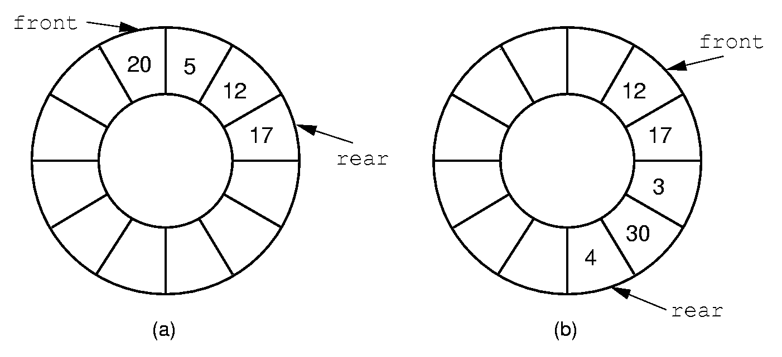
Queues Using Arrays
To solve the problem of memory waste, we use a circular array.

Slide 11
Circular Arrays
We can implement a circular array using a plain linear array:
When front/rear equals the last index (i.e., MAXSIZE-1), increment of front/rear gives the first index (i.e., 0).
1
4
6
2
7
front
rear
enqueue(5)
5
1
4
6
2
7
rear
front

Slide 12
Circular Arrays
To realize the “circular” increment, we can use modulo operation: front = (front+1) % MAXSIZE; rear = (rear+1) % MAXSIZE;
If front(or rear) == MAXSIZE-1, the statement sets front(or rear) to 0.

Slide 13
Boundary Conditions
Suppose that front points to the first element in the queue and that rear points to the last element in the queue.
What will a queue with one element look like?
What will an empty queue look like?
1
rear
front
rear
front

Slide 14
Boundary Conditions
What will a queue with one empty slot look like?
What will a full queue look like?
1
5
2
4
1
2
rear
front
versus an empty queue
1
6
5
2
4
1
2
rear
rear
front
front

Slide 15
Boundary Conditions
To distinguish between the full array and the empty array, we need a flag indicating empty or full, or a count on the number of elements in the queue.
1
6
5
2
4
1
2
versus
rear
rear
front
front

Slide 16
Queues Using Arrays
enqueue(Object o): increment rear, wrapping to the beginning of the array if the end of the array is reached; if rear becomes front, reallocate arrays. Insert o at the position of rear
dequeue(): increment front, wrapping to the beginning of the array if the end of the array is reached; if empty, throw queueEmpty.
isEmpty(): return (count == 0);
size(): return count;
Notes:
Note: to insert, we need to first increment rear. Then, rear points to an empty location

Slide 17
Outline
Queue
Implementation
Applications
Relative: Deque

Slide 18
Application of Queues
Request queue of a web server
Each user can send a request.
The arriving requests are stored in a queue and processed by the computer in a first-come-first-serve way.

Slide 19
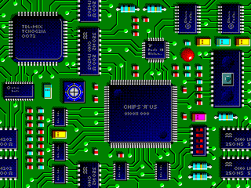
Application of Queue: Wire Routing
Select paths to connect all pairs of pins that need to be connected together.
An important problem in electronic design automation.

Slide 20
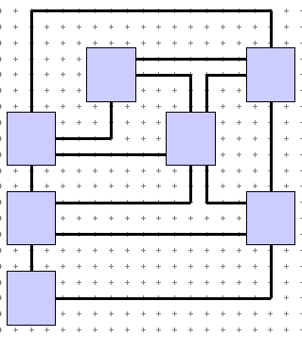
A Simplified Problem
Condition: We have all blocks laid on the chip. We also have some of the wires routed.
Problem: We want to connect the next pair of pins.
Constraint: we can only draw wires horizontally or vertically.
End Pin
Start Pin

Slide 21
Modeling as a Grid
Start Pin
End Pin
Blue squares are blocked squares.
Orange squares are available to route a wire.
How to find a path from the start pin to the end pin?

Slide 22
Wire Routing: Lee’s Algorithm
A queue of reachable squares from the start pin is used.
The cell of the start pin is set with a distance value of 0.
It is enqueued into an initial empty queue.
While the queue is not empty.
A cell is dequeued from the queue and made the examine cell.
Is the examine cell the end pin? If yes, path found and return.
Otherwise, all unreached unblocked squares adjacent to the examine cell are marked with their distance (this is 1 more than the distance value of the examine cell) and enqueued.
When queue becomes empty but not reach end pin yet, means no path found.

Slide 23
Illustration of Lee’s Algorithm
start pin
end pin
1
0
1
Expand “0”
queue: 0
Notes:
Assume the order is E, S, W, N

Slide 24
Illustration of Lee’s Algorithm
start pin
end pin
2
1
0
1
2
2
Expand right “1”
queue: 1, 1
Notes:
Now the queue becomes 1,1, since 0 is removed and two 1’s are added.

Slide 25
Illustration of Lee’s Algorithm
start pin
end pin
2
2
1
0
1
2
2
2
Expand left “1”
queue: 1,2,2,2
Notes:
Now the queue becomes 1,2,2,2.

Slide 26
Illustration of Lee’s Algorithm
start pin
end pin
2
2
1
0
1
2
2
2
Expand and reach all squares 3 units from start.
Notes:
It is like expand and reach all squares 2 units from start.

Slide 27
Illustration of Lee’s Algorithm
start pin
3
3
end pin
2
2
1
0
1
2
2
2
3
3
Expand and reach all squares 4 units from start.

Slide 28
Illustration of Lee’s Algorithm
start pin
4
3
3
end pin
2
2
1
0
1
2
2
2
3
4
3
4
4
4
Expand and reach all squares 5 units from start.

Slide 29
Illustration of Lee’s Algorithm
5
start pin
4
5
3
3
end pin
2
2
1
0
1
2
2
2
3
4
3
4
5
4
4
5
5
5
Expand and reach all squares 6 units from start.

Slide 30
Illustration of Lee’s Algorithm
6
5
6
start pin
4
5
3
3
end pin
2
2
1
0
1
2
2
2
6
3
4
3
4
5
6
4
4
5
6
5
6
5
6
6
End pin reached. Trace back.

Slide 31
Illustration of Lee’s Algorithm
6
5
6
start pin
4
5
3
3
end pin
2
2
1
0
1
1
2
2
2
2
6
3
4
3
3
4
4
5
5
6
4
4
5
6
5
6
5
6

Slide 32

A queue can be used:
Select all the correct answers.
A. to handle printing jobs on a printer
B. to reverse a string
C. to implement a waiting list
D. to share a CPU among different processes
Notes:
Correct answers: A, C, and D

Slide 33
Outline
Queue
Implementation
Applications
Relative: Deque

Slide 34
Deque
Not a proper English word, pronounced as “deck”.
Means double-ended queue
A combination of stack and queue.
Items can be inserted and removed from both ends of the list.
Methods supported:
push_front(Object o)
push_back(Object o)
pop_front()
pop_back()

Slide 35
Deque Implementation
Linked list
Which type of linked list will you choose to support fast insertion and removal?
Double-ended doubly-linked list
Circular array
front and rear not only need to be incremented (push_back, pop_front), but also need to be decremented (push_front, pop_back).
Notes:
push_back increament rear
pop_front increament front
push_front decrement front
pop_back decrement rear

Slide 36
Reference
Problem Solving with C++ (8th Edition), by Walter Savitch, Addison Wesley Publishing (2011)
Chapter 13.2 Queue

