Slide 1
Trading Bot
Product Specification — as built
Algorithmic trading assistant for US stocks, Taiwan stocks (TWSE) and crypto Version 0.2 · 2026-07-10 · screenshots captured live from the running app

Slide 2
Product Overview
What the product is and the rules it lives by
• What it is
– A personal analysis & planning tool for retail investors — it explains and simulates; it does not place orders.
– Markets: US equities, Taiwan equities (TWSE), crypto pairs (Binance).
• Four core capabilities
– Stock Analysis — indicators + news sentiment fused into one explainable Buy/Hold/Sell verdict.
– Strategy Backtest — 6 rule-based strategies, next-bar execution, always benchmarked vs buy & hold.
– Investment Planner — monthly DCA plans by sector, historically simulated vs 0050.
– Sentiment Engine — VADER over Google News, multi-query, per-article scores.
• Target user
– Individual investor comfortable with basic quant concepts (SMA, RSI, Sharpe) who wants explainable signals, not a black box.
• Guiding principles (enforced conventions)
– Quant engine is pure Python (stdlib + requests) — no numpy/pandas by design.
– Price data degrades gracefully: live source → fallback → deterministic synthetic; every degraded response carries a warning the UI must display.
– Backtests use next-bar execution (no look-ahead) and always include a buy-and-hold benchmark.
– API response shapes are mirrored 1:1 by TypeScript types in src/api/ — both sides change in the same task.
– Every simulated or projected figure ships with a disclaimer; verdicts are model output, not advice.
• UI idiom
– Dark Tailwind theme (gray-900/800 gradients, rounded-3xl cards, indigo accents), chart.js with instance cleanup.

Slide 3
System Architecture
Three processes in dev; the Vite proxy is the seam
Vue 3 + TS + Vite + Tailwind (dev :5173)
views + typed API clients (src/api/*.ts)
│ vite proxy
├── /api/login, /api/register → Express auth server :3000
│ MongoDB · bcrypt · JWT (1h)
├── all other /api/* → FastAPI app :8000
│ quant engine + sentiment (stateless)
└── /av, /twse → legacy external proxies (Dashboard only)
Outbound data: Yahoo Finance → Stooq → synthetic (stocks)
Binance → synthetic (crypto)
Google News RSS + VADER (sentiment)
• Frontend
– Vue 3 <script setup>, vue-router (history), Pinia (installed), chart.js, floating-vue.
• Analysis backend
– FastAPI, stateless, no auth/DB; all computation per request.
• Auth backend
– Express + MongoDB 'trading-bot'; bcrypt(10) password hashes; JWT, 1-hour expiry.
• Quality gates
– npm run type-check (gates build), lint, vitest; backend smoke snippets in .claude/skills/.

Slide 4
Price Data Layer
backend/python/quant/data.py — symbol routing and graceful degradation
Symbol shape | Interpreted as | Source order
ends in USDT / USD / BUSD / USDC | crypto pair | Binance daily klines → synthetic
all digits (2330, 0050) | TWSE listing | Yahoo (.TW) → Stooq (.tw) → synthetic
anything else (AAPL) | US listing | Yahoo → Stooq (.us) → synthetic
• Degradation contract
– On any upstream failure the layer returns a seeded synthetic random walk (weekends skipped) with source: "synthetic" and a human-readable warning — the app keeps working offline.
– The UI must surface that warning in a yellow banner; synthetic data must never look real. This applies to benchmarks too.
– days is clamped to [30, 2000]; Yahoo range picked by lookback (6mo → 10y).
• OHLCV shape
– Candle {date, open, high, low, close, volume}; PriceSeries {symbol, source, candles[], warning} — exposed raw via GET /api/history.

Slide 5
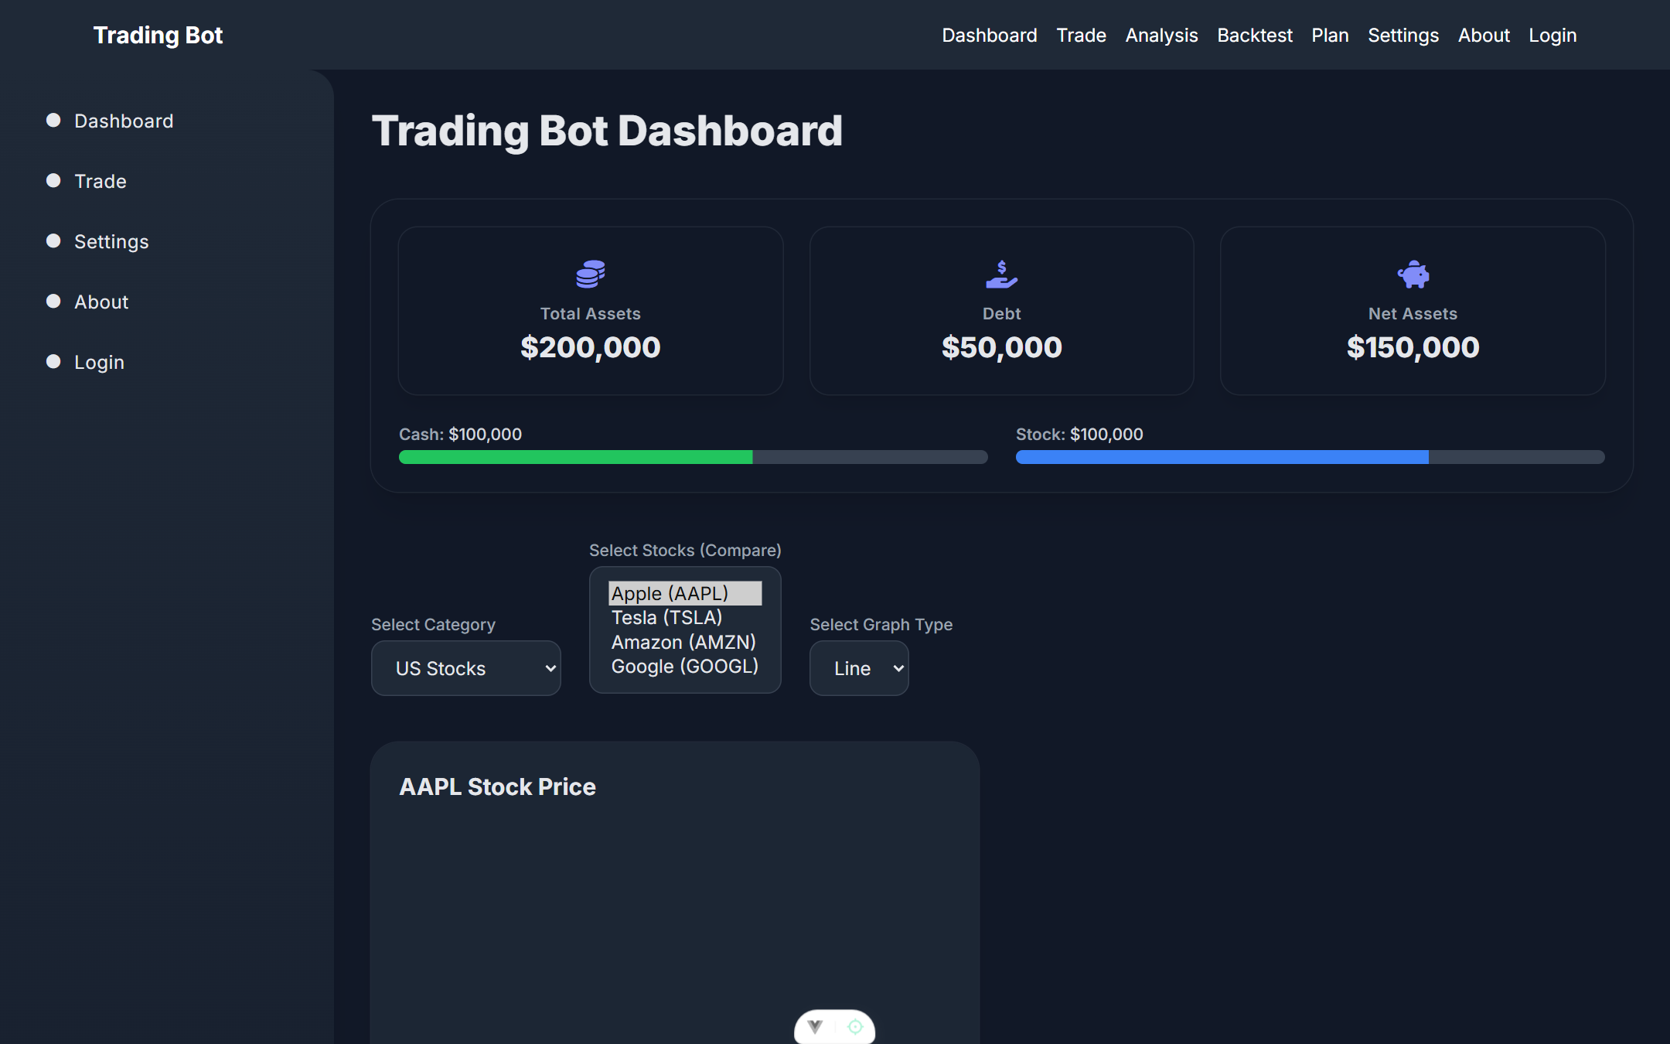
Dashboard ( / )
Landing page — portfolio snapshot + multi-symbol comparison
• Balance widget
– Total Assets / Debt / Net Assets cards + Cash & Stock progress bars (mock values — no portfolio backend yet).
• Comparison controls
– Category (US / Taiwan / Crypto), multi-select symbols from a static list, line/bar toggle.
– Per-symbol chart cards: price + volume & return/loss placeholders, redrawn on any change.
– News section + Start Trading CTA (static).
• Known issue (QA H1/H2)
– Price charts render blank today: legacy Alpha Vantage path has no API key and a chart-destroy bug. Spec intent: migrate to internal /api/history.
Live capture — balance widget, category/symbol/graph controls, per-symbol chart cards

Slide 6
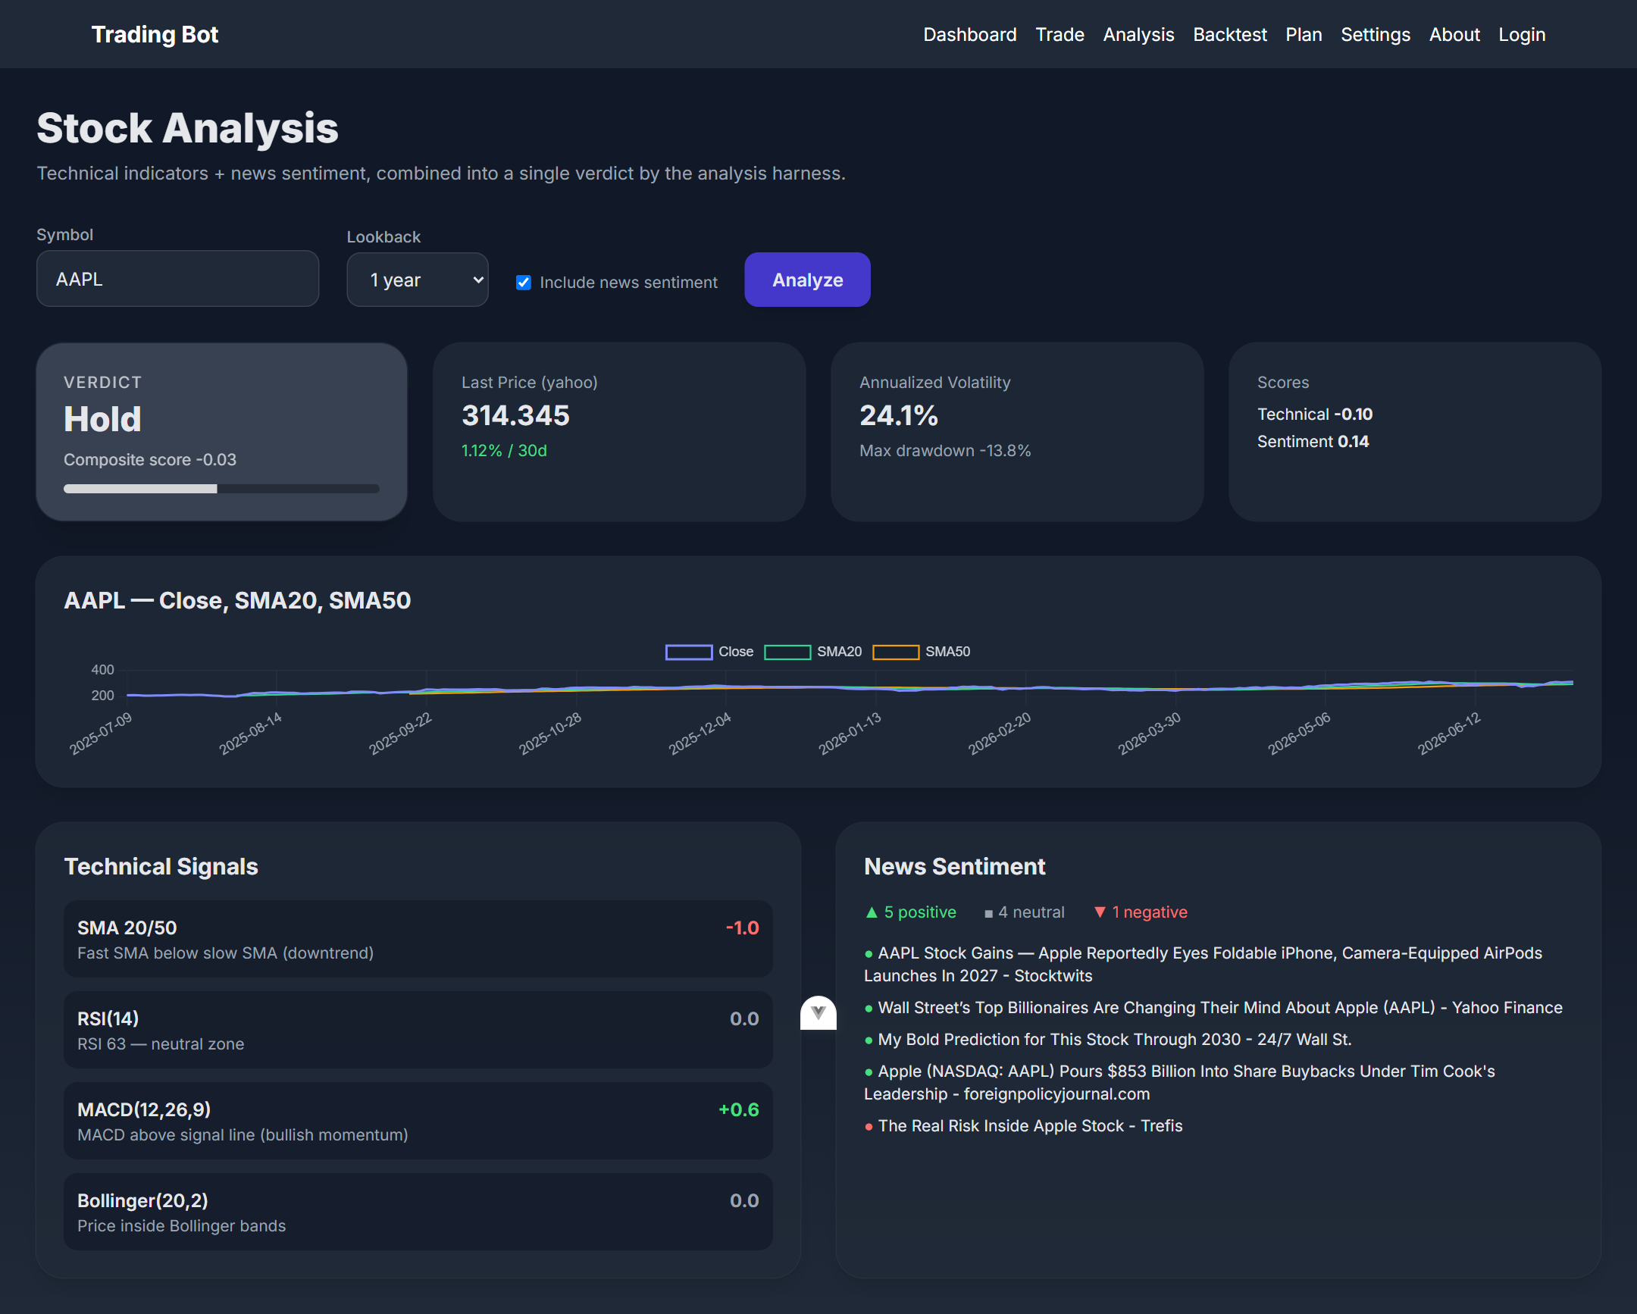
Stock Analysis ( /analysis )
Indicators + news sentiment → one explainable verdict
• Inputs
– Symbol (free text), lookback 6mo/1y/2y, include-sentiment toggle (default on).
• Output
– Verdict card (Strong Buy → Strong Sell) with composite score gauge in [-1, 1].
– Stat cards: last price + source, 30-day change, annualized volatility, max drawdown, sub-scores.
– Close + SMA20 + SMA50 chart.
– Signal list — every signal shows its indicator, reason and score contribution.
– News panel: pos/neu/neg counts + top-5 linked headlines.
• Degradation
– Synthetic-data warning banner; sentiment failure degrades to score 0 with its own warning; min 30 bars or HTTP 422.
Live run — AAPL, 1-year lookback, Yahoo data: Hold verdict, signal breakdown, headline sentiment

Slide 7
Analysis Scoring Model
composite = 0.7 × technical + 0.3 × sentiment, clamped to [-1, 1]
Signal | Rule | Score
SMA 20/50 trend | fast SMA above / below slow SMA | +1.0 / −1.0
RSI(14) momentum | oversold <30 / overbought >70 / neutral | +0.8 / −0.8 / 0
MACD(12,26,9) | histogram above / below zero | +0.6 / −0.6
Bollinger(20,2) %B | at lower band / upper band / inside | +0.5 / −0.5 / 0
News sentiment | avg VADER compound of ~10 articles | [−1, +1]
Verdict | Composite
Strong Buy | ≥ 0.50
Buy | ≥ 0.15
Hold | ≥ −0.15
Sell | ≥ −0.50
Strong Sell | otherwise
• Technical score = mean of the available signal scores (signals with insufficient history are skipped).
• If sentiment is disabled or unavailable, the composite falls back to the technical score alone.
• Each signal carries a human-readable reason so the frontend can show why the harness reached its verdict, not just the number.

Slide 8
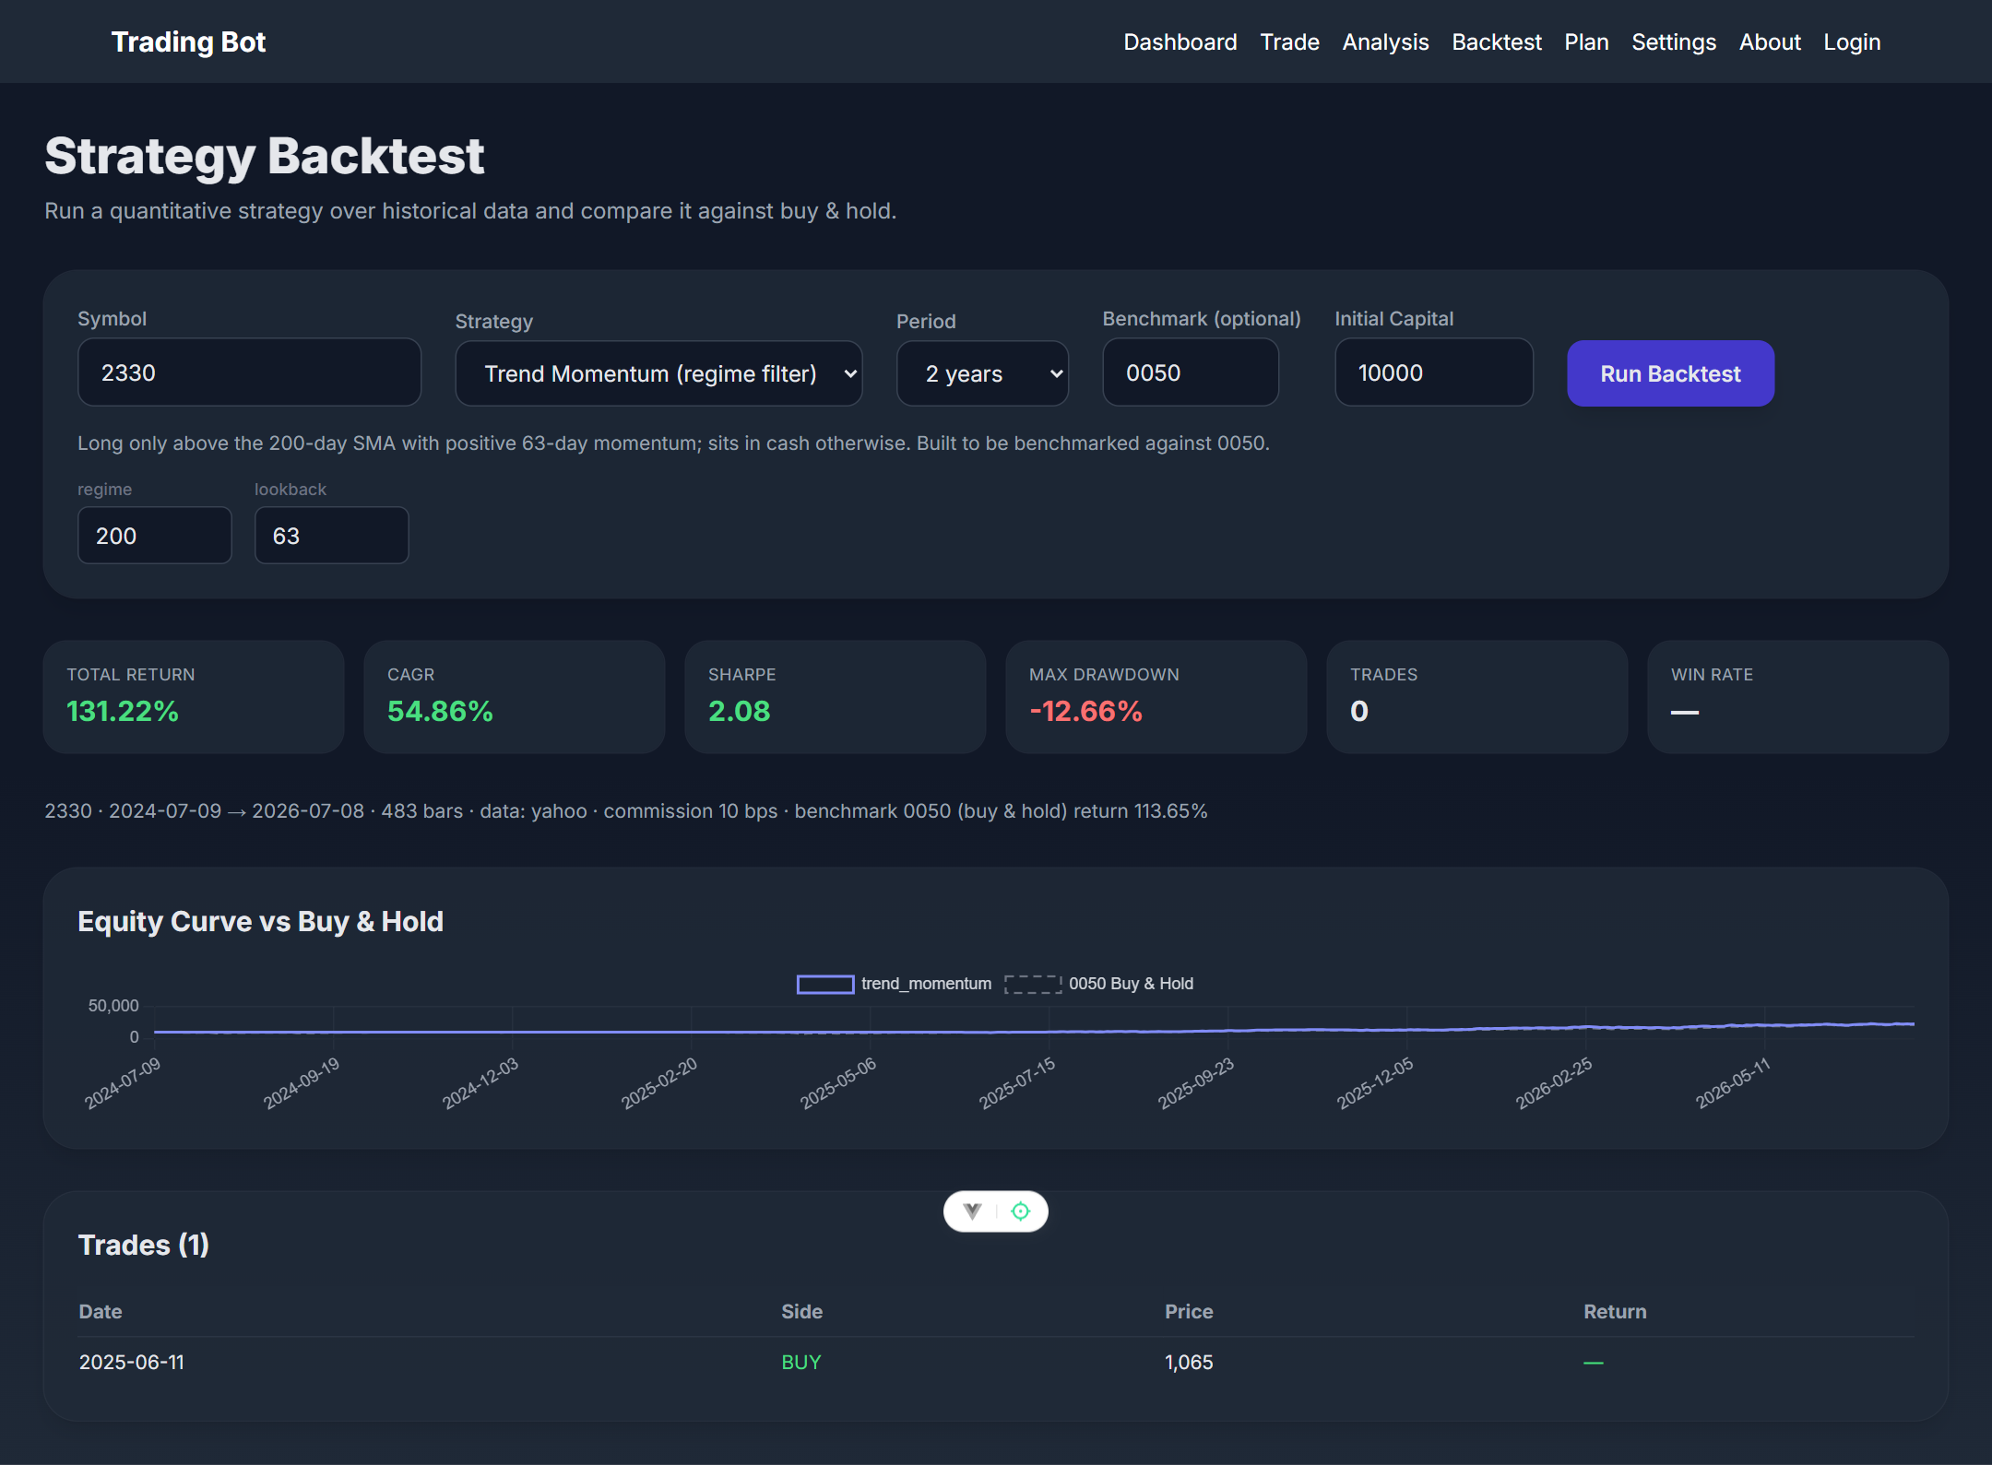
Strategy Backtest ( /backtest )
Rule-based strategies vs buy & hold — optionally on a different benchmark instrument
• Inputs
– Symbol, strategy (from /api/strategies), period, optional benchmark symbol, initial capital, per-strategy numeric params (auto-generated fields).
• Execution model
– Long/flat only; signals execute at the next bar's close (no look-ahead).
– Commission in bps (default 10, clamp 0–500) on every position change; open positions marked to market.
• Output
– Metric cards: Total Return, CAGR, Sharpe, Max DD, Trades, Win Rate.
– Equity curve vs benchmark (dashed), scrollable trade table with per-trade returns.
– Different benchmark symbols are forward-filled onto the strategy's date grid.
Live run — trend_momentum on 2330 (2y, Yahoo): 131.2% vs holding 0050 at 113.7%

Slide 9
Strategy Catalog
backend/python/quant/strategies.py — registry-driven; new entries appear in the UI automatically
Strategy | Logic | Default params
sma_crossover | Long while the fast SMA is above the slow SMA (trend following) | fast 20 · slow 50
rsi_mean_reversion | Buy when RSI drops below oversold, exit above overbought | 14 · 30 · 70
macd_momentum | Long while the MACD line is above its signal line | 12 · 26 · 9
bollinger_reversion | Buy at the lower band, exit at the middle band (mean reversion) | period 20 · 2.0σ
trend_momentum | Long only above the 200-day SMA AND positive 63-day return; cash otherwise. Built to be judged against 0050 | regime 200 · lookback 63
buy_and_hold | Fully invested from the first bar (benchmark) | —
• A strategy is a pure function (closes, **params) → 0/1 target positions, one per bar; the backtester applies changes next bar.
• Unknown strategy → 422 listing valid names; unexpected param names → 422 "Invalid params".

Slide 10
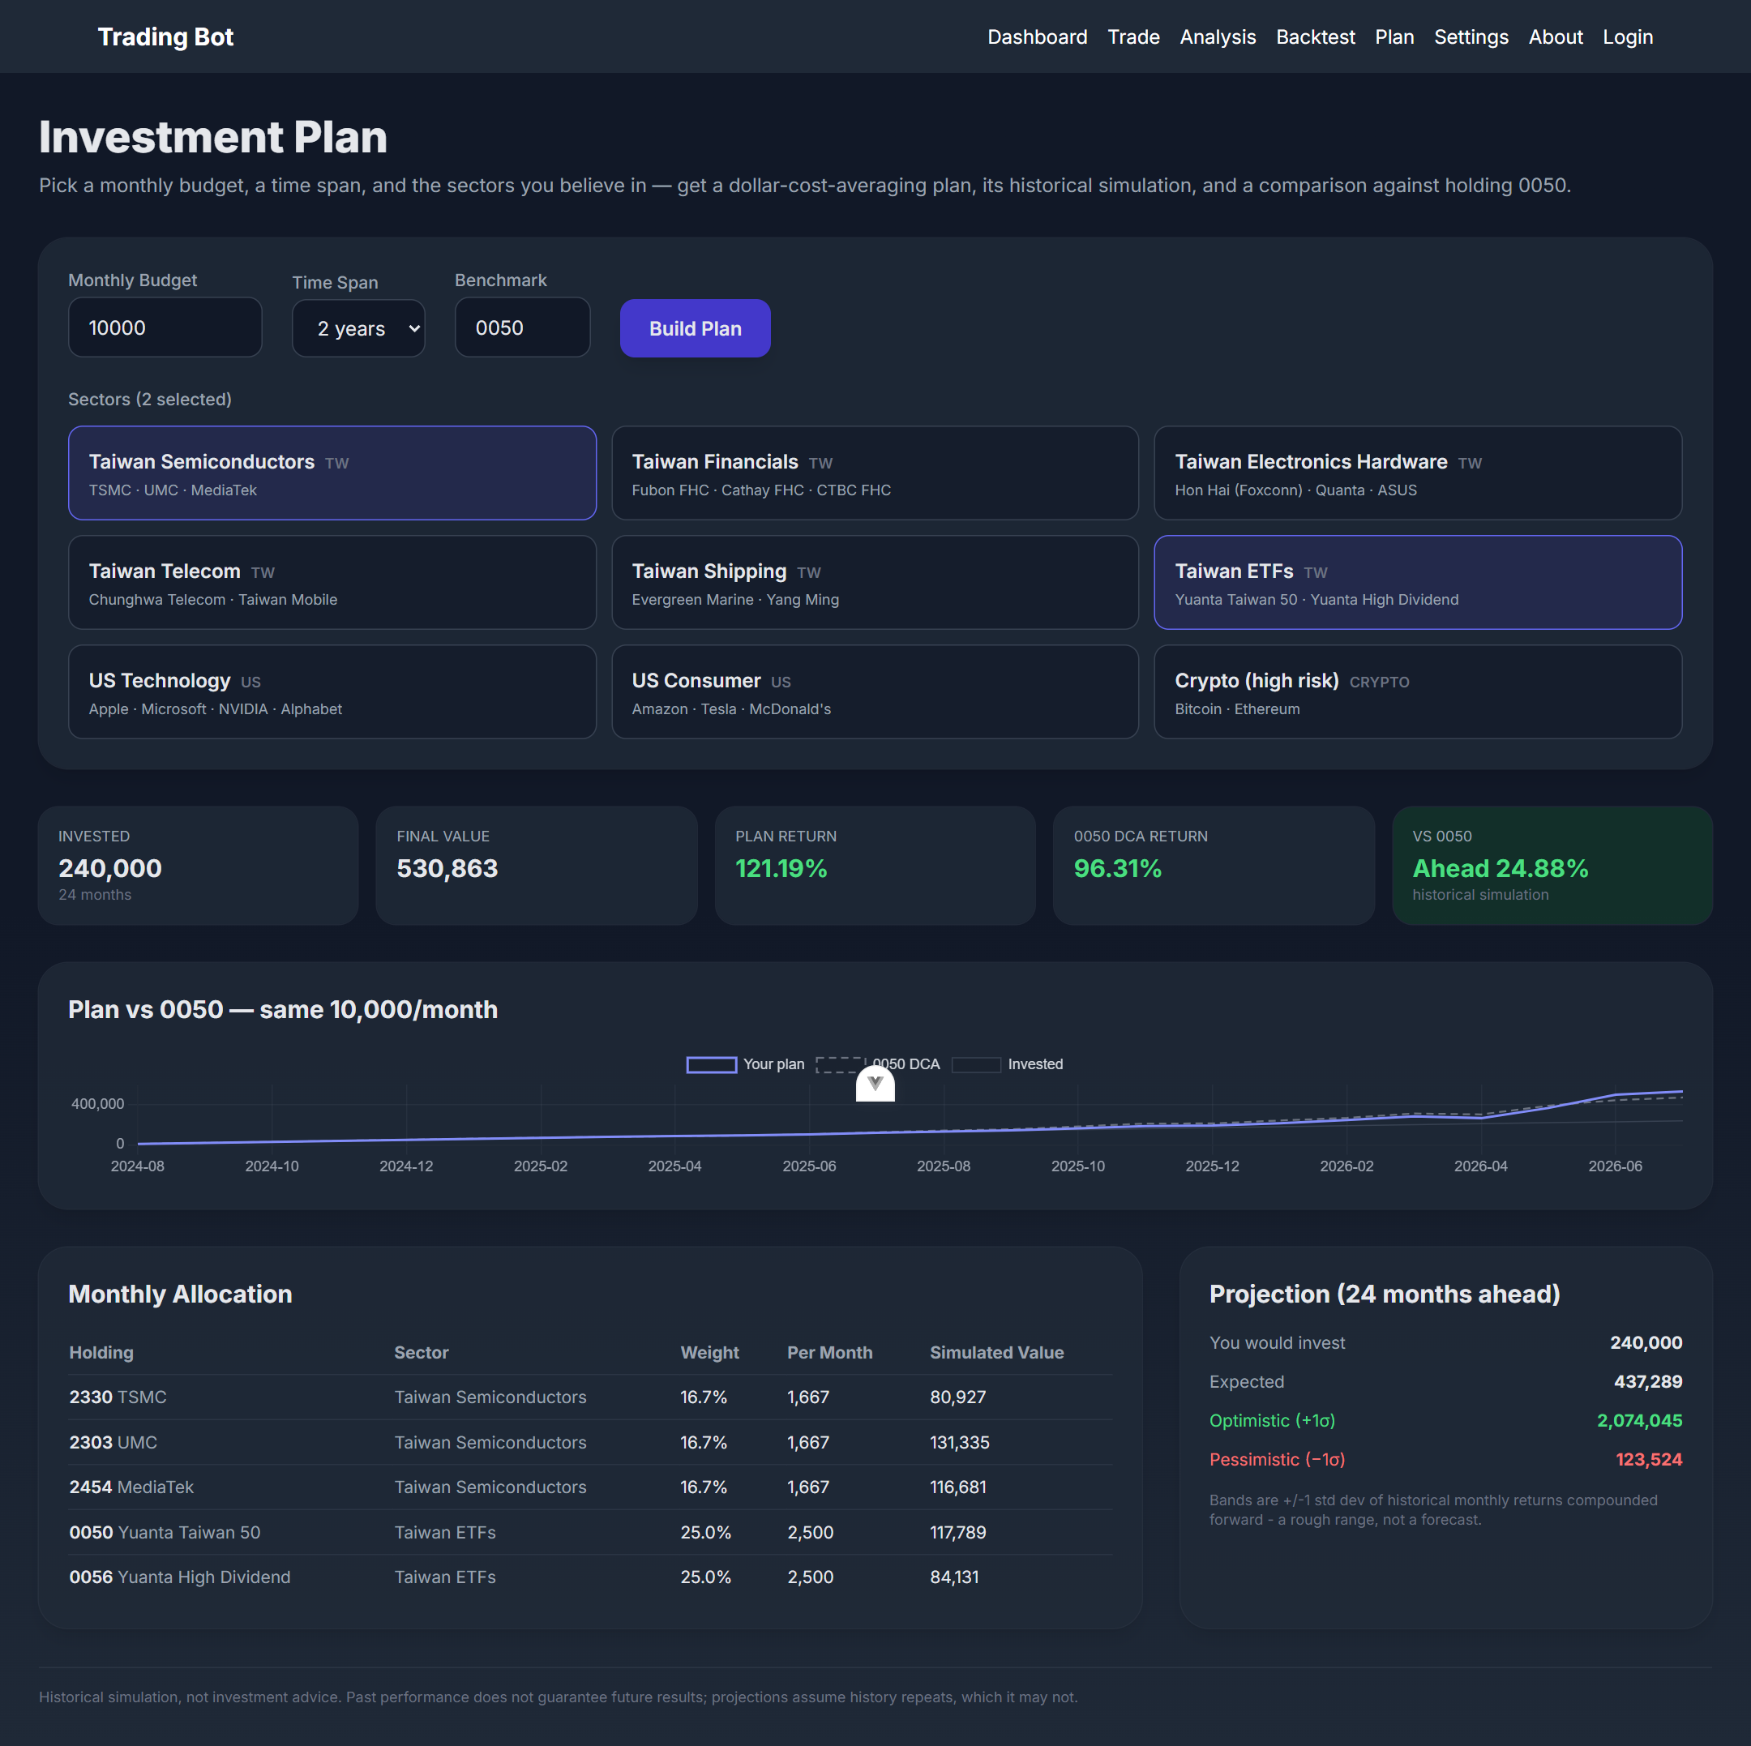
Investment Planner ( /plan )
Monthly DCA across chosen sectors, simulated on real history vs 0050
• Inputs
– Monthly budget (>0), span 1–5 years, benchmark (default 0050), sector cards: 6 Taiwan sectors, 2 US sectors, crypto.
• Allocation rule
– Equal weight per selected sector, equal per ticker inside a sector — simple and explainable, no return-chasing optimization.
• Historical simulation
– Buys at the first trading close of each month over the past N months (intersection of all holdings + benchmark; shortened with a warning if history is missing).
– Compared to identical monthly amounts into the benchmark; invested-cash line shown.
• Projection
– Expected / +1σ / −1σ future value from historical monthly return & volatility, labeled "a rough range, not a forecast"; mandatory disclaimer at the bottom.
Live run — 10,000/month × 24 months, TW Semis + TW ETFs: 121.2% vs 0050 DCA 96.3% (ahead 24.9%)

Slide 11
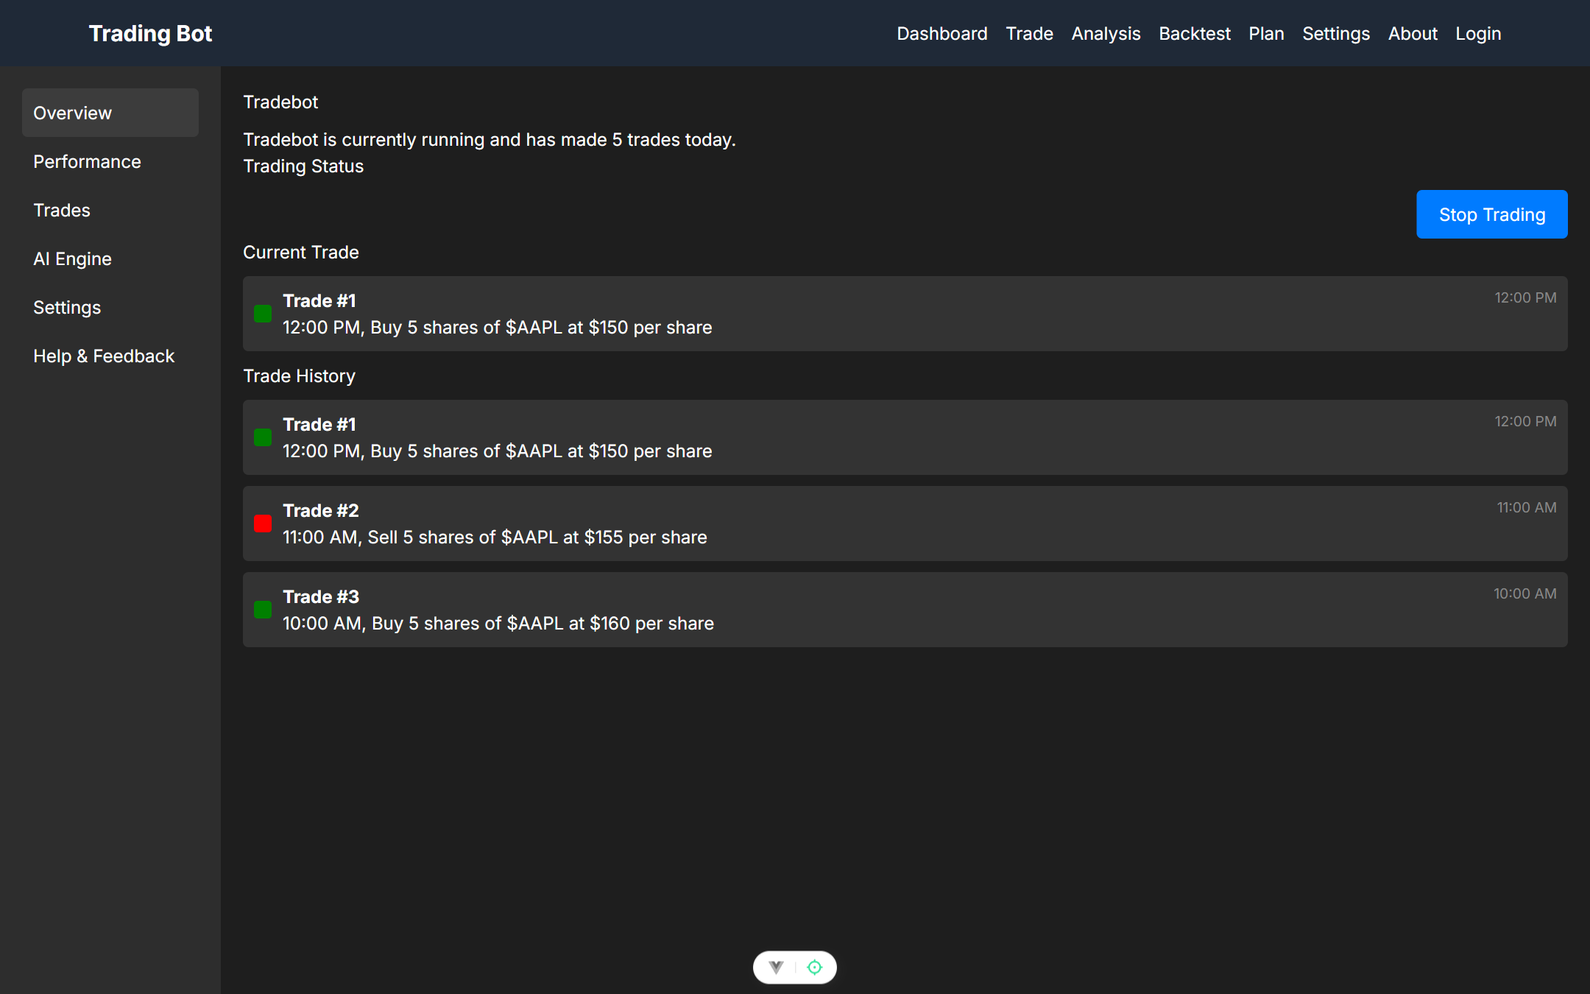
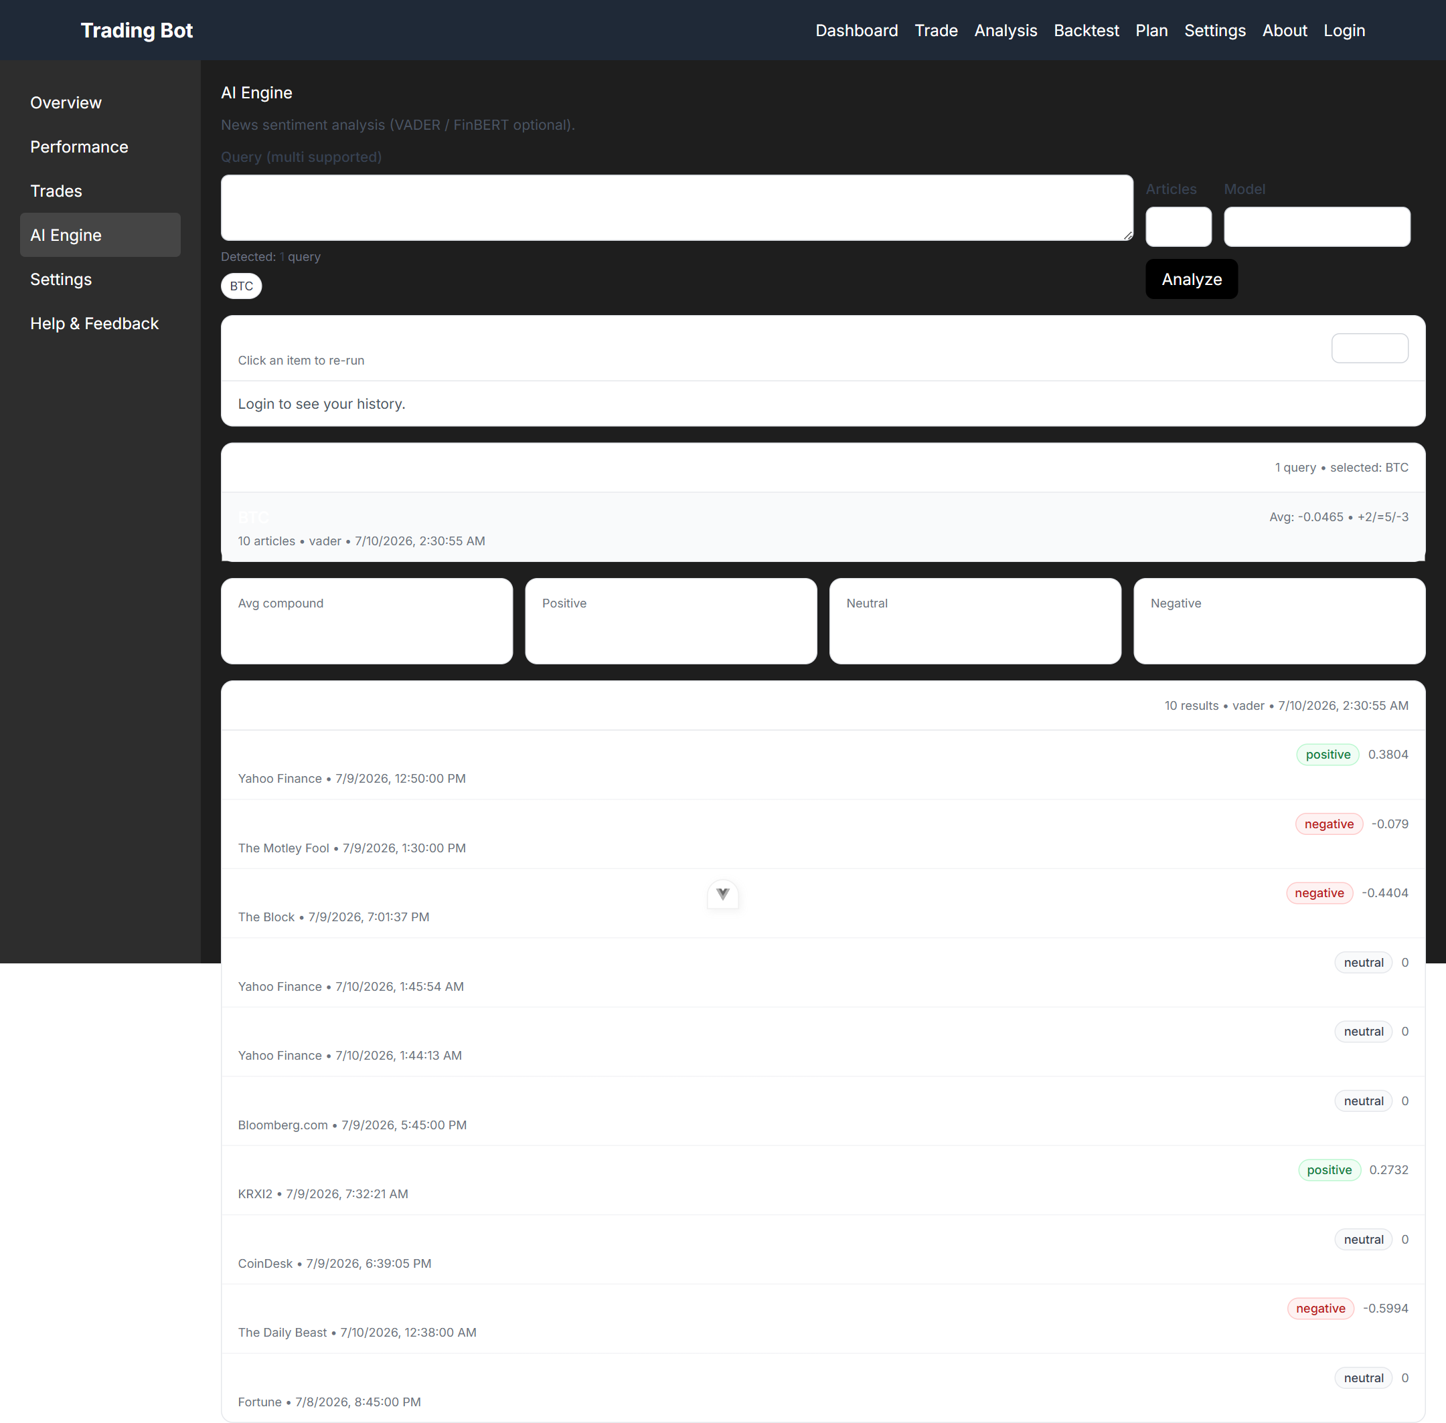
Trade Console & Sentiment Engine ( /trade )
Bot control surface (prototype) with the embedded AI Engine tab
Trade console — mock status & history (prototype)
• Tabs: Overview (mock bot status/trades), AI Engine, plus empty stubs. Spec intent: live-bot control surface once an execution backend exists.
• Sentiment: multi-query (comma/newline, max 10), 5–30 articles, per-article compound + label, excerpts, outbound links.
• Falls back to labeled mock data offline; "Recent Searches" awaits its endpoint (QA H3).
AI Engine — live VADER sentiment for "BTC": summary cards + per-article scores

Slide 12
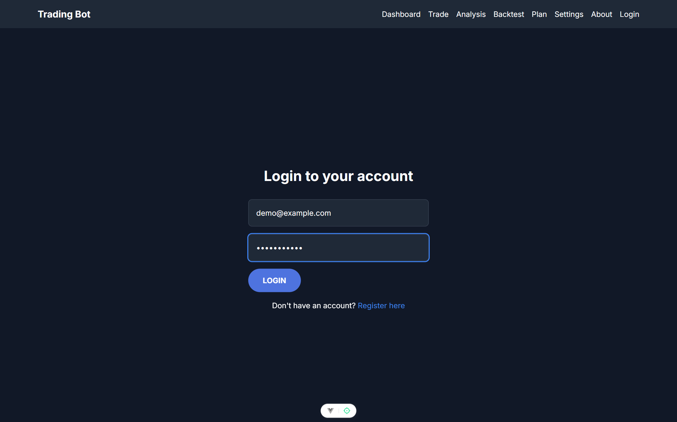
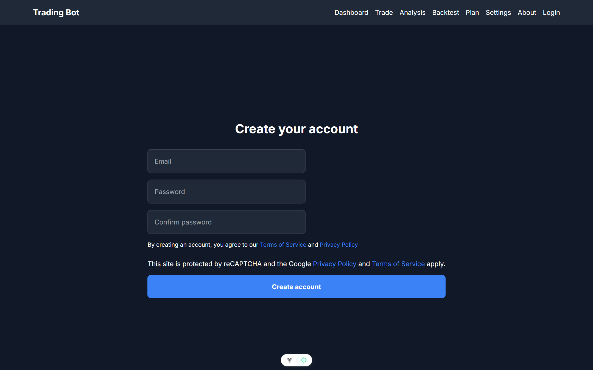
Authentication ( /login · /register )
Express + MongoDB + JWT — UI complete, enforcement pending
• Register
– Email + password + confirm; bcrypt(10); duplicate email → 409; success modal → Login.
• Login
– Unknown email → 404 "register first"; wrong password → 401; JWT (1h) stored in localStorage; modal → Dashboard.
• Gaps (QA M3)
– No route guards, no protected endpoints, no logout. Spec intent: guard Trade/Settings, verify JWT server-side, add logout to Navbar.
Login
Register
• Settings and About are static placeholders today. Settings intent: default market/benchmark, sentiment default, API keys.

Slide 13
API Contract
FastAPI :8000 unless noted · TypeScript mirrors in src/api/*.ts
Endpoint | Params / body | Returns | Errors
GET /api/analyze | symbol, days=365, include_sentiment=true | verdict + composite/technical/sentiment scores, signals[], stats, chart series, warning | 400 · 422
GET /api/history | symbol, days | raw OHLCV candles + source + warning | 400
GET /api/strategies | — | strategy catalog (name, label, description, params) | —
POST /api/backtest | symbol, strategy, params{}, days, initial_capital, commission_bps, benchmark_symbol? | equity curve, trades, num_trades, win_rate, metrics + benchmark block | 400 · 422
GET /api/sectors | — | sector catalog with tickers | —
POST /api/plan | monthly_budget, months 3–120, sectors[], benchmark | allocation, DCA simulation vs benchmark, ±1σ projection, warnings, disclaimer | 422
GET /api/sentiment | query, num_articles 1–50, model | summary counts + avg compound, per-article scores | —
POST /api/register (:3000) | email, password | 201 created | 400 · 409
POST /api/login (:3000) | email, password | JWT token (1h) | 404 · 401
Metrics = {total_return, cagr, sharpe, max_drawdown, volatility}. Referenced but not implemented: GET /api/sentiment/history (QA H3).

Slide 14
Non-Functional Requirements
• Availability
– Every price-driven feature keeps working offline via the synthetic fallback, and visibly labels degraded data. Never show synthetic data as real — benchmarks included.
• Correctness
– No look-ahead in backtests; benchmark always present; TS types must match API responses exactly (type-check gates the build).
• Performance
– Analyze/backtest ≤ ~3 s for 2 years of daily data (pure-Python engine is O(n) per indicator).
– Sentiment currently exceeds acceptable latency (article fetches are sequential, QA M6) — target ≤ 8 s for 10 articles.
• Security
– Secrets via environment only (QA H4); CORS locked to the frontend origin in production (M9); rate-limited auth endpoints (M10); JWT verified on any future user-scoped endpoint.
• Compliance / tone
– Every simulated or projected figure carries the disclaimer; verdicts are labeled model output, not advice.
• Quality gates
– npm run type-check · lint · test:unit; backend smoke snippets in .claude/skills/*/SKILL.md.

Slide 15
Known Gaps & Roadmap
Cross-referenced with docs/QA_REPORT.md
• Now — broken, fix first
– Dashboard chart pipeline → move to /api/history (QA H1/H2).
– Implement or remove sentiment history endpoint (H3).
– JWT secret from env; register proxy + validation (H4, M1, M2).
• Next — product debt
– Real portfolio model behind the Dashboard (positions, cash, P&L).
– Route guards + logout + persisted per-user sentiment history — gives Login a purpose.
– Trade page: paper-trading loop driven by an existing strategy, or label "coming soon".
– Proper Tailwind v4 build; remove CDN scripts and dead scaffold code.
• Later — ideas
– Strategy parameter sweeps / optimization view; save & compare backtest runs.
– Alerts on verdict changes / signal crossovers via scheduled jobs.
– FinBERT as an optional model; multilingual news for TW symbols.
– Export plan/backtest results (CSV / PNG).
Trading Bot · Product Specification v0.2 · 2026-07-10

