Slide 1
The Creation of our Discord Bot
By
Mateo Lufi
Minu Kim
Philipp Sawa

Slide 2
Intro – Problem Statement, Motivation
We, as students, have decided to use Discord as our main platform to communicate and study with each other. While it is a good platform that has a lot to offer, during breaks and even while studying, we felt like something was missing. We could not play music in the background or watch educational videos together without leaving the Discord – which was a problem for some students with only one monitor. There are similiar projects out there, but none really had what we were looking for. Additionally, most well-made Discord Bots are monetized and thus aren‘t free. This is why our IT Project was the perfect way to extend Discord to our likings. Everything that was missing we could simply create ourselves, instead of paying for a Discord Bot that someone else has programmed. That way we could not only make our study sessions more enjoyable, but create our first project that we could always extend to our needs in the future. That is why our main motivation behind this project was to try and create a Bot that would make our everyday student life more enjoyable. And it worked!

Slide 3
Which Tools did we use?
For planning and setting priorities we used an Agile Board
For coding we used Visual Studio, where multiple people can work on one project
To research, we used Discords Developer Portal and educational Videos

Slide 4
What were our goals?
01
03
05
02
04
06
API usage
Videos
Usability
We wanted to be able to use any websites API
We wanted to somehow be able to watch videos together
We included a few commands that made googling unnecessary
Play music
Scalability
Study tool
By just sending a message with a link, we wanted to be able to play music
From the beginning, we wanted this project to be expandable in the future
Altogether, we wanted to create something that made our study sessions more enjoyable

Slide 5
Implemented vs. Scrapped ideas
Video Player
Calculator
Play Music
Due to a lot of paid and expensive APIs, we ran into a lot of issues. Our last option worked!
We spent a lot of time on creating a calculator within Discord, but deemed it useless later
One of the hardest tasks but we did not give up and made it work!
Communication
Calendar
Auto-Mute
We made the Bot able to communicate with any user on our server
Just like the Calculator, we deemed it useless as everyone has a physical/digital calendar
Detect a Users bad words and automatically mute them – due to an unproceeded amount of effort, this was scrapped

Slide 6
What were our biggest challenges?
Challenges
At one point we decided to start over from scratch, which was a good but hard decision
Having 3+ people work on one project makes it chaotic sometimes
Many unexpected errors halted our whole progress at times
Different extents of knowledge means some work quicker than others – adapting to a team is key

Slide 7
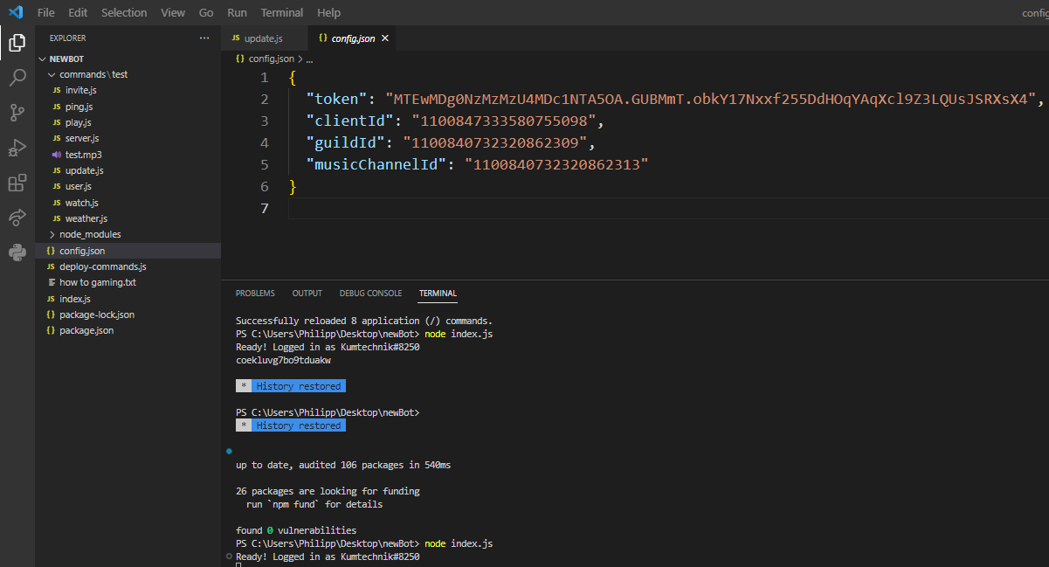
How our Bot connects to any Discord Server
Discord Channel & Server Information
By running index.js, the Bot connects to the Server with all commands available

Slide 8
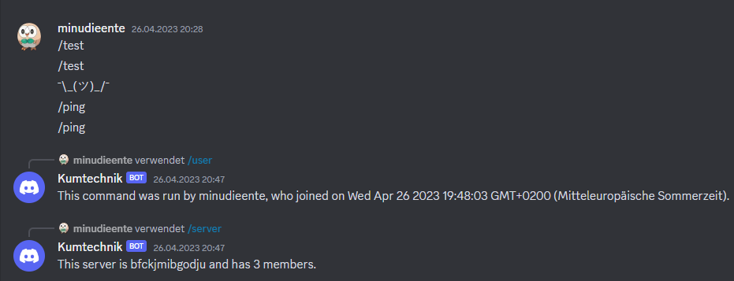
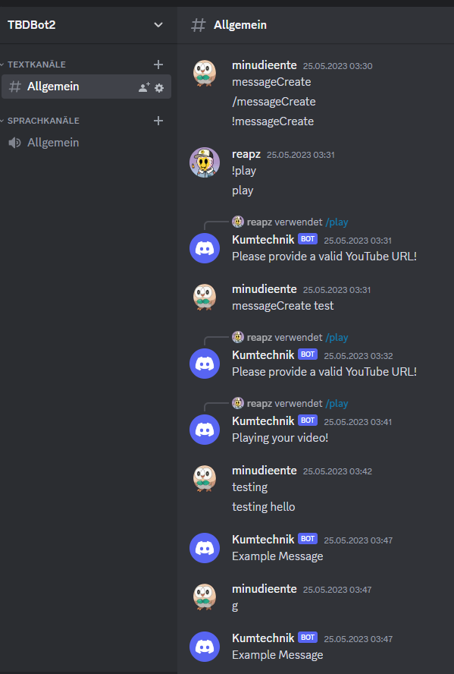
Our first proper interaction with the Bot
Reply to commands via /
Actively read and respond to messages

Slide 9
What we took away from this project
Lessons learned
The biggest lessons we all have taken away from this, is that it is important to work in a team and being open to learn from others. What is most importatnt hough is that it is part of the process to maybe start over from scratch or thinking a task is impossible. The key is to keep going and trying your best, because if it does not work, at least you tried and learned something along the way! We are all very happy with the outcome and are happy to display our results.

