Slide 1
MaskMaker Components
7/18/22

Slide 2
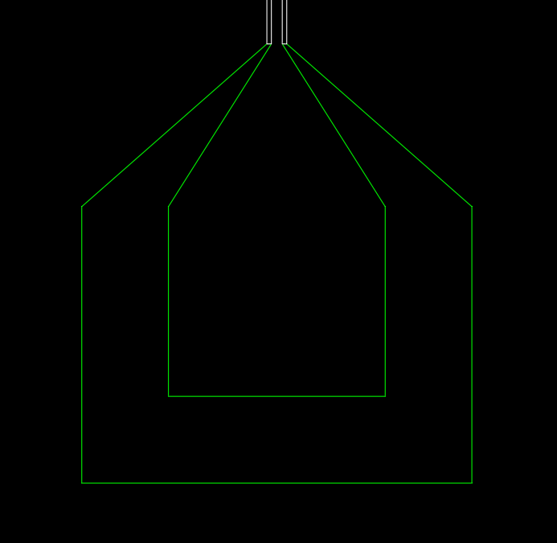
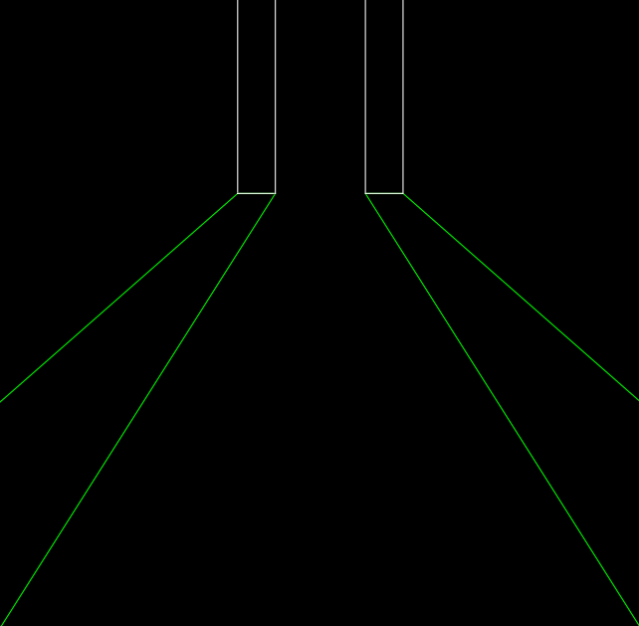
Bondpad
Notes:
‘spec’ has three options: ‘auto’, ‘start’, or ‘end’
If ‘spec’ is auto’:
If startjunc is passed, then the Bondpad will be drawn backwards (so as to start a feedline from the startjunc)
If startjunc is not passed (and Chip.last is used instead), the Bondpad will be drawn forwards (so as to end a feedline).
If ‘spec’ is ‘start’, the Bondpad starts the feedline
If ‘spec’ is ‘end’, the Bondpad ends the feedline
startjunc / cxns[‘out’]
launcher_gapw
taper_length
gapw
pinw
launcher_pinw
bond_pad_length
launcher_padding

Slide 3
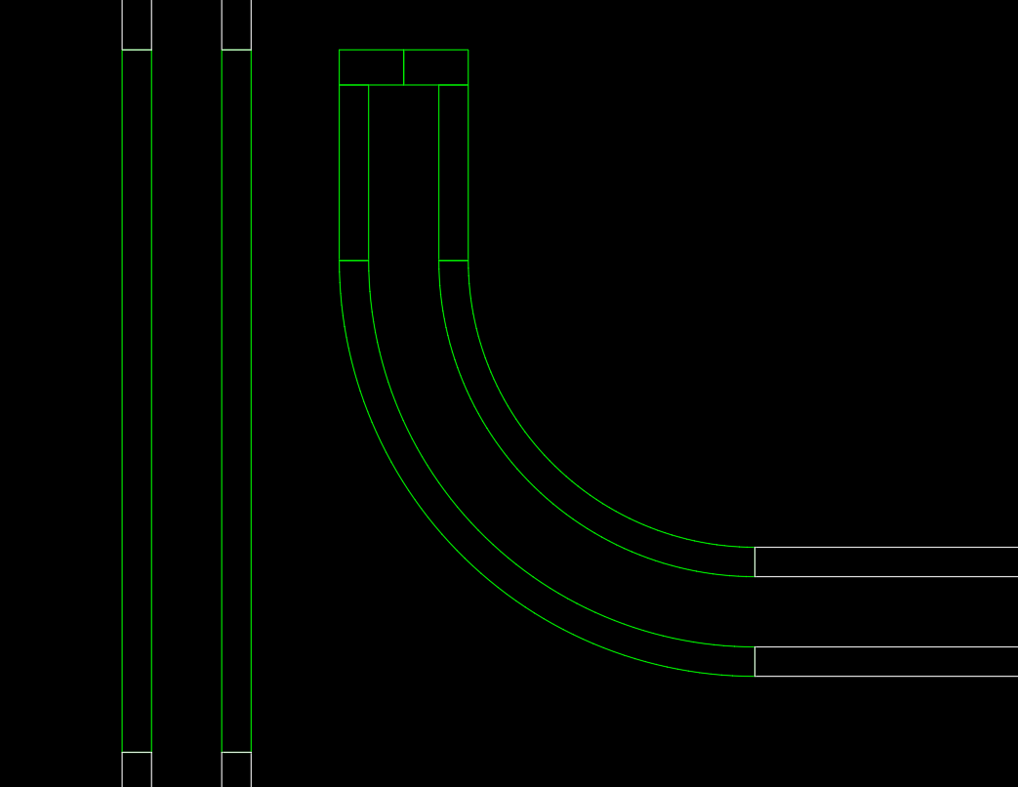
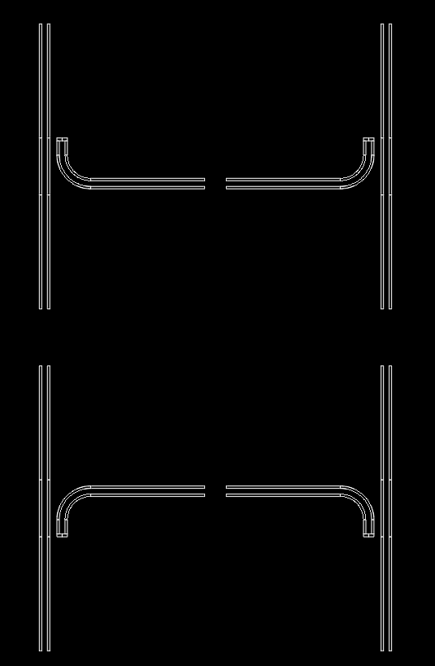
CouplingStraight
cxns[‘out’]
coupling_gap
cxns[‘hanger’] (‘add_hanger’: False)
Notes:
‘leftright’ and ‘updown’ are dependent on the direction of startjunc. The direction of startjunc is indicated by the blue arrows.
buffer
‘leftright’ : ’right’
‘updown’ : ’down’
‘leftright’ : left’
‘updown’ : ’down’
gapw
coupling_straight
pinw
pinw
gapw
radius
length
‘leftright’ : ’right’
‘updown’ : ‘up’
‘leftright’ : left’
‘updown’ : ‘up’
cxns[‘hanger’] (‘add_hanger’: True)
cxns[‘in’] = startjunc.reverse()

Slide 4
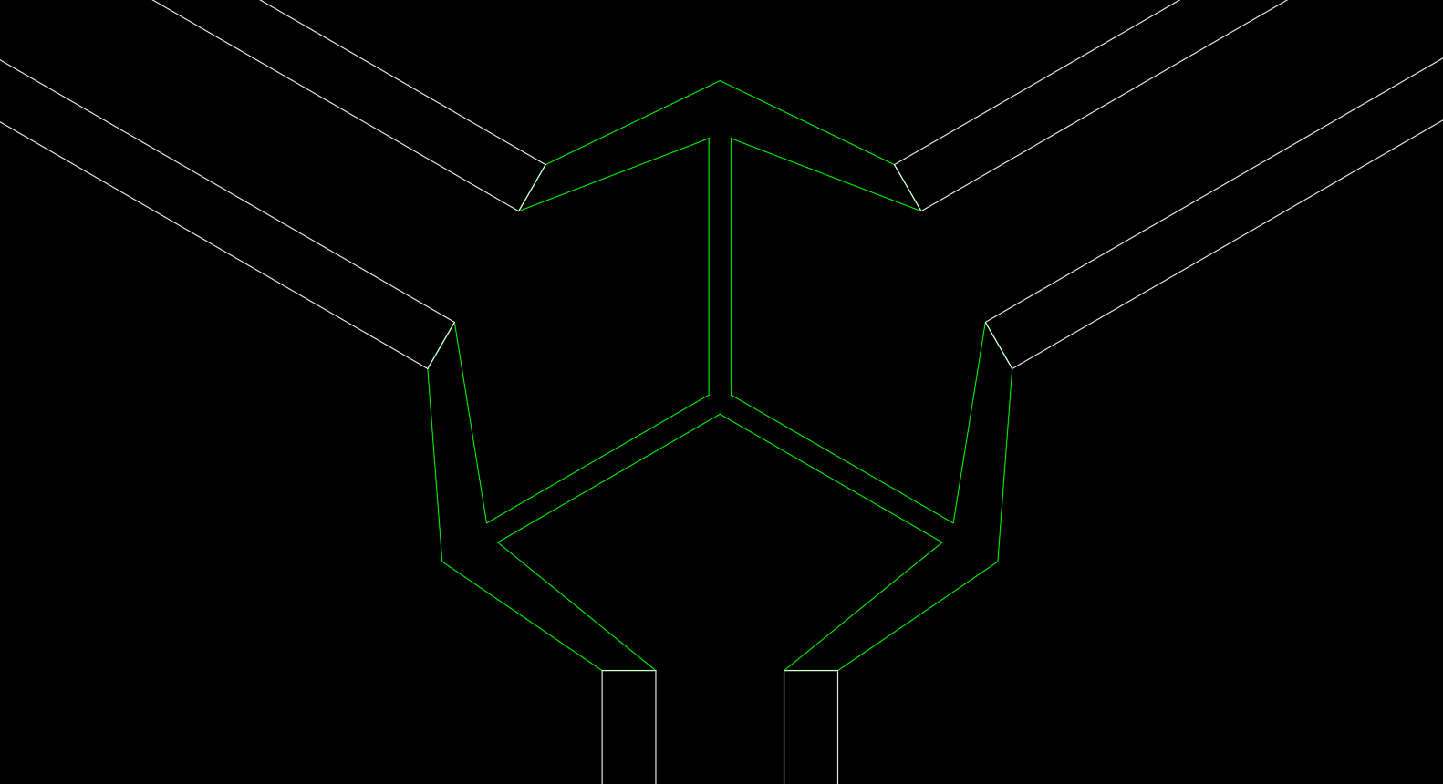
ThreeWayCoupler
coupling_distance
cxns[‘connB’]
pinw
cxns[‘connC’]
length
gapw
cap_edge
coupler_radius
cxns[‘connA’] =
startjunc.reverse()

Slide 5
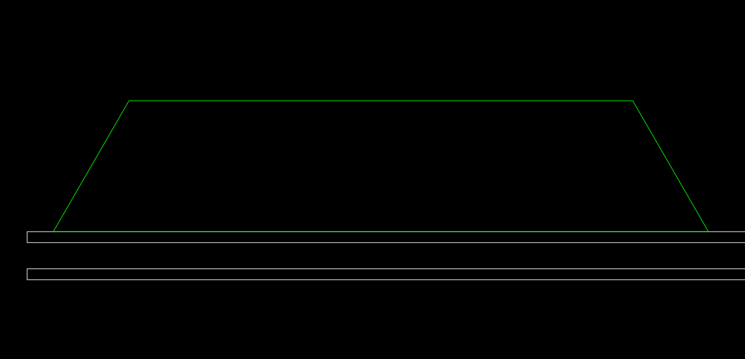
QubitNotchFromJunc
Notes:
- The qubit notch shown has ‘leftright’ = ‘right’
offset
length
height
taper_angle
refjunc

Slide 6
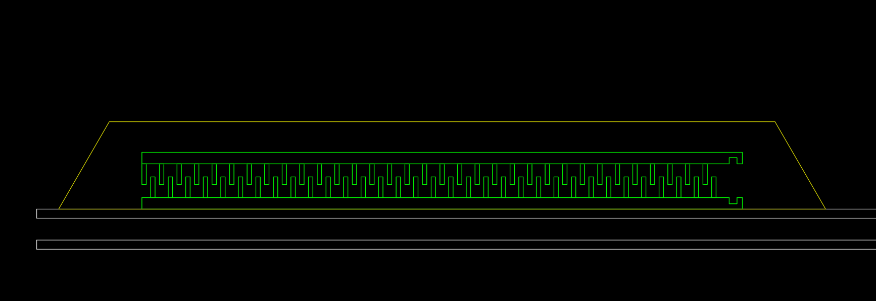
CustomQubit
offset
length
import_offset
height
taper_angle
pin_gap

Slide 7
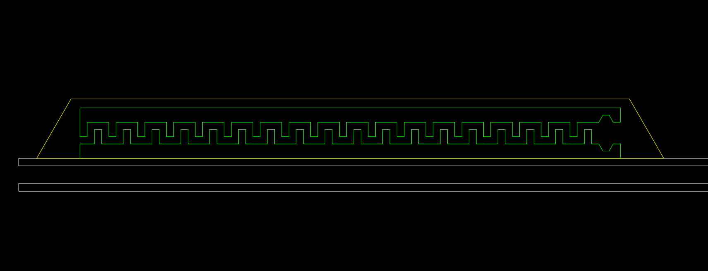
SawtoothQubit - 1
Notes:
The qubit drawn has ‘updown’: ‘up’
h_padding
paddle_length
v_paddiang
paddle_gap
pin_gap

Slide 8
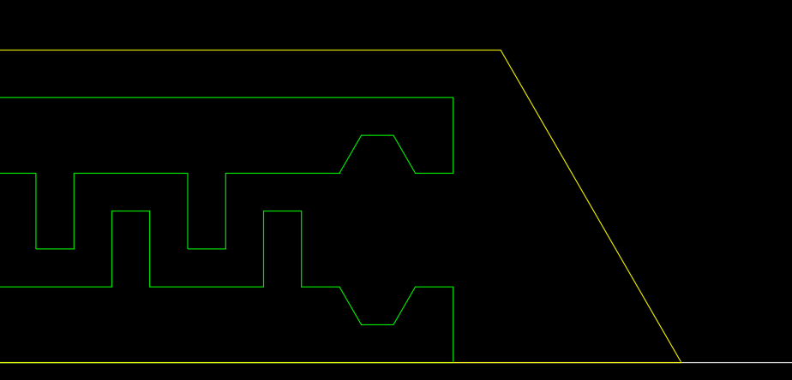
SawtoothQubit - 2
paddle_width
pocket_depth
tooth_width
pocket_length
tooth_height
tooth_spacing
pocket_offset
pocket_wall_angle
buffer (roughly)

