Slide 1
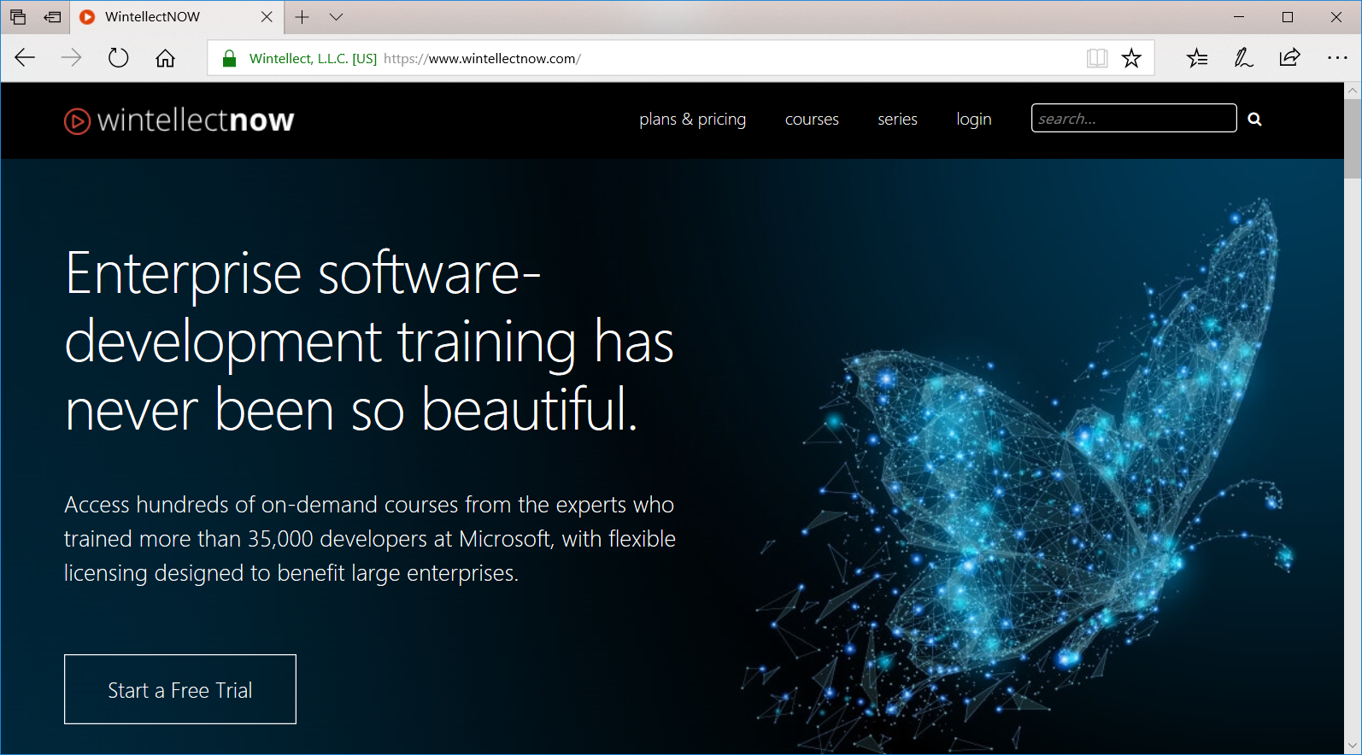
RVA Software Development Meetup Programming Blockchain
Blaize Stewart
Architect
Microsoft MVP, MCT, and PCSA
@theonemule www.blaize.net

Slide 2



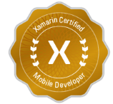
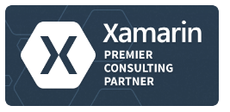


Wintellect Core Services
Consulting
Custom software application development and architecture
Instructor Led Training
Microsoft’s #1 training vendor for DevDiv
On-Demand Training
World class, subscription based online training

Slide 3
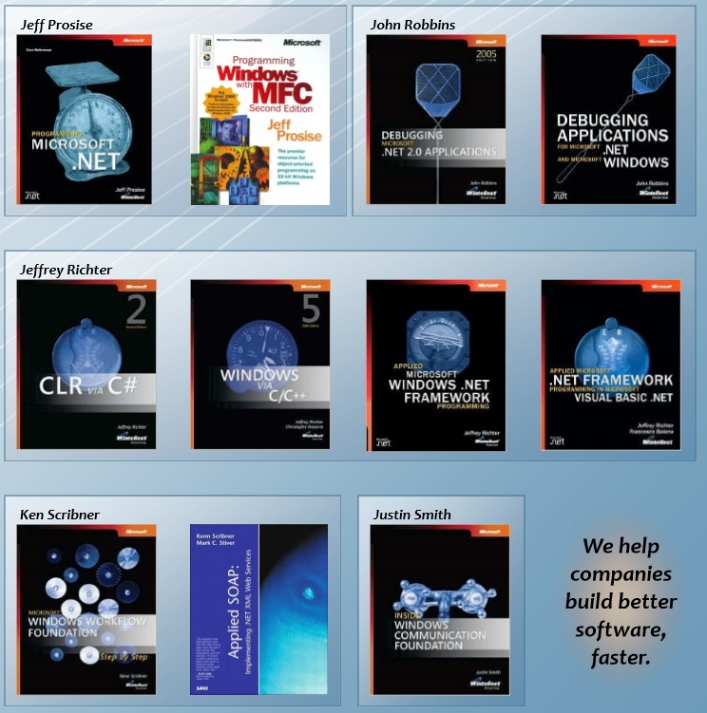
Industry Influencers We wrote the book (over 30 of them)

Slide 4
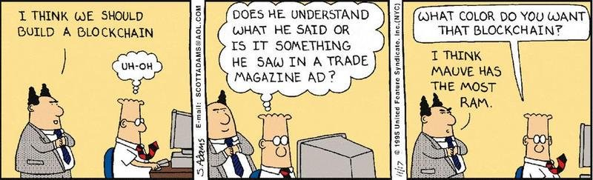
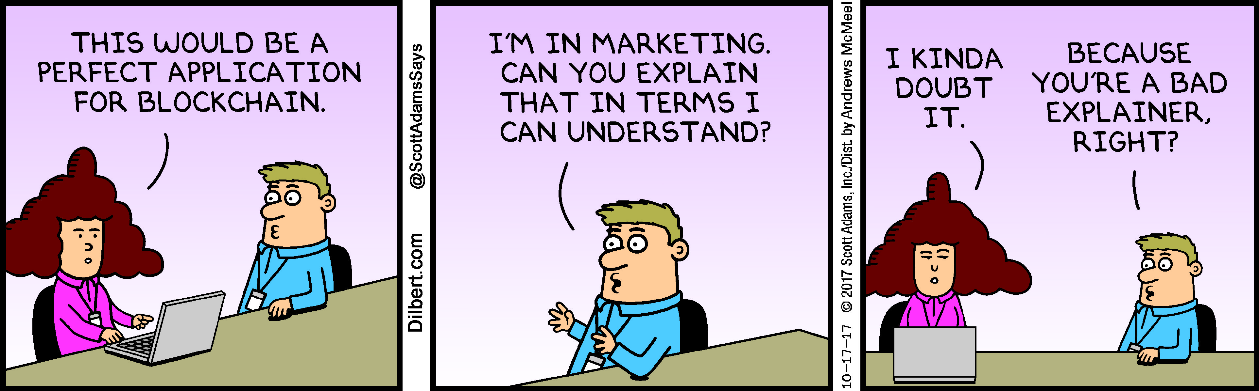
Notes:
Blockchains are essentially a distributed database wherein each block is linked to another block in the chain by way of hashes from another block. This means that a block cannot be modified without breaking the entire chain. Having these interlinking blocks makes the chain forward moving only – data cannot be retroactively changed once it is written to a block. With this limitation, the tradeoff means that the chain is tamper resistant because changing data would change hashes, secure in that the data is immutable, and verifiable in that the hashes can be reproduced from the data. Blockchain was invented for Bitcoin, but its uses go far beyond cryptocurrency. For an interesting read on how Blockchain might be used to implement secure electronic voting, see https://venturebeat.com/2016/10/22/blockchain-tech-could-fight-voter-fraud-and-these-countries-are-testing-it/.

Slide 5
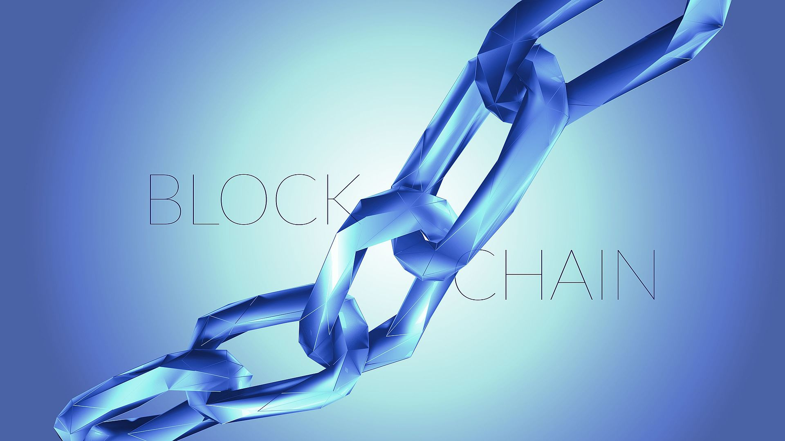
Hangin’ Tough: What is a Blockchain?
Blockchains are distributed databases or “ledgers” in which blocks representing “transactions” store data securely using hashes from previous blocks. Blockchains are tamper-resistant, secure, and verifiable.
Bitcoin is the most famous blockchain application.
Notes:
Blockchains are essentially a distributed database wherein each block is linked to another block in the chain by way of hashes from another block. This means that a block cannot be modified without breaking the entire chain. Having these interlinking blocks makes the chain forward moving only – data cannot be retroactively changed once it is written to a block. With this limitation, the tradeoff means that the chain is tamper resistant because changing data would change hashes, secure in that the data is immutable, and verifiable in that the hashes can be reproduced from the data. Blockchain was invented for Bitcoin, but its uses go far beyond cryptocurrency. For an interesting read on how Blockchain might be used to implement secure electronic voting, see https://venturebeat.com/2016/10/22/blockchain-tech-could-fight-voter-fraud-and-these-countries-are-testing-it/.

Slide 6
The Ledger
A ledger is basically a list of transactions in chronological order. The obvious example is the General Ledger from an account system, but some examples might be something like a checkbook or a logfile. Within a blockchain, all writes are stored in a ledger with:
a timestamp
a hash of a previous transaction
data for the transaction
Tx ID | Timestamp | Hash from Tx ID - 1 | Data
100 | 3/1/2018 12:20PM | Hash from Tx #99 | 12345…
101 | 3/2/2018 2:42 AM | Hash from Tx #100 | 6789…
102 | 3/2/2018 4:22 PM | Hash from Tx #101 | 9876…
103 | 3/4/2018 5:01 PM | Hash from Tx # 102 | abcd…
104 | 3/5/2018 3:03 PM | Hash from Tx # 103 | efgh…
105 | 3/6/2018 6:00 PM | Hash from Tx # 104 | Ijkl…

Slide 7
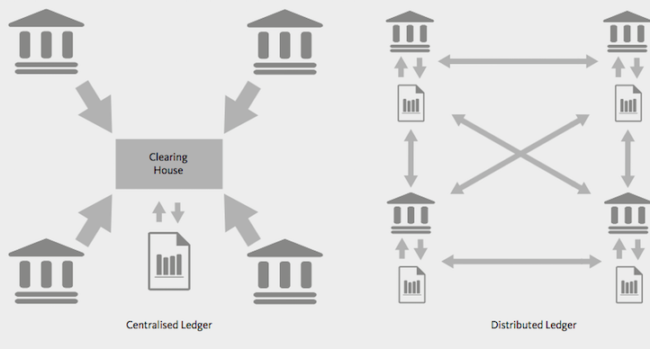
A Distributed Ledger
A blockchain ledger is said to be a “distributed ledger”. A centralized ledger is managed by a central authority, while a distributed ledger is spread across all involved parties.

Slide 8
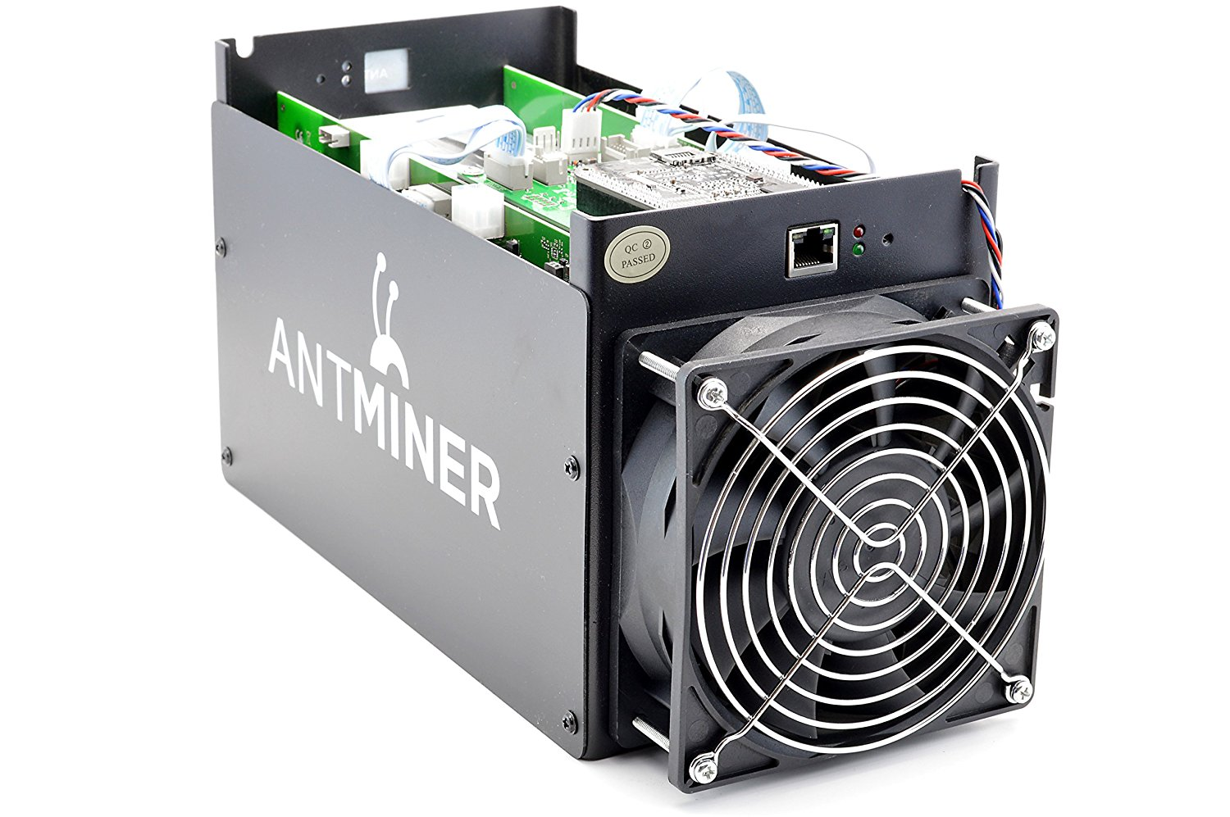
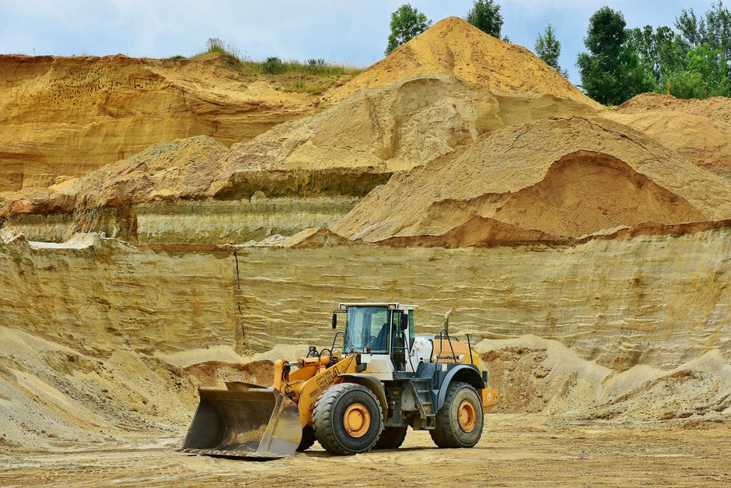
Blockchain Mining
A common concept in most blockchain implementations is that of “mining”. Mining is the process that nodes use to discover and validate new blocks. When a node processes a new block, it is rewarded with “coin” in the form of cryptocurrency.

Slide 9
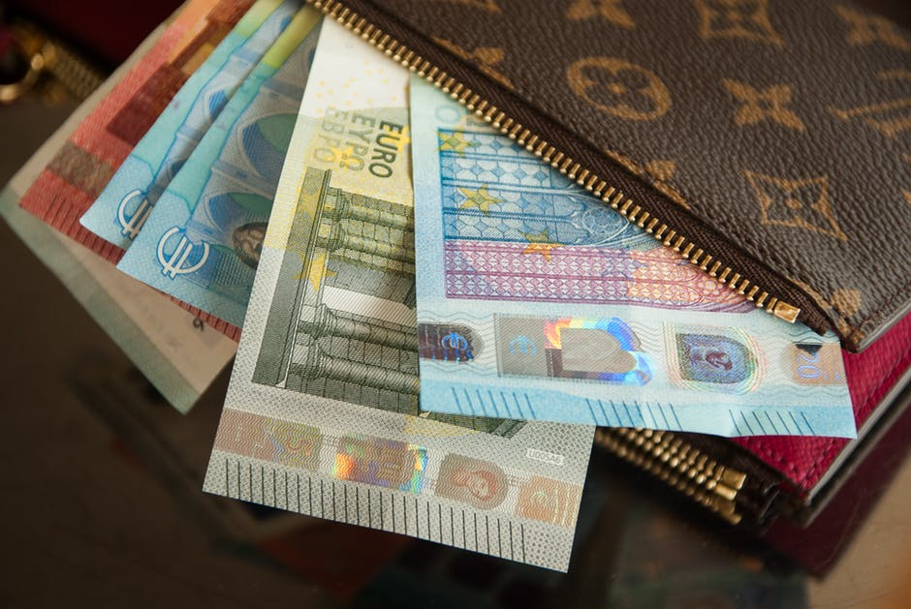
Wallets
Cryptocurrency users set up virtual “wallets” to secure accounts for coin that they own. A wallet is usually an app that acts as client on the blockchain network and that can send and receive coin.
One popular browser-based wallet app is MetaMask.

Slide 10
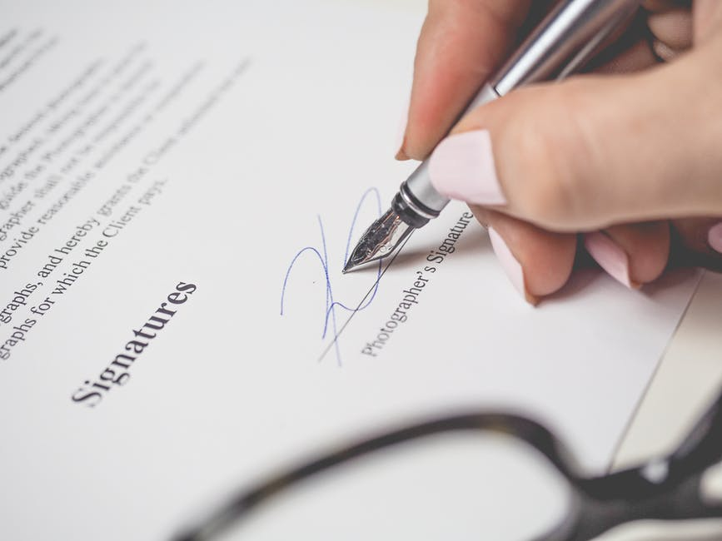
Smart Contracts
A “smart contract” is a program that runs on a blockchain network and is called via RPC.
Contracts offer ways to both process, store, and retrieve data on a blockchain for custom use cases.

Slide 11
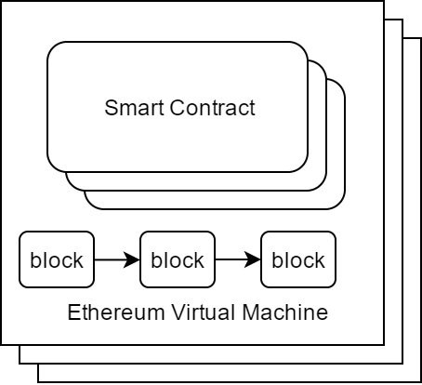
Smart Contracts
Smart Contracts (sometimes called “distributed apps” or “Dapps”) are apps that run on the Ethereum VM.
The contracts themselves become a part of the blockchain.
The contracts modify contract states, with each successive state change becoming a new transaction stored on the blockchain.

Slide 12
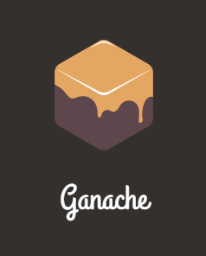
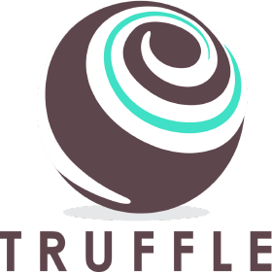
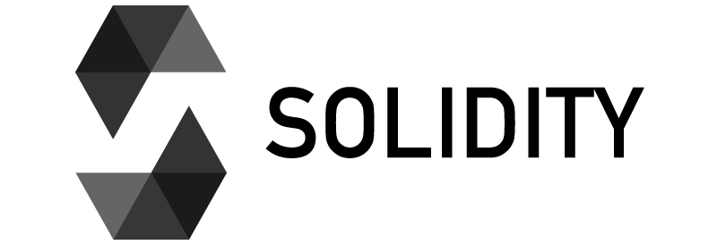
Tooling
Tooling for developing on Ethereum has matured with several offerings.
For offline development, use:
Ganache – a GUI-based development blockchain app
Truffle – a Solidity development and automation framework.
Solidity – The language and tools for writing Smart Contracts on Ethereum.

Slide 13
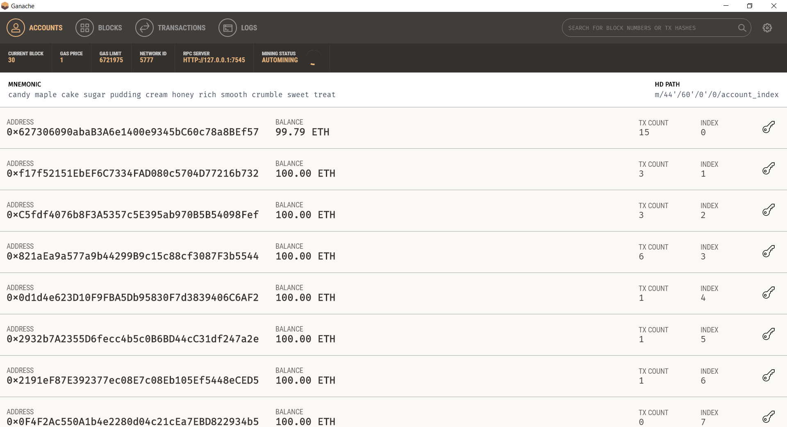
Ganache – A Personal, Development Blockchain
Ganache is a personal blockchain for development with a GUI frontend.
The GUI is not required for Ganache to run, but it does provide a easy-to-use interface for seeing activity on the development blockchain.
Ganache is available for Windows, Mac OS, and Linux
https://github.com/trufflesuite/ganache/releases

Slide 14
Truffle
Truffle is framework and utility for developing smart contracts with Solidity.
It automates contract deployment, contract testing, and facilitates debugging.
Truffle is scriptable, which enables developing pipelines for CI/CD.
npm install -g truffle

Slide 15
Common Truffle Commands
init – sets up a new project in an empty folder.
create – create an artifact within a Truffle project
migrate/deploy – deploy compiled contracts to a network
compile – compile smart contracts and create build artifacts
test – run a test against contracts.
debug – interactively debug a contract
console – interact with a contract with a CLI

Slide 16
Other Tools
geth console – A CLI tool for interacting with Ethereum.
Mist Browser – a custom browser that is used for running client apps and performing operations similar to Geth in a GUI.
Remix – An IDE for developing Solidity Smart Contracts that’s built into Mist
MetaMask – MetaMask is a browser plugin for popular web browsers for interacting with a blockchain. It also can be tied into apps running in a browsers.
Visual Studio Code (with a Solidity plugin) – Another tool for writing Smart Contracts

Slide 17
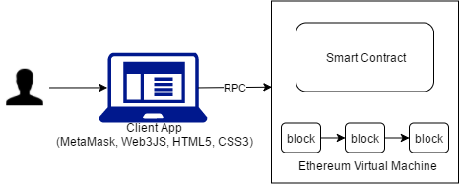
App Architecture #1
In some cases, apps on Ethereum can interact directly with an Ethereum Network.
These apps use browser-based technologies to interact with an Ethereum node running a Smart Contract.

Slide 18
MetaMask and Ganache – Using a Wallet on a Development Blockchain

Slide 19
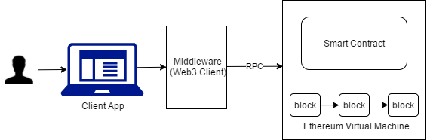
App Architecture #2
In some cases, apps use middleware, such as a webserver, to interact with Ethereum.
In this case, the middleware manages the accounts and RPC’s with the Ethereum nodes.

Slide 20
Solidity – A Language For Writing Ethereum Contracts

Slide 21
Questions???
Follow me on Twitter @theonemule
Hands-on lab: using NodeJS with Ethereum and Solidity. https://bit.ly/2utIb2w

