Slide 1


Unit Testing: The Chuck Norris Way
Dave Robertson
Senior Software Architect
@DeveloperWisdom

Slide 2

Chuck Norris’ Toughest Test
http://www.youtube.com/watch?v=T-DKx28Y07U

Slide 3
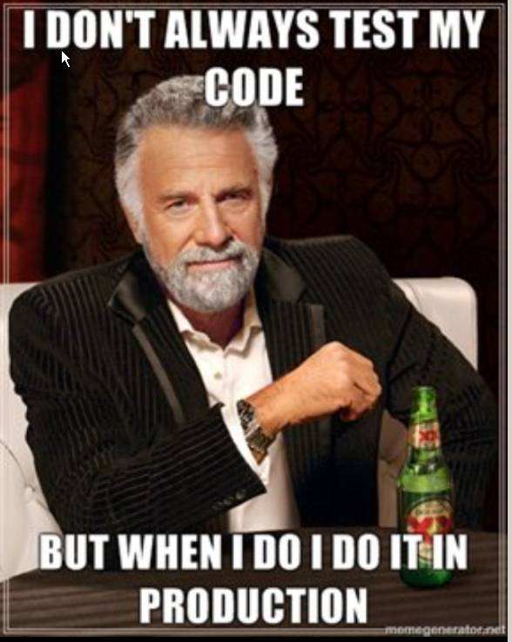

Slide 4
Definitions
Unit Test
Load Test
Performance Test
Integration Test

Slide 5
Definitions: Methodology
Arrange
Act
Assert
In 2003 William C. Wake blogged about using Arrange Act Assert pattern in unit tests. From that moment on it was obvious…that this was the only way to create tests that were:
easy to read
follow
understand
maintain

Slide 6
Definitions: Unit Test
What does a good Unit Test look like?
What does a bad Unit Test look like?
[Test] public void A_MapsTo_B() { var a = new A(); a.Name = "name"; var b = new B(); Mapper.MapNames(a, b); Assert.AreEqual(a.name, b.name); }
[TestFixture]
public Class SampleTest
{
[Test]
public void AddingOneAndOneResultsInTwo()
{
int two = 1 + 1;
Assert.AreEqual(2, two);
}
}

Slide 7
Definitions: Unit Test
Deterministic: repeatable; isolated; automated
Non-deterministic: database; web service; file
Eradicating Non-Determinism in Tests
An automated regression suite can play a vital role on a software project, valuable both for reducing defects in production and essential for evolutionary design. In talking with development teams I've often heard about the problem of non-deterministic tests - tests that sometimes pass and sometimes fail. Left uncontrolled, non-deterministic tests can completely destroy the value of an automated regression suite… Initially quarantine helps to reduce their damage to other tests, but you still have to fix them soon… the common causes for non-determinism: lack of isolation, asynchronous behavior, remote services, time, and resource leaks.
--Martin Fowler

Slide 8
Definitions: Unit Test
A good deterministic test
[TestMethod()]
[Timeout(1500)]
[TestCategory(“Unit Test”)]
public void CreateParagraphBasicTest()
{
// Arrange
string expected = "If a tree falls in the forest when no one is around, does Chuck Norris hear it?";
string expectedMore = "You betcha he does...";
string actual;
BusinessLogicStuff target = new BusinessLogicStuff();
List<string> sentences = new List<string>()
{
expected,
expectedMore
};
// Act
actual = target.CreateParagraph(sentences);
// Assert
Assert.IsTrue(actual.Contains(expected));
Assert.IsTrue(actual.Contains(expectedMore));
}

Slide 9
Definitions: Unit Test
A non-deterministic test
private LogAnalyzer logon;
[TestMethod]
public voidCreateAnalyzer_BadFileName_ReturnsFalse()
{
logon = new LogAnalyzer();
logon.Initialize();
bool valid = logon.IsValid("abc");
Assert.That(valid, Is.False);
}

Slide 10
Definitions: Integration Test
What is an Integration Test? Isn’t that just another form of Unit Test?? Integrate with what?
[TestMethod()]
[HostType("ASP.NET")]
[AspNetDevelopmentServerHost("C:\\Users\\%USER%\\Documents\\Visual Studio 2010\\Projects\\UnitTesting-Basic\\WcfService", "/")]
[UrlToTest("http://localhost:24059/")]
public void GetChuckNorrisFactTest()
{
ChuckNorrisService target = new ChuckNorrisService();
Nullable<int> value = new Nullable<int>();
string expected = string.Empty;
actual = target.GetChuckNorrisFact(value);
Assert.AreEqual(expected, actual);
Assert.Inconclusive("Verify the correctness of this test method.");
}

Slide 11
What’s in a name?
Test names should be meaningful and intuitive
[TestMethod()]
public void IHaveAValidDataSetSoIShouldGetBack42()
{
// Arrange
// Act
//Assert
}

Slide 12
Behavior-Driven Development (BDD)
Given…When…Then
Cucumber (Ruby)
SpecFlow
WatiN
[TestFixture]
class when_adding_numbers
{
Maths maths;
void Given_an_object_in_bigint_mode()
{
maths = new Maths();
maths.BigInt = true;
}
[Test]
public void it_doesnt_overflow_the_size_of_an_int()
{
Given_an_object_in_bigint_mode();
Assert.That(maths.Add(int.MAX, 1), Is.GreaterThan(int.Max));
}
}

Slide 13
Mocks and Stubs
Mock objects are simulated objects that mimic the behavior of real objects in controlled ways
Stubs provide canned answers to calls made during the test, usually not responding at all to anything outside what's programmed in for the test.
[TestMethod()]
public void InterrogatetheStuffIsNotChuckNorrisTest()
{
// Arrange
BusinessLogicStuff target = new BusinessLogicStuff();
// Here is my mock
ChuckNorrisStuff stuff = new ChuckNorrisStuff() { Name = "Sylvester Stalone" };
bool actual;
// Act
actual = target.InterrogatetheStuff(stuff);
// Assert
Assert.IsFalse(actual);
}

Slide 14
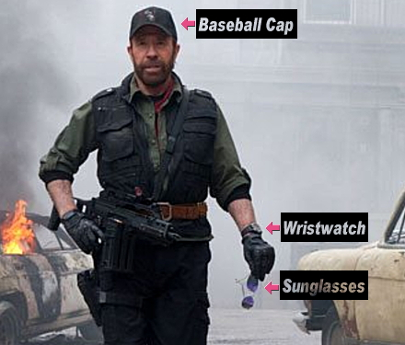
A Unit Test as if Chuck Norris were to write it
demo
demo

Slide 15
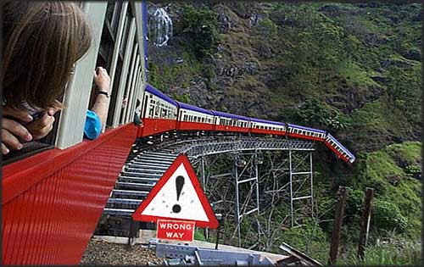
javaScript? Who? What?
demo

Slide 16
La Crème de la Crème
Chuck Norris doesn't call the wrong number. You answered the wrong phone.
Death once had a near-Chuck Norris experience.
Some magicians can walk on water. Chuck Norris can swim through land.
Chuck Norris counted to infinity…twice.

Slide 17
Resources
The Art of Unit Testing: With Examples in .Net
- Roy Osherove
xUnit Test Patterns: Refactoring Test Code
- Gerard Meszaros
http://martinfowler.com/articles/nonDeterminism.html
http://martinfowler.com/articles/mocksArentStubs.html
http://qunitjs.com/
Moq
Rhino Mocks
Jasmine
JSpec
QUnit
BDD

Slide 18
THANKS

