Slide 1
A Shot in the Dark
Wolf Richter

Slide 2
How to Study
Go through all the slides
Create condensed notes
One section in notes per slide set/topic
Study your few sheets
Read more on unclear topics
You know the feeling of understanding

Slide 3
How to Study
Go through all the slides
Create condensed notes
One section in notes per slide set/topic
Study your few sheets
Read more on unclear topics
You know the feeling of understanding
Pretend cheat sheets allowed

Slide 4
Remember, knowing the name of something is definitely not the same as knowing something.
This applies to tests...

Slide 5
Never Repeat a Mistake
Know how to do previous problems
Take a practice exam and focus on errors
Practice problems you mess up
Review any errors on midterm, HWs

Slide 6
Test Taking Tips
Find all the important words in the course
Learn their meanings
Memorize all the units you need

Slide 7
Test Taking Tips
Find all the important words in the course
Learn their meanings
Memorize all the units you need
(1) Boosts Confidence
(2) Saves Time

Slide 8
If you never panic,
you'll do better than most in all life situations.

Slide 9
Let's Not Waste Time
Units: If unsure, ask for clarification
Power of 10 vs power of 2
Stored Data: usually powers of 2
Network Bandwidth: often powers of 10
  And expressed as bits vs bytes (x8)

Slide 10
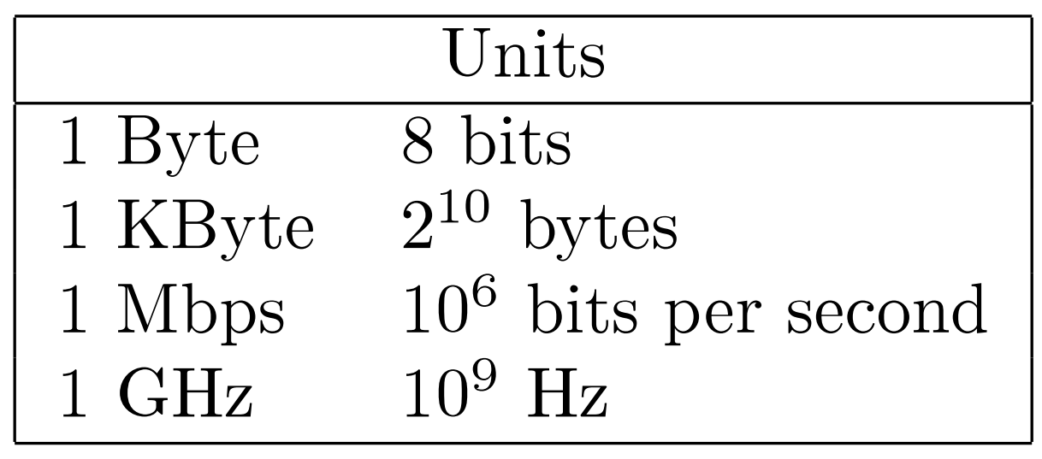

Slide 11
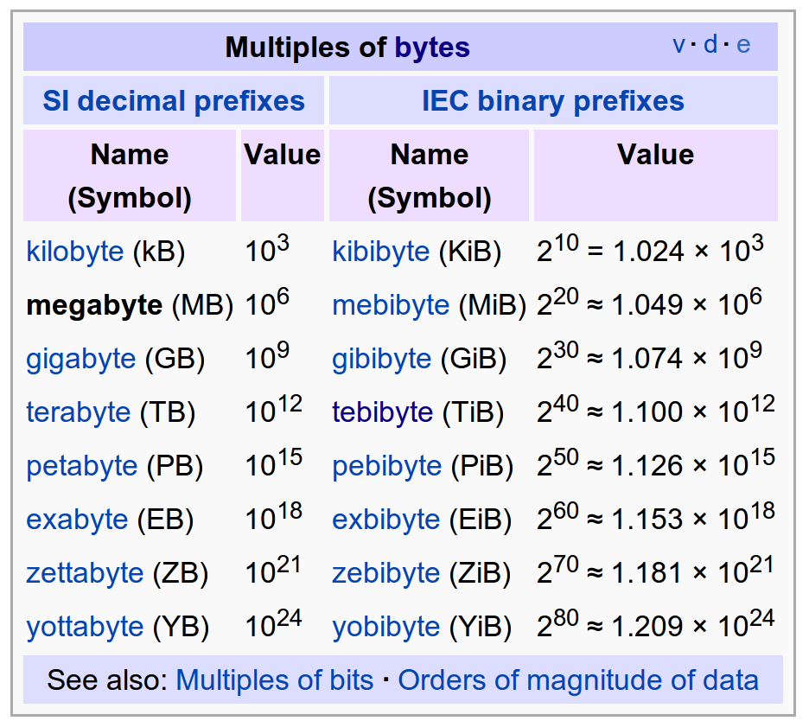

Slide 12
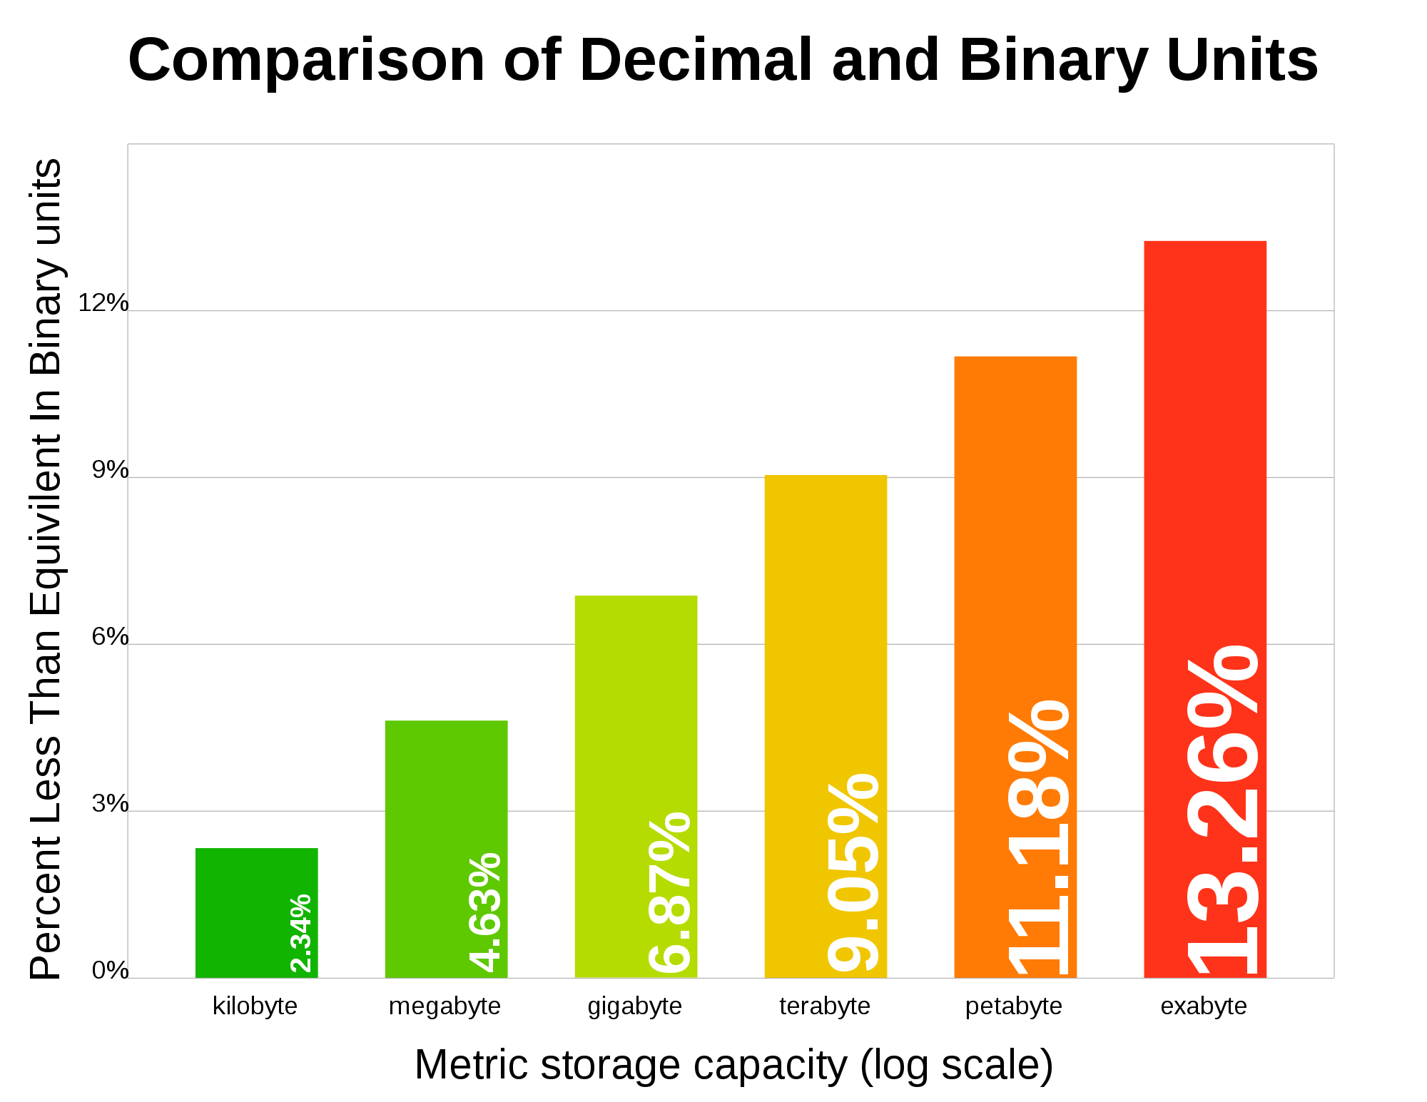

Slide 13
What is a nibble?

Slide 14
How We Make the Exam
List all topics (since midterm) by lecture
Pick 1 problem per topic from database
Create first draft
Cut down number of problems
  Kill very difficult ones
  Murder super long ones
  Asphyxiate poorly worded ones
Add in 1-2 review questions

Slide 15
Key Topics Before Midterm
Layering/Network Stack
Ethernet/Bridging/Switching/Routing
DNS/IP/BGP
Things kind of build on each other...

Slide 16
Topics After Midterm
Tunnels
TCP
Congestion Control
CDNs
P2P
VoIP
Multimedia
QoS
Mobile IP
  Issue: RPF
Wireless
Questioning IP
Security/Firewalls
  Also: NAT

Slide 17
Try to be logical.
Once you're lost, not remembering terms and acronyms,
Don't panic.
Think through with a logical engineering mind and try to think what you would do/how you would design.

Slide 18
Final Exam
Where: Scaife Hall, 125
Day: Tuesday, December 20, 2011
Time: 8:30 AM – 11:30 AM
Good luck!

Slide 19

GitHub:
Git it, got it, good.
git clone git://github.com/theonewolf/15-441-Recitation-Sessions.git

