Slide 1
Learning the Pythonic Way
Athula Balachandran
Wolf Richter

Slide 2
The Man, The Legend: Zed Shaw
So, he made a web server too.
It's called mongrel2.
Oh, and Learning Python the Hard Way [LPTHW].
and... Programming, Motherfuckers...
Need I say more?

Slide 3
Why Python?
My job is to convince you that:
  Python is incredibly easy to program in
  Python “comes with batteries”
  Python enables rapid prototyping
  All your pseudo-code are belong to Python
Practicality?
  Systems scripting language of choice
  Alongside Perl and Ruby; OK, fine

Slide 4
Let's do this.
One at a time.
  All your pseudo-code are belong to Python

Slide 5
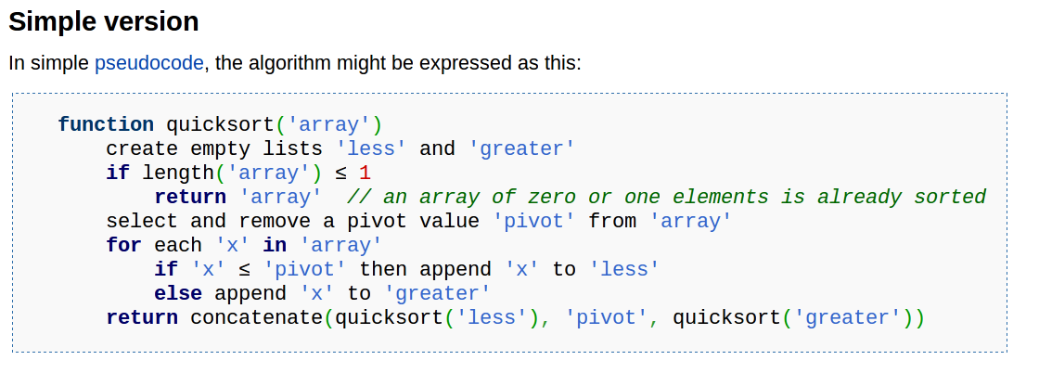
Wikipedia: What is Quicksort?

Slide 6
And...Pseudo-what-Python!?
def quicksort(array):
less = []; greater = []
if len(array) <= 1:
return array
pivot = array.pop()
for x in array:
if x <= pivot: less.append(x)
else: greater.append(x)
return quicksort(less)+[pivot]+quicksort(greater)

Slide 7
Really? Yes!
>>> quicksort([9,8,4,5,32,64,2,1,0,10,19,27])
[0, 1, 2, 4, 5, 8, 9, 10, 19, 27, 32, 64]

Slide 8
  Python “comes with batteries”

Slide 9
There's an app a library for that
import httplib
  HTTP protocol client
  Test your web servers!
  Also: fptlib, poplib, imaplib, nntplib, smtlib...
import os and import sys
  misc. OS interfaces, and system-specific parameters and functions
import random
  Generate pseudo-random numbers
  Sampling, shuffling, etc. – good for testing
import socket
  First test script used this for PJ1CP1
  also SimpleHTTPServer, BaseHTTPServer...

Slide 10
Python enables rapid prototyping

Slide 11
Give me a dynamic web app NOW
from flask import Flask
app = Flask(__name__)
@app.route("/")
def hello():
return "Hello World!"
if __name__ == "__main__":
app.run()

Slide 12
Python is incredibly easy to program in

Slide 13
Use the Interpreter
Code and experiment interactively
Use help()
Explore functionality and ideas
Then code in your main editor

Slide 14
Just one thing
Whitespace matters
Defines blocks → C-world thinks { }
Use spaces
4 spaces per indentation level
spaces > tab → just be consistent
Really though, generally aids readablity
Set your editor preferences ahead of time

Slide 15
Lists
Sorting
Comprehensions
Zip
Slicing
Length
Can masquerade as a stack
Can masquerade as a queue

Slide 16
Dictionaries
Key-Value Storage
del

Slide 17
Tuples and Sequences

Slide 18
Sets
Union
Intersection
Difference
Adding

Slide 19
Strings
Strip
Length
Slicing
Formatted

Slide 20
Raw Strings

Slide 21
Looping
For
While
Range, xrange

Slide 22
Branching
if
elif
else

Slide 23
Defining Functions
def
Keyword arguments
Unpacking
Lambda!

Slide 24
The Power of Passing
Rapidly create a skeleton
Pass

Slide 25
True/False and None
Booleans
None is kind of like NULL

Slide 26
The Colon
Required for if/for/while/with/def/class statements
Enhances readability
Has English meaning
Helps auto-indenting editors
From the Python Design FAQ

Slide 27
Decorators
A software pattern
Dynamically alter a fucntion, method or class

Slide 28
Classes

Slide 29
Exceptions

Slide 30
math?
Pretty much the same as in C
import math → extra math functions

Slide 31
Writing Tests
import doctest
import unittest

Slide 32
@zedshaw LPTHW Reference
We did lessons
  1-5, 10, 13, 18, 23, 29, 32, 40, 47
Bonus: Up to 10 points on Project 1
What should you do:
  Finish the rest of LPTHW/fill in the gaps
  Type in all the Python code yourself
  Follow instructions!
  Place all code into your Project 1 repo
    /scripts/ subfolder
    Email us your feelings/experience

Slide 33
How do I get LPTHW?
Free online
  http://learnpythonthehardway.org/book/
Zed Shaw provided PDF
  Password protected site
  http://xxx.xxx.xxx.xxx
How long does it take?
  ~1-2 days for an experienced programmer

Slide 34
More Python References
Python Tutorial
http://docs.python.org/tutorial/
Super Useful Python Documentation
http://docs.python.org/library/
Python Interpreter
python
>>> help(x)

Slide 35
Shameless plug.
www.phototags.org
Help my research.

Slide 36

GitHub:
Git it, got it, good.
git clone git://github.com/theonewolf/15-441-Recitation-Sessions.git

