Slide 1
Cryptography:
Gur Cbjre bs Xabjyrqtr
15-441, Lecture 5
Wolf Richter
Copyright CMU 2007-2011

Slide 2
Announcements
HW1 deadline extended to 9/20
Project 1 Checkpoint 1 this Friday
Repos: [4:12PM 9/12/11] 21/59 = 35.5%

Slide 3
What will we learn today?
Why: brief history
How: Cryptography and Steganography
  Codes
  Ciphers
    Symmetric, Asymmetric
Today: Kerberos, HTTPS

Slide 4
A continuous arms race
1000's of years of guarding secrets
Spartans – scytale, transposition cipher
Romans – Caesar Cipher, rotation cipher
Allied Analysis broke the ADFGVX
  Led to the Zimmerman Letter decryption
  Led to US involvement in WWI
Breaking ENIGMA during WWII
  Led to Allied tactical advantages

Slide 5
A continuous arms race
Devise cryptosystems
Cryptographers
Cryptanalysts
Find weaknesses

Slide 6
Desired properties [Schneier96]
Confidentiality – Ensure that an eavesdropper can not read a message.
Authentication – It should be possible for the receiver of a message to ascertain its origin; an intruder should not be able to masqeurade as someone else.
Integrity – It should be possible for the receiver of a message to verify that it has not been modified in transit; an intruder should not be able to substitute a false message for a legitimate one.
Nonrepudiation – A sender should not be able to falsely deny later that he sent a message.

Slide 7
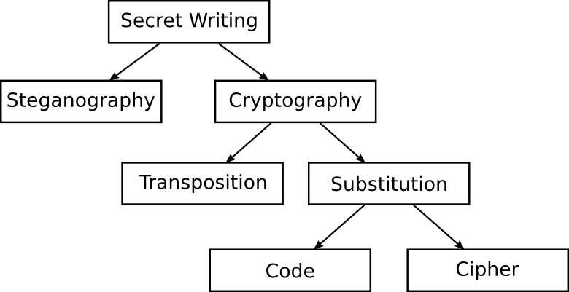
The history of communication

Slide 8
Steganography
The act of hiding information
Often in plain sight...
Example: slightly modify pixel data...
  (R,G,B): (255,255,255) → (255,255,254)
See app: steghide
  Operates on both images and audio
  Graph-theoretic basis
  man steghide

Slide 9
Steganography
The act of hiding information
Often in plain sight...
Example: slightly modify pixel data...
  (R,G,B): (255,255,255) → (255,255,254)
See app: steghide
  Operates on both images and audio
  Graph-theoretic basis
  man steghide
When successful, any eavesdropper never knows
that a certain message has been transmitted.

Slide 10

Stegonagraphy
The act of hiding information
Often in plainsight...
Slightly modify pixel data...
See app: steghide
When successful, any eavesdropper never knows
that a certain message has been transmitted.

Slide 11
Stegonagraphy
The act of hiding information
Often in plainsight...
Slightly modify pixel data...
See app: steghide
When successful, any eavesdropper never knows
that a certain message has been transmitted.
Plausible Deniability
I just sent a picture of a flower...
Deny that any message was sent!

Slide 12
American Revolution, 1775
One if by land, two if by sea.
American troops depended on this information about British movements
“Paul Revere's Ride,” Henry Wadsworth Longfellow
Military message in plain sight
Plausible deniability—risk of British arrest
Steganography at work!

Slide 13
Cryptography
The act of disguising information
Transforms what is called plain text into cipher text
Two forms: transposition, and substitution
  Transposition scrambles the plaintext letters
    book → kobo
  Substitution replaces words or characters
    book → cjjl
    Two forms: codes, and ciphers
    Codes replace words for other words
      book → bird
    Ciphers replace individual characters
      Title slide ciphertext: Gur Cbjre bs Xabjyrqtr

Slide 14
The unbreakable cipher
U.S. Patent 1,310,719
Vernam Cipher – one-time pad (OTP)
Mauborgne co-invented—thought of randomness
Shannon proved it is both unbreakable and fundamental!
Beautiful simplicity
Incredibly powerful technology

Slide 15
The unbreakable cipher
U.S. Patent 1,310,719
Vernam Cipher – one-time pad (OTP)
Mauborgne co-invented—thought of randomness
Shannon proved it is both unbreakable and fundamental!
Beautiful simplicity
Incredibly powerful technology
The NSA has called this patent "perhaps one of the
most important in the history of cryptography."

Slide 16
Is ⊕ a good stream cipher?
Plain Text | Key | Cipher Text
0 | 0 | 0
0 | 1 | 1
1 | 0 | 1
1 | 1 | 0

Slide 17
Vernam Cipher Encrypt
“Hi”
Plaintext
1101000 1101001
⊕⊕⊕⊕⊕⊕⊕ ⊕⊕⊕⊕⊕⊕⊕
Random OTP Key
1110100 1001101
“tM”
Cipher Text
0011100 0100100
“\x1c$”

Slide 18
Vernam Cipher Decrypt
“\x1c$”
Cipher Text
0011100 0100100
⊕⊕⊕⊕⊕⊕⊕ ⊕⊕⊕⊕⊕⊕⊕
Random OTP Key
1110100 1001101
“tM”
Plain Text
1101000 1101001
“Hi”

Slide 19
Symmetric Key Cryptography
Confidentiality via shared keys
EK(M) = C
DK(C) = M
OTP is impractical because key length equals message length
Alternatives
  Stream Ciphers: RC4, A5/1,2,3 (GSM...)
  Block Ciphers: AES, DES, Blowfish

Slide 20


The treasure chest analogy
Alice
Bob

Slide 21

The treasure chest analogy
Eve
Alice
Bob
Bad, can easily be intercepted and opened,
by the nefarious Eve!

Slide 22
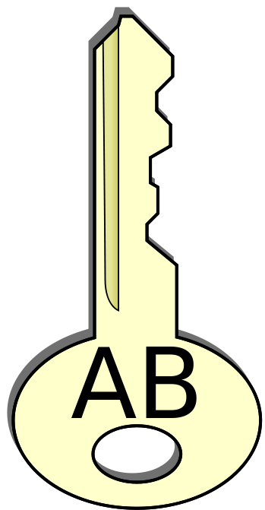

The treasure chest analogy
Alice
Bob

Slide 23
The treasure chest analogy
Alice
Bob
Our first very simple protocol.

Slide 24
Hash Message Authentication Code (HMAC, MAC)
Hash message using a hash keyed with shared key
Produce MAC
Alice or Bob verify integrity of messages based on these hashes

Slide 25
Problem: Replay Attacks
Eve can send messages again...with observed HMAC
Fix: introducing nonces
Random bitstrings used only once
Provides “sessions” for HMACs

Slide 26
Review: Symmetric
Confidentiality – Stream/Block Ciphers
Integrity – HMAC
Authentication – HMAC and nonce

Slide 27
Perfect crypto, what next?
Yes, we have the technology
But, we have a different problem
How can we share the one-time pads?
Fundamental problem in cryptography:
Key Distribution

Slide 28
Kerberos: Central Key DB
Key Distribution Center
  Database of clients and secret keys
  Handles key distribution in symmetric case
Trusted Arbitrator Service
  Secure network authentication to servers etc.
Based on Needham-Schroeder's protocol
From MIT's Project Athena

Slide 29
Kerberos: Authentication Steps
1. Request for ticket-granting ticket
2. Ticket-granting ticket
3. Request for server ticket
4. Server ticket
5. Request for service
Kerberos
TGS
2
3
1
4
Client
Server
5

Slide 30
Kerberos: Symbols
Symbol | Meaning
c | client
s | server
a | client address
v | valid times
t | timestamp
Kx | x's secret key
Kx,y | Session key for x and y
{m}Kx | m encrypted with Kx
Tx,y | x's ticket to use y
Ax,y | Authenticator from x to y

Slide 31
Kerberos: The protocol
Kc – one-way hash of client password
Tc,s = s,{c,a,v,Kc,s}Ks – ticket
Ac,s = {c,t,key}Kc,s – authenticator, session key optional
1. Client to Kerberos: c, tgs
2. Kerberos to Client: {Kc,tgs}Kc, {Tc,tgs}Ktgs
3. Client to TGS: {Ac,s}Kc,tgs, {Tc,tgs}Ktgs
4. TGS to Client: {Kc,s}Kc,tgs, {Tc,s}Ks
5. Client to Server: {Ac,s}Kc,s, {Tc,s}Ks

Slide 32
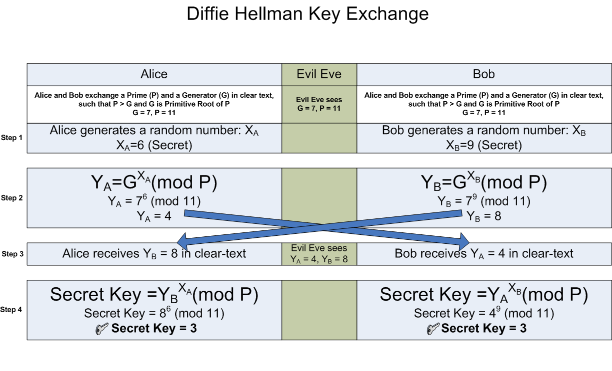
[Wikipedia]

Slide 33
One-Way Functions
Given x, f(x) is trivial to compute
Given f(x), x is hard to compute
Example: increase entropy, break a plate
Math: what we really want are trapdoor one-way functions

Slide 34
Trapdoor One-Way Functions
Given f(x) and y, x is trivial to compute
y is some secret information
Example: take apart a x = watch, pieces = f(x), y = assembly instructions
Math: 16 * 24 = 384
  x = 16, f = *, y = 24

Slide 35
Trapdoor One-Way Functions
Given f(x) and y, x is trivial to compute
y is some secret information
Example: take apart a x = watch, pieces = f(x), y = assembly instructions
Math: 16 * 24 = 384
  x = 16, f = *, y = 24
Caveat: No proof these exist, nor even evidence
that they can be constructed mathematically.

Slide 36
Asymmetric Key Cryptography
Confidentiality via private key
Epub(M) = C
Dpriv(C) = M
Distribute public key, hide private key
You made these with ssh-keygen -t rsa!
Very practical, but generally slow
Often (RSA, etc.) asymmetric methods are used to exchange symmetric keys for fast symmetric ciphers

Slide 37
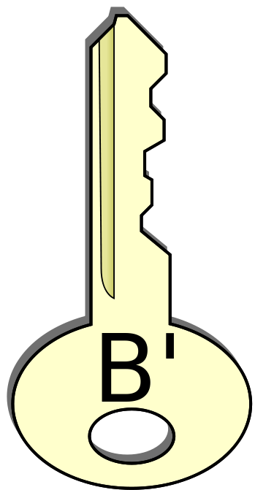
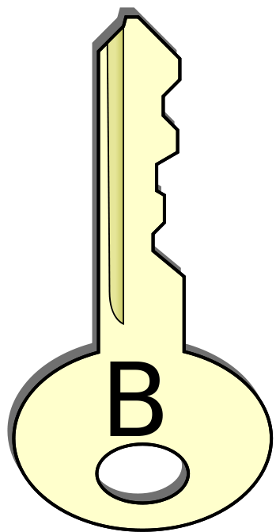

The treasure chest analogy
Alice
Bob

Slide 38
The treasure chest analogy
Alice
Bob
New protocol, no need to have the same key!

Slide 39
Digital Signing
Spriv(M) – sign by encrypting (RSA)
Vpub(M) – verify via decrypting (RSA)
Can sign entire messages
But, often signing a hash is good enough
Hashes are often shorter—quicker to compute

Slide 40
Getting to Identity/Authenticity
Send a nonce
Used only once!
Client
Server
nonce
Spriv(nonce)
Vpub(nonce)

Slide 41
Review: Asymmetric
Confidentiality – Public key encryption
Integrity – Sign message with private key
Authentication – Send a nonce challenge, use sign and verify

Slide 42
Digital Certificates
Issued to prove identity
Requires trusted third parties
We call these certificate authorities
Or just trusted entities in a web of trust
Used to implement TLS, HTTPS
x.509 – standardizations

Slide 43
Certificate Authorities: Issue
Bob's
Public Key
B'
Signed
SCA(B')
Bob's
Identifying
Information
CA Private Key
Bob's
Certificate

Slide 44
Certificate Authorities: Usage
Alice uses the CA's public key to verify Bob's
identity and obtain a trustable public key for Bob.
B'
Signed
VCA(B')
Bob's
Certificate
CA Public Key
Bob's
Public Key

Slide 45
Public Key Infrastructure (PKI)
Certificate Authorities
  Bind public keys to certain entities (KB' with Bob)
  DigiNotar – hacked, along with other CAs
  Admin Password: Pr0d@dm1n
  Iranian-based forged Google, and more certificates
Web of Trust
  P2P model, let many others sign your public key
  Place trust in certain signatures
  GnuPG, PGP → implement this

Slide 46
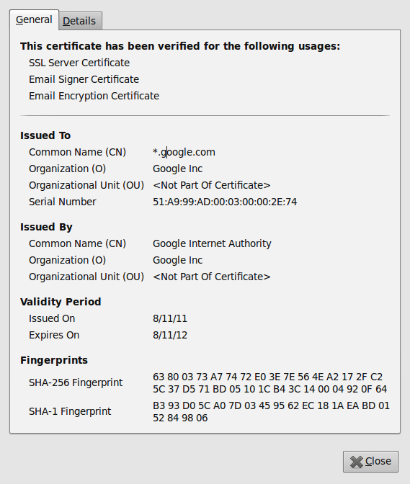
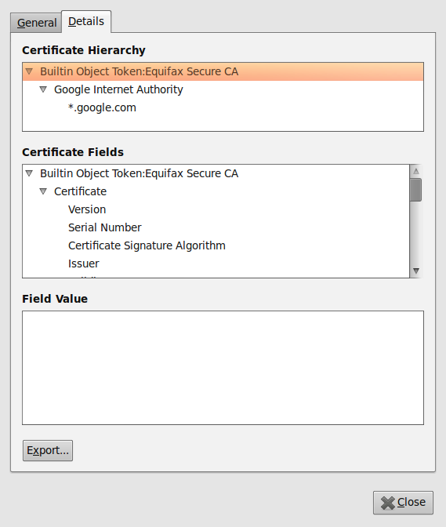
Really? Yes!

Slide 47
HTTPS = HTTP+TLS
Netscape made SSL,
IETF made TLS based
on SSL
HTTP is unmodified!
HTTP (Application)
HTTPS
Secure Transport/TLS
Transport Layer (TCP)
Network Layer (IP)
Link Layer (Ethernet)
Hardware Layer
Port 443 is dedicated
for this.

Slide 48
TLS—RFC 2246
Negotiate
1) Data integrity hash—HMACs
2) Symmetric-key cipher for confidentiality (DES, 3DES, AES)
3) Session key establishment (DH, RSA)
4) Compression algorithm*
HMACs and ciphers are keyed in both directions
6 keys needed total! All delivered with a shared master secret

Slide 49
TLS Handshaking [RFC 2246]
Client Server
ClientHello -------->
ServerHello
Certificate*
ServerKeyExchange*
CertificateRequest*
<-------- ServerHelloDone
Certificate*
ClientKeyExchange
CertificateVerify*
[ChangeCipherSpec]
Finished -------->
[ChangeCipherSpec]
<-------- Finished
Application Data <-------> Application Data
Figure 1. Message flow for a full handshake
* Indicates optional or situation-dependent messages that are not
always sent.

Slide 50
What's going on?
Negotiation Hello's == protocols, crypto methods, compression
Server certificate (signed public key)
  Validate with browser set of CA's
Client sends encrypted value to server, server decrypts proving private key ownership
Secret value used to derive symmetric session keys for encryption and MACs

Slide 51
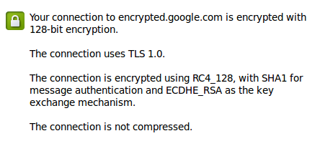
Really? Yes!

Slide 52
TLS Data Stream
1) Data arrives as stream (TCP expected!)
2) TLS segments into chunks
3*) Session key encrypts chunks, MAC algorithm used to create TLS record with short header
4) Records form byte stream for TCP layer

Slide 53
Takeaways
Serious challenges in communicating securely
Don't design your own
Practical solutions combine multiple methods
Defense in depth is needed in the real-world—cryptography alone is not enough

Slide 54
Resources
Textbook CH8
Beware of Snake Oil, Phil Zimmerman
  Easy read, available online
Applied Cryptography, Bruce Schneier
RFC's
OpenSSL (www.openssl.org)

Slide 55

GitHub:
git clone git://github.com/theonewolf/15-441-Recitation-Sessions.git

