Slide 1
No Web Server Left Behind:
Doing Project 1 in Close to 48 Hours
Athula Balachandran
Wolf Richter

Slide 2
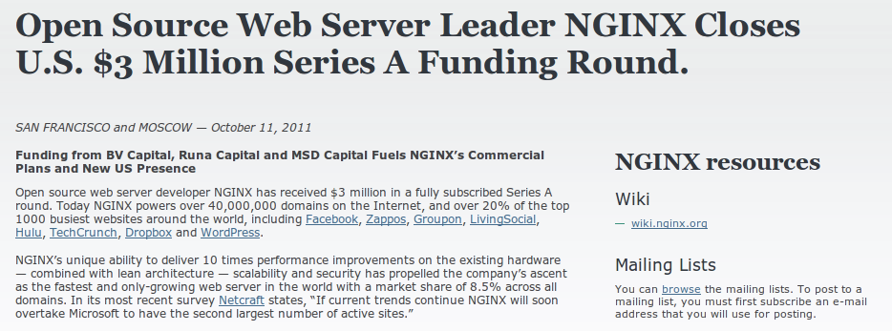
First things First
Don't sleep, focus on the money
andrewid's Liso

Slide 3
CP1: select()able Sockets
Every fd goes into a select() set
Every time around the loop
Single IO per fd returned in sets
  Only, only, only do things when select() says
Buffer all IO in and out
Close out clients on SIGPIPE/write fails
Close out clients when read fails

Slide 4
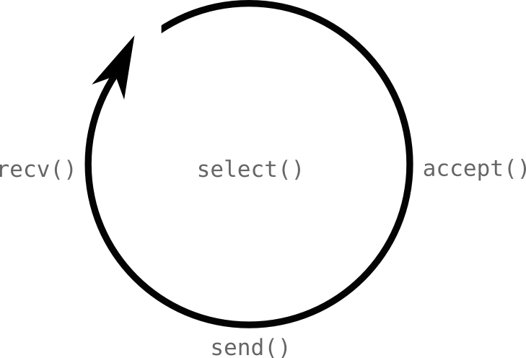

Slide 5
andrewid's Connection State
struct connection
{
int socket;
char buf_in[8192];
char buf_out[8192];
};

Slide 6
CP2: HTTP/1.1
GET + HEAD + POST
Read annotated RFC2616
  A million times, then RFC2616 for anything else
Pipelining is necessary
Requests straddling buffers occur
Connection: Close
HTTP/1.0 – more for ab nicety
Errors should become valid error responses

Slide 7
CP2: HTTP/1.1
GET / HTTP/1.1
GET / HTTP/1.1
GET / HTTP/1.1
buf[0]
buf[8191]
You must handle the case of requests split across buffers.

Slide 9
andrewid's Connection State
struct connection
{
int socket;
char buf_in[8192];
char buf_out[8192];
/* HTTP state information */
};

Slide 10
CP3: SSL
Another server socket
Check out the SSL example C code
Wrap accept()'d fd with SSL_accept()
For IO use SSL_write() and SSL_read()
SSL_write() and SSL_read() may block...
Use non-blocking sockets underneath
fcntl(), O_NONBLOCK etc.
Read OpenSSL documentation as needed

Slide 11
CP3: SSL Blocking?
Your Plaintext
Ciphertext
Ciphertext
These might not come with a single recv() call.

Slide 12
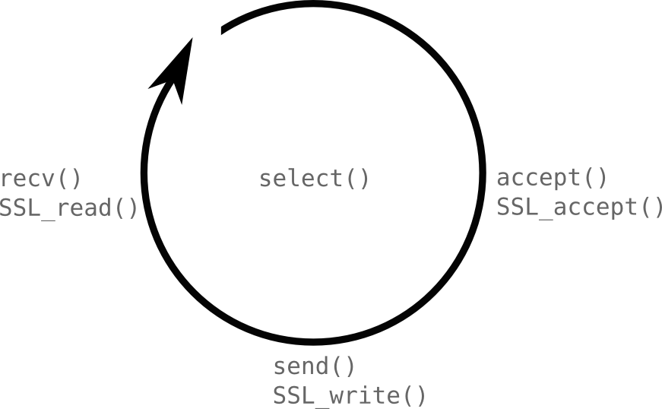

Slide 13
andrewid's Connection State
struct connection
{
int socket;
char buf_in[8192];
char buf_out[8192];
/* HTTP state information */
bool ssl;
};

Slide 14
CP3: CGI
<cgi folder> → <cgi web app>
All /cgi/* URIs handled by single executable
Parse URI: <scheme>://<authority><path>?<query>
pipe2(), pipe2(), fork(), dup2(), dup2()...
Redirect stdin and stdout
Setup environment variables
  According to CGI_Requirements doc
execve() executable

Slide 15
CP3: CGI
More fd's for select()!
Parent keeps: stdin [r,w], stdout [r,w]
Child keeps: stdin [r,w], stdout [r,w]
Child dup2()'s these to stdin and stdout
Follow the example C code
Transparent IO to executed processes
Response end when stdout read() == 0

Slide 16
CP3: CGI IO
[9,10] [11,12]
Parent
message body
execve()
process
10
9
[9,10] [11,12]
execve()
process
response
Parent
12
11

Slide 17
CP3: CGI Request Anatomy
HTTP Headers
Environment
Variables
\r\n
Message Body
stdin

Slide 18
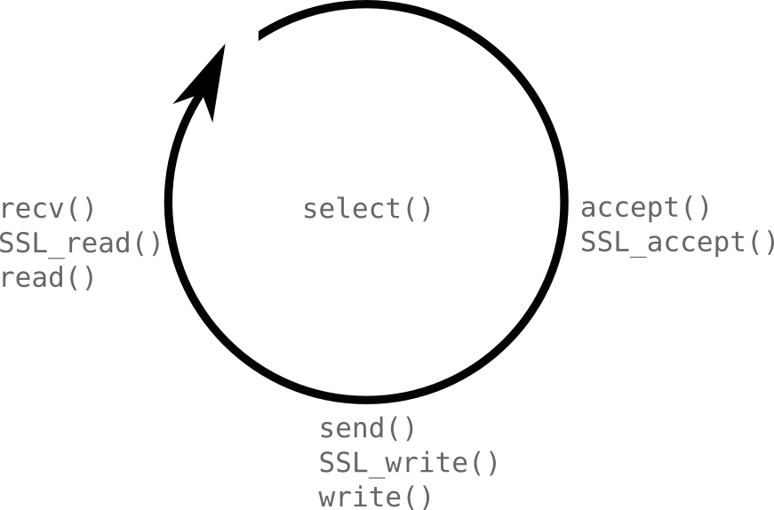

Slide 19
andrewid's Connection State
struct connection
{
int socket;
char buf_in[8192];
char buf_out[8192];
/* HTTP state information */
bool ssl;
int stdin;
int stdout;
};

Slide 20
Grading?
CP1: Turn In (5) + 5 from Robust IO
CP2: Turn In (5) + 5 from HTTP 1.1
CP3: Final Grade...
CP1 + CP2 + Read the Rubric...
CP1 + CP2 + Robust IO (30) +
HTTP 1.1 (20) + HTTPS via TLS (15) +
CGI (15) + Robustness and Testing (5) +
Style (5) == 100

Slide 21
Grading? CP2?
I personally apologize for the delay...
So CP2 and CP3 will be coming this weekend together
Why: HotMobile deadlines Friday
Wolf – 2
Athula – 1
If you need to know about CP2 for CP3, contact me directly

Slide 22
Project 1...
New for the course
Parts were ambiguous
  Sorry!
But, now you're 15-441 history
Hopefully you had fun!

Slide 23
So ask away.

Slide 24

GitHub:
Git it, got it, good.
git clone git://github.com/theonewolf/15-441-Recitation-Sessions.git

