Slide 1
GluriBridge
Evidence-backed partner discovery for Gluri's Indonesia forest-carbon dMRV pilot
Mentoring session · I'm in Busan Impact Hackathon 2026

Slide 2
THE CLIENT
Gluri
● Busan-based startup — 2-person team
● Product: treXchange — satellite + AI forest-carbon dMRV (digital measurement, reporting, verification)
● Preparing their first Indonesia proof-of-concept
● Competing in Theme 2, Forestry & Ocean ESG — “I'm in Busan” Impact Hackathon 2026
treXchange
Satellite + AI
Forest-carbon dMRV
Measurement · Reporting · Verification
GluriBridge — I'm in Busan Impact Hackathon 2026 · Demo Day 5 Sep 2026

Slide 3
THE PROBLEM
In their own words
“We measure and verify forest carbon with satellites and AI, but abroad we can't
check the rules, pilot conditions, or find local partners.” — organizer's framing
GLURI'S OWN ANSWERS, WHEN ASKED DIRECTLY
● No existing candidate list, no trusted starting source, no fixed target region/org-type
● The hardest part isn't finding candidates — it's judging whether a real point of collaboration exists
● A useful shortlist needs: name, location, reason, contact, permits, next questions — plus fact vs. hypothesis labeling
● Indonesia is priority, not exclusive — India/Nepal admissible if genuinely stronger
ORGANIZER'S DIAGNOSIS
“부지 권한·수요’처럼 겉으로 안 보이는
조건 판별이 핵심 난이도”
Judging hidden conditions — like land rights and demand — is the core difficulty.
GluriBridge — I'm in Busan Impact Hackathon 2026 · Demo Day 5 Sep 2026

Slide 4
SOLUTION OVERVIEW
How the pipeline works
Scrapers auto-refresh on a background scheduler — SRUK/Verra daily, SRN-PPI monthly, BRWA manual
SRUK + SRN-PPI
carbon registries
Verra
intl. carbon standard
BRWA
land-rights registry
(2,283 territories)
Tavily web search
(discovery + corroboration)
Per-source normalizer → Unified Candidate Record (same schema for every source)
Identity resolution — fuzzy org/name/desc/geo match + conflict detection (not “first match wins”)
Attach BRWA land-rights evidence — spatial fact about a PLACE, never a separate candidate
Score: need_score +
credibility_score (never blended)
Compliance check
Permenhut 6/2026 — 25 rules
Dossier + bilingual (EN/ID)
outreach generation
FastAPI + SQLite database — real candidate rows, indexed, persisted status/history
React + Vite frontend — Dashboard · Candidates · Territory Discovery · Partnerships
Tavily is a parallel discovery input feeding the SAME candidate pool as the registries — not a separate verification-only step.
GluriBridge — I'm in Busan Impact Hackathon 2026 · Demo Day 5 Sep 2026

Slide 5
DATA SOURCES
Where the real data comes from
Source | What it is | Real raw records | In the 144 final candidates
SRUK | Carbon-unit registry (launched 9 Jul 2026) | 92 project records | 87 candidates
SRN-PPI | Broader climate-action registry (since ~2017) | 191 project records | 1 candidate
Verra | International carbon-credit standard | 1,976 AFOLU-filtered (of 5,281 listed) | 47 candidates
BRWA | Customary/indigenous land-rights registry | 2,283 territories (1,756 w/ geometry, 77%) | 11 confirmed overlaps
Tavily | Web search — discovery + corroboration, not a registry | 146 real queries run | 16 new + 114 corroborated
All record counts pulled live from the running database/API at build time.
GluriBridge — I'm in Busan Impact Hackathon 2026 · Demo Day 5 Sep 2026

Slide 6
HOW SCORING WORKS
Need vs. credibility — never blended
● need_score = how much of a real documentation/verification GAP exists (opportunity for Gluri)
● credibility_score = how mature/confirmed the project already is — NOT a quality judgment on need
● A high-credibility, low-need project is a correctly-scored mature partner, not a bad candidate
CONFIRMED — mature, no gap
OPPORTUNITY — real, live gap
Katingan Peatland Restoration and Conservation Project
Pengembangan tata kelola lahan dan hutan rendah emisi dan berketahanan…
11.1
88.2
100.0
41.2
NEED SCORE / 100
CREDIBILITY / 100
NEED SCORE / 100
CREDIBILITY / 100
Real label: Confirmed
Real label: Opportunity
GluriBridge — I'm in Busan Impact Hackathon 2026 · Demo Day 5 Sep 2026

Slide 7
HOW COMPLIANCE WORKS
Permenhut No. 6/2026
● The real regulation encodes 25 rules — this pipeline has 4 wired into live scoring (4/25), the other 21 each flagged with a specific reason, never silently skipped
● R016 (Pasal 61), R006 (Pasal 10), R003 (Pasal 6(1)), R022 (Pasal 20) are wired today
REAL LIVE EXAMPLE — PASAL 61 DEADLINE MATH
Pengembangan tata kelola lahan dan hutan rendah emisi dan berketahanan iklim di wilayah Kabupaten Nabire, Provinsi Papua Tengah
Registered 2025-11-06, before the 2026-04-13 effective date — the Pasal 61 reporting deadline (2026-10-13) is 46 days away.
46
Computed live, right now — as of 2026-08-28. This candidate is compliance_badge = AMBER,
one of 53 candidates (of 144 total) facing this same transitional deadline.
days until 2026-10-13
GluriBridge — I'm in Busan Impact Hackathon 2026 · Demo Day 5 Sep 2026

Slide 8
DOSSIER & OUTREACH
Deterministic templates, no LLM
● Every dossier sentence traces to a specific real field or rule — nothing generated freeform
● Every claim tagged evidence_level: fact or hypothesis, per Gluri's own direct requirement
● Real citations to real source documents (registry record, decree PDF, news article)
● Bilingual (EN/ID) outreach emails, hedging language verified sentence-by-sentence
● Honest missing-contact warnings — never a fabricated email address
REAL EXAMPLE — KATINGAN
“Registration is actively progressing — organization is currently engaged with the process.”
evidence_level: FACT
Derived from the registration workflow's step statuses on file — a computed momentum signal, not a single document.
REAL CONTACT ON FILE
Asep Ayat — PT Rimba Makmur Utama
WHY NO LLM HERE
recipient_status: name_only_no_email
→ honest warning shown, not a fabricated email address
Auditability · zero hallucination risk · cheap to re-run at any scale
GluriBridge — I'm in Busan Impact Hackathon 2026 · Demo Day 5 Sep 2026

Slide 9
WEB DISCOVERY VERIFICATION
Tavily — tested and hardened, not assumed
● Tavily is a discovery + corroboration input, not a primary registry — every hit still goes through the same normalize → identity-resolve → score pipeline
REAL QUERIES RUN
REAL HITS PROCESSED
CORROBORATED EXISTING
NEW THIN CANDIDATES
146
685
114
16
A REAL BUG FOUND AND FIXED DURING HARDENING
Fuzzy org-name matching risked merging two genuinely different, unrelated real Indonesian
foundations sharing a common naming template:
“Yayasan Meramu Alam Nusantara” vs. “Yayasan Konservasi Alam Nusantara” — scored 83.87
Fixed by requiring real CONTENT corroboration (district/province name or a distinctive project
keyword actually present in the article) before accepting any match in the 80–100 score band.
GluriBridge — I'm in Busan Impact Hackathon 2026 · Demo Day 5 Sep 2026

Slide 10
REAL NUMBERS, RIGHT NOW
Live snapshot — not estimates
TOTAL CANDIDATES
RICH / THIN
RESOLVED CONTACT
INSUFFICIENT CONTACT
144
128 / 16
85
59
live from the API
data richness split
83 named (Tier A) · 2 org-only (Tier B)
honest gap, not fabricated
COMPLIANCE: AMBER
COMPLIANCE: N/A
BRWA GEOMETRY COVERAGE
CONFIRMED LAND-RIGHTS OVERLAP
53
91
1756 / 2283
11
Pasal 61 deadline approaching
no applicable rule triggered
77% — confirmed real ceiling
of 144 real candidates
By source (candidates can carry more than one): SRUK: 87 · Verra: 47 · News/Tavily: 16 · Tavily (contact lookup): 2 · SRN-PPI: 1
Pulled live from GET /candidates and GET /stats at build time — 2026-08-28 05:15 UTC.
GluriBridge — I'm in Busan Impact Hackathon 2026 · Demo Day 5 Sep 2026

Slide 11
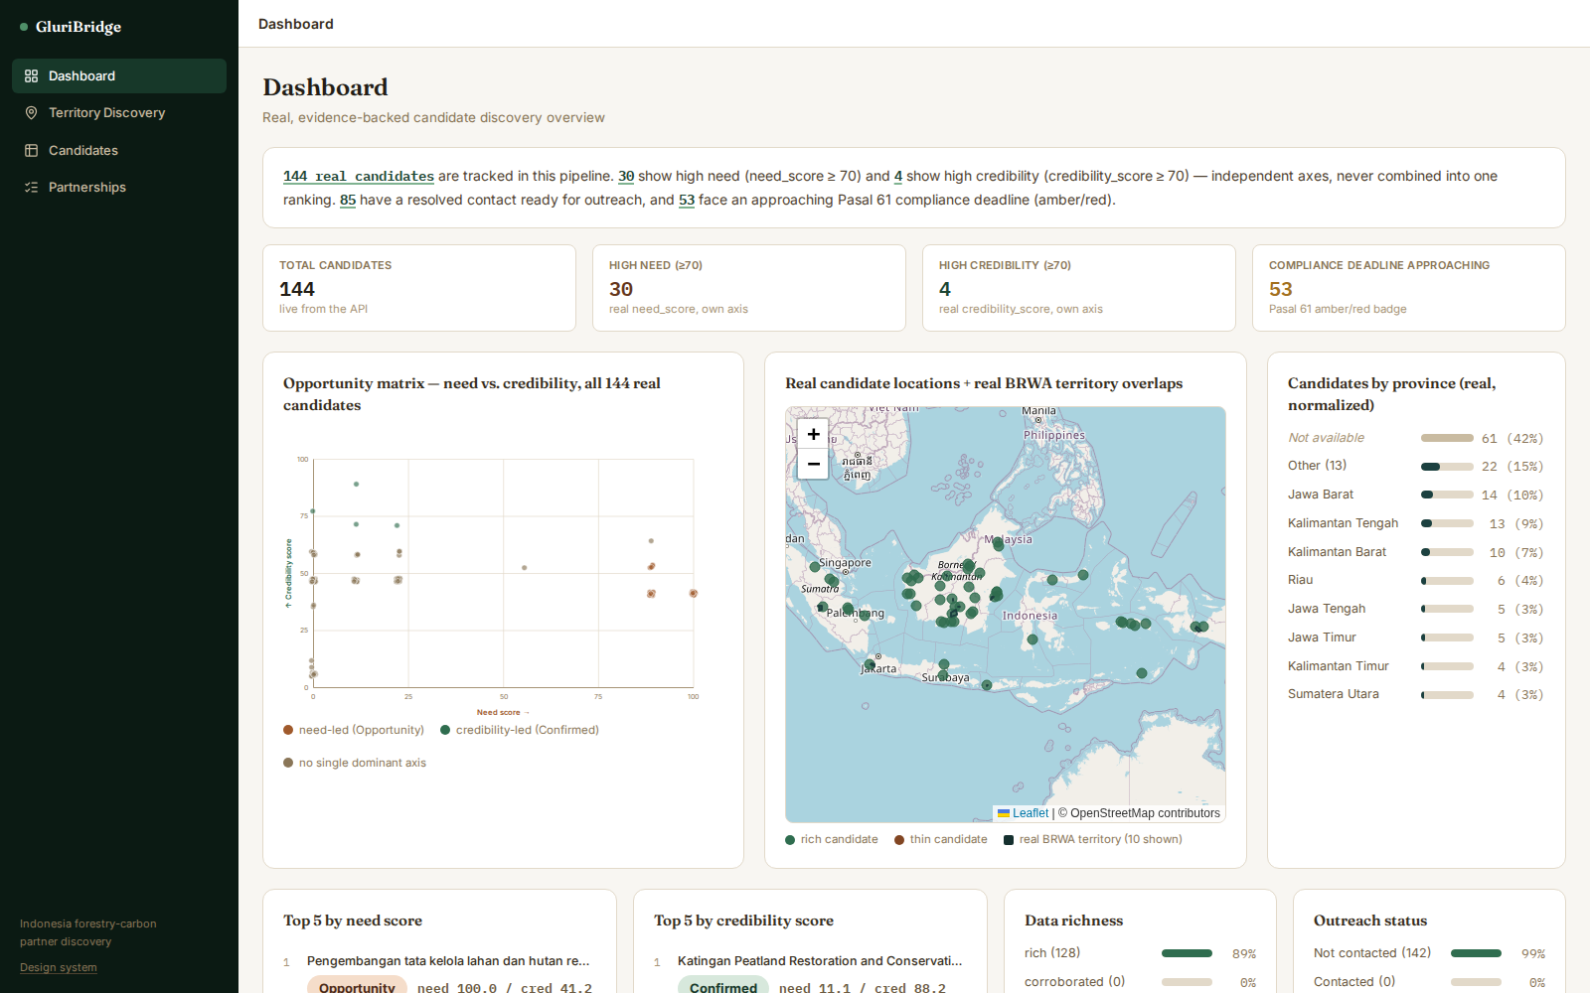
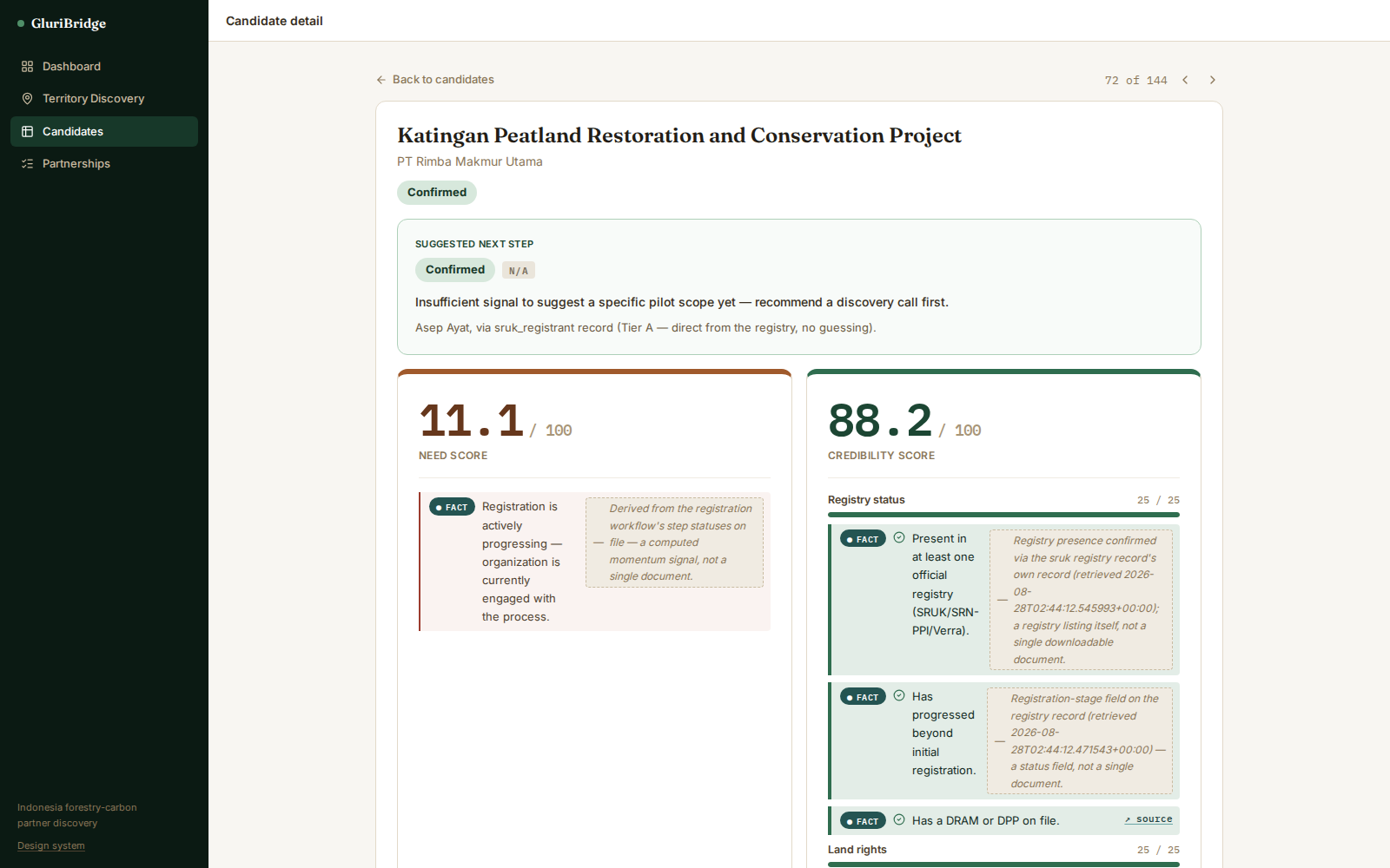
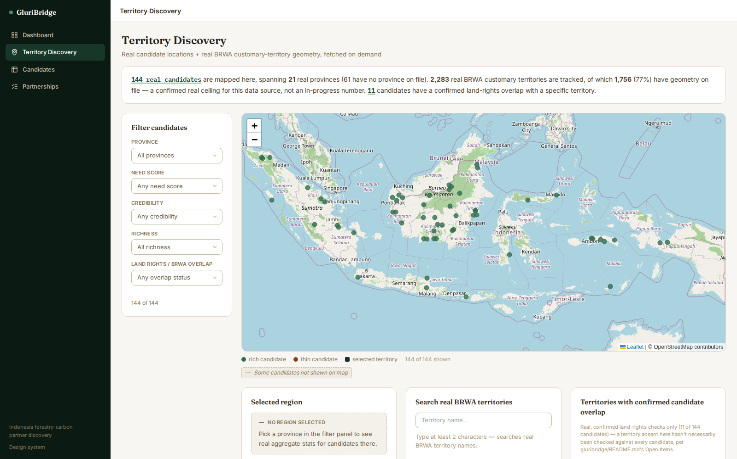
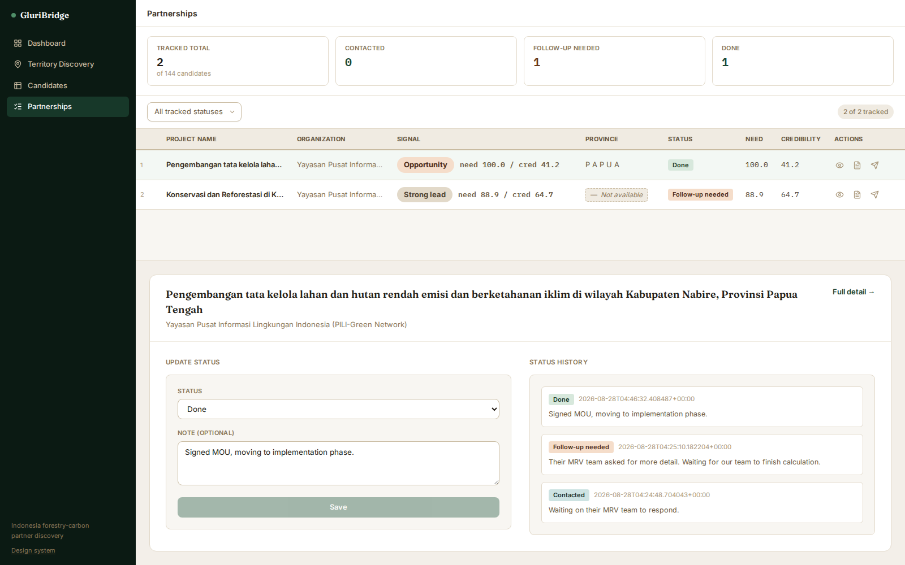
WHERE WE STAND
The live frontend, right now
Dashboard
Candidate Detail — Katingan
Territory Discovery
Partnerships (tracking)
Real screenshots taken from the running app at build time — not mockups.

Slide 12
TECH STACK
What it's actually built with
FRONTEND
BACKEND
React
FastAPI
Vite
SQLite
TypeScript
Python
Tailwind CSS
Background scheduler
Dashboard · Candidates ·
Per-source refresh cadence:
Territory Discovery · Partnerships
SRUK/Verra daily · SRN-PPI monthly · BRWA manual
GluriBridge — I'm in Busan Impact Hackathon 2026 · Demo Day 5 Sep 2026

Slide 13
API COST
Real usage, honestly labeled
REAL TAVILY QUERIES LOGGED
SEARCH DEPTH USED
≈ CREDITS CONSUMED
146
basic
146
GET /stats, this session's runs
1 credit / call, per Tavily's published pricing
146 queries × 1 credit/call
WHAT WE CAN'T CONFIRM — STATED HONESTLY, NOT GUESSED
● This codebase has no billing/API-key access — we cannot see which Tavily plan/tier is actually active
● Tavily's public free tier is commonly 1,000 credits/month; at basic-search rates, 146 total real queries would fit comfortably within one free month if that's the plan in use
● We are NOT stating a confirmed dollar figure — that requires access to the actual Tavily billing dashboard, which this session doesn't have
GluriBridge — I'm in Busan Impact Hackathon 2026 · Demo Day 5 Sep 2026

Slide 14
NEXT STEPS
Real open items, deliberately scoped
Korean localization
Scoped, not built: ~2-3 dev-days for swappable UI chrome (labels/nav/headers). Executive-summary sentences need real ICU-style templates, not simple key-swaps. Real candidate/evidence data stays untranslated — no lossy paraphrase of real source text. Deferred pending confirmation the need is real.
Tier C contact resolution
Deferred, not an oversight: extracting a named contact from free-form news prose has no structural anchor to verify against (no copyright footer, no contact page) — Tier B already needed 4 hardening rounds to trust for just 1 of 128 real candidates.
LLM-based prose polish
Deliberately not pursued: today's deterministic templates guarantee zero hallucination and full auditability. Any future LLM layer would need the same hedging rigor already proven for the bilingual templates before it's trustworthy.
India / Nepal scope
Gluri said these are admissible if genuinely stronger than an Indonesia candidate — not built yet. The pipeline is Indonesia-only today.
GluriBridge — I'm in Busan Impact Hackathon 2026 · Demo Day 5 Sep 2026

Slide 15
OPTIONAL — DAY TO DAY
How a non-technical user actually uses this
● Open the Dashboard — one real snapshot: total candidates, the need/credibility matrix, the live map, outreach status
● Go to Candidates — sort/filter by need OR credibility (never blended), by province, richness, or land-rights status
● Click into a candidate — real fact/hypothesis-tagged evidence, land rights, compliance deadline, a suggested next step
● Generate the dossier and bilingual (EN/ID) outreach email in one click — real citations, honest contact warnings
● Go to Partnerships — set a real status (contacted / follow-up / done / rejected), add a note, see the full real history
GluriBridge — I'm in Busan Impact Hackathon 2026 · Demo Day 5 Sep 2026

