Slide 1
Chapter 6 Design Patterns
Creational Design Patterns
Structural Design Patterns
Behavioral Design Patterns

Slide 2
GoF Design Patterns

Slide 3
GoF Design Pattern Categories
 |  | Purpose
 |  | Creational | Structural | Behavioral
Scope | Class | Factory Method | Adapter | Interpreter Template Method
 | Object | Abstract Factory Builder Prototype Singleton | Adapter Bridge Composite Decorator Facade Proxy Flyweight | Chain of Responsibility Command Iterator Mediator Memento Observer State Strategy Visitor

Slide 4
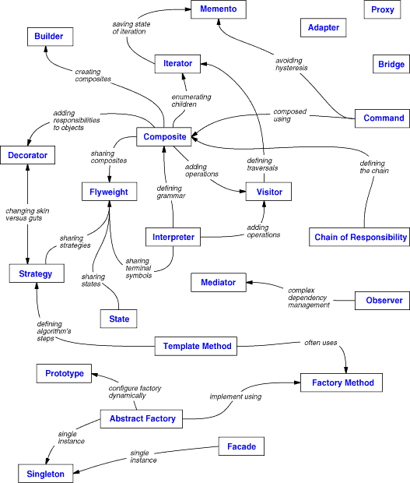
GoF Design pattern relationships

Slide 5
6.1 Creational Design Patterns
Factory Method
Abstract Factory
Builder
Prototype
Singleton

Slide 6
Creational patterns
Creational design patterns abstract the instantiation process.
There are two recurring themes in these patterns.
  First, they all encapsulate knowledge about which concrete classes the system uses.
  Second, they hide how instances of these classes are created and put together.

Slide 7
Abstract Factory - Motivation
Abstract Factory Motivation
1) Implement a user interface toolkit that supports multiple looks
and feel standards such as Motif, Windows 95 or the finder in MacOS.
 How can you write a single user interface and make it portable across the different look and feel standards for these window managers?
2) Implement a facility management system for an intelligent
house that supports different control systems such as Siemens’
Instabus, Johnson & Control Metasys or Zumtobe’s proprietary standard.
 How can you write a single control system that is independent from the manufacturer?

Slide 8
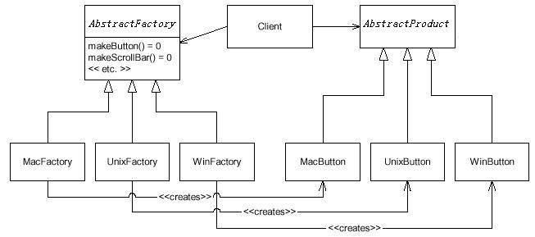
Abstract Factory
The Client remains blissfully unaware of the various concrete classes in this example. Client code deals with the simpler, abstract, general case.

Slide 9
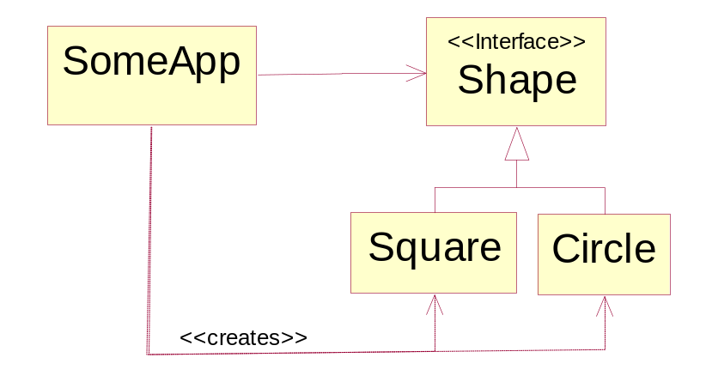
Abstract Factory - Example
We have a class named SomeApp that depends on the interface Shape.
Shape uses instances of Shape solely through the Shape interface.
Problem: SomeApp also creates instances of Square and Circle and thus has to depend on the concrete classes.

Slide 10
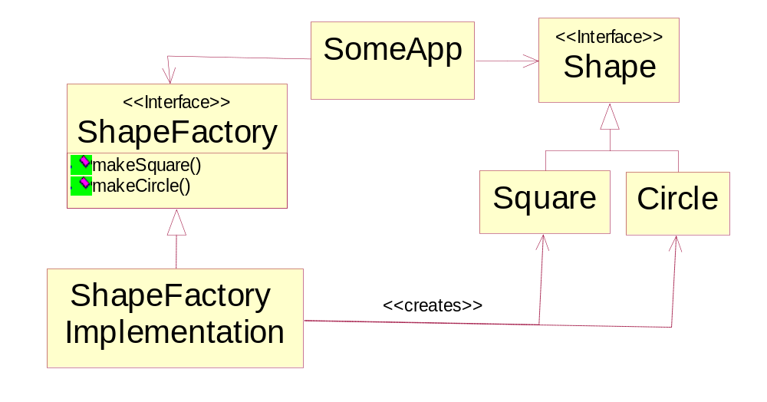
Abstract Factory - Example
Solution: ShapeFactory interface.

Slide 11
Abstract Factory - Example
Problem: Every time we add a new Shape derivative, we have to add a method to the ShapeFactory.
Solution:
public interface ShapeFactory {
public Shape make (String shapeName) throws Exception
}
public class ShapeFactoryImplementation implements ShapeFactory {
public Shape make(String shapeName) throws Exception {
if (shapeName.equals("Circle")) return new Circle();
else if (shapeName.equals("Square")) return new Square();
else
throw new Exception("ShapeFactory cannot create " + shapeName);
}
}
………………………
private ShapeFactory factory;
factory = new ShapeFactoryImplementation();
Shape s = factory.make("Circle");

Slide 12
Abstract Factory
Intent:
Provide an interface for creating families of related or dependent objects without specifying their concrete classes.
Applicability - Use the Abstract Factory pattern when
  1) Independence from Initialization or Represenation:
  The system should be independent of how its products are created, composed or represented
  2) Manufacturer Independence:
  A system should be configured with one of multiple family of products
  You want to provide a class library for a customer (“facility management library”), but you don’t want to reveal what particular product you are using.
  3) Constraints on related products
  A family of related products is designed to be used together and you need to enforce this constraint
  4) Cope with upcoming change:
  You use one particular product family, but you expect that the underlying technology is changing very soon, and new products will appear on the market.

Slide 13
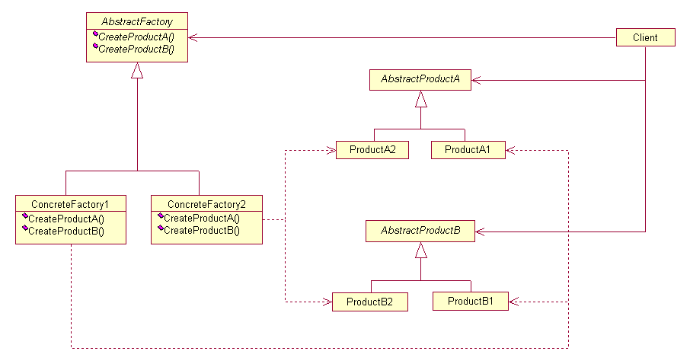
Abstract Factory - Structure

Slide 14
Factory Method - example
For example, a framework for a windowing application has a class Application which must create an object of class Document
But the actual applications and documents are not written yet!
Solution:
Let subclasses decide which objects to instantiate
Application subclasses redefine an abstract CreateDocument operation on Application to return the appropriate Document subclass.
Once an Application subclass is instantiated, it can then instantiate application-specific Documents without knowing their class.
We call CreateDocument a factory method because it's responsible for "manufacturing" an object.

Slide 15
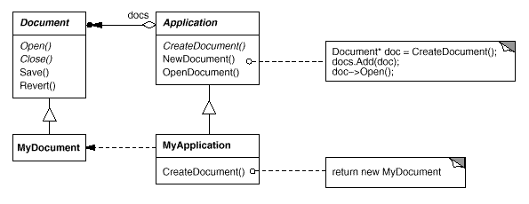
Factory Method - example
Separate creation into a method
the factory method in the MyApplication class:
public Document CreateDocument() { return new MyDocument();}
client code:
public Application app1;
app1 = new MyApplication();
app1.CreateDocument();

Slide 16
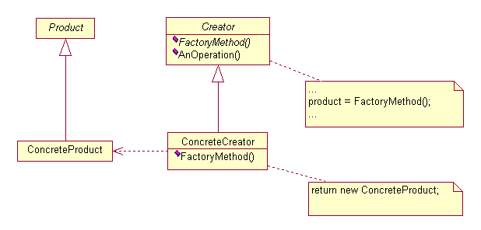
Factory Method
Intent:
  Define an interface for creating an object, but let subclasses decide which class to instantiate.
  Factory Method lets a class defer instantiation to subclasses.
Structure

Slide 17
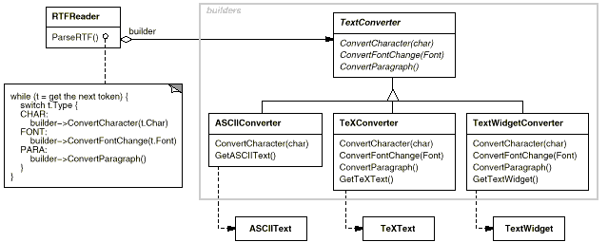
Builder – Motivation (GoF)
Problem:
  A reader for the RTF (Rich Text Format) document exchange format should be able to convert RTF to many text formats.
  The problem is that the number of possible conversions is open-ended. So it should be easy to add a new conversion without modifying the reader.
Solution:
  to configure the RTFReader class with a TextConverter object that converts RTF to another textual representation.
  Subclasses of TextConverter specialize in different conversions and formats.

Slide 18
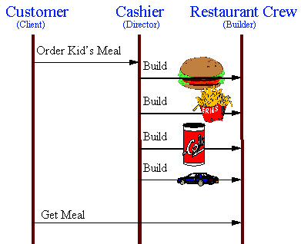
Builder - Example

Slide 19
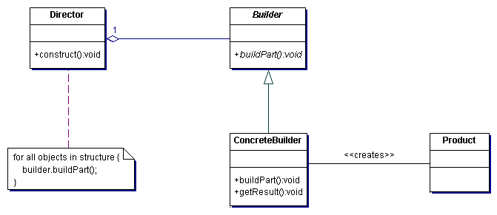
Builder
Intent:
Separate the construction of a complex object from its representation so that the same construction process can create different representations.
Structure

Slide 20
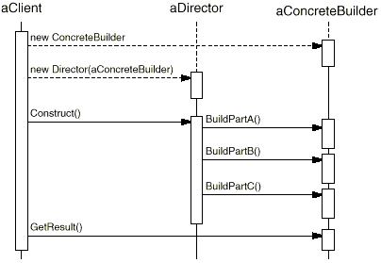
Builder
Collaborations :
  The client creates the Director object and configures it with the desired Builder object.
  Director notifies the builder whenever a part of the product should be built.
  Builder handles requests from the director and adds parts to the product.
  The client retrieves the product from the builder.

Slide 21
Builder - Example (GoF)
Client Code:
Maze* maze; MazeGame game; StandardMazeBuilder builder;
game.CreateMaze(builder); maze = builder.GetMaze();
Bulider Code:
class MazeBuilder {
public:
virtual void BuildMaze() { }
virtual void BuildRoom(int room) { }
virtual void BuildDoor(int roomFrom, int roomTo) { }
virtual Maze* GetMaze() { return 0; }
protected:
MazeBuilder();
};
Director Code:
Maze* MazeGame::CreateMaze (MazeBuilder& builder) {
builder.BuildMaze();
builder.BuildRoom(1);
builder.BuildRoom(2);
builder.BuildDoor(1, 2);
return builder.GetMaze();
}
ConcreteBuilder Code:
class StandardMazeBuilder : public MazeBuilder {
public:
StandardMazeBuilder(); virtual void BuildMaze();
virtual void BuildRoom(int); virtual void BuildDoor(int, int);
virtual Maze* GetMaze();
private:
Direction CommonWall(Room*, Room*); Maze* _currentMaze;
};

Slide 22
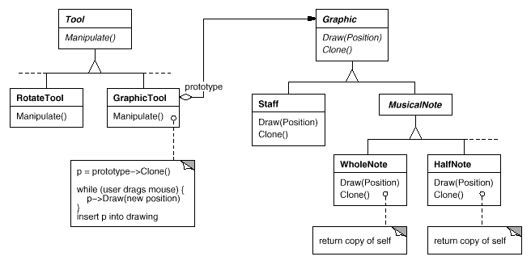
Prototype – Motivation (GoF)
Problem:
  The classes for notes and staves are specific to our application, but the GraphicTool class belongs to the framework. GraphicTool doesn't know how to create instances of our music classes to add to the score.
  We could subclass GraphicTool for each kind of music object, but that would produce lots of subclasses that differ only in the kind of music object they instantiate.
Solution:
  making GraphicTool create a new Graphic by copying or "cloning" an instance of a Graphic subclass. We call this instance a prototype.

Slide 23
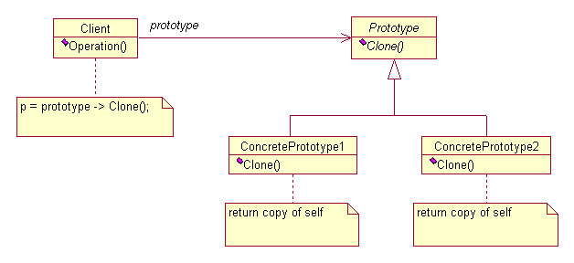
Prototype
Intent:
Specify the kinds of objects to create using a prototypical instance, and create new objects by copying this prototype.
Structure
A client asks a prototype to clone itself

Slide 24
Prototype
Discussion:
  Declare an abstract base class that specifies a pure virtual "clone" method, and, maintains a dictionary of all "cloneable" concrete derived classes.
  Any class that needs a "polymorphic constructor" capability: derives itself from the abstract base class, registers its prototypical instance, and implements the clone() operation.
  The client then, instead of writing code that invokes the "new" operator on a hard-wired class name, calls a "clone" operation on the abstract base class, supplying a string or enumerated data type that designates the particular concrete derived class desired.

Slide 25
Prototype – Example in Java
In SwimInfo.java
sxdata = (SwimData)sdata.clone();
or: sxdata = (SwimData)sdata.deepClone();
In SwimData.java
  public class SwimData implements Cloneable , Serializable {
  public Object clone() {
  try{ return super.clone(); }
  catch(Exception e) {System.out.println(e.getMessage()); return null;} }
  public Object deepClone(){
  try{ ByteArrayOutputStream b = new ByteArrayOutputStream();
  ObjectOutputStream out = new ObjectOutputStream(b);
  out.writeObject(this);
  ByteArrayInputStream bIn = new ByteArrayInputStream(b.toByteArray());
  ObjectInputStream oi = new ObjectInputStream(bIn);
  return (oi.readObject());
  } catch (Exception e) { System.out.println("exception:"+e.getMessage());
  e.printStackTrace(); return null; } }
  }

Slide 26
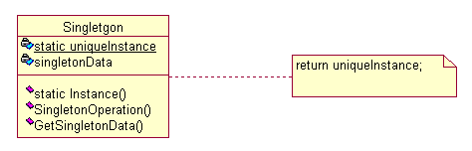
Singleton
Intent:
Ensure a class only has one instance, and provide a global point of access to it.
Structure

Slide 27
Singleton - example
public abstract class ForumFactory {
private static Object initLock = new Object();
private static String className = "com.abc.forum.db.DbForumFactory";
private static ForumFactory factory = null;
public static ForumFactory getInstance(Authorization authorization) {
if (authorization == null) {return null;}
if (factory == null) {// Singleton pattern
synchronized(initLock) {
if (factory == null) {
......
try {
Class c = Class.forName(className);
factory = (ForumFactory)c.newInstance();
catch (Exception e) {return null;}
}
} }
.....
}

Slide 28
6.2 Structural patterns
Adapter
Bridge
Composite
Façade
Decorator
Proxy
Flyweight

Slide 29
Adapter Pattern
Adapter Pattern
1) “Convert the interface of a class into another interface
expected by the client. Adapter lets classes work together that
couldn’t otherwise because of incompatible interfaces
2) Used to provide a new interface to existing legacy components
(Interface engineering, reengineering).
3) Also known as a wrapper
4) Two adapter patterns:
 Class adapter:
- Uses multiple inheritance to adapt one interface to another
 Object adapter:
- Uses single inheritance and delegation
5) We will mostly use object adapters and call them simply
adapters

Slide 30
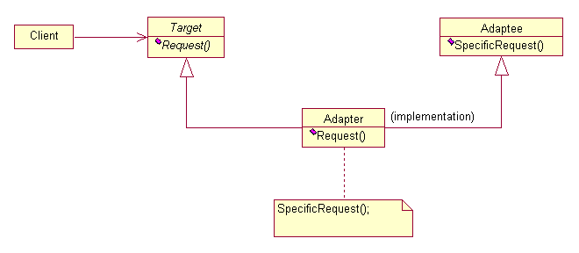
Adapter
Intent:
Convert the interface of a class into another interface clients expect. Adapter lets classes work together that couldn't otherwise because of incompatible interfaces.
Structure

Slide 31
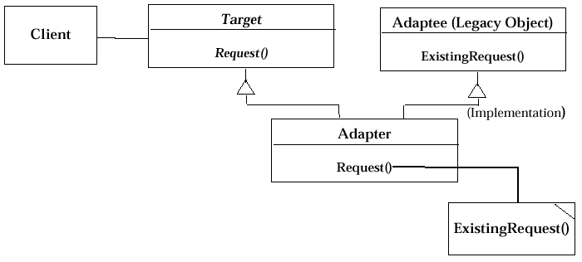
Class Adapter Pattern
Class Adapter Pattern (based on Multiple Inheritance)

Slide 32
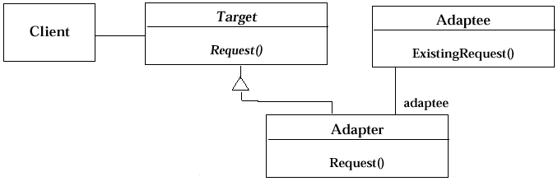
Adapter pattern uses delegation and inheritance
Adapter pattern uses delegation and inheritance
Delegation is used to bind an Adapter and an Adaptee
1) Interface inheritance is use to specify the interface of the
Adapter class.
2) Adaptee, usually called legacy system, pre-exists the Adapter.
3) Target may be realized as an interface in Java.

Slide 33
Adapter - Example
Client Code:
Adaptee a = new Adaptee(); Target t = new Adapter(a);
public void test() { t.request(); }
Target Code:
class Target {
public void request() {}
}
Adaptee Code:
class Adaptee {
public void specificRequest() {
System.out.println("Adaptee: SpecificRequest");
}
}
Adapter Code:
class Adapter extends Target {
private Adaptee adaptee;
public Adapter(Adaptee a) { adaptee = a;}
public void request() { adaptee.specificRequest();}
}

Slide 34
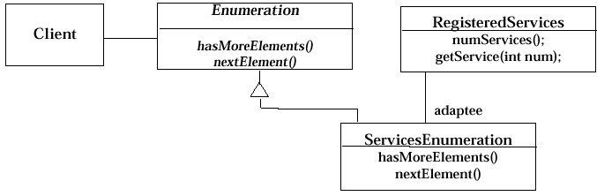


Object Adapter - example
Adapter pattern example
Client
<<Interface>>
ServicesEnumeration
RegiteredServices
Enumeration
hasMoreElements()
-adaptee
numServices()
hasMoreElements()
nextElement()
getService()
nextElement()

Slide 35
Object Adapter - example
public class ServicesEnumeration implements Enumeration {
public boolean hasMoreElements() {
return this.currentServiceIdx <= adaptee.numServices();
}
public Object nextElement() {
if (!this.hasMoreElements()) {
throw new NoSuchElementException();
}
return adaptee.getService(this.currentSerrviceIdx++);
}
}
Notes:
In the Best Practices module, we discussed some characteristics common to successful projects. OO facilitates the following best practices:
Develop Iteratively
Model Visually
Use Component Architecture
Defining basic OO terms and concepts allows everyone in the class to start on a level playing field.

Slide 36
Adapter Pattern – Modem example
Hayes Modem
<<Interface>>
Modem
Modem Clients
+dial
+hangup
+send
+receive
Robotics Modem
Ernie’s Modem
Modem Problem
Problem:
  Suppose that there were hundreds of modem clients all making happy use of the Modem interface.
  Now suppose that customer have given us a new kind of modem that don’t dial - dedicated modem.
  There are several new applications (Ded Users) that use these dedicated modems and don’t bother to dial.
  All the current modem clients to be able to use these dedicated modems and needn’t to modify their applications.

Slide 37
Adapter Pattern – Modem example
Hayes Modem
<<Interface>>
Dialler
+dial
+hangup
Robotics Modem
Modem Clients
Ernie’s Modem
<<Interface>>
Modem
+send
+receive
Ded Users
Ideal solution to the Modem Problem
Dedicated Modem
Problem:
  Unfortunately this requires us to make changes to all the modem clients – something that our customer forbade.

Slide 38
Adapter Pattern – Modem example
<<Interface>>
Modem
Modem Clients
Hayes Modem
+dial
+hangup
+send
+receive
Robotics Modem
Ernie’s Modem
Dedicated
Modem
Dedicated Modem Adapter
Ded Users
<<delegates>>
+send
+receive
Dial and Hangup are implemented to simulate connection state. Send and Receive are delegated to DedicatedModem
Solving the Modem Problem with ADAPTER

Slide 39
Bridge Pattern – Modem example
Another way to look at the modem problem
  Solving the Modem Problem by merging type hierarchies
Modem
DialModem
DedicatedModem
Hayes Dial Modem
USR Dial Modem
Hayes Dedicated Modem
USR Dedicated Modem
Ernies Dial Modem
Ernies Dedicated Modem

Slide 40
Bridge Pattern – Modem example
Split the modem hierarchy into two hierarchies:
  One represents the connection mothod
  The other represents the hardware
ModemConnectionController
<<interface>>
Modem
Implementation
Modem Clients
<<Interface>>
Modem
#dialImp
#hangupImp
#sendImp
#receiveImp
+dial
+hangup
+send
+receive
<<delegates>>
+dial
+hangup
+send
+receive
+dial
+hangup
+send
+receive
Ded Users
<<Interface>>
Modem
Hayes Modem
USR Modem
+send
+receive
DedModem
Controller
DialModem
Controller
Ernies Modem
Dial and Hangup are implemented to simulate connection state. Send and Receive delegate to their respective imps.
+dial
+hangup
+send
+receive
+dial
+hangup
+send
+receive
All mothods delegate to their respective imps.

Slide 41
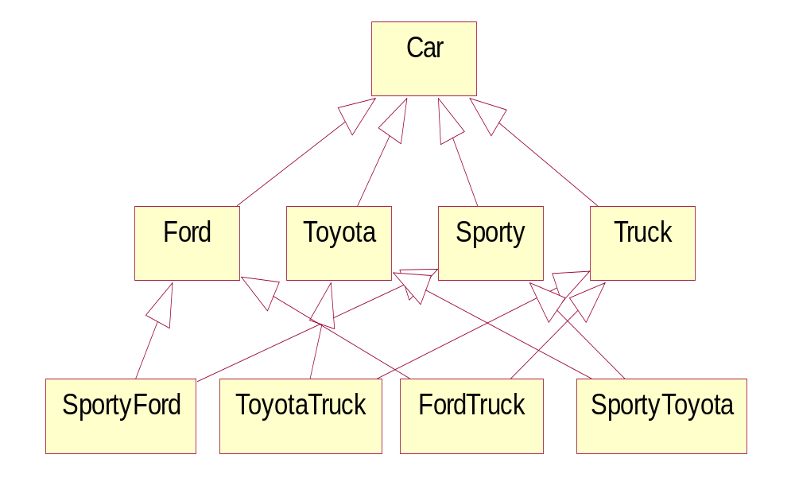
Design Patterns - Bridge Pattern Example
How can we simplify this design?
Notes:
In the Best Practices module, we discussed some characteristics common to successful projects. OO facilitates the following best practices:
Develop Iteratively
Model Visually
Use Component Architecture
Defining basic OO terms and concepts allows everyone in the class to start on a level playing field.

Slide 42
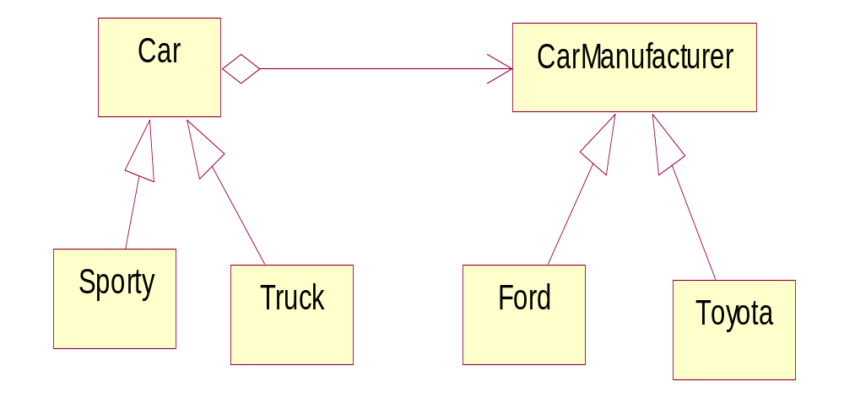
Design Patterns - Bridge Pattern Example
Apply the Bridge Design Pattern
Intent: Decouple a class abstraction from its implementation.
- You might use Bridge when you might otherwise be tempted to use multiple inheritance...
Notes:
In the Best Practices module, we discussed some characteristics common to successful projects. OO facilitates the following best practices:
Develop Iteratively
Model Visually
Use Component Architecture
Defining basic OO terms and concepts allows everyone in the class to start on a level playing field.

Slide 43
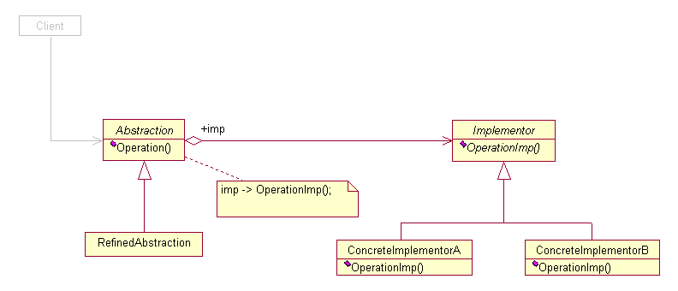
Design Patterns - Bridge Pattern
Intent:
Decouple an abstraction from its implementation so that the two can vary independently.
Solution:
Abstraction forwards client requests to its Implementor object

Slide 44
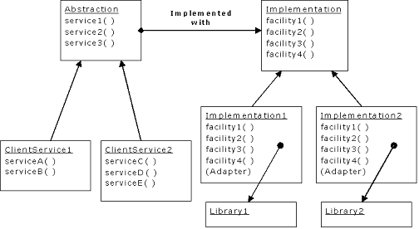
Bridge Pattern - example

Slide 45
Bridge Pattern - example
Client Code:
public void test1() { ClientService1 cs1 = new ClientService1(new Implementation1());
cs1.serviceA(); cs1.serviceB(); }
public void test2() { ClientService1 cs1 = new ClientService1(new Implementation2());
cs1.serviceA(); cs1.serviceB(); }
public void test3() { ClientService2 cs2 = new ClientService2(new Implementation1());
cs2.serviceC(); cs2.serviceD(); cs2.serviceE();}
}
Abstraction Code:
class Abstraction {
private Implementation implementation;
public Abstraction(Implementation imp) { implementation = imp;}
public void service1() {implementation.facility1(); implementation.facility2(); }
public void service2() {implementation.facility2(); implementation.facility3(); }
public void service3() {implementation.facility1(); implementation.facility2(); implementation.facility4();}
protected Implementation getImplementation() {return implementation;}
}
class ClientService1 extends Abstraction {
public ClientService1(Implementation imp) { super(imp); }
public void serviceA() {service1(); service2();} public void serviceB() {service3();}}
class ClientService2 extends Abstraction {
public ClientService2(Implementation imp) { super(imp); }
public void serviceC() {service2(); service3();} public void serviceD() {service1(); service3();}
public void serviceE() {getImplementation().facility3();}}

Slide 46
Bridge Pattern - example
Implementation Code:
interface Implementation { void facility1(); void facility2(); void facility3(); void facility4();}
class Library1 { public void method1() {System.out.println("Library1.method1()");}
public void method2() {System.out.println("Library1.method2()"); }}
class Library2 {public void operation1() {System.out.println("Library2.operation1()");}
public void operation2() {System.out.println("Library2.operation2()");}
public void operation3() {System.out.println("Library2.operation3()");}}
class Implementation1 implements Implementation {
private Library1 delegate = new Library1();
public void facility1() {System.out.println("Implementation1.facility1"); delegate.method1(); }
public void facility2() {System.out.println("Implementation1.facility2"); delegate.method2(); }
public void facility3() {System.out.println("Implementation1.facility3");
delegate.method2(); delegate.method1();}
public void facility4() {System.out.println("Implementation1.facility4"); delegate.method1();}
}
class Implementation2 implements Implementation {
private Library2 delegate = new Library2();
public void facility1() {System.out.println("Implementation2.facility1");delegate.operation1();}
public void facility2() {System.out.println("Implementation2.facility2");delegate.operation2();}
public void facility3() {System.out.println("Implementation2.facility3");delegate.operation3();}
public void facility4() {System.out.println("Implementation2.facility4");delegate.operation1();}
}

Slide 47
Design Patterns - Composite Pattern Example
Problem:
: Assembly
Contains
Contains
: Part
: Assembly
Contains
Contains
: Part
: Part
: CatalogueEntry
: CatalogueEntry
name = “screw”
name = “strut”
Fig. A hierarchical assembly

Slide 48
Design Patterns - Composite Pattern Example
Solution:
Component
+ cost() : double
n
Part
Assembly
0..1
+ cost() : double
+ cost() : double

Slide 49
Design Patterns - Composite Pattern Example
public abstract class Component {
public abstract double cost () ;
}
public class Part extends Component {
public double cost () {
return entry.getCost();
}
}
public class Assembly extends Component {
private Vector components = new Vector();
public double cost() {
double total = 0.0; Enumeration enum = components. elements();
while (enum.hasMoreElements()) {
total += ((Component) enum.nextElement()).cost();}
return total;
}
}

Slide 50
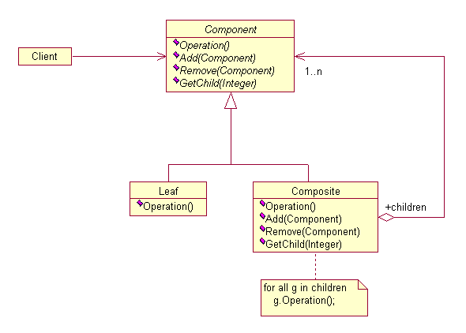
Design Patterns - Composite Pattern
Intent:
Compose objects into tree structures to represent part-whole hierarchies. Composite lets clients treat individual objects and compositions of objects uniformly.
Solution:

Slide 51
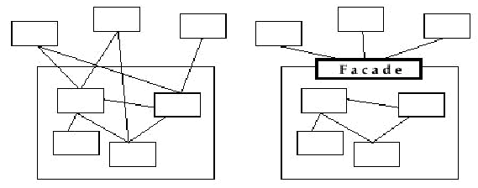
Design Patterns - Facade Pattern
Facade Pattern
1) Provides a unified interface to a set of objects in a subsystem.
A facade defines a higher-level interface that makes the
subsystem easier to use (i.e. it abstracts out the gory details)
2) Facades allow us to provide a closed architecture

Slide 52
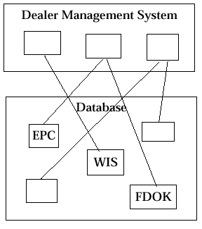
Design Patterns - Open vs Closed Architecture
Open vs Closed Architecture
1) Open architecture:
 Any dealer management system can call any component or class operation of the PAID databases.
2) Why is this good?
 Efficiency
3) Why is this bad?
 Can’t expect the client to understand how the subsystem works or any of the complex relationships that may exist within the subsystem.
 We can (pretty much) be assured that the subsystem will be
misused, leading to non-portable code

Slide 53
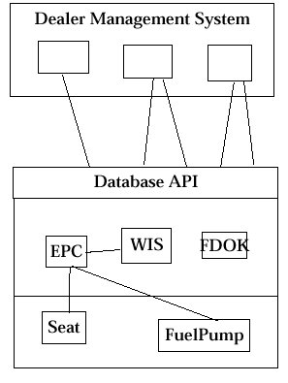
Realizing a Closed Architecture with a Facade
Realizing a Closed Architecture with a Facade
1) The subsystem decides exactly how it is accessed.
2) No need to worry about misuse by clients
3) If a façade is used the subsystem can be used in an early integration
 We need to write only a driver

Slide 54
Decorator Pattern - Motivation
Widget Example
  Suppose you have a user interface toolkit and you wish to make a border or scrolling feature available to clients without defining new subclasses of all existing classes.
  The client "attaches" the border or scrolling responsibility to only those objects requiring these capabilities.
  Widget* aWidget = new BorderDecorator(
  new ScrollDecorator(new TextView), 1);
  aWidget->draw();
Stream Example
  cascading responsibilities on to an output stream
  Stream* aStream = new CompressingStream(
  new ASCII7Stream(
  new FileStream( "fileName.dat" )));
  aStream->putString( "Hello world" );

Slide 55








Decorator Pattern - Motivation
VisualComponent
draw()
TextView
Decorator
+component
draw()
draw()
component.draw()
ScrollDecorator
BorderDecorator
scrollPosition
borderWidth
draw()
draw()
super.draw()
scrollto()
drawBorder()
drawBorder()
Decorator subclasses are free to add operations for specific functionality.
For example, ScrollDecorator's ScrollTo operation lets other objects scroll the interface if they know there happens to be a ScrollDecorator object in the interface.

Slide 56
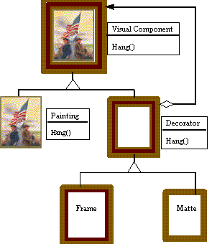
Decorator Pattern - Motivation
Painting Example
  Although paintings can be hung on a wall with or without frames, frames are often added, and it is the frame which is actually hung on the wall.
  Prior to hanging, the paintings may be matted and framed, with the painting, matting, and frame forming a single visual

Slide 57
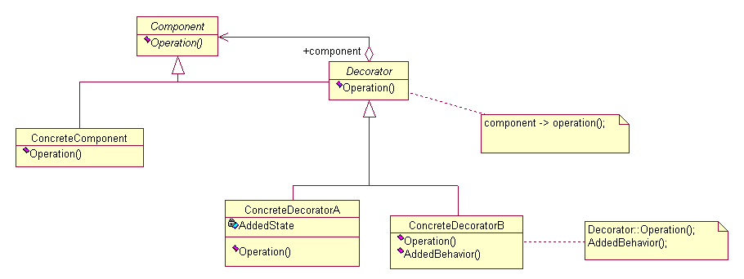
Decorator Pattern - Structure
Intent
  Attach additional responsibilities to an object dynamically.
  Decorators provide a flexible alternative to subclassing for extending functionality.
Structure
Structure

Slide 58
Decorator Pattern – Example (TestEoF.java)
import java.io.*;
public class TestEOF {
public static void main(String[] args) throws IOException {
DataInputStream in =
new DataInputStream(
new BufferedInputStream(
new FileInputStream("TestEof.java")));
while(in.available() != 0)
System.out.print((char)in.readByte());
}
}

Slide 59
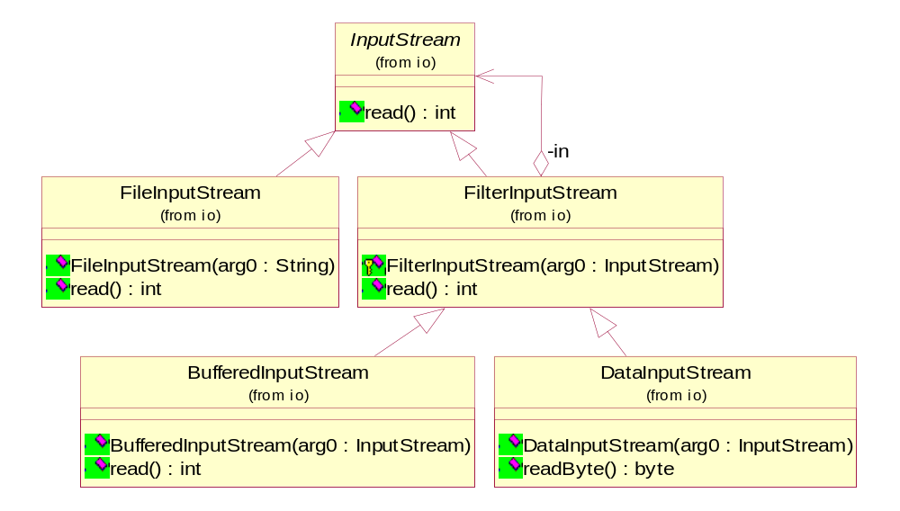
Decorator Pattern – Example(TestEoF.java)

Slide 60
Decorator Pattern – Example (java.io.*)
java.io.FilterInputStream Code:
public class FilterInputStream extends InputStream {
protected InputStream in;
protected FilterInputStream(InputStream in) {this.in = in;}
public int read() throws IOException {return in.read();}
……}
java.io. BufferedInputStream Code:
public class BufferedInputStream extends FilterInputStream {
protected byte buf[]; protected int count; protected int pos; protected int markpos = -1;
public BufferedInputStream(InputStream in) {this(in, defaultBufferSize); }
public synchronized int read() throws IOException {
ensureOpen(); if (pos >= count) {fill(); if (pos >= count) return -1;}
return buf[pos++] & 0xff;}
private void ensureOpen() throws IOException {if (in == null) throw new IOException("Stream closed");}
private void fill() throws IOException {if (markpos < 0) pos = 0; else if (pos >= buf.length) if (markpos > 0) {
int sz = pos - markpos; System.arraycopy(buf, markpos, buf, 0, sz); pos = sz; markpos = 0;}
else if (buf.length >= marklimit) {markpos = -1; pos = 0; }
else {int nsz = pos * 2;if (nsz > marklimit) nsz = marklimit; byte nbuf[] = new byte[nsz];
System.arraycopy(buf, 0, nbuf, 0, pos); buf = nbuf;}
count = pos; int n = in.read(buf, pos, buf.length - pos);
if (n > 0) count = n + pos;}
…….
}

Slide 61
Decorator Pattern - Example (java.io.*)
java.io. DataInputStream Code:
public class DataInputStream extends FilterInputStream implements DataInput {
public DataInputStream(InputStream in) {super(in); }
public final byte readByte() throws IOException {
int ch = in.read();
if (ch < 0) throw new EOFException();
return (byte)(ch);
}
…….
}

Slide 62
Proxy Pattern - Motivation
What is expensive?
  Object Creation
  Object Initialization
Defer creation and initialization to the time you need the object
Reduce the cost of access to objects
  Use another object (“the proxy”) that acts as a stand-in for the real object
  The proxy creates the real object only if the user asks for it

Slide 63
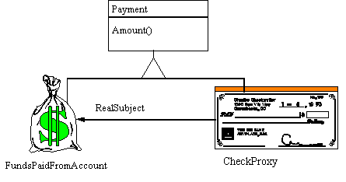
Proxy Pattern - Motivation
Example
  The Proxy provides a surrogate or place holder to provide access to an object.
  A check or bank draft is a proxy for funds in an account.
  A check can be used in place of cash for making purchases and ultimately controls access to cash in the issuer's account.

Slide 64
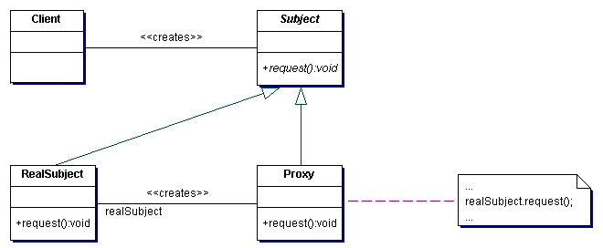
Proxy Pattern - Structure
Intent
  Provide a surrogate or placeholder for another object to control access to it.
Problem
  You need to support resource-hungry objects, and you do not want to instantiate such objects unless and until they are actually requested by the client.
Structure

Slide 65
Proxy Pattern – Simple Example (ProxyDemo.java)
Client Code:
Proxy p = new Proxy();
public void test() { p.f(); p.g(); p.h(); }
Proxy and ProxyBase Code:
interface ProxyBase { void f(); void g(); void h();}
class Proxy implements ProxyBase {
private ProxyBase implementation;
public Proxy() { implementation = new Implementation(); }
public void f() {implementation.f();}
public void g() {implementation.g();}
public void h() {implementation.h();}
}
class Implementation implements ProxyBase {
public void f() {System.out.println("Implementation.f()");}
public void g() {System.out.println("Implementation.g()");}
public void h() {System.out.println("Implementation.h()");}
}

Slide 66
Proxy – Example (ConnectionPoolProxyDemo.java)
Client Code:
public class ConnectionPoolProxyDemo extends TestCase {
static {ConnectionPool.addConnections(5);}
public void test() {
Connection c = ConnectionPool.getConnection();
c.set(new Object()); c.get(); c.release();
}
public void testDisable() {
Connection c = ConnectionPool.getConnection();
String s = null; c.set(new Object()); c.get(); c.release();
try {c.get();} catch(Exception e) {s = e.getMessage();System.out.println(s);}
assertEquals(s, "Tried to use reference after it was released");}
public static void main(String args[]) {
junit.textui.TestRunner.run(ConnectionPoolProxyDemo.class);
}
}

Slide 67
Proxy – Example (ConnectionPoolProxyDemo.java)
Connection, ConnectionImplementation and ConnectionPool Code:
interface Connection { Object get(); void set(Object x); void release();}
class ConnectionImplementation implements Connection {
public Object get() { return null; } public void set(Object s) {} public void release() {}}
class ConnectionPool { // A singleton
private static PoolManager pool = new PoolManager();
private ConnectionPool() {} // Prevent synthesized constructor
public static void addConnections(int number) {
for(int i = 0; i < number; i++) pool.add(new ConnectionImplementation());}
public static Connection getConnection() {
PoolManager.ReleasableReference rr = (PoolManager.ReleasableReference)pool.get();
if(rr == null) return null; return new ConnectionProxy(rr);}
private static class ConnectionProxy implements Connection {
private PoolManager.ReleasableReference implementation;
public ConnectionProxy(PoolManager.ReleasableReference rr) {implementation = rr;}
public Object get() {return ((Connection)implementation.getReference()).get();}
public void set(Object x) {((Connection)implementation.getReference()).set(x);}
public void release() { implementation.release(); }
}
}

Slide 68
Proxy – Example (PoolManager.java)
PoolManager Code:
public class PoolManager {
private static class PoolItem {
boolean inUse = false; Object item; PoolItem(Object item) { this.item = item; }
}
public class ReleasableReference { // Used to build the proxy
private PoolItem reference; private boolean released = false;
public ReleasableReference(PoolItem reference) {this.reference = reference;}
public Object getReference() {
if(released) throw new RuntimeException("Tried to use reference after it was released");
return reference.item;}
public void release() {released = true; reference.inUse = false;}
}
private ArrayList items = new ArrayList();
public void add(Object item) {items.add(new PoolItem(item));}
public static class EmptyPoolItem {}
public ReleasableReference get() {
for(int i = 0; i < items.size(); i++) {
PoolItem pitem = (PoolItem)items.get(i);
if(pitem.inUse == false) {pitem.inUse = true; return new ReleasableReference(pitem);}
}
return null; // temporary
}
}

Slide 69
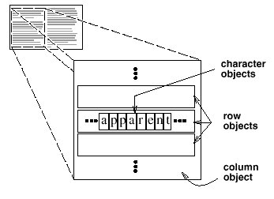
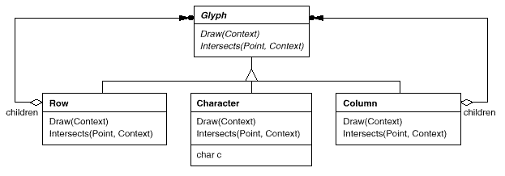
Flyweight Pattern - Motivation
How can a document editor use objects to represent characters?
  The drawback of such a design is its cost.
  Even moderate-sized documents may require hundreds of thousands of character objects, which will consume lots of memory and may incur unacceptable run-time overhead.
The Flyweight pattern describes how to share objects to allow their use at fine granularities without prohibitive cost.
  A flyweight is a shared object that can be used in multiple contexts simultaneously.

Slide 70
Flyweight Pattern – Example
consider a DataPoint object
  Suppose you need to create a million of these objects
class DataPoint {
private static int count = 0; private int id = count++; private int i; private float f;
public int getI() { return i; } public void setI(int i) { this.i = i; } public float getF() { return f; }
public void setF(float f) { this.f = f; } public String toString() {return "id: " + id + ", i = " + i + ", f = " + f;}
}
public class ManyObjects {
static final int size = 1000000;
public static void main(String[] args) {
DataPoint[] array = new DataPoint[size];
for(int i = 0; i < array.length; i++) array[i] = new DataPoint();
for(int i = 0; i < array.length; i++) { DataPoint dp = array[i]; dp.setI(dp.getI() + 1); dp.setF(47.0f); }
System.out.println(array[size -1]);
}
}
This program may result in excessive slowness or running out of memory.

Slide 71
Flyweight Pattern – Example
To solve the problem
  the DataPoint can be reduced from a million objects to one object by externalizing the data held in the DataPoint
class ExternalizedData {
static final int size = 5000000;
static int[] id = new int[size];
static int[] i = new int[size];
static float[] f = new float[size];
static { for(int i = 0; i < size; i++) id[i] = i;}
}
class FlyPoint {
private FlyPoint() {}
public static int getI(int obnum) {
return ExternalizedData.i[obnum]; }
public static void setI(int obnum, int i) {
ExternalizedData.i[obnum] = i; }
public static float getF(int obnum) {
return ExternalizedData.f[obnum]; }
public static void setF(int obnum, float f) {
ExternalizedData.f[obnum] = f; }
public static String str(int obnum) {
return "id: " + ExternalizedData.id[obnum] + ", i = “
+ ExternalizedData.i[obnum] + ", f = " +
ExternalizedData.f[obnum]; }
}
public class FlyWeightObjects {
public static void main(String[] args) {
for(int i = 0; i < ExternalizedData.size; i++) {
FlyPoint.setI(i, FlyPoint.getI(i) + 1);
FlyPoint.setF(i, 47.0f); }
System.out.println(
FlyPoint.str(ExternalizedData.size -1));
}
}
Now all the data is in ExternalizedData
  each call to a FlyPoint method must include the index into ExternalizedData

Slide 72
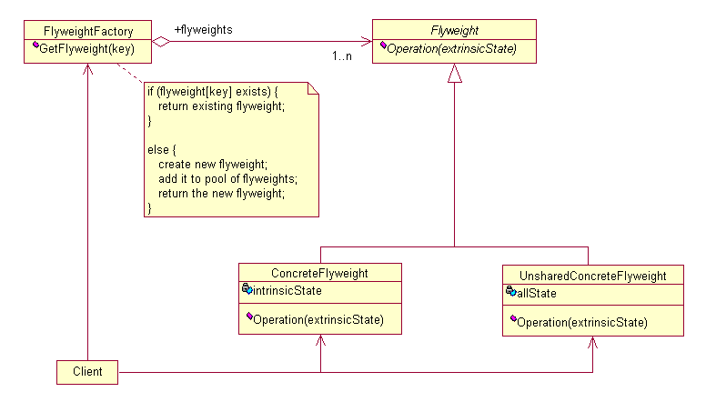
Flyweight Pattern - Structure
Intent
  Use sharing to support large numbers of fine-grained objects efficiently.
Structure

Slide 73
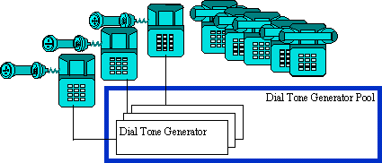
Flyweight Pattern – Example
The Flyweight uses sharing to support large numbers of objects efficiently
Example: The public switched telephone network
  There are several resources such as dial tone generators, ringing generators, and digit receivers that must be shared between all subscribers.
  A subscriber is unaware of how many resources are in the pool when he or she lifts the handset to make a call.
  All that matters to subscribers is that a dial tone is provided, digits are received, and the call is completed.

Slide 74
6.3 Behavioral design patterns
Observer pattern
Command Pattern
Chain of Responsibility
Visitor
Template Method
Strategy pattern
State pattern
Iterator
Memento
Mediator

Slide 75
Observer pattern
Also known as: “Publish / Subscribe,” “Model / View,” and “Source / Listener.”
Motivation: Two File Managers are both observing the same Directory; the user
deletes a subdirectory using File Manager A; we want File Manager B to
immediately and automatically get updated, reflecting the change...
Applicability:
– When there are multiple views of a model (subject) that need to stay in sync.
No view should know about any other.
– When an object needs to communicate to other objects of unknown type (but known Observer interface) it can notify them.
Pros:
– Promotes loose coupling between objects.
– Excellent communication protocol.
– Avoids polling
Cons:
– None. Knowledge of this pattern is essential.

Slide 76
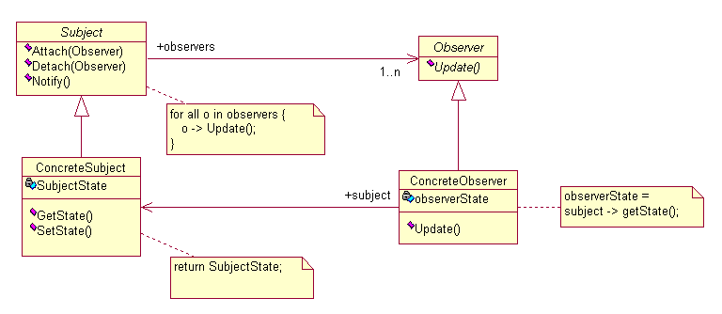
Observer pattern
Intent: Define a one-to-many dependency between objects so that when one object changes state, all its dependents are notified and updated automatically.

Slide 77
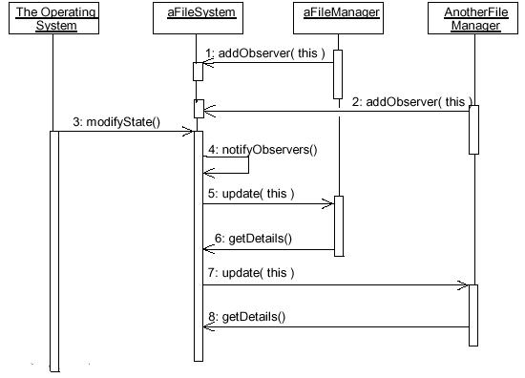
Observer pattern Example

Slide 78
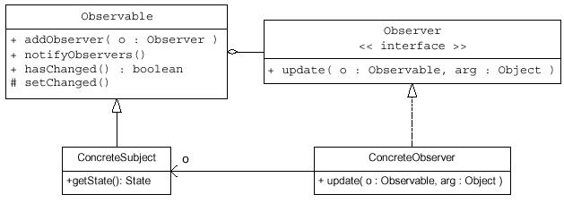
Java Support for Observer
 The java.util package provides an Observable class and an Observer interface:

Slide 79
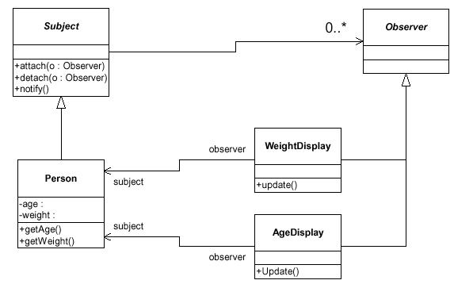
Example: A GUI Observes a Person

Slide 80
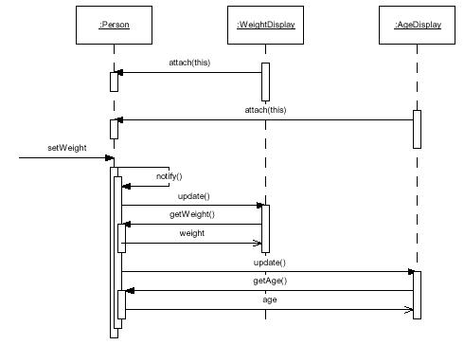
Example: A GUI Observes a Person

Slide 81
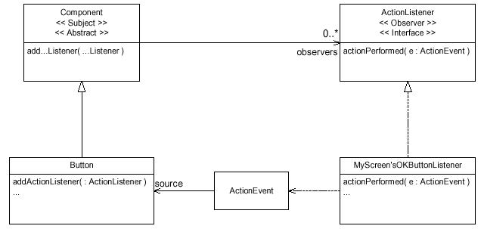
Example: Java AWT 1.1 Event Model

Slide 82
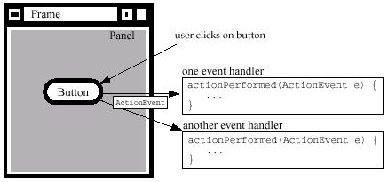
Example: event-driven programming
Notes:
In the Best Practices module, we discussed some characteristics common to successful projects. OO facilitates the following best practices:
Develop Iteratively
Model Visually
Use Component Architecture
Defining basic OO terms and concepts allows everyone in the class to start on a level playing field.

Slide 83

Example: event-driven programming
import javax.swing.*; import java.awt.event.*; import java.awt.*;
import com.bruceeckel.swing.*;
public class Button2 extends JApplet {
JButton b1 = new JButton("Button 1"), b2 = new JButton("Button 2");
JTextField txt = new JTextField(10);
class BL implements ActionListener {
public void actionPerformed(ActionEvent e){
String name = ((JButton)e.getSource()).getText(); txt.setText(name);}
}
BL al = new BL();
public void init() {
b1.addActionListener(al); b2.addActionListener(al);
Container cp = getContentPane(); cp.setLayout(new FlowLayout());
cp.add(b1); cp.add(b2); cp.add(txt); }
public static void main(String[] args) {Console.run(new Button2(), 200, 75);}
}
Event Sources
Event handler
Events
Register event handler to event source
Notes:
In the Best Practices module, we discussed some characteristics common to successful projects. OO facilitates the following best practices:
Develop Iteratively
Model Visually
Use Component Architecture
Defining basic OO terms and concepts allows everyone in the class to start on a level playing field.

Slide 84
Example: event-driven programming
In the case of a JButton, this “event of interest” is that the button is pressed. To register your interest in when a button is pressed, you call the JButton’s addActionListener( ) method. This method expects an argument that is an object that implements the ActionListener interface, which contains a single method called actionPerformed( ). So all you have to do to attach code to a JButton is to implement the ActionListener interface in a class, and register an object of that class with the JButton via addActionListener( ). The method will be called when the button is pressed (this is normally referred to as a callback).
<<Interface>>
Event handler
Event Sources
EventListener
Button2
JButton
(from util)
EventObject
init() : void
(from swing)
(from util)
getSource() : Object
<<Interface>>
ActionListener
AbstractButton
(from event)
AWTEvent
(from swing)
actionPerformed(arg0 : ActionEvent) : void
(from awt)
addActionListener(arg0 : ActionListener) : void
Events
Register event handler to event source
BL
(from Button2)
ActionEvent
actionPerformed(arg0 : ActionEvent) : void
(from event)
Notes:
In the Best Practices module, we discussed some characteristics common to successful projects. OO facilitates the following best practices:
Develop Iteratively
Model Visually
Use Component Architecture
Defining basic OO terms and concepts allows everyone in the class to start on a level playing field.

Slide 85
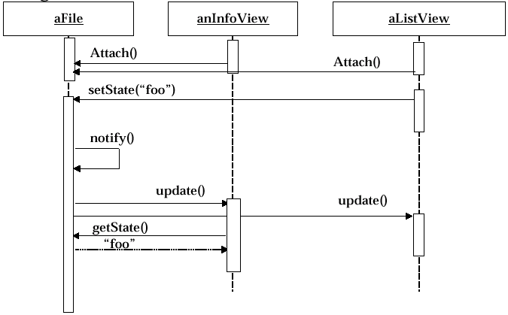
Example: Sequence diagram for scenario: Change filename to “foo”
Sequence diagram for scenario: Change filename to “foo”

Slide 86
Command Pattern - Motivation
You want to make the user interface reusable across many applications
  You cannot hardcode the meanings of the menus for the various applications
  The applications only know what has to be done when a menu is selected.
You want to support Undo and Redo

Slide 87
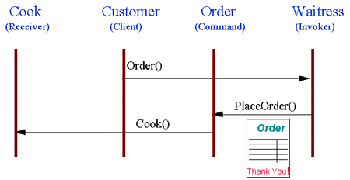
Command Pattern - Example
The "check" at a diner
  The waiter or waitress takes an order or command from a customer and encapsulates that order by writing it on the check.
  The order is then queued for a short order cook.
  Note that the pad of "checks" used by each waiter is not dependent on the menu, and therefore they can support commands to cook many different items.

Slide 88
Command Pattern – Example
Client Code:
Macro macro = new Macro();
macro.add(new Hello());
macro.add(new World());
macro.add(new IAm());
macro.run();
// An object that holds commands
class Macro {
private List commands = new ArrayList();
public void add(Command c) { commands.add(c); }
public void run() {
Iterator it = commands.iterator();
while(it.hasNext()) ((Command)it.next()).execute();
}
}
Command object:
class Hello implements Command {public void execute() {System.out.print("Hello ");}}
class World implements Command {public void execute() {System.out.print("World! ");}}
class IAm implements Command {
public void execute() {System.out.print("I'm the command pattern!");}
}
Command interface:
interface Command { void execute();}

Slide 89
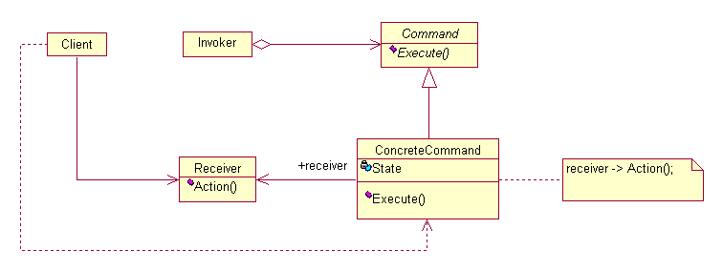
Command pattern
Intent
  Encapsulate a request as an object, thereby letting you parameterize clients with different requests, queue or log requests, and support undoable operations.
Structure
The Invoker offers a variety of commands
ConcreteCommand implements execute() by calling corresponding operation(s) in Receiver.
Client instantiates the ConcreteCommands and sets its Receiver.
Receiver knows how to perform the operation.

Slide 90
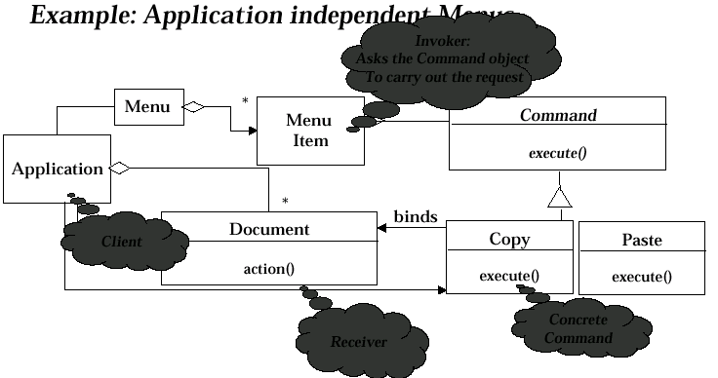
Example: Application independent Menus

Slide 91
Command Pattern – Example in Wmvc
Client Code in WmvcController.java:
public class WmvcController implements ActionListener, ItemListener{
private WmvcExecutor wmvcExecutor;
public WmvcController(JComponent comp,String tip, WmvcExecutor wExec) {
wmvcExecutor = wExec; …… }
public void actionPerformed(ActionEvent event) {
if (wmvcExecutor != null) wmvcExecutor.execute(event);}
public void itemStateChanged(ItemEvent event) {
if (wmvcExecutor != null) wmvcExecutor.execute(event);}
………
}
Concrete command (anonymous WmvcExecutor classes) in MainView.java:
WmvcMenuItemCtl fileOpen = new WmvcMenuItemCtl ( fileMenu, "Open","images/open-16.gif", 'O', null,
new WmvcExecutor() { public void execute(ActionEvent event){ ……}} );
Command interface:
public class WmvcExecutor{
public void execute(ActionEvent event){}
public void execute(ItemEvent event){}
public void execute(ChangeEvent event){}
}

Slide 92
Chain of Resposibility Pattern - Motivation
Consider a context-sensitive help facility for a GUI
  The user can obtain help information on any part of the interface just by clicking on it.
  The help that's provided depends on the part of the interface that's selected and its context.
Problem
  How to decouple the button that initiates the help request from the objects that might provide help information?
Solution
  to decouple senders and receivers by giving multiple objects a chance to handle a request. The request gets passed along a chain of objects until one of them handles it.
  The first object in the chain receives the request and either handles it or forwards it to the next candidate on the chain, which does likewise.
  The object that made the request has no explicit knowledge of who will handle it

Slide 93
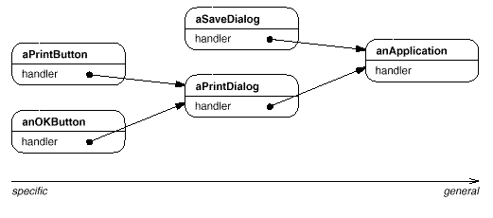
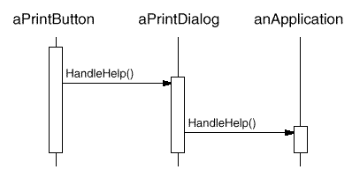
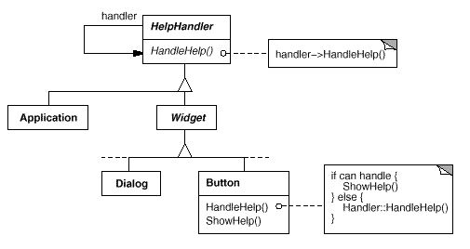
Chain of Resposibility Pattern - Motivation

Slide 94
Chain of Resposibility – Sample Code
Client Code:
Application* application = new Application(APPLICATION_TOPIC);
Dialog* dialog = new Dialog(application, PRINT_TOPIC);
Button* button = new Button(dialog, PAPER_ORIENTATION_TOPIC);
button->HandleHelp();
class HelpHandler {
private: HelpHandler* _successor;
public: HelpHandler ( HelpHandler* h, Topic t ) : _successor(h), _topic(t) { }
virtual void HandleHelp() { if (_successor != 0) { _successor->HandleHelp(); } }
…….};
class Widget : public HelpHandler {……};
class Button : public Widget {
public: virtual void HandleHelp() { if (HasHelp()) { // offer help on the button }
else { HelpHandler::HandleHelp();
//the request gets forwarded to the successor using the HandleHelp operation in HelpHandler. }} ;
class Dialog : public Widget {
public: virtual void HandleHelp() { if (HasHelp()) { // offer help on the button }
else { HelpHandler::HandleHelp();}} ;
class Application : public HelpHandler {
public: Application(Topic t) : HelpHandler(0, t) { }
virtual void HandleHelp() { // show a list of help topics }};

Slide 95
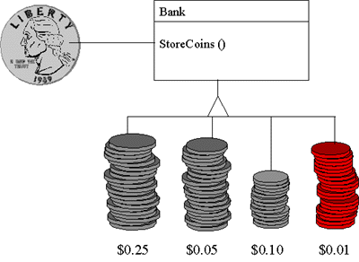
Chain of Resposibility Pattern - Example
Mechanical coin sorting banks
  Rather than having a separate slot for each coin denomination coupled with a receptacle for the denomination, a single slot is used.
  When the coin is dropped, the coin is routed to the appropriate receptacle by the mechanical mechanisms within the bank.

Slide 96

Chain of Resposibility Pattern
Intent
  Avoid coupling the sender of a request to its receiver by giving more than one object a chance to handle the request. Chain the receiving objects and pass the request along the chain until an object handles it.
Structure

Slide 97
Visitor Pattern – Modem example
How can we configure these modems for UNIX without putting the ConfigureForUnix method in the Mdem interface?
<<interface>>
Modem
+dial
+hangup
+send
+receive
Hayes
Zoom
Ernie

Slide 98
Visitor Pattern – Modem example
How can we configure these modems for UNIX without putting the ConfigureForUnix method in the Mdem interface?
<<Interface>>
ModemVisitor
<<interface>>
Modem
+visit(Hayes)
+visit(Zoom)
+visit(Ernie)
+dial
+hangup
+send
+receive
Hayes
Zoom
Ernie
UnixModemConfigurator
Public void accept (ModemVisitor v) { v.visit(this) }

Slide 99
Visitor Pattern – Modem example
Client Code:
v = new UnixModemConfigurator(); h = new HayesModem(); h.accept(v);
z = new ZoomModem(); z.accept(v); e = new ErnieModem(); e.accept();
public interface Modem {
public void dial(String pno); public void hangup(); public void send(char c);
public char recv(); public void accept (ModemVisitor v); };
public interface ModemVisitor {
public void visit (HayesModem modem); public void visit (ZoomModem modem);
public void visit (ErnieModem modem); };
public class HayesModem implements Modem {
public void dial(String pno){}; public void hangup(){}; public void send(char c){};
public char recv(){return 0};
public void accept (ModemVisit v) {v.visit(this);
String configurationString =null; };
public class ZoomModem implements Modem {
public void dial(String pno){}; public void hangup(){}; public void send(char c){};
public char recv(){return 0};
public void accept (ModemVisit v) {v.visit(this);
int configurationValue = 0; };

Slide 100
Visitor Pattern – Modem example
public class ErnieModem implements Modem {
public void dial(String pno){}; public void hangup(){}; public void send(char c){};
public char recv(){return 0}; public void accept (ModemVisit v) {v.visit(this);
String internalPattern = null; };
public UnixModemConfigurator implements ModemVisitor {
public void visit (HayesModem m) {m.configrationString = “$s1=4$D=3” };
public void visit (ZoomModem m) {m.configrationValue = 42 };
public void visit (ErnieModem m) {m.internalPattern =“c is too slow” }}
};

Slide 101
Visitor Pattern – A cyclic Visitor Modem example
There is a cycle of dependencies that ties all the visited derivatives (all the Modems) together.
public interface ModemVisitor {}
Public void accept (ModemVisitor v){
try {
HayesVisitor hv = (HayesVisitor) v;
hv.visit(this);
} catch (ClassCastException) {}
}
<<interface>>
Modem
<<degenerate>>
ModemVisitor
+dial
+hangup
+send
+receive
UnixModemConfigurator
Hayes
Zoom
Ernie
<<interface>>
HayesVisitor
<<interface>>
ZoomVisitor
<<interface>>
ErnieVisitor
+visit(Hayes)
+visit(Zoom)
+visit(Ernie)

Slide 102
Visitor Pattern - Motivation
abstract syntax trees
  Consider a compiler that represents programs as abstract syntax trees.
  It will need to perform operations on abstract syntax trees for "static semantic" analyses like checking that all variables are defined. It will also need to generate code.
Problem
  distributing all these operations across the various node classes leads to a system that's hard to understand, maintain, and change.
  It would be better if each new operation could be added separately, and the node classes were independent of the operations that apply to them.
Solution
  packaging related operations from each class in a separate object, called a visitor, and passing it to elements of the abstract syntax tree as it's traversed.
  When an element "accepts" the visitor, it sends a request to the visitor that encodes the element's class. It also includes the element as an argument.
  The visitor will then execute the operation for that element—the operation that used to be in the class of the element.

Slide 103


Visitor Pattern - Motivation

Slide 104

Visitor Pattern - Example
Taxi Company
  When a person calls a taxi company (accepting a visitor), the company dispatches a cab to the customer.
  Upon entering the taxi the customer, or Visitor, is no longer in control of his or her own transportation, the taxi (driver) is.

Slide 105
Visitor Pattern - Example
Iterator iterator = collection.iterator()
while (iterator.hasNext()) {
Object o = iterator.next();
if (o instanceof Collection)
messyPrintCollection((Collection)o);
else if (o instanceof String)
System.out.println("'"+o.toString()+"'");
else if (o instanceof Float)
System.out.println(o.toString()+"f");
else
System.out.println(o.toString());
}

Slide 106
Visitor Pattern
Intent
  Represent an operation to be performed on the elements of an object structure. Visitor lets you define a new operation without changing the classes of the elements on which it operates.
Structure
  A client that uses the Visitor pattern must create a ConcreteVisitor object and then traverse the object structure, visiting each element with the visitor.
  When an element is visited, it calls the Visitor operation that corresponds to its class. The element supplies itself as an argument to this operation to let the visitor access its state, if necessary.

Slide 107

Visitor Pattern - Structure

Slide 108
Visitor Pattern - Example
public interface Element {
public void accept(Visitor visitor);
}
public class StringElement implements Element {
private String value;
public StringElement(String string) {value = string;}
public String getValue(){return value;}
public void accept(Visitor visitor) {
visitor.visitString(this);
}
}

Slide 109
Visitor Pattern - Example
public class FloatElement implements Element
{ private Float value;
public FloatElement(Float value) {
this.value = value;
}
public Float getValue(){
return value;
}
public void accept(Visitor visitor) {
visitor.visitFloat(this);
}
}

Slide 110
Visitor Pattern - Example
public interface Visitor
{
public void visitString(StringElement stringE);
public void visitFloat(FloatElement floatE);
public void visitCollection(Collection collection);
}

Slide 111
Visitor Pattern - Example
public class ConcreteVisitor implements Visitor
{ public void visitCollection(Collection collection) {
Iterator iterator = collection.iterator()
while (iterator.hasNext()) {
Object o = iterator.next();
if (o instanceof Element)
((Element)o).accept(this);
}
｝

Slide 112
Visitor Pattern - Example
public void visitString(StringElement stringE) {
System.out.println("'"+stringE.getValue()+"'");
}
public void visitFloat(FloatElement floatE){
System.out.println(floatE.getValue().toString()+"f");
}
}

Slide 113
Visitor Pattern - Example
Visitor visitor = new ConcreteVisitor();
StringElement stringE = new StringElement("I am a String");
visitor.visitString(stringE);
Collection list = new ArrayList();
list.add(new StringElement("I am a String1"));
list.add(new StringElement("I am a String2"));
list.add(new FloatElement(new Float(12)));
list.add(new StringElement("I am a String3"));
visitor.visitCollection(list);

Slide 114

Template Method Pattern – Motivation
Consider an application framework that provides Application and Document classes.
  Applications built with the framework can subclass Application and Document to suit specific needs.
  The abstract Application class defines the algorithm for opening and reading a document in its OpenDocument operation:

Slide 115
Template Method Pattern – Motivation
The abstract Application class defines the algorithm for opening and reading a document in its OpenDocument operation:
void Application::OpenDocument (const char* name) {
if (!CanOpenDocument(name)) {
// cannot handle this document
return;
}
Document* doc = DoCreateDocument();
if (doc) {
_docs->AddDocument(doc);
AboutToOpenDocument(doc);
doc->Open();
doc->DoRead();
}
}
OpenDocument defines each step for opening a document. We call OpenDocument a template method.
  A template method defines an algorithm in terms of abstract operations that subclasses override to provide concrete behavior.

Slide 116
Template Method Pattern – Example
Consider following main-loop structure
Initialize();
While (!done()) { //main loop
Idle(); //do something useful
}
Cleanup();
Ftocraw.java is a example program
public class ftocraw {
public static void main(String[] args) throws Exception {
InputStreamReader isr = new InputStreamReader(System.in);
BufferedReader br = new BufferedReader(isr);
boolean done = false;
while (!done) {
String fahrString = br.readLine();
if (fahrString == null || fahrString.length() == 0) done = true;
else { double fahr = Double.parseDouble(fahrString); double celcius = 5.0/9.0*(fahr-32);
System.out.println("F=" + fahr + ", C=" + celcius); }
}
System.out.println("ftoc exit");
}
}

Slide 117
Template Method Pattern – Example
We can separate this main-loop structure from ftoc program by employing the Template Method pattern
public abstract class Application {
private boolean isDone = false;
protected abstract void init();
protected abstract void idle();
protected abstract void cleanup();
protected void setDone() {isDone = true;}
protected boolean done() {return isDone;}
public void run() {
init();
while (!done())
idle();
cleanup();
}
}

Slide 118
Template Method Pattern – Example
We can rewrite the ftoc class by inheriting from Application and just filling in the abstract methods
public class ftocTemplateMethod extends Application {
private InputStreamReader isr;
private BufferedReader br;
public static void main(String[] args) throws Exception {
(new ftocTemplateMethod()).run();
}
protected void init() {isr = new InputStreamReader(System.in); br = new BufferedReader(isr); }
protected void idle() {
String fahrString = readLineAndReturnNullIfError();
if (fahrString == null || fahrString.length() == 0) setDone();
else {double fahr = Double.parseDouble(fahrString); double celcius = 5.0/9.0*(fahr-32);
System.out.println("F=" + fahr + ", C=" + celcius);}
}
protected void cleanup() { System.out.println("ftoc exit"); }
private String readLineAndReturnNullIfError() {
String s; try { s = br.readLine(); } catch(IOException e) { s = null; } return s;
}
}

Slide 119

Template Method Pattern
Intent
  Define the skeleton of an algorithm in an operation, deferring some steps to client subclasses. Template Method lets subclasses redefine certain steps of an algorithm without changing the algorithm's structure.
Structure
  ConcreteClass relies on AbstractClass to implement the invariant steps of the algorithm.

Slide 120

Template Method Pattern - example
The Template Method defines a skeleton of an algorithm in an operation, and defers some steps to subclasses.
Home builders use the Template Method when developing a new subdivision.
  A typical subdivision consists of a limited number of floor plans with different variations available for each.
  Within a floor plan, the foundation, framing, plumbing, and wiring will be identical for each house.
  Variation is introduced in the later stages of construction to produce a wider variety of models.

Slide 121

Strategy Pattern - Structure
Intent
  Define a family of algorithms, encapsulate each one, and make them interchangeable. Strategy lets the algorithm vary independently from the clients that use it.
Structure

Slide 122

Strategy Pattern - example
A Strategy defines a set of algorithms that can be used interchangeably.
Modes of transportation to an airport is an example of a Strategy.
  Several options exist such as driving one's own car, taking a taxi, an airport shuttle, a city bus, or a limousine service.
  For some airports, subways and helicopters are also available as a mode of transportation to the airport.
  Any of these modes of transportation will get a traveler to the airport, and they can be used interchangeably.
  The traveler must chose the Strategy based on tradeoffs between cost, convenience, and tlme.

Slide 123

Strategy Pattern – Example
In this inflexible example, all the NumberCruncher code is in one big class… Why is this bad?
Strategy is similar to Bridge; same basic structure; very different intent.
The Strategy pattern is also similar to State, which allows a class to be
configured with different behaviors from which it can select whenever it
makes an interesting state transition.

Slide 124

Strategy Pattern – Example
What if there were not a CrunchAlgorithm interface… suppose instead that
NumberCruncher had two subclasses, CorrectButSlowNumberCruncher, and
FastButSloppyNumberCruncher…? Why is this bad?

Slide 125

Strategy Pattern – Example
Here’s another “correct” design... But there can be no polymorphism in the
chooseAlgorithm() or implCode() methods, leading to maintenance difficulties.
Adding a NewAndImprovedCrunch would require adding if-then-else logic
everywhere that the different Crunches are used. If the Strategy pattern were
applied instead, the only place where the concrete CrunchImpls would get referred to specifically is the one place that they get instantiated.

Slide 126

Strategy Pattern – Example
Intent: Allows multiple implementation strategies to be interchangeable, so that they can easily be swapped at run-time, and so that new strategies can be easily added.
In this example, notice that client’s of NumberCruncher do not know about the different crunch algorithms. The NumberCruncher.crunch() method is free to decide which CrunchImpl to use at any time; new algorithms can be easily added.

Slide 127

Applying a Strategy Pattern in a Database Application

Slide 128
Applicability of Strategy Pattern
Applicability of Strategy Pattern
1) Many related classes differ only in their behavior. Strategy
allows to configure a single class with one of many behaviors
2) Different variants of an algorithm are needed that trade-off
space against time. All these variants can be implemented as a
class hierarchy of algorithms

Slide 129

State Pattern - Structure
Intent
  Allow an object to alter its behavior when its internal state changes. The object will appear to change its class.
Structure

Slide 130

State Pattern - example
The State pattern allows an object to change its behavior when its internal state changes.
This pattern can be observed in a vending machine.
  Vending machines have states based on the inventory, amount of currency deposited, the ability to make change, the item selected, etc.
  When currency is deposited and a selection is made, a vending machine will either deliver a product and no change, deliver a product and change, deliver no product due to insufficient currency on deposit, or deliver no product due to inventory depletion.

Slide 131

State Pattern – Example
Intent: Allow an object to alter its behavior when its internal state changes. The object will appear to change its class, from the point of view of the client.

Slide 132

State Pattern – Example
How does a ConcreteState know what state to go to on a transition?
– Each class can have its own table or switch statement, or a hash table of transitions keyed by their triggers.
– Consider using Event and Transition classes.
– Note: The Event class might be implemented using the Command pattern.

Slide 133

Iterator Pattern – Motivation
An aggregate object such as a list should give you a way to access its elements without exposing its internal structure.
The key idea is to take the responsibility for access and traversal out of the list object and put it into an iterator object.

Slide 134
Iterator Pattern – Example
Consider a type-safe container
package java.util;
public interface Iterator {
boolean hasNext();
Object next();
void remove();
}
import java.util.*;
public class TypedIterator implements Iterator {
private Iterator imp;
private Class type;
public TypedIterator(Iterator it, Class type) {
imp = it; this.type = type;}
public boolean hasNext(){return imp.hasNext();}
public void remove() { imp.remove(); }
public Object next() {
Object obj = imp.next();
if(!type.isInstance(obj))
throw new ClassCastException(
"TypedIterator for type " + type +
" encountered type: " + obj.getClass());
return obj;
}
}

Slide 135

Iterator Pattern - Structure
Intent
  Provide a way to access the elements of an aggregate object sequentially without exposing its underlying representation.
Structure

Slide 136
Memento Pattern – Motivation
Sometimes it's necessary to record the internal state of an object.
  This is required when implementing checkpoints and undo mechanisms
  Exposing this state would violate encapsulation
A memento is an object that stores a snapshot of the internal state of another object—the memento's originator.
  The undo mechanism will request a memento from the originator when it needs to checkpoint the originator's state.
  The originator initializes the memento with information that characterizes its current state.
  Only the originator can store and retrieve information from the memento—the memento is "opaque" to other objects.

Slide 137

Memento Pattern - Structure
Intent
  Without violating encapsulation, capture and externalize an object's internal state so that the object can be returned to this state later.
Structure

Slide 138
Memento Pattern – Example
public class Originator {
private int number; private File file = null;
public Originator(){}
public Memento getMemento() { return new Memento(this);}
public void setMemento(Memento m){number = m.number; file = m.file;}
}
private class Memento implements java.io.Serializable{
private int number;
private File file = null;
public Memento( Originator o){ number = o.number; file = o.file;}
}

Slide 139

Memento
Intent: Save an object’s state without violating the principle of encapsulation.
Applicability: The state of an object must be saved (by a client) so that it can be
restored later. The Memento object contains all the necessary state information.
 This is another way to implement “undo.”
 Example: Java Beans save their state to a .ser file after being configured.
 How is it possible, in Java & C++, for methods & data in the class Memento to be
available to SomeClass, but not to Clients?

Slide 140


Mediator Pattern – Motivation
How the objects cooperate to handle a change in a list box's selection
Encapsulating collective behavior in a separate mediator object

Slide 141

Mediator Pattern – Motivation

Slide 142

Mediator Pattern - Structure
Intent
  Define an object that encapsulates how a set of objects interact. Mediator promotes loose coupling by keeping objects from referring to each other explicitly, and it lets you vary their interaction independently.
Structure
  Colleagues send and receive requests from a Mediator object. The mediator implements the cooperative behavior by routing requests between the appropriate colleague(s).

Slide 143
6.4 Applying Design Patterns
MVC pattern
Wmvc Framework
MovieCat Application using Wmvc
Thermometer Application using Wmvc

