Slide 1
Towards Analyzing Neural Time Series Data Affected by Stimulation Artifact
Evan Dastin-van Rijn
Brown University
Senior Undergraduate

Slide 2
Agenda
Period-based Artifact Reconstruction and Removal Method (PARRM)
Periodic Estimation of Lost Packets (PELP)
Plans for evaluating analysis approaches with missing data

Slide 3
PARRM Motivation
Robust across sampling rates (low and high)
Flexible to varying artifact waveforms (short and long)
Robust to aliasing
Implementable in real-time
Loss agnostic

Slide 4
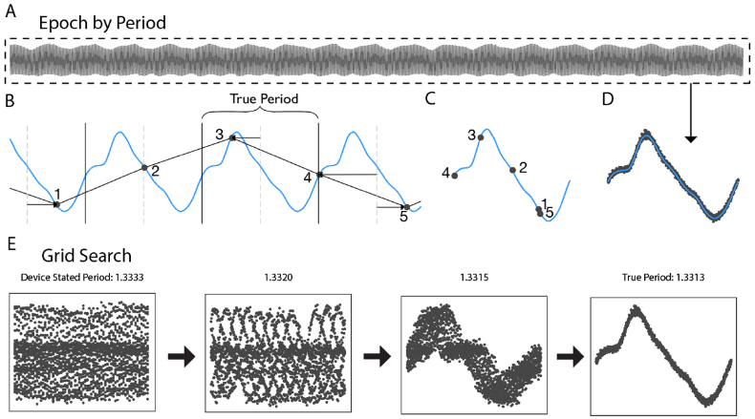
Period Estimation
https://github.com/neuromotion/PARRM
Dastin-van Rijn, Evan M. and Provenza, et al. Uncovering Biomarkers During Therapeutic Neuromodulation with PARRM: Period-Based Artifact Reconstruction and Removal Method. Available at SSRN: https://ssrn.com/abstract=3748590 or http://dx.doi.org/10.2139/ssrn.3748590

Slide 5
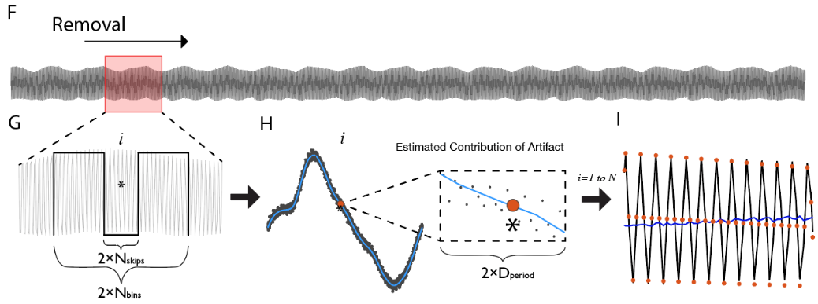
Period-based Artifact Reconstruction and Removal Method (PARRM)

Slide 6
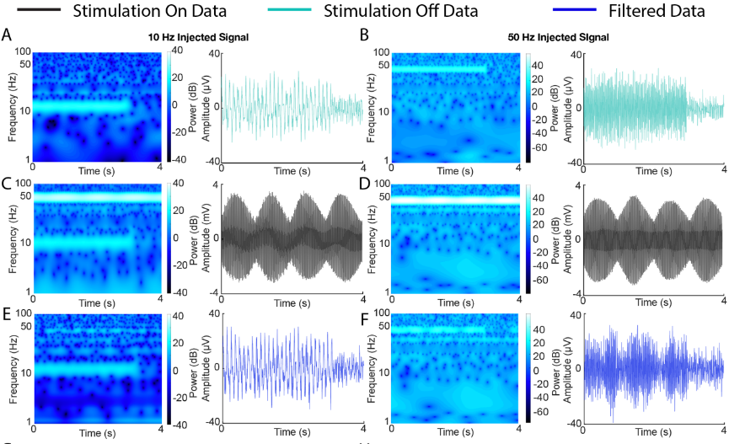
Validation of Method in Saline
Injected 10 Hz and 50 Hz signals
200 Hz sampling rate, 150 Hz stimulation frequency (alias at 50 Hz)

Slide 7
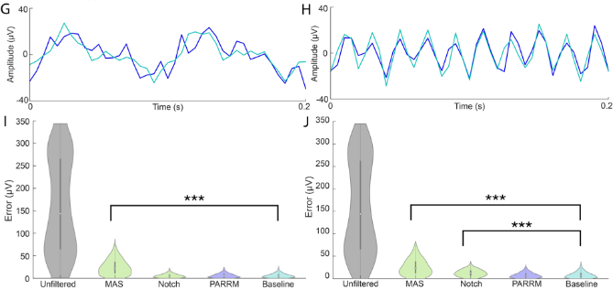
Validation of Method in Saline
Similar in time domain
PARRM returns absolute error distribution to the level of baseline noise exceeding a template subtraction approach and notch filter

Slide 8
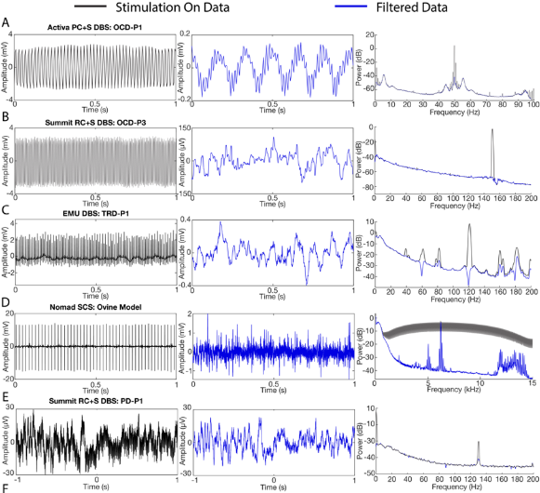
PARRM Performance in-vivo

Slide 9
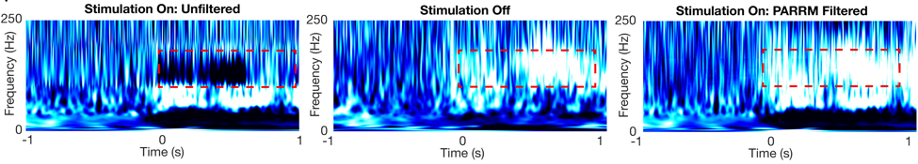
PARRM Recovers Biomarker Coincident with Artifact
130 Hz stimulation obscures gamma movement biomarker during task
Biomarker is recovered following filtering using PARRM despite coinciding with stimulation artifact

Slide 10
Motivation for PELP
PELP provides a method to exactly determine the number of samples missing due to packet losses for recordings where stimulation is on.
We validated the method using a stimulation model added to EEG data and simulated packet losses along with RC+S data in the clinic and from the patient’s own home.

Slide 11
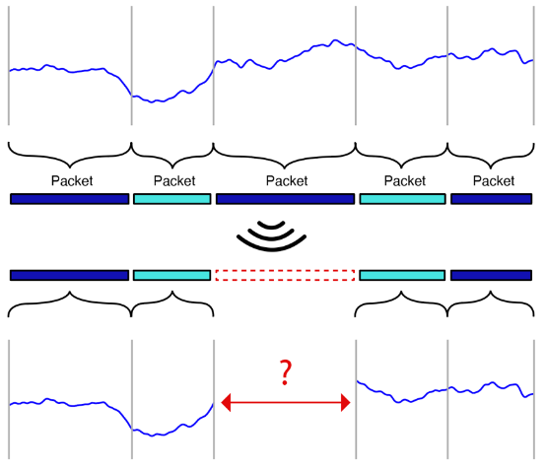
Packet loss
Continuous data sampled onboard are organized into discrete chunks of variable size called packets
During wireless transmission, it is possible for some packets to not be received
Lost packets result in missing data and uncertain relative timing of remaining samples

Slide 12
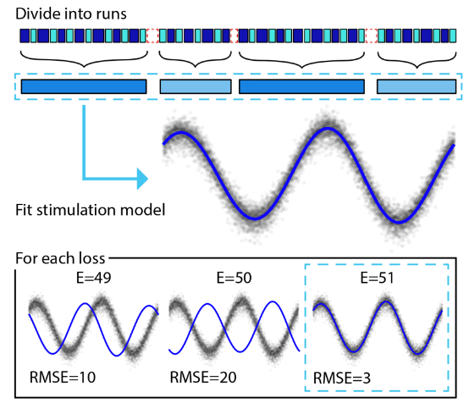
Periodic Estimation of Lost Packets (PELP)
Identify locations of all packet losses
Estimate size of each packet loss using systemTick
Group contiguous packets into continuous runs
Find stimulation period using period estimation component of PARRM
Fit harmonic regression model to longest run
For each loss, compute RMSE between samples and model prediction. The loss size that minimizes RMSE is the true size
Evan M. Dastin-van Rijn, et al.
Accounting for missing data in neural time series using PELP: Periodic Estimation of Lost Packets (in preparation)

Slide 13
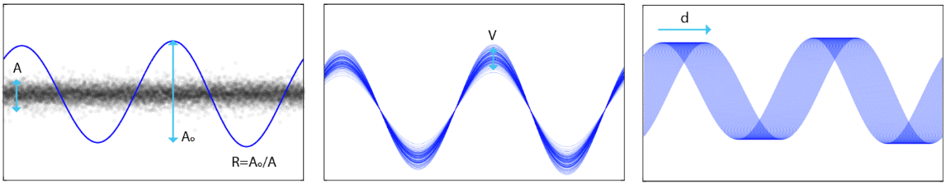
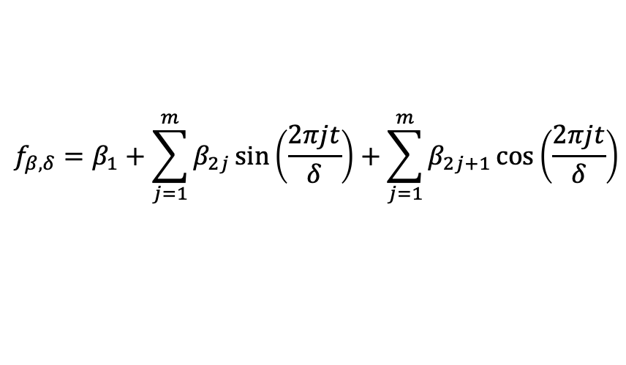
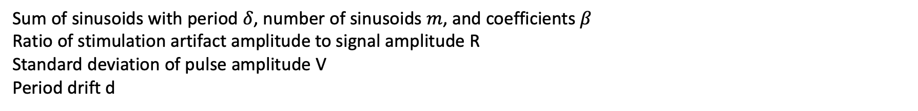
Harmonic Regression Model
$$f_{β,δ}=β_{1}+\sum_{j=1}^{m}{β_{2j}\sin\left(\frac{2πjt}{δ}\right)}+\sum_{j=1}^{m}{β_{2j+1}\cos\left(\frac{2πjt}{δ}\right)}$$
Sum of sinusoids with period $δ$, number of sinusoids $m$, and coefficients $β$
Ratio of stimulation artifact amplitude to signal amplitude R
Standard deviation of pulse amplitude V
Period drift d

Slide 14
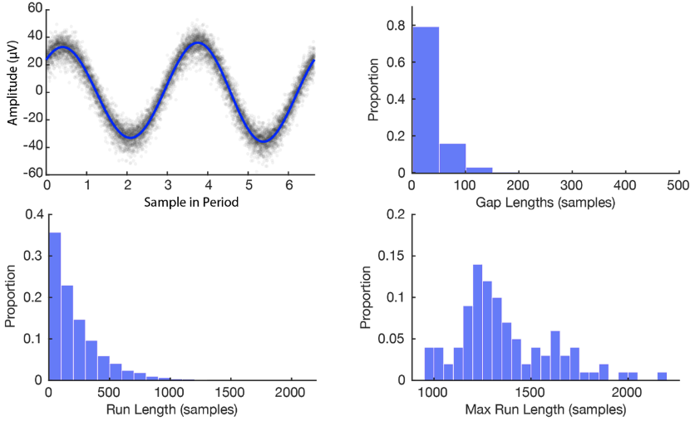
Simulation Features
Stimulation model is well fit to EEG data (1000 Hz sampling rate, 150.6 Hz stimulation frequency)
20% of data were randomly removed as 50 sample packets. Random removal was repeated 100 times.

Slide 15
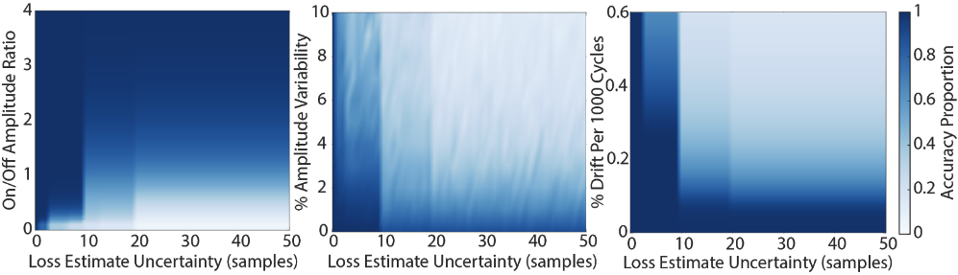
Validation Using Simulation
Ran a sweep of stimulation parameters as a function of uncertainty in the loss estimate (the range of difference from the estimate that were compared)
Discrete transitions occur at multiples of 3 since the period is 6.64000 samples and stimulation is bilateral
PELP is effective over a range of parameters but is most sensitive to amplitude variability

Slide 16
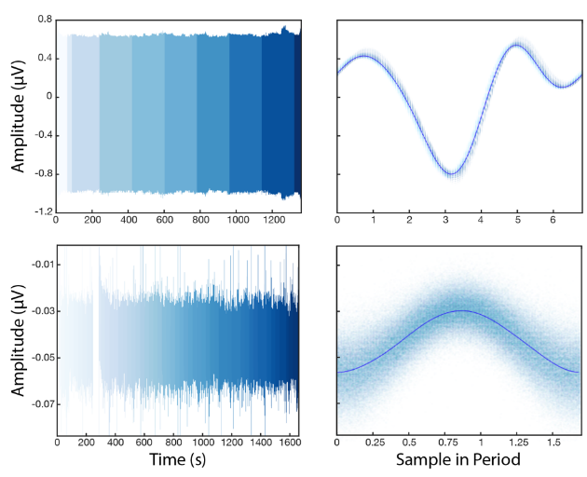
Validation Using RC+S Data
PELP was applied to data from the clinic sampled at 1000 Hz and data recorded in the patient’s home at 250 Hz during the same behavioral task
15 sets of missing samples in the clinic, 121 at home
Amplitude ratio of 27 in clinic and 1.1 at home
LFP samples are well consolidated about stimulation model indicating accurate estimation of losses

Slide 17
Packet Loss and Data Analysis
Standard approaches to filtering data, computing power spectral densities, and time frequency decomposition cannot be used for continuous recordings containing missing data
For stable recordings, packet losses can be ignored by looking at continuous runs individually and removing transient artifacts at boundaries
At home, packet losses are far more frequent and removing transients would lead to the rejection of most of the data

Slide 18
Analyzing Data with Losses
Two general approaches:
Loss interpolation
Mean fill
Linear/spline
AR models
Loss agnostic methods
Normalized convolution
Lomb-Scargle
Adaptive wavelet transforms
Method performance depends on presence of stimulation and accuracy of loss estimates

Slide 19
Evaluating Solutions
Use published EEG datasets with known signals of interest (ERPs, PSDs, ERSPs)
Simulate stimulation and packet losses (accurate and jittered)
Apply corrective method
Compare ability to resolve signal of interest to ground truth
Realistic noise conditions and true biological signals

Slide 20


Acknowledgements
Baylor
Psychiatry: Eric Storch PhD, Nithya Ramakrishan PhD, Greg Vogt, BS, Michelle Avendano-Ortega, BS, Andrew Weise, PhD
Neurosurgery: Sameer Sheth MD, PhD, Ashwin Viswanathan MD, Mike Beauchamp PhD, Meghan Robinson PhD
Neurology: Jay Gavvala, MD, Adriana Strutt PhD
Radiology: Gordon Xu, PhD
Medical Ethics: Gabe Lazaro JD, PhD, Amy McGuire JD, PhD;
Medtronic
Rob Raike PhD, Rene Molina PhD, Thaddeus Brink, PhD
Devices: PC/RC+S
NIH
Nick Langhals PhD, Kari Ashmont PhD, David McMullen MD, Mi Hillefors MD, PhD, Brooks Gross, PhD
NIH BRAIN Funding
UH3NS100549-01 Adaptive DBS in Non-Motor Neuropsychiatric Disorders: Regulating Limbic Circuit Imbalance
Brown Engineering
Dave Borton, PhD
Nicole Provenza, MS
Michael Frank, PhD
Matthew Harrison, PhD
Evan Dastin-van Rijn
University of Pittsburgh Psychology
Jeff Cohn, PhD
Yaohan Ding, PhD
Carnegie Mellon University
Laszlo Jeni, PhD
Itir Ertugrul, PhD
Notes:
Large and scientifically diverse team: psychiatry, psychology, neurosurgery, neurology, engineering, machine learning, medical ethics, neuroanatomy and imaging.

Slide 21
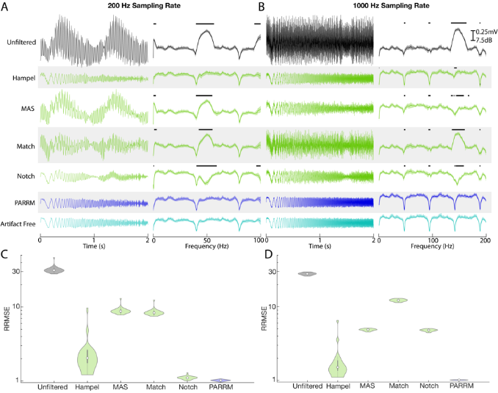
Validation of Method with Simulation

