Slide 1
Effects of Data Losses on Neural Time Series Analysis
Evan Dastin-van Rijn

Slide 2
OpenMind Approach to Loss Estimation
PacketGenTime (default)
Unavoidable time error distribution with a standard deviation of 30 ms
No accrued error over long timescales
System Tick
Millisecond accuracy on short timescales
Large accrued error over long timescales (~20 minutes)
How does the PacketGenTime timing error impact the recovery of averaged signals?

Slide 3
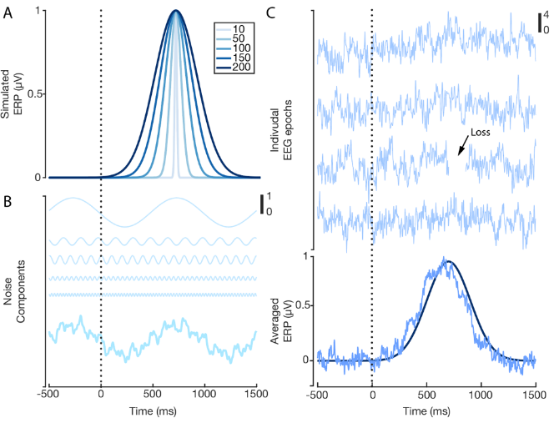
Simulation Set-up
Modeled ERPs as positive going Gaussian peaks of variable duration
Modeled neurological noise as a sum of sinusoids with random phase and 1/f distribution for amplitude
Concatenated 300 simulated trials of combined noise and ERP
Randomly added 30, 100 ms packet losses and estimated them for a range of timing errors (0-50 ms standard deviation)

Slide 4
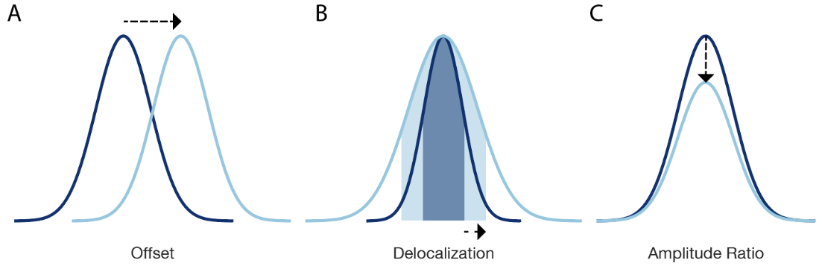
Measures of Interest
Additionally, simulated variable trial conditions by reducing amplitude by a factor of 0.75 for comparisons based on a t-test and Cohen’s d effect size

Slide 5
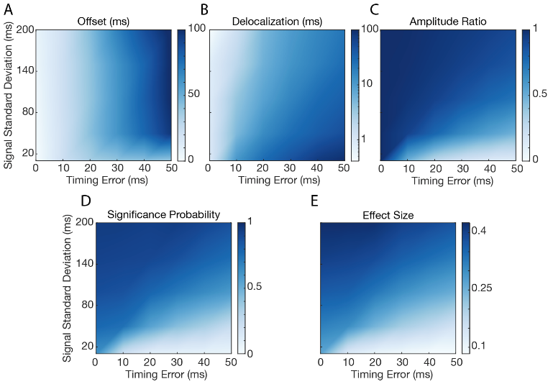
Simulation Results
1000 simulated experiments for each combination of offset and timing error
Metrics were averaged and displayed in each heatmap

Slide 6
Analyzing Time Series with Missing Data
Problem – cannot use standard filters, wavelet transforms, or FFTs when there are missing samples in a timeseries
Solutions
Analyze continuous segments, however, this is only possible if losses are infrequent
Use loss agnostic methods, however, they are slow and non-standard
Impute missing data, however, this may introduce artifacts at the loss and in the window affected by the loss

Slide 7
Loss Imputation
Simulation set-up
Randomly insert 50 sample losses to remove a set percentage of the data
Apply one of four straightforward imputation methods
Estimate effect on a ground truth signal for DBS off, DBS on, and PARRM-filtered DBS on

Slide 8
Simulation Dataset
ERP and ERSP data from an online EEG recording during a cognitive control task were used
28 healthy participants
Time domain data was low-pass filtered at 20 Hz prior to ERP computation
ERSP was computed via a continuous wavelet transform
Correct and error trials were significantly different at the group level

Slide 9
Time Domain Correlations
Raw R² correlation in time domain for different sample types
Losses-removed samples that were imputed
Filtered-samples in the same low-pass filter window as a loss
ERP-samples within the window of interest for the ERP

Slide 10
Time Domain Hypothesis Testing
Top-row – plot of ERP p-value for each simulated loss experiment for 5% data loss against the original p-value for the participant. ⍺=0.05 shown by dotted line. Lines are fit for each imputation approach
Middle-row – proportion of simulated experiments that were non-significant but the original data were significant for each loss percentage
Bottom-row – slope of fit line for each loss percentage

Slide 11
Frequency Domain Correlations
Raw R² correlation in time domain for different sample types
Losses-removed samples that were imputed
Filtered-samples in the same wavelet convolution window as a loss
Results are shown across frequencies and for two loss percentages
ERSP-samples within the window of interest for the ERSP

Slide 12
Frequency Domain Hypothesis Testing
Top-row – plot of ERP p-value for each simulated loss experiment for 5% data loss against the original p-value for the participant. ⍺=0.05 shown by dotted line. Lines are fit for each imputation approach
Middle-row – proportion of simulated experiments that were non-significant but the original data were significant for each loss percentage
Bottom-row – slope of fit line for each loss percentage

Slide 13
Cognitive Control Results with RC+S
Linear interpolation used to impute losses and applied to DBS off data (top) and PARRM-filtered DBS on data (bottom)
Significant differences in the difference spectrogram are highlighted

Slide 14


Acknowledgements
Baylor
Psychiatry: Eric Storch PhD, Nithya Ramakrishan PhD, Greg Vogt, BS, Michelle Avendano-Ortega, BS, Andrew Weise, PhD
Neurosurgery: Sameer Sheth MD, PhD, Ashwin Viswanathan MD, Mike Beauchamp PhD, Meghan Robinson PhD
Neurology: Jay Gavvala, MD, Adriana Strutt PhD
Radiology: Gordon Xu, PhD
Medical Ethics: Gabe Lazaro JD, PhD, Amy McGuire JD, PhD;
Medtronic
Rob Raike PhD, Rene Molina PhD, Thaddeus Brink, PhD
Devices: PC/RC+S
NIH
Nick Langhals PhD, Kari Ashmont PhD, David McMullen MD, Mi Hillefors MD, PhD, Brooks Gross, PhD
NIH BRAIN Funding
UH3NS100549-01 Adaptive DBS in Non-Motor Neuropsychiatric Disorders: Regulating Limbic Circuit Imbalance
Brown Engineering
Dave Borton, PhD
Nicole Provenza, MS
Michael Frank, PhD
Matthew Harrison, PhD
University of Pittsburgh Psychology
Jeff Cohn, PhD
Yaohan Ding, PhD
Carnegie Mellon University
Laszlo Jeni, PhD
Itir Ertugrul, PhD
Notes:
Large and scientifically diverse team: psychiatry, psychology, neurosurgery, neurology, engineering, machine learning, medical ethics, neuroanatomy and imaging.

