Slide 1
Rajat & Theo Simple
C++ Applications

Slide 2
SML Compiler
Machine Reads Number in form XXYY
XX = Command Name
YY = Location / Value
XX
10 – Read value into YY from keyboard
11 – Write value in YY onto monitor
20 – Load value in YY into accumulator
21 – Store accumulator into YY
22 – Store number YY into accumulator
23 – Add number YY * 100 into accumulator
30 – Add value in YY to accumulator
31 – Subtract value in YY from accumulator
32 – Divide value in YY from accumulator
33 – Multiply value in YY by accumulator
40 – Branch to YY
41 – Branch to YY if accumulator is negative
42 – Branch to YY if accumulator is zero
43 – Branch to YY if accumulator is positive
44 - Halt
10 99
XX
YY

Slide 3
Simple Language
Keyword | Definition | Example
rem | Comment | 10_rem_This is a comment
input | Enter number into variable | 20_input_x
print | Print variable to screen | 30_print_x
goto | Go to line number | 40_goto_50
if | Compare two numbers | 50_if_x|+|5_<_x|*|x_goto_70
let | Initialize variable | 60_let_y_=_30|*|x
end | End Program | 70_end

Slide 4
Simple Language – pass One
Variable Name | Location
w | 99
x | 98
y | 97
z | 96
temp | 95
symIndex – starts at 0 and incremented when a new command is put in
valueIndex – starts at 99 and decrements whenever a new variable is put in
Command | Example
input | 10_input_w 20_input_x
let | 30_let_y_=_x|*|5|+|w 40_let_z_=_y|/|x 50_let_temp_=_x

Slide 5
Simple Language – Pass two
Compiler Location
rem += 0
Expression:
Number += 3
Variable += 2
Operation += 3
Comparison:
“<“, “>”, or “==“
+=3
“<=“, “>=“, or “!=“
+= 4
Else:
input, print, goto, end += 1
Line Number | Command | Simple Location | Compiler Location
10 | rem | 0 | 0
20 | input | 1 | 0
30 | print | 2 | 1
40 | let | 3 | 2
50 | print | 4 | 7
60 | if | 5 | 8
70 | end | 6 | 27

Slide 6
Simple Language – Pass Three
Loops through the entire simple language file and writes the corresponding SML code into the output file
Switch statement handles cases based on commands (if, goto, let, etc.)
Simple Language Commands | Corresponding SML Code
input | Read
goto | Branch
print | Write
let | Operation commands
if | Subtraction then branch

Slide 7
Postfix – if and let Statements
Two passes through expression to make new string
1st Pass: Deals with multiplication and division since these operators have precedence
2nd Pass = Deals with addition and subtraction
Parentheses are handled with recursion
Must input the expression using | as delimiters between constants and operators
Ex. 2|*| ( | y | + | 2 | )

Slide 8
Error Checking
Errors handled:
Invalid file name or file not found
Invalid operators in expressions
Using uninitialized variables in if or let statements
SML memory is overflowed (over 100 lines)
Using invalid commands

Slide 9
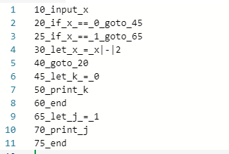
Example program – Even.txt

Slide 10
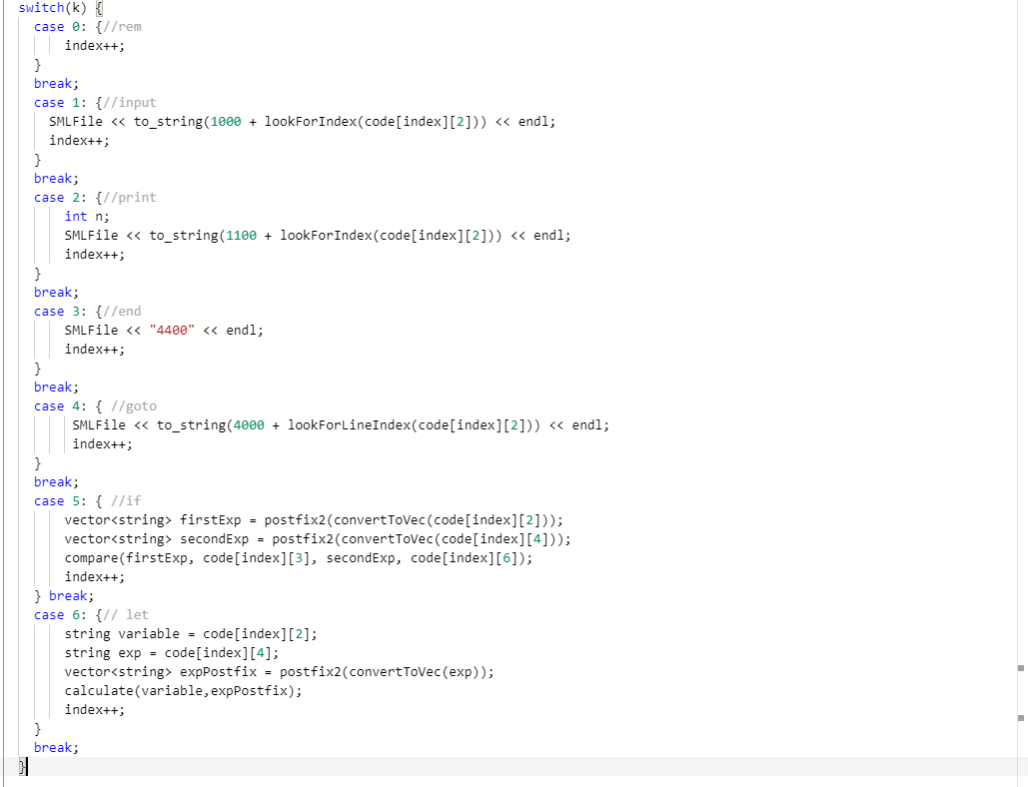
Conclusion
We accomplished our goal of creating a simple language compiler
Overall, the changes we made to the conventional language include:
New commands (branch positive, storing numbers into accumulator)
Separating words using _ and expressions using | as delimiters
Many different error types are handled

