Slide 1
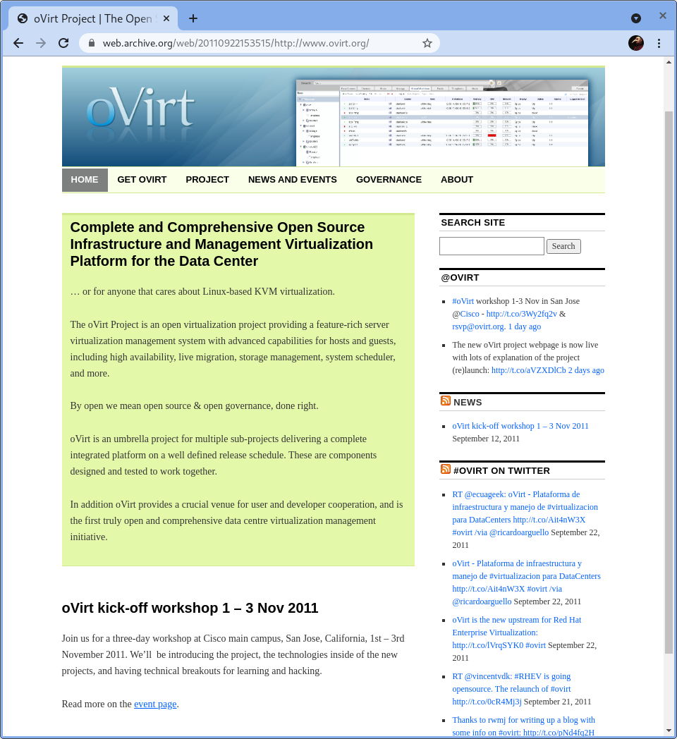
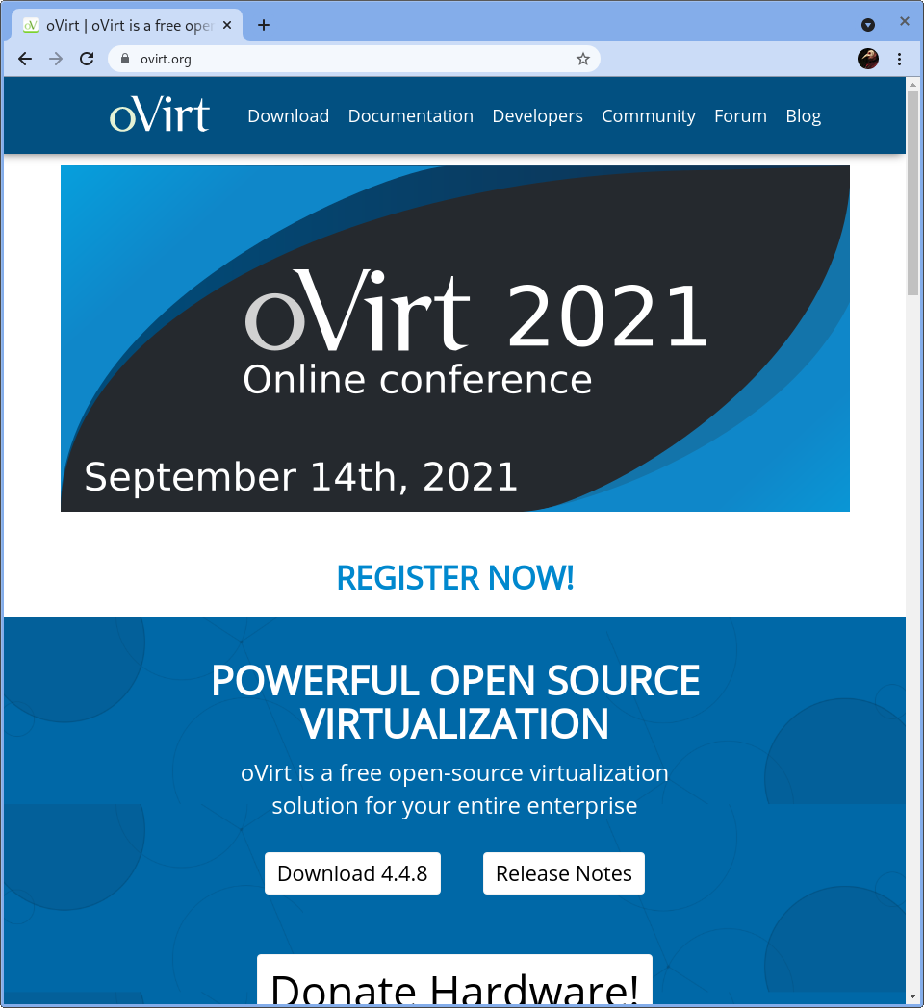
oVirt—Ten years of open source
Reflections from a Community Architect
Karsten Wade, Senior Community Architect
oVirt 2021 Online conference, 14 Sep 2021
Notes:
Hi, I’m Karsten or you may know me as ‘quaid’, one of the community architects who worked on open sourcing this project, and I’d like to take you on a short journey through ten years of open source principles at work through my lens of working with the oVirt project.

Slide 2
Notes:
Let’s take a moment and look at the difference of ten years.
We’ve progressed a bit in how we present the project, in how we work to attract users.
Both of these pages represent best practices of the time.
In 2011, the focus was on news, lots of words, and active social media all above the fold. The Workshop is below the fold, not very prominent for such an important thing. The download button is small and on the menubar.
In 2021, other calls to actions are in the center. This conference here is top of the fold, a large Download area and an even larger (looking) Donate Hardware area are below.
Oh, and we’ve returned to blue as the main color.

Slide 3
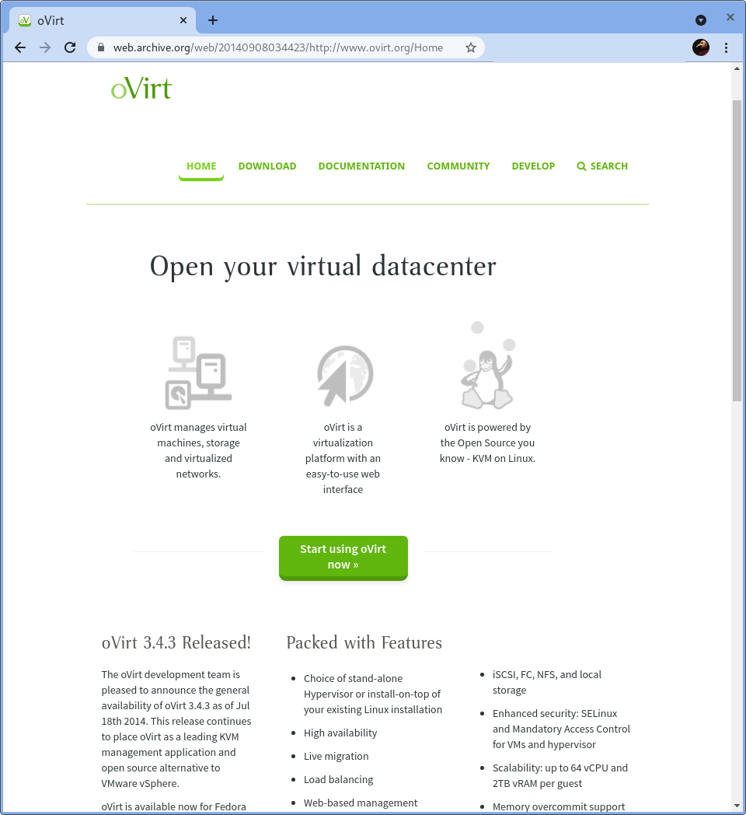
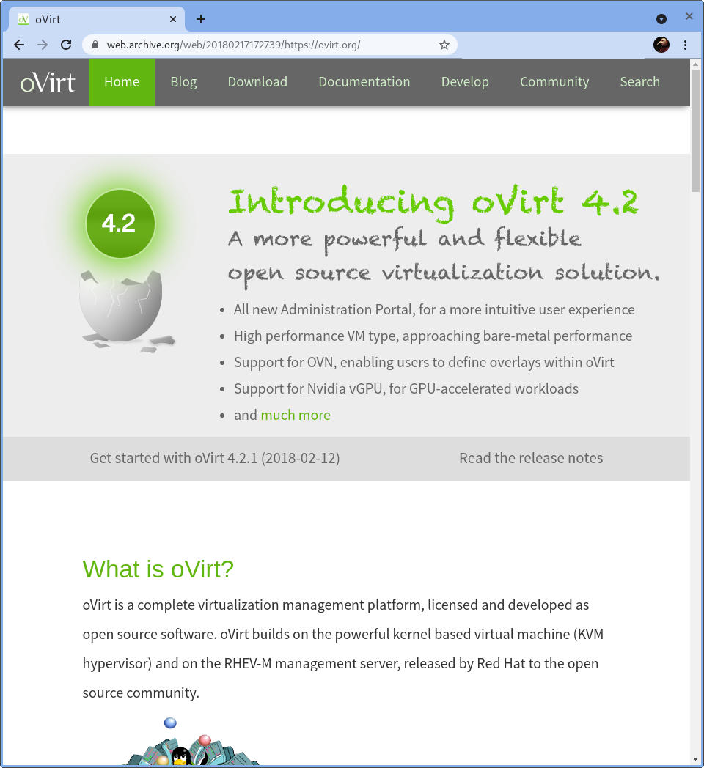
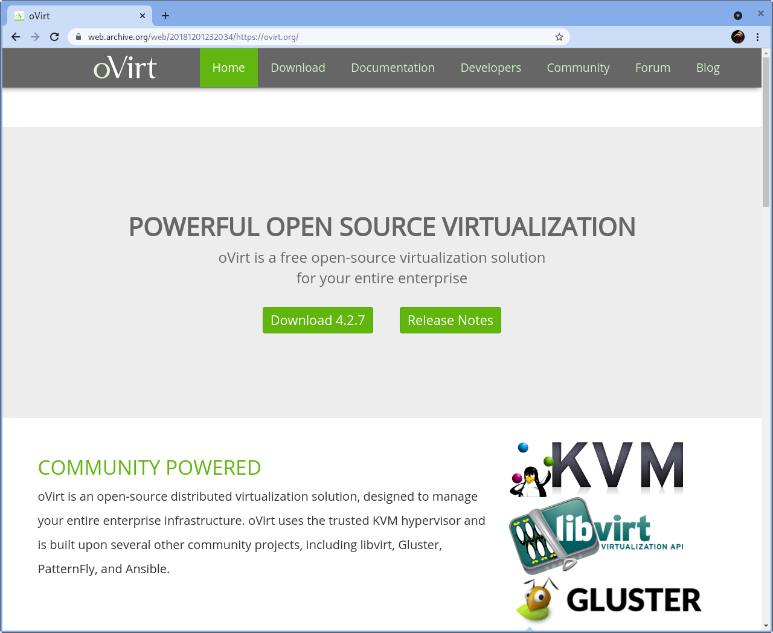
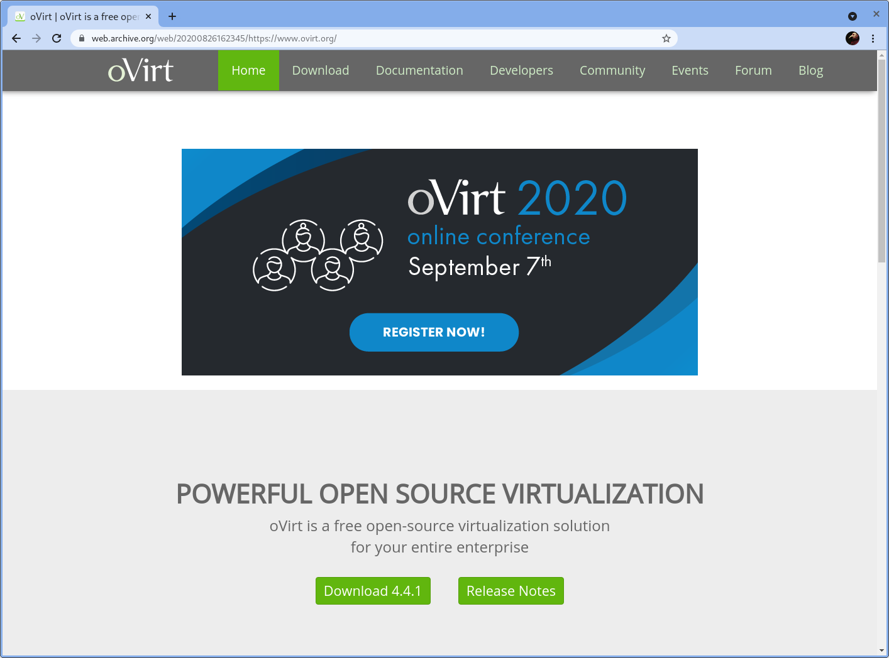
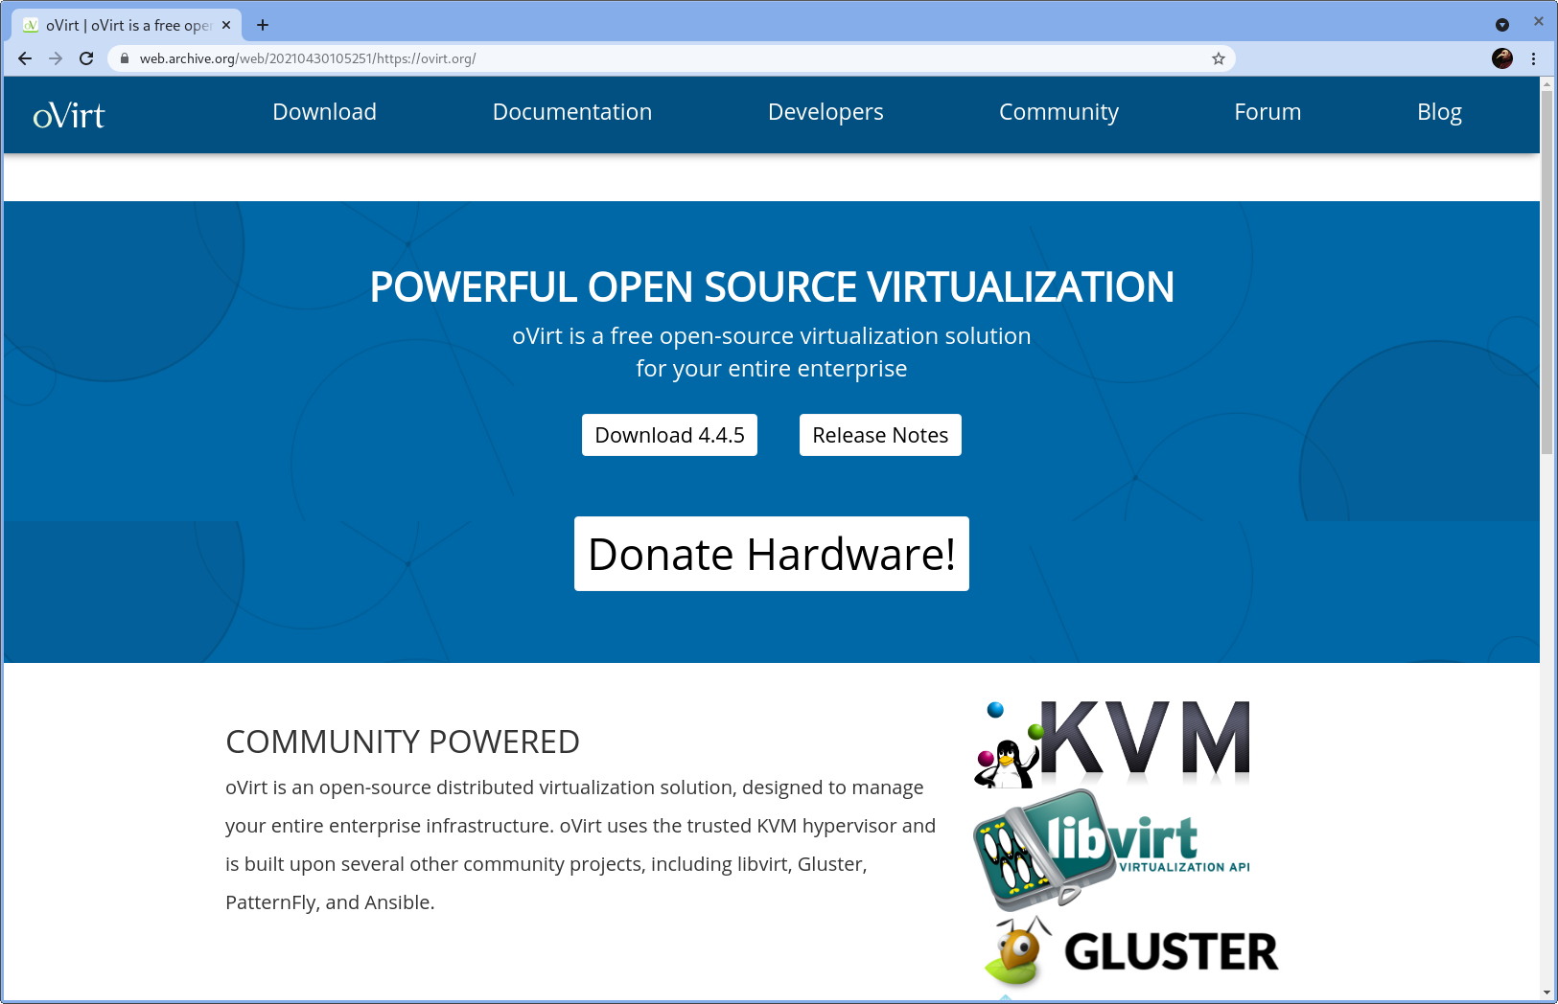
Notes:
So yes, since we’re looking, let’s see what happened during the green years.
[Click through all five images]
Lots of movement around the calls to action in different locations. Always some way to download the latest code. Different tooling but similar look and feel. And the latest brings us back to blue.

Slide 4
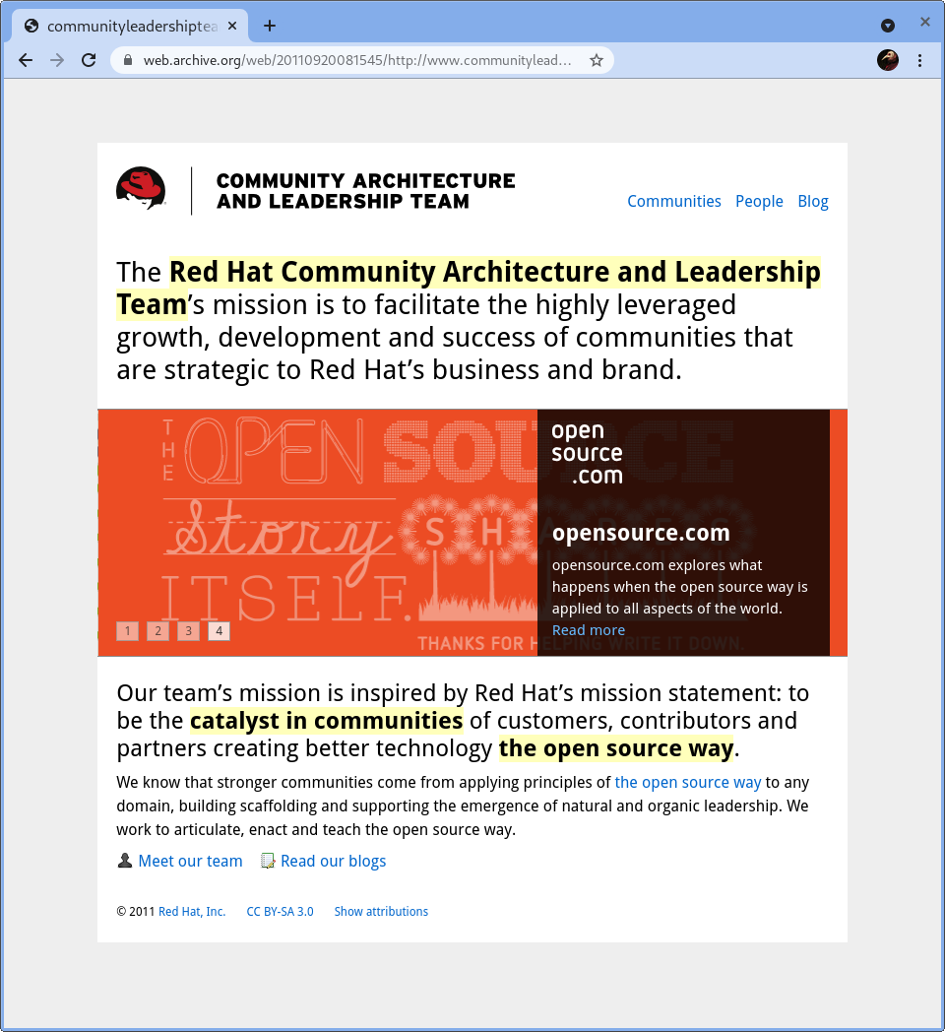
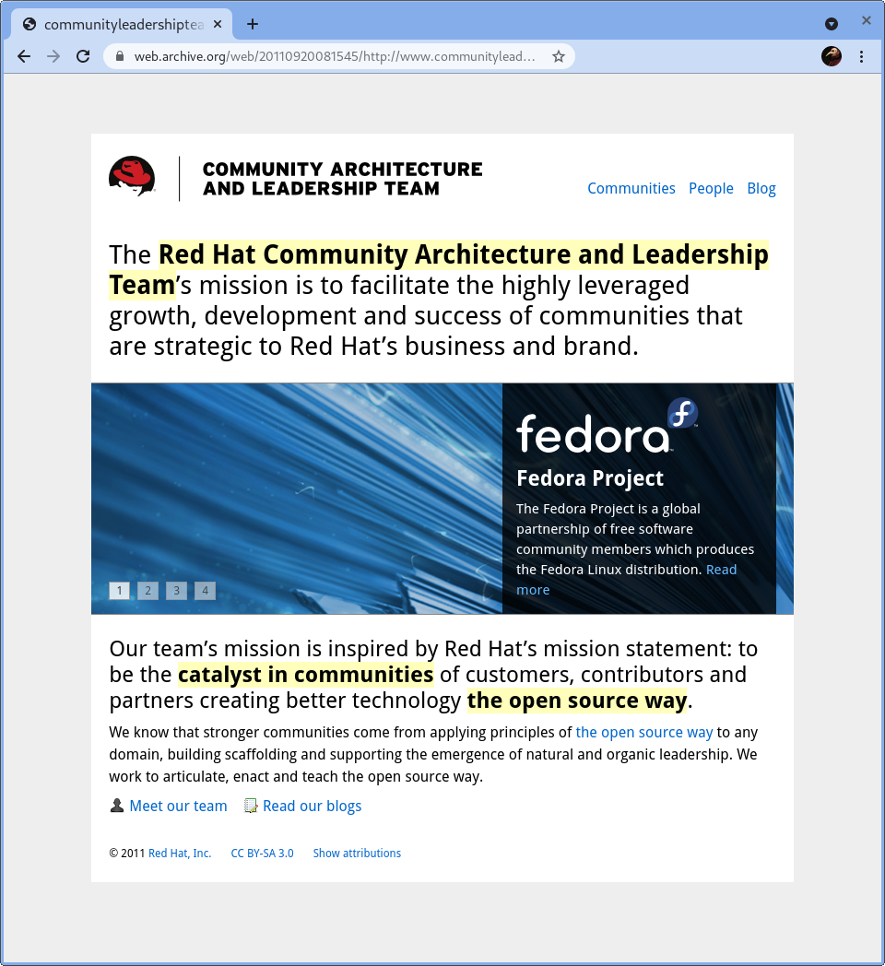
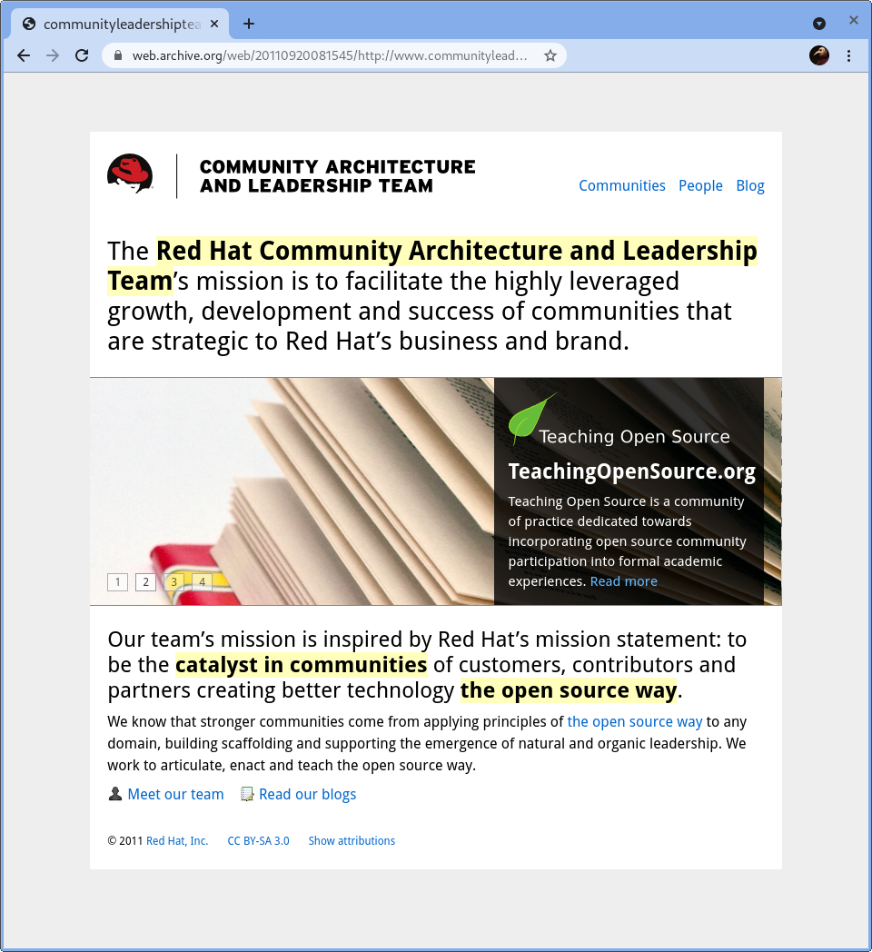
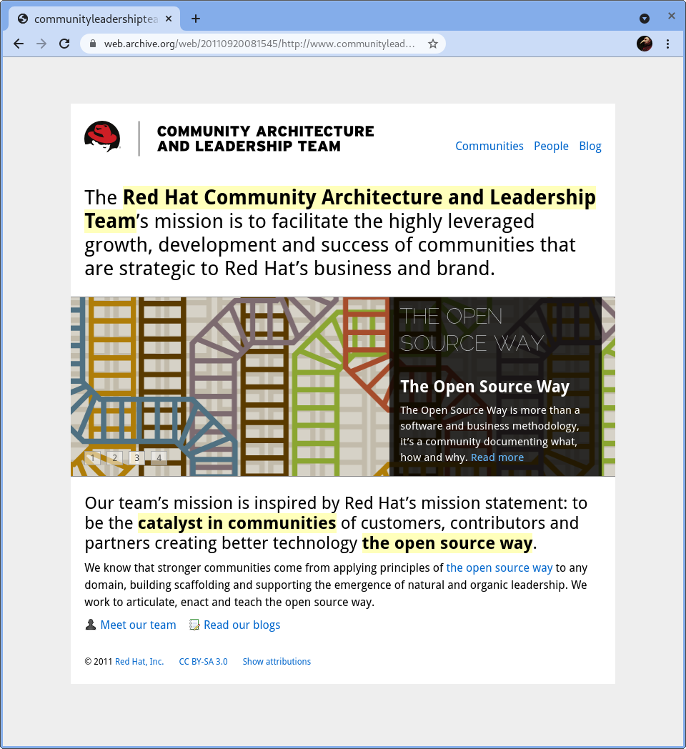
Notes:
Now what was happening in 2011 that got me involved in this project?
I was working for this team, the Community Architecture and Leadership Team, and we had our roots in the Fedora Project, including myself. We also worked on other efforts like [CLICK] Teaching Open Source and [CLICK] OpenSource.com.
What I did for this team [CLICK] included leading the efforts to capture community management best practices as we knew them best, get them into a handbook, and work to get other people to read the book, use the book, and contribute to the book.
One day we were at a team multi-day offsite meeting, with a few extended team members including Robyn Bergeron, and we got a call from Carl Trieloff asking if we wanted to help with the open sourcing of oVirt.

Slide 5
Applying the principles
Started with the workshop in Nov 2011, put together by Robyn and myself.
Infrastructure of participation around the existing developers and leaders:
  Mailing lists
  Websites
  Blogs
  Version control
  Etc.
By the end of 2012 our involvement tapered off
But we learned a lot about the use and evolution of the principles of the open source way
Notes:
The oVirt project offered a full hands-on opportunity to apply the principles of the Open Source Way guidebook, to measure their success, and improve them. Or to learn how they had to adapt and change for different projects. But to really try them out again across an entire project, not just piecemeal or suggestions, was a great opportunity.
So I got started with Robyn Bergeron (of Fedora and Ansible fame), and we co-lead as Community Architects for the open sourcing of the codebase. This including providing infrastructure of participation such as version control, websites, mailing lists, blogs, news, and social media. This included finding speaking opportunities for other contributors, and standing in front of audiences ourselves.
Robyn and I tapered off our involvement, myself through near the end of 2012. I continued to be involved with the infrastructure team for a few years after that, because it’s hard when there are a few keys only you know how to turn.
Not-so fun fact: for the first three+ years of the project, we had several services running on a Linode instance, back when they only had Xen for VMs.
So that is a good segue into the few things I want to talk about today, around the principles of the open source way. How sometimes you have to make a decision that moves you forward, such as using an open source solution but not YOUR open source solution because of whatever details were true at that time and then became A Running System back before we had the idea those needn’t be so fragile and hard to replace.

Slide 6
Three example principles
Governance and self-direction
Creating value from the codebase
Your contribution, your CV
Notes:
In these three areas I’m going to see how we approached things ten years ago, and compare that to where we are today for the oVirt project and for the evolution of the underlying principles along the jo

Slide 7
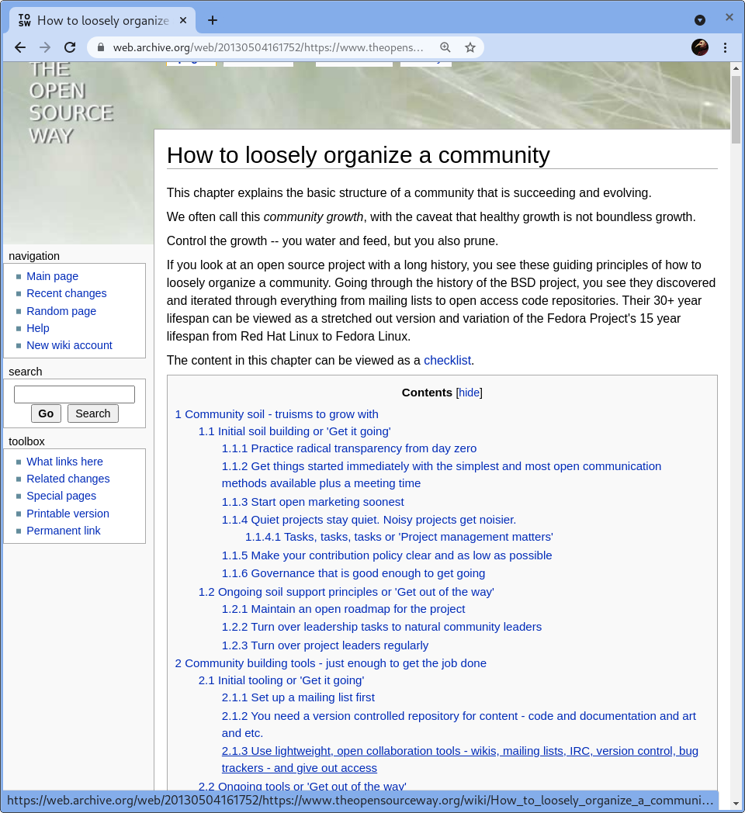
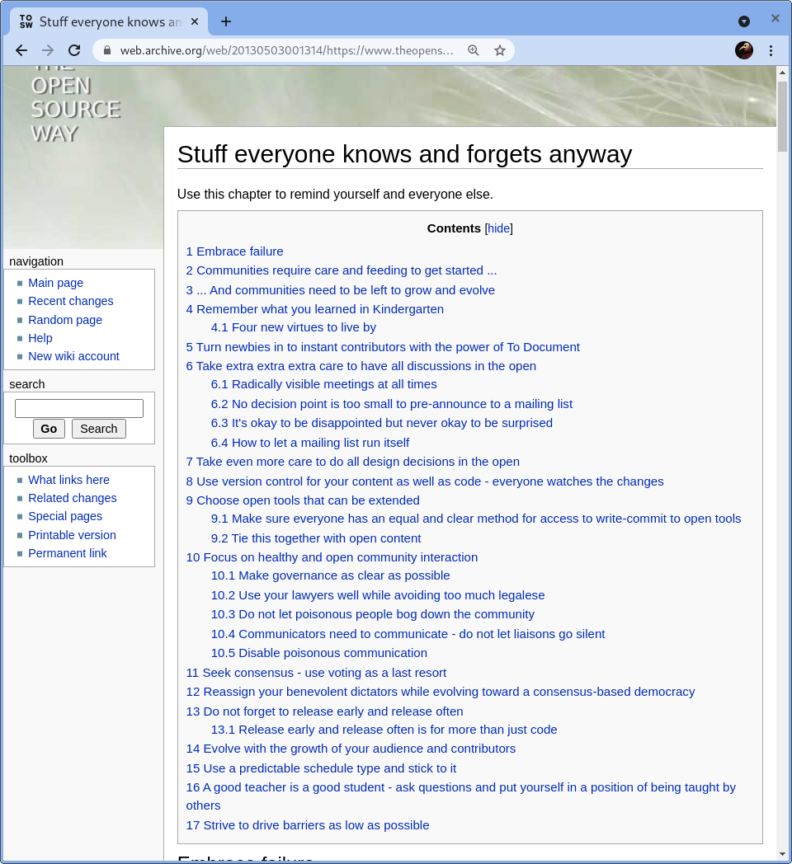
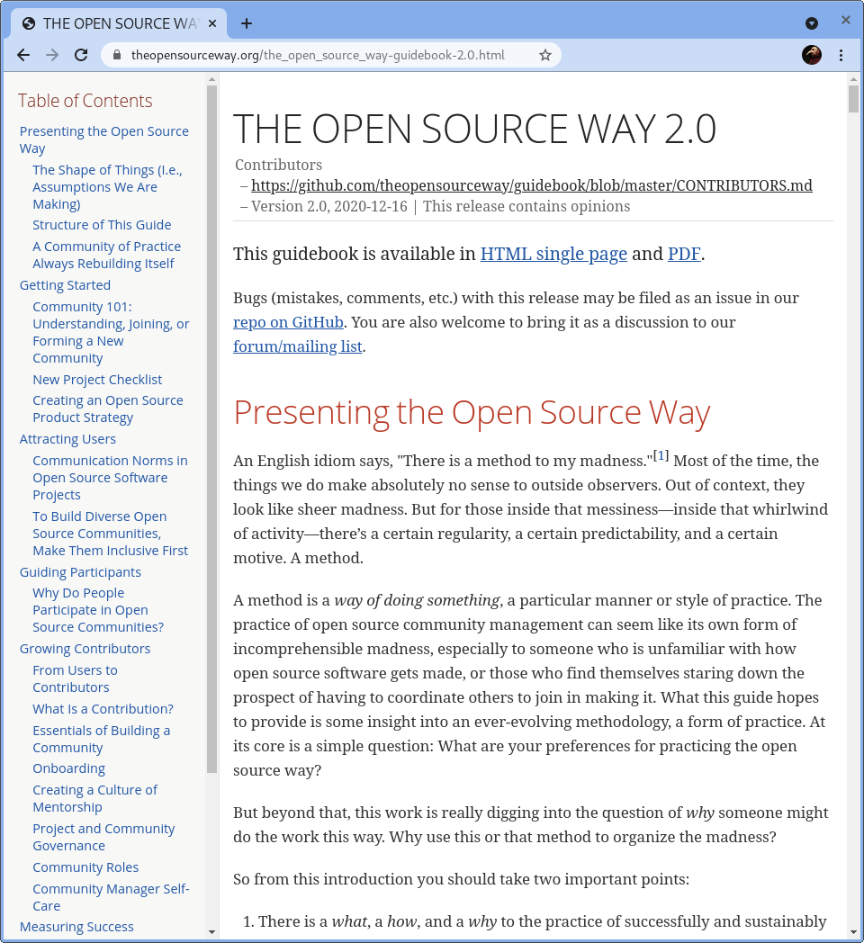
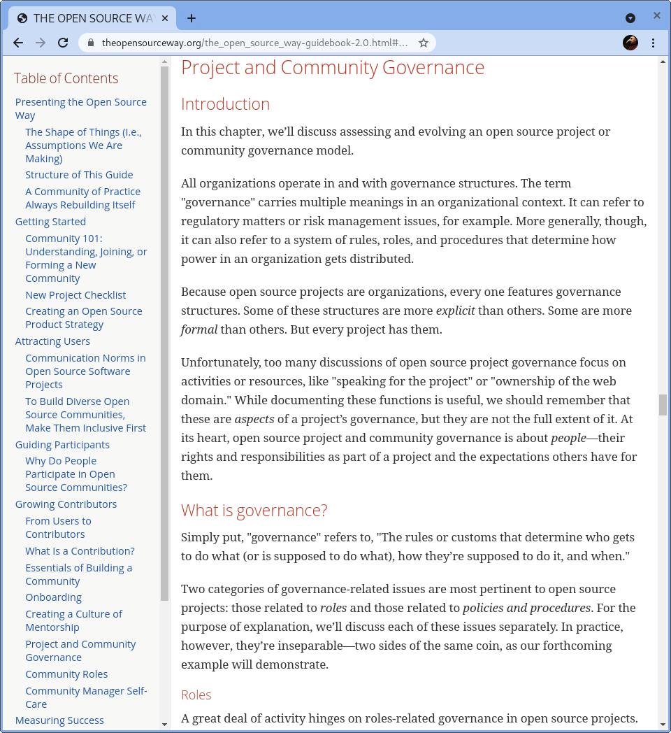
Governance principles
We adopted recent models e.g. from OpenStack
We applied the open source way principles
Now more robust guidance for governance and similar principles
Notes:
Topics:
governance and self-directing a project
we used a new governance model similar to the recent OpenStack model
we applied the principles across the board, as we understood them
today we understand a lot more and have a lot of approaches [OSW page]
[CLICK principles 2]
we now recommend a high-degree of self-governance with well documented procedures, codes of conduct, and so forth.
https://www.theopensourceway.org/the_open_source_way-guidebook-2.0.html#_project_and_community_governance

Slide 8
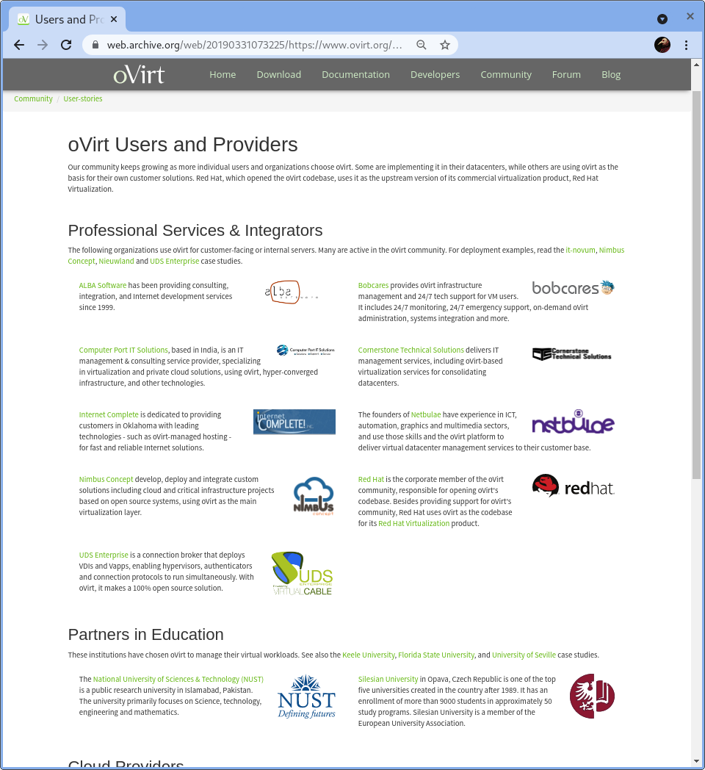
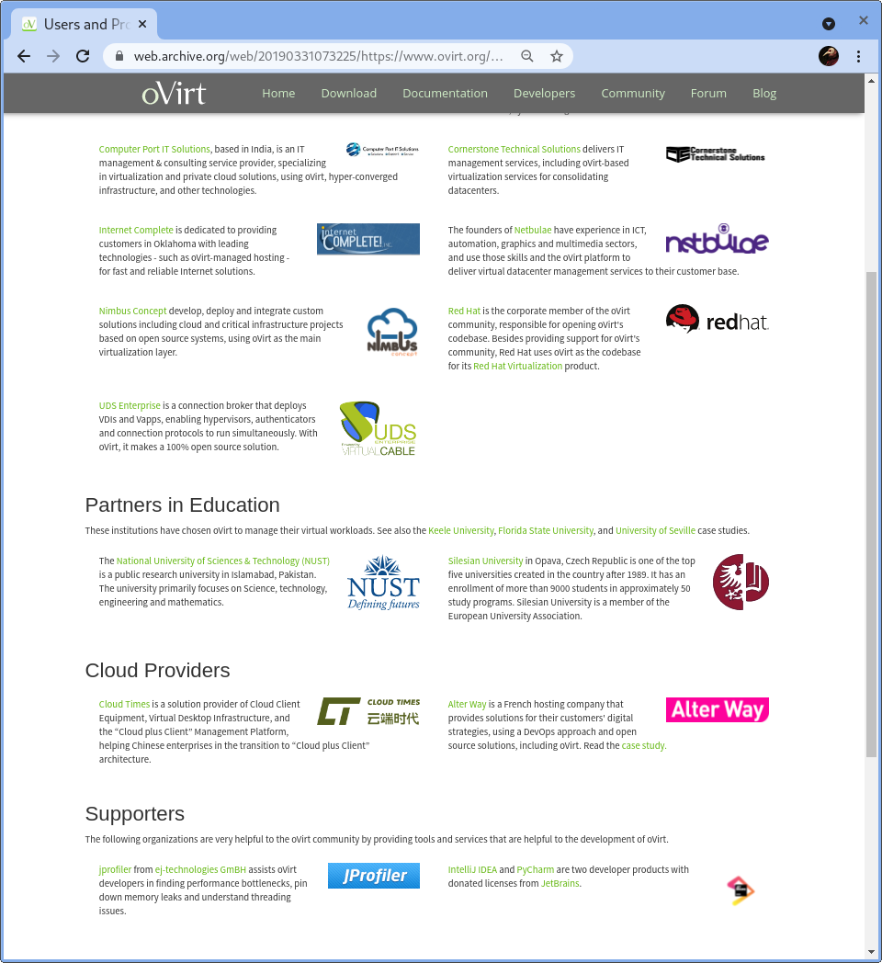
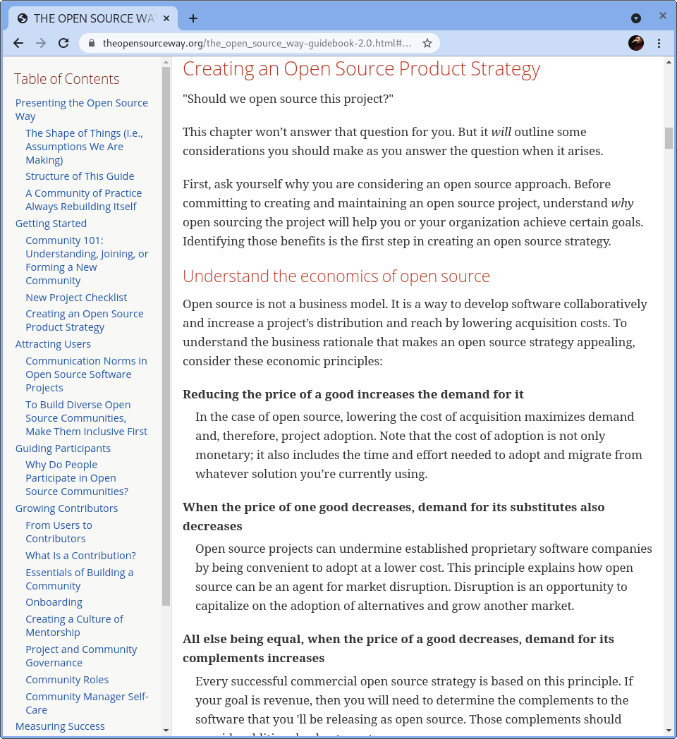
Creating value
Creating value in many ways: products, managed services, integrated solutions, research, etc.
From the general idea then, now we have processes
Notes:
Topics:
always wanting to have other people able to make products too
It was always an important idea, this ability to create value out of the codebase in many ways—products, managed services, integrated solutions, research, and so on.
back then it was an idea that we were enabling this to happen, now we have processes and checklists [OSW page]
https://www.theopensourceway.org/the_open_source_way-guidebook-2.0.html#_creating_an_open_source_product_strategy

Slide 9
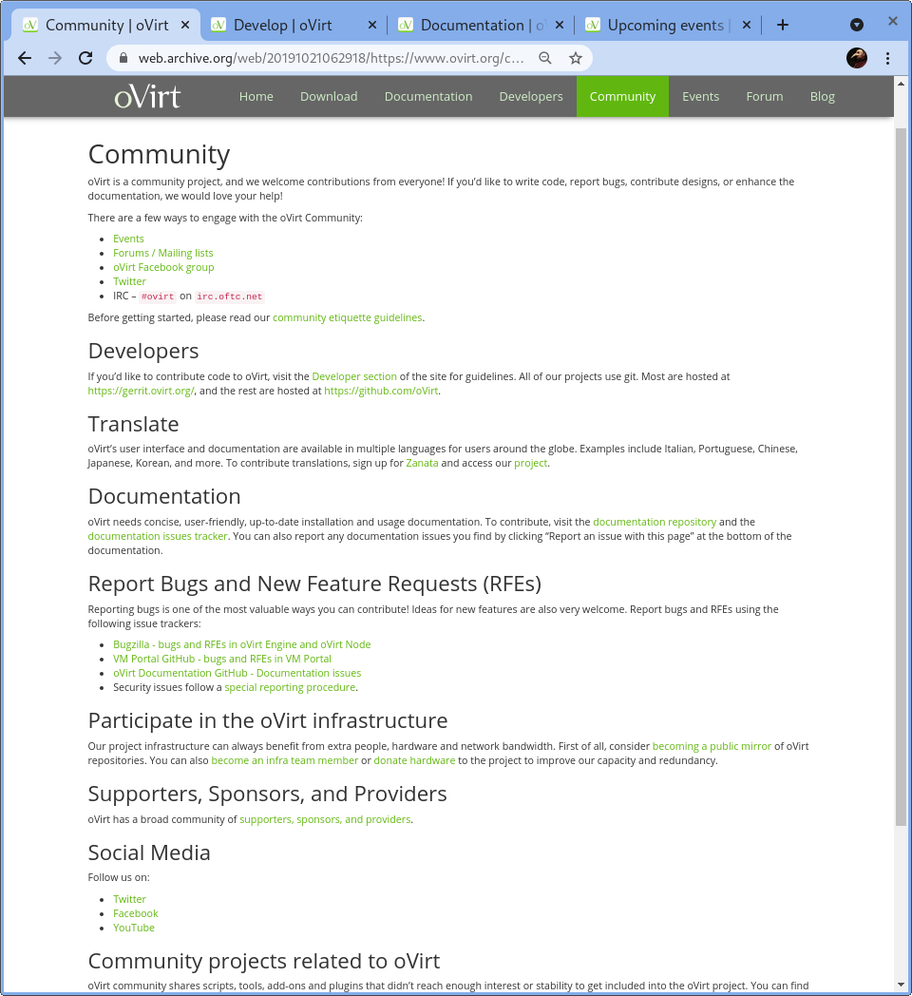
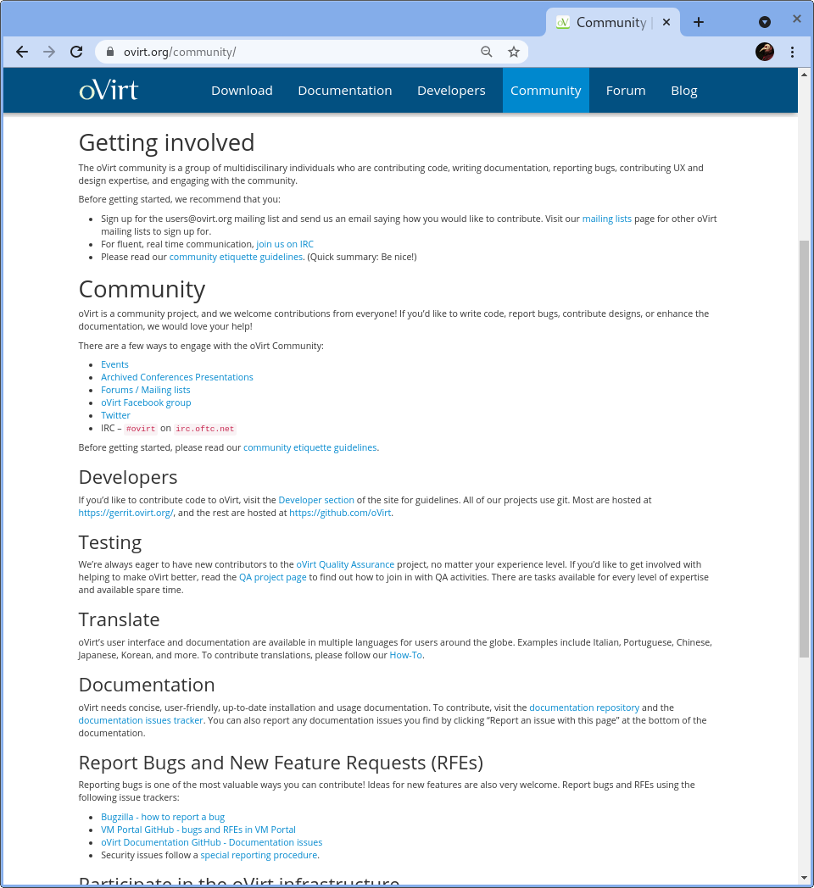
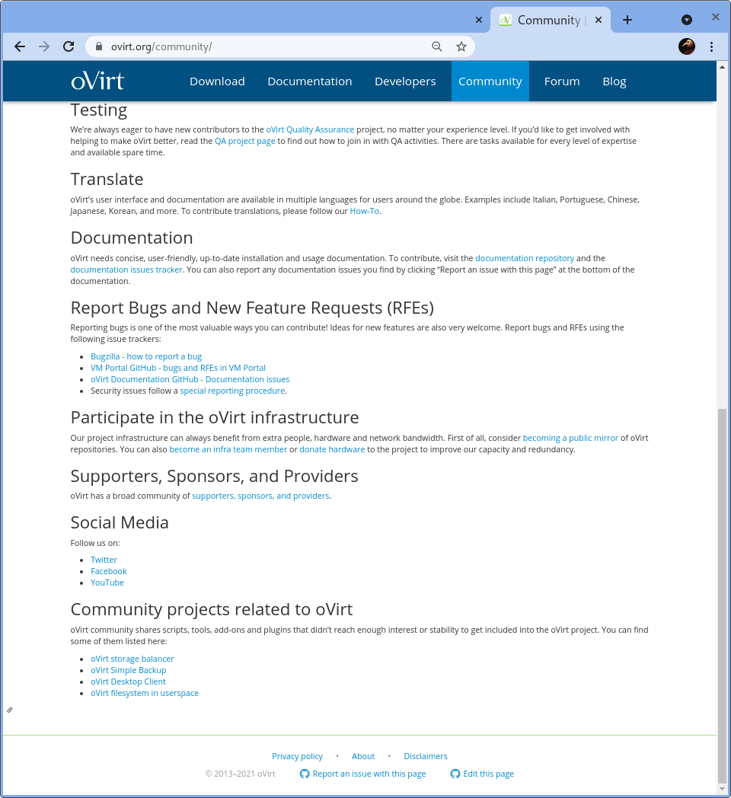
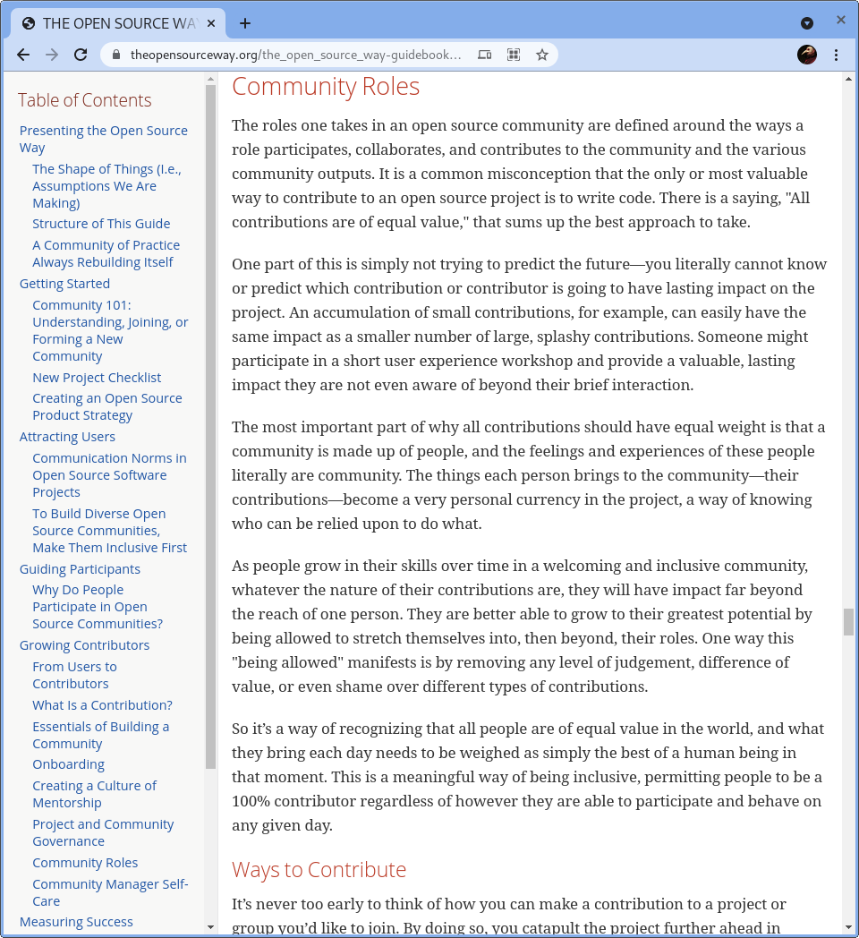
Valuing all contributions
oVirt clearly works to showcase and value contributions of all types
  Docs, social media, design, UX, etc.
It is useful to attract contributors around their career interests
Notes:
Topics:
oVirt is another project that really worked to showcase and value contributions of all kinds. This was another important tenet that we saw into place from the start, a key of turning users into contributors.
the documentation, social media activity, project design, all have showcased the range of areas of contribution [click, click]
As a current way of looking at this concept, we have some content here on how to attract contributors around their career interests and how to improve those in a project. [click]
with open source, more people than developers can carry their project as part of their CV
https://www.theopensourceway.org/the_open_source_way-guidebook-2.0.html#_community_roles

Slide 10
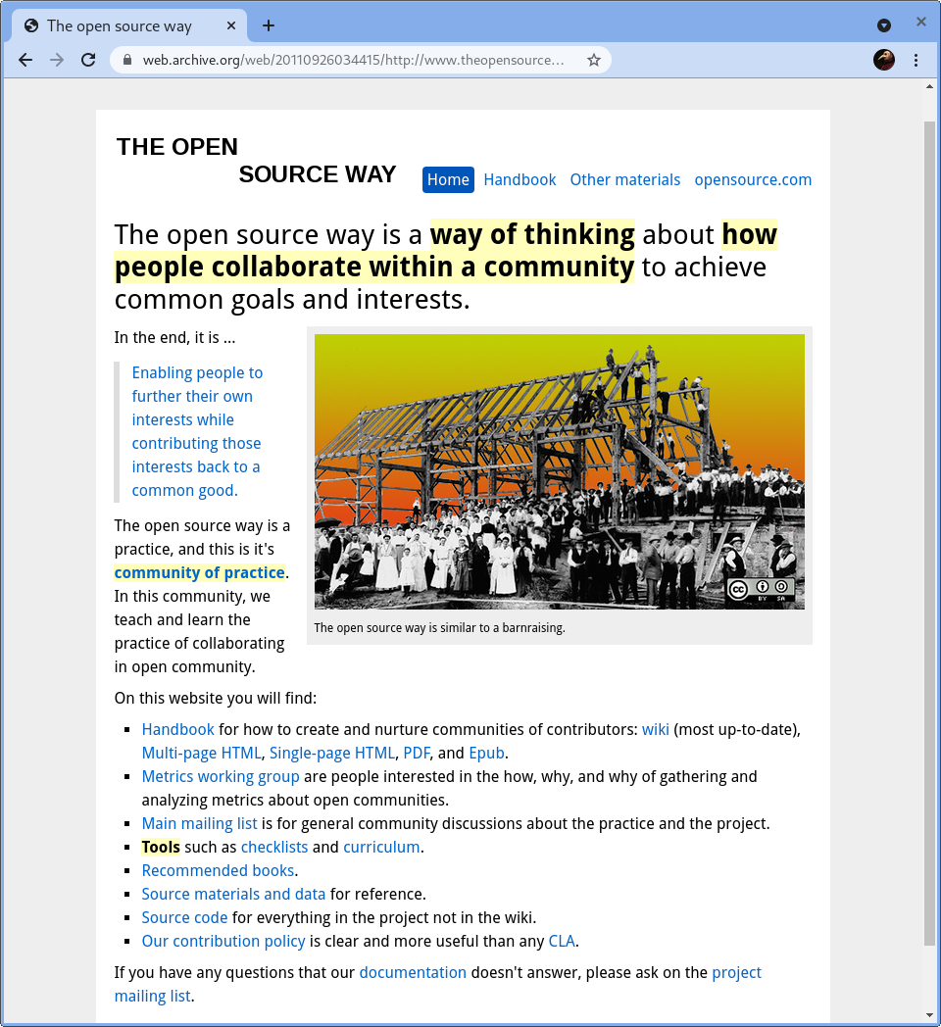
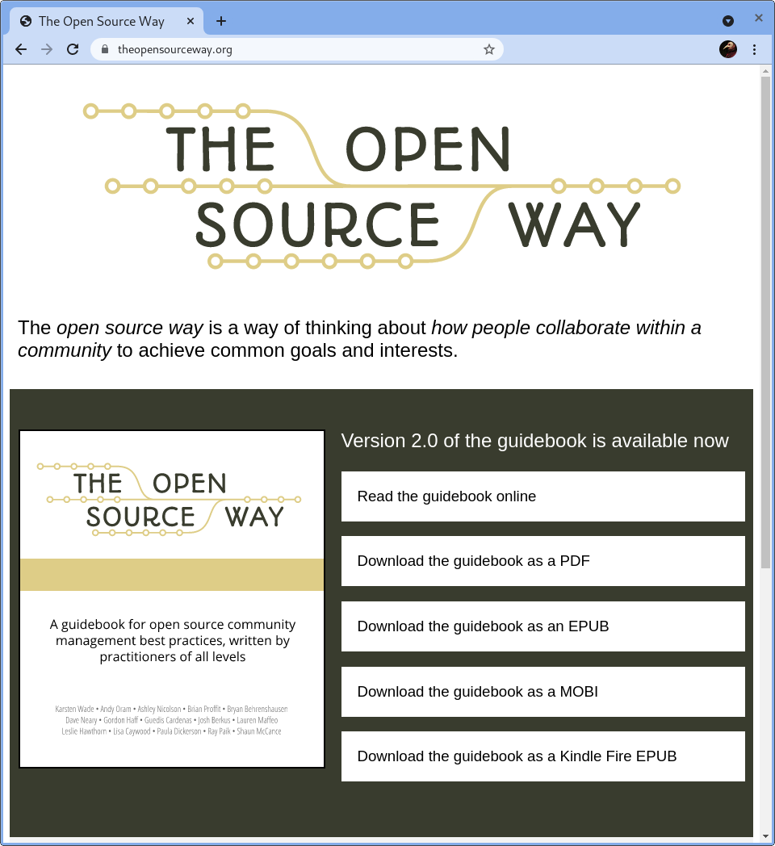
https://theOpenSourceWay.org
https://www.theopensourceway.org/presentations/oVirt-A_decade_of_open_source.odp.
CC BY SA 4.0
Notes:
Ten years ago and today.

Slide 11
oVirt—Ten years of open source
Reflections from a Community Architect
https://theopensourceway.org … @quaid
Notes:
Thanks for walking down memory lane with me today.
If you want to read more about the Open Source Way, you can find the guidebook in all its formats at theopensourceway.org.
You can also find information on contributing, how the book is written (AsciiDoc and a git-based workflow), and more on that same website.
You can find me on twitter and other places as @quaid.

