Slide 1
Chess in 200 lines
“As long as our hypothetical Blub programmer is looking down the power continuum, he knows he's looking down. Languages less powerful than Blub are obviously less powerful, because they're missing some feature he's used to. But when our hypothetical Blub programmer looks in the other direction, up the power continuum, he doesn't realize he's looking up. What he sees are merely weird languages. He probably considers them about equivalent in power to Blub, but with all this other hairy stuff thrown in as well. Blub is good enough for him, because he thinks in Blub.”
From the essay “Beating the Averages” by Paul Graham
(Startup Millionaire, co-Founder of YCombinator)
October 16th, 2017

Slide 2



Motivation: Power Continuum
higher lower
„Declarative“: What!
Easy for humans
Semantic Gap
„Procedural“: How!
Easy for machines

Slide 3
What does process do?
void swap(int *a, int *b)
{
int tmp = *a;
*a = *b;
*b = tmp;
}
void process(int *begin, int *end)
{
int *ptr;
int *split;
if (end - begin <= 1)
return;
ptr = begin;
split = begin + 1;
while (++ptr <= end) {
if (*ptr < *begin) {
swap(ptr, split);
++split;
}
}
swap(begin, split - 1);
process(begin, split - 1);
process(split, end);
}

Slide 4
What does process2 do?
process2 [] = []
process2 (first:rest) = let smaller = filter (<= first) rest
bigger = filter (> first) rest
in
process2 smaller ++ [first] ++ process2 bigger

Slide 5
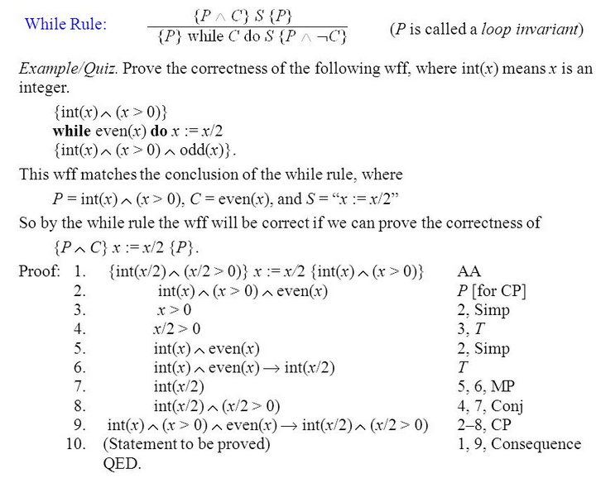
How to prove the functionality?
void swap(int *a, int *b)
{
int tmp = *a;
*a = *b;
*b = tmp;
}
void process(int *begin, int *end)
{
int *ptr;
int *split;
if (end - begin <= 1)
return;
ptr = begin;
split = begin + 1;
while (++ptr <= end) {
if (*ptr < *begin) {
swap(ptr, split);
++split;
}
}
swap(begin, split - 1);
process(begin, split - 1);
process(split, end);
}
Hoare Calculus:

Slide 6
How to prove the functionality?
process2 [] = []
process2 (first:rest) = let smaller = filter (<= first) rest
bigger = filter (> first) rest
in
process2 smaller ++ [first] ++ process2 bigger
<=
<

Slide 7
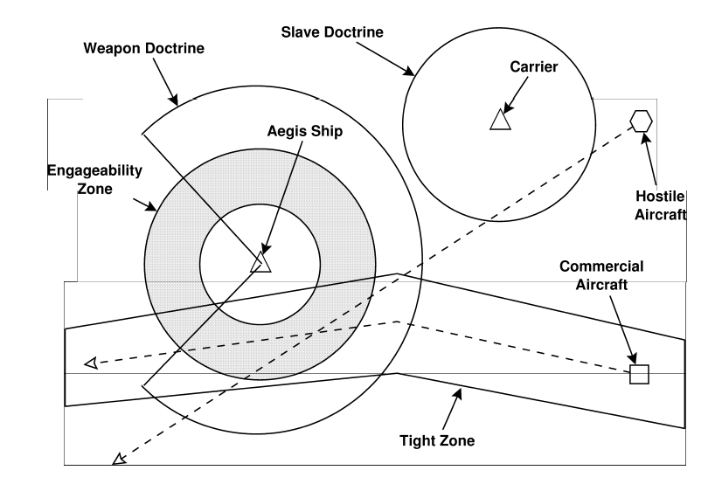
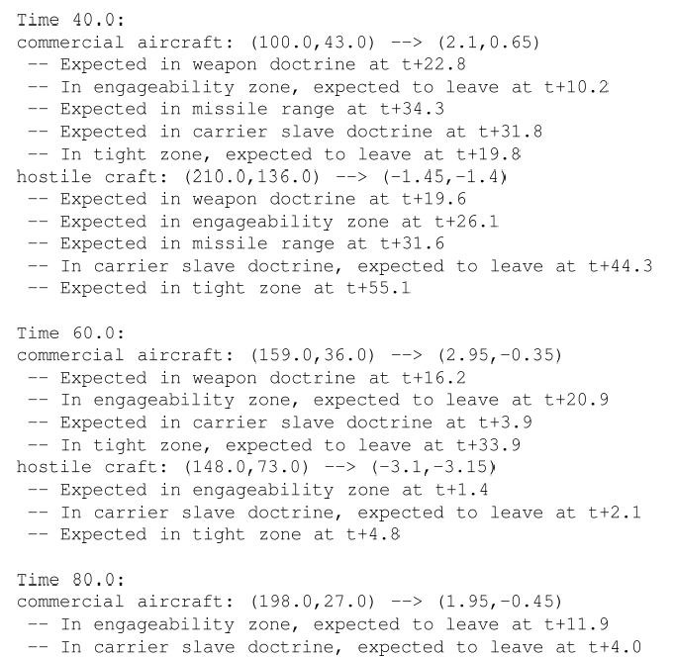
The NSWC Prototyping Experiment
ADA vs. C++ vs. awk vs. Relational Lisp vs. Haskell vs. …

Slide 8
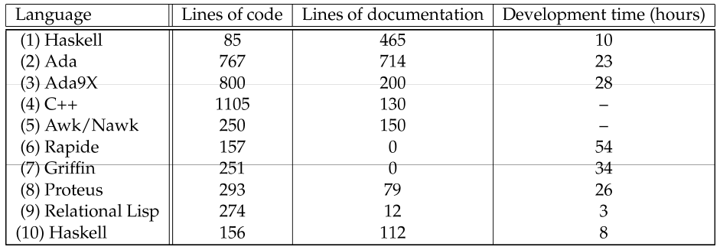

NSWC Prototyping Results
(2) NSWC lead programmer (“control group”)
(4) After awk solution, plus 500 LOC test harness, no development time reported
(6)+(7) Code never executed
(9) Development time excluding 4 hours in kickoff
(10) Novice college graduate, given 8 days to learn Haskell and an expert to ask

Slide 9
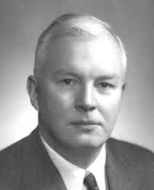
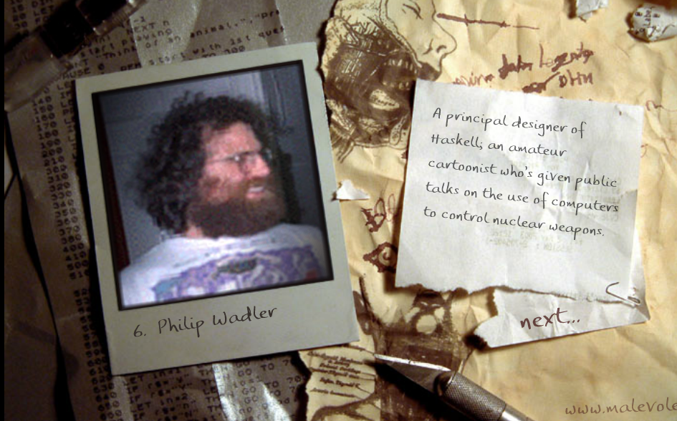
Haskell Brooks Curry
Currying
Curry-Howard-Isomorphism

Slide 10
“List Comprehension”
Task: Enumerate all prime numbers up to 100!
“Compute the list of numbers x where
x is between 2 and 100, and x is not dividable by all numbers 2 up to x-1.”
[ x | x <- [2..100], all (x `notDivableBy`) [2..(x-1)] ]
where
x `notDivableBy` d = mod x d /= 0

Slide 11
Lazy Evaluation
Evaluate only if needed!
… enables lazy programming:
minimum list =
head ( process2 list )

Slide 12
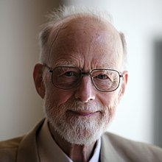
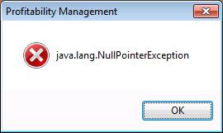
Sir Tony Hoare’s billion-dollar mistake
“I call it my billion-dollar mistake. It was the invention of the null reference in 1965.”

Slide 13
No Null Pointer, No Cry...
data Maybe typ = Just typ | Nothing
case measurement of
Just value -> …
Nothing -> <deal with it somehow>

Slide 14
Shell Hacking
In chess, two players
> data Colour = White | Black
> deriving (Show,Eq,Enum)
> instance Hashable Colour
are taking turns
> nextColour White = Black
> nextColour Black = White
-- In chess, two players
data Colour = White | Black
deriving (Show,Eq,Enum)
instance Hashable Colour
-- are taking turns
nextColour White = Black
nextColour Black = White
GHCi, version 8.0.2: http://www.haskell.org/ghc/ :? for help
Prelude> f <- readFile "lit.lhs"
Prelude> import Data.List
Prelude Data.List> data Line = Code String | Other String
Prelude Data.List> let ls = map (\ l -> if "> " `isPrefixOf` l then Code l else Other l) $ lines f
Prelude Data.List> writeFile "unlit.hs" $ unlines $
map (\l -> case l of Code s -> drop 2 s; Other s -> if null s then s else "-- "++s) ls

Slide 15
Domain Specific Languages
<fn name=„f1“ fc_cov=1>
<fn name=„f2“ fc_cov=1>
<fn name=„f3“ fc_cov=1>
-
<fn name=„f1“ fc_cov=1>
<fn name=„f2“ fc_cov=0>
= ?
Covered Functions
in Production Use
Covered Functions
executing Test Suite
diff file1 file2 = do
cov1 <- readCov file1
writeFile (replaceExtension file1 "txt") $ unlines (sort cov1)
cov2 <- readCov file2
writeFile (replaceExtension file2 "txt") $ unlines (sort cov2)
writeFile "uncovered.txt" $ unlines (sort $ cov1 \\ cov2)
readCov file = runX $ do
readDocument ([ withValidate no, withRemoveWS yes, withExpat True ]) file
>>>
getChildren >>> isElem >>> hasName "BullseyeCoverage" >>> deep extractFn
extractFn = isElem >>> hasName "fn" >>> hasAttr "name" >>> hasAttr "fn_cov" >>>
hasAttrValue "fn_cov" (=="1") >>> getAttrValue "name"
DSL for XML

Slide 16
Without DSL (Python,procedural)
#
#
# Argumente
$file1 = $ARGV[0];
$file2 = $ARGV[1];
$diffopt = $ARGV[2];
[..]
#Öffne Dateien
open(IN, $file1) or die "could not open $file1 !";
@inhalt1=<IN>;
close(IN);
open(IN, $file2) or die "could not open $file2 !";
@inhalt2=<IN>;
close(IN);
$line_nr = 0;
$fn_name = "";
$print_fn_name = 0;
while ( defined($inhalt1[$line_nr]) ) {
$line1 = $inhalt1[$line_nr];
$line2 = $inhalt2[$line_nr];
#print $inhalt1[$line_nr];
#print $inhalt2[$line_nr];
if ( $line1 =~ /^<fn name=\"/ ) {
#print last Funktionsnamen;
if ( $print_fn_name == 1 ) {
print "$fn_name\n";
$print_fn_name = 0;
}
#Extrahiere Funktionsname aus file1
@tmp = $line1 =~ /^<fn name=\"([^\"]*)/;
$fn_name = $tmp[0];
#print "fn name1=$fn_name\n";
#Extrahiere Funktionsparameter aus file1
@tmp = $line1 =~ /fn_cov=\"([^\"]*)/;
$fn_cov1 = $tmp[0];
@tmp = $line1 =~ /cd_cov=\"([^\"]*)/;
$cd_cov1 = $tmp[0];
@tmp = $line1 =~ /d_cov=\"([^\"]*)/;
$d_cov1 = $tmp[0];
#Extrahiere Funktionsparameter aus file2
@tmp = $line2 =~ /fn_cov=\"([^\"]*)/;
$fn_cov2 = $tmp[0];
@tmp = $line2 =~ /cd_cov=\"([^\"]*)/;
$cd_cov2 = $tmp[0];
@tmp = $line2 =~ /d_cov=\"([^\"]*)/;
$d_cov2 = $tmp[0];
#print "$fn_name (f): '$fn_cov1' '$fn_cov2'\n";
#print "$fn_name (d): '$cd_cov1' '$cd_cov2'\n";
#print "$fn_name (c): '$d_cov1' '$d_cov2'\n";
if ( ($diffopt =~ /f/ ) and $fn_cov1==1 and $fn_cov2==0) {
$print_fn_name = 1;
}
}
if ( $line1 =~ /^<probe line=\"/ ) {
if ( ($line1 =~ /kind=\"decision\"/ and $diffopt =~ /d/ ) or
($line1 =~ /kind=\"condition\"/ and $diffopt =~ /c/ ) ) {
@tmp = $line1 =~ /kind=\"([^\"]*)/;
$probe_kind = $tmp[0];
@tmp = $line1 =~ /event=\"([^\"]*)/;
$cd_event1 = $tmp[0];
@tmp = $line2 =~ /event=\"([^\"]*)/;
$cd_event2 = $tmp[0];
#print "$fn_name $d_event1 $d_event2 \n";
if ( ($cd_event1 eq "full" and $cd_event2 ne "full") or
($cd_event1 eq "true" and ($cd_event2 eq "false" or $cd_event2 eq "none")) or
($cd_event1 eq "false" and ($cd_event2 eq "true" or $cd_event2 eq "none") )
) {
if ($diffopt =~ /F/ ) {
$print_fn_name = 1;
} else {
@tmp = $line1 =~ /line=\"([^\"]*)/;
printf("%-15s: probe line=\"$tmp[0]\" kind=\"$probe_kind\" - event=\"$cd_event1\" vs. \"$cd_event2\"\n", $fn_name);
}
}
}
}
$line_nr +=1;
}
if ( $print_fn_name == 1 ) {
print "$fn_name\n";
}

Slide 17
The Board and Positions
data Colour = White | Black
deriving (Show,Eq,Enum,Bounded,Ord)
nextColour White = Black
nextColour Black = White
data Piece = Ù | Ú | Û | Ü | Ý | Þ
deriving (Eq,Enum,Bounded,Ord,Show)
type Board = Array Coors Square
type Square = Maybe (Colour,Piece)
type Coors = (Int,Int)
instance Show Coors where
show (file,rank) = ['a'..]!!(file-1) : show rank
data Position = Position {
pBoard :: Board,
pColourToMove :: Colour,
pCanCastleQueenSide :: [Colour],
pCanCastleKingSide :: [Colour],
pEnPassant :: Maybe (Coors,Coors),
pHalfmoveClock :: Int,
pNextMoveNumber :: Int }

Slide 18
Initial Position
initialPosition = Position {
pBoard = boardFromString [
"âïáòäðàñ",
"îßîßîßîß",
"ØçØçØçØç",
"çØçØçØçØ",
"ØçØçØçØç",
"çØçØçØçØ",
"ÙèÙèÙèÙè",
"ëÚêÝíÛéÜ" ],
pColourToMove = White,
pCanCastleQueenSide = allOfThem,
pCanCastleKingSide = allOfThem,
pEnPassant = Nothing,
pHalfmoveClock = 0,
pNextMoveNumber = 1 }
allOfThem :: (Enum a,Bounded a,Ord a) => [a]
allOfThem = [minBound..maxBound]
boardFromString ranks = array ((1,1),(max_f,max_r)) $
zip [ (f,r) | r <- reverse [1..max_r], f <- [1..max_f] ]
(concatMap read_rank ranks)
where
read_rank = map read_square
(max_f,max_r) = (maximum (map length ranks),length ranks)

Slide 19
Printing Squares
show_square darksquare square = case square of
Nothing | darksquare → 'ç'
Nothing → 'Ø'
Just (White,piece) | darksquare → "èéêëìí" !! (fromEnum piece)
Just (White,piece) → "ÙÚÛÜÝÞ" !! (fromEnum piece)
Just (Black,piece) | darksquare → "îïðñòó" !! (fromEnum piece)
Just (Black,piece) → "ßàáâãä" !! (fromEnum piece)
read_square c = lookup c all_squares where
all_squares = [ (show_square dark (Just (col,piece)), (col,piece)) |
col <- allOfThem, piece <- allOfThem, dark <- allOfThem ]

Slide 20
Coordinates
(north,east) = ((0,1),(1,0))
(south,west) = (-north,-east)
pawnStep White = north
pawnStep Black = south
baseRank White = 1
baseRank Black = 8
addCoors :: Board -> Coors -> (Int,Int) -> Maybe Coors
addCoors board coors offset = case coors+offset of
coors' | coors' ∈ (indices board) → Just coors'
_ | otherwise → Nothing

Slide 21
A Move
data Move =
Move {
moveFrom :: Coors,
moveTo :: Coors,
moveTakes :: Maybe Coors,
movePromote :: Maybe Piece } |
Castling CastlingSide
deriving Eq
data CastlingSide = Queenside | Kingside deriving Eq
instance Show Move where
show Move{..} = show moveFrom ++ show moveTo ++ case movePromote of
Nothing → ""
Just Ú → "N"
Just Û → "B"
Just Ü → "R"
Just Ý → "Q"
show (Castling Queenside) = "O-O-O"
show (Castling Kingside) = "O-O"

Slide 22
Moving
doMove :: Position → Move → Position
doMove pos@Position{..} move = pos {
pBoard = pBoard // case move of
Move{..} → ( case moveTakes of
Nothing → []
Just take_coors → [(take_coors,Nothing)] )
++
[ (moveFrom,Nothing), (moveTo,case movePromote of
Nothing → pBoard!moveFrom
Just promote_to → Just (pColourToMove,promote_to) ) ]
Castling Queenside → [ ((1,base),Nothing), ((4,base),pBoard!(1,base)),
((5,base),Nothing), ((3,base),pBoard!(5,base)) ]
Castling Kingside → [ ((8,base),Nothing), ((6,base),pBoard!(8,base)),
((5,base),Nothing), ((7,base),pBoard!(5,base)) ],
pColourToMove = nextColour pColourToMove,
pHalfmoveClock = case move of
Move{..} | Just _ <- moveTakes → 0
Move{..} | Just (_,Ù) <- pBoard!moveFrom → 0
_ | otherwise → pHalfmoveClock + 1,

Slide 23
Castling, En Passant
pEnPassant = case move of
Move from to Nothing Nothing |
Just (_,Ù) <- pBoard!from,
Just to == addCoors pBoard from (2*pawn_step),
Just middle <- addCoors pBoard from pawn_step → Just (middle,to)
_ | otherwise → Nothing,
pCanCastleQueenSide = (if forfeit_queenside then delete pColourToMove else id)
pCanCastleQueenSide,
pCanCastleKingSide = (if forfeit_kingside then delete pColourToMove else id)
pCanCastleKingSide }
where
pawn_step = pawnStep pColourToMove
base = baseRank pColourToMove
(forfeit_queenside,forfeit_kingside) = case move of
Castling _ → (True, True )
Move (1,rank) _ _ _ | rank == base → (True, False)
Move (5,rank) _ _ _ | rank == base → (True, True )
Move (8,rank) _ _ _ | rank == base → (False,True )
_ | otherwise → (False,False)

Slide 24
Generating all Possible Moves
moveGen Position{..} = filter king_not_in_check $ potentialMoves pos
where
king_not_in_check move = all (coorsNotInCheck pos_after_move) $ case move of
Move{..} → [ kingsCoors pos_after_move ]
Castling Queenside → map (,baseRank pColourToMove) [3..5]
Castling Kingside → map (,baseRank pColourToMove) [5..7]
where
pos_after_move = (doMove pos move) { pColourToMove = pColourToMove }
coorsNotInCheck pos@Position{..} coors = all (≠coors) [ moveTo |
-- Castling moves do not take a piece, hence it is not considered here
Move{..} <- potentialMoves $ pos {
pColourToMove = nextColour pColourToMove,
pBoard = pBoard // [ (coors,Just (pColourToMove,Ý)) ] } ]
-- Place some figure at coors in order to also catch pawn takes
kingsCoors Position{..} = head [ coors |
(coors,Just (col,Þ)) <- assocs pBoard, col == pColourToMove ]

Slide 25
Move Targets
initial_rank = if pColourToMove==White then 2 else 7
[..]
diagonals = [ north+east,north+west,south+east,south+west ]
straights = [ north,west,south,east ]
knight_moves = [ north+2*east,north+2*west,2*north+west,2*north+east,
south+2*west,south+2*east,2*south+west,2*south+east ]
maybe_move from δ = case addCoors pBoard from δ of
Nothing → []
Just dest → case pBoard!dest of
Nothing → [ (dest,Nothing ) ]
Just (col,_) | col ≠ pColourToMove → [ (dest,Just dest) ]
_ | otherwise → []
maybe_move_direction from δ = case maybe_move from δ of
moves@[ (_,Just _) ] → moves
moves@[ (to,Nothing) ] → moves ++ maybe_move_direction to δ
_ | otherwise → []

Slide 26
Potential Moves 1
potentialMoves Position{..} = normal_moves ++ castling_moves where
normal_moves = [ Move src dest mb_takes mb_promote |
(src,Just (colour,piece)) <- assocs pBoard,
colour==pColourToMove,
(dest@(_,to_rank),mb_takes) <- [..] case piece of
Ù → pawn_moves ++ pawn_takes where
Just dest = addCoors pBoard src pawn_step
-- There cannot be a pawn on the opposite base rank
pawn_moves = if square_empty dest then [ (dest,Nothing) ] ++ pawn_double else []
pawn_double = case addCoors pBoard src (2*pawn_step) of
Just dest2 | square_empty dest2 ∧ snd src == initial_rank → [(dest2,Nothing)]
_ | otherwise → []
pawn_takes = [ (dest,Just take_on) |
Just dest <- map (addCoors pBoard src) [pawn_step+east,pawn_step+west],
take_on <- case pBoard!dest of
Just (colour,_) | colour ≠ pColourToMove → [ dest ]
Nothing | Just (middle,pawn_coors) <- pEnPassant,
middle==dest → [ pawn_coors ]
_ | otherwise → [ ] ]
Ú → concatMap (maybe_move src) knight_moves
Û → concatMap (maybe_move_direction src) diagonals
Ü → concatMap (maybe_move_direction src) straights
Ý → concatMap (maybe_move_direction src) (straights++diagonals)
Þ → concatMap (maybe_move src) (straights++diagonals),

Slide 27
Potential Moves 2
mb_promote <- case piece of
Ù | to_rank == baseRank (nextColour pColourToMove) → map Just [Ý,Ú,Û,Ü]
_ | otherwise → [ Nothing ] ]
castling_moves =
[ Castling Kingside | pColourToMove ∈ pCanCastleKingSide,
all square_empty [(6,base),(7,base)] ]
++
[ Castling Queenside | pColourToMove ∈ pCanCastleQueenSide,
all square_empty [(4,base),(3,base),(2,base)] ]
base = baseRank pColourToMove
square_empty = isNothing . (pBoard!)

Slide 28
Position Rating 1
data MatchResult = Winner Colour WinReason | Draw DrawReason deriving Show
data WinReason = Resignation | Checkmate deriving Show
data DrawReason = Fifty_Halfmoves | Stalemate | NoMatePossible deriving Show
type Rating = Float
mAX = 10000.0
mIN = negate mAX
eQUAL = 0.0
rate :: Position → (Rating,Maybe MatchResult)
rate Position{..} | pHalfmoveClock ≥ 50 = (eQUAL,Just $ Draw Fifty_Halfmoves)
rate pos@Position{..} | moveGen pos == [] = case (king_in_check,pColourToMove) of
(False,_ ) → (eQUAL,Just $ Draw Stalemate)
(True ,White) → (mIN, Just $ Winner Black Checkmate)
(True ,Black) → (mAX, Just $ Winner White Checkmate)
where
king_in_check = not $ coorsNotInCheck pos $ kingsCoors pos

Slide 29
Position Rating 2
rate pos@Position{..} | max_one_light_figure = (eQUAL,Just $ Draw NoMatePossible) where
max_one_light_figure = case sort $ filter ((≠Þ).snd) $ catMaybes $ elems pBoard of
[] → True
[(_,fig)] | all_light_figures [fig] → True
[(col1,fig1),(col2,fig2)] | col1≠col2 ∧ all_light_figures [fig1,fig2] → True
_ | otherwise → False
all_light_figures = all (∈ [Ú,Û])
rate pos = (rating,Nothing) where
rating = 0.01 * mobility +
sum [ (if colour==White then id else negate) (piece_val piece colour coors) |
(coors,Just (colour,piece)) <- assocs $ pBoard pos ]
piece_val fig colour (_,rank) = case fig of
Ù → 1 + case abs $ fromEnum rank - fromEnum (baseRank (nextColour colour)) of
1 → 4
2 → 2
_ | otherwise → 0
Ú → 3
Û → 3
Ü → 5
Ý → 9
Þ → 0
mobility = fromIntegral $
length (potentialMoves $ pos { pColourToMove = White }) -
length (potentialMoves $ pos { pColourToMove = Black })

Slide 30
Searching Brute Force Minimax
type Depth = Int
type Line = [Move]
search :: Depth → Position → Line → (Rating,Line)
search depth pos line | moveGen pos == [] ∨ depth==0 = (fst $ rate pos,line)
search depth pos line = minimax (comparing fst) (map go_deeper $ moveGen pos)
where
minimax = if pColourToMove == White then maximumBy else minimumBy
go_deeper move = search (depth-1) (doMove pos move) (move:line)
import Control.Parallel.Strategies
parMap rpar
This parallelization works because no side effects!

Slide 31
Driver Loop
main = loop 2 initialPosition stackNew where
loop :: Depth → Position → Stack Position → IO ()
loop maxdepth pos pos_history = do
print pos
putStrLn $ printf "Rating = %.2f" (fst $ rate pos)
putStrLn $ "Possible moves are:" ++ show (moveGen pos)
case rate pos of
(_,Just matchresult) → print matchresult
_ | otherwise → return ()
input <- putStr "? " >> hFlush stdout >> getLine
case input of
"i" → loop maxdepth initialPosition stackNew
"q" → return ()
"s" → execute_move $ last $ snd $ search maxdepth pos []
"b" → case stackPop pos_history of
Nothing → do
putStrLn "There is no previous position."
loop maxdepth pos pos_history
Just (stack',prev_pos) → loop maxdepth prev_pos stack'
depth_str | [(depth,[])] <- reads depth_str → loop depth pos pos_history
move_str → case lookup move_str $ map (\ m → (show m,m)) (moveGen pos) of
Nothing → do
putStrLn "This is no (legal) move or command."
loop maxdepth pos pos_history
Just move → execute_move move
where
execute_move move = do
putStrLn $ "Moving " ++ show move
loop maxdepth (doMove pos move) (stackPush pos_history pos)

Slide 32
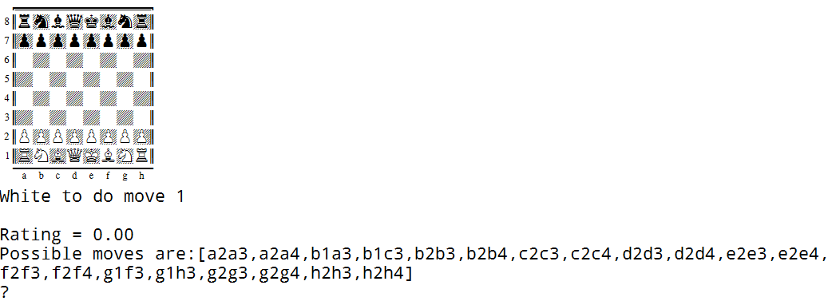
Example Game

Slide 33
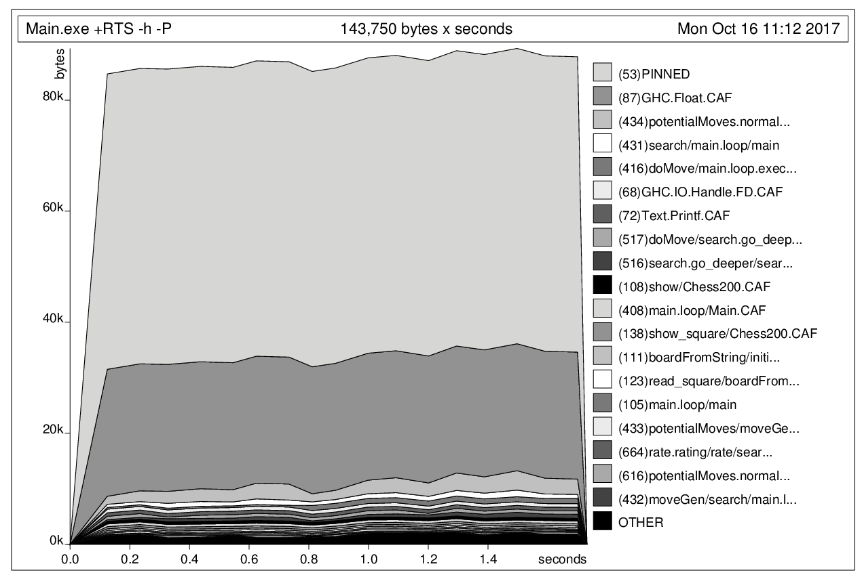
Profiling Memory Usage

Slide 34
Profiling Time Consumption
Mon Oct 16 11:12 2017 Time and Allocation Profiling Report (Final)
Main.exe +RTS -h -P -RTS
total time = 1.73 secs (1734 ticks @ 1000 us, 1 processor)
total alloc = 1,796,857,300 bytes (excludes profiling overheads)
COST CENTRE MODULE SRC %time %alloc ticks bytes
addCoors Chess200 Chess200.hs:(96,1)-(98,56) 85.2 92.3 1477 1659115360
potentialMoves.normal_moves Chess200 Chess200.hs:(178,9)-(217,90) 5.0 3.5 86 62413784
+ Data.NumInstances.Tuple src\Data\NumInstances\Tuple.hs:25:3-31 2.0 2.2 35 38970432
potentialMoves.normal_moves.maybe_move Chess200 Chess200.hs:(187,25)-(192,79) 1.7 0.2 30 2705376

Slide 35
Beyond Naïve Brute Force…
Alpha-Beta Window
Move Ordering, Killer Move Heuristic
Position Hashtables
Principal Variation, Iterative Deepening
Parallelization
Quiescence Search
Opening / Endgame Database
Null Window Search / SCOUT
Null Move Heuristic
…

Slide 36










Industrial Strength

Slide 37

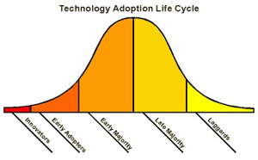

When not to use Haskell
Tight Realtime properties required
Very low level problem (machine oriented)
In conservative and laggard enviroment (e.g. personal, political reasons):

Slide 38
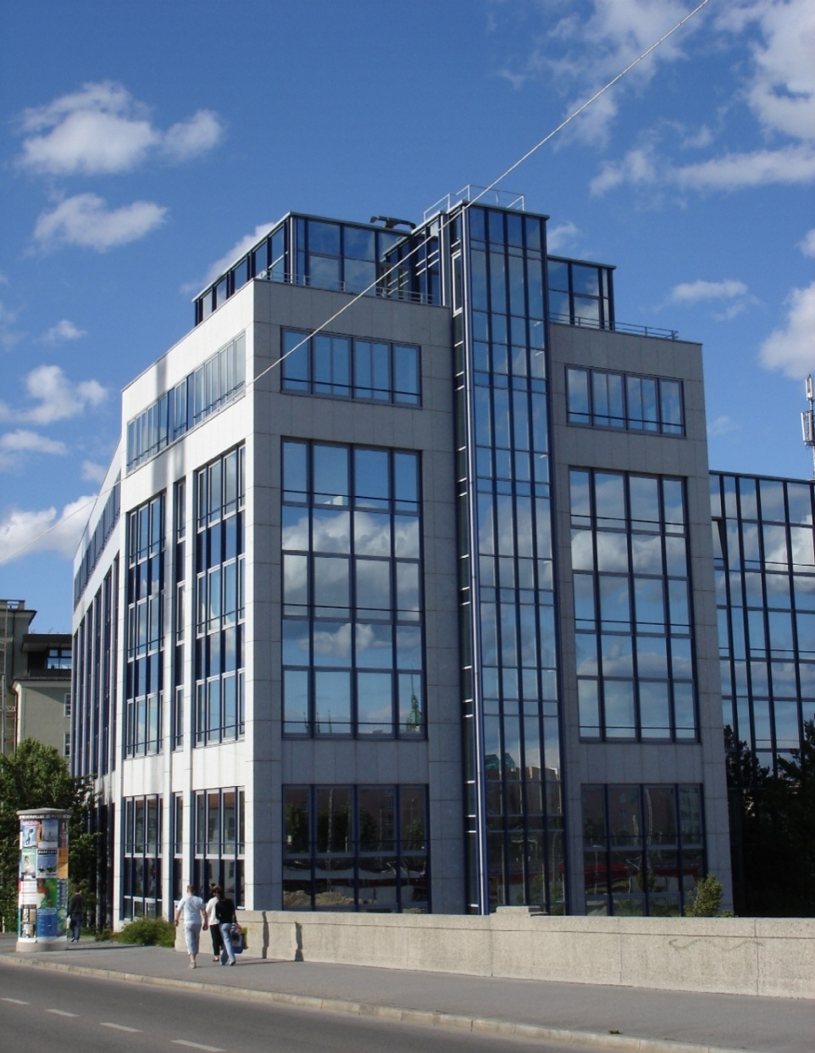

putStrLn „Thank you!“
“LISP is worth learning for a different reason — the profound enlightenment experience you will have when you finally get it.
That experience will make you a better programmer for the rest of your days, even if you never actually use LISP itself a lot.”
From “How to Become a Hacker”
by Eric Raymond

