Slide 1

Chess in 200 lines
October Xth, 2017

Slide 2
What does process do?
void swap(int *a, int *b)
{
int tmp = *a;
*a = *b;
*b = tmp;
}
void process(int *begin, int *end)
{
int *ptr;
int *split;
if (end - begin <= 1)
return;
ptr = begin;
split = begin + 1;
while (++ptr <= end) {
if (*ptr < *begin) {
swap(ptr, split);
++split;
}
}
swap(begin, split - 1);
process(begin, split - 1);
process(split, end);
}

Slide 3
What does process2 do?
process2 [] = []
process2 (first:rest) = process2 smaller_eq ++ [first] ++ process2 greater
where
smaller_eq = filter (<= first) rest
greater = filter (> first) rest

Slide 4
How to prove that it’s sorting?
process2 [] = []
process2 (first:rest) = process2 smaller_eq ++ [first] ++ process2 greater
where
smaller_eq = filter (<= first) rest
greater = filter (> first) rest

Slide 5
Features
Infinite Lists, lazy evaluation, Producer-Consumer Model
Profiling
Central Library
Compiler and Interpreter
Full Programming at command line
Industrial Strength (Galois, …)
Easy parallelization, Semaphores, …
“If it typechecks, it works”
Inspiring F#, Java, C#, …
Every Monad is a DSL
List Comprehension

Slide 6
So called “List Comprehension”
Task: All prime Numbers up to 100!
Lets compute the list of all numbers x where
x is between 2 and 100, and there is
not any divisor of x from 2 to (n-1):
[ x | x <- [2..100], not (any (divisorOf x)) [2..(n-1)] ]
where
divisorOf x i = mod x i == 0

Slide 7

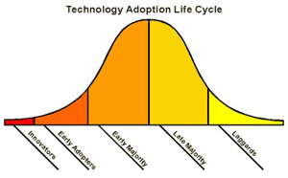

When not to use Haskell
Tight Realtime properties required
Very low level problem (machine oriented)
In conservative and laggard enviroment (e.g. personal, political reasons):

Slide 8
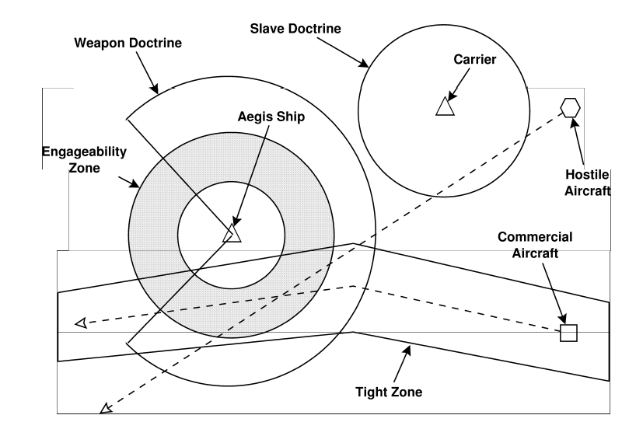
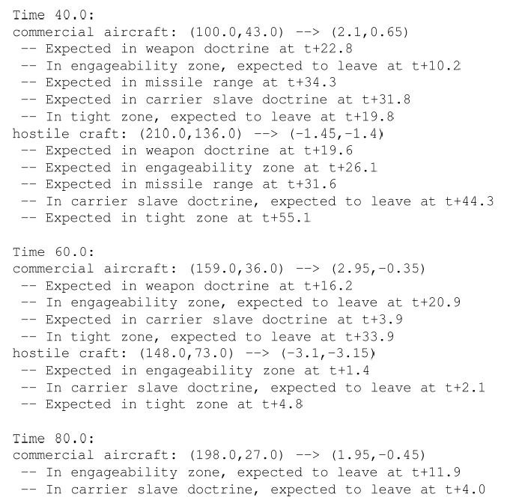
The NSWC Experiment
ADA vs. C++ vs. awk vs. Relational Lisp vs. Haskell vs. …

Slide 9
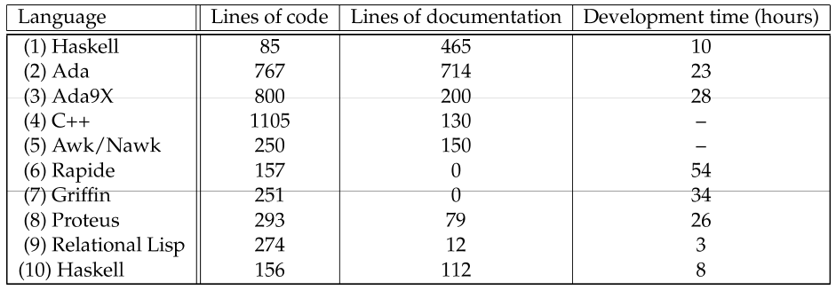

NSWC Prototyping Results
(2) NSWC lead programmer (“control group”)
(4) After awk solution, plus 500 LOC test harness, no development time reported
(6)+(7) Code never executed
(9) Developmen time excluding 4 hours in kickoff
(10) Novice college graduate, given 8 days to learn Haskell and an expert to ask

Slide 10
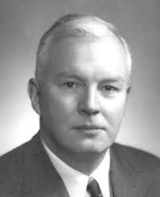
Haskell Brooks Curry
Haskell Brooks Curry

Slide 11
About us
We are a technology consultancy for quality assurance of embedded systems. Our core competences are model based development, model based testing, test automation, tool qualification
We develop innovative software engineering methods, implement them in form of tools and processes and we support our customers in their application.

Slide 12
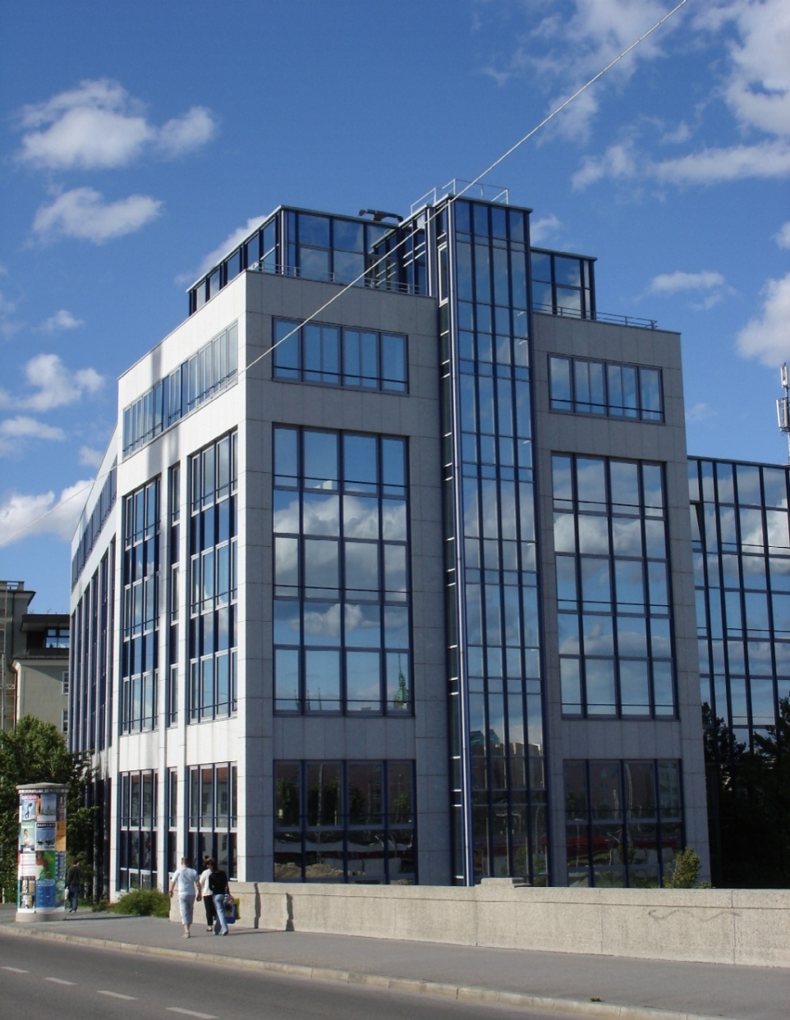

Thank you !
Arnulfstraße 27
80335 München
www.validas.de
info@validas.de

