Slide 1
Chess in 200 lines
“As long as our hypothetical Blub programmer is looking down the power continuum, he knows he's looking down. Languages less powerful than Blub are obviously less powerful, because they're missing some feature he's used to. But when our hypothetical Blub programmer looks in the other direction, up the power continuum, he doesn't realize he's looking up. What he sees are merely weird languages. He probably considers them about equivalent in power to Blub, but with all this other hairy stuff thrown in as well. Blub is good enough for him, because he thinks in Blub.”
From the essay “Beating the Averages” by Paul Graham
(Startup Millionaire, co-Founder of YCombinator)
October 16th, 2017

Slide 2
The “Semantic Gap”

Slide 3
What does process do?
void swap(int *a, int *b)
{
int tmp = *a;
*a = *b;
*b = tmp;
}
void process(int *begin, int *end)
{
int *ptr;
int *split;
if (end - begin <= 1)
return;
ptr = begin;
split = begin + 1;
while (++ptr <= end) {
if (*ptr < *begin) {
swap(ptr, split);
++split;
}
}
swap(begin, split - 1);
process(begin, split - 1);
process(split, end);
}

Slide 4
What does process2 do?
process2 [] = []
process2 (first:rest) = let smaller = filter (<= first) rest
bigger = filter (> first) rest
in
process2 smaller ++ [first] ++ process2 bigger

Slide 5
How to prove the functionality?
void swap(int *a, int *b)
{
int tmp = *a;
*a = *b;
*b = tmp;
}
void process(int *begin, int *end)
{
int *ptr;
int *split;
if (end - begin <= 1)
return;
ptr = begin;
split = begin + 1;
while (++ptr <= end) {
if (*ptr < *begin) {
swap(ptr, split);
++split;
}
}
swap(begin, split - 1);
process(begin, split - 1);
process(split, end);
}

Slide 6
How to prove the functionality?
process2 [] = []
process2 (first:rest) = let smaller = filter (<= first) rest
bigger = filter (> first) rest
in
process2 smaller ++ [first] ++ process2 bigger

Slide 7
Features
Infinite Lists, lazy evaluation, Producer-Consumer Model
Profiling
Central Library
Compiler and Interpreter
Full Programming at command line
Industrial Strength (Galois, …)
Easy parallelization, Semaphores, …
“If it typechecks, it works”
Inspiring F#, Java, C#, …
Every Monad is a DSL
List Comprehension
No null pointer

Slide 8
So called “List Comprehension”
Task: All prime Numbers up to 100!
Lets compute the list of all numbers x where
x is between 2 and 100, and there is
not any divisor of x from 2 to (n-1):
[ x | x <- [2..100], not (any (divisorOf x)) [2..(n-1)] ]
where
divisorOf x i = mod x i == 0

Slide 9



When not to use Haskell
Tight Realtime properties required
Very low level problem (machine oriented)
In conservative and laggard enviroment (e.g. personal, political reasons):

Slide 10
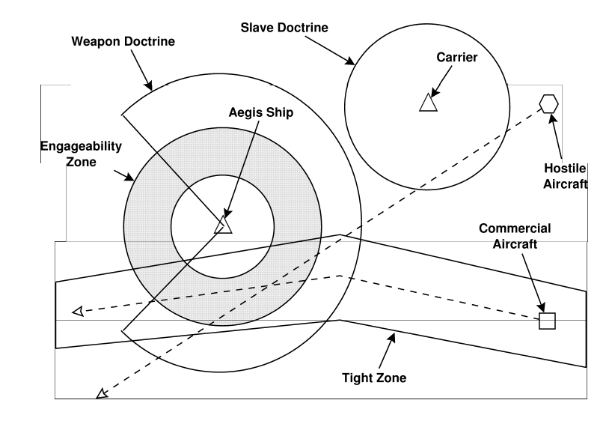
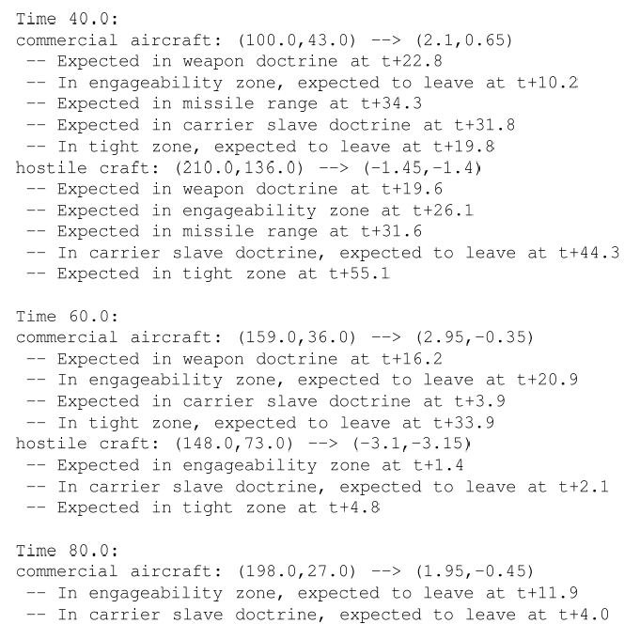
The NSWC Experiment
ADA vs. C++ vs. awk vs. Relational Lisp vs. Haskell vs. …

Slide 11
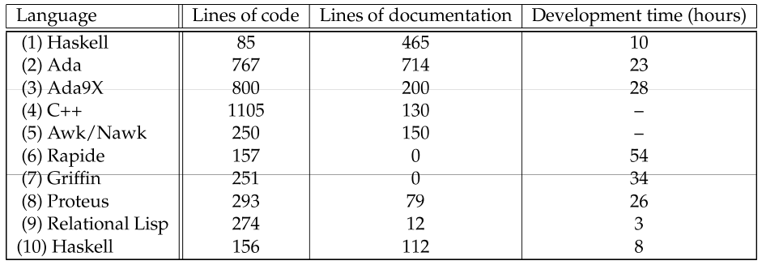

NSWC Prototyping Results
(2) NSWC lead programmer (“control group”)
(4) After awk solution, plus 500 LOC test harness, no development time reported
(6)+(7) Code never executed
(9) Developmen time excluding 4 hours in kickoff
(10) Novice college graduate, given 8 days to learn Haskell and an expert to ask

Slide 12
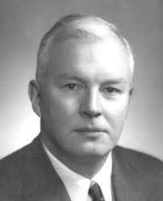
Haskell Brooks Curry
Haskell Brooks Curry

Slide 13


Thank you !
Arnulfstraße 27
80335 München
www.validas.de
info@validas.de

