Slide 1
Automatic Code Coverage
Robert Reitmeier, Validas AG
Notes:
+

Slide 2
Contents
Motivation / The Problem
Small Examples
Other Tools
SAT Solving Modulo Theories: Z3
Integrated Verification
The State Space Explosion and some Heuristics
FalconLib: Solution to Jorge’s and Alex’s Challenge
Call for Challenges
Haskell’s Amenities (Quasi-Quoting, UniCode Syntax, Generics, Laziness->ProducerConsumer…)

Slide 3
Stichpunkte
Loop Prediction (easy with “for” in MISRA)
Automatic Verification Test Harness
Producer/Comsumer Model (Memory!)
Enums, Structs, Floats, …
Full coverage is desirable only for target function
Reports vectors to cover coverable code and reports (presumably?) dead code
Heuristics:
Restriction to a subspace
Random Condition Branch Skipping

Slide 4
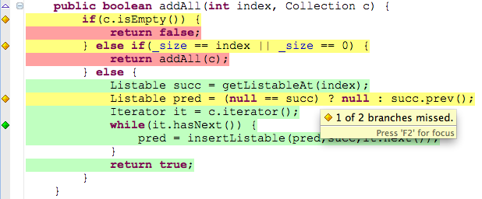
Motivation
ISO 26262/*: Code Coverage for libraries/SWCs at ASIL D!
=> Test Suite does test all parts of the code

Slide 5
The Problem
Which inputs lead to 100% code coverage?
int g(int x,int y)
{
int erg = x;
while(y>0)
{
erg = erg << 1;
y=y-1;
}
if(erg<=1) { erg=100; }
return(erg);
}
int f(int y)
{
if(g(2,y)>5) return 1;
else return 0;
}

Slide 6
Other Tools
KLEE
VectorCast
AutoCode for Cantata

Slide 7
Some Implementation Strategies
Function expansion by β-reduction
Lazyness enabling Producer-Consumer-Model necessary for pipelining extremely big trees
Type inference because Z3 has none ☹
Using “quasi-quoter” as template for C test harness
Splitting up products (i.e. structs) into separate variables, indexed by the instance (i.e. pointer or struct instance name)
Rewriting switch to equivalent if-then-elses (difficult with breaks!)
Unrolling loops (with loop length prediction for “normal” cases, containing the state space explosion)
Simplification (e.g. Pointer-AddressOf-Cancellation) needed as intermediate steps
Using case distinction completeness for maximum defensive coding
Uncode-Syntax for mathematical comprehension

Slide 8

The End

