Slide 1
Automatic Code Coverage
Robert Reitmeier
Notes:
+

Slide 2
Contents
Motivation / The Problem
Small Examples
Other Tools
SAT Solving Modulo Theories: Z3
Integrated Verification
The State Space Explosion and some Heuristics
FalconLib: Solution to Jorge’s and Alex’s Challenge
Call for Challenges
Haskell’s Amenities (Quasi-Quoting, UniCode Syntax, Generics, Laziness->ProducerConsumer…)

Slide 3
Stichpunkte
Loop Prediction (easy with “for” in MISRA)
Automatic Verification Test Harness
Producer/Comsumer Model (Memory!)
Enums, Structs, Floats, …
Full coverage is desirable only for called function
Reports test vectors and reports (presumably?) dead code
Heuristics:
Restriction to a subspace
Random Condition Branch Skipping

Slide 4
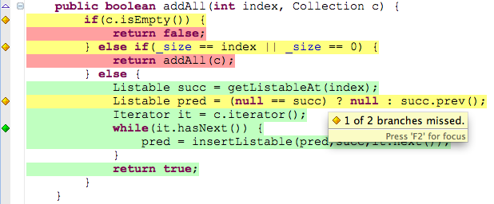
Motivation
Did we miss some functionality during testing?
ISO 26262: Code Coverage for libraries at ASIL D! (SWC all ASILs)

Slide 5
The Problem
Which inputs (“test vectors”) lead to 100% code coverage?
int g(int x,int y)
{
int erg = x;
while(y>0)
{
erg = erg << 1;
y=y-1;
}
if(erg<=1) { erg=100; }
return(erg);
}
int f(int y)
{
if(g(2,y)>5) return 1;
else return 0;
}
I.e. What does g(2,y) return?

Slide 6
Jorge’s and Alex’ Challenge
fp_number_type * _fpdiv_parts (fp_number_type * a, fp_number_type * b)
{
[...]
bit = IMPLICIT_1; // = 30
quotient = 0;
while (bit)
{
if (numerator >= denominator)
{
quotient |= bit;
numerator -= denominator;
}
bit >>= 1;
numerator *= 2;
}
if (!ROUND_TOWARDS_ZERO && (quotient & GARDMASK) == GARDMSB)
{
if (quotient & (1 << NGARDS)) { }
else if (numerator)
{
quotient += GARDROUND + 1;
quotient &= ~(fractype) GARDMASK;
}
}
a->fraction.ll = quotient;
return (a);
}
}
How to cover that code?

Slide 7

Oscar: Existing Tools?
Denise’s Report:
CREST
KLEE (Problems with Library Functions)
VectorCast
float

Slide 8
tvg
Predecessors from the same tooling family:
code coverage tool
DSL for pattern recognition in C source (“prevent”)
calltree
calltree with partial function pointer resolution
Rapid prototyping,
two major refactorings,
extremely defensive programming,
1200 LoC (Chess Engine had 230).

Slide 9
tvg’s Solution to Initial Problem
C:\Data\tvg>stack exec analyzer-exe -- gcc analyzer\whiletest.c f
===== SUMMARY =====
Test Vector covering [2,2] :
f ( y = 0 )
= return_val = 0
Test Vector covering [1,6] :
f ( y = 2 )
= return_val = 1
OK, we have full branch coverage.
int g(int x,int y)
{
int erg = x;
while(y>0)
{
erg = erg << 1;
y=y-1;
}
if(erg<=1) { erg=100; }
return(erg);
}
int f(int y)
{
if(g(2,y)>5) return 1;
else return 0;
}

Slide 10
Verification of tvg’s Results
--- SOLUTION [1,6] ----------------------
[("y",2),("return_val",1)]
f ( y = 2 )
= return_val = 1
C:\Data\tvg\analyzer>whiletest.exe 2
f(2) =
1
checkSolution args = ["2"]
checkSolutionM [1,6] OK.
int g(int x,int y)
{
int erg = x;
while(y>0)
{
erg = erg << 1;
y=y-1;
}
if(erg<=1) { erg=100; }
return(erg);
}
int f(int y)
{
if(g(2,y)>5) return 1;
else return 0;
}

Slide 11
Jorge/Alex’s Challenge
bit = IMPLICIT_1; // = 30
quotient = 0;
while (bit)
{
if (numerator >= denominator)
{
quotient |= bit;
numerator -= denominator;
}
bit >>= 1;
numerator *= 2;
}
if (!ROUND_TOWARDS_ZERO && (quotient & GARDMASK) == GARDMSB)
{
if (quotient & (1 << NGARDS)) { }
else if (numerator)
{
quotient += GARDROUND + 1;
/* Avoid further rounding in pack_d. */
quotient &= ~(fractype) GARDMASK;
}
How many potential traces?

Slide 12
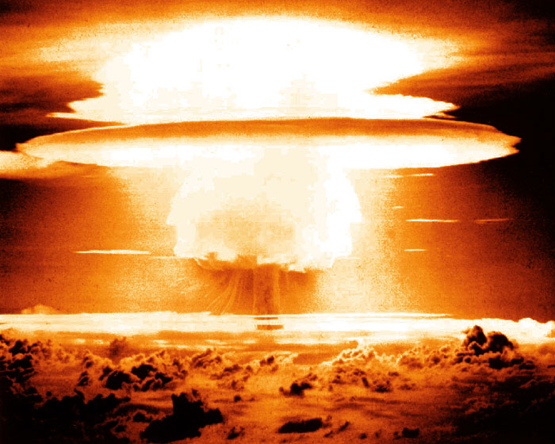
State Space Explosion
Containment by tuning the search:
Reduce to sub space, that hopefully contains an example trace
Loop length prediction
…

Slide 13
Jorge/Alex’s Challenge
bit = IMPLICIT_1; // = 30
quotient = 0;
while (bit)
{
if (numerator >= denominator)
{
quotient |= bit;
numerator -= denominator;
}
bit >>= 1;
numerator *= 2;
}
if (!ROUND_TOWARDS_ZERO && (quotient & GARDMASK) == GARDMSB)
{
if (quotient & (1 << NGARDS)) { }
else if (numerator)
{
quotient += GARDROUND + 1;
/* Avoid further rounding in pack_d. */
quotient &= ~(fractype) GARDMASK;
}
How big would the whole
trace tree be?

Slide 14

Tree Size Explosion
Containment by Producer-Consumer Model:
Powered by Lazyness (“evaluation by need”)
Producer
Consumer
Maybe Result

Slide 15
Solution to Jorge/Alex’s Challenge
===== SUMMARY =====
Test Vector covering [2,2,2,2,2,1,1,1,2,2,2,2,2,1,2,1] :
_fpdiv_parts ( a = 0 , a_ARROW_class = 3 , a_ARROW_sign = 0 , a_ARROW_normal_exp = 0 , a_ARROW_fraction_DOT_ll = 7689560 , b = 0 , b_ARROW_class = 3 , b_ARROW_sign = 0 , b_ARROW_normal_exp = 0 , b_ARROW_fraction_DOT_ll = 8388611 )
= return_val = 0 , return_val_ARROW_class = 3 , return_val_ARROW_sign = 0 , return_val_ARROW_normal_exp = -1 , return_val_ARROW_fraction_DOT_ll = 1968526720
if (!ROUND_TOWARDS_ZERO && (quotient & GARDMASK) == GARDMSB)
{
if (quotient & (1 << NGARDS))
{
}
else if (numerator)
{
#ifdef CALC
printf("GOT IT!\n");
#endif
quotient += GARDROUND + 1;
quotient &= ~(fractype) GARDMASK;
}
Demonstration

Slide 16
Some Implementation Features
Function expansion by β-reduction
Lazyness enabling Producer-Consumer-Model necessary for pipelining extremely large trees
Type inference because Z3 has none ☹
Using Quasi-Quoter as template for C test harness
Splitting up products (i.e. structs) into separate variables, indexed by the instance (i.e. pointer or struct instance name)
Rewriting switch to equivalent if-then-elses (nasty breaks!)
Unrolling loops (with loop length prediction for “easy”/MISRA cases
Simplification (e.g. Pointer-AddressOf-Cancellation) needed as intermediate steps
Using case distinction completeness for maximum defensive coding
Unicode-Syntax for mathematical comprehension

Slide 17
Things left to do
It is still a prototype!
Fixing up Coder’s (i.e. C’s) sloppyness automatically, for example: tmp->sign = a->sign != b->sign; // tmp->sign is unsigned int ↓ tmp->sign = 1 & (~((a->sign)&(b->sign) | (~(a->sign) & ~(b->sign))));
Automatically generate C test harness
Implement remaining C (for, ternary-if, etc.)
More stats and control for solution search => Automatically derive Search strategies
Implement all my ideas for heuristics

Slide 18

The End

