Slide 1
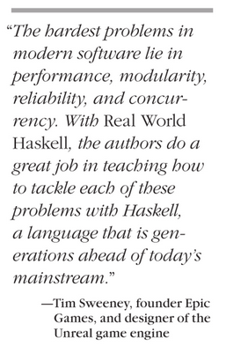
Towards Functional Paradigm
Robert Reitmeier, Validas AG
Notes:
+

Slide 2
Contents
Motivation
Why and when to switch to Haskell
What to expect
The NSWC Experiment
Strategic Choices (and how they manifest)
Glasgow Haskell Compiler [Interactive] / Hackage / Stackage
Hello World!
Closing the “Semantic Gap”
“Executable Proof”: Quicksort
“Executable Specification”: Chess in 200 Lines

Slide 3



Motivation: Power Continuum
higher lower
„Declarative“: What!
Easy for humans
Semantic Gap
„Procedural“: How!
Easy for machines

Slide 4
What does process do?
void swap(int *a, int *b)
{
int tmp = *a;
*a = *b;
*b = tmp;
}
void process(int *begin, int *end)
{
int *ptr;
int *split;
if (end - begin <= 1)
return;
ptr = begin;
split = begin + 1;
while (++ptr <= end) {
if (*ptr < *begin) {
swap(ptr, split);
++split;
}
}
swap(begin, split - 1);
process(begin, split - 1);
process(split, end);
}

Slide 5
What does process2 do?
process2 [] = []
process2 (first:rest) =
process2 smaller ++ [first] ++ process2 bigger
where
smaller = filter (<= first) rest
bigger = filter (> first) rest

Slide 6
How to prove it?
void swap(int *a, int *b)
{
int tmp = *a;
*a = *b;
*b = tmp;
}
void process(int *begin, int *end)
{
int *ptr;
int *split;
if (end - begin <= 1)
return;
ptr = begin;
split = begin + 1;
while (++ptr <= end) {
if (*ptr < *begin) {
swap(ptr, split);
++split;
}
}
swap(begin, split - 1);
process(begin, split - 1);
process(split, end);
}

Slide 7
How to prove it?
process2 [] = []
process2 (first:rest) =
process2 smaller ++ [first] ++ process2 bigger
where
smaller = filter (<= first) rest
bigger = filter (> first) rest

Slide 8
How to prove it?
process2 [] = []
process2 (first:rest) =
process2 smaller ++ [first] ++ process2 bigger
where
smaller = filter (<= first) rest
bigger = filter (> first) rest
≤
≤
sorted
sorted
sorted
⇒
sorted

Slide 9
Obstacles
“As long as our hypothetical Blub programmer is looking down the power continuum, he knows he's looking down. Languages less powerful than Blub are obviously less powerful, because they're missing some feature he's used to. But when our hypothetical Blub programmer looks in the other direction, up the power continuum, he doesn't realize he's looking up. What he sees are merely weird languages. He probably considers them about equivalent in power to Blub, but with all this other hairy stuff thrown in as well. Blub is good enough for him, because he thinks in Blub.”
From the essay “Beating the Averages” by Paul Graham
(Startup Millionaire, co-Founder of YCombinator)
“Any sufficiently advanced technology is indistinguishable from magic.”
Arthur C. Clarke‘s third law

Slide 10

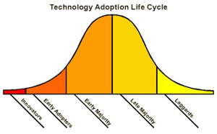

When not to use Haskell
no acceptance for “esoteric” (i.e. modern) technology
In conservative and laggard enviroment (e.g. personal, political reasons):

Slide 11
Motivation
Why and when to switch to Haskell:
Medium to high level problem
Wish for rapid prototyping
High quality software
When not to switch:
Low level problem
real-time system requirements

Slide 12
What to expect
What to expect:
Paradigm shift in your head: “Lisp is worth learning for the profound enlightenment experience you will have when you finally get it; that experience will make you a better programmer for the rest of your days, even if you never actually use Lisp itself a lot.” => Despise of mainstream languages
Mathematical principledness and cleanliness
Rich tooling (library/build management, time and resources profiling e.g.)
Wealth of working libraries
Highly educated community with very good expertise (community is small, but growing)
Specialized librares sometimes come with very sparse documentation
“Once U go black, U don’t go back.”

Slide 13
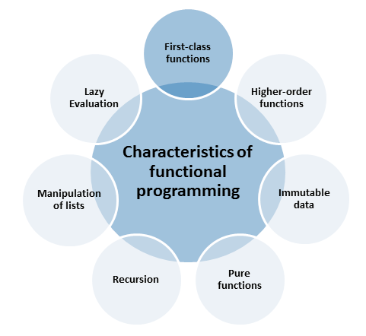
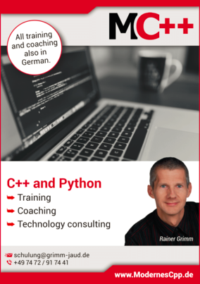
From modernescpp.com

Slide 14
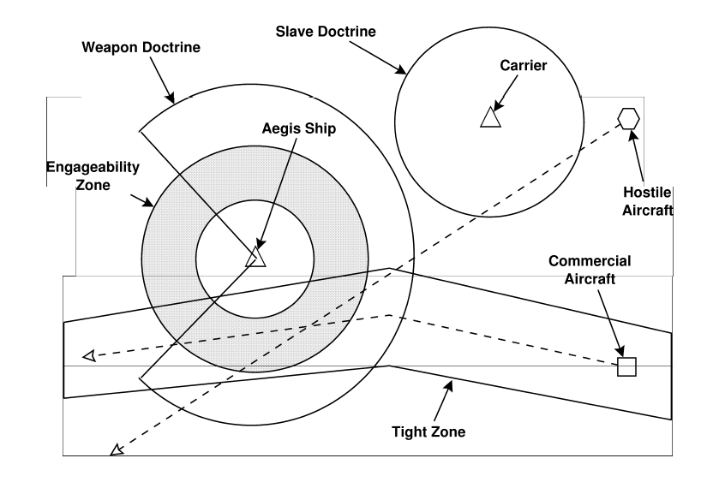
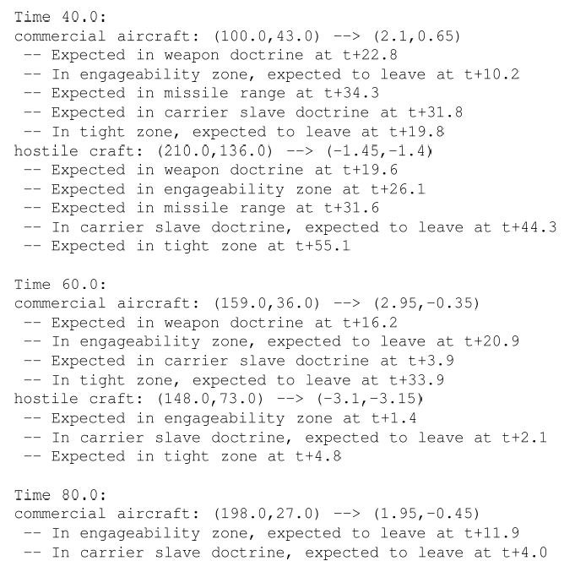
The NSWC Experiment in 1993
ADA vs. C++ vs. awk vs. Relational Lisp vs. Haskell vs. …

Slide 15
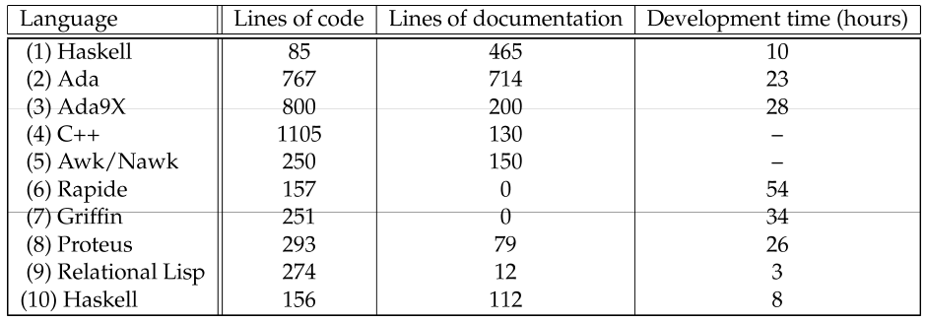

NSWC Prototyping Results
(2) NSWC lead programmer (“control group”)
(4) After awk solution, plus 500 LOC test harness, no development time reported
(6)+(7) Code never executed
(9) Developmen time excluding 4 hours in kickoff
(10) Novice college graduate, given 8 days to learn Haskell and an expert to ask

Slide 16
Strategic Choices

Slide 17
Purely Functional = No Side Effects
f(x) == f(x)

Slide 18
Strong Static Type System
Types are your friend!

Slide 19
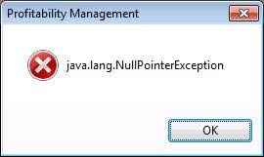
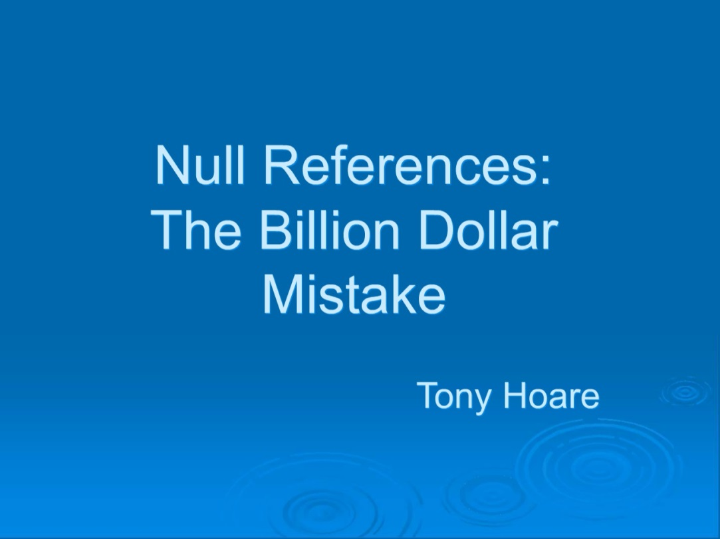
Completeness of Case Distinctions
Object obj;
<..>
obj.function();
case o :: Maybe Value of
Nothing -> <have to do something here>
Just value -> …

Slide 20
Lazy Evaluation
Deal with infinity
Efficiency without explicitly thinking about it
No need for fixed upper bounds: char text[100];
Checking of the upper bounds
Problems when bounds exceeded

Slide 21
List Comprehension
Mathematical/declarative way of defining lists
[ x | x <- [1..], not (any (x `isDividableBy`) [2..(x-1)]) ]
where
a `isDividableBy` b = mod a b == 0

Slide 22
No (i.e. Automatic) Memory Management
Programmer not harassed with explicit memory management void *mem = malloc(1000*sizeof(int)); for(int i=0;i<1000;i++) mem[i]=i;
Crashes when out of memory!
Forgot free(mem); => memory leak!

Slide 23
Functions are First Class

Slide 24
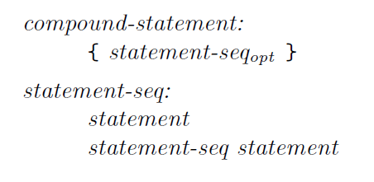
DSLs for free!
Every “Monad” is a DSL by construction
Example: Parsing
Formal Grammar:
Parsing DSL code:
compound_statement = Compound_Statement <$> braces (many statement)

Slide 25
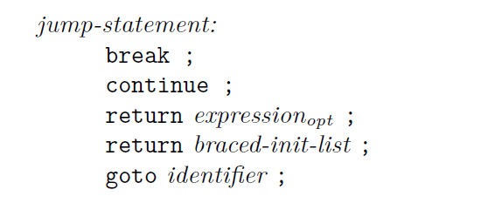

DSLs for free!
jump_statement =
Break_Statement <$ (reserved "break" *> semi) <|>
Continue_Statement <$ (reserved "continue" *> semi) <|>
Return_Statement <$> (reserved "return" *> optionMaybe expression <* semi)
Goto_Statement <$> (identifier <* semi)

Slide 26

Let’s get concrete now!

Slide 27
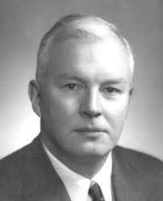
Haskell Brooks Curry
Currying
Curry-Howard-Isomorphism

Slide 28


https://vole.wtf/coder-serial-killer-quiz/

Slide 29
Glasgow Haskell Compiler (GHC)
Developed by Microsoft Research Cambridge
Currently de facto standard
On the scientific forefront

Slide 30
Hello World!
“Hello World!”

Slide 31
Exercises
Quicksort
squareroot
maximum of a list (show: fold geq l where geq x y = if x>=y then x else y)
data Employee = Employee Name Age
data Company = Company1 CEO CTO Depts | Company2 [Board] Depts
data Dept = Dept Name Head [(Employee,Salary)]
Extract all employees from Company, Functor fmap: total salary, sorted people’s list
n-th Prime Number
IO monad in GHCI: getDirectoryContents, writeFile, …
Parser

Slide 32










Industrial Strength

Slide 33


putStrLn „Thank you!“
“LISP is worth learning for a different reason — the profound enlightenment experience you will have when you finally get it.
That experience will make you a better programmer for the rest of your days, even if you never actually use LISP itself a lot.”
From “How to Become a Hacker”
by Eric Raymond

