Slide 1
Automatic Code Coverage
Robert Reitmeier, Validas AG
Notes:
+

Slide 2
Contents
Motivation / The Problem
Small Examples
Other Tools
SAT Solving Modulo Theories: Z3
Integrated Verification
The State Space Explosion and some Heuristics
FalconLib: Solution to Jorge’s and Alex’s Challenge
Call for Challenges
Haskell’s Amenities (Quasi-Quoting, UniCode Syntax, Generics, Laziness->ProducerConsumer…)

Slide 3
Stichpunkte
Loop Prediction (easy with “for” in MISRA)
Automatic Verification Test Harness
Producer/Comsumer Model (Memory!)
Enums, Structs, Floats, …
Full coverage is desirable only for target function
Reports vectors to cover coverable code and reports (presumably?) dead code
Heuristics:
Restriction to a subspace
Random Condition Branch Skipping

Slide 4
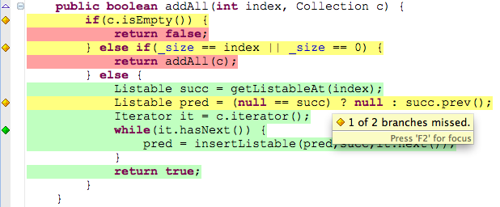
Motivation
ISO 26262/*: Code Coverage for libraries/SWCs at ASIL D!
=> Test Suite does test all parts of the code

Slide 5
The Problem
Which inputs lead to 100% code coverage?
int g(int x,int y)
{
int erg = x;
while(y>0)
{
erg = erg << 1;
y=y-1;
}
if(erg<=1) { erg=100; }
return(erg);
}
int f(int y)
{
if(g(2,y)>5) return 1;
else return 0;
}

Slide 6
Other Tools
KLEE
VectorCast
AutoCode for Cantata

Slide 7

The End

