Slide 1
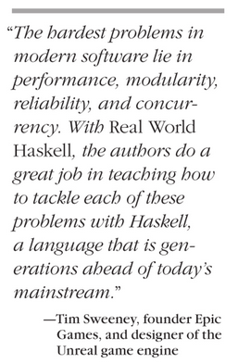
Towards Functional Paradigm
Robert Reitmeier, Validas AG
Notes:
+

Slide 2
Contents TODO!
Motivation
Why and when to switch to Haskell
What to expect
The NSWC Experiment
Strategic Choices (and how they manifest)
Glasgow Haskell Compiler [Interactive] / Hackage / Stackage
Hello World!
Closing the “Semantic Gap”
“Executable Proof”: Quicksort
“Executable Specification”: Chess in 200 Lines

Slide 3



The Level Continuum
higher lower
„Declarative“: What!
Easy for humans
Semantic Gap
„Procedural“: How!
Easy for machines

Slide 4
Example: What does process do?
void swap(int *a, int *b)
{
int tmp = *a;
*a = *b;
*b = tmp;
}
void process(int *begin, int *end)
{
int *ptr;
int *split;
if (end - begin <= 1)
return;
ptr = begin;
split = begin + 1;
while (++ptr <= end) {
if (*ptr < *begin) {
swap(ptr, split);
++split;
}
}
swap(begin, split - 1);
process(begin, split - 1);
process(split, end);
}

Slide 5
Example2: What does process2 do?
process2 [] = []
process2 (first:rest) =
process2 smaller ++ [first] ++ process2 bigger
where
smaller = filter (<= first) rest
bigger = filter (> first) rest

Slide 6
How to prove it?
void swap(int *a, int *b)
{
int tmp = *a;
*a = *b;
*b = tmp;
}
void process(int *begin, int *end)
{
int *ptr;
int *split;
if (end - begin <= 1)
return;
ptr = begin;
split = begin + 1;
while (++ptr <= end) {
if (*ptr < *begin) {
swap(ptr, split);
++split;
}
}
swap(begin, split - 1);
process(begin, split - 1);
process(split, end);
}

Slide 7
How to prove it?
process2 [] = []
process2 (first:rest) =
process2 smaller ++ [first] ++ process2 bigger
where
smaller = filter (<= first) rest
bigger = filter (> first) rest

Slide 8
How to prove it?
process2 [] = []
process2 (first:rest) =
process2 smaller ++ [first] ++ process2 bigger
where
smaller = filter (<= first) rest
bigger = filter (> first) rest
≤
≤
sorted
sorted
sorted
⇒
sorted

Slide 9
Psychological Obstacles
“As long as our hypothetical Blub programmer is looking down the power continuum, he knows he's looking down. Languages less powerful than Blub are obviously less powerful, because they're missing some feature he's used to. But when our hypothetical Blub programmer looks in the other direction, up the power continuum, he doesn't realize he's looking up. What he sees are merely weird languages. He probably considers them about equivalent in power to Blub, but with all this other hairy stuff thrown in as well. Blub is good enough for him, because he thinks in Blub.”
From the essay “Beating the Averages” by Paul Graham
(Startup Millionaire, co-Founder of YCombinator)
“Any sufficiently advanced technology is indistinguishable from magic.”
Arthur C. Clarke‘s third law

Slide 10
Motivation
Why and when to switch to Haskell:
Medium to high level problem
Wish for rapid prototyping
High quality software
When not to switch:
Low level problem
real-time system requirements

Slide 11

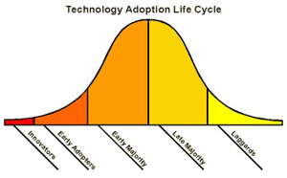

When not to use Haskell
no acceptance for “esoteric” (i.e. modern) technology
In conservative and laggard enviroment (e.g. personal, political reasons):

Slide 12
What to expect
What to expect:
Paradigm shift in your head: “Lisp is worth learning for the profound enlightenment experience you will have when you finally get it; that experience will make you a better programmer for the rest of your days, even if you never actually use Lisp itself a lot.” => Despise of mainstream languages
Mathematical principledness and cleanliness paying off!
Rich tooling (library/build management, time and resources profiling e.g.)
Wealth of working libraries
Highly educated community with very good expertise (community is small, but growing)
Specialized librares sometimes come with very sparse documentation
“Once U go black, U don’t go back.”

Slide 13
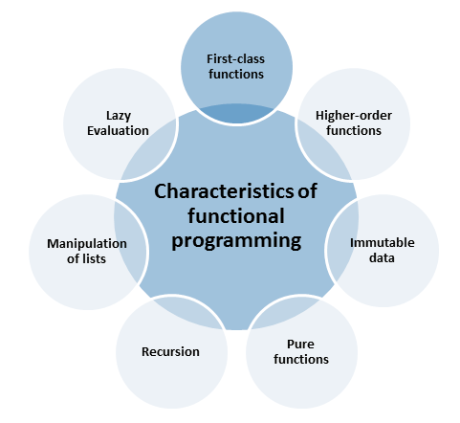

From modernescpp.com

Slide 14
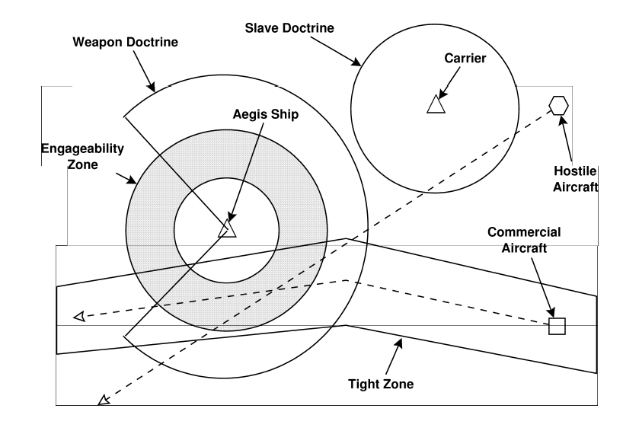
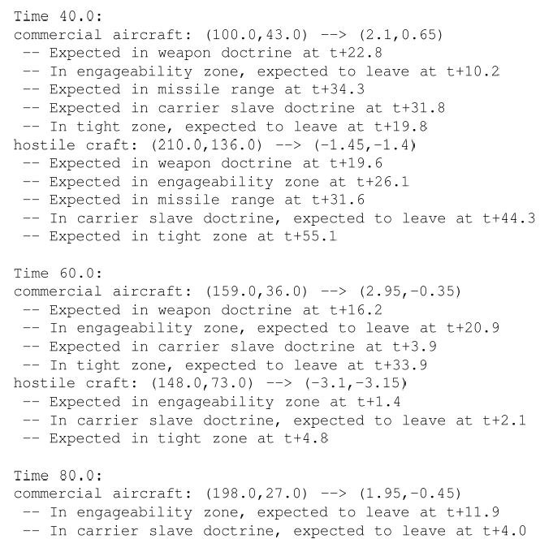
The NSWC Experiment in 1993
ADA vs. C++ vs. awk vs. Relational Lisp vs. Haskell vs. …

Slide 15
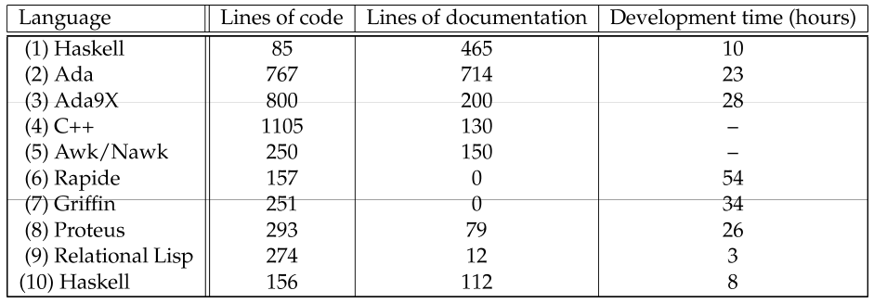

NSWC Prototyping Results
(2) NSWC lead programmer (“control group”)
(4) After awk solution, plus 500 LOC test harness, no development time reported
(6)+(7) Code never executed
(9) Developmen time excluding 4 hours in kickoff
(10) Novice college graduate, given 8 days to learn Haskell and an expert to ask

Slide 16
Strategic Choices

Slide 17
Purely Functional = No Side Effects
int sideeffect = 0;
int f(int x)
{
sideeffect++;
return(2*x + sideeffect);
}
f(5) ≠ f(5) !

Slide 18
Strong Static Type System
Types are your friend!

Slide 19
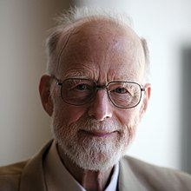
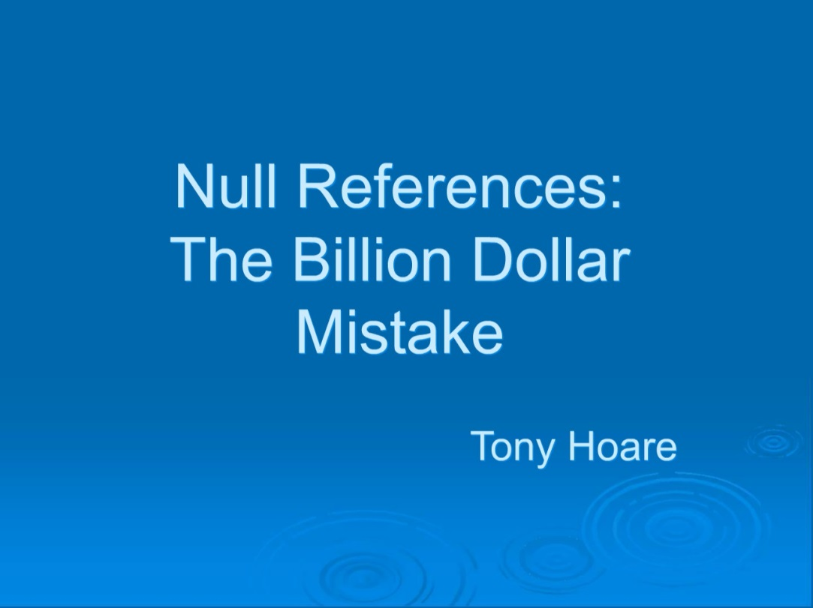
Sir Tony Hoare’s billion-dollar mistake
“I call it my billion-dollar mistake. It was the invention of the null reference in 1965.”

Slide 20
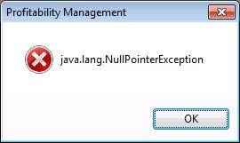
Null Pointer Constructor
Object obj; // Meaning: Object obj = null;
.. some forgotten path not setting obj ..
obj.setterX(42);

Slide 21
No Null Pointer, No Cry!
data Maybe typ = Just typ | Nothing
…
case input :: Maybe Int of
Nothing -> <deal with it somehow!>
Just intval -> …

Slide 22
List Comprehension
Mathematical/declarative way of defining lists
[ x | x <- [2..100], all (x `notDividibleBy`) [2..(x-1)] ]
where
x `notDividibleBy` d = mod x d /= 0

Slide 23
Lazy Evaluation: Only if needed!
Deal with infinity take 100 primes
Efficiency without explicitly thinking about it minimum list = head (qsort list)
No need for fixed upper bounds: char text[100]; gets(text);
Need checking of the upper bound!
Problems when not checked and bounds exceeded

Slide 24
No (i.e. Automatic) Memory Management
Human being not harassed with explicit memory management void *mem = malloc(1000*sizeof(int)); for(int i=0;i<1000;i++) mem[i]=i;
Crashes when out of memory!
Forgot free(mem); => memory leak!

Slide 25
Functions are First Class

Slide 26
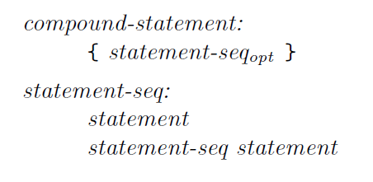
DSLs for free!
Every “Monad” is a DSL by construction
Example: Parsing
Formal Grammar:
Parsing DSL code:
compound_statement = Compound_Statement <$> braces (many statement)

Slide 27
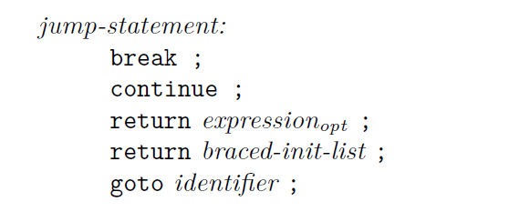

DSLs for free!
jump_statement =
Break_Statement <$ (reserved "break" *> semi) <|>
Continue_Statement <$ (reserved "continue" *> semi) <|>
Return_Statement <$> (reserved "return" *> optionMaybe expression <* semi)
Goto_Statement <$> (identifier <* semi)

Slide 28

Let’s get concrete now!

Slide 29
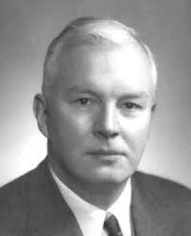
Haskell Brooks Curry
Currying
Curry-Howard-Isomorphism

Slide 30

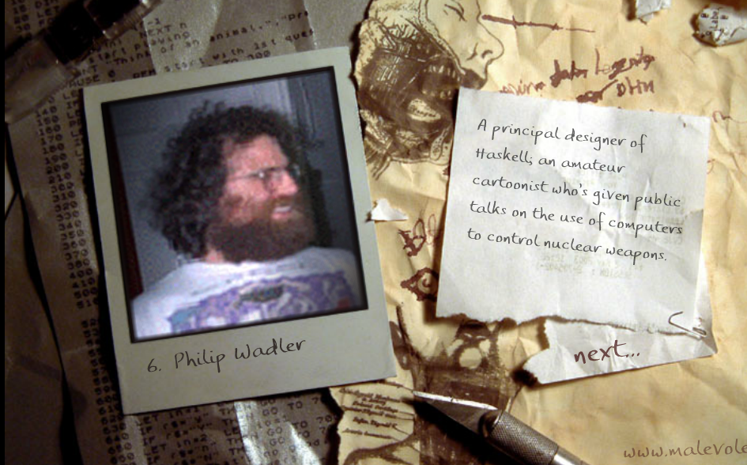
https://vole.wtf/coder-serial-killer-quiz/

Slide 31
Glasgow Haskell Compiler (GHC)
Developed by Microsoft Research Cambridge
Currently de facto standard
On the scientific forefront

Slide 32
Compiler vs. Interactive
Compiler is GHC
Interactive Interpreter is GHCi

Slide 33
Example: Chess in 200 Lines
High level specification: reads (mostly) like a Chess manual
initialPosition = Position {
pBoard = boardFromString [
"âïáòäðàñ",
"îßîßîßîß",
"ØçØçØçØç",
"çØçØçØçØ",
"ØçØçØçØç",
"çØçØçØçØ",
"ÙèÙèÙèÙè",
"ëÚêÝíÛéÜ" ],
pColourToMove = White,
pCanCastleQueenSide = allOfThem,
pCanCastleKingSide = allOfThem,
pEnPassant = Nothing,
pHalfmoveClock = 0,
pNextMoveNumber = 1 }

Slide 34
The Board and Positions
data Colour = White | Black
deriving (Show,Eq,Enum,Bounded,Ord)
nextColour White = Black
nextColour Black = White
data Piece = Ù | Ú | Û | Ü | Ý | Þ
deriving (Eq,Enum,Bounded,Ord,Show)
type Board = Array Coors Square
type Square = Maybe (Colour,Piece)
type Coors = (Int,Int)
instance Show Coors where
show (file,rank) = ['a'..]!!(file-1) : show rank
data Position = Position {
pBoard :: Board,
pColourToMove :: Colour,
pCanCastleQueenSide :: [Colour],
pCanCastleKingSide :: [Colour],
pEnPassant :: Maybe (Coors,Coors),
pHalfmoveClock :: Int,
pNextMoveNumber :: Int }

Slide 35
Initial Position
initialPosition = Position {
pBoard = boardFromString [
"âïáòäðàñ",
"îßîßîßîß",
"ØçØçØçØç",
"çØçØçØçØ",
"ØçØçØçØç",
"çØçØçØçØ",
"ÙèÙèÙèÙè",
"ëÚêÝíÛéÜ" ],
pColourToMove = White,
pCanCastleQueenSide = allOfThem,
pCanCastleKingSide = allOfThem,
pEnPassant = Nothing,
pHalfmoveClock = 0,
pNextMoveNumber = 1 }
allOfThem :: (Enum a,Bounded a,Ord a) => [a]
allOfThem = [minBound..maxBound]
boardFromString ranks = array ((1,1),(max_f,max_r)) $
zip [ (f,r) | r <- reverse [1..max_r], f <- [1..max_f] ]
(concatMap read_rank ranks)
where
read_rank = map read_square
(max_f,max_r) = (maximum (map length ranks),length ranks)

Slide 36
Coordinates
(north,east) = ((0,1),(1,0))
(south,west) = (-north,-east)
pawnStep White = north
pawnStep Black = south
baseRank White = 1
baseRank Black = 8
addCoors :: Board -> Coors -> (Int,Int) -> Maybe Coors
addCoors board coors offset = case coors+offset of
coors' | coors' ∈ (indices board) → Just coors'
_ | otherwise → Nothing

Slide 37
A Move
data Move =
Move {
moveFrom :: Coors,
moveTo :: Coors,
moveTakes :: Maybe Coors,
movePromote :: Maybe Piece } |
Castling CastlingSide
deriving Eq
data CastlingSide = Queenside | Kingside deriving Eq
instance Show Move where
show Move{..} = show moveFrom ++ show moveTo ++ case movePromote of
Nothing → ""
Just Ú → "N"
Just Û → "B"
Just Ü → "R"
Just Ý → "Q"
show (Castling Queenside) = "O-O-O"
show (Castling Kingside) = "O-O"

Slide 38
Potential Moves 1
potentialMoves Position{..} = normal_moves ++ castling_moves where
normal_moves = [ Move src dest mb_takes mb_promote |
(src,Just (colour,piece)) <- assocs pBoard,
colour==pColourToMove,
(dest@(_,to_rank),mb_takes) <- [..] case piece of
Ù → pawn_moves ++ pawn_takes where
Just dest = addCoors pBoard src pawn_step
-- There cannot be a pawn on the opposite base rank
pawn_moves = if square_empty dest then [ (dest,Nothing) ] ++ pawn_double else []
pawn_double = case addCoors pBoard src (2*pawn_step) of
Just dest2 | square_empty dest2 ∧ snd src == initial_rank → [(dest2,Nothing) ]
_ | otherwise → []
pawn_takes = [ (dest,Just take_on) |
Just dest <- map (addCoors pBoard src) [pawn_step+east,pawn_step+west],
take_on <- case pBoard!dest of
Just (colour,_) | colour ≠ pColourToMove → [ dest ]
Nothing | Just (middle,pawn_coors) <- pEnPassant,
middle==dest → [ pawn_coors ]
_ | otherwise → [ ] ]
Ú → concatMap (maybe_move src) knight_moves
Û → concatMap (maybe_move_direction src) diagonals
Ü → concatMap (maybe_move_direction src) straights
Ý → concatMap (maybe_move_direction src) (straights++diagonals)
Þ → concatMap (maybe_move src) (straights++diagonals),

Slide 39
Position Rating 1
data MatchResult = Winner Colour WinReason | Draw DrawReason deriving Show
data WinReason = Resignation | Checkmate deriving Show
data DrawReason = Fifty_Halfmoves | Stalemate | NoMatePossible deriving Show
type Rating = Float
mAX = 10000.0
mIN = negate mAX
eQUAL = 0.0
rate :: Position → (Rating,Maybe MatchResult)
rate Position{..} | pHalfmoveClock ≥ 50 = (eQUAL,Just $ Draw Fifty_Halfmoves)
rate pos@Position{..} | moveGen pos == [] = case (king_in_check,pColourToMove) of
(False,_ ) → (eQUAL,Just $ Draw Stalemate)
(True ,White) → (mIN, Just $ Winner Black Checkmate)
(True ,Black) → (mAX, Just $ Winner White Checkmate)
where
king_in_check = not $ coorsNotInCheck pos $ kingsCoors pos

Slide 40
Searching Brute Force Minimax
type Depth = Int
type Line = [Move]
search :: Depth → Position → Line → (Rating,Line)
search depth pos line | moveGen pos == [] ∨ depth==0 = (fst $ rate pos,line)
search depth pos line = minimax (comparing fst) (map go_deeper $ moveGen pos)
where
minimax = if pColourToMove == White then maximumBy else minimumBy
go_deeper move = search (depth-1) (doMove pos move) (move:line)
import Control.Parallel.Strategies
parMap rpar
This parallelization works because no side effects!

Slide 41
Exercises
Poker Hands
squareroot
maximum of a list (show: fold geq l where geq x y = if x>=y then x else y)
data Employee = Employee Name Age
data Company = Company1 CEO CTO Depts | Company2 [Board] Depts
data Dept = Dept Name Head [(Employee,Salary)]
Extract all employees from Company, Functor fmap: total salary, sorted people’s list
n-th Prime Number
IO monad in GHCI: getDirectoryContents, writeFile, …
Parser

Slide 42










Industrial Strength

Slide 43
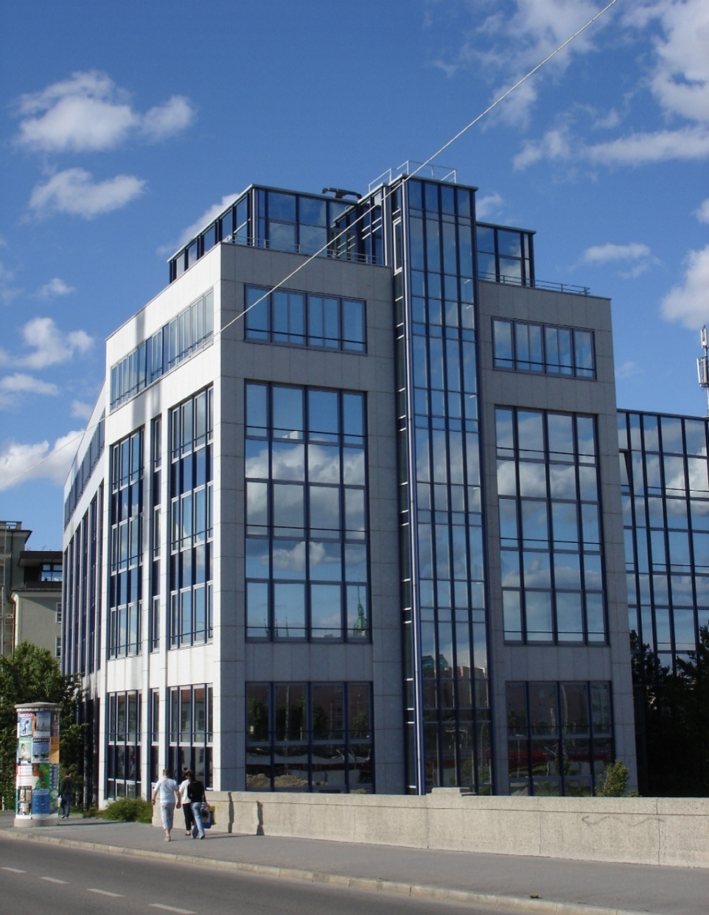

putStrLn „Thank you!“
“LISP is worth learning for a different reason — the profound enlightenment experience you will have when you finally get it.
That experience will make you a better programmer for the rest of your days, even if you never actually use LISP itself a lot.”
From “How to Become a Hacker”
by Eric Raymond

