Slide 1
Hacking Competitions
a Grand Unified Theory
Notes:
Welcome everyone to BeVXcon!
I would like to thank Anthony for this opportunity to speak with you and thank Beyond Security hosting this event.
My hope is to take a few minutes of your time this morning and discuss how we can improve hacking competitions.
There are several styles of competitions, and it is important to find the style that motivates you to continue improving.
Since this is BeVX, I will talk about competitions that support the mastery of exploitation skill.

Slide 2


Capture the Flag
Pwn2own-style
Bug Bounty
Notes:
For those who are not familiar with hacking competitions, there are three types I want to mention today:
CTFs are short competitions (around 24-48 hours) where teams compete to solve challenges written by the organizers
While I will focus on CTF competitions, I will also discuss the benefits of other styles of competitions, such as Hack2Win, Pwn2Own, and bug bounties.
Pwn2Own style competitions, such as Hack2Win here at BeVX, require participants to come prepared with 0-days to exploit browsers, mobile phones, and operating systems. The teams that participate usually spend weeks preparing or finding bugs.
Lastly, bug bounties are continuous programs run by companies to reward researchers who report bugs in their software.

Slide 3

A quixotic quest?
Notes:
Through the later half of Einstein's life, he tried to unify the forces of physics to develop a Grand Unified Theory.
I believe it is possible to do the same for hacking competitions and find common ground between these three styles.
While I will focus on a small part of this task today, I hope that we can continue to evolve all of these competitions to a higher level.
And, unlike Einstein, show that our task is not futile.

Slide 4
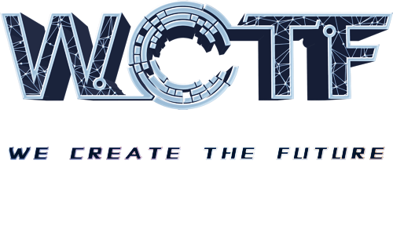


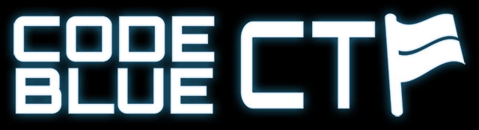

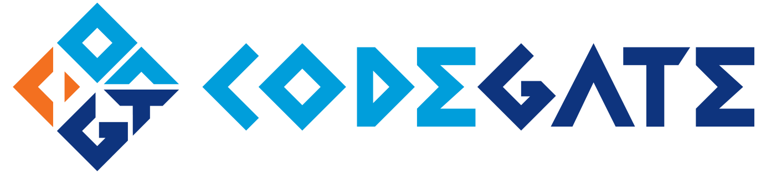
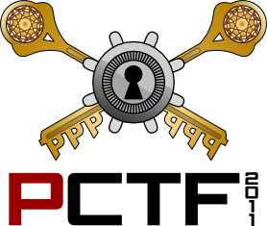
Capture The Flag
Notes:
There are a variety of Capture the Flag competitions that take place around the world.
The most famous is Defcon CTF finals, where the top CTF teams compete every year.
Other CTFs include Codegate in Korea, WCTF in Beijing, CodeBlue in Japan, and PlaidCTF in the United States. And many many more.

Slide 5
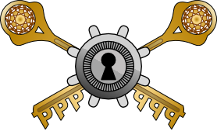
Jeopardy
Attack-Defense
Notes:
There are two main types of CTFs: Jeopardy style and attack-defense.
Most CTFs are Jeopardy style, meaning that teams are given a set of challenges which they must solve, and each challenge provides a flag which is worth some points.
Types of challenges include exploitation, reverse engineering, forensics, and web.
Attack-defense, of which Defcon CTF finals is the prime example, require teams to constantly attack services to gain more flags, constantly find more bugs and exploit them, while patching and defending their own services.
For this talk, I will focus on Jeopardy-style competitions because these have the most space for disruption and innovation.

Slide 6
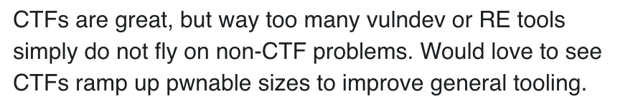
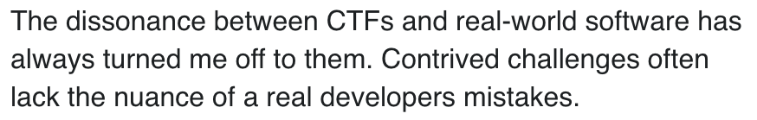
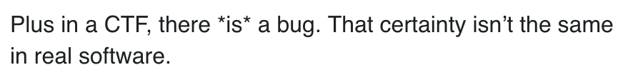
Notes:
While this talk is an evolution on how CTFs have changed for me over time, it is also an answer to a Twitter thread from earlier this year.
One person writes: "CTFs are great, but too many vulnerability dev tools simply do not fly on non-CTF problems. Would love to see CTFs ramp up pwnable sizes."
This sparked another to add: "The dissonance between CTFs and real-world software has turned me off to them. Contrived challenges lack the nuance of a real developers mistakes."
And lastly: "In a CTF, there is a bug. That certainly isn't the same in real software."
While I will avoid addressing these individually, I believe that they generally miss the point of CTF. Also I find it hard to believe there is real software without any bugs.

Slide 7
What are the goals?
CTF
Pwn2Own
Educational
Approachable
Challenging
Fun
Fix bugs in real software
Evaluate current mitigations
PR
Fame and Fortune
Notes:
So if the goal of CTF is not to improve general tooling, what is it?
I believe CTF should be:
Educational
Approachable
Challenging
and Fun
We can compare this to the goals of Hack2Win or Pwn2Own:
Fix bugs in real software
Evaluate current mitigations
PR for the companies running the competition and the companies whose software is tested
Fame and fortune for the researchers when they find 0-days
Right away, we can notice that these two styles of hacking competitions have very different goals. CTF is oriented towards education, whereas Pwn2Own-style feels more like a job.

Slide 8
Has CTF been successful?
@lokihardt
@rz_fluorescence
@nedwilliamson
Notes:
Partcipating in Pwn2Own and Hack2Win
Exploited Chrome, Edge, and Firefox
Speaking personally, CTF prepared me to get to the point where I could find and exploit vulnerabilities in Firefox, Edge, and mobile devices.

Slide 9
CTFs: Educational
Capture the flag competitions are a form of deliberate practice.
Notes:
Part of what makes CTFs educational is that they are a form of deliberate practice for the security field.

Slide 10
Deliberate Practice
How you practice is as important as how much you practice
You must practice at a level that is slightly more challenging than your current skill
Practice requires focused attention
Professor K. Anders Ericsson
Notes:
Deliberate Practice is an area of psychology that focuses on how people become masters of a skill or gain expertise.
Professor K Anders Ericsson published a paper on this topic in 1993 called
“The Role of Deliberate Practice in the Acquisition of Expert Performance”.
Professor Ericsson believes that:
Not all practice is equal. How you practice is very important for determining whether you gain skill, rather than merely performing a skill a large number of times.
You must practice at a level that is more challenging than your current skill. But it must not be so hard that it is impossible for you to do. And it should also be paired with immediate feedback about what you did wrong or how to improve.
Deliberate practice requires focused attention.

Slide 11
CTFs: Educational
CTFs are a form of “Deliberate Practice”
PlaidCTF, WCTF, and others continue to produce difficult challenges that force participants to stretch their skills
CTFs require “focused attention” from the participants
Write-ups and solutions from other participants provide feedback that further improves skills
Notes:
PlaidCTF, WCTF, and other CTFs produce novel challenges that force individuals to stretch their skills.
CTFs are short and time bound, so if you want to do well you are forced to focus on the task at hand.
The write-ups and interactions with organizers during and after a CTF provide feedback that helps the individuals improve.
Professor Ericsson also adds that:
Engagement in deliberate practice is not inherently motivating.
individuals must be engaged and motivated to take part in improvement
As an example:
children who were simply exposed to an activity for months by their parents in a fun way were more successful at gaining mastery
I believe CTFs are the fun way to expose people to security

Slide 12
CTFs: Approachable
A CTF that is too difficult is not fun or useful for a participant.
Not all CTFs and CTF players are equal. Some people have more experience and a higher skill level.
We need to be honest about the difficulty level for a CTF and encourage players to pick CTFs that are appropriate for them.
Easy and hard CTFs are plentiful. High-quality CTFs that are in between are much rarer.
Notes:
Not all CTFs and players are equal. Some people will have more experience and more skill than others at this point in time. Some CTFs will be easier or harder than others.
We should be more open about the difficulty of individual CTFs, and encourage people to play the CTFs that are appropriate for them.
Easy and hard CTFs exist. CTFs that focus on the middle area are important and I feel are currently neglected. Part of this is the natural evolution of the CTF organizers as their own skills increase.
Needless to say, Hack2Win and Pwn2Own represent competitions that are not approachable to newcomers. Nor is it their goal.
Bug bounties, however, are more similar to CTFs in that there is a wide variety of targets with different skill requirements. Some of these could be good for newcomers, but they are not generally organized by difficulty.

Slide 13
CTFs: Challenging
CTF exploitation is as difficult as real-world exploitation.
Modern CTF binaries typically include: ASLR with PIE, NX, FORTIFY_SOURCE, and stack canaries.
Heap overflows, use-after-free, and info leaks are now the norm.
Linux challenges require the exploiter to understand glibc internals and develop exploitation strategies on-the-fly.
Real-world software with their heaps and mitigations.

Slide 14
CTFs: Challenging
Avoid complexity that is just for the sake of wasting time
Tasks should be challenging because you require new skills or growth.
Avoid random obfuscation of binaries just to make a challenge take longer to solve.
Obfuscation itself can be a good challenge but map it to something real.
When writing a challenge, ask yourself what you want people to learn

Slide 15
CTFs: Fun
In the end, CTF is a competitive game, not a job.
While some CTFs have a cash prize, many do not.
CTFs are time bound which makes it easier to incorporate with life.
In-person CTFs provide an opportunity to meet and hang out with people who share the same passion for hacking.

Slide 16
CTF + Pwn2Own
What elements of Pwn2Own competitions are important?
Fixing bugs in real software
Evaluating current mitigations
Provide examples of state-of-the-art exploits

Slide 17
CTF + Pwn2Own
How can we incorporate these elements into CTFs?
Fixing bugs in real software
Use real software with real bugs in CTFs
CTF organizer must find at least one exploitable bug first
The software should not have a monetary reward for finding bugs
Bug bounties, Pwn2Own, interest from 0-day vendors, etc.

Slide 18
CTF + Pwn2Own
How can we incorporate these elements into CTFs?
Evaluating current mitigations
CTFs already do a good job of this with Linux
iOS and Windows challenges would help test mitigations that are specific to those platforms
New control flow integrity techniques in compilers are ripe

Slide 19
CTF + Pwn2Own
How can we incorporate these elements into CTFs?
Examples of state-of-the-art exploits
Finding vulnerabilities can be time-consuming
Use patched vulnerabilities to develop 1-day exploits
Exploits must still bypass mitigations and work remotely
Is there a way to encourage “weaponized” exploits?
Highly reliable (>95% success rate)
Resilient to minor version changes

Slide 20
Pwn2Own-style will always be different
“Unlimited” time to find a vulnerability, exploit it, and test
Bug hunting requires extra time that does not fit within a weekend
Developing a 0-day exploit for Chrome, iOS, or Windows is always more glamorous than winning a CTF
Higher cash prize because competing against 0-day vendors
$100k from Pwn2Own is less than $250k market price, but > $0

Slide 21
Pwn2Own and Bug Bounties
The reward does not generally match with the work required
If you are exchanging cash for 0-day, then at a minimum researchers should be sufficiently paid for their time
Companies should generally value exploits and bugs higher
Zerodium prices x2 is a good approximation of current market
Globalization of vulnerability research
Salaries in some parts of the world are lower than others
Good for companies, may be good or bad for researchers

Slide 22
Real World CTF
A recent CTF hosted by Chaitlin Tech
Demonstrated the potential for using real software in a CTF, in a way that is still approachable and fun
In Dash, a macOS app, multiple 0-days were found by teams and reported to vendor who quickly fixed them
The result: a real difference for the security of real users without any additional burden on the CTF players

Slide 23
RWCTF-esque
Other CTFs should consider a similar style for some challenges
It should be clearly marked that finding a 0-day is intentional, and that the organizer has an exploit that works
Avoid software that is annoying to setup or difficult to reverse engineer
Emphasize open source software as a way to give back to the computing community at-large

Slide 24
9 years of playing CTF
Joined PPP in 2009
1st place at Defcon CTF four times
Played in many CTFs and host PlaidCTF every year
CSAW
Codegate
PhDays
SecuInside
WCTF

Slide 25
9 years of playing CTF
I agree with the criticism that CTFs tend to focus on tricks
As a player, I want to actively learn and not be stumped by a trick for hours
I play less CTF now because I get to grow my skills at my day job
I try to incorporate what I learn into PlaidCTF if possible
The competitive nature of CTF and the opportunity to play with and against my friends and coworkers keeps me playing CTF

Slide 26
Summary
CTFs are supposed to be fun and educational, not a job
CTF organizers are busy, we should avoid making that task harder
Encourage CTFs to use real world software
A challenge can use 1-day vulnerability and still have a higher purpose
If a CTF can help improve the security of open source software by exposing it to elite hackers, it is a win for computing

Slide 27
Thank you!
Send hate mail to andrew@theori.io or @zoaedk on Twitter

