Slide 1
MPG Standards - good for Consumers?
Greg Kittilson
Colorado State University Global
MIS581: Capstone: Business Intelligence and Data Analytics
Dr. Steve Chung
September 10, 2023
Notes:
Hi, I'm Greg Kittilson. My MIS581 Capstone Research Project was to answer the question if the miles per gallon standard is good for consumers.

Slide 2
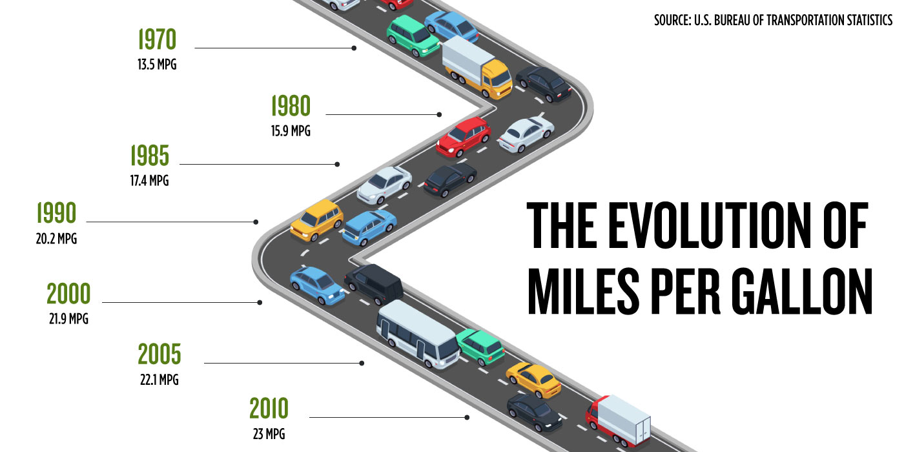
MPG Standards - good for Consumers?
The CAFE Standard
Research Question
Hypotheses
Literature Review
Research Design and Sources
Findings
Conclusions & Recommendations
Figure 1
Miles per gallon (MPG) over time
Note: Seattle Credit Unit graphic based on U.S. Bureau of Transportation Statistics (https://www.seattlecu.com/blog/the-evolution-of-miles-per-gallon)
Notes:
This presentation shares the details of my research project which addresses the specific question of the CAFE standard benefit to the U. S. consumer in examining its influence on automobile total cost of ownership, reduction in CO2, and net oil imports since CAFE was first enacted to the present day. This presentation is broken into the definition of the CAFE standard, followed by the research question and hypotheses, recent literature, the research design and data sources, a review of the findings, and then wraps up with conclusions and recommendations.

Slide 3
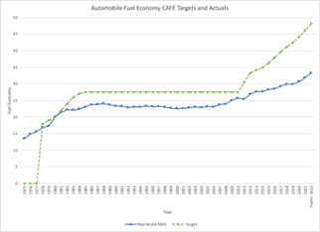
The Cafe Standard
Corporate Average Fuel Economy (CAFE) standards were created in 1975 by Congress.
Initially doubled MPG targets from 1978 to 1985 settling at 27.5 MPG.
Updated in 2007, 2009, 2012, 2020, and in 2022.
Latest goal is 49 MPG by 2026.
Consumers claimed as beneficiaries.
Figure 2
Miles per gallon (MPG) – targets and achievements
Note: Actual MPG values were downloaded from the EPA website (EPA, 2023) and the MPG targets from the U. S. Department of Energy (DOE) (DOE, 2013)
Notes:
The Corporate Average Fuel Economy (CAFE) standards were created in 1975 by Congress. The establishment was “largely in response to the 1973 oil embargo” to reduce the United States’ dependence on foreign oil (Union of Concerned Scientists, 2017). The standards originally had targets for new passenger cars to have double the average fuel economy (AFE) as measured in miles per gallon (mpg) from 1978 to 1985. In 1985 the AFE was expected to be 27.5 mpg. The standards have been refreshed several times.
Updated efficiency standards again were passed in 2007 by Congress with a “historic” agreement being reached in 2009 between the Federal Government, states, and the auto industry (Union of Concerned Scientists, 2017). This agreement included global warming pollution standards. In 2012, the National Highway Traffic and Safety Administration (NHTSA) set new CAFE standards with the target of 41.0 mpg by 2021 (U. S. Department of Transportation, 2014) and 54 mpg by 2025 (Davenport, 2020). Under the Trump administration, the targets were lowered to 40 mpg by 2025 (Davenport, 2020). In 2022 the Biden administration reset targets to 49 mpg by 2026 citing gas savings for U. S. consumers and reduction of greenhouse gases. Figure 2 on the right captures the targets and the actual fuel economy over time.
As justification of the rollback in 2020, Andrew Wheeler, the head of the Environmental Protection Agency (EPA), stated that consumers would see a reduction in the price of new automobiles (Davenport, 2020). Consumers were used again in the justification for increasing the standard with the current Transportation Secretary claiming, “real relief and benefits for families across the country … Americans will spend less on gas than they would have if we hadn’t taken this step.” (Laing, 2022).

Slide 4
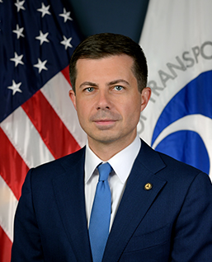
Research question
Historical Perspective
CAFE standard targeted reduction in U. S. oil imports and CO2 gases.
Further justifications have been reduction in consumer car and fuel costs.
Research Question
Has the CAFE standard benefitted U. S. Consumers in total cost of car ownership, reduction in CO2 gases, and by lessening dependence on foreign oil imports?
Figure 3
Pete Buttigieg set the latest MPG targets in 2022
Note: Transportation Secretary Pete Buttigieg increased the MPG target in 2022 claiming, “real relief and benefits for families across the country … Americans will spend less on gas than they would have if we hadn’t taken this step.” (Laing, 2022). Image source: U. S. Department of Transportation (2023).
Notes:
Has the CAFE standard benefitted U. S. consumers? In 2004 Parry et. al. evaluated tightening of the CAFE standards. They shared that the standard produced moderate improvements to little or no effects dependent upon consumers view of the technologies and trade-offs in costs. The authors concluded:
“It appears to be difficult to justify tightening car and light truck fuel economy standards on externality grounds alone. The key reason for this result is that external costs from carbon emissions and oil dependency estimates in other studies are small in magnitude relative to external costs that increase through the rebound effect; they even fall short of current fuel taxes. Higher fuel economy standards may moderately improve welfare if there is an additional market failure due to consumers substantially undervaluing fuel savings, and fuel-saving technologies have little value in alternative uses; however, there is no firm consensus among analysts on the magnitude of this additional market failure.”
This leads into the research question … Has the CAFE standard benefitted U. S. Consumers in total cost of car ownership, reduction in CO2 gases, and by lessening dependence on foreign oil imports?

Slide 5
Hypotheses
First Hypothesis – U. S. consumer saved money?
H₀ (null): The CAFE standard has had no impact on the total cost of car ownership over time.
H_{A} (alternate): The CAFE standard has reduced the total cost of car ownership over time.
Second Hypothesis – U. S. consumer have better air quality?
H₀ (null): The CAFE standard has had no impact on CO2 emissions over time.
H_{A} (alternate): The CAFE standard has reduced the CO2 emissions over time.
Third Hypothesis – U. S. less dependent on foreign oil?
H₀ (null): The CAFE standard has had no impact on oil imports over time.
H_{A} (alternate): The CAFE standard has reduced the oil imports over time.
Notes:
The first hypothesis is to understand if the CAFE standard saved a consumer money in the total cost of car ownership. This total cost is the cost of a new car plus the gas over its lifetime.
H₀ (null): The CAFE standard has had no impact on the total cost of car ownership over time.
H_{A} (alternate): The CAFE standard has reduced the total cost of car ownership over time.
The second hypothesis is to see if the CAFE standard has improved the air quality as measured by CO2 emissions. The U. S. consumer would benefit from having clean air for their health.
H₀ (null): The CAFE standard has had no impact on CO2 emissions over time.
H_{A} (alternate): The CAFE standard has reduced the CO2 emissions over time.
The third and final hypothesis for this research question is to ascertain if the CAFE standard has reduced the U. S. dependency on foreign oil. A U. S. consumer would benefit from a lessening of dependence by spending less time at the gas pump unlike the oil embargo times in the 1970s where lines were common. The spillover on consumers included the 55-mile national speed limit, gas rationing system, and wider economic fallout (Thebault, 2021).
H₀ (null): The CAFE standard has had no impact on oil imports over time.
H_{A} (alternate): The CAFE standard has reduced the oil imports over time.

Slide 6
literature review
Three recent papers about the CAFE standard.
2019 - Zirogiannis, et. al.
Examined vehicle sales and consumers’ valuation of the fuel savings.
Concluded fuel economy and fuel price uncertainty are greater impact than any price premiums.
2020 - Greene, et. al.
Long-term assessment dating back to 1975 with real-world impact evaluation in saving fuel and greenhouse gases (GHG).
Found the standard has been successful at the reduction of GHG, fuel savings, and reduction in fatalities.
Additionally, the savings in fuel costs have “exceeded” the vehicle improvement costs.
2021- Wang & Miao.
Empirical evaluation of the standard and the rate of automobile technology improvements.
Found when the standard was unchanged, the automobile design technical progress had slowed significantly.
Notes:
Three papers all offer a unique perspective on fuel economy and have developed models in support of their research questions.
Zirogiannis, et. al. examine vehicle sales and consumers’ valuation of the fuel savings due to the CAFE standard. They establish a total cost of ownership (TCO) model based on a “net” premium compromised of the resale value, fuel savings, sales tax, insurance, and auto loan costs. Their conclusion was that fuel economy and fuel price uncertainty are “likely to have a greater impact on changes in cars sales” rather than any price premiums due to the CAFE standard (Zirogiannis, 2019).
In 2021, Wang & Miao performed an empirical evaluation of the CAFE standard and the rate of technology improvements in passenger cars. Their paper presents horsepower and weight comparisons to the improvement in fuel economy with a non-government dataset, Ward’s Automotive Yearbook and the Automobile Catalog. Their observation was technical improvements outside of weight and horsepower enabled fuel economy improvements when the CAFE standards were first implemented. When the CAFE standard was unchanged, the same indicators revealed the technical progress had slowed significantly (Wang & Miao, 2021).
A long-term assessment of the CAFE standard dating back to its inception in 1975 and evaluating real-world impact in saving fuel and greenhouse gases (GHG) was performed by Greene, et. al. in 2020. The authors captured datasets including gas prices over time, the CAFE standard and similar legislation over time, vehicle travel in miles and fuel consumption since the standard was implemented, and fuel economy vehicle improvement costs. They also evaluated traffic fatality rates compared to the fuel economy. They concluded that the CAFE standard has been successful at the reduction of GHG, fuel savings, and reduction in fatalities (Greene, et. al., 2020). The savings in fuel costs have “exceeded” the vehicle improvement costs. However, the tie-in to reduction in fatalities is linked by the needed reduction in vehicle weight to achieve the higher fuel economy.

Slide 7
research design and data sources
Research Method
Linear regression models were developed for each hypothesis.
Measures are the correlation coefficient (r) and the coefficient of determination (R²).
Research Limitations
Data sets are time series and may not be linear.
The CAFE standard was held constant for a number of years.
Linear regressions using time series are known to have shortcomings with residuals.
Data sources
Data comes from the U. S. Government including the Bureau of Labor Statistics (BLS), the Environmental Protection Agency (EPA), and the Department of Energy (DOE).
Notes:
The research question can only be answered by looking at responses over time to the CAFE standard changes.
The research method was to use tools that include time series plots and correlation matrices to observe relationships between variables within the datasets. The limitations of the research are that the data sets are time series and may not be linear. There are several years that the standard held constant. Given this non-linearity, the linear regression models were challenged. Beyond the data set, another limitation was the modeling itself. Linear regression models using time series are known to have errors as residuals may have a time series structure.
The data sources are from the U. S. Government including the Bureau of Labor Statistics (BLS), the Environmental Protection Agency (EPA), and the Department of Energy (DOE).

Slide 8
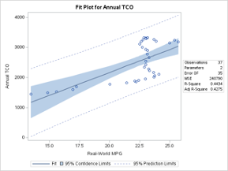
findings page 1
Has the CAFE standard benefitted U. S. Consumers in total cost of car ownership (TCO)?
H₀ (null): The CAFE standard has had no impact on the TCO (𝛽₁ > 0).
H_{A} (alternate): The CAFE standard has reduced the TCO (𝛽₁ < 0).
The linear regression resulted in a 𝛽₁ of 152.39 with a t-value of 5.28 and a p-value < 0.0001.
Significant finding resulting in proving the null hypothesis.
The CAFE standard for miles per gallon has not benefitted U. S. Consumers in TCO.
TCO is defined as the cost of a new car + the cost of gas for the lifetime of the car.
Figure 4
Total cost of ownership (TCO) linear model fit plot
Note: Linear regression fit plot for annual TCO versus the CAFE Standard in achieved miles per gallon.
Notes:
The findings for the first hypothesis of "Has the CAFE standard benefitted U. S. Consumers in total cost of car ownership (TCO)?"
Recall our H₀ (null): The CAFE standard has had no impact on the TCO (𝛽₁ > 0).
H_{A} (alternate): The CAFE standard has reduced the TCO (𝛽₁ < 0).
The linear regression resulted in a 𝛽₁ of 152.39 with a t-value of 5.28 and a p-value < 0.0001. This is a significant finding resulting in proving the null hypothesis. The CAFE standard for miles per gallon has not benefitted U. S. Consumers in TCO. Captured in Figure 4 is the fit plot.
Recall that the TCO was determined as the cost of a new car plus the cost of gas for the lifetime of the car. The cost of gasoline was calculated from the consumer price index for each year multiplied by the number of miles driven estimated by the Bureau of Transportation at 13,476 (Rivelli, 2023). The lifetime of a car is estimated to be 11.8 years which is rounded up to 12 for this analysis (Energy.gov, 2019). Given the lifespan, TCO was only calculated to 2011.
The linear regression model had an R² of 0.44. The residuals appear to have a normal distribution with the Q-Q plot presenting a slight S curve with residuals off the line at the two extremes.

Slide 9
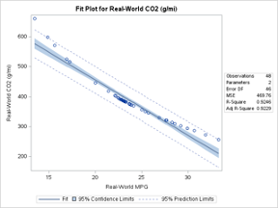
findings page 2
Has the CAFE standard benefitted U. S. Consumers by reducing CO2 gases?
H₀ (null): The CAFE standard has had no impact on CO2 emissions (𝛽₁ > 0).
H_{A} (alternate): The CAFE standard has reduced the CO2 emissions (𝛽₁ < 0).
The linear regression resulted in a 𝛽₁ of -18.45 with a t-value of -23.75 and a p-value < 0.0001.
Significant finding resulting in rejecting the null hypothesis and accepting the alternate hypothesis.
The CAFE standard has benefitted U. S. consumers in reduction of CO2 gases.
Figure 5
CO2 linear model fit plot
Note: Linear regression fit plot for CO2 versus the CAFE Standard in achieved miles per gallon.
Notes:
The findings for the second hypothesis of "Has the CAFE standard benefitted U. S. Consumers by reducing CO2 gases?"
Recall H₀ (null): The CAFE standard has had no impact on CO2 emissions (𝛽₁ > 0).
H_{A} (alternate): The CAFE standard has reduced the CO2 emissions (𝛽₁ < 0).
The linear regression resulted in a 𝛽₁ of -18.45 with a t-value of -23.75 and a p-value < 0.0001. This is a significant finding resulting in rejecting of the null hypothesis and accepting the alternate hypothesis. The CAFE standard for miles per gallon has benefitted U. S. Consumers in reduction of CO2. The linear regression model had an R² of 0.92. The residuals appear to have a right skewed distribution with the Q-Q plot presenting a 150-degree line centered at 0 and matching on the upper quartiles. The skewed residual distribution suggests that the linear model may not be the best fit (Berman, 2023) and a non-linear approach such as the Box Cox transformation may improve the results. A Box Cox transformation was performed on the CO2 emissions to understand if the residuals would better fit a normalized distribution. Using SAS Studio’s TRANSREG function and a Box Cox model, the function resulted in a similar distribution with no impact to the overall model as measured by R².

Slide 10
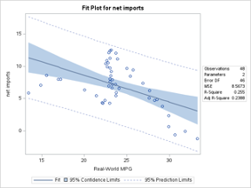
findings page 3
Has the CAFE standard benefitted U. S. consumers by lessening dependence on foreign oil imports?
H₀ (null): The CAFE standard has had no impact on oil imports (𝛽₁ > 0).
H_{A} (alternate): The CAFE standard has reduced the oil imports (𝛽₁ < 0).
The linear regression resulted in a 𝛽₁ of -0.41 with a t-value of -3.97 and a p-value of 0.0006 (single sided) under the 0.05 target.
Significant finding resulting in rejecting of the null hypothesis and accepting the alternate hypothesis.
The CAFE standard has benefitted U. S. Consumers in reducing dependence on foreign oil.
Figure 6
Net imports linear model fit plot
Note: Linear regression fit plot for net imports versus the CAFE Standard in achieved miles per gallon.
Notes:
Here are the findings for the third hypothesis of "Has the CAFE standard benefitted U. S. consumers by lessening dependence on foreign oil imports?"
Recall H₀ (null): The CAFE standard has had no impact on oil imports (𝛽₁ > 0).
H_{A} (alternate): The CAFE standard has reduced the oil imports (𝛽₁ < 0).
The linear regression resulted in a 𝛽₁ of -0.41 with a t-value of -3.97 and a p-value of 0.0006 (single sided) under the 0.05 target. This is a significant finding resulting in rejecting of the null hypothesis and accepting the alternate hypothesis. The CAFE standard for miles per gallon has benefitted U. S. Consumers in reducing dependence on foreign oil as net imports have been reduced with higher miles per gallon. The linear regression model had an R² of 0.26. The residuals appear to have a normal distribution with the Q-Q plot nearly matched.

Slide 11
conclusion & recommendations
Regarding the research question of the CAFE standard benefitting U. S. consumers, the results are mixed.
The total cost of ownership (TCO) of a car for U. S. consumers has not been reduced as MPG increased.
The CO2 was reduced as the MPG improved.
Net oil imports decreased with higher MPG.
All three hypotheses were answered with linear regression models.
The slopes were found to be statistically significant.
Not all the models had a strong fit with only the CO2 model have an R² above 0.90.
The CO2 model did not have normalized residuals implying poor model fit.
Recommendations
The TCO model assumed car lifespan and miles per year based on current estimates. Could be improved with historical data.
The CO2 model may be improved with non-linear approaches such as Box-Cox transformations.
The net oil imports model may be improved with inclusion of additional variables as MPG is likely not the only influence.
Notes:
In conclusion, while answering the research question about the CAFE standard benefitting U. S. consumers, the results are mixed. A direct effect of lower car lifetime gas purchases did not offset the rising prices of a car considering the total cost of ownership for a car (TCO). The CO2 was reduced as the MPG improved. Also, decreases in net oil imports correlates to higher MPG. However, correlation does not mean causation.
As stated within the findings, the TCO includes the cost of a new car plus the cost of gas for its lifetime. There are two main assumptions in the calculation: the number of miles per year and the lifespan of a car. Both may have changed over the timespan of the research. Cars built in 1975 may not have had a lifespan of 12 years and the average number of miles driven each year may not be the same as it is today. Additionally, insurance and maintenance are not considered in this TCO calculation.
The best fit of the linear regression models is MPG to CO2. However, the residuals did not meet a normalized distribution. A non-linear model is likely required for improved fit. The relationship though should not be a surprise. To achieve higher MPG, engine sizes have been reduced over time. There are more four-cylinder vehicles on the road today than in 1975. Smaller engines output a smaller volume of C02. Reduction in CO2 benefits U. S. consumers although it may not be as noticeable as saving money.
The final part of the research question emphasizes a reduction in the reliance of foreign oil as measured by net oil imports. Of the three hypotheses, this result might have the least connection to causation. There are many factors that can lead to net oil import reduction beyond the CAFE standard including the U. S. government encouraging domestic oil production. For example, the U. S. government has provided tax preferences for energy development including fossil fuels (CBO, 2015).
There are three recommendations following this research:
The first is that the TCO calculation can be improved by considering car lifespans and the number of miles over the life of a car. Further studies with the data collected may yield additional insights to guide automakers to further reduce CO2 emissions or provide cost savings to the U. S. Consumer. An example would be to dive into the motor sizes and the adoption rate for smaller engines. Government policies could be crafted to incentize U. S. Consumers to adopt new technology faster or to provide relief in TCO.
The CAFE standard remains an important U. S. government policy. As the policy has become a focus once again in the U. S. government’s pursuit of C02 emissions, it is important to understand its benefits and clearly explain the needs to the U.S Consumer. The C02 reduction was highly correlated to real world MPG but with non-normal residuals in the model developed. The second recommendation is that the CO2 MPG relationship should be further explored in alternate models.
While the reduction of net oil imports null hypothesis was rejected in favor of the alternate hypothesis, the linear regression model did not have a strong fit. This suggests that additional variables need to be researched that contribute to the decreased need of imported oil. The final recommendation is that a multiple linear regression model should be built for net oil imports exploring the contributors to yield better depth into potential influences such as the government incentives.
This concludes the presentation of my research project. The next slides capture the references used for the research project. Thanks for listening.

Slide 12
References page 1
Berman H.B. (2023). Residual Analysis in Regression. Stattrek.com. https://stattrek.com/regression/residual-analysis
BLS. (2023, July 21). U.S. Bureau of Labor Statistics. https://www.bls.gov/
Bouchrika, I. (2023, May 15). How to Write Research Methodology: Overview, Tips, and Techniques. Research.com. https://research.com/research/how-to-write-research-methodology
CBO. (2015, November 18). Federal support for the development, production, and use of fuels and Energy Technologies. Congressional Budget Office. https://www.cbo.gov/publication/50980
Colorado State University Global. (2023). Module 5: Critical Thinking [MIS581-1 Assignments]. Canvas. https://portal.csuglobal.edu
Davenport, C. (2020). Trump calls new fuel economy rule a boon. Some experts see steep costs. The New York Times.
DOE. (2013, September 13). Maps and Data. Alternative Fuels Data Center: Maps and Data. https://afdc.energy.gov/data
EIA. (2023, July 5). U.S. Energy Information Administration - EIA - independent statistics and analysis. Oil imports and exports - U.S. Energy Information Administration (EIA). https://www.eia.gov/energyexplained/oil-and-petroleum-products/imports-and-exports.php
Energy.gov. (2019, August 19). FOTW #1095, August 19, 2019: The average age of light-duty vehicles has increased to 11.8 years. https://www.energy.gov/eere/vehicles/articles/fotw-1095-august-19-2019-average-age-light-duty-vehicles-has-increased-118

Slide 13
References page 2
EPA. (2023, March 9). Automotive Trends Report. EPA. https://www.epa.gov/automotive-trends/explore-automotive-trends-data#DetailedData
Greene, D. L., Greenwald, J. M., & Ciez, R. E. (2020). US fuel economy and greenhouse gas standards: What have they achieved and what have we learned?. Energy Policy, 146, 111783.
Keith, D. R., Houston, S., & Naumov, S. (2019). Vehicle fleet turnover and the future of fuel economy. Environmental Research Letters, 14(2), 021001.
Laing, K. (2022, April 1). Biden administration orders 49 mpg fuel-economy standard by 2026. Bloomberg.com. https://www.bloomberg.com/news/articles/2022-04-01/biden-administration-speeds-gas-mileage-rules-slowed-by-trump#xj4y7vzkg
LinkedIn. (2023). How do you communicate your data analysis results and recommendations in a transparent and responsible way?. How to Avoid Ethical Issues in Data Analysis. https://www.linkedin.com/advice/3/how-do-you-communicate-your-data-analysis-results#:~:text=One%20of%20the%20most%20important,is%20from%20errors%20and%20biases.
Machi, L. A., & McEvoy, B. T. (2021). The literature review: Six steps to success.
O'Leary, Z. (2021). The essential guide to doing research. Sage.
Penn State University. (2018). 10.2 - autocorrelation and time series methods. 10.2 - Autocorrelation and Time Series Methods | STAT 462. https://online.stat.psu.edu/stat462/node/188/

Slide 14
References page 3
Penn State University. (2023). 8.1 – Linear regressions models with autoregressive errors. 8.1 – Linear Regression Models with Autoregressive Errors | STAT 510. https://online.stat.psu.edu/stat510/lesson/8/8.1
Rao, K. (2020, August 4). R2 or R2 - when to use what. Medium. https://towardsdatascience.com/r%C2%B2-or-r%C2%B2-when-to-use-what-4968eee68ed3
Rivelli, E. (2023, April 7). What is average mileage per year?. Car and Driver. https://www.caranddriver.com/auto-loans/a32880477/average-mileage-per-year/
SEC. (2023, April 6). Edgar: Company filings. SEC Emblem. https://www.sec.gov/edgar/searchedgar/companysearch
Thebault, R. (2021, May 13). Long lines, high prices and fisticuffs: The 1970s gas shortages fueled bedlam in America. The Washington Post. https://www.washingtonpost.com/history/2021/05/13/gas-shortages-1970s/
Union of Concerned Scientists. (2017). Brief History of US Fuel Efficiency Standards: Where we are and where we're going.
U. S. Department of Transportation. (2014, August 11). Corporate average fuel economy (CAFE) standards. U.S. Department of Transportation. https://www.transportation.gov/mission/sustainability/corporate-average-fuel-economy-cafe-standards
Wang, Y., & Miao, Q. (2021). The impact of the corporate average fuel economy standards on technological changes in automobile fuel efficiency. Resource and Energy Economics, 63, 101211.

Slide 15
References page 4
World Bank. (2023, June 19). A global database of inflation. World Bank. https://www.worldbank.org/en/research/brief/inflation-database
Zirogiannis, N., Duncan, D., Carley, S., Siddiki, S., & Graham, J. D. (2019). The effect of CAFE standards on vehicle sales projections: A Total Cost of Ownership approach. Transport Policy, 75, 70-87.

