Slide 1

The
VitalitySync
Application
“Stay Ahead, Stay Healthy”
Michael Dankwah Agyeman-Prempeh (MEng DTI ‘25)
#DTK531_MIDSEMPROJECT_SPRING2025

Slide 2
#1
Introduction

Slide 3





Problem Space Probing
Time Wasting
Save Time
Imagine spending hours at hospitals just to check your vitals.
01
02
Need for a solution concept that saves us a lot of time
Vitals To Track
Secured Tracking
It tracks heart rate etc. —giving you control over your health data.
03
04
Stay ahead with real-time monitoring and secure sharing.

Slide 4
#2
Problem & User Need

Slide 5
Solving The Problem of Long Hospital Wait Times
Problem
Long hospital waits for basic vitals waste time and delay care
Venus
Venus has a beautiful name and is the second planet from the Sun
Instant, personal health insights, anytime, anywhere
User Need
VitalitySync monitors continuously, so you ‘stay ahead’
Solution Concept
Share your health history instantly with health providers (as & when and freely)
Personal Health Data On-hand

Slide 6
#3
How It Works

Slide 7
Taking Charge of Your Health
1
3
Use of MQTT & SQLite
Intuitive Visualizations
Data flows in real-time via MQTT (broker.hivemq.com) to a secure SQLite database.
See your health with graphs—resting vs. current comparisons
Data Simulation
Data Into Insights
VitalitySync simulates wearable data with Python scripts
Gemini AI turns raw data into friendly insights, delivered via user (text) input
2
4
VitalitySync
“Stay Ahead, Stay Healthy”

Slide 8
#4
Flowcharts

Slide 9
Start
User gets/purchases device (with RasPi integration)
Initial setup
Generate Resting Values (via publisher originally generate_health values)
Store in SQLite (health_data.db: resting_values table)
Display “Setup Complete” message

Slide 10
Background Monitoring
generate_healthvalues.py (publisher) runs
Generate Current Health Data (Heart_Rate, SpO2, etc.)
Store in SQLite (current_values table: timestamp, context)
Publish to MQTT Topic (health_sensor/data via broker.hivemq.com)
Continuous Loop (Every 1s)

Slide 11
User Interaction
User Presses Ctrl+C in gain_healthinsightswithllm.py(subscriber) Terminal
subscriber.py Stops Listening
User Input
"exit"
Display "Signing off with love! 💖 Take care! 🌟
End
"Tell me about my health!"
Input Metrics (e.g., "Heart_Rate, SpO2" or "all")
Fetch Data
Resting Values from SQLite
Latest Current Values from SQLite
Input Context (e.g., "running")
Validate Inputs
Metrics in Available List? → If No, Error
Display Options
Metrics: Heart_Rate, SpO2, Blood_Glucose, Body_Temperature
(or 'all')
Context in Possible List? → If No, Error
Visualize
Plot Bar Graph
(Title: "Health Metrics Comparison")
Contexts: resting, running, walking, exercising
Prepare LLM Prompt
Resting Values (e.g., Heart_Rate: 70)
Prompt User: "Tell me about my health! or exit"
Current Values (e.g., Heart_Rate: 120)
Context (e.g., running)
Query Gemini API (Gemini)
Display Insights (Bullet Points)

Slide 12
End
Feedback Loop
Return to User
Input Prompt
Option to Resume Monitoring or Exit

Slide 13
#5
Live Demo Video

Slide 14
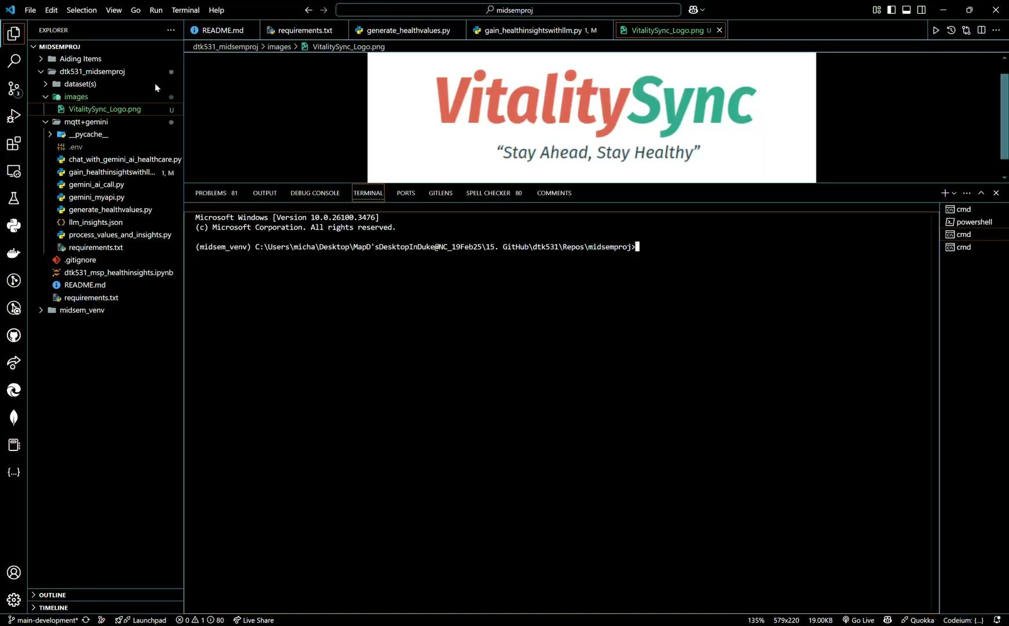

Slide 15
VitalitySync
Thank You
“Stay Ahead, Stay Healthy”
Any Questions?

Slide 16
VitalitySync
Links to All Deliverables
“Stay Ahead, Stay Healthy”
Working Prototype (GitHub Source Code)
Documentation and Diagrams (GitHub .ipynb file)
Product Description (Pitch) and Reflection (GitHub README.md file)
Product Presentation

