Slide 1
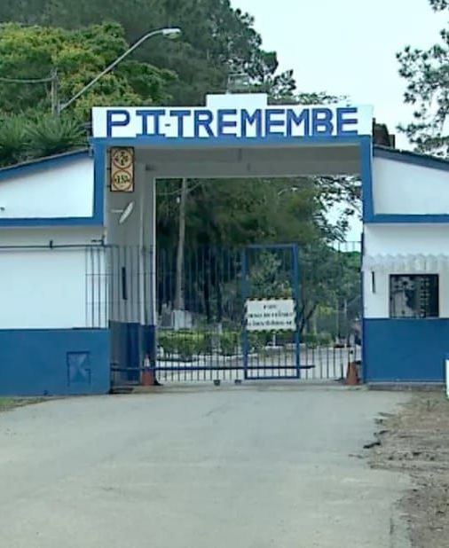
BEHIND THE WALLS
Tremembé
Prison
Behind Brazil's “Prison of Celebrities”
TREMEMBÉ, SÃO PAULO, BRAZIL
Presented by: [student names]
01
Notes:
Tremembé is a municipality in the Paraíba Valley, in the interior of São Paulo state. Its prison complex became nationally known because several inmates were connected to high-profile criminal cases. This presentation looks beyond the nickname and explains the institution's history, routine and changing role.
Sources: CNN Brasil, Aug. 22, 2025: https://www.cnnbrasil.com.br/nacional/sudeste/sp/tremembe-entenda-de-onde-surgiu-fama-de-presidio-dos-famosos/

Slide 2
TREMEMBÉ PRISON
02
Basic Facts
A COMPLEX, NOT A SINGLE BUILDING
Five prison units in the complex
Facilities for men and women
Closed and semi-open regimes
P2 opened on August 26, 1955
1955
Penitentiary II
Dr. José Augusto César Salgado
The unit commonly called P2
Notes:
The name Tremembé Prison can refer to more than one institution. The best-known unit is Penitentiary II Dr. José Augusto César Salgado, commonly called P2. Other units in the complex have different populations and security functions. São Paulo's prison administration records P2's inauguration on August 26, 1955.
Sources: São Paulo State Prison Administration, prison units: https://www1.sap.sp.gov.br/sp/unidades-prisionais/unidades-prisionais-mobile-ceprvali.html | SAP, Inaugurated Units: https://www1.sap.sp.gov.br/sp/unidades-prisionais/impressao/pdf/inauguradas.pdf | CNN Brasil, Aug. 22, 2025

Slide 3
TREMEMBÉ PRISON
03
Why Did It Become Famous?
“PRISON OF CELEBRITIES”
01
High-profile cases
Several inmates appeared in major national news stories.
02
Protection
Authorities separated people who could face threats in ordinary prison populations.
03
Media attention
The concentration of well-known names created a lasting public image.
The nickname came from the media. It did not mean a luxury prison.
Notes:
People involved in cases with major public attention could face threats in ordinary prison populations. Tremembé became associated with protective separation and therefore concentrated several well-known names. The media nickname did not mean a luxury prison, and most prisoners were never celebrities.
Sources: CNN Brasil, Aug. 22, 2025: https://www.cnnbrasil.com.br/nacional/sudeste/sp/tremembe-entenda-de-onde-surgiu-fama-de-presidio-dos-famosos/

Slide 4
TREMEMBÉ PRISON
04
Who Was Imprisoned There?
FORMER INMATES CONNECTED TO NATIONALLY KNOWN CASES
01
Suzane von Richthofen
FORMER INMATE
02
Alexandre Nardoni
FORMER INMATE
03
Elize Matsunaga
FORMER INMATE
04
Cristian Cravinhos
FORMER INMATE
Each case received extensive media coverage in Brazil.
Notes:
These people were convicted in different cases that received extensive coverage in Brazil. Suzane von Richthofen was convicted for her role in the murder of her parents. Alexandre Nardoni was convicted in the death of his daughter Isabella. Elize Matsunaga and Cristian Cravinhos were also convicted in widely reported homicide cases. Keep the explanation neutral and avoid graphic details.
Sources: CNN Brasil, Aug. 22, 2025 | CNN Brasil, Jan. 13, 2026: https://www.cnnbrasil.com.br/nacional/sudeste/sp/presidio-dos-famosos-comeca-a-ser-desfeito-e-presos-sao-transferidos/

Slide 5
TREMEMBÉ PRISON
05
Life Inside the Prison
01
02
03
04
SECURITY
WORK
EDUCATION
GARDEN
Strict rules and daily routines
Prison labor and vocational activities
Classes, culture and religious programs
Vegetable and herb production at P2
Official reports describe an organic garden where incarcerated workers grew vegetables and herbs.
Notes:
Official and reported programs have included workshops, schooling, religious activities, music or theatre, and prison labor. A state government report described an organic garden at P2 where incarcerated workers grew vegetables and herbs. These activities can build skills and responsibility. Work and study may also contribute to sentence reduction under Brazilian law when legal requirements are met.
Sources: São Paulo State Prison Administration, prison gardens: https://www1.sap.sp.gov.br/noticias/not1932.html | CNN Brasil, Aug. 22, 2025

Slide 6
TREMEMBÉ PRISON
06
A Famous Story
SUZANE VON RICHTHOFEN
Her case became one of Brazil's most discussed criminal cases.
2002
~20 YEARS
2023
The crime drew
national attention
Sentence served largely
in Tremembé
Moved to the
open regime
A legal and social case, not entertainment
Notes:
The Richthofen case became one of Brazil's most discussed criminal cases. Suzane spent roughly twenty years in the women's unit at Tremembé. In January 2023, the justice system moved her to the open regime. Her story helped build the complex's media image, but we should discuss it as a legal and social case, not as entertainment.
Sources: CNN Brasil, Aug. 22, 2025: https://www.cnnbrasil.com.br/nacional/sudeste/sp/tremembe-entenda-de-onde-surgiu-fama-de-presidio-dos-famosos/

Slide 7
2026 UPDATE
07
The Prison Today
The complex
remains active
Several high-profile inmates transferred
The special concentration began to end
Tremembé's public image still remains
ROLE CHANGING
Reports in January 2026 described a new distribution policy for notable prisoners.
Notes:
Reports published in January 2026 said São Paulo authorities were dispersing notable prisoners to other facilities. Tremembé continues to operate, but its role as a single destination for famous inmates is changing. This matters because many older articles describe a situation that is no longer fully current.
Sources: CNN Brasil, Jan. 13, 2026: https://www.cnnbrasil.com.br/nacional/sudeste/sp/presidio-dos-famosos-comeca-a-ser-desfeito-e-presos-sao-transferidos/ | São Paulo State Prison Administration, prison units

Slide 8
TREMEMBÉ PRISON
08
Conclusion & Sources
Tremembé became famous because security decisions brought several high-profile inmates to the same complex.
Its history connects three public debates:
PRISON SECURITY
MEDIA ATTENTION
REHABILITATION
Sources
São Paulo State Prison Administration (SAP): prison units, inauguration list and prison garden report
CNN Brasil: Tremembé and the origin of its nickname, Aug. 22, 2025
CNN Brasil: transfers and the end of the special wing, Jan. 13, 2026
Thank you
Notes:
End by separating the media reputation from the institution's real functions. Tremembé matters because it shows how prison security, public attention and rehabilitation can intersect. Its role changed in 2026, but its history still influences public discussion about Brazil's prison system.
Sources: SAP prison units: https://www1.sap.sp.gov.br/sp/unidades-prisionais/unidades-prisionais-mobile-ceprvali.html | SAP inauguration list: https://www1.sap.sp.gov.br/sp/unidades-prisionais/impressao/pdf/inauguradas.pdf | SAP garden report: https://www1.sap.sp.gov.br/noticias/not1932.html | CNN Brasil, Aug. 22, 2025 | CNN Brasil, Jan. 13, 2026

